Slide 2
9.9 CONNECTION: Many inherited traits in humans are controlled by a single gene
Because a trait is dominant does not mean that it is
  “normal” or
  more common than a recessive trait.
Wild-type traits
  those most often seen in nature
  not necessarily specified by dominant alleles.
Notes:
Teaching Tips
• Ask your class (a) what the odds are of a person developing Huntington’s disease if a parent has this disease (50%) and (b) whether they would want this genetic test if they were a person at risk. The Huntington’s Disease Society website, www.hdsa.org, offers many additional details. It is a good starting point for those who want to explore this disease in more detail.
Active Lecture Tips
• See the Media Review: “Learn.Genetics” Genetic Science Learning Center from the University of Utah on the Instructor Exchange. Visit the Instructor Exchange in the MasteringBiology instructor resource area for a description of this activity.
• As a simple test of comprehension, ask students to work in pairs to explain why lethal alleles are not eliminated from a population. Several possibilities exist: (a) The lethal allele might be recessive, persisting in the population due to the survival of carriers, or (b) the lethal allele might be dominant, but is not expressed until after the age of reproduction.
• See the activity Personal Genomics: Would You Give Your DNA Away? on the Instructor Exchange. Visit the Instructor Exchange in the MasteringBiology instructor resource area for a description of this activity.

Slide 3
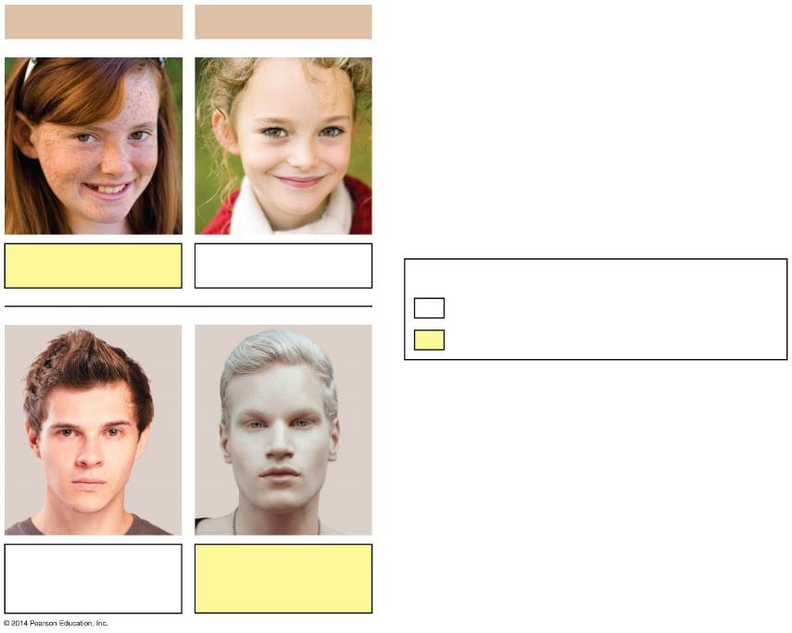
Figure 9.9a-0
Dominant Traits
Recessive Traits
Freckles
No freckles
Key
Wild-type (more common) trait
Mutant (less common) trait
Normal
pigmentation
Albinism
Notes:
Figure 9.9a-0 Examples of single-gene inherited traits in humans

Slide 4
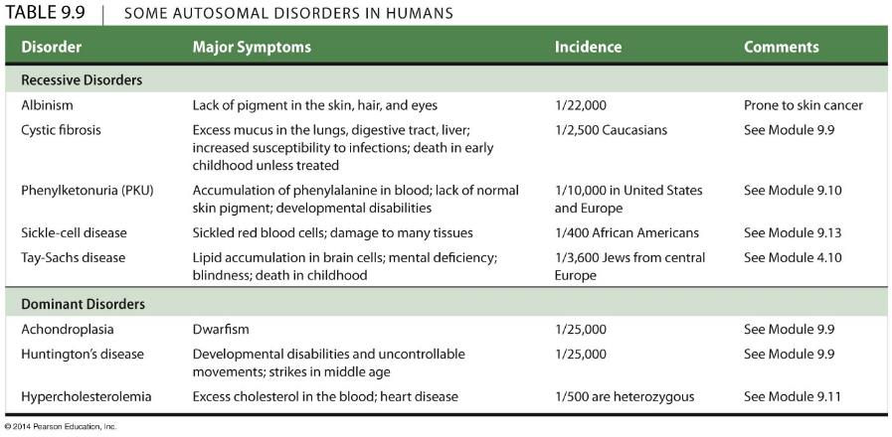
Table 9.9
Notes:
Table 9.9 Some autosomal disorders in humans

Slide 5
9.13 A single gene may affect many phenotypic characters
Pleiotropy occurs when one gene influences multiple characters.
Sickle-cell disease is a human example of pleiotropy.
  This disease affects the type of hemoglobin produced and the shape of red blood cells and causes anemia and organ damage.
  Sickle-cell and nonsickle alleles are codominant.
  Carriers of sickle-cell disease have increased resistance to malaria.
Notes:
Student Misconceptions and Concerns
• As your class size increases, the chances increase that at least one student will have a family member with one of the genetic disorders discussed. Some students may find this embarrassing, but others might have a special interest in learning more about these topics and may even be willing to share some of their family’s experiences with the class.
• After reading the preceding modules, students might expect all traits to be governed by a single gene with two alleles, one dominant over the other. Modules 9.11–9.15 describe deviations from simplistic models of inheritance.
• As these variations of Mendel’s laws are introduced, students are likely to get confused and become uncertain about the prior definitions. Consider keeping a clear definition of these different patterns of inheritance available for the class to refer to as new patterns are discussed (perhaps as a handout for student reference).
Teaching Tips
• Students can think of blood types as analogous to socks on their feet. You can have socks that match, a sock on one foot but not the other, you can wear two socks that do not match, or you can even go barefoot (type O blood)! Developed further, think of amber (A) and blue (B) socks. Type A blood can have an amber sock with either another amber sock or a bare foot (or “zero” sock). Blue socks work the same way. One amber and one blue sock represent the AB blood type. Having no socks, as already noted, represents type O.
• Consider specifically comparing the principles of codominance (expression of both alleles) and incomplete dominance (expression of one intermediate trait). Students will likely benefit from this direct comparison.
Active Lecture Tips
• See the activity Who Wants to Be a Millionaire? Inheritance on the Instructor Exchange. Visit the Instructor Exchange in the MasteringBiology instructor resource area for a description of this activity.

Slide 6
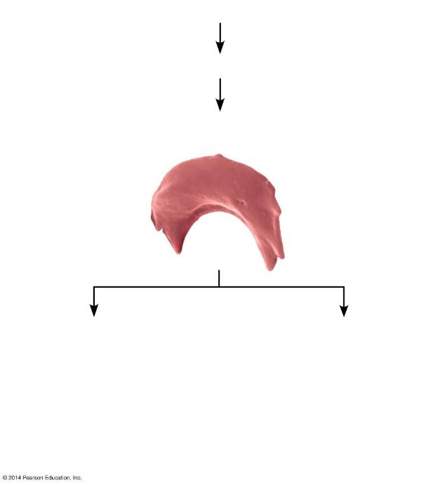
Figure 9.13b
An individual homozygous for the sickle-cell allele
Produces sickle-cell (abnormal) hemoglobin
The abnormal hemoglobin crystallizes,
causing red blood cells to become sickle-shaped
Damage to organs
Other effects
Kidney failure
Heart failure
Spleen damage
Brain damage (impaired
mental function, paralysis)
Pain and fever
Joint problems
Physical weakness
Anemia
Pneumonia and other
infections
Notes:
Figure 9.13b Sickle-cell disease, an example of pleiotropy

Slide 7
9.14 A single character may be influenced by many genes
Many characters result from polygenic inheritance, in which a single phenotypic character results from the additive effects of two or more genes on a single phenotypic character.
Human skin color is an example of polygenic inheritance.
Notes:
Student Misconceptions and Concerns
• As your class size increases, the chances increase that at least one student will have a family member with one of the genetic disorders discussed. Some students may find this embarrassing, but others might have a special interest in learning more about these topics and may even be willing to share some of their family’s experiences with the class.
• After reading the preceding modules, students might expect all traits to be governed by a single gene with two alleles, one dominant over the other. Modules 9.11–9.15 describe deviations from simplistic models of inheritance.
• As these variations of Mendel’s laws are introduced, students are likely to get confused and become uncertain about the prior definitions. Consider keeping a clear definition of these different patterns of inheritance available for the class to refer to as new patterns are discussed (perhaps as a handout for student reference).
Teaching Tips
• Polygenic inheritance makes it possible for children to inherit genes to be taller or shorter than either parent. Similarly, skin tones can be darker or lighter than either parent. The environment also contributes significantly to the final phenotype for both of these traits.
• The authors note that polygenic inheritance is the opposite of pleiotropy. This is worth noting in lecture as these concepts are discussed. We often remember concepts better when they are contrasted in pairs.
Active Lecture Tips
• See the activity Who Wants to Be a Millionaire? Inheritance on the Instructor Exchange. Visit the Instructor Exchange in the MasteringBiology instructor resource area for a description of this activity.

Slide 8
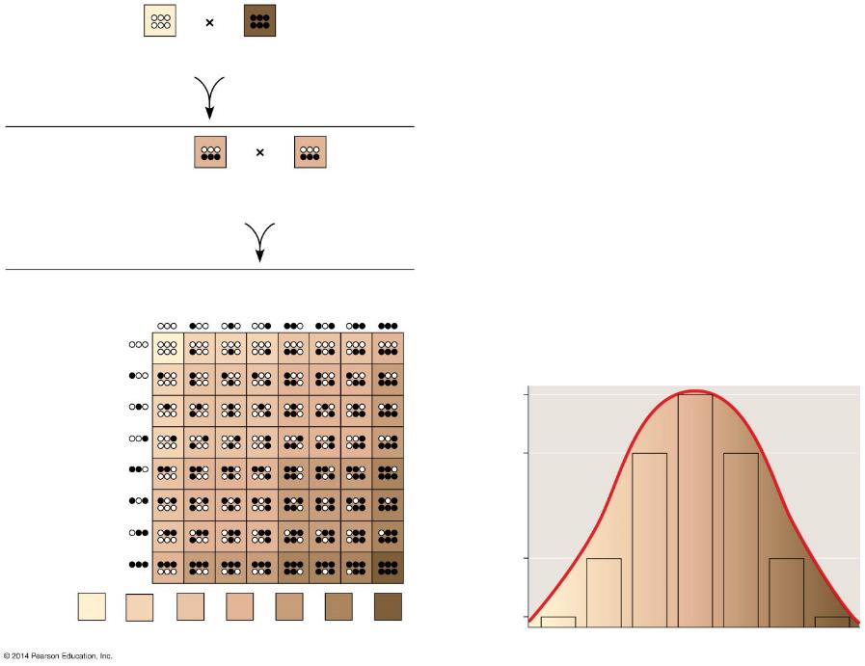
Figure 9.14-0
P generation
aabbcc
(very light)
AABBCC
(very dark)
F₁ generation
AaBbCc
(medium
shade)
AaBbCc
(medium
shade)
Sperm
1
8
1
8
1
8
1
8
1
8
1
8
1
8
1
8
F₂ generation
1
8
1
8
20
64
1
8
1
8
15
64
Eggs
1
8
1
8
Fraction of population
1
8
1
8
6
64
1
64
1
64
6
64
15
64
20
64
15
64
6
64
1
64
Skin color
Notes:
Figure 9.14-0 A model for polygenic inheritance of skin color

Slide 9
9.15 The environment affects many characters
Many characters result from a combination of heredity and the environment.
  skin color is affected by exposure to sunlight
  heart disease and cancer are influenced by genes and the environment.
Identical twins show that a person’s traits are the results of
  genetics
  the environment.
Notes:
Student Misconceptions and Concerns
• As your class size increases, the chances increase that at least one student will have a family member with one of the genetic disorders discussed. Some students may find this embarrassing, but others might have a special interest in learning more about these topics and may even be willing to share some of their family’s experiences with the class.
• After reading the preceding modules, students might expect all traits to be governed by a single gene with two alleles, one dominant over the other. Modules 9.11–9.15 describe deviations from simplistic models of inheritance.
• As these variations of Mendel’s laws are introduced, students are likely to get confused and become uncertain about the prior definitions. Consider keeping a clear definition of these different patterns of inheritance available for the class to refer to as new patterns are discussed (perhaps as a handout for student reference).
Teaching Tips
• The authors note that polygenic inheritance is the opposite of pleiotropy. This is worth noting in lecture as these concepts are discussed. We often remember concepts better when they are contrasted in pairs.
• As the authors are careful to note, although genetics and the environment both contribute to the final phenotypes, only the genetic factors are inherited. This distinction is important to understanding the limitations of Lamarck’s mechanisms of evolution. If you will address principles of evolution soon after this chapter, this may be an important distinction to reinforce in lecture. References to tattoos, piercing, and circumcision may also help to distinguish between environmental influences and inheritance. Students with tattoos will not produce children born with tattoos!
Active Lecture Tips
• See the activity Who Wants to Be a Millionaire? Inheritance on the Instructor Exchange. Visit the Instructor Exchange in the MasteringBiology instructor resource area for a description of this activity.

Slide 10
9.5 The law of independent assortment is revealed by tracking two characters at once
A dihybrid cross is a mating of parental varieties that differ in two characters.
Mendel performed the following dihybrid cross with the following results:
  P generation: round yellow seeds × wrinkled green seeds
  F₁ generation: all plants with round yellow seeds
  F₂ generation:
    9/16 had round yellow seeds
    3/16 had wrinkled yellow seeds
    3/16 had round green seeds
    1/16 had wrinkled green seeds
Notes:
Student Misconceptions and Concerns
• Students using Punnett squares need to be reminded that the calculations are expected statistical probabilities and not absolutes. Just as we would expect that any six playing cards dealt might be half black and half red, we frequently find that this is not true. This might be a good time to show how larger sample sizes increase the likelihood that sampling will reflect expected ratios.
Teaching Tips
• Dihybrid crosses may be the most difficult concept in this chapter. Consider spending additional time to make these ideas very clear. As the text indicates, dihybrid crosses are essentially two monohybrid crosses occurring simultaneously.
Active Lecture Tips
• See the Media Review: “Learn.Genetics” Genetic Science Learning Center from the University of Utah on the Instructor Exchange. Visit the Instructor Exchange in the MasteringBiology instructor resource area for a description of this activity.
• See the activity Interactive Celebrity Parents Genetic Inheritance Game on the Instructor Exchange. Visit the Instructor Exchange in the MasteringBiology instructor resource area for a description of this activity.

Slide 11
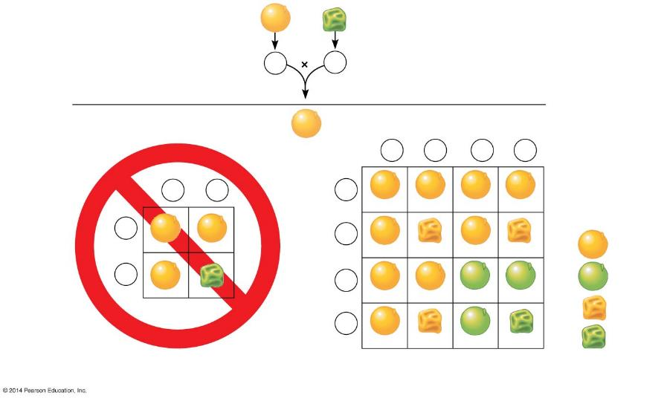
Figure 9.5a-0
P generation
RRYY
rryy
Gametes
RY
ry
F₁ generation
RrYy
Sperm
1
4
RY
1
4
rY
1
4
Ry
1
4
ry
Sperm
1
2
RY
1
2
ry
1
4
RY
RRYY
RrYY
RRYy
RrYy
Results:
RY
1
4
rY
Yellow
round
F₂
generation
Eggs
9
16
Eggs
RrYY
rrYY
RrYy
rrYy
1
2
ry
1
4
3
16
Green
round
Ry
RRYy
RrYy
RRyy
Rryy
3
16
Yellow
wrinkled
1
4
ry
Green
wrinkled
RrYy
rrYy
Rryy
rryy
1
16
The hypothesis of dependent assortment
Not actually seen; hypothesis refuted
The hypothesis of independent assortment
Actual results; hypothesis supported
Notes:
Figure 9.5a-0 Two hypotheses for segregation in a dihybrid cross

Slide 12
9.5 The law of independent assortment is revealed by tracking two characters at once
Mendel needed to explain why the F₂ offspring
  had new nonparental combinations of traits and
  had a 9:3:3:1 phenotypic ratio.
Mendel
  suggested that the inheritance of one character has no effect on the inheritance of another
  suggested that the dihybrid cross is the equivalent to two monohybrid crosses
  called this the law of independent assortment.
Notes:
Student Misconceptions and Concerns
• Students using Punnett squares need to be reminded that the calculations are expected statistical probabilities and not absolutes. Just as we would expect that any six playing cards dealt might be half black and half red, we frequently find that this is not true. This might be a good time to show how larger sample sizes increase the likelihood that sampling will reflect expected ratios.
Teaching Tips
• Dihybrid crosses may be the most difficult concept in this chapter. Consider spending additional time to make these ideas very clear. As the text indicates, dihybrid crosses are essentially two monohybrid crosses occurring simultaneously.
Active Lecture Tips
• See the Media Review: “Learn.Genetics” Genetic Science Learning Center from the University of Utah on the Instructor Exchange. Visit the Instructor Exchange in the MasteringBiology instructor resource area for a description of this activity.
• See the activity Interactive Celebrity Parents Genetic Inheritance Game on the Instructor Exchange. Visit the Instructor Exchange in the MasteringBiology instructor resource area for a description of this activity.

Slide 13
9.5 The law of independent assortment is revealed by tracking two characters at once
The following figure demonstrates the law of independent assortment as it applies to two characters in Labrador retrievers:
  black versus chocolate color
  normal vision versus progressive retinal atrophy.
Notes:
Student Misconceptions and Concerns
• Students using Punnett squares need to be reminded that the calculations are expected statistical probabilities and not absolutes. Just as we would expect that any six playing cards dealt might be half black and half red, we frequently find that this is not true. This might be a good time to show how larger sample sizes increase the likelihood that sampling will reflect expected ratios.
Teaching Tips
• Dihybrid crosses may be the most difficult concept in this chapter. Consider spending additional time to make these ideas very clear. As the text indicates, dihybrid crosses are essentially two monohybrid crosses occurring simultaneously.
Active Lecture Tips
• See the Media Review: “Learn.Genetics” Genetic Science Learning Center from the University of Utah on the Instructor Exchange. Visit the Instructor Exchange in the MasteringBiology instructor resource area for a description of this activity.
• See the activity Interactive Celebrity Parents Genetic Inheritance Game on the Instructor Exchange. Visit the Instructor Exchange in the MasteringBiology instructor resource area for a description of this activity.

Slide 14
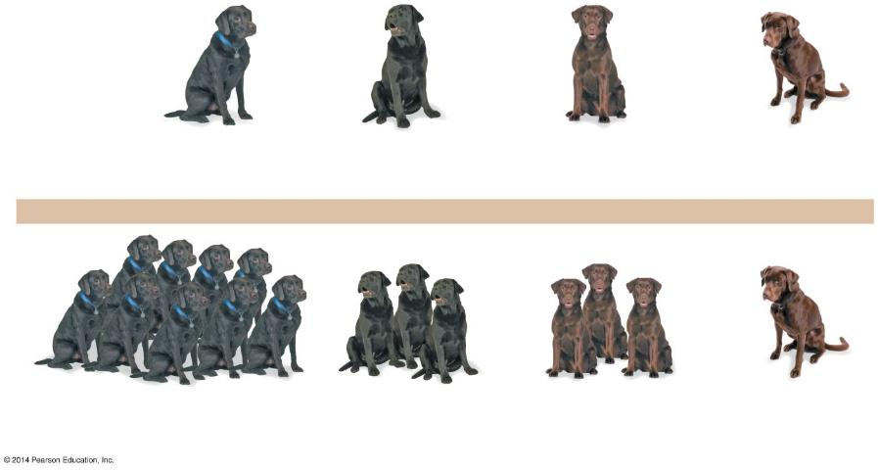
Figure 9.5b-0
Blind
Blind
Phenotypes
Black coat,
normal vision
Black coat,
blind (PRA)
Chocolate coat,
normal vision
Chocolate coat,
blind (PRA)
Genotypes
B_N_
B_nn
bbN_
bbnn
Mating of double heterozygotes (black coat, normal vision)
BbNn × BbNn
Blind
Blind
Phenotypic ratio
of the offspring
9
Black coat,
normal vision
3
Black coat,
blind (PRA)
3
Chocolate coat,
normal vision
1
Chocolate coat,
blind (PRA)
Notes:
Figure 9.5b-0 Independent assortment of two genes in Labrador retrievers

Slide 16
Answer in Notebooks:
#12.

Slide 17
9.16 Chromosome behavior accounts for Mendel’s laws
Mendel’s laws correlate with chromosome separation in meiosis.
  The law of segregation
    states that pairs of alleles separate from each other during gamete formation via meiosis and
    depends on separation of homologous chromosomes in anaphase I.
  The law of independent assortment
    states that each pair of alleles sorts independently of other pairs of alleles during gamete formation and
    depends on alternative orientations of chromosomes in metaphase I.
Notes:
Student Misconceptions and Concerns
• This section of the chapter relies upon a good understanding of the chromosome sorting process of meiosis. If students were not assigned Chapter 8, and meiosis has not otherwise been addressed, it will be difficult for students to understand the chromosomal basis of inheritance or linked genes.
Teaching Tips
• Figure 9.16 requires an understanding of meiosis and the general cell cycle from Chapter 8. Students may need to be reminded that chromosomes are duplicated in the preceding interphase, as indicated in the first step. Furthermore, students may not initially notice that this diagram represents four possible outcomes, not stages of any one meiotic cycle.

Slide 18
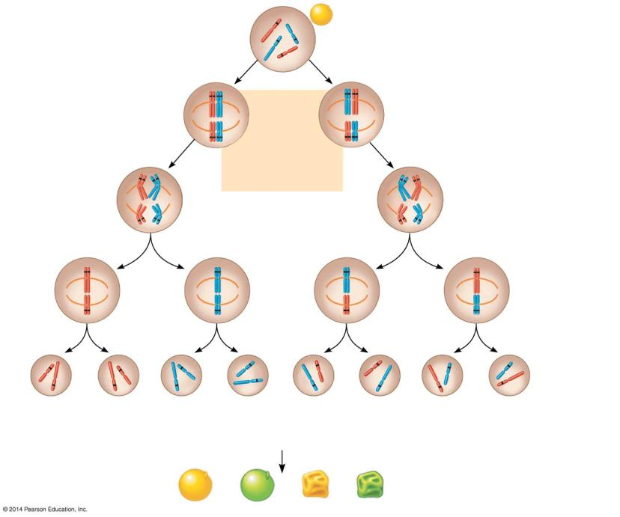
Figure 9.16-1-3
F₁ generation
R
y
All yellow round seeds
(RrYy)
r
Y
R
r
r
R
Two
equally
probable
arrangements
of chromosomes
at metaphase I
Meiosis I
Y
y
Y
y
R
r
r
R
Anaphase I
Y
y
Y
y
R
r
Metaphase
II
r
R
Y
y
Y
y
Meiosis II
Gametes
Y
Y
y
y
Y
Y
y
y
R
R
r
r
r
r
R
R
1
4
RY
1
4
ry
1
4
rY
1
4
Ry
Fertilization among the F₁ plants
F₂ generation
9
: 3
: 3
: 1
Notes:
Figure 9.16-1-3 The chromosomal basis of Mendel’s laws (step 3)

