Slide 1
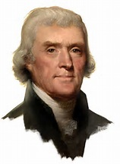
So you think you are as smart as Thomas Jefferson
A Small Quiz

Slide 2
Directions:
On your square, number it from 1 – 10.
You will be given ten statements.
You will answer the statements with “True” or “False”.
All statements are prefaced with the phrase, “At the time Thomas Jefferson was living…”
Answer the questions truthfully – remember – this is during the time of Thomas Jefferson, NOT NOW.

Slide 3
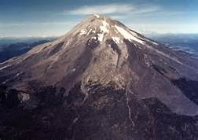
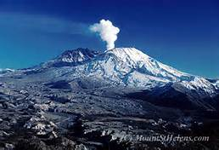
1. At the time Thomas Jefferson was living…”
The West had many erupting volcanoes.

Slide 4
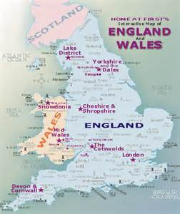
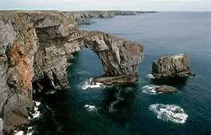
2. At the time Thomas Jefferson was living…”
There was a tribe of blue-eyed Indians living in the West who spoke Welsh, the language of people from Wales, a region on the west coast of the island of Great Britain.

Slide 5
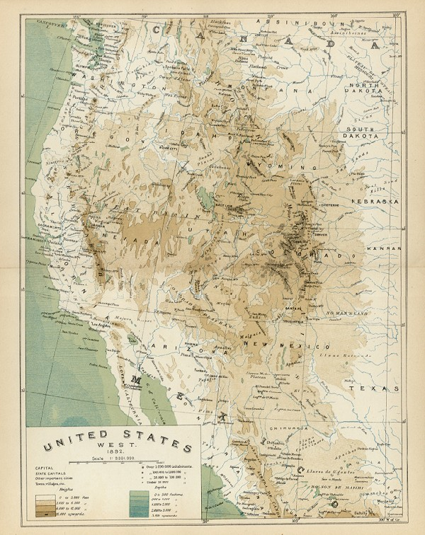
3. At the time Thomas Jefferson was living…”
There was a river or series of connected rivers, starting at the Mississippi, that crossed the western mountains and reached the Pacific Ocean.

Slide 6
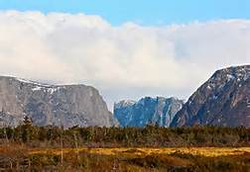
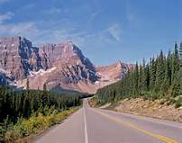
4. At the time Thomas Jefferson was living…”
The Blue Mountains (Appalachians) were taller than the Rocky Mountains.
Appalachian Mountains
Rocky Mountains

Slide 7
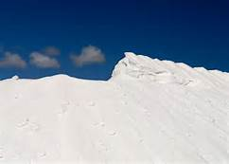
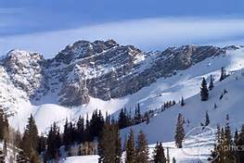
5. At the time Thomas Jefferson was living…”
There were mountains in the West made of undissolved salt.

Slide 8
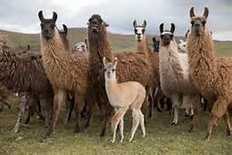
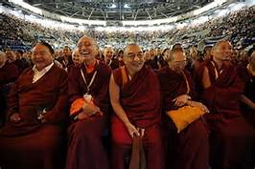
6. At the time Thomas Jefferson was living…”
Peruvian llamas roamed the West.
Peruvian llamas
NOT
Tibetan lamas

Slide 9
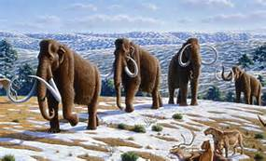
7. At the time Thomas Jefferson was living…”
There were woolly mammoths roaming the West.

Slide 10
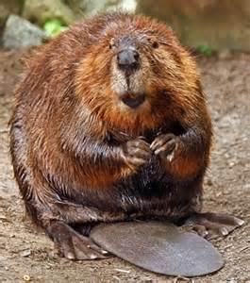
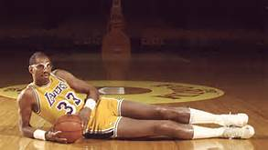
8. At the time Thomas Jefferson was living…”
Some beavers in the West were seven feet tall.

Slide 11
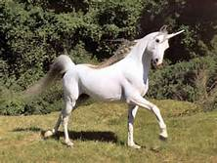
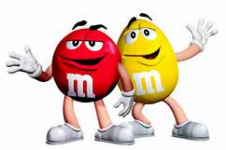
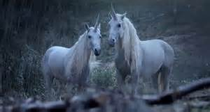
9. At the time Thomas Jefferson was living…”
Look, they do exist!!
Unicorns could be found in the West.

Slide 12
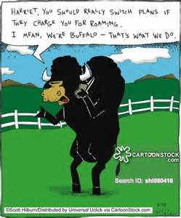
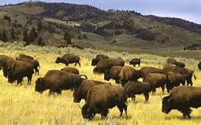
10. At the time Thomas Jefferson was living…”
Buffaloes were friendly and had slim waists.

Slide 13
So … At the time Thomas Jefferson was living…”
How many “True” do you have?
How many “False” do you have?
They were all “FALSE”

