Slide 1
CHAPTER 4: The Chemical Basis of Life
4-3: Compounds of Life:
Lipids

Slide 2
Lipids
Lipids are common organic molecules found in all forms of life.
Some examples of lipids include:
  Fats
  Oils
  Cholesterol
  Testosterone
  Waxes
  Phospholipids

Slide 3
Lipids
Biological functions of lipids:
  Long-term energy storage
  Cell membranes (phospholipids)
  Communication (hormones)
  Insulation

Slide 4
Lipids
What elements are found in all lipids?
Carbon, hydrogen and oxygen
These are the same elements that we found in Carbohydrates. How are lipids different than carbohydrates?
Lipids have much less oxygen than carbohydrates.

Slide 5
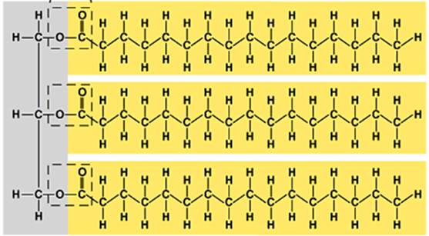
Lipids
General structure of a lipid:
  Fats and oils are formed when 3 fatty acids combine with a 3 carbon molecule called
Glycerol.
glycerol
Fatty acids

Slide 6
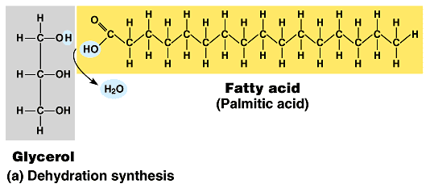
Lipids
General structure of a lipid:
Each fatty acid is joined to the glycerol by the process of
Dehydration Synthesis.

Slide 7
Lipids
What are the differences between fats, oils and waxes?
  Fats use saturated fatty acids, are solid at room temperature and are found in animals.
  Oils use polyunsaturated fatty acids, are liquid at room temperature and are found in plants.
  Waxes are not made with glycerol.

Slide 8
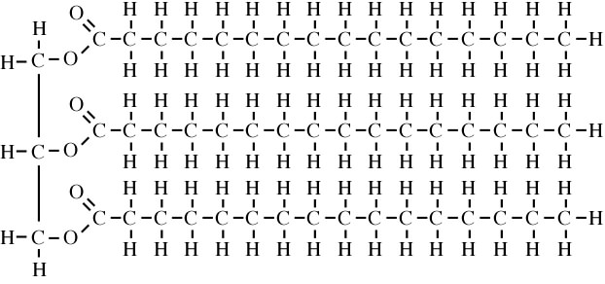
Lipids
Saturated Fats
When we say that a fat is saturated, we mean that it is saturated with . The Carbons are holding onto as many Hydrogens as they can. This is because all of the bonds between the Carbons are .
Hydrogen
Single bonds

Slide 9
Lipids
Why are Saturated Fats solid at room temperature?
Notice that the fatty acids have a and regular shape. This allows them to pack closely together (have a density) and makes them solid at room temperature.
very straight
high

Slide 10
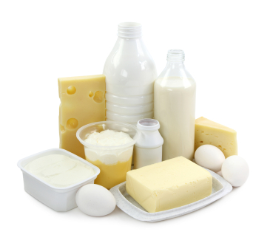
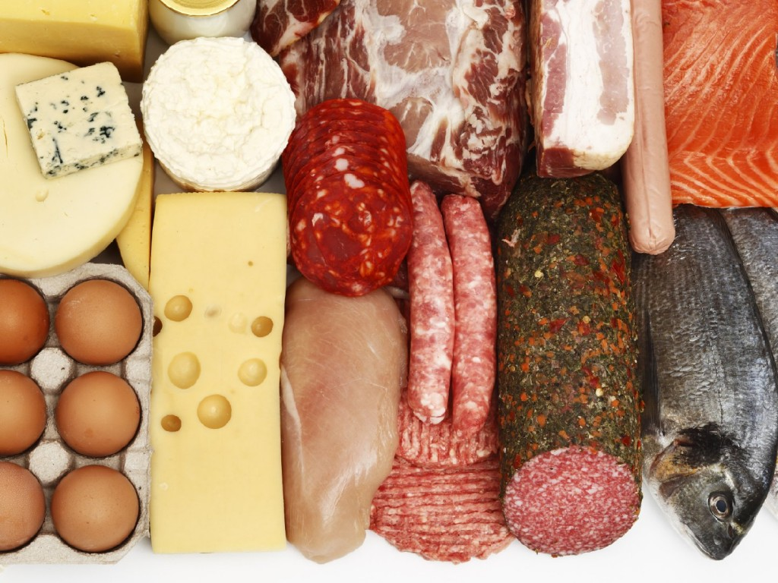
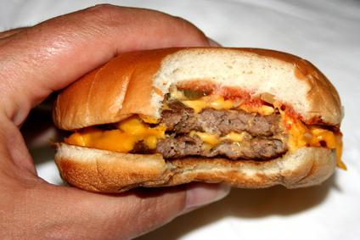
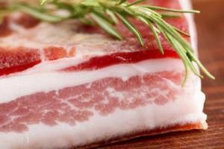
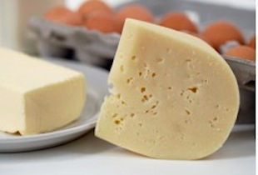
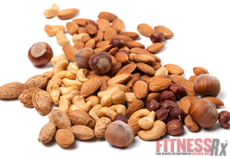
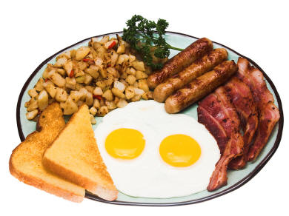
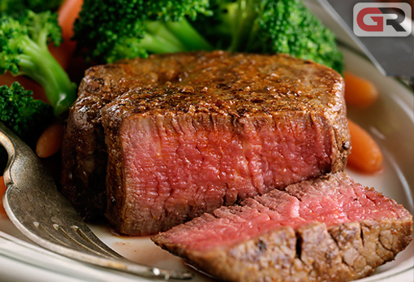
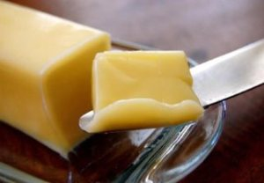
Lipids
Examples of Saturated fats

Slide 11
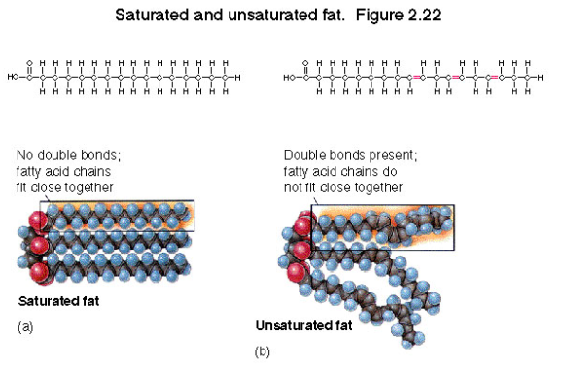
Lipids
Unsaturated Fats
Being an unsaturated fat means that the Carbons are holding onto as many Hydrogens as they can. This is because some
NOT
of the bonds between the Carbons in the fatty acids are .
Double or
Triple bonds

Slide 12
Lipids
Why are Unsaturated Fats liquid at room temperature?
The double or triple bonds along the fatty acid creates . This means that they cannot
kinks
pack closely together (have a density) and makes them liquid at room temperature.
low

Slide 13
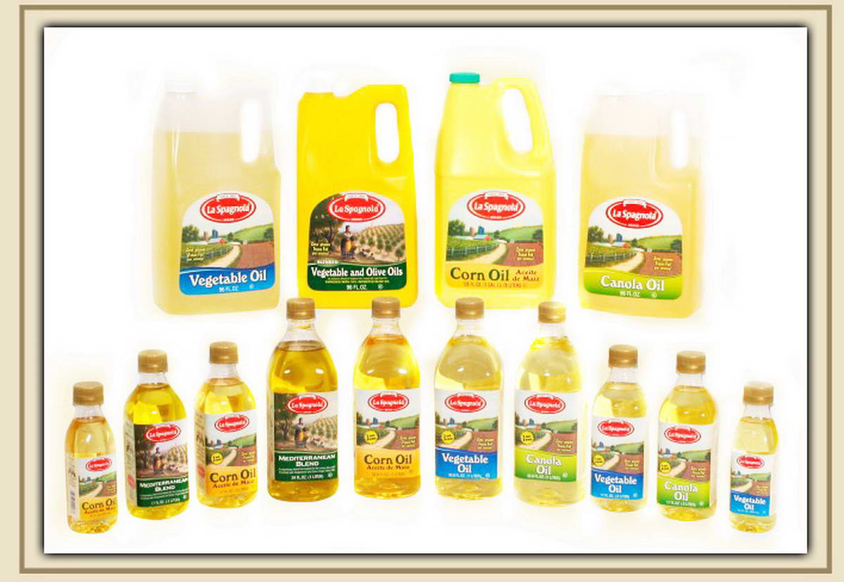
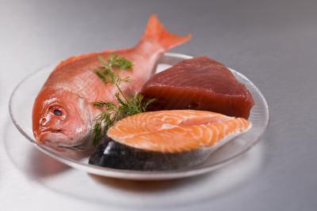
Lipids
Examples of polyunsaturated fats

Slide 14
Lipids
Unsaturated Fats
  Monounsaturated fats have double or triple bond.
  Polyunsaturated fats have double or triple bonds.
Trans fats or hydrogenated oils are the result of forcing hydrogens onto an unsaturated fat.
  Why would food manufacturers do this?
one
many

Slide 15
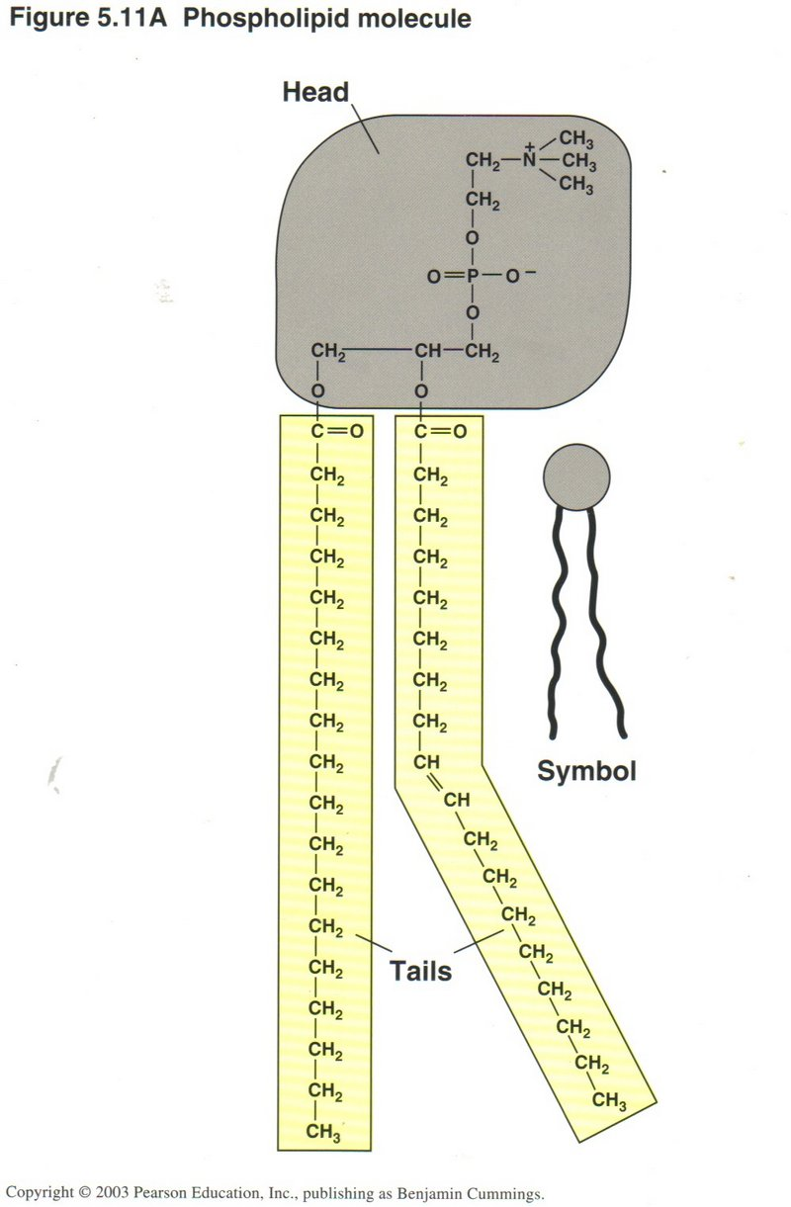
Lipids
Phospholipids –
Like a regular lipid, a phospholipid
starts with a molecule of
To this are attached
and a
This phosphate group has
on it and therefore
being around water.
a special type of lipid used to make biological membranes
glycerol
2 fatty acids
Phosphate group
negative
charges
loves

Slide 16
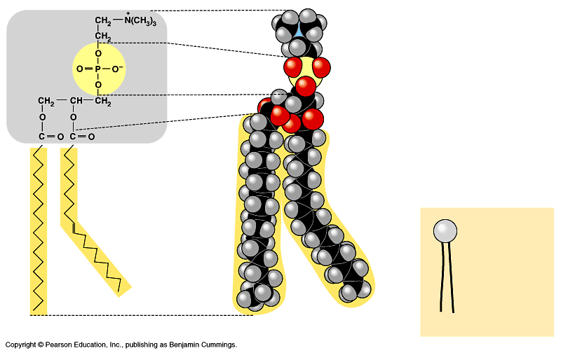
Phospholipid

Slide 17
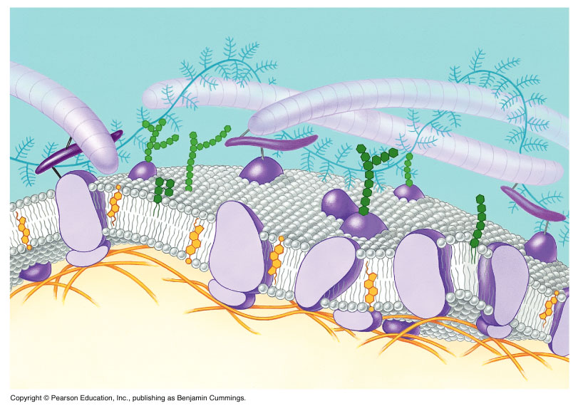
Cell Membrane
Used to control how FLUID the membrane is

Slide 18
Other Lipids

Slide 19
Lipids as Hormones

