Slide 1
11.3 Nationalism and Sectionalism

Slide 2
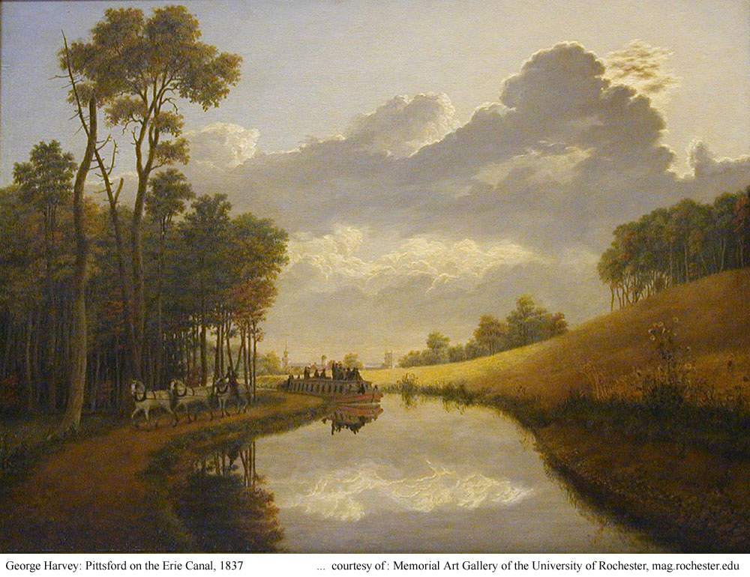
Lesson 11.3 – Nationalism and Sectionalism
We will learn that while patriotic pride increased national unity, tensions grew between the North and the South.

Slide 3
Key Questions
What factors helped promote national unity?
What factors increased sectional tension?
How were U.S. borders made more secure?

Slide 4
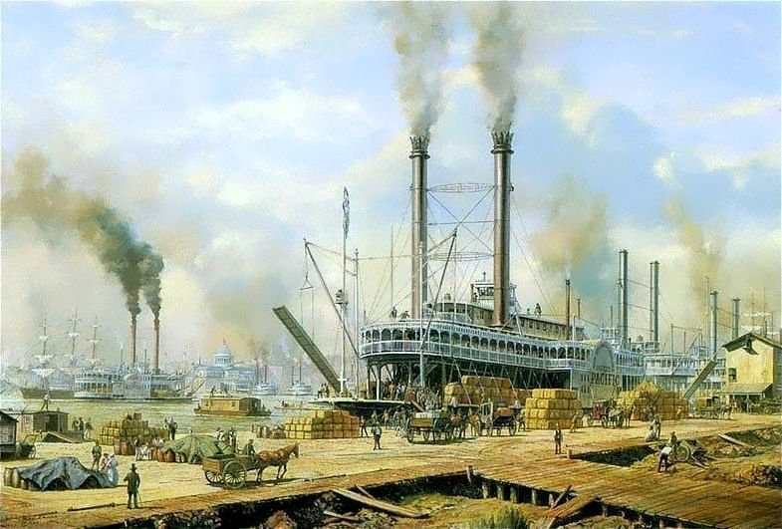
What We Already Know
Men like Robert Fulton and Henry Miller Shreve had developed steam ships that opened much of the nation’s interior to trade.

Slide 5
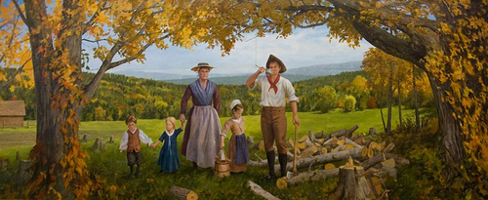
What We Already Know
The Louisiana Purchase opened up land west of the Mississippi River to settlement, and Americans quickly began settling there.

Slide 6
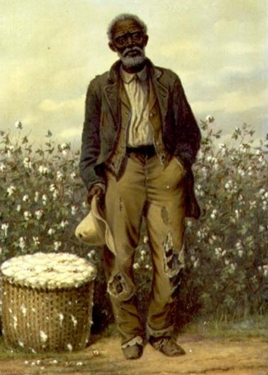
What We Already Know
As the plantation system spread westward into new areas, so too did slavery.

Slide 7
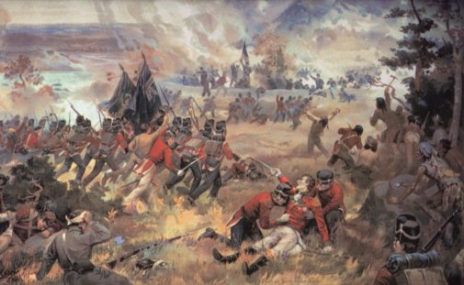
What We Already Know
America’s ability to stand up to the British during the War of 1812 caused a huge wave of national pride to sweep across the country, even though the war itself had ended in a draw.

Slide 8
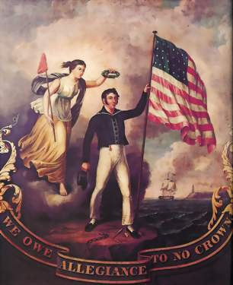
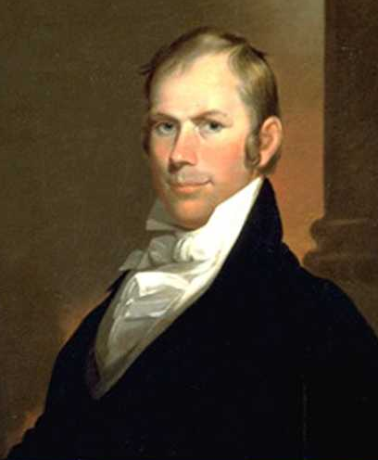
After the War of 1812, a wave of nationalism swept across the United States.
Nationalism is a feeling of pride, loyalty, and protectiveness toward your country.
Henry Clay, from Kentucky, was the Speaker of the House of Representatives, and a strong nationalist.
Clay’s goal was to make the country stronger and more unified.

Slide 9
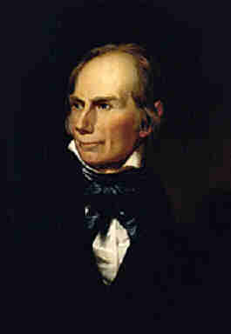
Clay’s plan to strengthen the country and unify its regions was based on making the country more self-reliant.
“Every nation should anxiously endeavor to establish its absolute independence, and consequently be able to feed and clothe and defend itself. If it rely upon a foreign supply that may be cut off . . . it cannot be Independent.”
-- Henry Clay

Slide 10
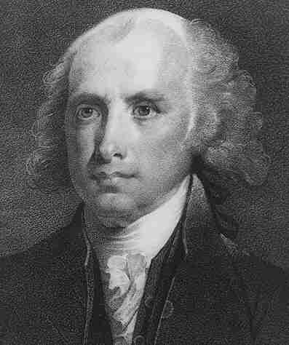
Nationalism Unites the Country
In 1815, President Madison presented a plan developed by Henry Clay to Congress.
The goal of the plan, known as the American System, was to make the country economically self-sufficient.

Slide 11
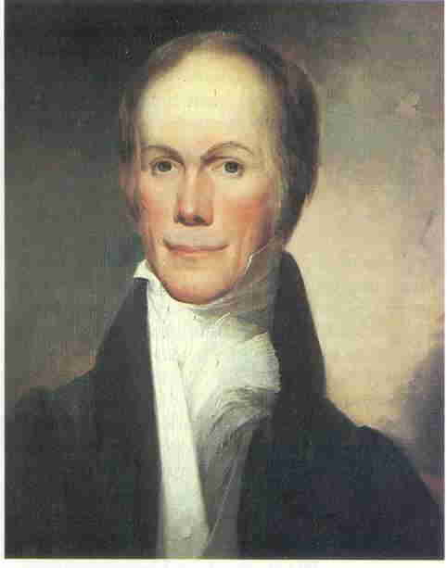
Nationalism Unites the Country
Clay’s plan included three main actions:
a system of protective tariffs
a national bank with a single currency
a series of improvements to the country’s transportation systems (roads and canals)
These are often referred to as internal improvements.

Slide 12
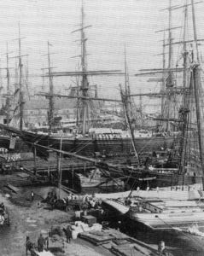
The protective tariff made European goods more expensive and encouraged Americans to buy cheaper American-made products.
Nationalism Unites the Country

Slide 13
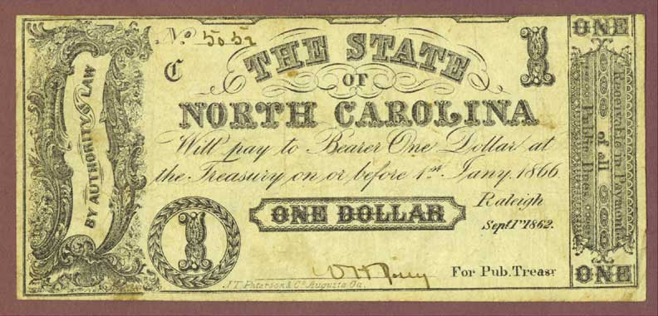
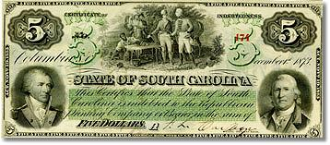
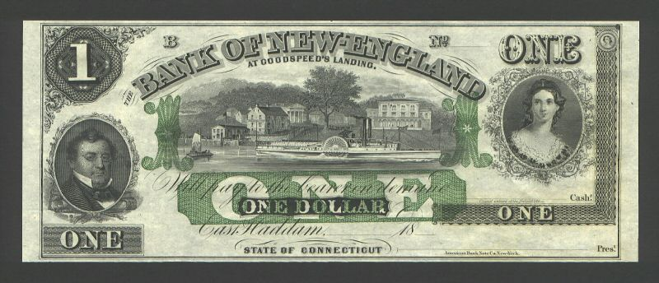
A national bank would make trade easier by promoting a single currency.
Nationalism Unites the Country
In 1816, Congress passed a protective tariff and set up the second Bank of the United States.

Slide 14

Improving the country’s transportation systems would contribute to a strong economy, because poor roads made transportation slow and costly.
Nationalism Unites the Country

Slide 15
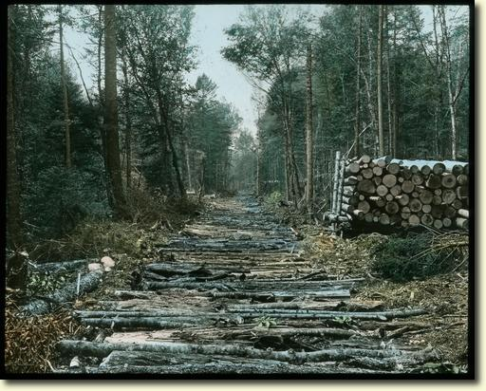
Corduroy Road through the Forest

Slide 16
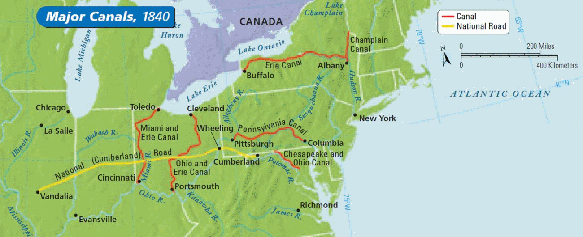
Roads and Canals Link Cities
Between 1806 and 1841, Congress had funded the construction of the National Road linking Cumberland, Maryland, to Vandalia, Illinois.
Water transportation also improved between 1825 and 1850, which is often called the Age of Canals.

Slide 17
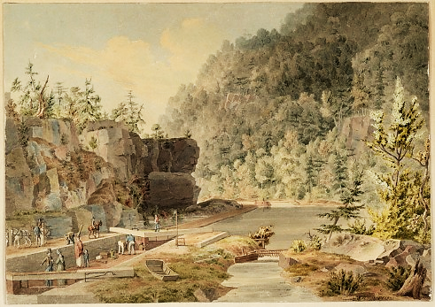
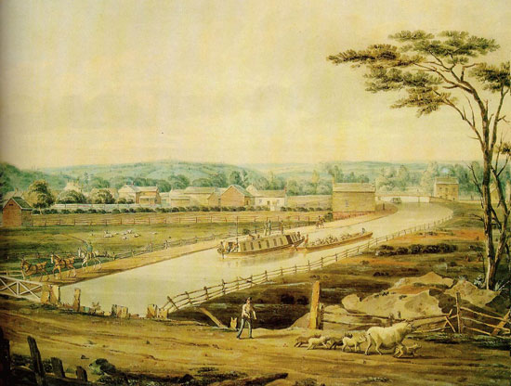
Roads and Canals Link Cities
The first canal major canal project completed was the massive Erie Canal.
The Erie Canal created a water route between New York City and Buffalo, New York.
Completed in 1825, the canal opened the upper Ohio Valley and the Great Lakes region to settlement and trade.

Slide 18
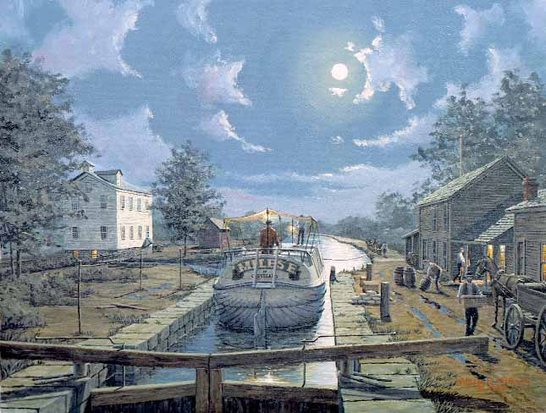
The Erie Canal stimulated nationalism.
The canal allowed farm products from the Great Lakes region to flow east and people and factory goods from the East to flow west.

Slide 19
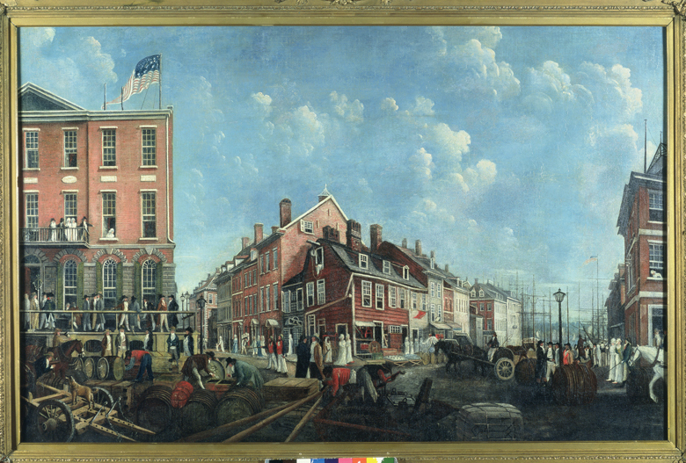
Trade stimulated by the canal helped New York City become the nation’s largest city.

Slide 20
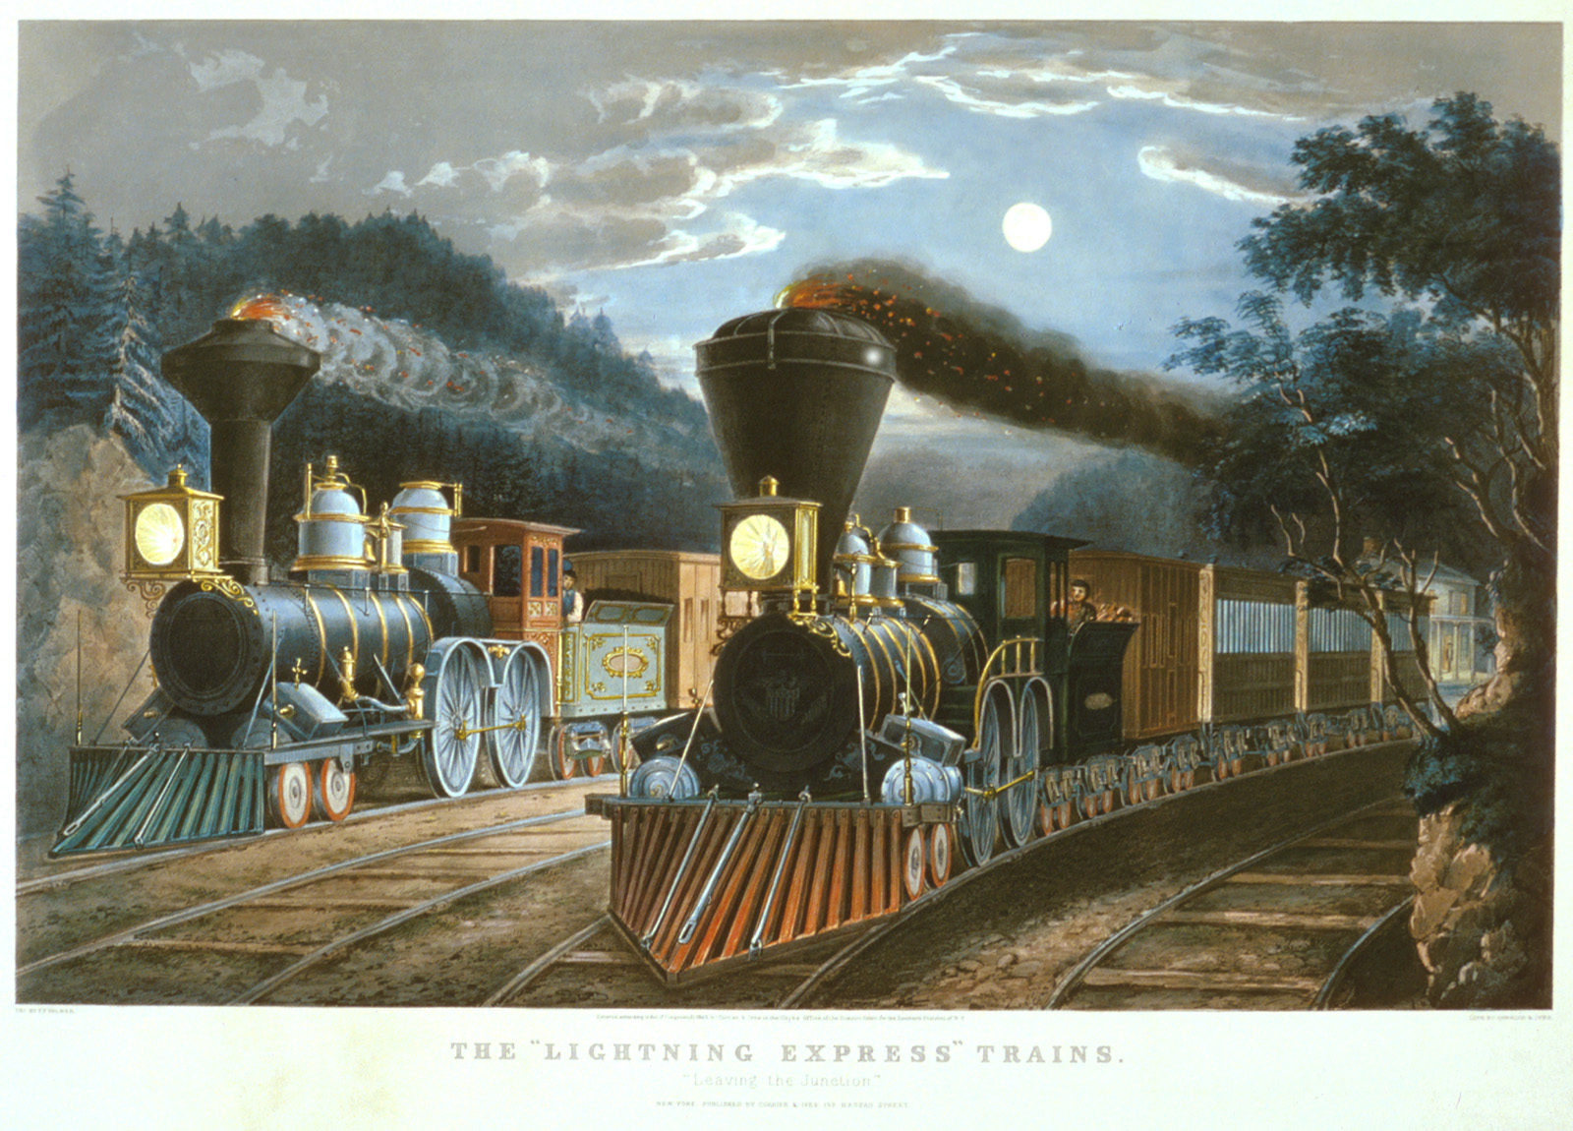
A New Way to Travel
Around the 1830s, the nation began to use steam-powered trains for transportation.
In 1830, only about 30 miles of track existed in the United States.
By 1850, the number had climbed to 9,000 miles.
Improvements in rail travel led to a decline in the use of canals.

Slide 21
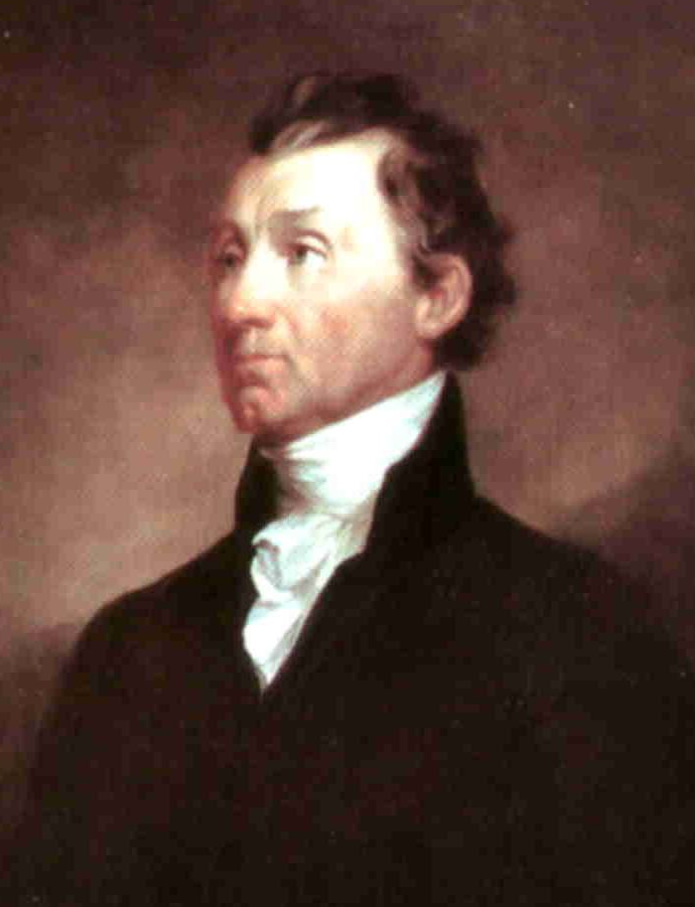
The Era of Good Feelings
As nationalist feelings spread, the people’s loyalty shifted away from state governments toward the federal government.
Democratic-Republican James Monroe won the presidency in 1816 by a large majority.

Slide 22
The Era of Good Feelings
The Federalist Party provided little opposition to Monroe, and it soon disappeared.
This period without major political differences was called the Era of Good Feelings.

Slide 23
Supreme Court Decisions:
McCulloch v. Maryland
Key issue: State Powers vs. Federal Supremacy
McCulloch v. Maryland:
  In 1816, Congress created the Second Bank of the U.S. (1st charter expired)
  Opponents of the bank want to hurt its operation by having state banks tax the federal bank
  James McCulloch, a cashier from Maryland, refused to pay the tax
  Supreme Court decided that the government did have the right to set up the bank and that states did not have the authority to tax a federal agency.
“The power to tax involves the power to destroy”

Slide 24
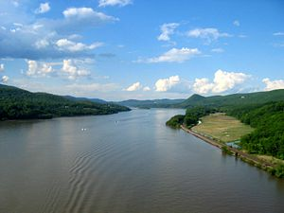
Supreme Court Decisions:
Gibbons v. Ogden 1824
In 1824, two steamship operators from N.Y. and N.J. fought over shipping rights on the Hudson River.
The Court ruled that interstate commerce could only be regulated by the federal government.

Slide 25
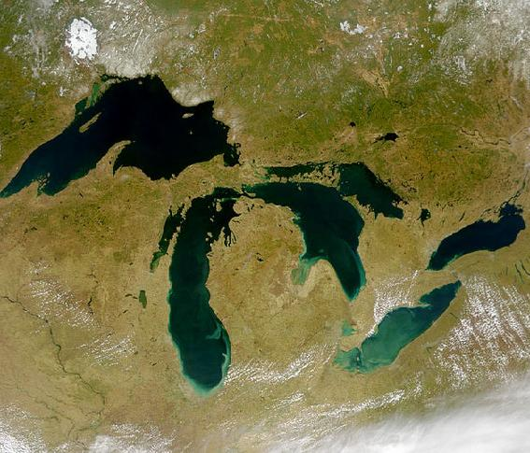
Settling National Boundaries
President Monroe used treaties to ease tensions between the United States and Britain.
The Rush-Bagot Agreement (1817) with Britain limited each side’s naval forces on the Great Lakes.

Slide 26
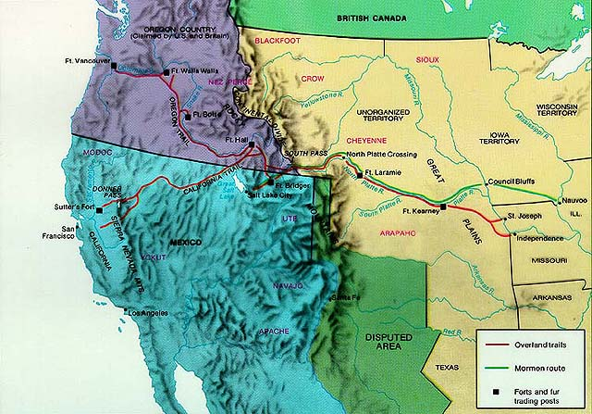
Settling National Boundaries
President Monroe used treaties to ease tensions between the United States and Britain.
The Rush-Bagot Agreement (1817) with Britain limited each side’s naval forces on the Great Lakes.
The Convention of 1818 set the 49th parallel as the U.S.-Canadian border as far west as the Rocky Mountains.

Slide 27
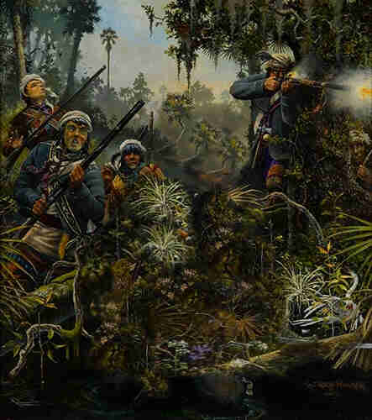
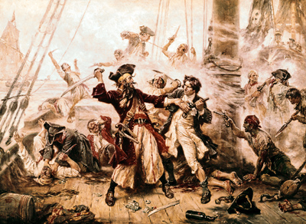
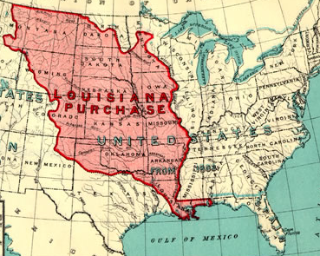
Settling National Boundaries
Spain and the United States disagreed on the boundaries of the Louisiana Purchase and the ownership of West Florida.
Pirates and runaway slaves used Spanish-held East Florida as a refuge.
The Seminoles of East Florida raided white settlements in Georgia.

Slide 28
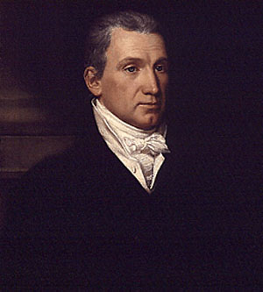
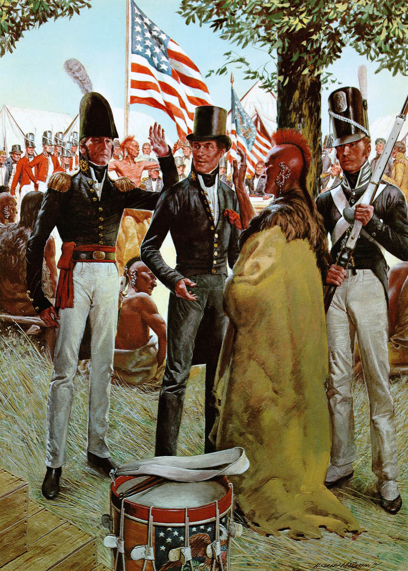
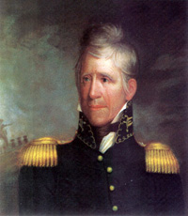
In 1817, President Monroe ordered General Andrew Jackson to stop the Seminole raids, but Jackson also went on to claim the Floridas for the United States.
When Spain protested, Monroe suggested Spain could either police the Floridas or turn them over to the United States.

Slide 29
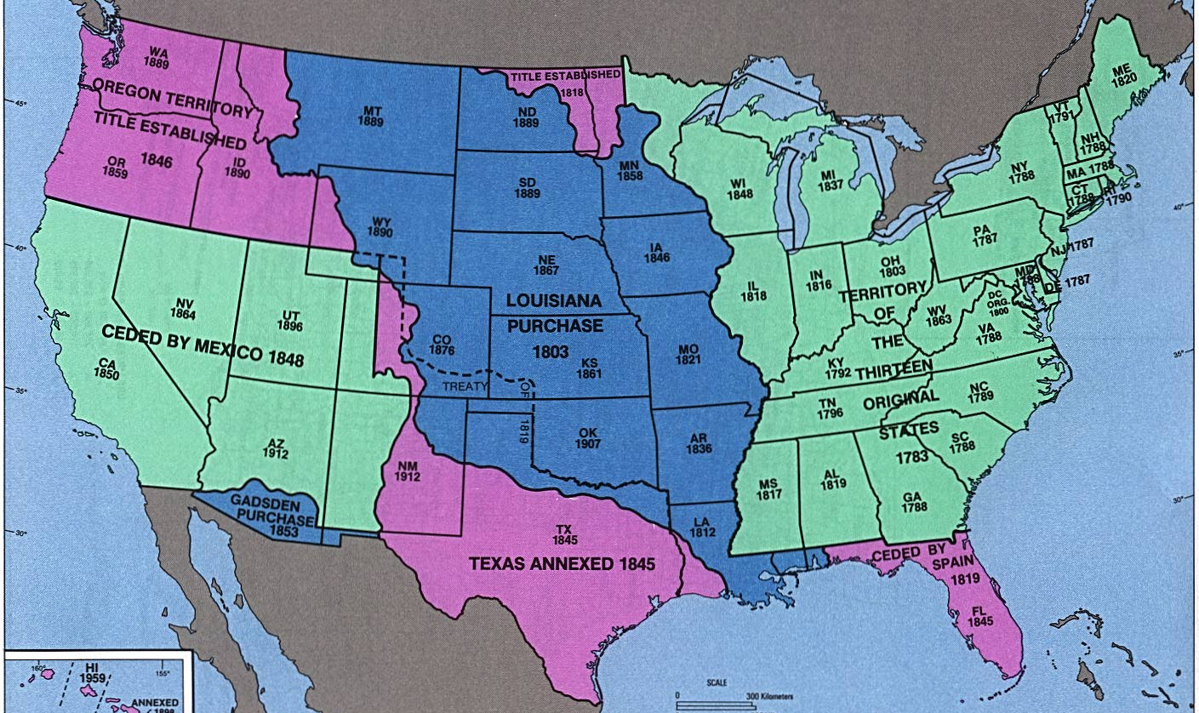
In the Adams-Onís Treaty of 1819, Spain handed Florida to the United States and gave up claims to the Oregon Country.

Slide 30
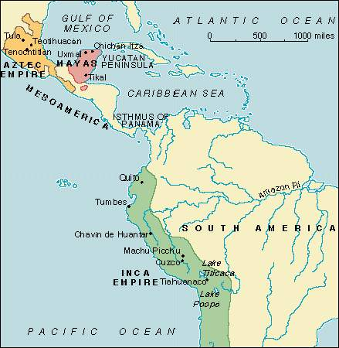
The Monroe Doctrine
The United States was concerned by events in Latin America.

Slide 31
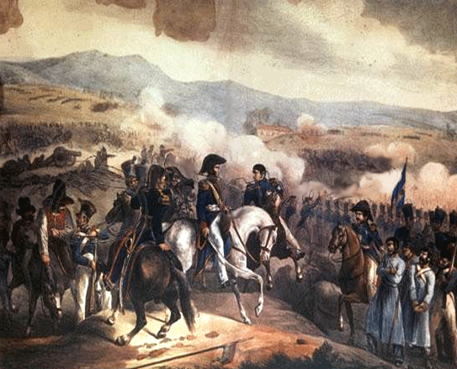
The Monroe Doctrine
Several European monarchies planned to help Spain and Portugal regain the colonies which had successfully fought for their independence.
U.S. leaders feared that if this happened, their own government would be in danger.

Slide 32
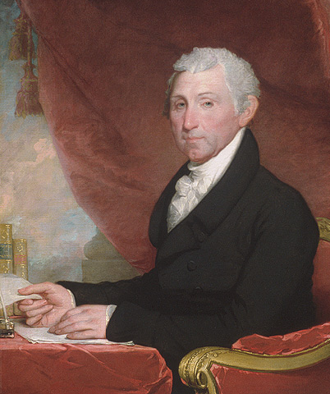
The Monroe Doctrine
In December 1823, President Monroe issued a statement that became known as the Monroe Doctrine.
He warned that efforts to reestablish colonies would be seen as a threat to American peace and safety. (warned Europe to stay out of Americas)
He promised that the U.S. would stay out of European affairs.
The Monroe Doctrine showed that the United States saw itself as a world power and protector of Latin America.

Slide 33
Invoking the Monroe Doctrine
We have used the Monroe Doctrine several times…
1895 – Venezuela and British Guinea had a boundary dispute; America forces them to settle dispute
Used Monroe Doctrine to send troops to Nicaragua, Haiti, Guatemala, Cuba, the Dominican Republic, Grenada, and Panama to prevent spread of Communism

Slide 34
Sectional Tensions Increase
At the same time nationalism was unifying the country, sectionalism was threatening to drive it apart.

Slide 35
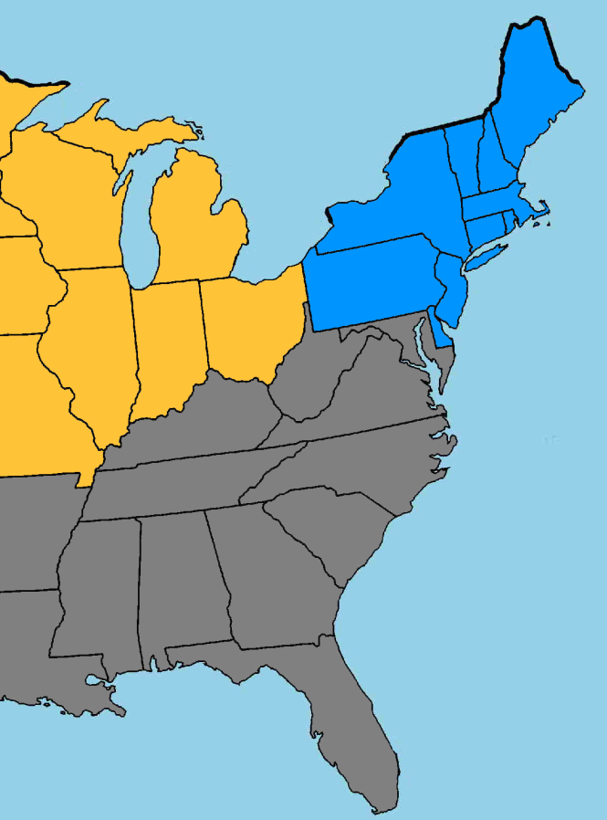
The United States in 1820
The South was relying on a plantation economy that used slavery.
In the Northeast, wealth was based on manufacturing and trade.
In the West, settlers wanted cheap land and good transportation.
The interests of these sections were often in conflict.

Slide 36
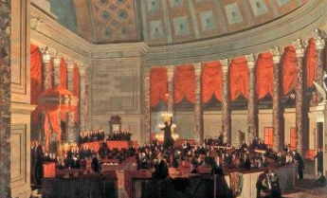
Territorial expansion threatened national unity.
Sectionalism became a major issue when Missouri applied for statehood in 1817.
At the time, the United States consisted of 11 slave states and 11 free states.

Slide 37
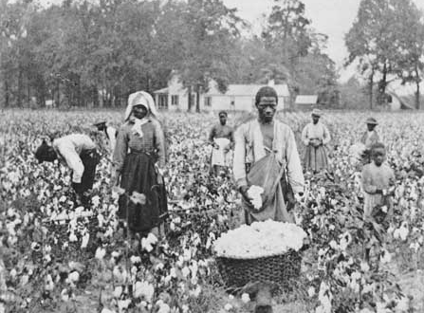
Territorial expansion threatened national unity.
This balance (11 free states & 11 slave states) made it impossible for any national law banning slavery to pass in the Senate.

Slide 38
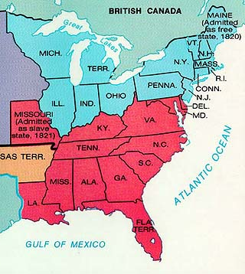
Sectional Tensions Increase
Adding Missouri as a slave state would upset the balance of power in Congress.
Northerners opposed its admission as a slave state while Southerners supported it.
So what should the U.S. do? Any ideas?

Slide 39
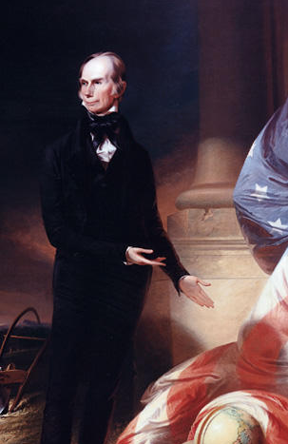
The Missouri Compromise
Henry Clay, the Speaker of the House, came up with a compromise that he hoped would reduce the sectional tensions.
Clay suggested that Missouri be admitted as a slave state and Maine as a free state.

Slide 40
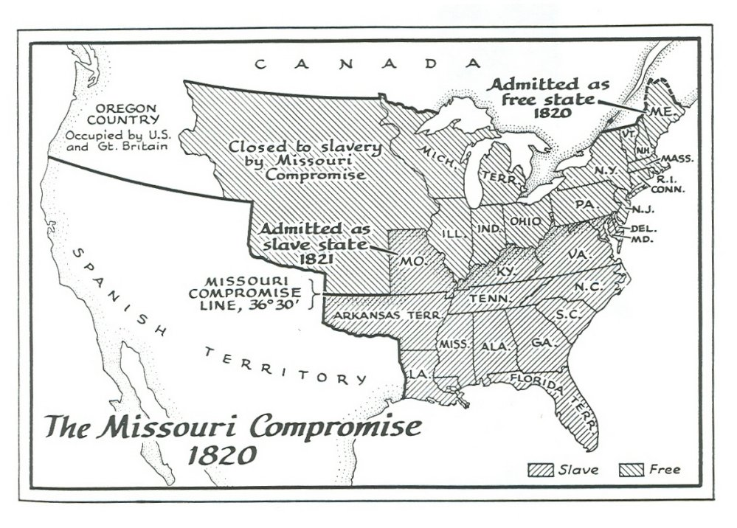
The Missouri Compromise
Clay’s plan, known as the Missouri Compromise, would keep the balance of power in the Senate between the slave states and free states.

Slide 41
It also called for slavery to be banned from the Louisiana Territory north of the parallel 36° 30', Missouri’s southern border.

Slide 42
The Missouri Compromise keeps the peace…for now...

Slide 43
Sources
Nationalism and Sectionalism. Quia. 28 Dec. 2014 <www.quia.com/files/quia/users/awilliams67/Lesson_11.3b.ppt >
Dallek, Robert, Jesus Garcia, Donna Ogle, and C F. Risinger. American History: Beginnings to 1914. Evanston, Ill: McDougal Littell,
2008. Print.

