Slide 1
Creating the Constitution
Chapter 8, Section 2

Slide 2

Call for a C______ Convention
Annapolis Convention – Yr: ___
Purpose: Navigation & T______
Only 5 states show up
A. H _________ suggests meeting again

Slide 3
B. Constitutional Convention (5/25/1787 – 9/17/1787)
Promote national ____ laws
A______ the Articles of Confederation
_____ of the 13 states came: NO R________ I________
Proceedings kept _____ (shh)
U.S. Constitution passed by Constitutional Convention on:
9/17/1787 (KNOW THIS DATE)

Slide 4
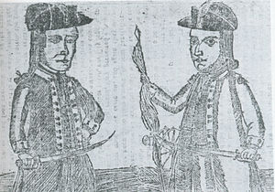
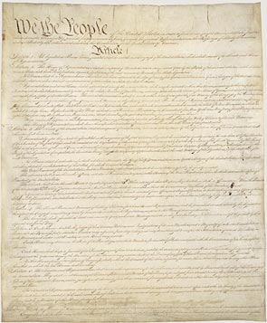
C. Shays’s Rebellion Effect
Ends January, 1787
Fear of farmer uprising plays a part in deciding – SCRAP The A of C
Some call to create a STRONGER NATIONAL gov’t through a NEW CONSTITUTION

Slide 5
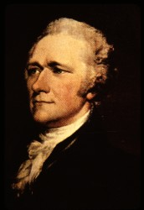
D. Be There or Be Square – OUR FOUNDING FATHERS ALL
1. THERE
G. W____________ (VA)- ___________of the Constitutional Convention
A. H_________ (NY) - pushed for a s_______, n_______ government

Slide 6
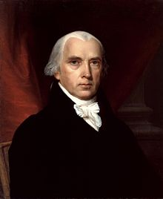
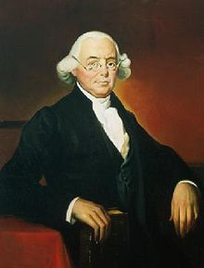
J. M___________ (VA)- “ F____________ of the Constitution” & the V_______ Plan – favored the ________ states; kept great notes; well-read – used Enlightenment ideas
J. W________ (PA) – pushed idea of “popular sovereignty” – means “P________ r_______”

Slide 7
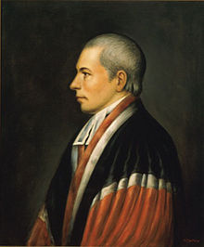
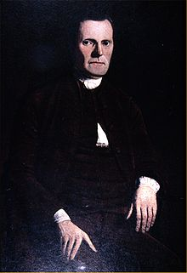
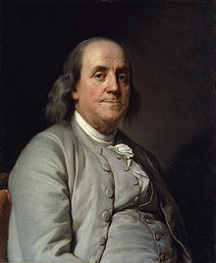
W. Paterson – developed the N___ J________ Plan which favored _____ states
R. S________ - saved the day with the “G________ Compromise” a.k.a. the Connecticut Compromise
B. F________ (PA) – steady leadership; sought compromise; oldest there

Slide 8
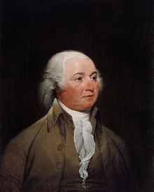
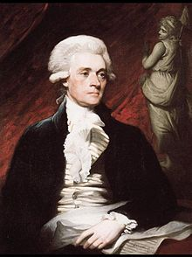
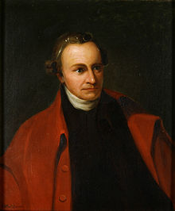
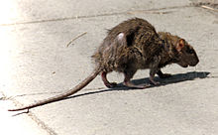
2. SQUARE – not there
J. A__________ - Minister (ambassador) to Britain
T. J__________ - Minister to France
P. H_________ - “he smelled a rat …
tending toward
monarchy”
Monarchy?

Slide 9
Close - Check on Comprehension
The Annapolis Convention was held to try to create:
National trade laws B. A new constitution C. National fishing rights
2. True or False The original reason for the special meeting of the states in Philadelphia in 1787 was to write a new constitution.
3. Called “the Father of the U.S. Constitution” because most of his ideas were used.
A. George Washington B. James Madison C. Ben Franklin
4. Who was the oldest member present that provided calm words?
George Washington B. Ben Franklin C. Roger Sherman
5. The president of the Constitutional Convention was:
Ben Franklin B. George Washington C. James Madison

