Slide 2
9.8 VISUALIZING THE CONCEPT: Genetic traits in humans can be tracked through family pedigrees
The inheritance of human traits follows Mendel’s laws.
A pedigree
shows the inheritance of a trait in a family through multiple generations
demonstrates dominant or recessive inheritance
can also be used to deduce genotypes of family members.
Notes:
Student Misconceptions and Concerns
• Students might think that dominant alleles are naturally (a) more common, (b) more likely to be inherited, and (c) better for an organism. The text notes that this is not necessarily true. However, this might need to be emphasized further in lecture.
Active Lecture Tips
• See the Media Review: “Learn.Genetics” Genetic Science Learning Center from the University of Utah on the Instructor Exchange. Visit the Instructor Exchange in the MasteringBiology instructor resource area for a description of this activity.

Slide 3
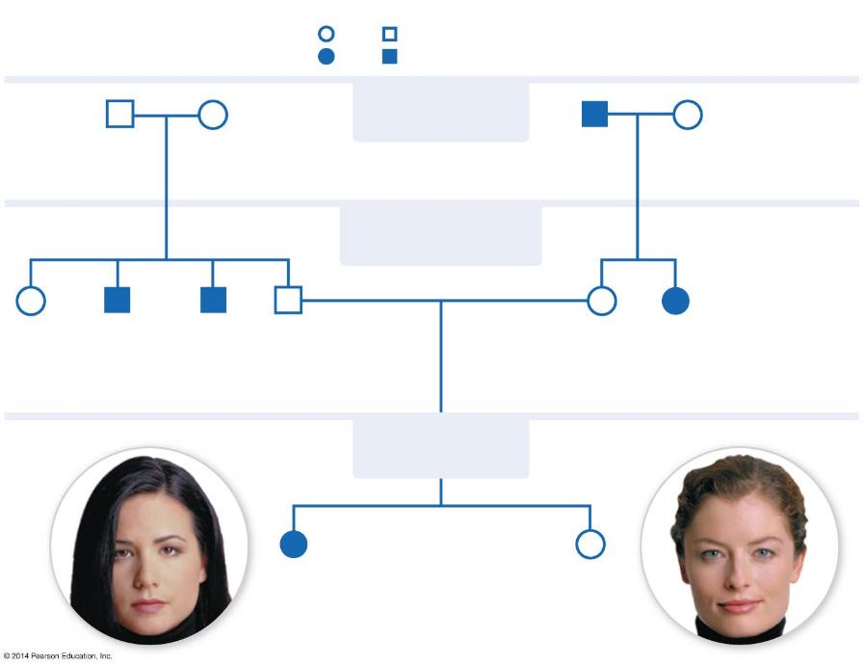
Figure 9.8-2
KEY
Female
Male
Widow’s peak hairline trait
H: widow’s peak allele
Straight hairline trait
h: straight allele
Mating
1st GENERATION
Al
Beth
Charles
Debbie
Children
2nd GENERATION
Evelyn
Frank
Gary
Henry
Isabel
Juliana
Straight hairline
3rd GENERATION
Widow’s peak
Kristin
Lori
Notes:
Figure 9.8-2 Reading a pedigree (step 2)

Slide 4
Figure 9.8-3
KEY
Female
Male
Widow’s peak hairline trait
H: widow’s peak allele
Straight hairline trait
h: straight allele
1st GENERATION
Al
Beth
Charles
Debbie
Hh
Hh
hh
Hh
2nd GENERATION
Evelyn
Frank
Gary
Henry
A parent with a widow’s peak who has a child with a straight hairline must be Hh.
Isabel
Juliana
hh
hh
Hh
Hh
hh
Straight hairline
3rd GENERATION
Widow’s peak
Kristin
Kristin has a straight hairline but her parents do not, so straight hairline
must be homozygous recessive (hh).
Lori
hh
Notes:
Figure 9.8-3 Reading a pedigree (step 3)

Slide 5
Figure 9.8-4
KEY
Female
Male
Widow’s peak hairline trait
H: widow’s peak allele
Straight hairline trait
h: straight allele
1st GENERATION
Al
Beth
Charles
Debbie
Hh
Hh
hh
Hh
2nd GENERATION
Evelyn
Frank
Gary
Henry
Isabel
Juliana
HH or Hh
hh
hh
Hh
Hh
hh
Straight hairline
3rd GENERATION
Widow’s peak
Not all genotypes can be determined. Lori could be HH or Hh and there is no way to know (unless she has some children and the pedigree is extended).
Kristin
Lori
hh
HH or Hh
Notes:
Figure 9.8-4 Reading a pedigree (step 4)

