Slide 1
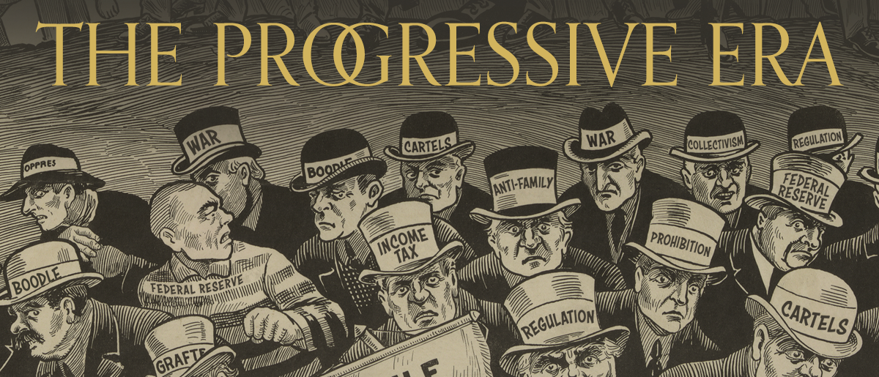
Progressivism
Module 5

Slide 2
Lesson 1: Origins of Progressivism
Big Idea: Political, economic, and social change in the late 19th century America led to broad progressive reforms.
Why it Matters Now: Progressive reforms in areas such as labor and voting rights reinforced democratic principles that continue to exist today.
Key Terms & People: Progressive Movement / Florence Kelley / Prohibition / Muckraker / Scientific Management / Henry Ford / Robert La Follette / Initiative / Referendum / Recall / 17th Amendment

Slide 3
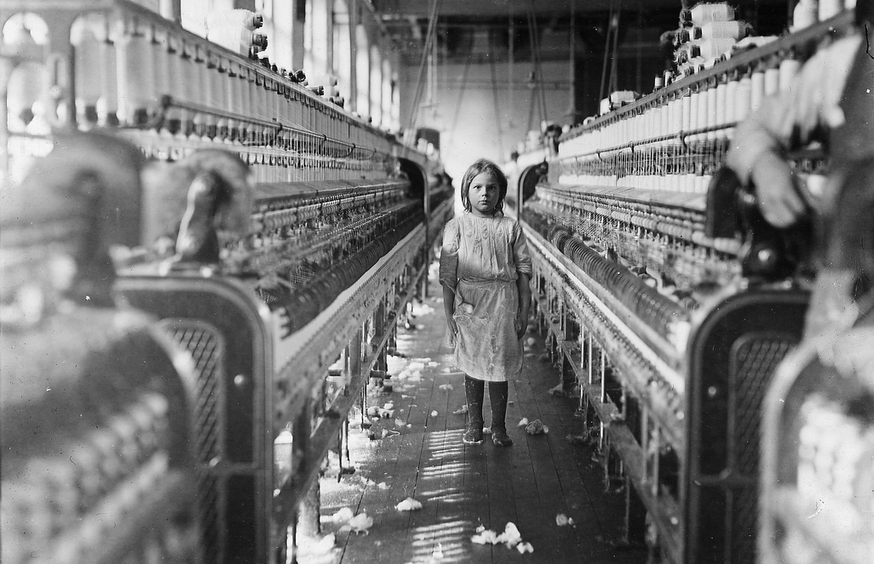
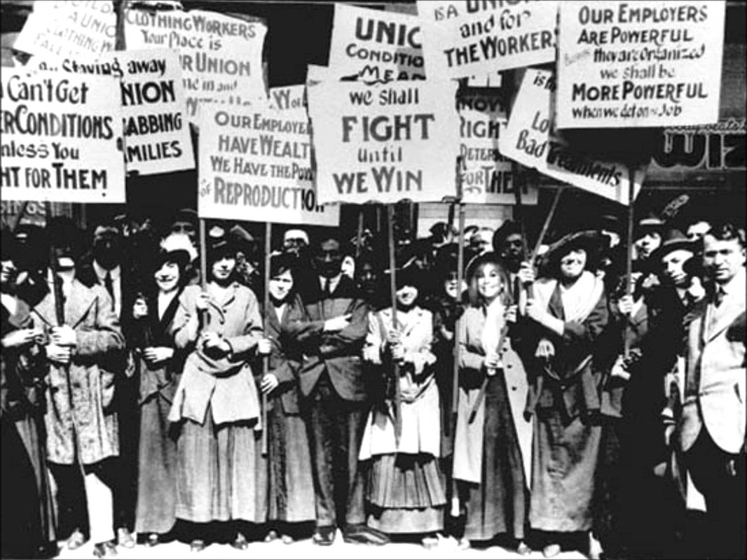
I. Four Goals of Progressivism
No agreement on the problems and their solutions
Shared one of the following four goals
The Progressive Movement:
Restore economic opportunity
Correct injustices

Slide 4
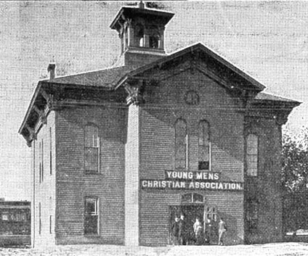
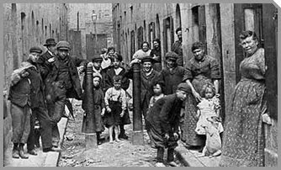
A. Protecting Social Welfare
Softening the harsh conditions of industrialization
YMCA: libraries, classes, pools, courts
Florence Kelley: advocated for women and children
Illinois Factory Act of 1893 – an example for other states

Slide 5
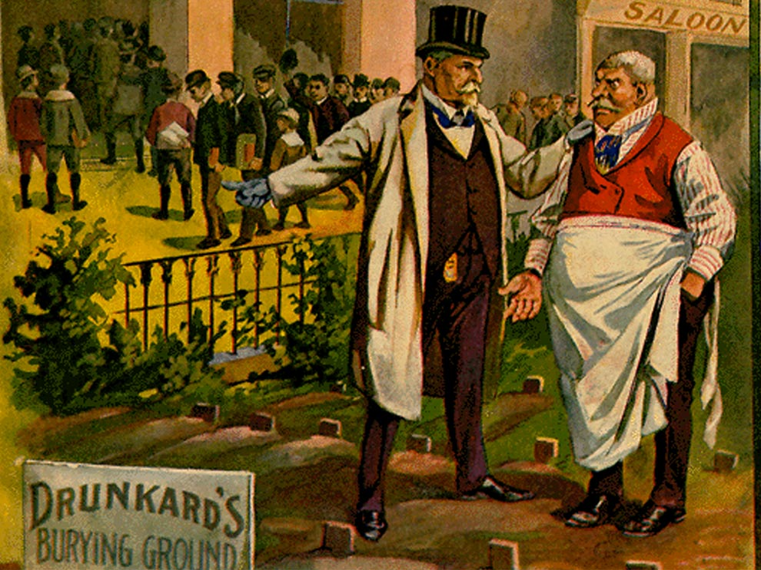
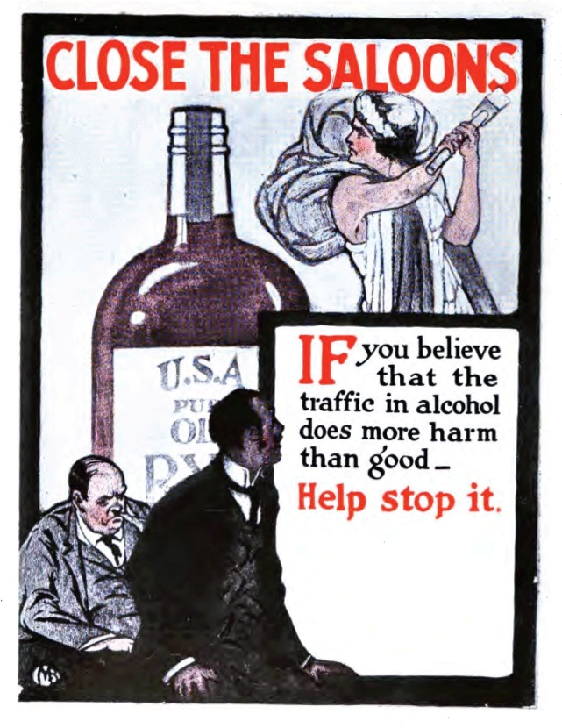
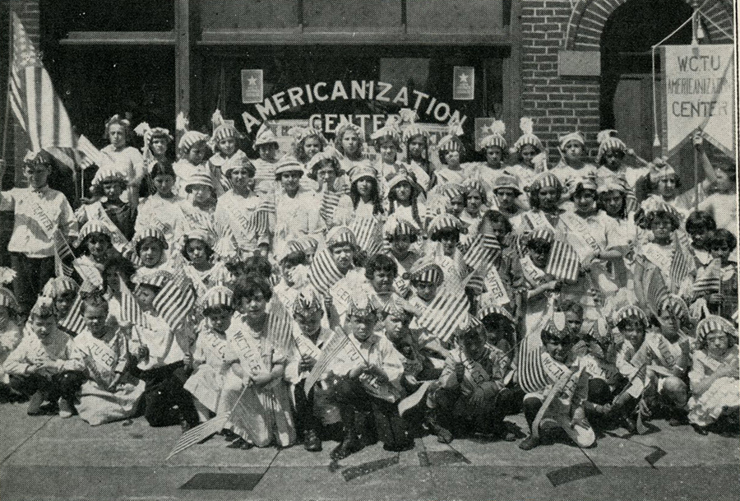
B. Promoting Moral Improvement
Felt morality was key
Ex. Prohibition
WCTU: Women’s Christian Temperance Union
Anti-Saloon League
“Wets”
“Drys”

Slide 6
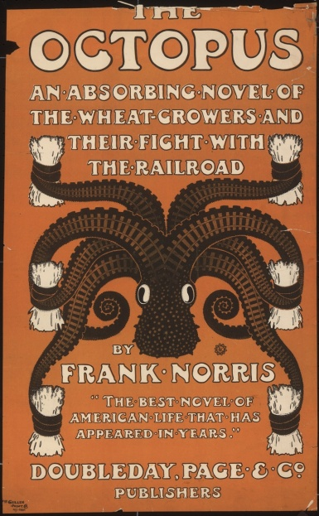
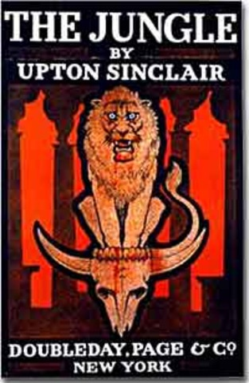
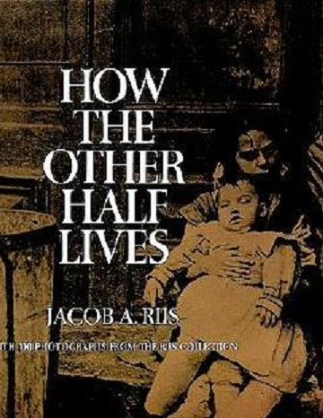
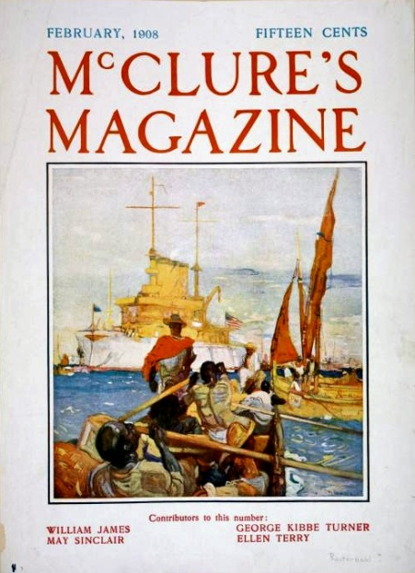
C. Creating Economic Reform
1893 made many push for economic reorganization
1901: Eugene Debs – American Socialist Party
Many distanced themselves from this
Muckrakers
The Octopus
The Jungle
How the Other Half Lives
McClure’s Magazine

Slide 7
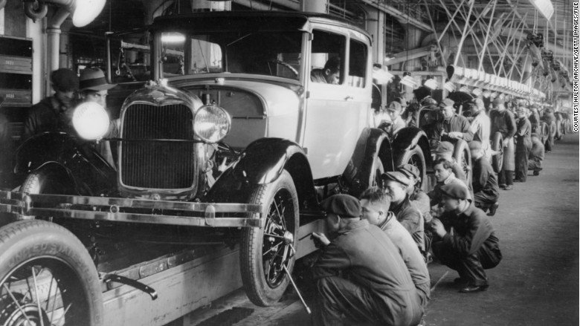
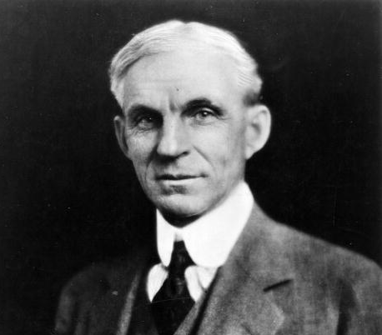
D. Fostering Efficiency
Felt scientific principles would bring efficiency
Louis Brandeis – scientific study of working hours
Frederick Taylor – Taylorism – broke tasks into smaller parts
“Scientific Management”
Henry Ford
Model T
Assembly Line Systems
Rapid Turnover
8 Hrs @ $5 Per Day

Slide 8
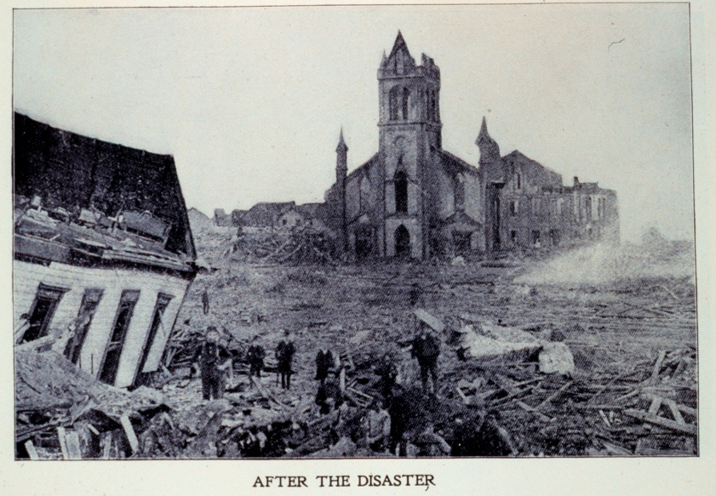
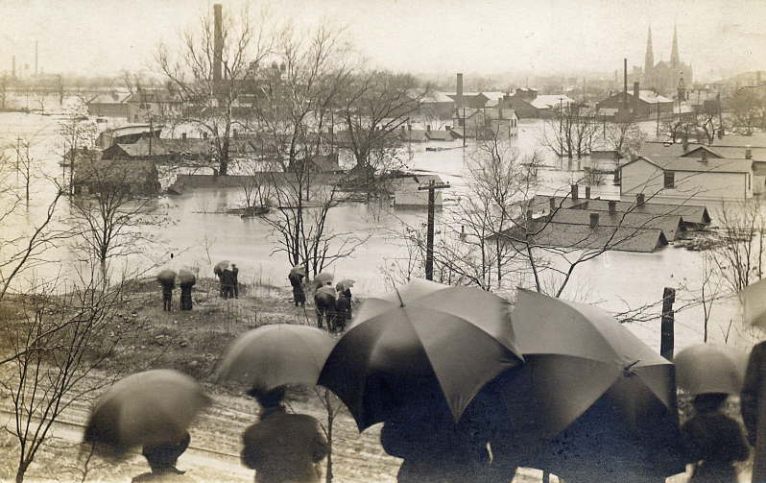
II. Cleaning Up Local Government
A. Reforming Local Government
Natural Disasters
1900 – Hurricane in Galveston, Texas
5 Member Commission
1913 – Dayton, Ohio Flood
City councils appointed department managers

Slide 9
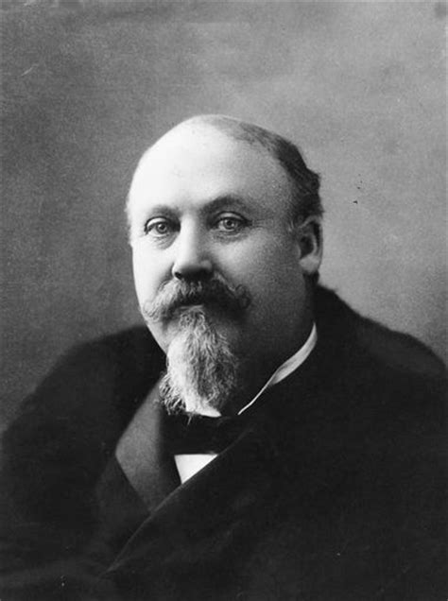
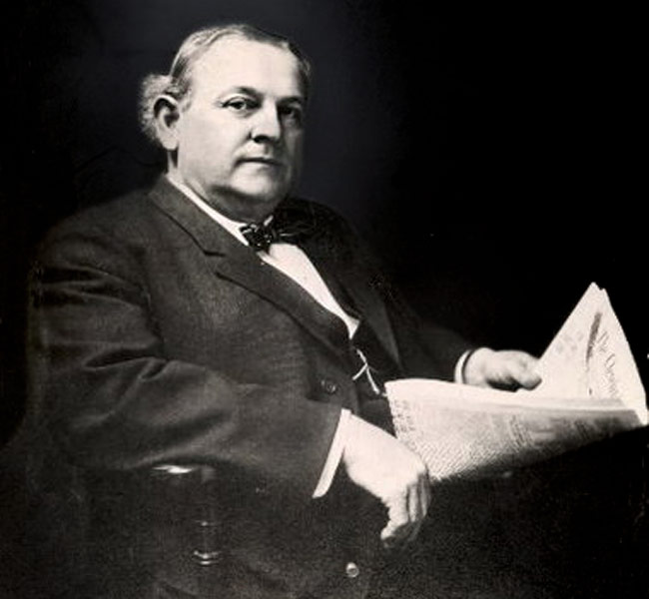
B. Reform Mayors
Some introduced change without altering gov’t
Hazen Pingree – Detroit: fair taxes, lower fares, work relief, built schools, parks, plants
Tom Johnson – Cleveland: dismissed greedy owners of enterprises, circus tent meetings,

Slide 10
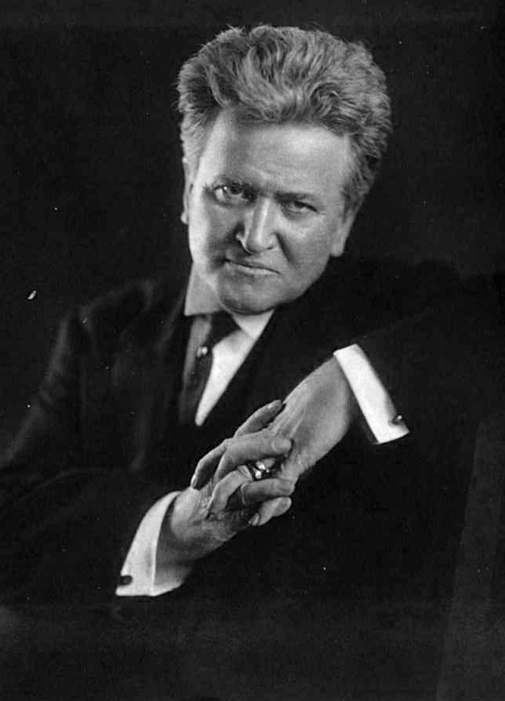
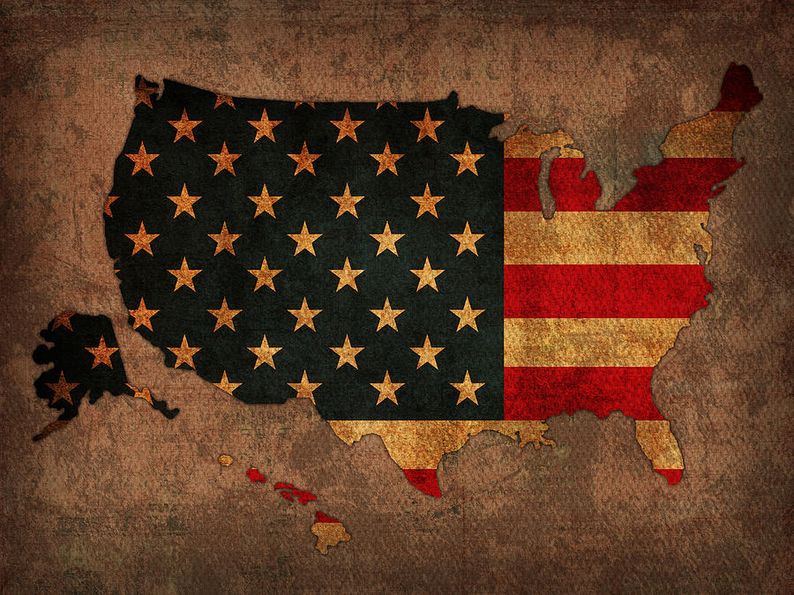
III. Reform at the State Level
A. Reform Governors
Robert La Follette: Laboratories of Democracy / the Wisconsin Idea
Felt voters, not business leaders should control gov’t
Specifically targeted railroads
Taxed, regulated, and forbade free passes

Slide 11
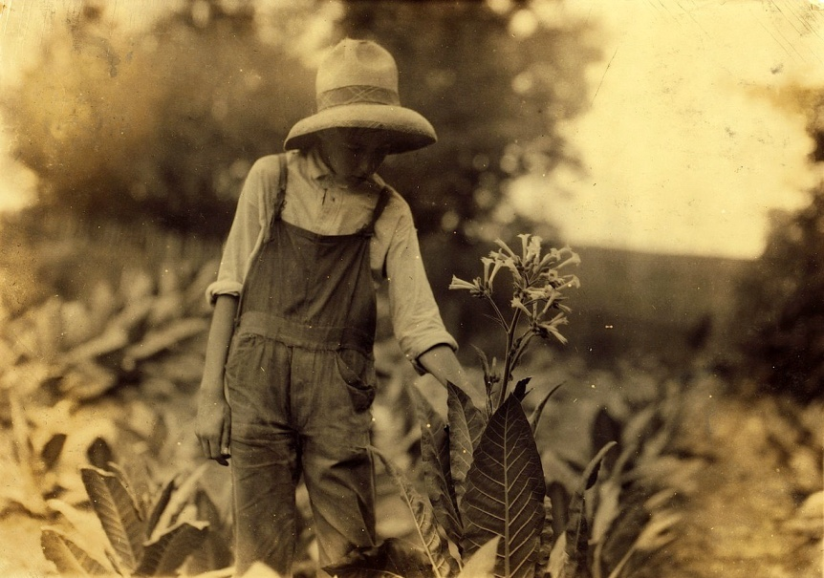
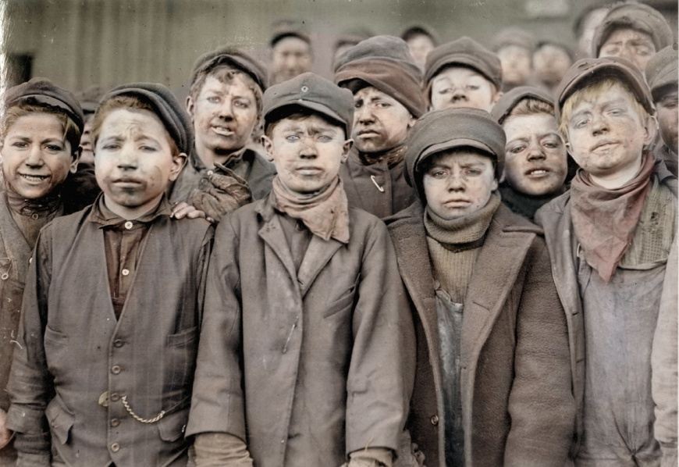
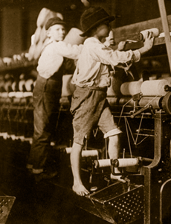
B. Protecting Working Children
Prone to accidents from fatigue
1904: National Child Labor Committee
Investigated working conditions
Published photos & exhibits
1916 – Keating Owens Act: Forbade child labor
Declared unconstitutional
States banned it on their own

Slide 12
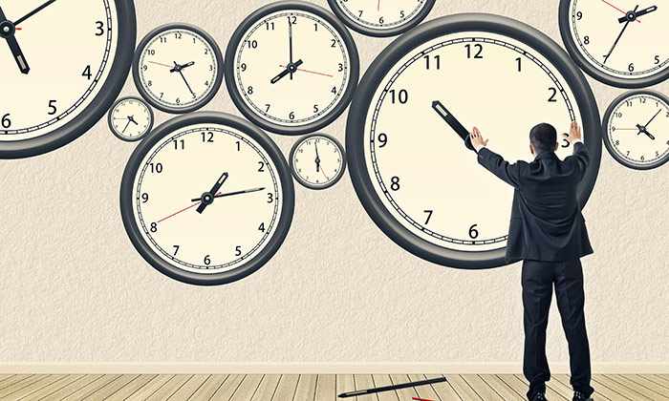
C. Efforts to Limit Working Hours
1908: Muller v. Oregon: reduced women’s working hours to 10
1917: Bunting v. Oregon: upheld a 10 Hr. workday for men.
1902: Maryland was first of many to add benefits upon death and Worker’s Compensation

Slide 13
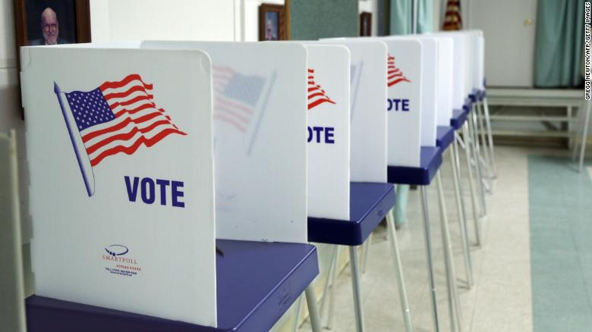
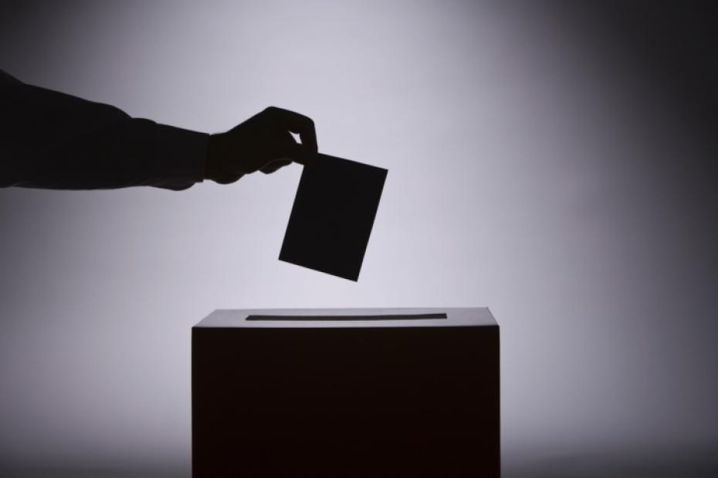
D. Reforming Elections
William U’Ren: gained several victories in Oregon
Secret Ballot
Initiative
Referendum
Recall
I.R.R. were brought about by election rigging in 1888
1899: Minnestota – introduced mandatory statewide primaries

Slide 14
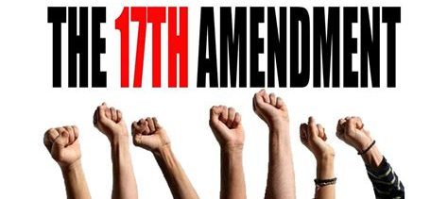
E. Direct Election of Senators
17th Amendment
Previously chosen by sate legislatures
Limited the power of political machines
Allowed more power into the hands of voters

