Slide 1
Lessons 4 & 5: New Technologies & the Dawn of Mass Culture
The Big Ideas: 1. Advances in science and technology helped solve urban problems. 2. More time for leisure led to a new American mass culture
Why it Matters Now: 1. Cities still depend on scientific & technological research. 2. The U.S. today has a worldwide impact on culture.
Key Terms & People: Louis Sullivan / Daniel Burnham / Frederick Law Olmsted / The Wright Bro’s / George Eastman / Ashcan School / Pragmatism / Mark Twain / Joseph Pulitzer / William Randolph Hearst / Rural Free Delivery (RFD)

Slide 2
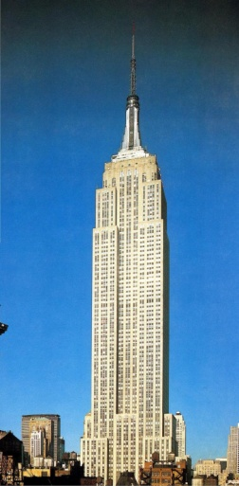
4-I. Technology & City Life
Skyscrapers
Louis Sullivan & the Wainwright Building
Daniel Burnham’s Flatiron Building
Electric Transit
1888 – Richmond, Virginia’s streetcars and trolleys
Commuter rails and “el” trains
Engineering and Urban Planning
Frederick Law Olmsted – Planned urban parks
City Planning
Daniel Burnham – built futuristic cities (ex. Chicago: The White City)
Feeding Cities
George Washington Carver – Crop Rotation
Fritz Haber – Chemical Fertilizers

Slide 3
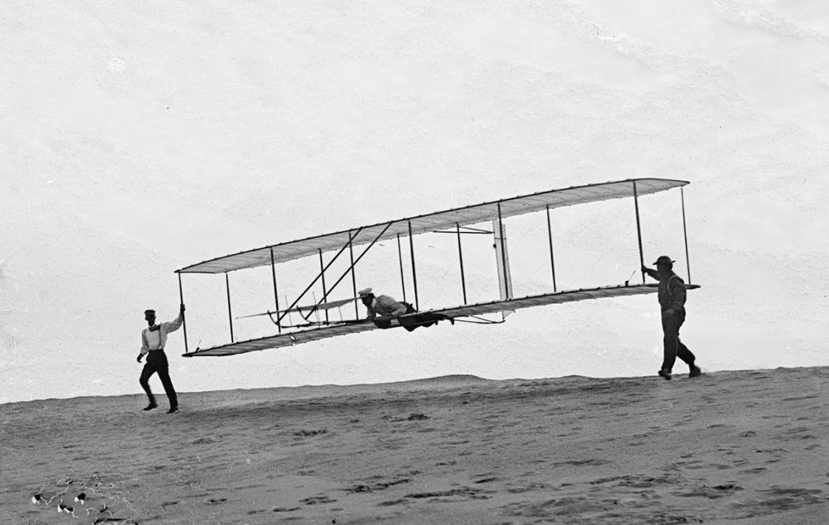
4-II. Advances in Communication
Revolutions in Printing
1890 – Us Literacy Rate is 90%
Electric printing pressed brought newspapers to a penny each
Airplanes
Orville & Wilbur Wright – 1st flight at Kitty Hawk, NC
Dec 7th, 1903 – 120 ft. 12 seconds.
Photographic Explosion
George Eastman – Flexible film, studio processing
1888 – Kodak camera: $25 w/ 100 picture roll
$10 to develop & reload
Turned everyone into a photographer

Slide 4
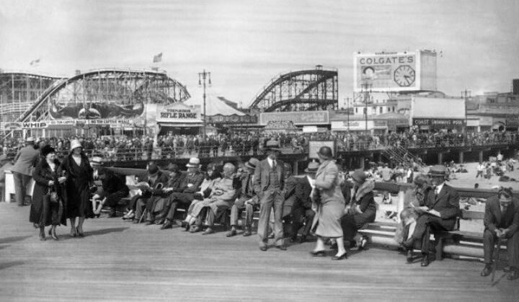
5-I. American Leisure
Amusement Parks
1884: Coney Island
1893: Chicago World’s Exposition
Bicycling & Tennis
Accompanied by Coca-Cola in 1886 and Hershey’s Chocolate in 1900
Spectator Sports
Boxing & Baseball

Slide 5
5-II: The Spread of Mass Culture
Promoting Fine Arts
1900 – Every major city has an art gallery & library
Realism was a popular style
Ashcan School of American Art
Philosophy
Charles Peirce & William James – Pragmatism
Performing Arts
Vaudeville Theater / Motion Pictures & Nickelodeons / Ragtime / Thomas Edison’s Phonograph
Popular Fiction
Dime Novels / Mark Twain: the Adventures of Huckleberry Finn
Mass-Circulation Newspapers:
Joseph Pulitzer & William Randolph Hearst

Slide 6
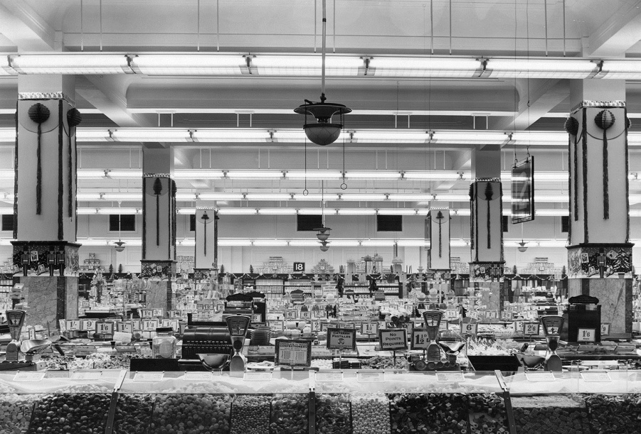
5-III. New Ways to Sell Goods
Urban Shopping
Birth of the shopping center (malls)
The Department Store
The Chain Store – 1870: F.W. Woolworth
Advertising
Medicines / soaps / baking powders
Barns / houses / billboards / rocks used to advertise
Catalogs & RFD
Montgomery Ward & Sears Roebuck
RFD – Rural Free Delivery

