Slide 1
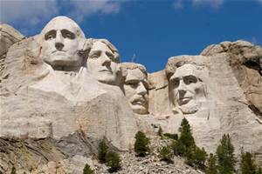
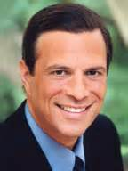
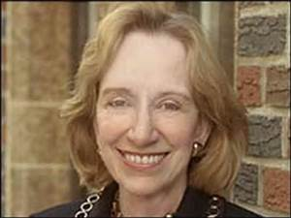
History & Historians:
Michael Beschloss
Vocabulary Explained
Doris Kearns Goodwin

Slide 2
This slide show was created by Mr. Stemler, a confirmed Luddhite, to be used in the completion of the History and Historians definitions on the back of the “Food Fight” worksheet.

Slide 3
Evidence

Slide 4

A clue or something that proves what happened or proves a belief

Slide 5
History

Slide 6
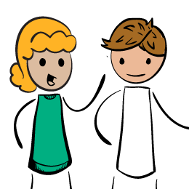
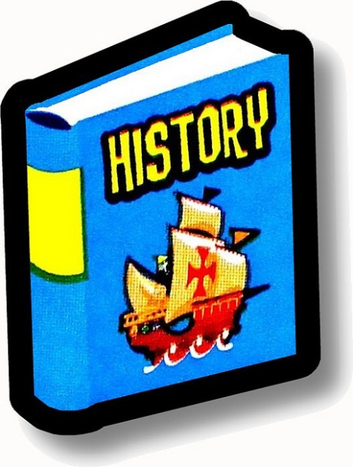
An oral or written account or interpretation of past events
Oral
Written

Slide 7
Historian

Slide 8
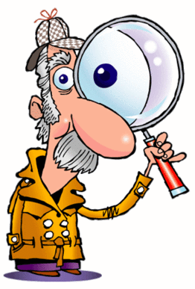
A person who interprets past events through the investigation of clues

Slide 9
Interpret

Slide 10
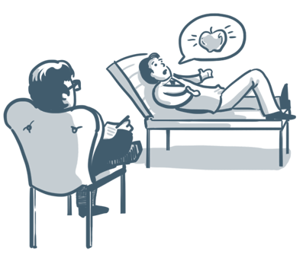
To explain the meaning or importance of evidence
William Tell shot an apple off his son’s head to prove his hatred of Austrian rule.
What was my Dad thinking? I could have been killed.

Slide 11
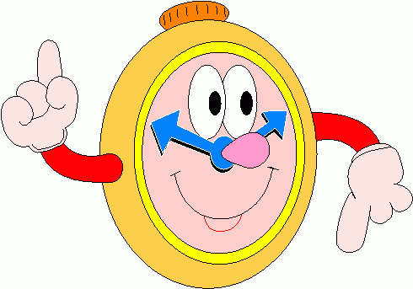
The order or time sequence in which things happen

Slide 12
Contemporary

Slide 13
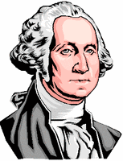

Means “at the time of” or it can mean “modern”
=
George Washington
Thomas Jefferson

Slide 14
Provenance
a.k.a.
provenience

Slide 15

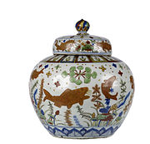
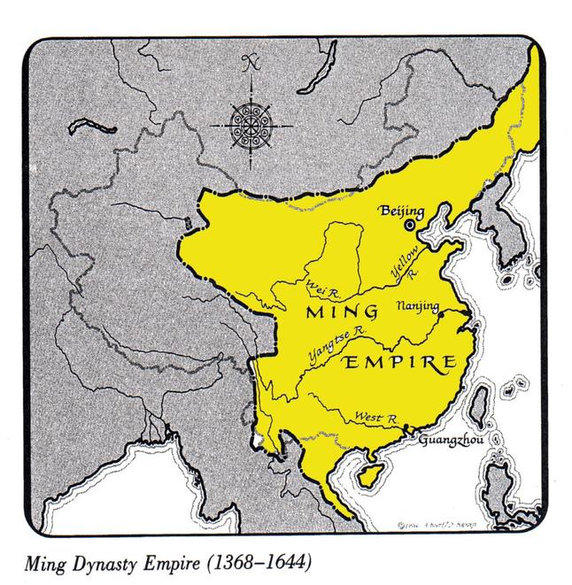
The origin of an idea or object
From
Ming Vase
Who or where an idea starts?

Slide 16
Primary Source

Slide 17

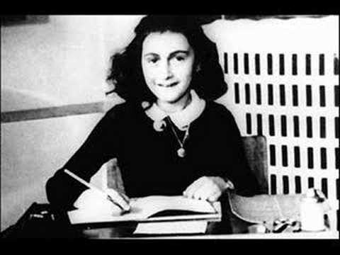
First hand account; original source of information
&

Slide 18
Secondary Source

Slide 19
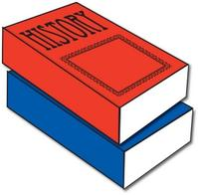
An account made from original, contemporary sources

Slide 20
Oral History

Slide 21
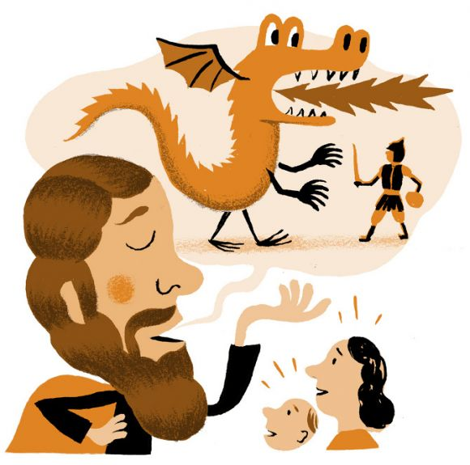
An account of the past which is passed down by word of mouth

Slide 22
Artifact

Slide 23
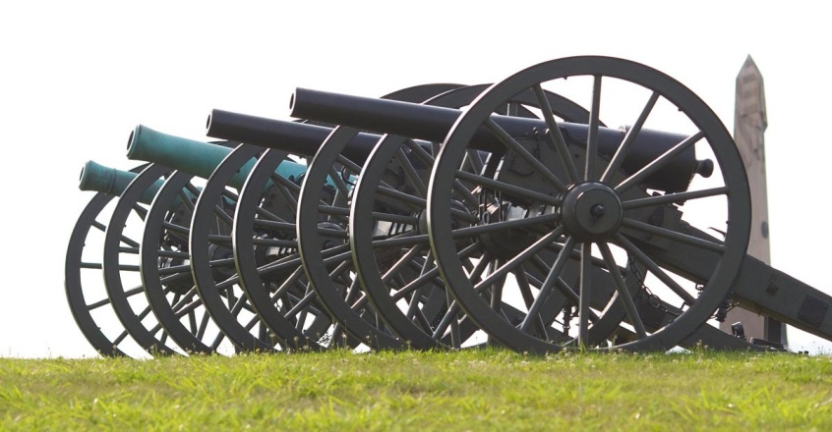
Man-made object of historical importance
Not an example!!
Why?
An example

Slide 24
Perspective

Slide 25
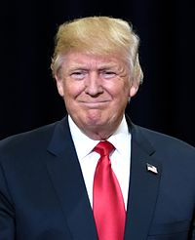
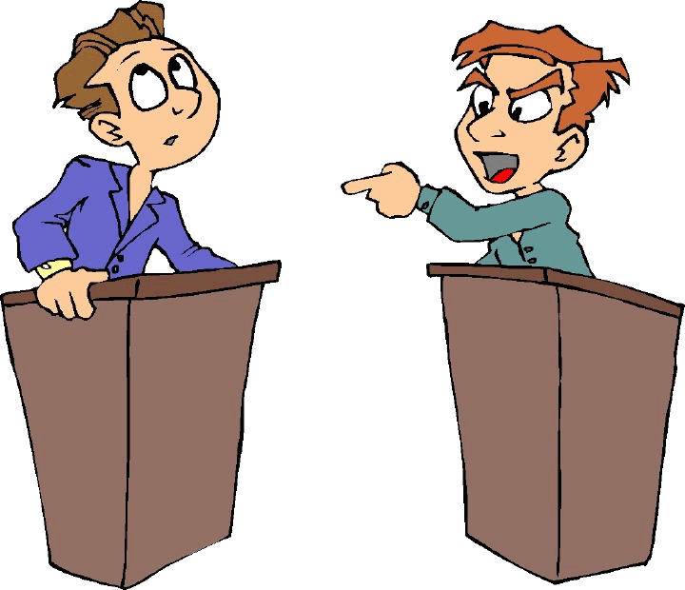
SAD!!!
Point of view of a person.
President Obama has been doing a great job as President. More people are working now than under the President Bush Era.
Are you kidding me? Under President Obama peoples’ wages have dropped in comparison to prices.

