Slide 1
Chapter 4
Demand

Slide 2
4-1: Understanding Demand

Slide 3
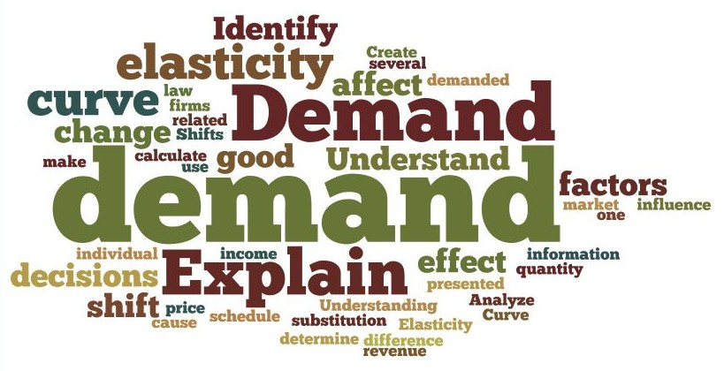
I. Demand
A. The Law of Demand
Demand – the desire to own something and the ability to pay for it
Law of Demand – low price = more purchases and higher price = less purchases
How many slices of pizza would you buy if a slice cost $1… $3… $6…. $12…

Slide 4
B. The Substitution Effect
The rise in the cost of a good causes the consumer to purchase less of that good and more of another
This can also occur when a price decreases

Slide 5
C. The Income Effect
Rising prices also make us feel poor and purchase less
Income Effect – when we purchase less of an item because of cost increase without substituting another good, which will decrease demand
Remember… consumption is measured by the amount purchased, not the amount spent

Slide 6
II. A Demand Schedule
A. Understanding Demand
If you cannot afford a good, then you cannot demand it
Demand schedule – a table that lists the quantity of a good a person will purchase at varying prices
Individual Demand Schedule |  | Market Demand Schedule
Price of a slice of pizza | Quantity demanded per day | Price of a slice of pizza | Quantity demanded per day
$ 1.00 | 5 | $ 1.00 | 300
$ 2.00 | 4 | $ 2.00 | 250
$ 3.00 | 3 | $ 3.00 | 200
$ 4.00 | 2 | $ 4.00 | 150
$ 5.00 | 1 | $ 5.00 | 100
$ 6.00 | 0 | $ 6.00 | 50

Slide 7
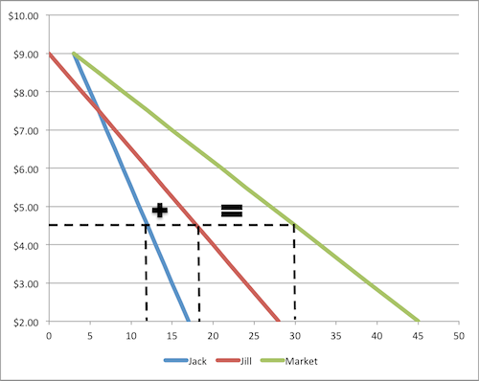
B. Market Demand Schedules
This is the cumulative schedule of all individual demands
Demand schedule – shows the demand at varying prices for all consumers in the market.
This allows producers to predict sales

Slide 8
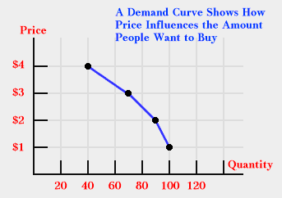
III. The Demand Graph
Demand Curve – a graphic representation of a demand schedule
The vertical axis shows the prices
The horizontal axis shows the quantity demanded

Slide 9
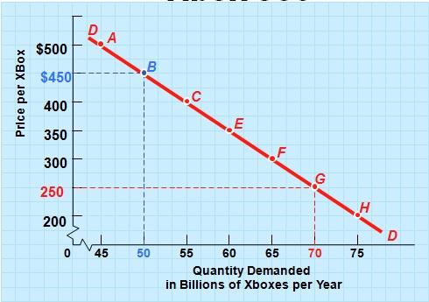
A. Reading a Demand Curve
Only shows price and consumption. All other variables are assumed to remain constant
All demand curves slope from the top left to the bottom right

Slide 10
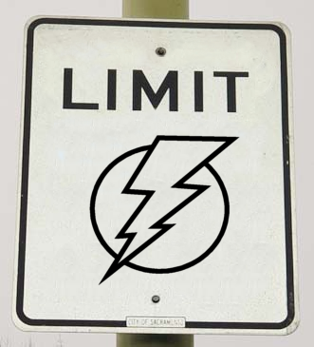
B. Limits of a Demand Curve
Can predict changes in buying habits based on price change
Only accurate for a specific set of conditions
Cannot predict changing market conditions
Can shift based on other factors besides price

Slide 11
4-2: Shifts in the Demand Curve
I. Changes in Demand
Ceteris Paribus – we assume in a demand schedule that nothing else changes
A demand curve is only accurate as long as this holds true
If not, the entire line can shift move

Slide 12
II. What Causes a Shift?
A. Income
Most goods are normal goods. Demand for them increases when income rises
This is shown on the curve through a shift to the right
Inferior goods – these are goods that we buy less of if income rises

Slide 13
B. Consumer Expectations
An expectation of a rising price can increase current demand
The expectation of a drop in price will decrease demand

Slide 14
C. Population
Increase in population creates increase in demand
More people need more houses, food, clothing, etc.
And example of this in our history is the Baby Boom the followed WWII
We can see the demand follow then through the stages of life

Slide 15
D. Demographics
These are the statistical characteristics of populations
Age, race, occupation, etc. etc.
This data helps businesses know what to sell and how to advertise
These numbers and statistics are constantly changing in the US

Slide 16
E. Consumer Tastes and Advertising
Social trends and fads
Ex. Bell bottoms, 3d TV, disco
Cannot be explained by income, population, or expectations.
Digital media has made it easy to avoid advertisement
This means marketing strategies are changing

Slide 17
In 2008, $1.9 billion was spent on advertising on sites such as Facebook and MySpace
Social media has allowed companies more connection to their customers
Companies believe spending money on advertising will increase income

Slide 18
III. Prices of Related Goods
The demand curve for one good can cause a shift on the demand curve for another
Complements – 2 goods bought and used together
Substitutions – goods that are used in place of one another
Ex. Selling skis also sells ski boots
Ex. Selling snowboards stops the sale of skis

Slide 19
4-3:Elasticity of Demand
I. Defining Elasticity
Elasticity of demand – a measurement of how drastically buyers will cut back or increase spending when prices change
Inelastic = little change
Elastic = great change

Slide 20
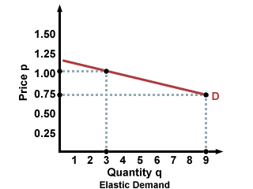
A. Calculating Elasticity
To find elasticity…
Divide the percentage change in quantity demanded by the percentage change of price.
This will always give you a negative number, but economists drop the negative.

Slide 21
B. Price Range
Elasticity varies at every price level
Can be high at some points and low at others
Magazine Prices
Rise from $.60 to $.90 = inelastic
Rise from $4.00 to $6.00 = higher chance of elasticity
Both are 50% increases

Slide 22
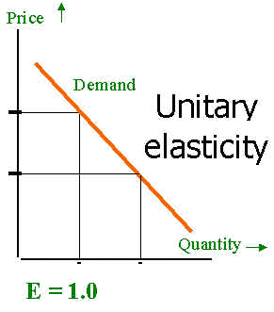
C. Values of Elasticity
Unitary Elastic – when elasticity is equal to exactly 1.
This happens when price change and demand change are exactly the same.

Slide 23
II. Factors Affecting Elasticity
A. Availability of Substitutes
If there are no substitutes, we are more willing to accept price increase
Ex. Concert tickets rise from $30 to &$70, but you want to see the band, so you still buy them.
This is an example of inelasticity
Life saving medicines and procedures are similar
Opposite ex. There are dozens of brands of orange juice

Slide 24
B. Relative Importance
How much of your budget will the good require?
Price increase on a high percentage item creates tough decisions
Ex. - You already spend ½ your money on clothing
- Clothing prices double
- You reduce the clothing you purchase
- This is elastic
Would you cut back on shoelaces if their price doubled?

Slide 25
C. Necessities Versus Luxuries
Varies from person to person
Necessity – a good that people will always buy – regardless of price
Ex. Parents will buy milk whether it is $3.49 or $5.49. Milk to them is vital. Therefore inelastic
Ex. The same parents would not continuously buy steak if its price increased 20%. It is elastic because it is not a necessity.

Slide 26
D. Change Over Time
People can be inelastic in short term, but elasticity can develop over time.
This is because we need time to find substitutes
Ex. Living far from work & the supermarket make it difficult to find substitutes for gasoline, but you may eventually move or get a better vehicle.

Slide 27
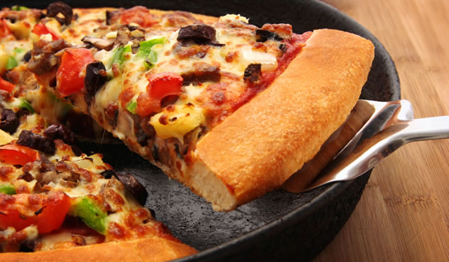
III. Elasticity and Revenue
A. Computing a Firm’s Total Revenue
Total Revenue = the amount of money a company receives for selling goods.
Determined by price and quantity sold
150 slices of pizza at $4.00 per slice = $600 per day.

Slide 28
B. Total Revenue and Elastic Demand
Law of demand: increase in price = decrease in quantity demanded
An increase of cost by 20% = decrease in sales by 50%
A company can have its revenue decreased. (or reverse!)
Price of a Slice of Pizza | Quantity Demanded | Total Revenue
$1.00 | 300 | $300
$2.00 | 250 | $500
$3.00 | 200 | $600
$4.00 | 150 | $600
$5.00 | 100 | $500
$6.00 | 50 | $300

Slide 29
C. Total Revenue and Inelastic Demand
When demand is inelastic, price and revenue move in the same direction
Prices rise 25%... Demand can fall, but not enough to stop revenue from rising
Opposite: decrease price by 25%, demand rises, but not enough to increase revenue

Slide 30
IV. Elasticity and Pricing Policies
Knowledge of elasticity helps firms
Used to make decisions that create the most revenue
The Rules of Elasticity and Revenue!
Elastic Demand
Price is lowered = Total revenue rises
Price is raised = Total revenue falls
Inelastic Demand
Price is lowered = Total Revenue Falls
Price is raised = Total revenue rises

