Slide 1
ZAP

Slide 2
1
Add two points to your team’s score
1
2
Switch scores with another team
2
3
ZAP another team
3
4
ZAP all teams
4
5
ZAP Your team
5
6
Subtract two points from another team’s score
6
7
ZAP another team
7
8
Give another team two points from your team’s score
8
9
Subtract two points from your team’s score
9
10
ZAP Your team
10
11
ZAP all teams
11
12
Switch scores with another team
12
13
ZAP Your team
13
14
Erase Another team’s score
14
15
Add two points to Another team
15
Game play

Slide 3
Scoreboard
Game play
Team 1
Team 2
Team 3
Team 4

Slide 4
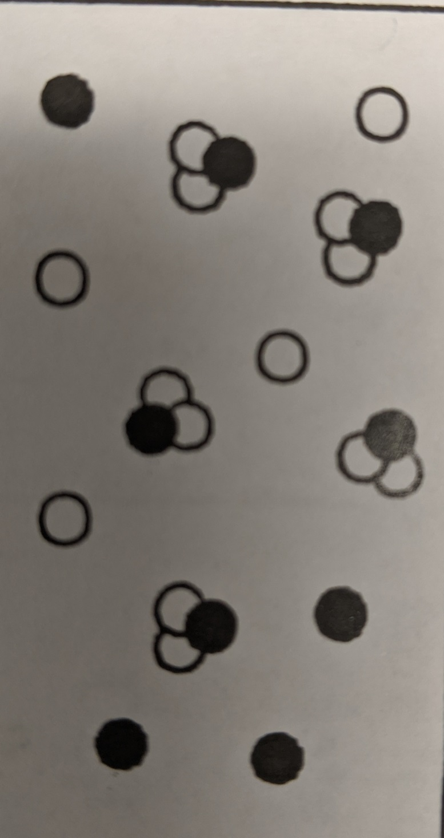
Question 1
A= Element
B= Compound
C= Mixture of elements
D=Mixture of compounds
E= Mixture of elements and compounds

Slide 5
Answer 1
E= Mixture of elements and compounds
SCOREBOARD

Slide 6
Question 2
Which of the following DOES NOT belong?
Melting point
Boiling point
Color
Flammability
Taste
Luster

Slide 7
Answer 2
Flammability.
All of the other words were PHYSICAL properties. Flammability is a CHEMICAL property.
SCOREBOARD

Slide 8
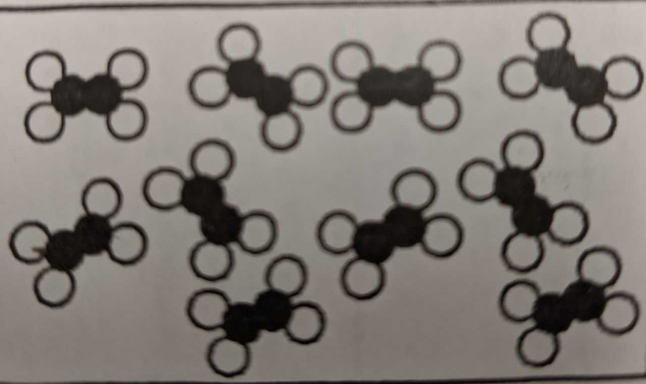
Question 3
A= Element
B= Compound
C= Mixture of elements
D=Mixture of compounds
E= Mixture of elements and compounds

Slide 9
Answer 3
B= Compound
SCOREBOARD

Slide 10
Question 4
Name two clue words that show a CHEMICAL Change

Slide 11
Answer 4
Examples: Reacts, burns, produces, rust
SCOREBOARD

Slide 12
Question 5
Which item does not belong?
Milk goes sour
Salt dissolves in water
Vinegar and baking soda react
A piece of toast burns

Slide 13
Answer 5
Salt dissolves in water
This is a physical change. The other items are chemical changes.
SCOREBOARD

Slide 14
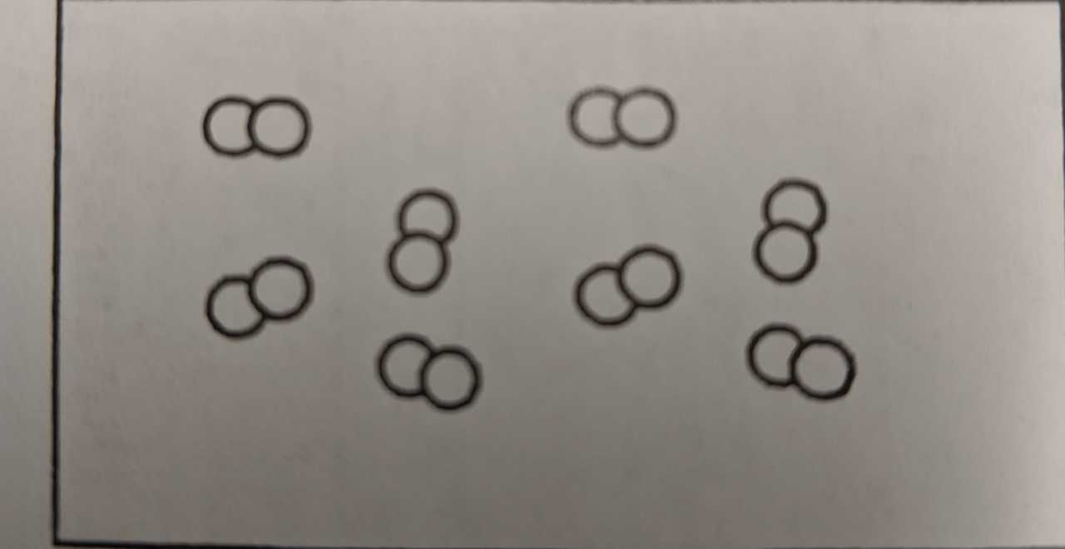
Question 6
A= Element
B= Compound
C= Mixture of elements
D=Mixture of compounds
E= Mixture of elements and compounds

Slide 15
Answer 6
A= Element
SCOREBOARD

Slide 16
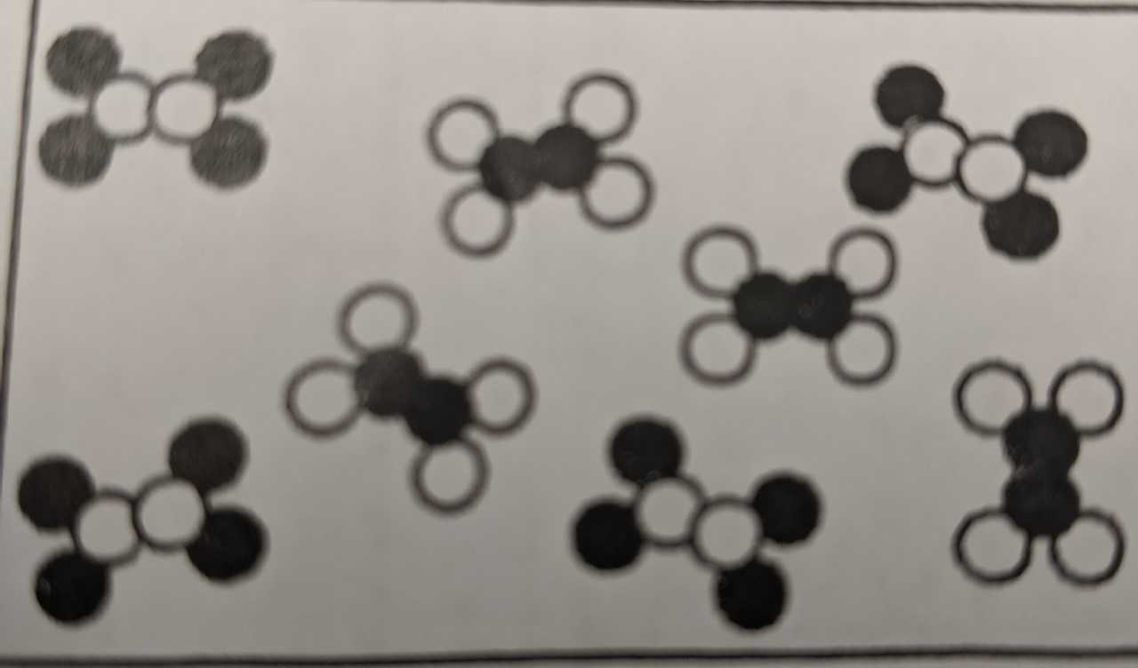
Question 7
A= Element
B= Compound
C= Mixture of elements
D=Mixture of compounds
E= Mixture of elements and compounds

Slide 17
Answer 7
Mixture of compounds
SCOREBOARD

Slide 18
Question 8
If something neutralizes an acid, is that a physical or chemical property?

Slide 19
Answer 8
Chemical property
SCOREBOARD

Slide 20
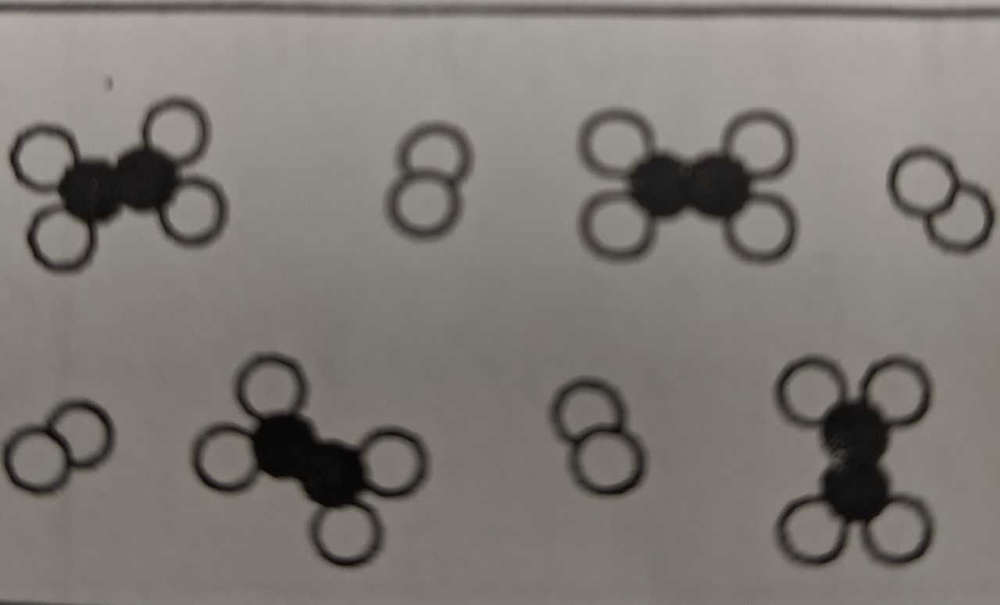
Question 9
A= Element
B= Compound
C= Mixture of elements
D=Mixture of compounds
E= Mixture of elements and compounds

Slide 21
Answer 9
E= Mixture of elements and compounds
SCOREBOARD

Slide 22
Question 10
Is solubility a physical or chemical property?

Slide 23
Answer 10
Physical property.
This means a substance’s ability to dissolve.
SCOREBOARD

Slide 24
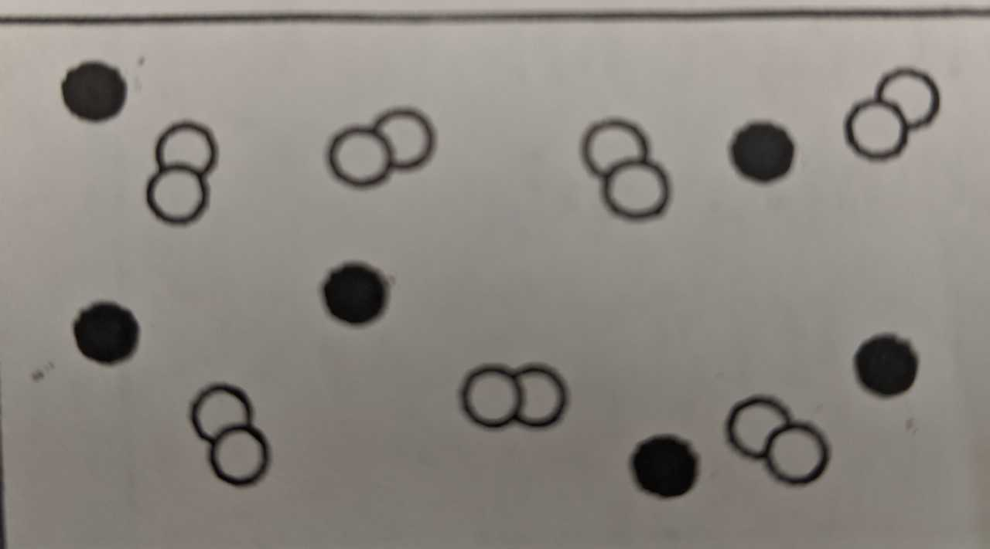
Question 11
A= Element
B= Compound
C= Mixture of elements
D=Mixture of compounds
E= Mixture of elements and compounds

Slide 25
Answer 11
C= Mixture of elements
SCOREBOARD

Slide 26
Question 12
Freezing, melting, and boiling refer to what kind of changes?

Slide 27
Answer 12
Physical changes
SCOREBOARD

Slide 28
Question 13
A= Element
B= Compound
C= Mixture of elements
D=Mixture of compounds
E= Mixture of elements and compounds

Slide 29
Answer 13
A= Element
SCOREBOARD

Slide 30
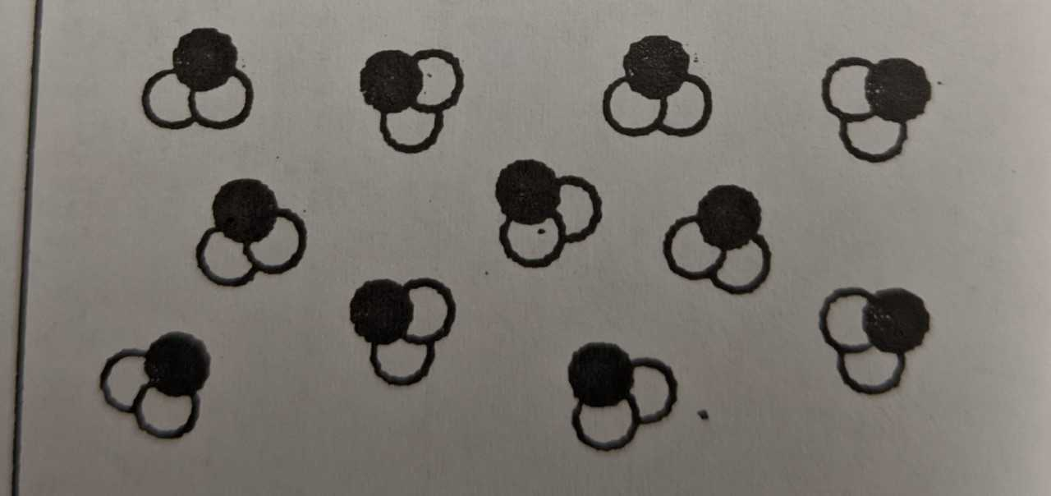
Question 14
A= Element
B= Compound
C= Mixture of elements
D=Mixture of compounds
E= Mixture of elements and compounds

Slide 31
Answer 14
B= Compound
SCOREBOARD

Slide 32
Question 15
Give one example of a chemical change, and one example of a physical change.

Slide 33
Answer 15
Answers will vary
SCOREBOARD

Slide 34
Instructions to Play ZAP
Type questions and answers into the slides.
Group your class into four teams and decide on a rotation order (e.g. clockwise).
Ask the question. Then, show the answer. If the team gets it right they get two points and a chance to play the ZAP board.
Click on the ‘Scoreboard’ icon to go to the scoreboard slide. On the Scoreboard slide, hit the zap splat for the team that answered correctly. The zap splat will change color to let you know the score. If a team loses points, click the zap splat again to change it back to gray. Hit the ‘Game Play’ icon to go back to the game.
Click on the ‘ZAP’ button so that the team can play the ZAP board.
A spokesperson from the team picks a number on the ZAP board. Click that number to reveal the team’s fate (points added or taken away). Please see ZAP key on the next slide.
Click the ZAP card again so that you know which cards have already been chosen (it will reveal the number with an X though it).
On the ZAP board, click ‘Game Play” to return to the questions and answers.
To move to the next question, hit the mouse button or keyboard.
At the end of the game, whichever team has the most points, wins the game.

Slide 35
ZAP Key
Zap your team = that team’s points are lost
Zap another team = team chooses another team to lose points
Zap all teams = points lost for all teams

