Slide 1
Chapter 1
An Introduction to the Human Body
Lecture Outline

Slide 2
INTRODUCTION
The purpose of the chapter is:
Introduce anatomy and physiology as specific disciplines.
Consider how living things are organized.
Reveal shared properties of all living things.
Homeostasis is the major theme in every chapter of the book.

Slide 3
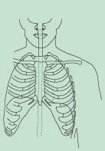
Chapter 1 An Introduction to the Human Body
Anatomy
science of structure
relationships revealed by dissection (cutting apart)
imaging techniques
Physiology
science of body functions
normal adult physiology is studied in this text
some genetic variations are described

Slide 4
ANATOMY AND PHYSIOLOGY DEFINED
Through a study of anatomy and its subdivisions, the body may be examined at different levels of structural organization.
Anatomy
the study of structure and the relationships among structures.
Subdivisions
surface anatomy, gross anatomy, systemic anatomy, regional anatomy, radiographic anatomy, developmental anatomy, embryology, cytology, and pathological anatomy as summarized in Table 1.1.

Slide 5
ANATOMY AND PHYSIOLOGY DEFINED
Physiology
the study of how body structures function
Subdivisions of physiology include
cell physiology, systems physiology, pathophysiology, exercise physiology, neurophysiology, endocrinology, cardiovascular physiology, immunophysiology, respiratory physiology, renal physiology, and reproductive physiology, as summarized in Table 1.1.

Slide 6
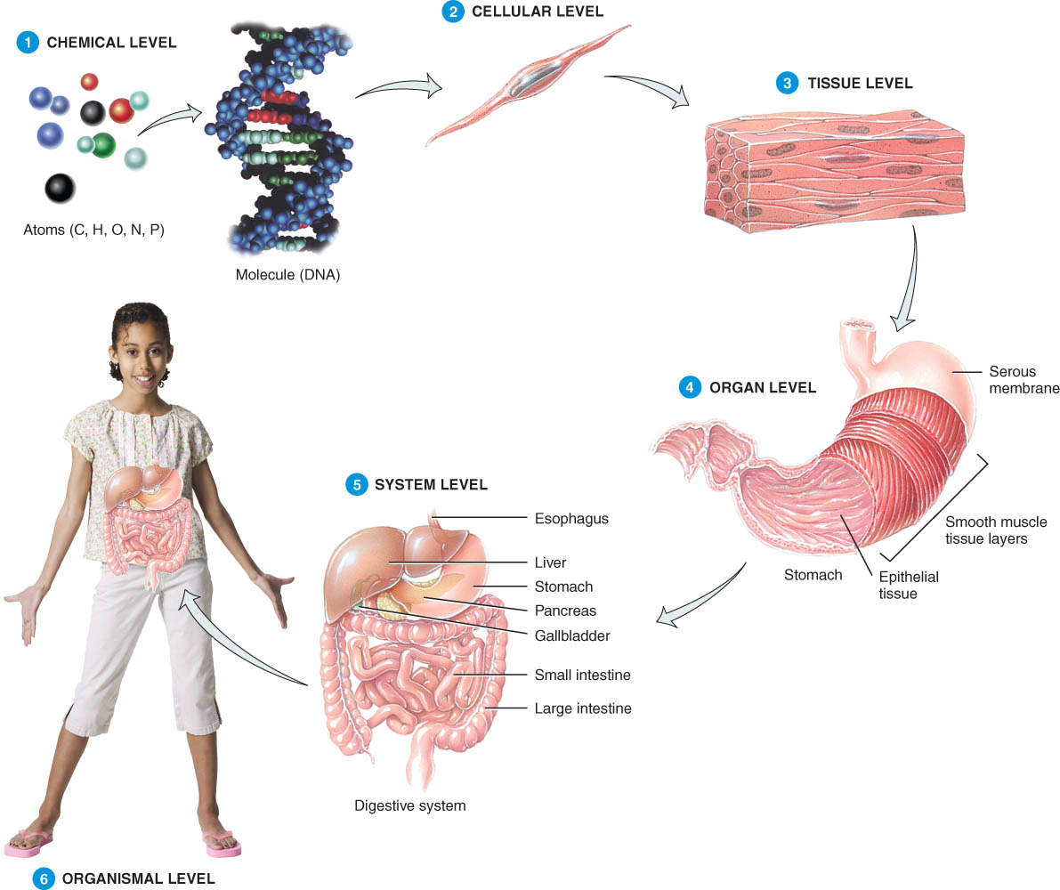
Levels of Organization
Chemical
Cellular
Tissue
Organs
System Level
Organismic Level

Slide 7
LEVELS OF ORGANIZATION
The human body consists of several levels of structural organization (Figure 1.1).
The chemical level
atoms, the smallest units of matter that participate in chemical reactions, all chemicals needed to sustain life.
Cells
the basic structural and functional units of an organism.
Tissues
groups of similarly specialized cells that perform certain special functions.

Slide 8
LEVELS OF ORGANIZATION
Organs
structures of definite form that are composed of two or more different tissues and have specific functions.
Systems
related organs that have a common function.
The human organism
a collection of structurally and functionally integrated systems; any living individual.

Slide 9
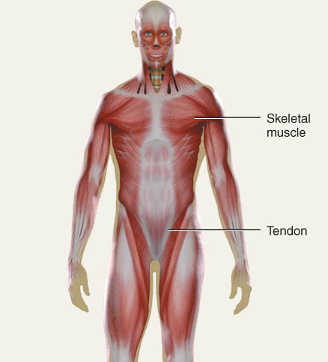
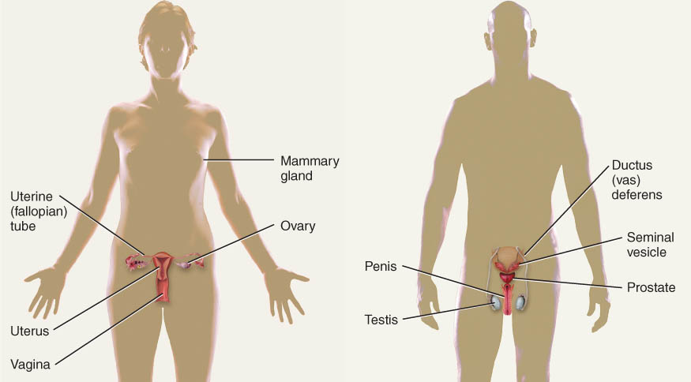
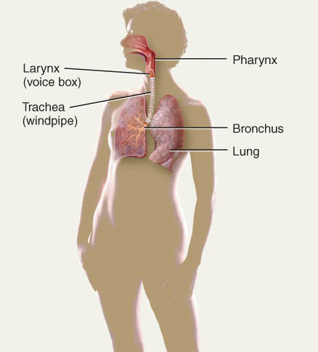
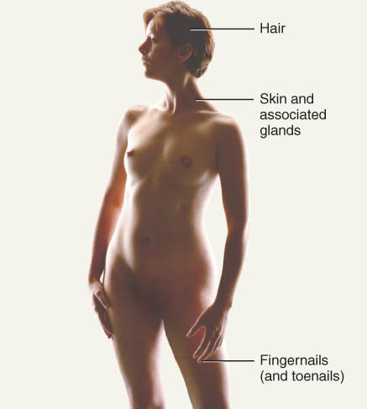
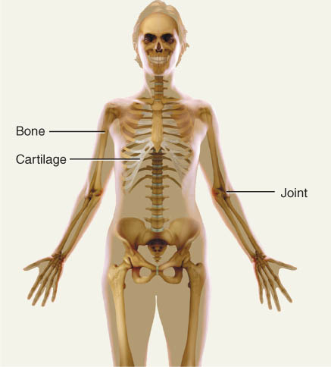
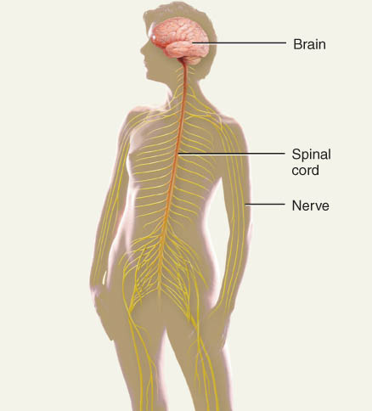
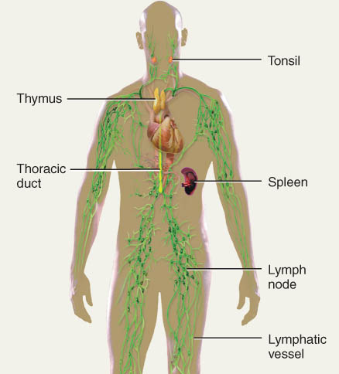
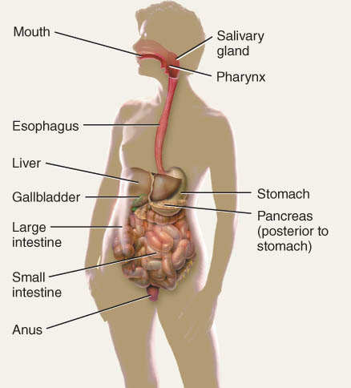
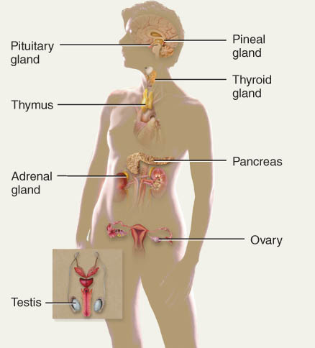
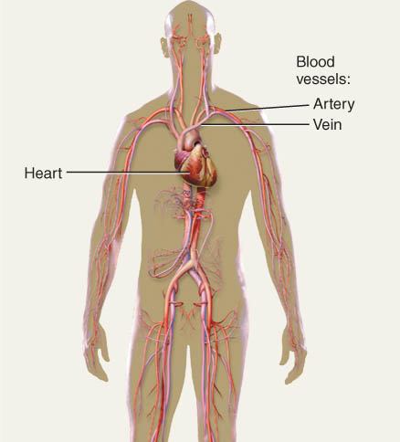
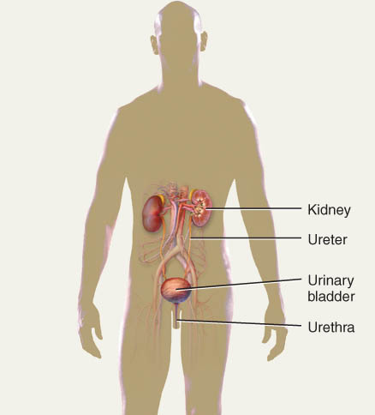
Organ Systems

Slide 10
Systems of the Human Body
The systems of the human body are the integumentary, skeletal, muscular, nervous, endocrine, cardiovascular, lymphatic, respiratory, urinary, digestive, and reproductive (Table 1.2).

Slide 11
Clinical Application
Three noninvasive techniques of palpation, auscultation, and percussion are used to assess certain aspects of body structure and function.
palpation
The examiner feels body surfaces with the hands; an example would be pulse and heart rate determination.
auscultation
The examiner listens to body sounds to evaluate the functioning of certain organs, as in listening to the lungs or heart.
percussion
The examiner taps on the body surface with the fingertips and listens to the resulting echo.

Slide 12
Basic Life Processes
All living things have certain characteristics that distinguish them from nonliving things.
Metabolism is the sum of all chemical processes that occur in the body, including catabolism and anabolism.
Responsiveness is the ability to detect and respond to changes in the external or internal environment.
Movement includes motion of the whole body, individual organs, single cells, or even organelles inside cells.

Slide 13
Basic Life Processes
Growth refers to an increase in size and complexity, due to an increase in the number of cells, size of cells, or both.
Differentiation is the change in a cell from an unspecialized state to a specialized state.
Reproduction refers either to the formation of new cells for growth, repair, or replacement, or the production of a new individual.
An autopsy (see text) is a postmortem examination of the body and dissection of its internal organs to confirm or determine the cause of death.

Slide 14
HOMEOSTASIS
Homeostasis is a condition of equilibrium in the body’s internal environment produced by the ceaseless interplay of all the body’s regulatory processes.
Maintaining the internal environment within physiological limits
Example
blood glucose level is kept within narrow range 70-110/100ml (chemical levels)
Body temperature 98.6
Blood pressure 120/70

Slide 15
Body Fluids
For the body’s cells to survive, the composition of the surrounding fluids must be precisely maintained at all times.
Fluid inside body cells is called intracellular fluid.
Fluid outside body cells is called extracellular fluid (ECF) and is found in two principal places.
ECF filling the narrow spaces between cells of tissues is called interstitial fluid, intercellular fluid, or tissue fluid.
ECF in blood vessels is termed plasma.

Slide 16
Control of Homeostasis
Homeostasis is continually being disrupted by
external stimuli
intense heat, cold , and lack of oxygen
internal stimuli
psychological stresses
exercise
Disruptions are usually mild & temporary
If homeostasis is not maintained, death may result

Slide 17
CONTROL OF HOMEOSTASIS
Homeostatic imbalances occur because of disruptions from the external or internal environments.
Homeostasis is regulated by the nervous system and endocrine system, acting together or independently.
The nervous system detects changes and sends nerve impulses to counteract the disruption.
The endocrine system regulates homeostasis by secreting hormones.
Whereas nerve impulses cause rapid changes, hormones usually work more slowly.
Examples: CO2, O2, temperature, pH, blood pressure, …

Slide 18
Feedback Systems
General Principles
A feedback system is a cycle of events in which information about the status of a condition is continually monitored and fed back (reported) to a central control region (Figure 1.2).
Any disruption that changes a controlled condition is called a stimulus.

Slide 19
Feedback Systems
A feedback system consists of three basic components.
A receptor monitors changes in a controlled condition and sends input in the form of nerve impulses or chemical signals to a control center.
The control center sets the range of values within which a controlled condition should be maintained, evaluates the input it receives from the receptors, and generates output commands when they are needed.
An effector is a body structure that receives output from the control center and produces a response or effect that changes the controlled condition.

Slide 20
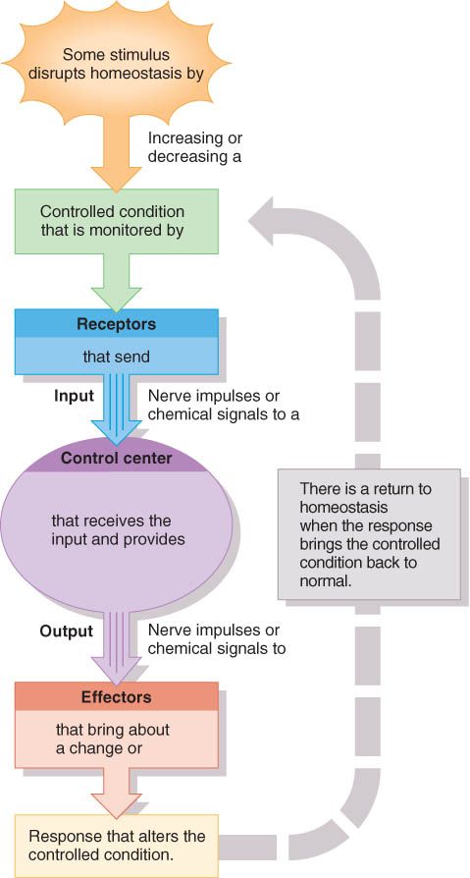
Components of Feedback Loop
Receptor
monitors a controlled condition
Control center
determines next action
Effector
receives directions from the control center
produces a response that changes the controlled condition

Slide 21
Components of Feedback Loop
Questions?

Slide 22
Negative Feedback Systems
If a response reverses the original stimulus, the system is a negative feedback system.
A negative feedback system reverses a change in a controlled condition.
Homeostasis of Blood Pressure (BP): Negative Feedback (Figure 1.3)
The activity of the effector produces a result, a drop in blood pressure, that opposes the stimulus, an increase in blood pressure.

Slide 23
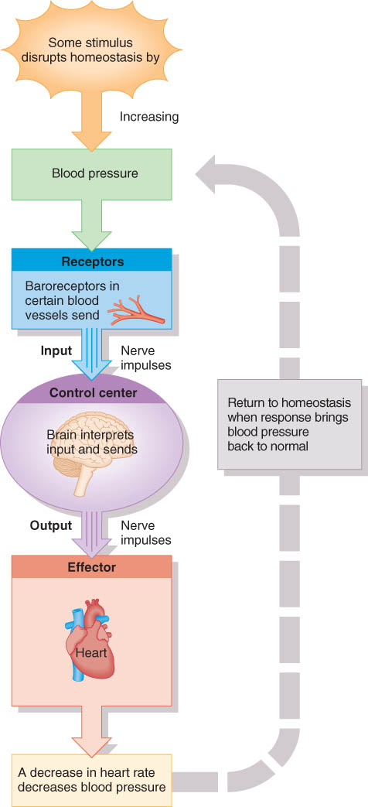
Homeostasis of Blood Pressure
Pressure receptors in walls of certain arteries detect an increase in BP
blood Pressure = force of blood on walls of vessels
Brain receives input and then signals heart and blood vessels
Heart rate slows and arterioles dilate (increase in diameter)
BP returns to normal

Slide 24
Positive Feedback System
If a response enhances the original stimulus, the system is a positive feedback system.
Normal childbirth provides a good example of a positive feedback system (Figure 1.4).
The positive feedback system reinforces a change in a controlled condition.

Slide 25
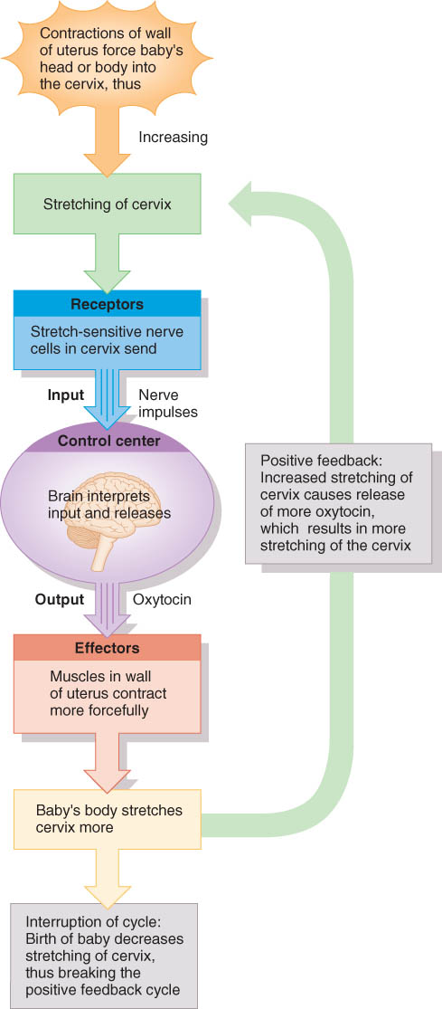
Positive Feedback during Childbirth
Stretch receptors in walls of the uterus send signals to the brain
Brain releases a hormone (oxytocin) into bloodstream
Uterine smooth muscle contracts more forcefully
More stretch ➔ more hormone ➔ more contraction ➔ etc.
The cycle ends with birth of the baby & decrease in stretch

Slide 26
Homeostatic Imbalances
Disruption of homeostasis can lead to disease and death.
Disorder is a general term for any derangement of abnormality of function.
Disease is a more specific term for an illness characterized by a recognizable set of signs and symptoms.
Signs are objective changes that a clinician can observe and measure; e.g., fever or rash.
Symptoms are subjective changes in body functions that are not apparent to an observer; e.g., headache or nausea.
A local disease is one that affects one part or a limited region of the body.
A systemic disease affects either the entire body or several parts.

Slide 27
Homeostatic Imbalances
Diagnosis is the art of distinguishing one disease from another or determining the nature of a disease; a diagnosis is generally arrived at after the taking of a medical history and the administration of a physical examination.

Slide 28
Aging and Homeostasis
Aging is characterized by a progressive decline in the body’s responses to restore homeostasis
These changes are apparent in all body systems.
crinkled skin, gray hair, loss of bone mass, …

Slide 29
BASIC ANATOMICAL TERMINOLOGY
Anatomical position
Regions of the body
Anatomical planes, sections and directional terms

Slide 30
Anatomical Position
The anatomical position is a standardized method of observing or imaging the body that allows precise and consistent anatomical references.
When in the anatomical position, the subject stands (Figure 1.5).
standing upright
facing the observer, head level
eyes facing forward
feet flat on the floor
arms at the sides
palms turned forward (ventral)

Slide 31
Reclining Position
If the body is lying face down, it is in the prone position, or on the anterior surface.
If the body is lying face up, it is in the supine position,
or on the posterior surface.

Slide 32
Regional Names
Regional names are names given to specific regions of the body for reference.
Examples of regional names include:

Slide 33
Common Regional Names cranial (skull), thoracic (chest), brachial (arm), patellar (knee), cephalic (head), and gluteal (buttock) as seen in Figure 1.5.
Clinical terminology is based on a Greek or Latin root word.

Slide 34
Directional Terms
Directional terms are used to precisely locate one part of the body relative to another and to reduce length of explanations.

Slide 35
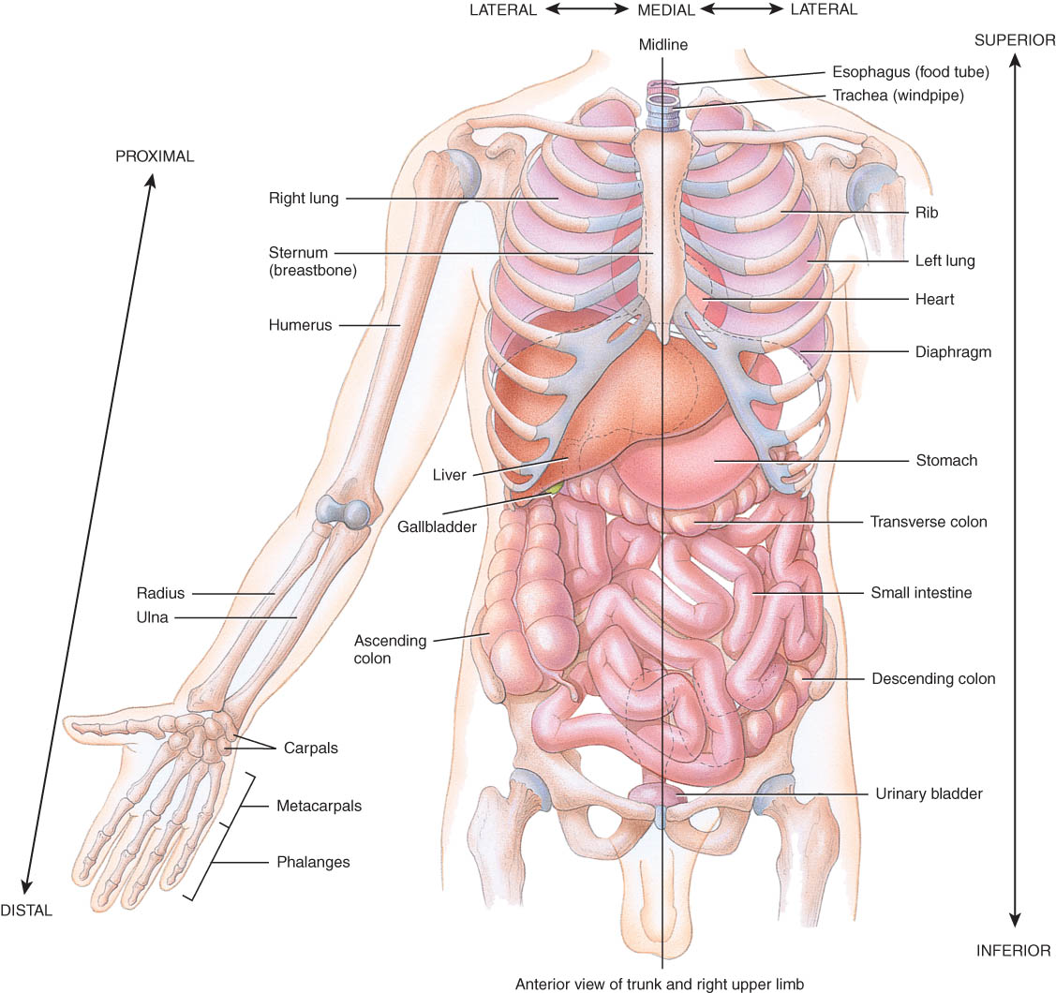
Major Directional Terms
See Definitions page 14

Slide 36
Superior or Inferior
Superior
towards the head
The eyes are superior to the mouth.
Inferior
away from the head
The stomach is inferior to the heart.

Slide 37
Dorsal or Ventral
Dorsal or Posterior
at the back of the body
The brain is posterior to the forehead.
Ventral or Anterior
at the front of the body
The sternum is anterior to the heart.

Slide 38
Medial or Lateral
Medial
nearer to the midline of the body
The heart lies medial to the lungs.
Lateral
farther from the midline of the body
The thumb is on the lateral side of the hand.

Slide 39
Proximal or Distal
Proximal
nearer to the attachment of the limb to the trunk
The knee is proximal to the ankle.
Distal
farther from the attachment of the limb to the trunk
The wrist is distal to the elbow.

Slide 40
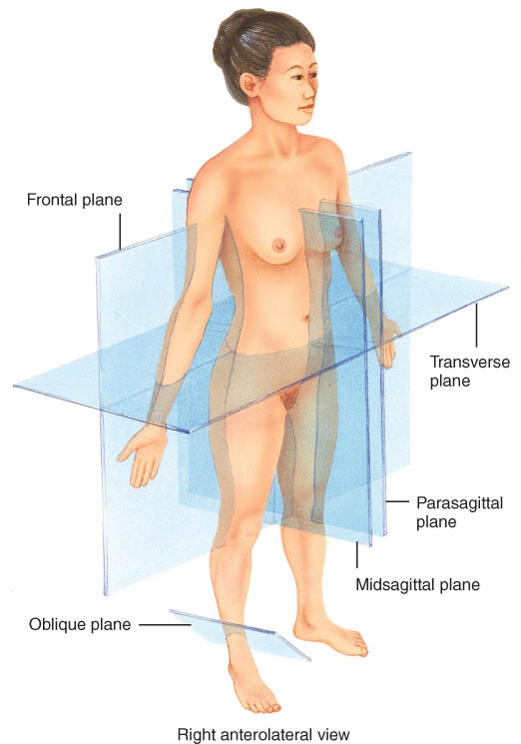
Planes and Sections
Planes are imaginary flat surfaces that are used to divide the body or organs into definite areas
Principal planes include:
midsagittal (medial) and parasagittal
frontal (coronal)
transverse (cross-sectional or horizontal)
Sections
flat surfaces resulting from cuts through body structures, named according to the plane on which the cut is made (transverse, frontal, and midsagittal sections, Fig 1.8)

Slide 41
Sagittal Plane
Sagittal plane
divides the body or an organ into left and right sides
Midsagittal plane
produces equal halves
Parasagittal plane
produces unequal halves

Slide 42
Other Planes and Sections
Frontal or coronal plane
divides the body or an organ into front (anterior) and back (posterior) portions
Transverse(cross-sectional) or horizontal plane
divides the body or an organ into upper (superior) or lower (inferior) portions

Slide 43
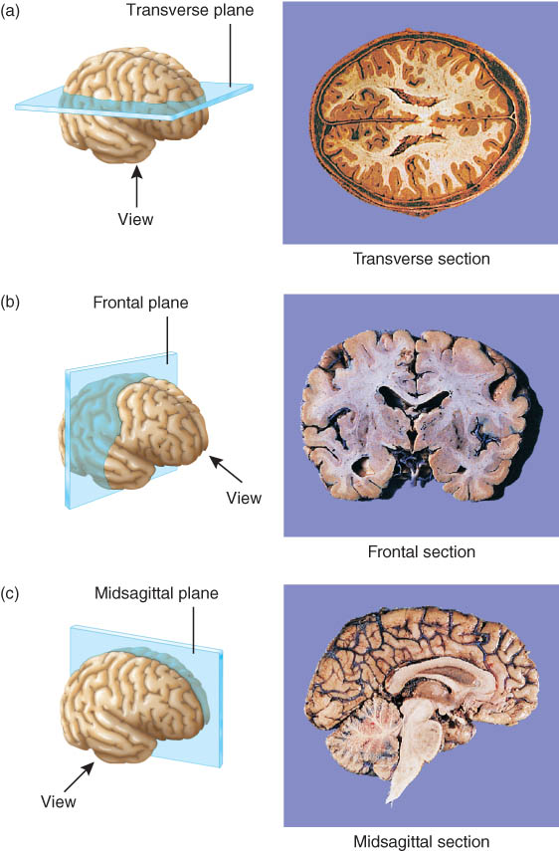
Planes and Sections of the Brain (3-D anatomical relationships revealed)
Horizontal Plane
Frontal Plane
Midsagittal Plane

Slide 44
Body Cavities
Body cavities are spaces within the body that help protect, separate, and support internal organs(visera).

Slide 45
Dorsal Body Cavity
The dorsal body cavity is located near the dorsal surface of the body and has two subdivisions, the cranial cavity and the vertebral canal.
The cranial cavity is formed by the cranial bones and contains the brain.
The vertebral (spinal) canal is formed by the bones of the vertebral column and contains the spinal cord.
Three layers of protective tissue, called meninges, line the dorsal body cavity.

Slide 46
Dorsal Body Cavity
Near dorsal surface of body
2 subdivisions
cranial cavity
holds the brain
formed by skull
vertebral or spinal canal
contains the spinal cord
formed by vertebral column
Meninges line dorsal body cavity

Slide 47
Ventral Body Cavity
The thoracic cavity contains two pleural cavities, and the mediastinum, which includes the pericardial cavity (Figure 1.10).
The pleural cavities enclose the lungs.
The pericardial cavity surrounds the heart.
The abdominopelvic cavity is divided into a superior abdominal and an inferior pelvic cavity (Figure 1.9).
Viscera of the abdominal cavity include the stomach, spleen, pancreas, liver, gallbladder, small intestine, and most of the large intestine (Figure 1.11).
Viscera of the pelvic cavity include the urinary bladder, portions of the large intestine and internal female and male reproductive structures.

Slide 48
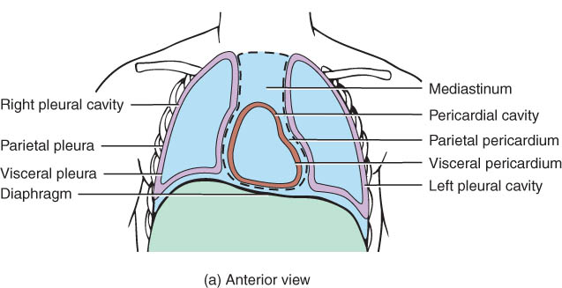
Ventral Body Cavity
Near ventral surface of body
2 subdivisions
thoracic cavity above diaphragm
abdominopelvic cavity below diaphragm
Diaphragm = large, dome-shaped muscle
Organs called viscera
Organs covered with serous membrane

Slide 49
Serous Membranes
Thin slippery membrane that lines the body cavities that do not open to the outside
parietal layer lines walls of cavities
visceral layer covers viscera within the cavities
Serous fluid reduces friction

Slide 50
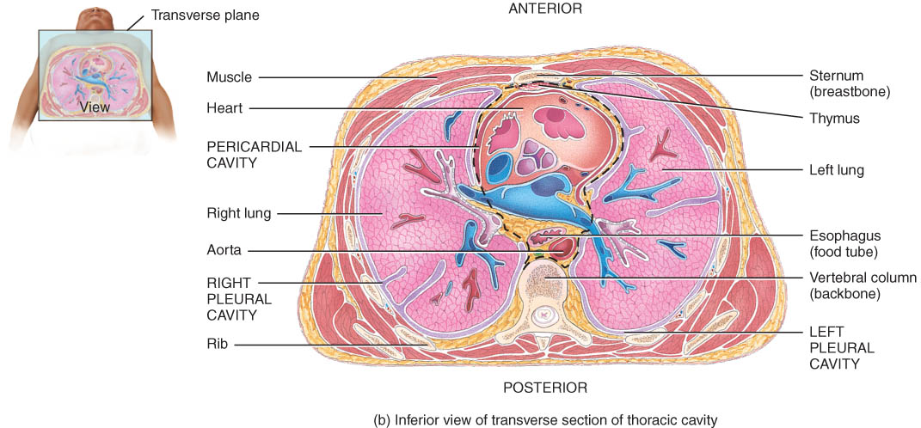
Mediastinum
The mediastinum is a broad, median partition between the lungs that extends from the sternum to the vertebral column, it contains all contents of the thoracic cavity except the lungs.
heart and great vessels, esophagus, trachea, thymus.

Slide 51
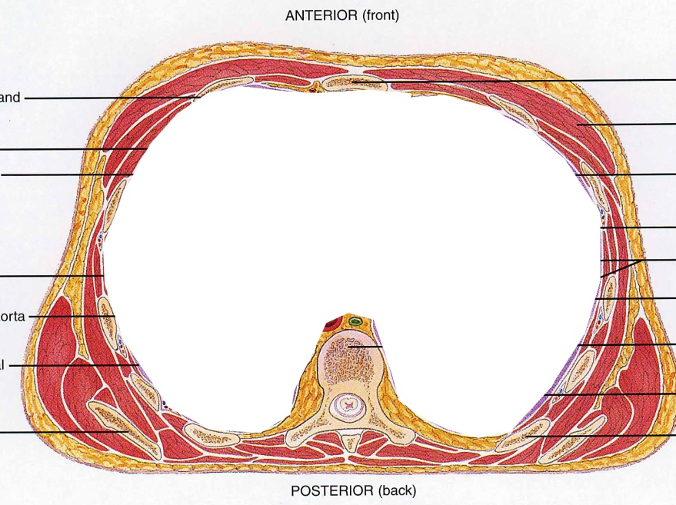
Thoracic Cavity
Encircled by ribs, sternum, vertebral column and muscle
Divided into 2 pleural cavities by mediastinum
Mediastinum contains all thoracic organs except lungs

Slide 52
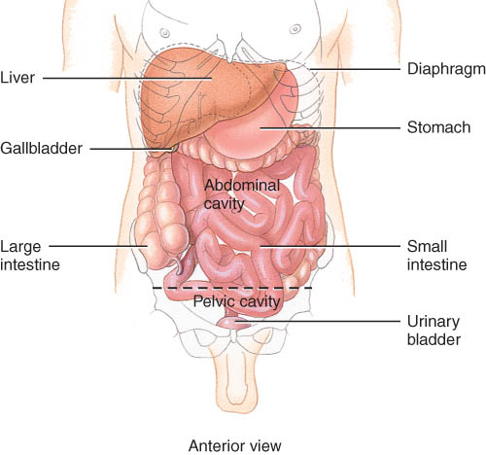
Abdominopelvic Cavity
Inferior portion of ventral body cavity below diaphragm
Encircled by abdominal wall, bones & muscles of pelvis

Slide 53
Thoracic and Abdominal Cavity Membranes
A thin, slippery serous membrane covers the viscera within the thoracic and abdominal cavities and also lines the walls of the thorax and abdomen.
Parts of the serous membrane
the parietal layer lines the walls of the cavities
the visceral layer covers and adheres to the viscera within the cavities.
Serous fluid between the two layers reduces friction and allows the viscera to slide somewhat during movements.

Slide 54
Serous membranes
The serous membranes include the pleura, pericardium and peritoneum (Table 1.3).
The pleural membrane surrounds the lungs
visceral pleura clings to the surface of the lungs
parietal pleura lines the chest wall
The pericardium is the serous membrane of the pericardial cavity
visceral pericardium covers the surface of the heart
parietal pericardium lines the chest wall
The peritoneum is the serous membrane of the abdominal cavity
visceral peritoneum covers the abdominal viscera
parietal peritoneum lines the abdominal wall

Slide 55
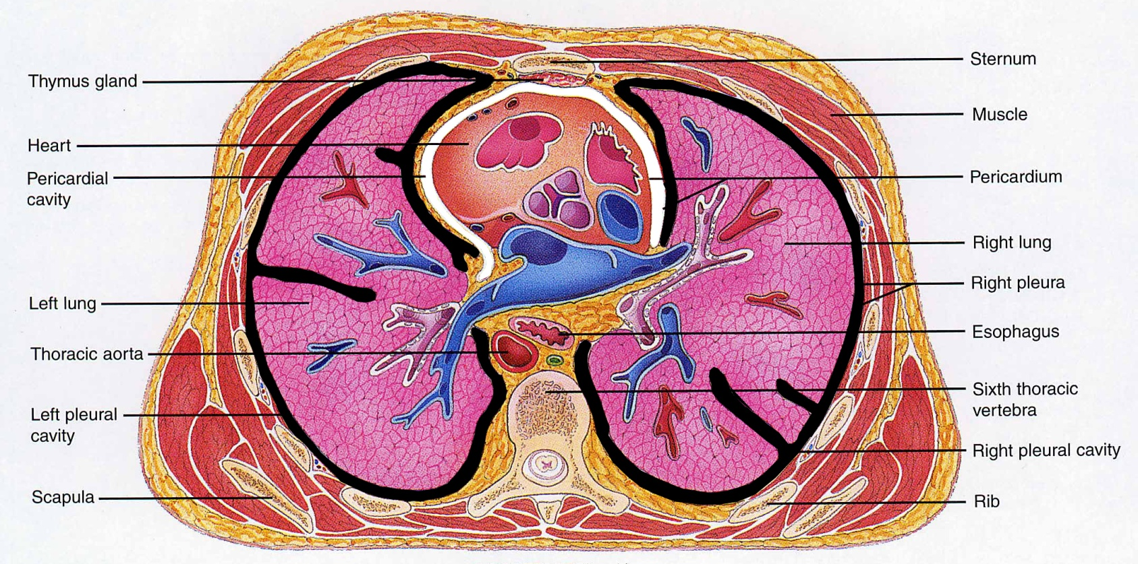
Pleural & Pericardial Cavities
Visceral and Parietal Pleura
Visceral and Parietal Pericardium

Slide 56
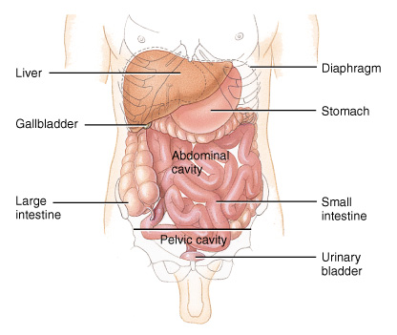
Peritoneum
Visceral peritoneum
serous membrane that covers the abdominal viscera
Parietal peritoneum
serous membrane that lines the abdominal wall

Slide 57
Abdominopelvic Regions and Quadrants
To describe the location of organs or abdominopelvic abnormalities easily, the abdominopelvic cavity may be divided into
nine regions by drawing four imaginary lines as shown in Figure 1.12.
quadrants by passing imaginary horizontal and vertical lines through the umbilicus (Figure 1.12).

Slide 58
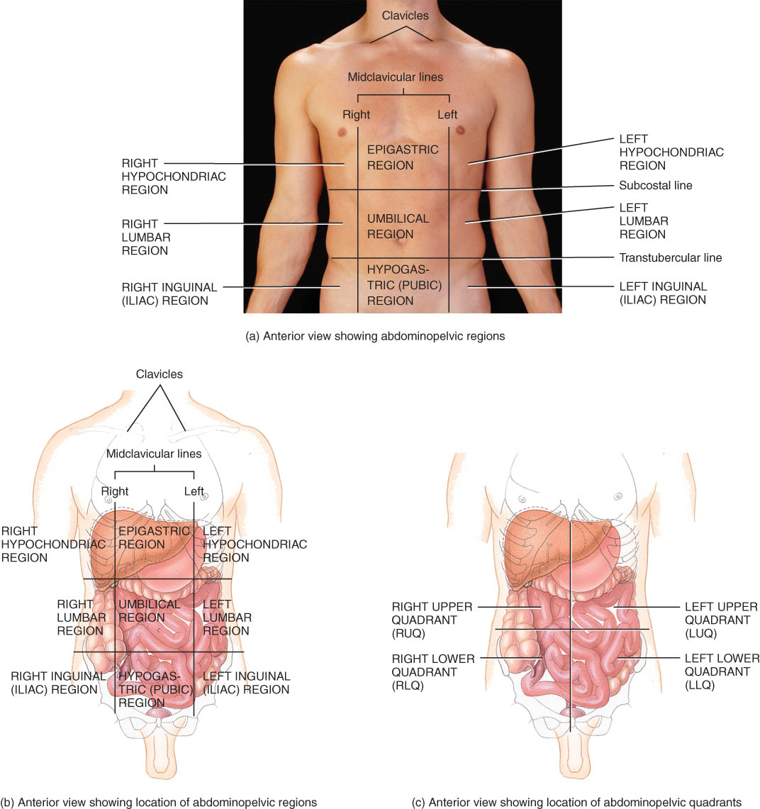
Abdominopelvic Regions & Quadrants
Quadrants
Used for clinical study
Describe locations of organs or source of pain
Tic-tac-toe grid or intersecting lines through navel

Slide 59
Regions
Used for anatomical study
9 regions

Slide 60
Clinical Application: Autopsy
An autopsy is a postmortem examination of the body and dissection of the internal organs to confirm or determine the cause of death.
An autopsy supplies information relating to the deceased individual.

Slide 61
MEDICAL IMAGING
A specialized branch of anatomy and physiology that is essential for the diagnosis of many disorders is medical imaging, one division of which is radiography, which includes the use of x-rays.
Medical imaging techniques allow physicians to peer inside the body to provide clues to abnormal anatomy and deviations from normal physiology in order to help diagnose disease.

Slide 62
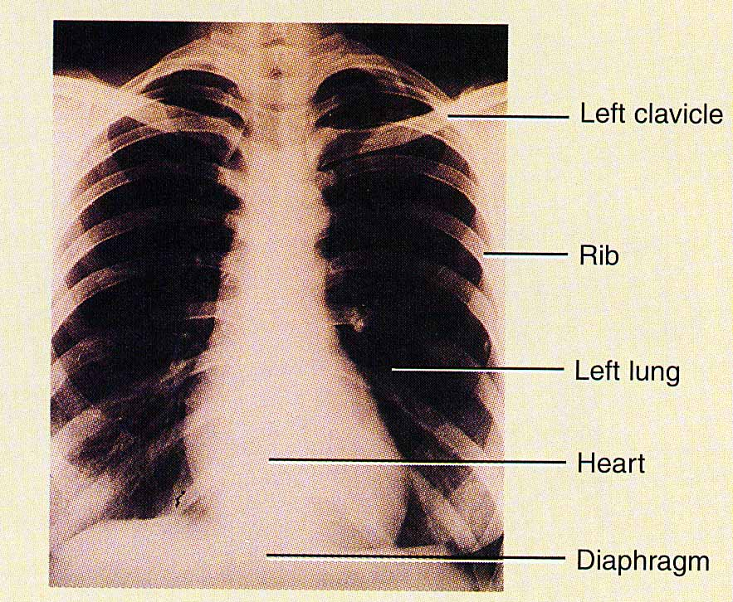
Conventional Radiography - X-Ray
A single burst of xrays
Produces 2-D image on film
Known as radiography or xray
Poor resolution of soft tissues
Major use is osteology

Slide 63
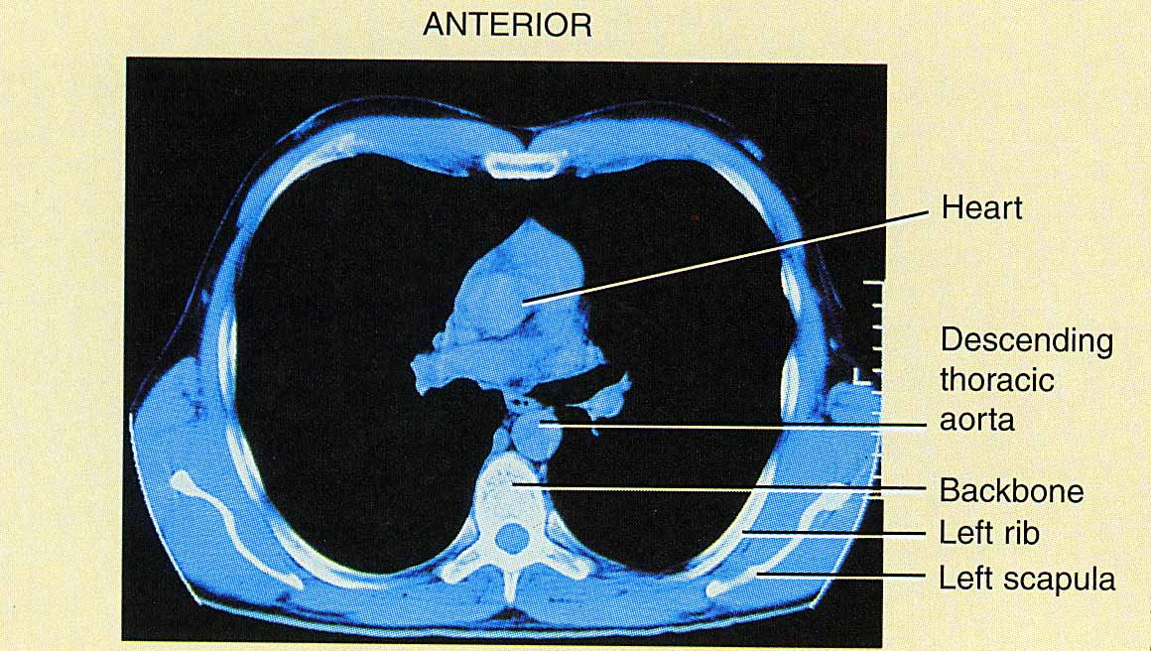
Computed Tomography (CT Scan)
Moving x-ray beam
Image produced on a video monitor of a cross-section through body
Computer generated image reveals more soft tissue detail
kidney & gallstones
Multiple scans used to build 3D views

Slide 64
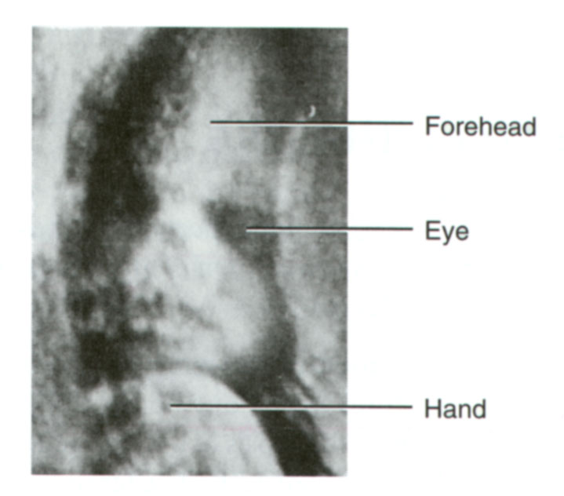
Ultrasound (US)
High-frequency sound waves emitted by hand-held device
Safe, noninvasive & painless
Image or sonogram is displayed on video monitor
Used for fetal ultrasound and examination of pelvic & abdominal organs, heart and blood flow through blood vessels

Slide 65
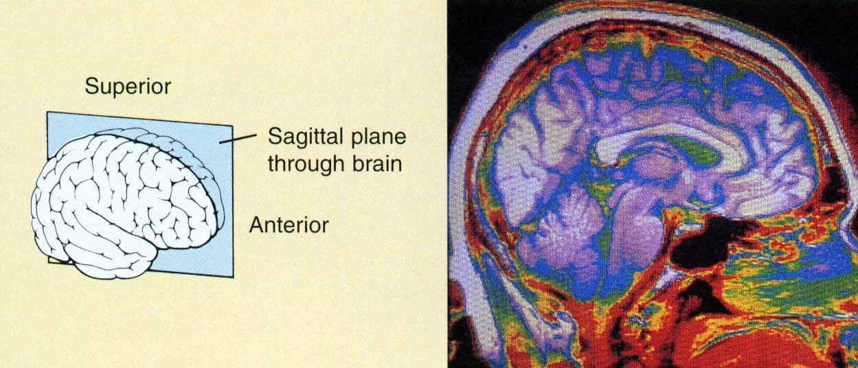
Magnetic Resonance Imaging (MRI)
Body exposed to high-energy magnetic field
Protons align themselves relative to magnetic field
Pulse of radiowaves used to generate an image on video monitor
Can not use on patient with metal in their body
Reveals fine detail within soft tissues

Slide 66
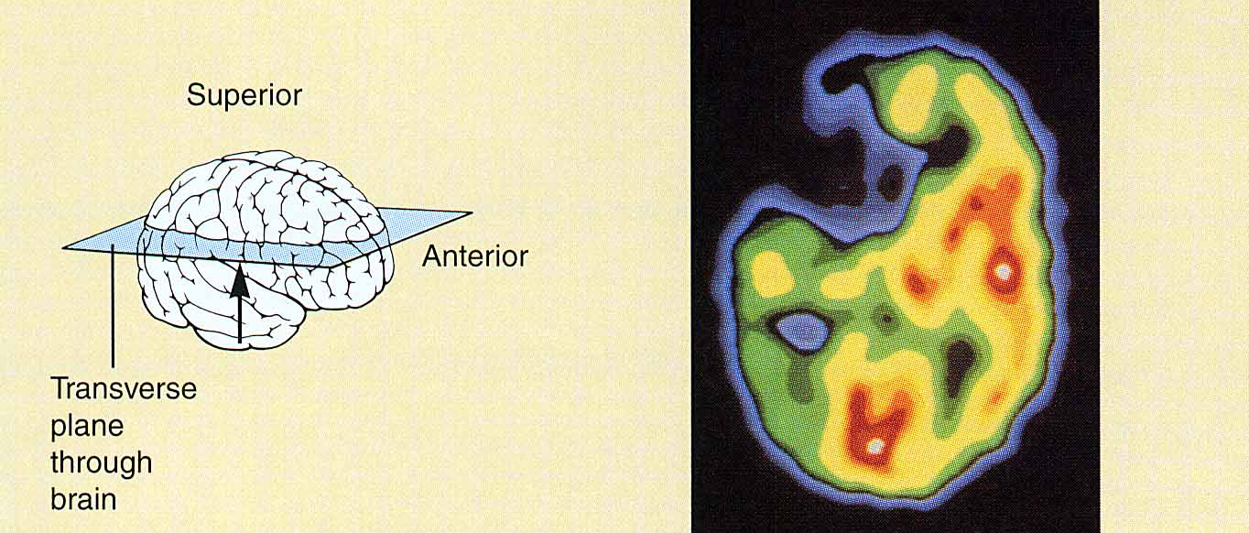
Positron Emission Tomography (PET)
Substance that emits positively charged particles is injected into body
Collision with negatively charged electrons in tissues releases gamma rays
Camera detects gamma rays & computer generates image displayed on monitor

