Slide 1
CHEMICAL BONDS
The atoms of a molecule are held together by forces of attraction called chemical bonds.

Slide 2
Ionic Bonds
When an atom loses or gains a valence electron, ions are formed.
Positively and negatively charged ions are attracted to one another.
Cations are positively charged ions that have given up one or more electrons (they are electron donors).
Anions are negatively charged ions that have picked up one or more electrons that another atom has lost (they are electron acceptors).
In general, ionic compounds exist as solids but some may dissociate into positive and negative ions in solution. Such a compound is called an electrolyte.

Slide 3
Covalent Bonds
Covalent bonds are formed by the atoms of molecules sharing one, two, or three pairs of their valence electrons.
Covalent bonds are common and are the strongest chemical bonds in the body.
Single, double, or triple covalent bonds are formed by sharing one, two, or three pairs of electrons, respectively.

Slide 4
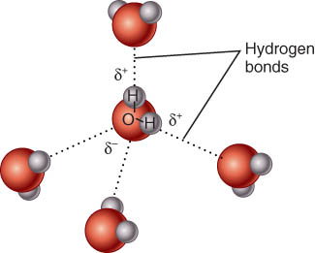
Hydrogen Bonds
Approximately only 5% as strong as covalent bonds
Useful in establishing links between molecules or between distant parts of a very large molecule
Hydrogen bonds are weak
intermolecular bonds; they serve
as links between molecules
(usually).

Slide 5
Chemical Reactions
New bonds form and/or old bonds are broken.
Metabolism is “the sum of all the chemical reactions in the body.”
A chemical reaction occurs when new bonds are formed or old bonds break between atoms.
The starting substances of a chemical reaction are known as reactants.
The ending substances of a chemical reaction are the products.

Slide 6
Metabolism refers to all the chemical reactions occurring in an organism and involves links between chemical reactions in different parts of the body, or even different parts of a cell.

Slide 7
Forms of Energy and Chemical Reactions
Energy is the capacity to do work.
Kinetic energy is the energy associated with matter in motion.
Temperature is an indirect measure of molecular motion.
Potential energy is energy stored by matter due to its position.
Chemical energy is a form of potential energy stored in the bonds of compounds or molecules.
The total amount of energy present at the beginning and end of a chemical reaction is the same; energy can neither be created nor destroyed although it may be converted from one form to another (law of conservation of energy).

Slide 8
Energy Transfer in Chemical Reactions
An exergonic reaction is one in which the bond being broken has more energy than the one formed so that extra energy is released, usually as heat (occurs during catabolism of food molecules).
An endergonic reaction is just the opposite and thus requires that energy be added, usually from a molecule called ATP, to form a bond, as in bonding amino acid molecules together to form proteins.
Catalysts are chemical compounds that speed up chemical reactions.

Slide 9
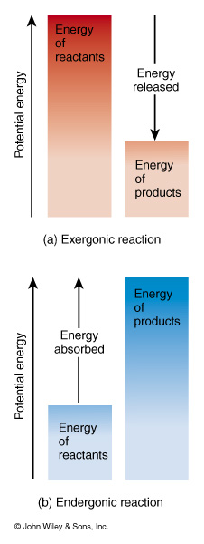
Reactions in living systems usually involve both kinds of reactions occurring together.
exergonic reactions release energy
endergonic reactions absorb energy

Slide 10
Types of Chemical Reactions
Synthesis reactions occur when two or more atoms, ions, or molecules combine to form new and larger molecules. These are anabolic reactions, meaning that bonds are formed.
In a decomposition reaction, a molecule is broken down into smaller parts. These are catabolic reactions, meaning that chemical bonds are broken in the process.

Slide 11
Synthesis Reactions--Anabolism
Two or more atoms, ions or molecules combine to form new & larger molecules
All the synthesis reactions in the body together are called anabolism
Usually are endergonic because they absorb more energy than they release

Slide 12
Decomposition Reactions--Catabolism
Large molecules are split into smaller atoms, ions or molecules
All decomposition reactions occurring together in the body are known as catabolism
Usually are exergonic since they release more energy than they absorb

Slide 13
Reaction Energy/Bonds Metabolism
synthesis endergonic anabolism
decomposition exergonic catabolism

