Slide 1
DISORDERS: HOMEOSTATIC IMBALANCES Skin Cancer
Skin cancer can be caused by excessive exposure to sunlight.
1 million cases diagnosed per year
3 common forms of skin cancer
basal cell carcinoma (rarely metastasize)
squamous cell carcinoma (may metastasize)
malignant melanomas (metastasize rapidly)
most common cancer in young women
arise from melanocytes ----life threatening
key to treatment is early detection watch for changes in symmetry, border, color and size
risks factors include-- skin color, sun exposure, family history, age and immunological status.

Slide 2
Burns
Tissue damage from excessive heat, electricity, radioactivity, or corrosive chemicals that destroys (denatures) proteins in the exposed cells is called a burn.
Generally, the systemic effects of a burn are a greater threat to life than are the local effects.
The seriousness of a burn is determined by its depth, extent, and area involved, as well as the person’s age and general health. When the burn area exceeds 70%, over half of the victims die.

Slide 3
Burns
Problems that result
shock due to water, plasma and plasma protein loss
circulatory & kidney problems from loss of plasma
bacterial infection
Two methods for determining the extent of a burn are the Rule of Nines and the Lund-Bowder method (Figure 5.10).

Slide 4
Burns Rule of Nines

Slide 5
Types of Burns
First-degree
only epidermis (sunburn)
Second-degree burn
destroys entire epidermis & part of dermis
fluid-filled blisters separate epidermis & dermis
epidermal derivatives are not damaged
heals without grafting in 3 to 4 weeks & may scar
Third-degree or full-thickness
destroy epidermis, dermis & epidermal derivatives
damaged area is numb due to loss of sensory nerves

Slide 6
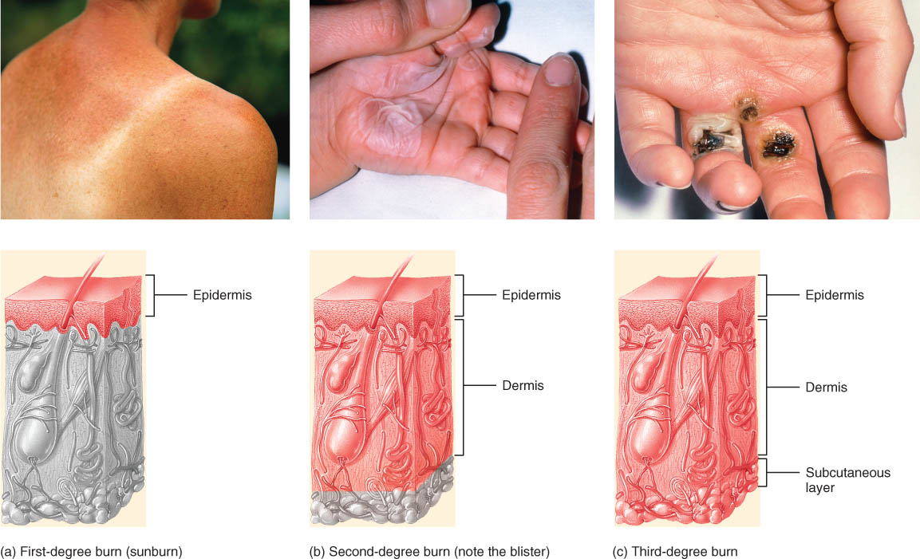
Burns

Slide 7
Pressure Sores
Pressure ulcers, also known as decubitus ulcers
caused by a constant deficiency of blood to tissues overlying a bony projection that has been subjected to prolonged pressure
typically occur between bony projection and hard object such as a bed, cast, or splint
the deficiency of blood flow results in tissue ulceration.
Preventable with proper care

Slide 8
end

