Slide 1
Chapter 5: Cell Structure & Function
5-2: Cell Structure

Slide 2
Most cells are so small that we need a microscope to see them.
Cells are measured in micrometers (μm).
A μm is one millionth of a meter.

Slide 3
The size of some cells
E. coli (prokaryote) 10 μm
Skin cell (eukaryote) 100 μm
Chaos chaos (euk.) 1,000 μm (1mm)
Chicken egg (euk.) 6 cm

Slide 4
Why must cells be small?
So that the entire cell may be nourished by diffusion, which is a slow process.
The small size allows for a large Surface Area to Volume ratio. The more surface area, the more ways there are for materials to move into and out of the cell.

Slide 5
The Cell Membrane
All cells are surrounded by a cell membrane.
Homeostasis must be maintained inside the cell so that the proteins keep their proper shape.
This is the main function of the cell membrane.
Cell membranes are phospholipid bylayers and are semipermeable. This means some materials can pass through and others cannot.

Slide 6
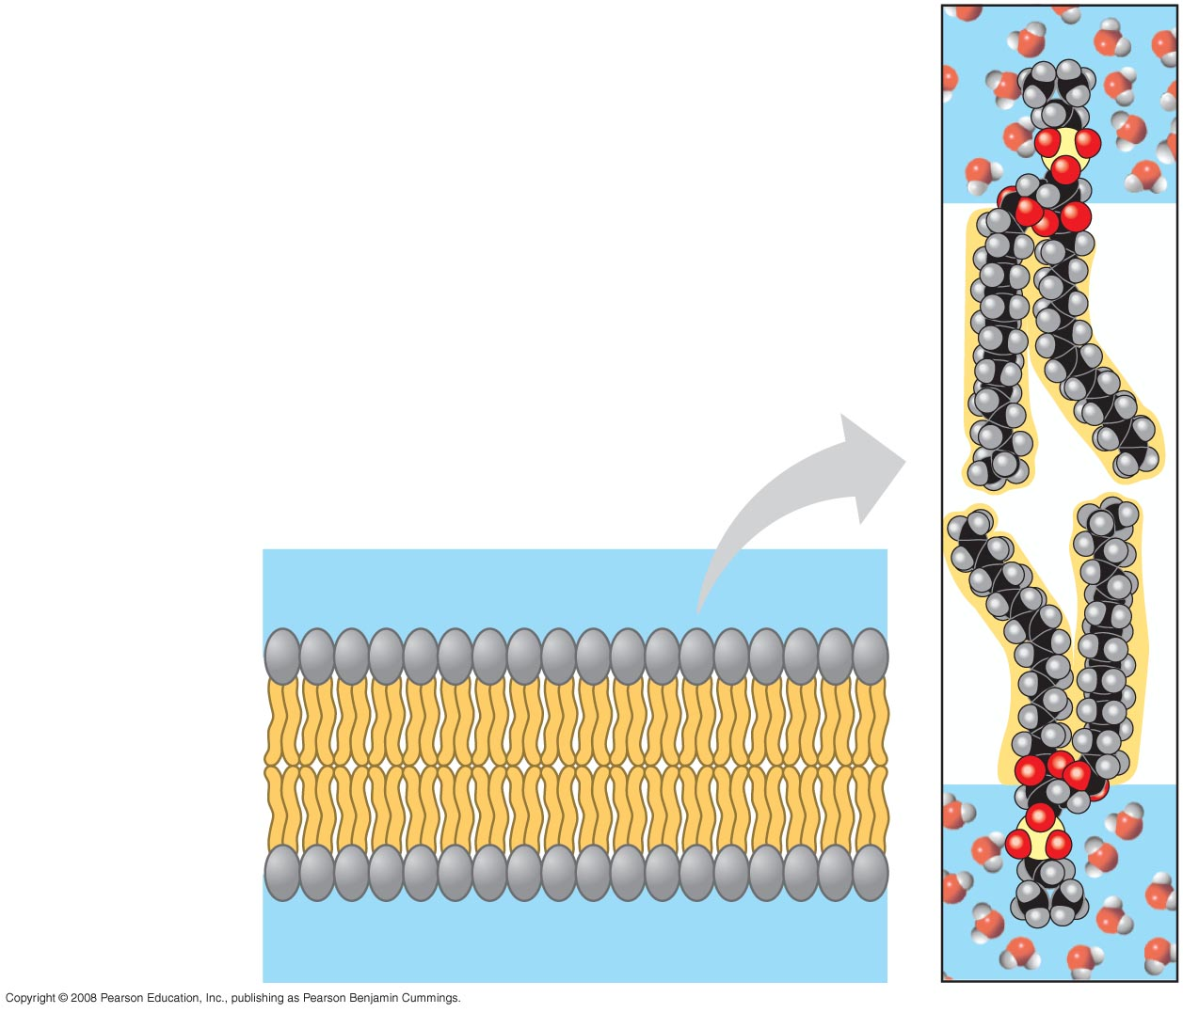
The Cell Membrane
Phospholipid
WATER
Hydrophilic
head
Hydrophobic
tails
Hydrophilic
head
WATER

Slide 7
The Cell Membrane
What types of materials can pass easiest through the membrane?
In addition to the phospholipids, membranes also include proteins, carbohydrates and cholesterol.

Slide 8
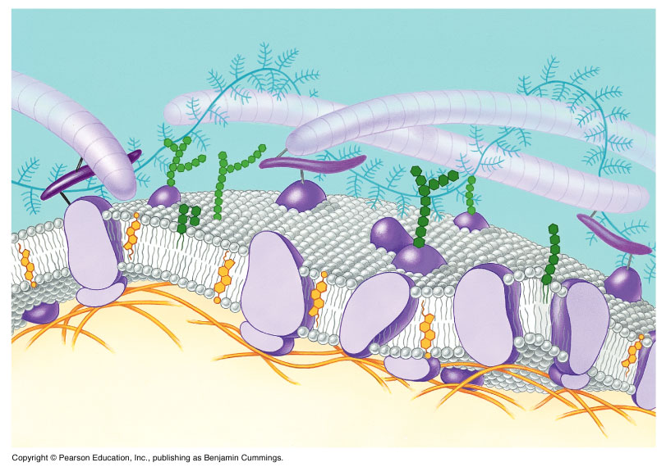
Outside Cell
Glycolipid
Glycoprotein
Carbohydrate
Proteins
Cholesterol
Cytoplasm
Inside Cell

Slide 9
The Cell Membrane
The functions of the membrane proteins are varied.
Some function as channels (tubes) through which molecules can pass.
Others act as pumps, moving molecules (ions) into or out of the cell

Slide 10
The Cell Membrane
The primary function of membrane carbohydrates is to act as identification tags for cells.
Cholesterol’s function is to help the membrane maintain proper fluidity regardless of temperature.

Slide 11
The Cell Wall
Outside the cell membrane of some cells is a cell wall.
Examples of cells with cell walls include plant cells, algae and some bacteria.
The function on the cell wall is to provide structure and support to the cell.
It is composed of cellulose and lignin – a protein that provides rigidity.

Slide 12
The Nucleus
Almost all eukaryotic cells contain a nucleus.
It is referred to as the control center of the cell. It contains DNA (in the form of chromatin or chromosomes).
The DNA has the instructions for making proteins, and the proteins control the functions of the cell.

Slide 13
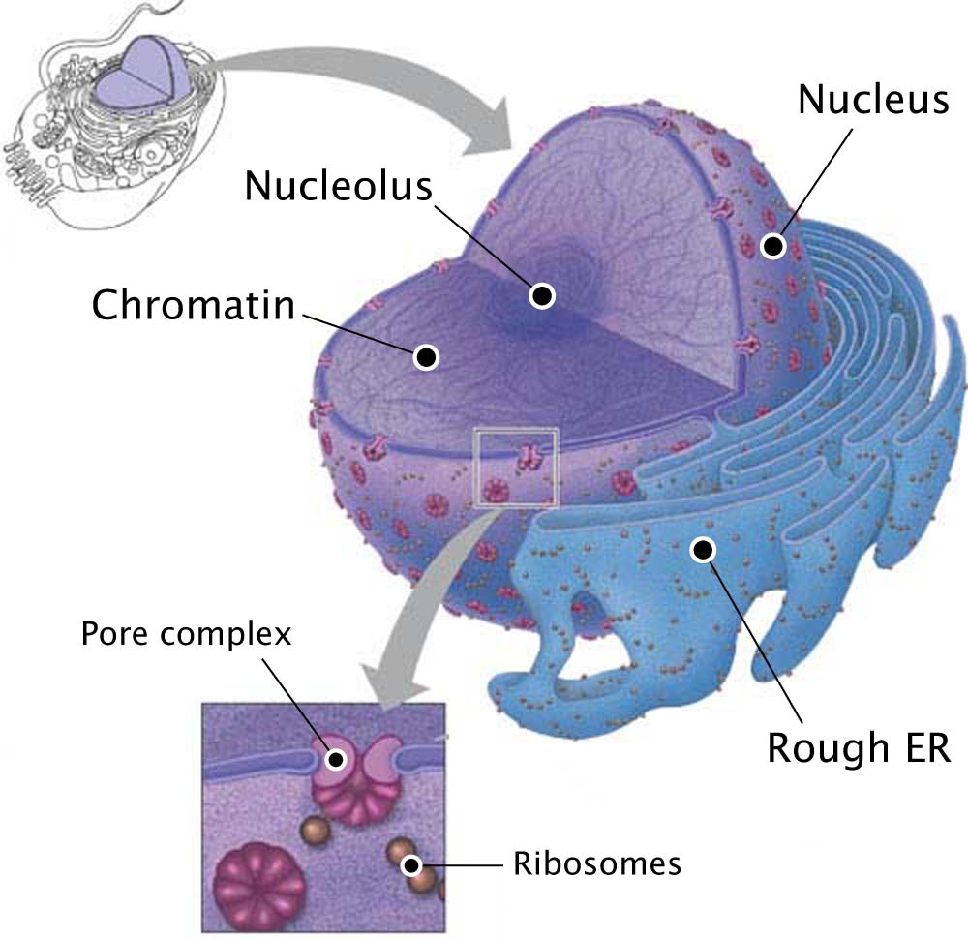

Slide 14
The Nucleus
The nucleus is surrounded by the nuclear envelope which is a double membrane system.
The membrane is perforated with holes, or Nuclear pores.
The pores allow for the passage of RNA, ribosomes and proteins into and out of the nucleus.

Slide 15
The Nucleus
Also located in the nucleus is a dark staining area known as the nucleolus.
The nucleolus is composed of RNA and proteins.
Its function is to produce ribosomes.

Slide 16
The Cytoplasm
The cytoplasm is the area between the nucleus and the cell membrane.

