Slide 1
Chapter 5: Cell Structure and Function 5-4: Movement of Materials Through the Cell Membrane
Molecules are constantly moving, colliding with one another and tend to spread out through space.
DIFFUSION: A passive process (does not require energy) by which molecules of a substance move from an area of higher concentration to an area of lower concentration.
Diffusion

Slide 2
Equilibrium

Slide 3
Diffusion occurs until equilibrium is reached.
Equilibrium is when the rate of movement of molecules in one direction is equal to the rate of movement of molecules in the opposite direction.

Slide 4
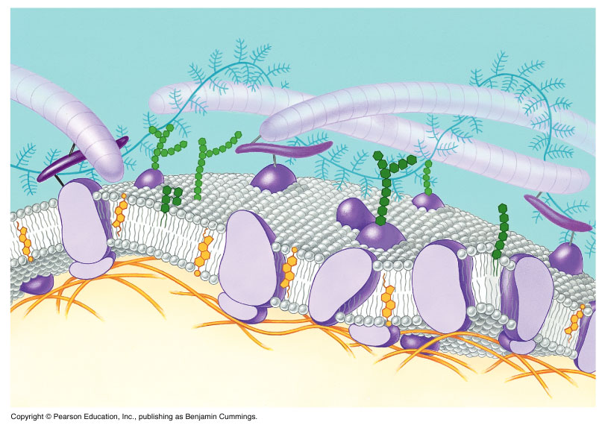
Biological membranes (cell membranes) are said to be selectively permeable. This means that it allows some, but not all materials through.
Because water is polar, it moves at a slow rate across the membrane.
Molecules that are small and nonpolar get through most easily.
Aquaporins are proteins
that help the H₂O through.

Slide 5
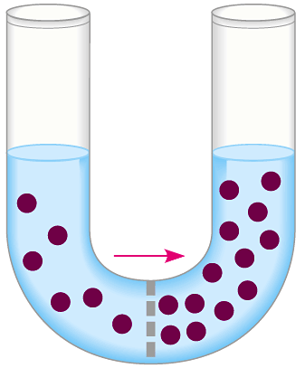
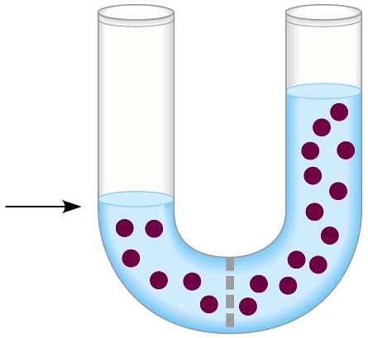
Osmosis is the diffusion of water. This is a passive process (does not require energy).
Osmosis

Slide 6
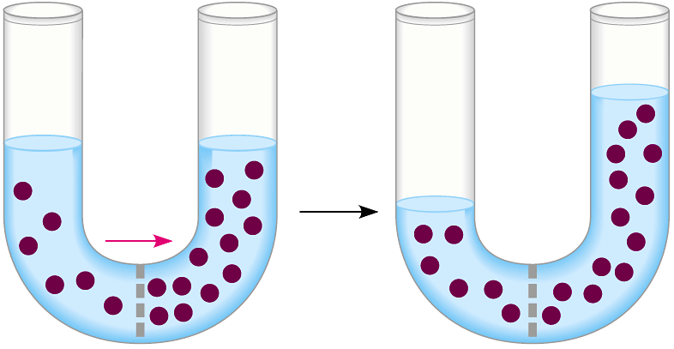
In this figure, the membrane is permeable to water and impermeable to sugar. Because water is more concentrated on the left side, it diffuses down its concentration gradient to the right side causing the water level to rise.
This is called osmotic pressure - the force exerted by osmosis

Slide 7
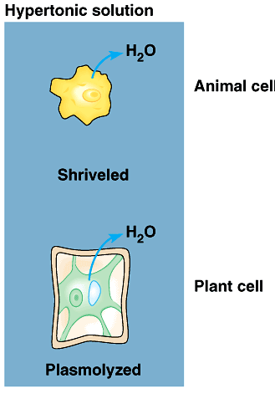
If a cell is put in a hypertonic (concentrated) solution ––
water is more concentrated in the cell
water will leave the cell and the cell will shrivel (plasmolysis)

Slide 8
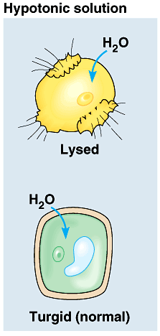
If a cell is put in a hypotonic (dilute) solution ––
water is less concentrated in the cell
water will enter the cell and the cell will swell. This pressure is known as osmotic pressure.
Plant cells will become turgid (rigid)
Animal cells may lyse (burst)

Slide 9
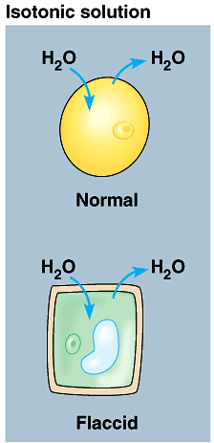
An isotonic solution has the same (equal) concentration as the cell.
There will be no net movement of water

Slide 10
Osmotic pressure might cause some problems for organisms. They can deal with this by:
Cells do not come in contact with fresh water
Cell walls prevent bursting
Water is pumped out of the cell
facilitated diffusion - Material is moved down its concentration gradient across the cell membrane by a carrier protein. (Ex. Aquaporins) This is a passive process (does not require energy).

Slide 11
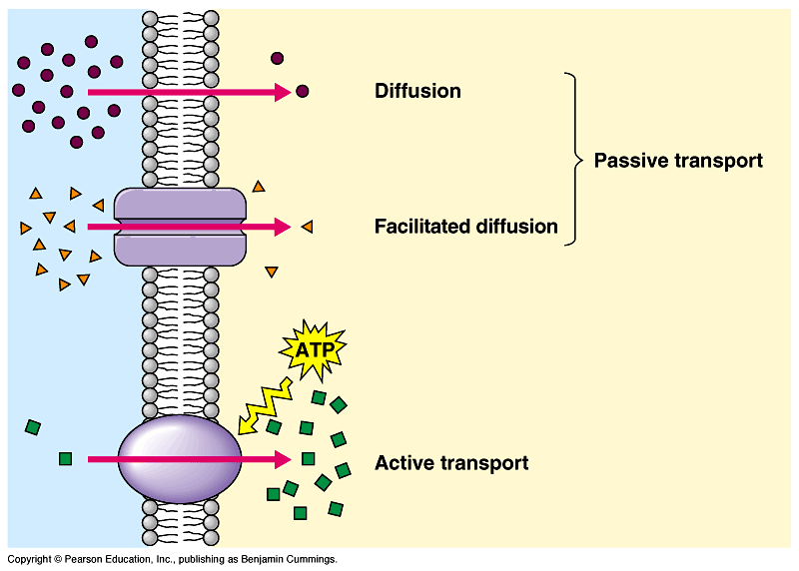

Slide 12
ACTIVE TRANSPORT vs PASSIVE TRANSPORT
Passive transport (osmosis, diffusion & facilitated diffusion) move down their concentration gradients and do not require energy.
Active transport works against concentration gradients and requires energy.

Slide 13
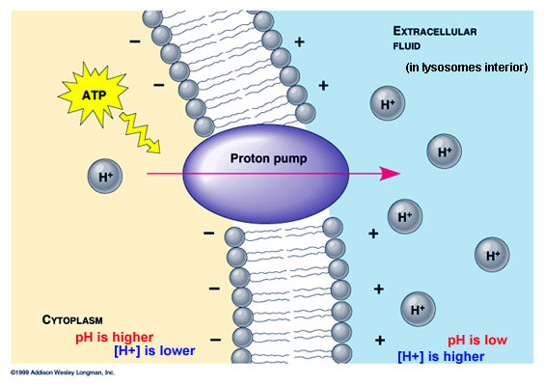
Active Transport
In our cells, pumps are often used to create an area of high concentration of an ion. This requires energy and is an active process.

Slide 14
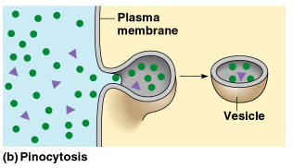
Pinocytosis is a type of endocytosis (into the cell) whereby liquids/droplets and small particles are taken into the cell (active process)

Slide 15
Phagocytosis is a type of endocytosis (into the cell) the cell engulfs large solids and takes them into the cell (active process)

Slide 16
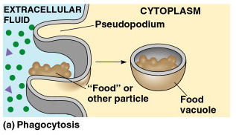
Types of Endocytosis

Slide 17
Exocytosis – large amounts of materials are transported out of the cell by vesicles which fuse with the cell membrane (active process)

Slide 18
The cell membrane is permeable to H₂O, fructose and glucose but impermeable to sucrose. The environment is initially hypotonic compared to the cell. Predict the net movement of H₂O and all solutes.

Slide 19
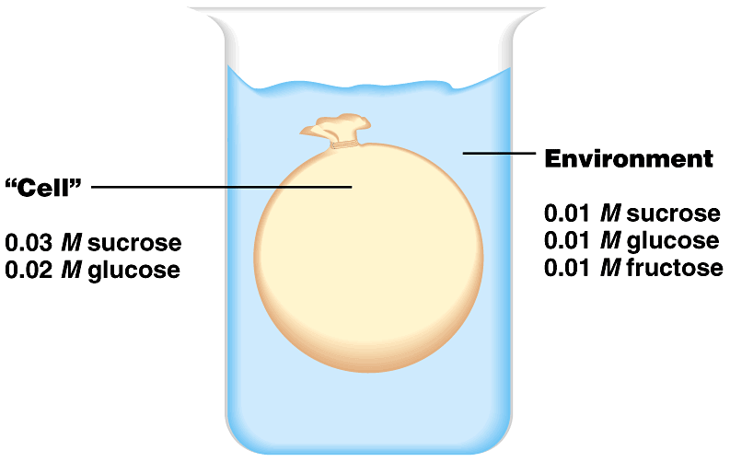
The cell membrane is permeable to H₂O, fructose and glucose but impermeable to sucrose. The environment is initially hypotonic compared to the cell. Predict the net movement of H₂O and all solutes.
H₂O

