Slide 1
CHAPTER 4: The Chemical Basis of Life
4-3: Compounds of Life:
Carbohydrates

Slide 2
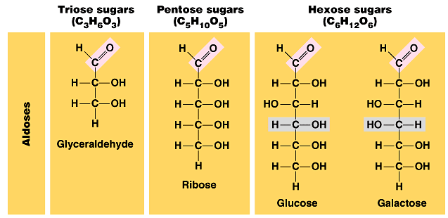
Carbohydrates
As you can see, all carbohydrates are made of Carbon, Hydrogen and Oxygen in a 1C:2H:1O ratio.
Carbohydrates are also called sugars. You can tell that a
molecule is a sugar if its name ends in ose.

Slide 4
Carbohydrates
Sugars are biologically important because they
Provide large amounts of energy
Provide structure for some organisms

Slide 5
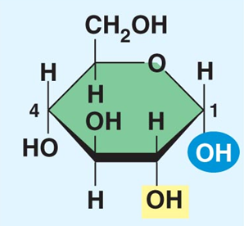
Carbohydrates
The structure of α glucose:

Slide 6
Carbohydrates
Simple sugars (monosaccharides) are joined together through a process called dehydration synthesis. This is building (synthesizing) by removing water (dehydration). When joined, these two sugars form a disaccharide.

Slide 7
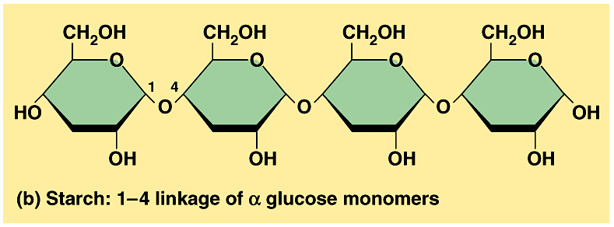
Carbohydrates
Many sugars are joined together by dehydration synthesis to form a polysaccharide.

Slide 8
Carbohydrates
In plants, excess sugar is stored in the form of the polysacchraride called starch.
In animals, excess sugar is stored in the liver and muscles as a polysacchraride called glycogen.

Slide 9
Carbohydrates
Notice how branched glycogen is compared to starch.

Slide 10
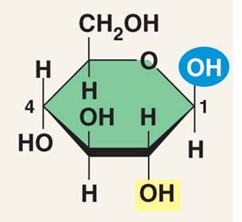
Carbohydrates
The structure of β glucose:

Slide 11
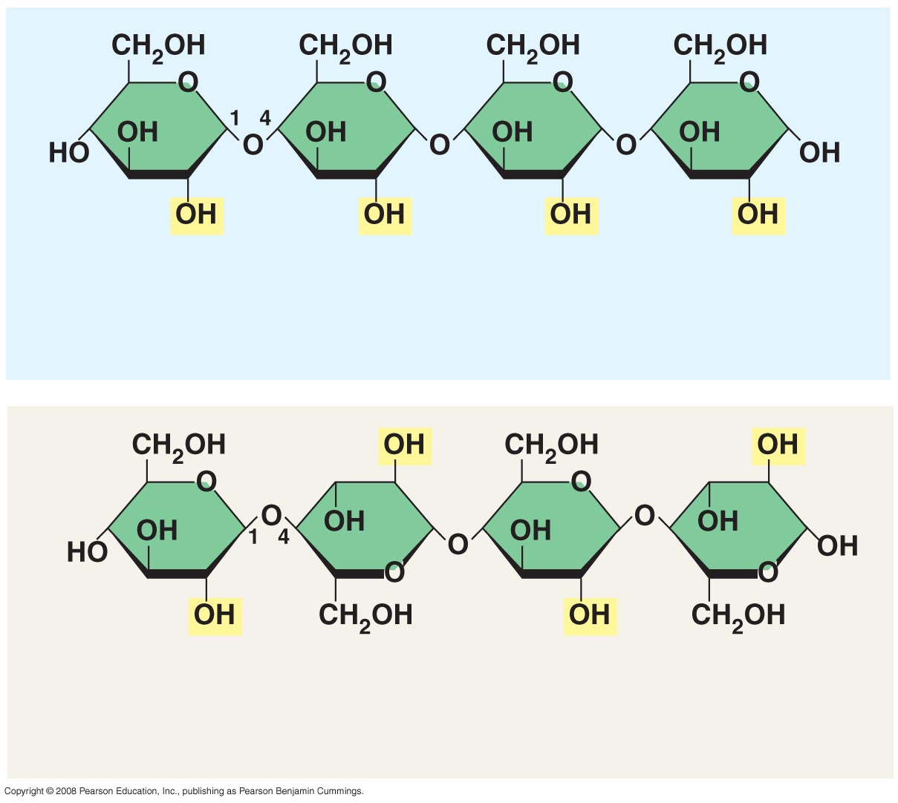
(b) Starch: 1–4 linkage of α glucose monomers
(c) Cellulose: 1–4 linkage of β glucose monomers

Slide 12
(b) Starch: 1–4 linkage of α glucose monomers
(c) Cellulose: 1–4 linkage of β glucose monomers

Slide 13
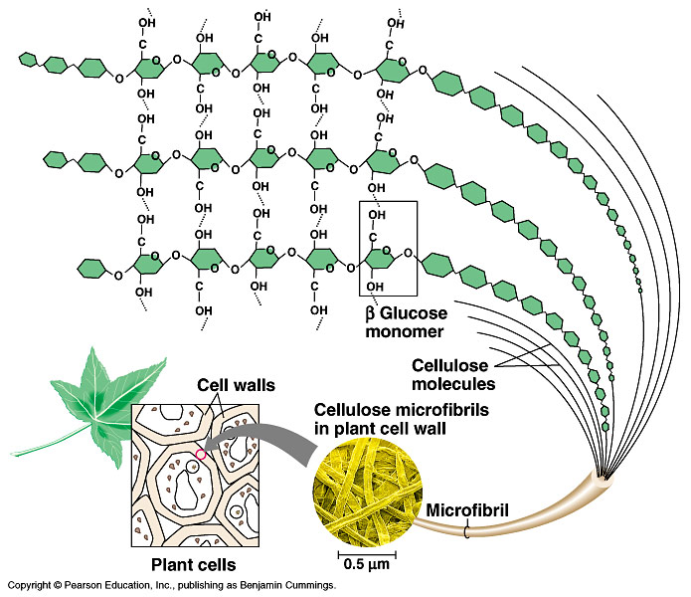
Carbohydrates
Other examples of polysaccarides include:
Cellulose – found in plant cell walls (β glucose)
Hydrogen Bonds
- Chitin – found in exoskeletons (cockroach’s shell)

Slide 14
Carbohydrates
Does the shape of the molecule have an impact on its function?
YOU BET IT DOES!
Both α and β glucose have the same amount of energy in them. We can retrieve this energy from α glucose, but β glucose passes through our system undigested.

Slide 15
Carbohydrates
In order to get the energy out of polysaccharides, they must be first be broken down into simple sugars.
This process is called hydrolysis – that is splitting (lysis) by adding water (hydro). This process is just the opposite of dehydration synthesis.

Slide 16
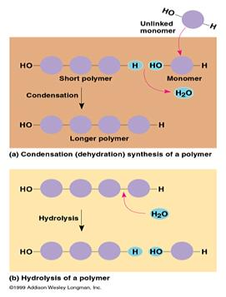
Carbohydrates Hydrolysis

