Slide 1
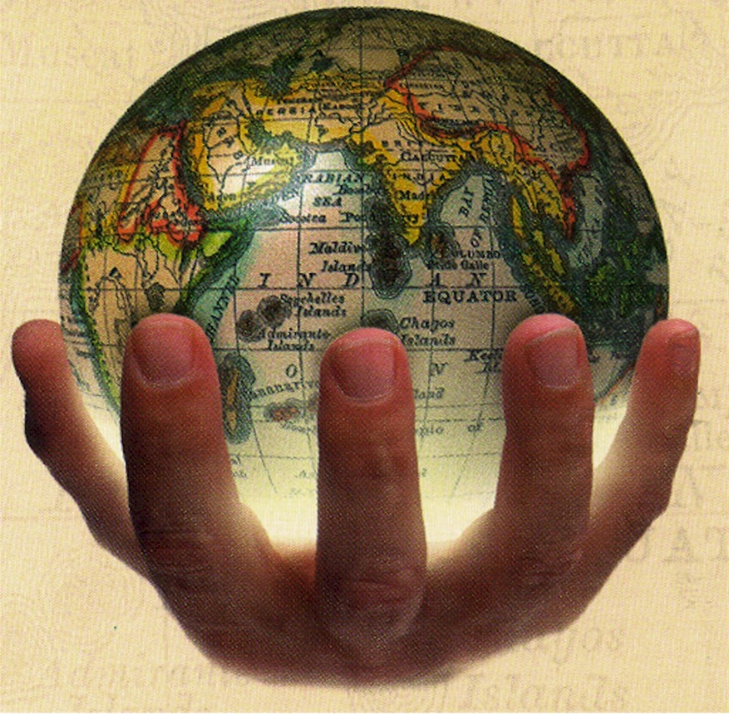
U.S. Imperialism
Global competition prompts the United States to expand its influence and territory, engage in conflicts around the globe, and build the Panama Canal.

Slide 2
U.S. Imperialism
Did American Imperialism have a positive or negative impact on the world and on the United States?
LESSON 1
Imperialism and America
LESSON 2
The Spanish-American War
LESSON 3
Acquiring New Lands
LESSON 4
America as a World Power

Slide 3
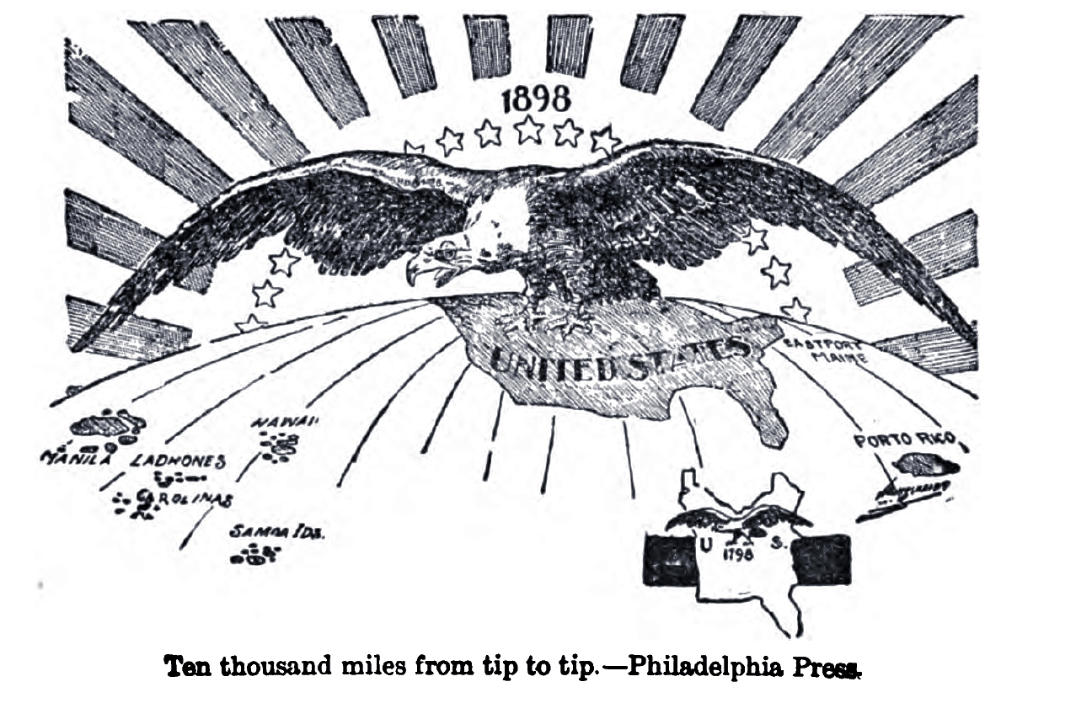
LESSON 1
Imperialism and America
Beginning in 1867 and continuing through the century, global competition causes the United States to expand.

Slide 4
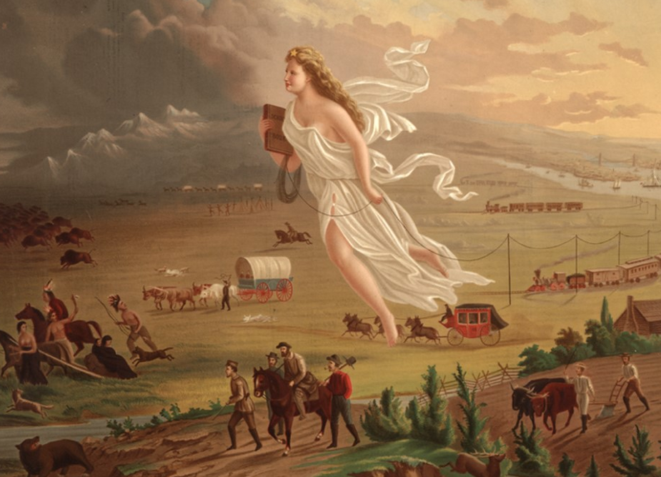
LESSON 1
Imperialism and America
American Expansionism
U.S. expands the size of the nation West toward the Pacific Ocean
Early Encounters
New port cities on the Pacific allow U.S. to expand global trade network
Attempt to expand diplomatic relation with China and Japan
U.S. uses gunboat diplomacy to open Japanese ports to trade
U.S. leaders want to join Europeans imperialists in establishing colonies
Imperialism—policy of extending control over weaker nations
Global Competition
In 1800s, Europeans divide up most of Africa, compete for China
Japan joins race for China; U.S. decides to expand overseas
Three factors fuel U.S. imperialism: military strength, new markets, cultural superiority
Continued…

Slide 5
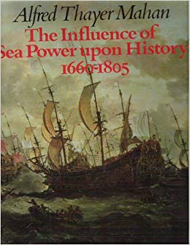
Lesson 1
American Expansionism (continued)
Desire for Military Strength
Admiral Alfred T. Mahan urges U.S. to build up navy to compete
U.S. builds modern battleships, becomes third largest naval power
Thirst for New Markets
U.S. farms, factories produce more than Americans can consume
U.S. needs raw materials, new markets for goods
Foreign trade: solution to overproduction, unemployment, depression
Belief in Cultural Superiority
Some combine Social Darwinism, belief in superiority of Anglo-Saxons
Argue U.S. has duty to Christianize, civilize “inferior peoples”

Slide 6
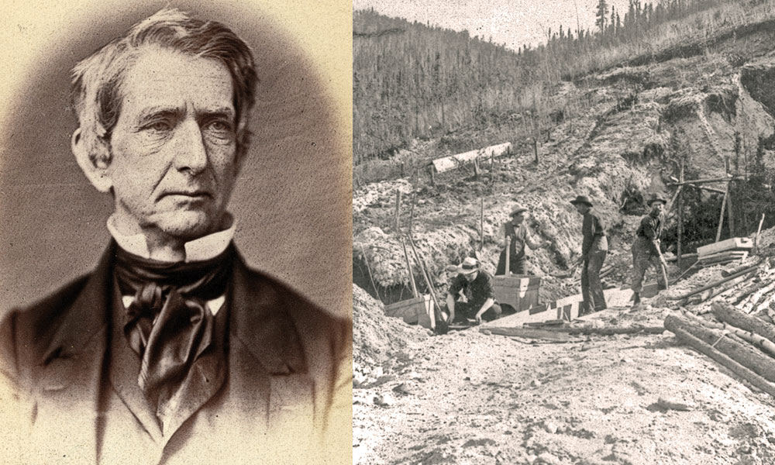
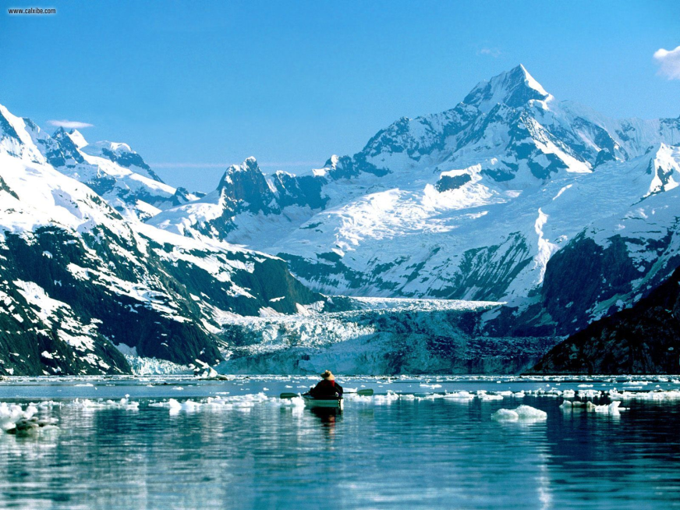
LESSON 1
Imperialism and America
The United States Acquires Alaska
William Seward—Secretary of State under Lincoln, Johnson
1867, arranges purchase of Alaska from Russia for $7.2 million
has trouble convincing House to fund purchase
Alaska called “Seward’s Icebox,” “Seward’s Folly”
Alaska rich in timber, minerals, oil

Slide 7
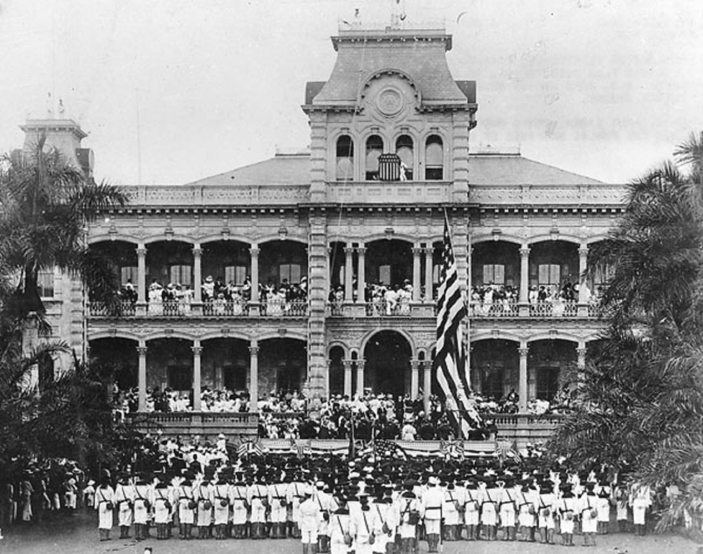
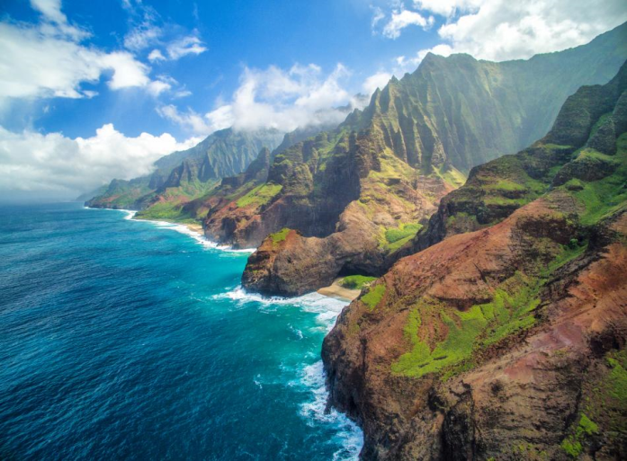
LESSON 1
Imperialism and America
The United States Takes Hawaii
Since 1790s, U.S. merchants stop in Hawaii on way to China, India
1820s, Yankee missionaries found schools, churches on islands
The Cry for Annexation
Mid-1800s, American-owned sugar plantations 75% of islands’ wealth
1887, U.S. pressures Hawaii to allow naval base at Pearl Harbor
becomes refueling station
1890 McKinley Tariff eliminates duty-free status of Hawaiian sugar
By 1900, foreigners outnumber native Hawaiians 3 to 1
Planters call for U.S. to annex islands so will not have to pay duty
Continued…

Slide 8
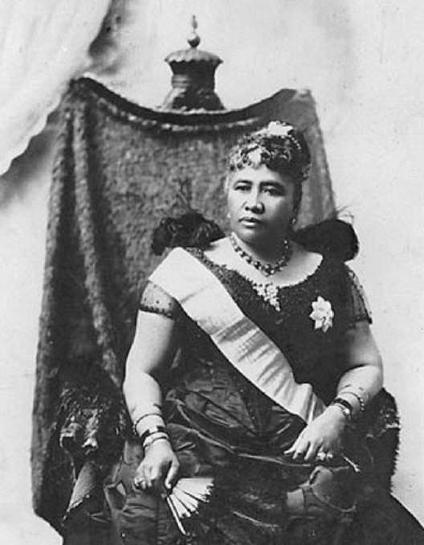
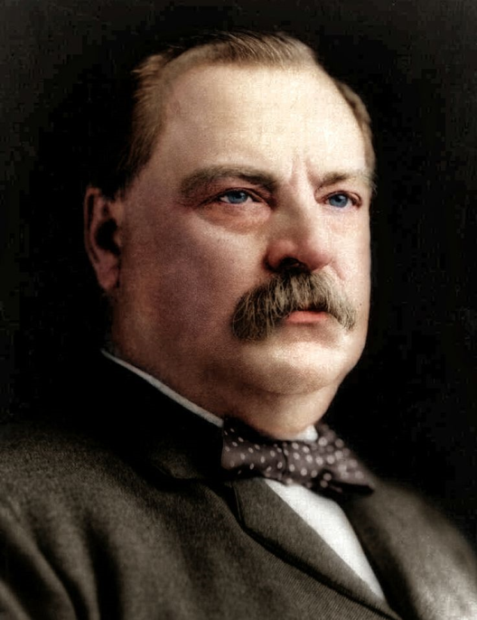
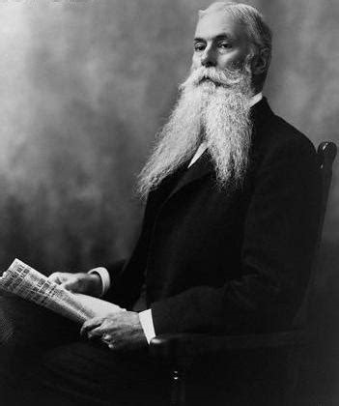
Lesson 1
The United States Takes Hawaii (continued)
The End of a Monarchy
1887, businessmen force King Kalakaua to limit vote to landowners
Queen Liliuokalani tries to remove landowning requirement
With help of marines, business groups overthrow the queen
Set up government headed by Sanford B. Dole
President Cleveland cannot make Dole surrender power to queen
recognizes Republic of Hawaii
Under President McKinley, Congress proclaims Hawaii U.S. territory

Slide 9
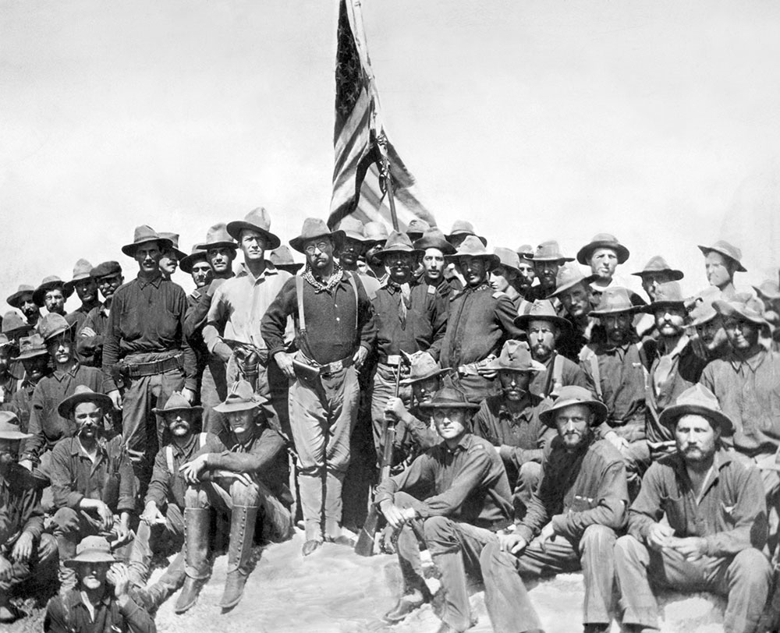
LESSON 2
The Spanish-American War
In 1898, the United States goes to war to help Cuba win its independence from Spain.

Slide 10
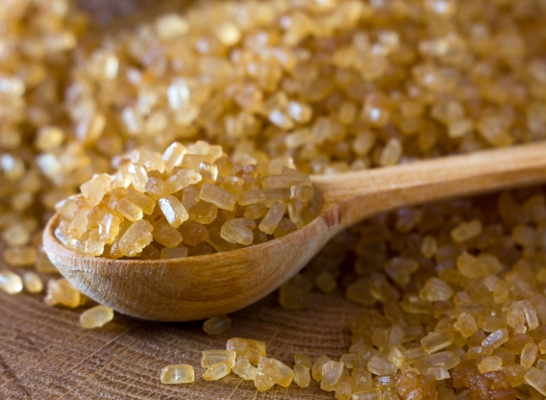
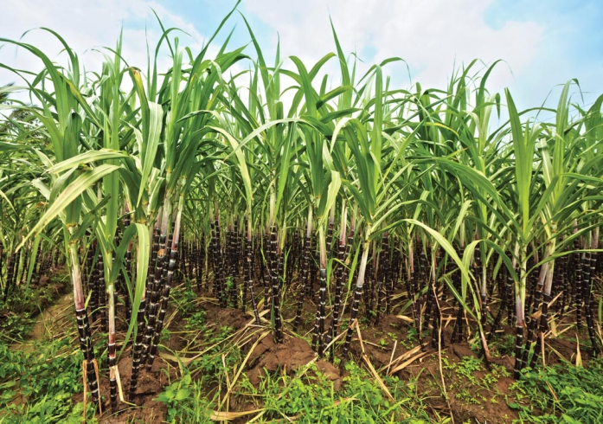
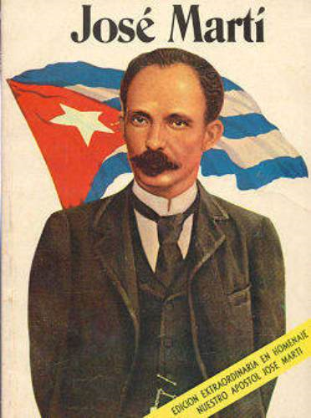
LESSON 2
The Spanish-American War
Cubans Rebel Against Spain
By the late-1800s, Spain power as a colonial nation had declined
American Interest in Cuba
U.S. long interested in Cuba; wants to buy Cuba from Spain
During 1868–1878 war for independence, American sympathies with Cuba
1886 abolition of slavery leads to U.S. investment in sugar cane
The Second War for Independence
José Martí—poet, journalist—launches second revolution in 1895
Guerrilla campaign destroys American-owned sugar mills, plantations
U.S. public opinion split:
business wants to support Spain
others favor Cuban cause

Slide 11
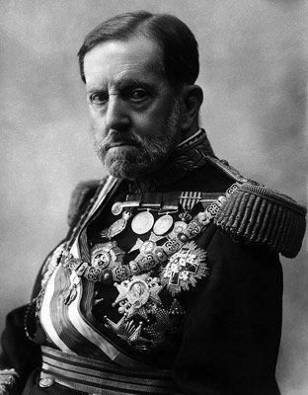
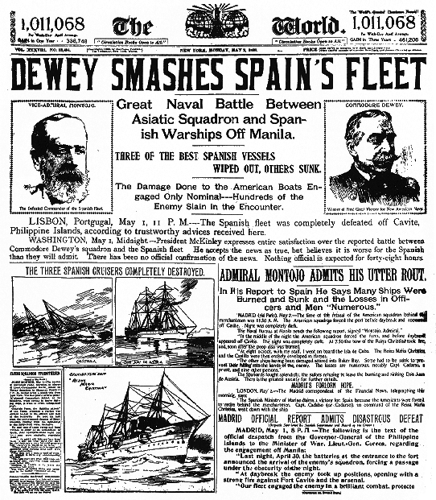
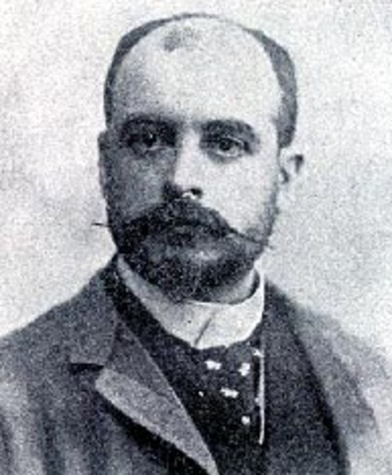
LESSON 2
The Spanish-American War
War Fever Escalates
1896, General Valeriano Weyler sent to Cuba to restore order
Puts about 300,000 Cubans in concentration camps
Headline Wars
Newspapers exploit Weyler’s actions in circulation war; Hearst vs. Pulitzer
Yellow journalism—sensational writing used to lure, enrage readers
The De Lôme Letter
Headlines increase American sympathy for independent Cuba
McKinley wants to avoid war, tries diplomacy to resolve crisis
Private letter by Spanish minister Enrique Dupuy de Lôme published
calls McKinley weak, swayed by public
Spain apologizes, de Lôme resigns; American public angry
Continued…

Slide 12
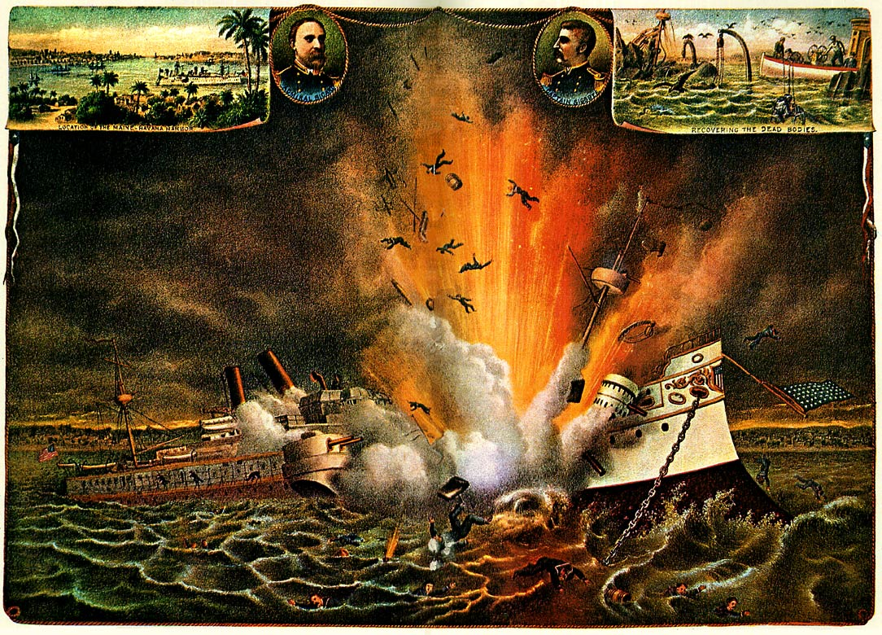
Lesson 2
War Fever Escalates (continued)
The USS Maine Explodes
U.S.S. Maine sent to pick up U.S. citizens, protect U.S. property
Ship blows up in Havana harbor; newspapers blame Spain

Slide 13
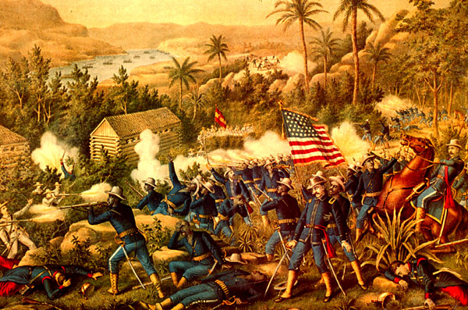
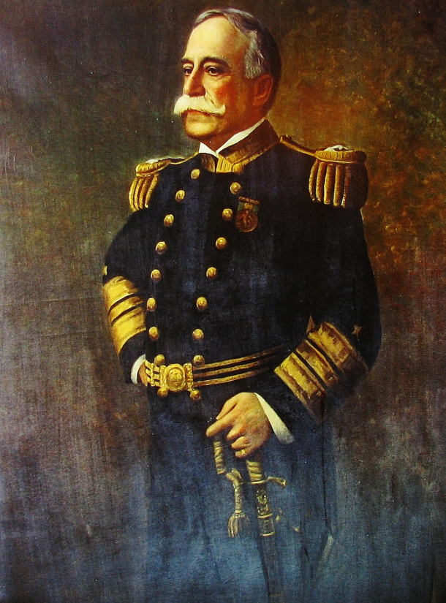
LESSON 2
The Spanish-American War
War with Spain Erupts
Spain agrees to most U.S. demands, public opinion still favors war
U.S. declares war April 1898
The War in the Philippines
First battle with Spain occurs in Spanish colony of the Philippines
Commodore George Dewey destroys Spanish fleet in Manila harbor
Filipino rebels, led by Emilio Aguinaldo, support the U.S.
August 1898, Spanish troops in Manila surrender to U.S
The War in the Caribbean
U.S. blockades Cuba; Spanish fleet in Santiago de Cuba harbor
Unlike navy, U.S. army has small professional force, many volunteers
volunteers ill-prepared, ill-supplied
Continued…

Slide 14
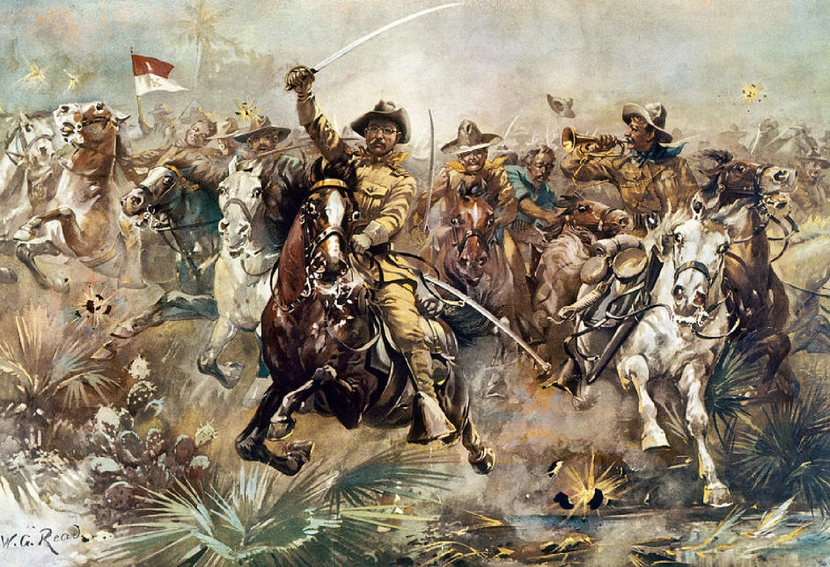
Lesson 2
War with Spain Erupts (continued)
Rough Riders
Rough Riders—Leonard Wood, Theodore Roosevelt lead volunteer cavalry
Roosevelt declared hero of attack on strategic San Juan Hill
Spanish fleet tries to escape blockade, is destroyed in naval battle
U.S. troops invade Puerto Rico soon after
Treaty of Paris
Spain, U.S. sign armistice August 1898; meet in Paris to make treaty
Spain frees Cuba; hands Guam, Puerto Rico to U.S.; sells Philippines
Debate over the Treaty
Treaty of Paris touches off great debate over imperialism
McKinley tries to justify annexation of Philippines on moral grounds
Opponents give political, moral, economic arguments against

Slide 15
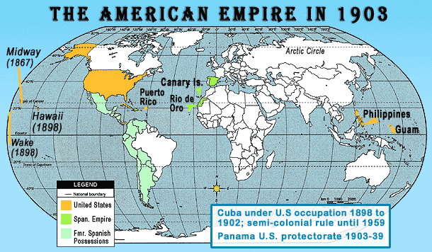
LESSON 3
Acquiring New Lands
In the early 1900s, the United States engages in conflicts in Puerto Rico, Cuba, and the Philippines.

Slide 16
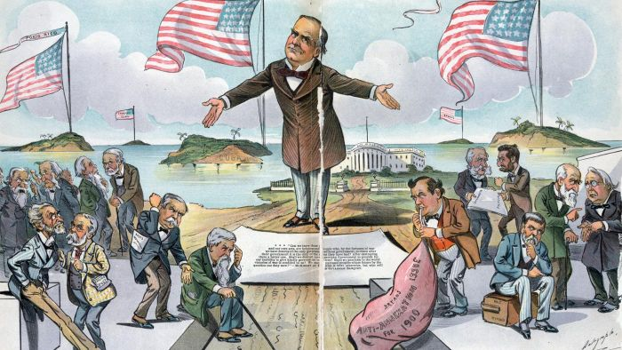
LESSON 3
Acquiring New Lands
Ruling Puerto Rico
People split on independence, statehood, self-government under U.S.
The U.S. gave Puerto Ricans no guarantees about statehood or independence
Military Rule
During Spanish-American War, General Nelson A. Miles occupies island
Puerto Rico under military control
Return to Civil Government
Puerto Rico strategic as post in Caribbean, for protection of future canal
1900, Foraker Act sets up civil government
president appoints governor, upper house
1917, Puerto Ricans made U.S. citizens; elect both houses

Slide 17
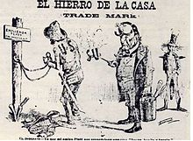
LESSON 3
Acquiring New Lands
Cuba and the United States
U.S. recognizes Cuban independence from Spain
Teller Amendment says U.S. has no intention of taking over Cuba
American Soldiers
After war U.S. occupies Cuba; has same officials in office as Spain
Cuban protestors imprisoned or exiled
American military government helps rebuild the country
Platt Amendment
U.S. makes Cuba add Platt Amendment to its 1901 constitution
Remains in effect for 31 years
Cuba becomes a U.S. protectorate
Continued…

Slide 18
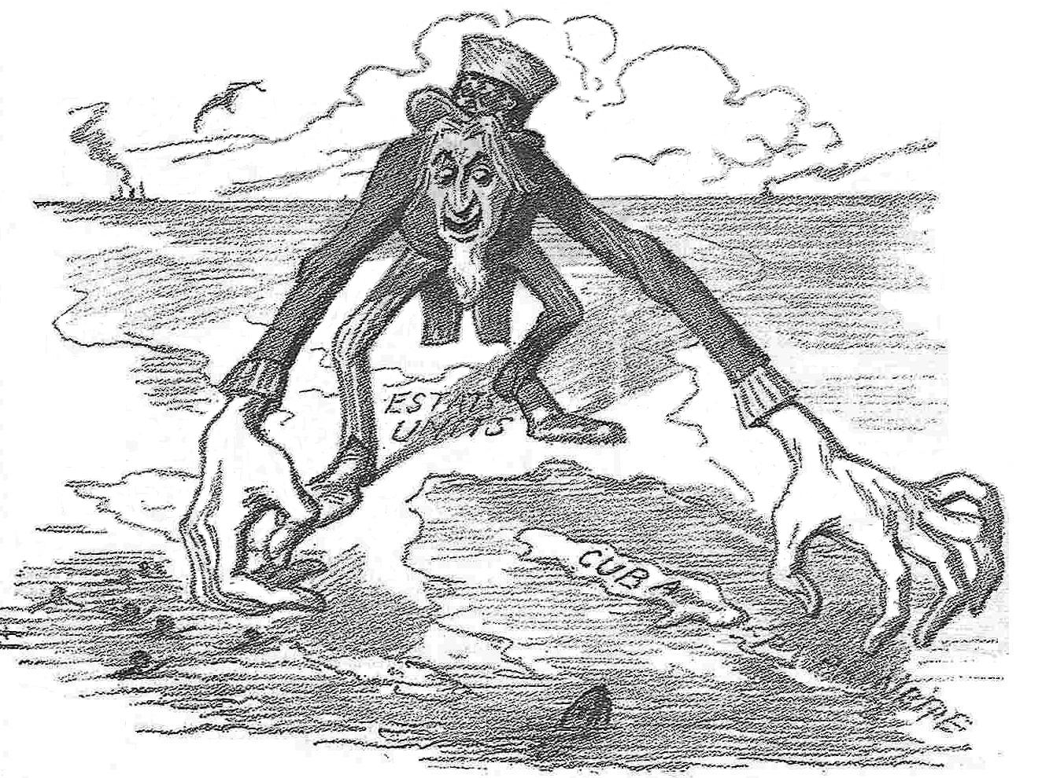
Lesson 3
Cuba and the United States (continued)
Protecting American Business Interests
U.S. companies invested in Cuba’s sugar, tobacco, and mining industries
Some U.S. business leaders favored colonial rule of Cuba, other were opposed
U.S. State Department continues to push for control of Latin American neighbors

Slide 19
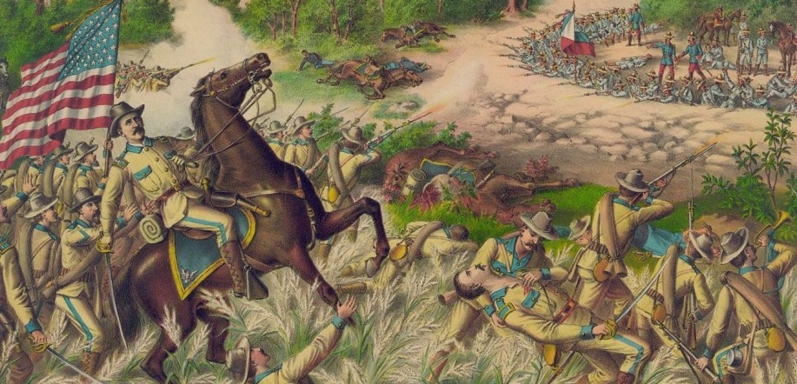
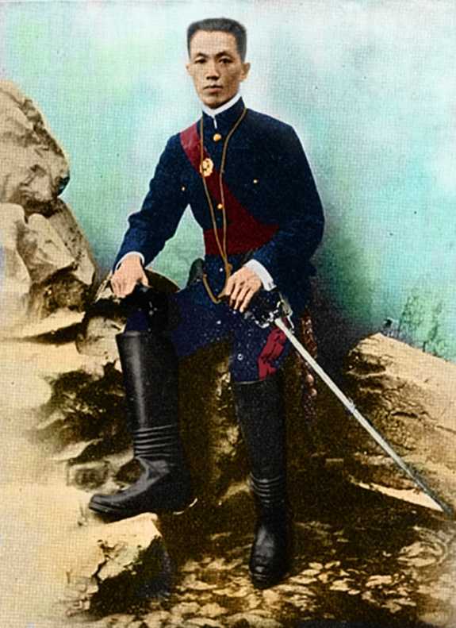
LESSON 3
Acquiring New Lands
Filipinos Rebel
Filipinos outraged at Treaty of Paris call for annexation
Emilio Aguinaldo leads rebel in fight for independence
Philippine-American War
U.S. forces Filipinos to live in designated zones in poor conditions
white U.S. soldiers see Filipinos as inferior
black troops troubled at spreading prejudice
Some black troops desert and join Filipinos
20,000 Filipinos die in fight for independence
Aftermath of the War
U.S. president appoints governor who appoints upper house
people elect lower house
July 4, 1946, Philippines become independent

Slide 20
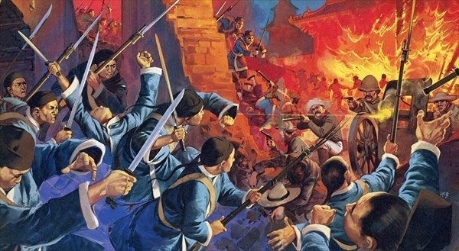
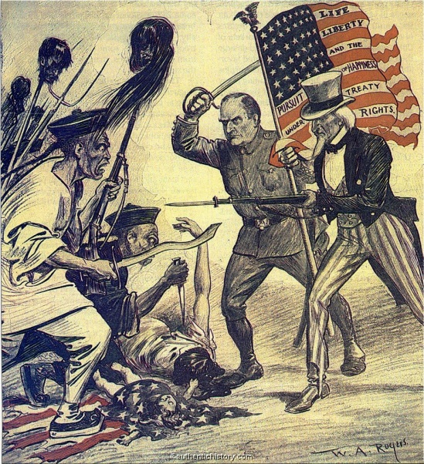
LESSON 3
Acquiring New Lands
Foreign Influence in China
U.S. sees China as vast potential market, investment opportunity
France, Britain, Japan, Russia have settlements, spheres of influence
John Hay’s Open Door Notes
U.S. Secretary of State John Hay issues Open Door notes
Notes ask imperialist nations to share trading rights with U.S.
Other powers reluctantly agree
The Boxer Rebellion in China
Europeans dominate most large Chinese cities
Chinese form secret societies, including Boxers, to expel foreigners
Boxers kill hundreds of foreigners, Chinese converts to Christianity
U.S., Britain, France, Germany, Japan put down Boxer Rebellion; sign Boxer Protocol
Continued…

Slide 21
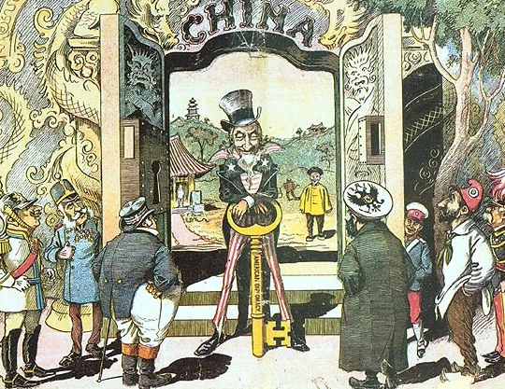
Lesson 3
Foreign Influence in China (continued)
Protecting American Rights
Hay issues new Open Door notes saying U. S. will keep trade open
Open Door policy reflects beliefs about U.S. economy:
growth depends on exports
U.S. has right to keep markets open
closing of area threatens U.S. survival

Slide 22
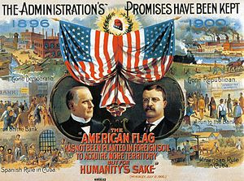
LESSON 3
Acquiring New Lands
The Impact of U.S. Territorial Gains
McKinley’s reelection confirms most Americans favor imperialism
Anti-Imperialist League has prominent people from different fields
For various reasons, agree wrong to rule others without their consent

Slide 23
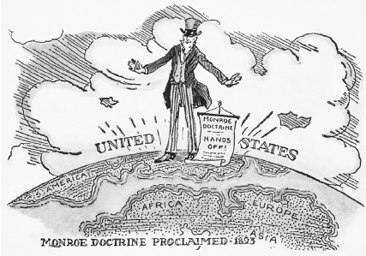
LESSON 4
America as a World Power
The Russo-Japanese War, the Panama Canal, and the Mexican Revolution add to America’s military and economic power.

Slide 24
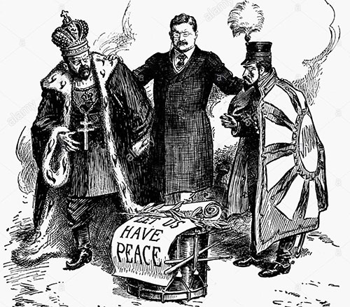
LESSON 4
America as a World Power
Teddy Roosevelt and the World
Roosevelt becomes president upon McKinley’s assassination
Roosevelt does not want Europeans to control world economy, politics
Roosevelt the Peacemaker
1904, Japan, Russia dispute control of Korea
Roosevelt negotiates Treaty of Portsmouth:
Japan gets Manchuria, Korea
Roosevelt wins Nobel Peace Prize
U.S., Japan continue diplomatic talks
pledge to respect each other’s possessions
Continued…

Slide 25
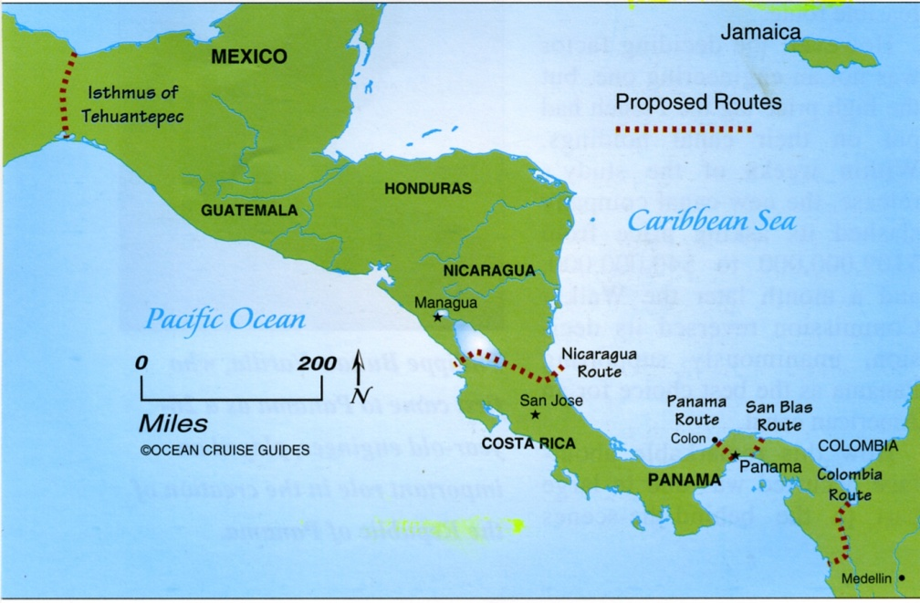
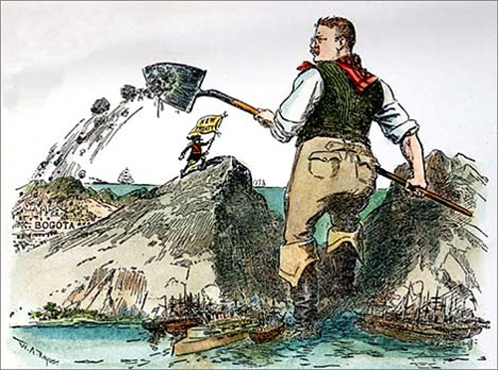
Lesson 4
Teddy Roosevelt and the World (continued)
Panama Canal
U.S. wants canal to cut travel time of commercial, military ships
1901, Hay-Pauncefote Treaty gives U.S. exclusive rights to canal
U.S. buys French company’s route through Panama
Negotiates with Colombia to build Panama Canal; talks break down
Bunau-Varilla helps organize Panamanian rebellion
U.S. gives military aid
U.S., Panama sign treaty; U.S. pays $10 million plus $250,00 per year for Canal Zone
Constructing the Canal
One of the greatest engineering feats:
fight diseases, geographic obstacles
at height, 43,400 workers employed
1914, Panama Canal opens, more than 1,000 merchant ships pass through in first year

Slide 26
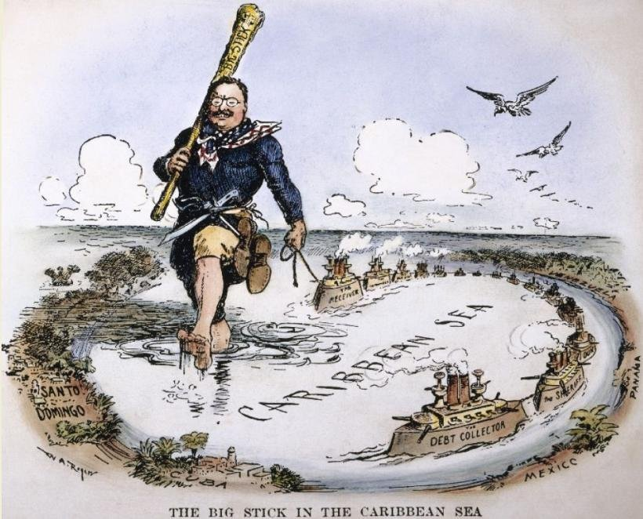
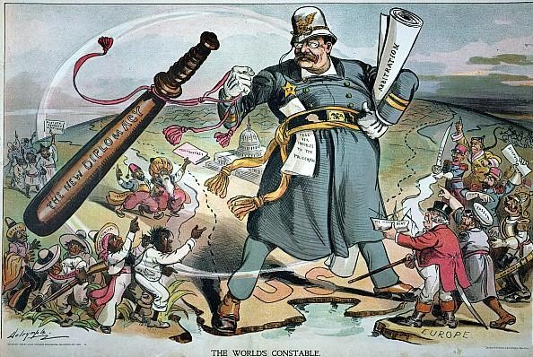
Lesson 4
Teddy Roosevelt and the World (continued)
The Roosevelt Corollary
Roosevelt fears European intervention if Latin America defaults on loans
Reminds Europeans of Monroe Doctrine, demands they stay out
Roosevelt Corollary—U. S. to use force to protect economic interests
Dollar Diplomacy
Early 1900s, U.S. exercises police power on several occasions
Dollar diplomacy—U.S. guarantees foreign loans by U.S. business

Slide 27
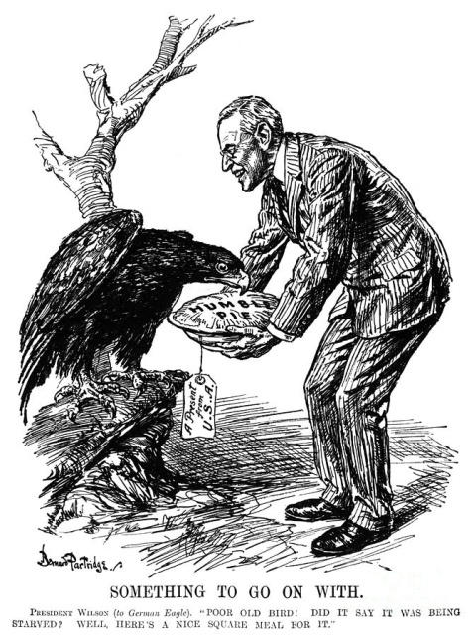
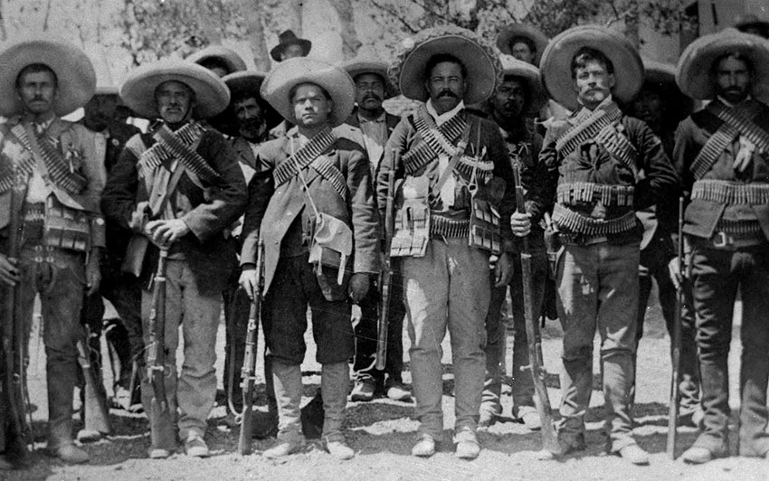
LESSON 4
America as a World Power
Woodrow Wilson’s Missionary Diplomacy
Missionary diplomacy—U.S. has moral responsibility:
will not recognize regimes that are oppressive, undemocratic
The Mexican Revolution
Under dictator Porfirio Díaz, much U.S. investment in Mexico
1911, peasants, workers led by Francisco Madero overthrow Díaz
General Victoriano Huerta takes over government; Madero is murdered
Wilson refuses to recognize Huerta’s government
Continued…

Slide 28
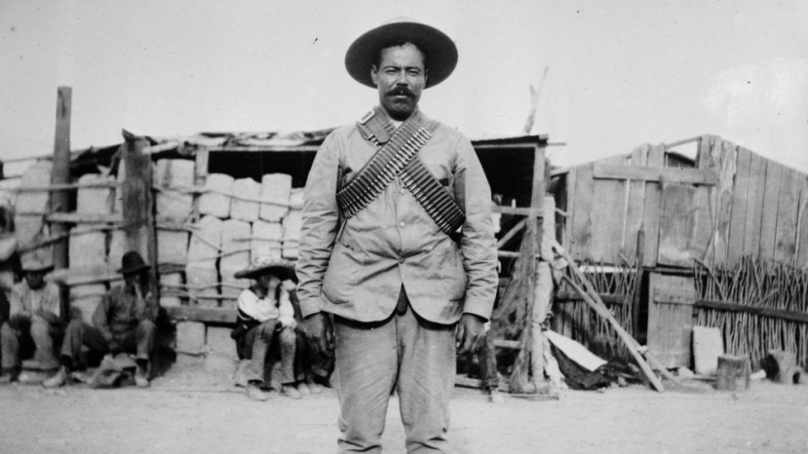
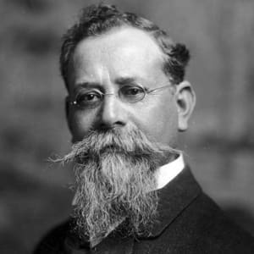
Lesson 4
Woodrow Wilson’s Missionary Diplomacy (continued)
Intervention in Mexico
Huerta’s officers arrest U.S. sailors, quickly release them
Wilson orders Marines to occupy Veracruz
Argentina, Brazil, Chile mediate to avoid war
Huerta regime falls; nationalist Venustiano Carranza new president
Rebellion in Mexico
Francisco “Pancho” Villa, Emiliano Zapata oppose Carranza
Zapata wants land reform
Villa a fierce nationalist
Wilson recognizes Carranza’s government; Villa threatens reprisals
Villa’s men kill American mine engineers
Villa raids Columbus, New Mexico
Continued…

Slide 29
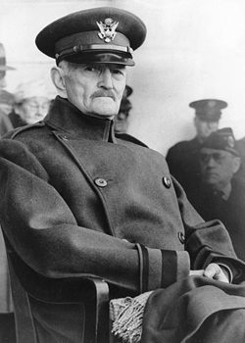
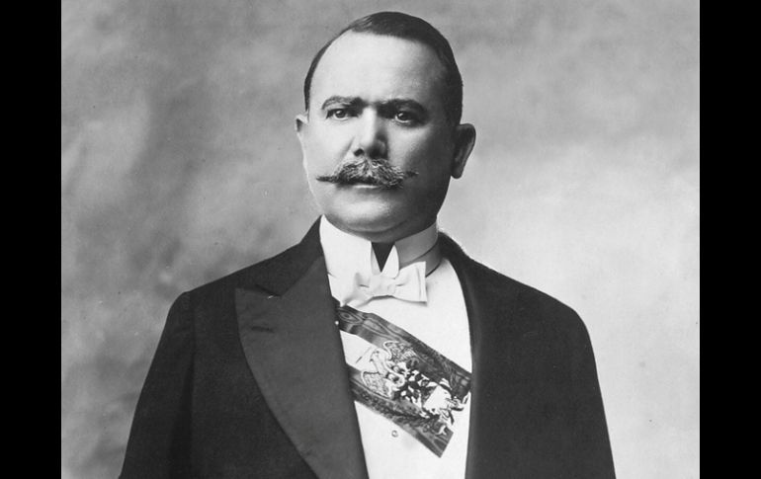
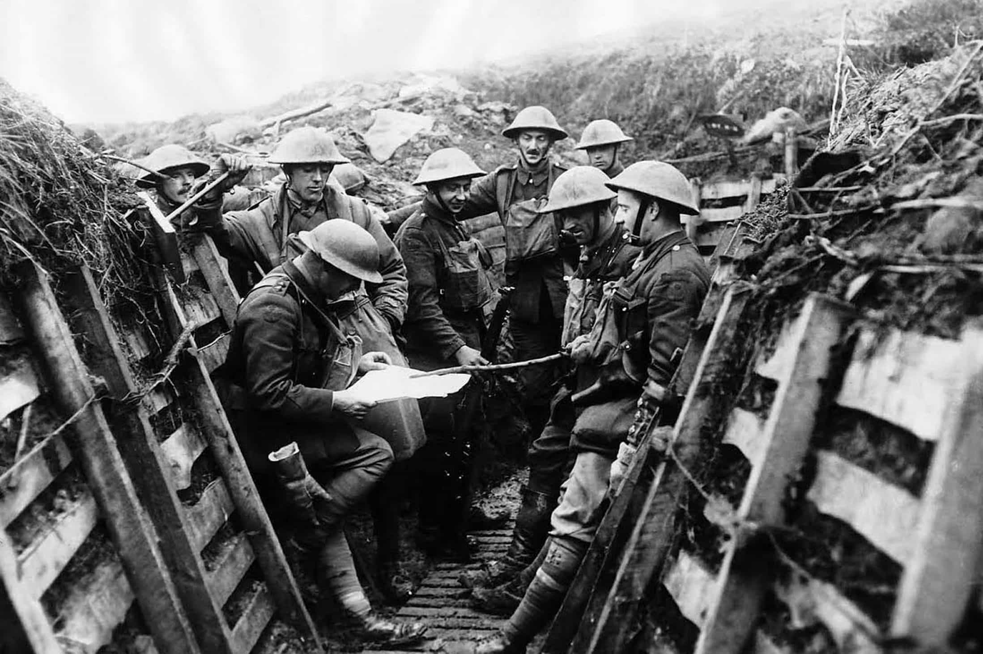
Lesson 4
Woodrow Wilson’s Missionary Diplomacy (continued)
Chasing Villa
Brigadier General John J. Pershing leads force to capture Villa
Carranza demands withdrawal of U.S. troops; Wilson at first refuses
U.S. faces war in Europe, wants peace on southern border
Wilson orders Pershing home
Mexico adopts new constitution:
government controls oil, minerals
restricts foreign investors
1920, Alvaro Obregón new president; ends civil war, starts reforms
Continued…

