Slide 2
Mendel’s Laws

Slide 3
Answer in Notebooks:
#1. How would you define genetics?

Slide 4
9.1 The study of genetics has ancient roots
The Greek physician Hippocrates explained inheritance by proposing that
particles called “pangenes” travel from each part of an organism’s body to the eggs or sperm
characteristics acquired during the parents’ lifetime could be transferred to the offspring.
Hippocrates’s idea is incorrect in several respects.
The reproductive cells are not composed of particles from somatic (body) cells.
Changes in somatic cells do not influence eggs and sperm.
Notes:
Teaching Tips
• The concept of pangenesis is analogous to the structure of United States representation in Congress. Each congressional district sends a person (pangene) to the U.S. House of Representatives (gamete). There, all parts of the United States (body) are represented.
• In this or future lectures addressing evolution, you may mention that pangenesis was a mechanism consistent with Lamarckian evolution.
Active Lecture Tips
• As you begin your lectures on genetics, consider challenging your students to work in small groups to explain why the theories of pangenesis or blending are incorrect. You might even ask for short responses from groups or use this as an assignment before the first lectures. In addition to arousing interest in the answers, the responses should reveal the diverse backgrounds of your students entering this discussion and reveal any preexisting confusion on the subject of genetics.
• See the Media Review: “Learn.Genetics” Genetic Science Learning Center from the University of Utah on the Instructor Exchange. Visit the Instructor Exchange in the MasteringBiology instructor resource area for a description of this activity.
Active Lecture Tips
• See the Media Review: “Learn.Genetics” Genetic Science Learning Center from the University of Utah on the Instructor Exchange. Visit the Instructor Exchange in the MasteringBiology instructor resource area for a description of this activity.

Slide 5
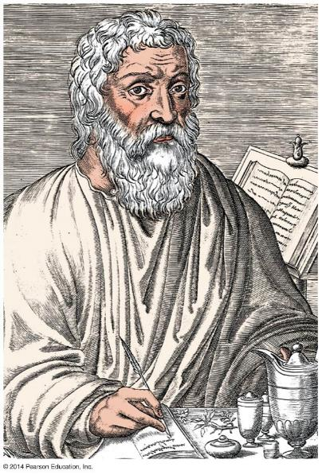
Figure 9.1
Notes:
Figure 9.1 Hippocrates (approximately 460–370 bce)

Slide 6
9.1 The study of genetics has ancient roots
The idea that hereditary materials mix in forming offspring, called the blending hypothesis
suggested in the 19th century by scientists studying plants
later rejected because it did not explain how traits that disappear in one generation can reappear in later generations.
Notes:
Teaching Tips
• The concept of pangenesis is analogous to the structure of United States representation in Congress. Each congressional district sends a person (pangene) to the U.S. House of Representatives (gamete). There, all parts of the United States (body) are represented.
• In this or future lectures addressing evolution, you may mention that pangenesis was a mechanism consistent with Lamarckian evolution.
Active Lecture Tips
• As you begin your lectures on genetics, consider challenging your students to work in small groups to explain why the theories of pangenesis or blending are incorrect. You might even ask for short responses from groups or use this as an assignment before the first lectures. In addition to arousing interest in the answers, the responses should reveal the diverse backgrounds of your students entering this discussion and reveal any preexisting confusion on the subject of genetics.
• See the Media Review: “Learn.Genetics” Genetic Science Learning Center from the University of Utah on the Instructor Exchange. Visit the Instructor Exchange in the MasteringBiology instructor resource area for a description of this activity.
Active Lecture Tips
• See the Media Review: “Learn.Genetics” Genetic Science Learning Center from the University of Utah on the Instructor Exchange. Visit the Instructor Exchange in the MasteringBiology instructor resource area for a description of this activity.

Slide 7
9.2 The science of genetics began in an abbey garden
Heredity is the transmission of traits from one generation to the next.
Genetics is the scientific study of heredity.
Gregor Mendel
began the field of genetics in the 1860s
deduced the principles of genetics by breeding garden peas
relied upon a background of mathematics, physics, and chemistry.
Notes:
Student Misconceptions and Concerns
• The authors note that Mendel’s work was published in 1866, seven years after Darwin published Origin of Species. Consider challenging your students to consider whether Mendel’s findings supported Darwin’s ideas. Some scientists have noted that Darwin often discussed the evolution of traits by matters of degree. Yet Mendel’s selection of pea plant traits typically showed complete dominance, rather than the possibility for such gradual inheritance.
Teaching Tips
• In Module 9.2, the authors make the analogy between genes and playing cards, noting that they are shuffled but retain their original identity. This analogy may form a very useful reference point for your students and can be used later, as new principles of genetics are discussed.
• This early material introduces many definitions that are vital to understanding the later discussions in this chapter. Therefore, students need to be encouraged to master these definitions immediately. This may be a good time for a short quiz to encourage their progress.
Active Lecture Tips
• See the Media Review: “Learn.Genetics” Genetic Science Learning Center from the University of Utah on the Instructor Exchange. Visit the Instructor Exchange in the MasteringBiology instructor resource area for a description of this activity.

Slide 8
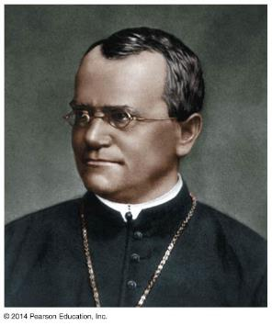
Figure 9.2a
Notes:
Figure 9.2a Gregor Mendel

Slide 9
9.2 The science of genetics began in an abbey garden
In 1866, Mendel
correctly argued that parents pass on to their offspring discrete “heritable factors”
stressed that the heritable factors (today called genes) retain their individuality generation after generation.
A heritable feature that varies among individuals, such as flower color, is called a character.
Each variant for a character, such as purple or white flowers, is a trait.
Notes:
Student Misconceptions and Concerns
• The authors note that Mendel’s work was published in 1866, seven years after Darwin published Origin of Species. Consider challenging your students to consider whether Mendel’s findings supported Darwin’s ideas. Some scientists have noted that Darwin often discussed the evolution of traits by matters of degree. Yet Mendel's selection of pea plant traits typically showed complete dominance, rather than the possibility for such gradual inheritance.
Teaching Tips
• In Module 9.2, the authors make the analogy between genes and playing cards, noting that they are shuffled but retain their original identity. This analogy may form a very useful reference point for your students and can be used later, as new principles of genetics are discussed.
• This early material introduces many definitions that are vital to understanding the later discussions in this chapter. Therefore, students need to be encouraged to master these definitions immediately. This may be a good time for a short quiz to encourage their progress.
Active Lecture Tips
• See the Media Review: “Learn.Genetics” Genetic Science Learning Center from the University of Utah on the Instructor Exchange. Visit the Instructor Exchange in the MasteringBiology instructor resource area for a description of this activity.

Slide 10
Answer in Notebooks:
#2. Give 3 different examples of a character and 3 examples of traits to go with those characters.

Slide 11
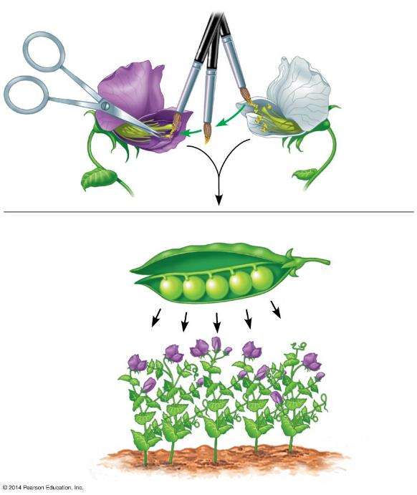
Figure 9.2c-3
1
Stamen removal
2
Pollen transfer
Parents (P)
Stamens
Carpel
3
Carpel matures into pod
4
Seeds from pod planted
Offspring (F₁)
Notes:
Figure 9.2c-3 Mendel’s technique for cross-fertilization of pea plants (step 3)

Slide 12
9.2 The science of genetics began in an abbey garden
True-breeding varieties result when self-fertilization produces offspring all identical to the parent.
The offspring of two different varieties are hybrids.
The cross-fertilization is a hybridization, or genetic cross.
True-breeding parental plants are the P generation.
Hybrid offspring are the F₁ generation.
A cross of F₁ plants produces an F₂ generation.
Notes:
Student Misconceptions and Concerns
• The authors note that Mendel’s work was published in 1866, seven years after Darwin published Origin of Species. Consider challenging your students to consider whether Mendel’s findings supported Darwin’s ideas. Some scientists have noted that Darwin often discussed the evolution of traits by matters of degree. Yet Mendel's selection of pea plant traits typically showed complete dominance, rather than the possibility for such gradual inheritance.
Teaching Tips
• In Module 9.2, the authors make the analogy between genes and playing cards, noting that they are shuffled but retain their original identity. This analogy may form a very useful reference point for your students and can be used later, as new principles of genetics are discussed.
• This early material introduces many definitions that are vital to understanding the later discussions in this chapter. Therefore, students need to be encouraged to master these definitions immediately. This may be a good time for a short quiz to encourage their progress.
Active Lecture Tips
• See the Media Review: “Learn.Genetics” Genetic Science Learning Center from the University of Utah on the Instructor Exchange. Visit the Instructor Exchange in the MasteringBiology instructor resource area for a description of this activity.

Slide 13
Answer in Notebooks:
#3. What is the difference between true-breeding and cross fertilization?

Slide 14
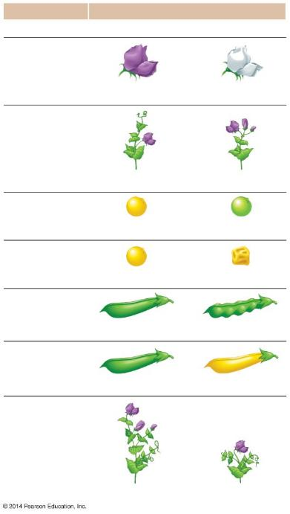
Figure 9.2d-0
Character
Traits
Dominant
Recessive
Flower color
Purple
White
Flower position
Axial
Terminal
Seed color
Yellow
Green
Seed shape
Round
Wrinkled
Pod shape
Inflated
Constricted
Pod color
Green
Yellow
Stem length
Tall
Dwarf
Notes:
Figure 9.2d-0 The seven pea characters studied by Mendel

Slide 15
9.3 Mendel’s law of segregation describes the inheritance of a single character
A cross between two individuals differing in a single character is a monohybrid cross.
Mendel performed a monohybrid cross between a plant with purple flowers and a plant with white flowers.
The F₁ generation produced all plants with purple flowers.
A cross of F₁ plants with each other produced an F₂ generation with ¾ purple and ¼ white flowers.
Notes:
Student Misconceptions and Concerns
• Students using Punnett squares need to be reminded that the calculations are expected statistical probabilities and not absolutes. Just as we would expect that any six playing cards dealt might be half black and half red, we frequently find that this is not true. This might be a good time to show how larger sample sizes increase the likelihood that sampling will reflect expected ratios.
Teaching Tips
• This early material introduces many definitions that are vital to understanding the later discussions in this chapter. Therefore, students need to be encouraged to master these definitions immediately. This may be a good time for a short quiz to encourage their progress.
• Many students benefit from a little quick practice with a Punnett square. Have them try these crosses for practice: (a) PP × pp and (b) Pp × pp.
• For students struggling with basic terminology, an analogy between a genetic trait and a pair of shoes might be helpful. A person might wear a pair of shoes in which both shoes match (homozygous), or less likely, a person might wear shoes that do not match (heterozygous).
• Another analogy that might help struggling students is a pair of people trying to make a decision about where to eat tonight. One person wants to eat at a restaurant; the other wants to eat a meal at home. If this “heterozygous” couple eats at home, the dominant allele “wins.”
Active Lecture Tips
• See the Media Review: “Learn.Genetics” Genetic Science Learning Center from the University of Utah on the Instructor Exchange. Visit the Instructor Exchange in the MasteringBiology instructor resource area for a description of this activity.
• See the activity Interactive Celebrity Parents Genetic Inheritance Game on the Instructor Exchange. Visit the Instructor Exchange in the MasteringBiology instructor resource area for a description of this activity.

Slide 16
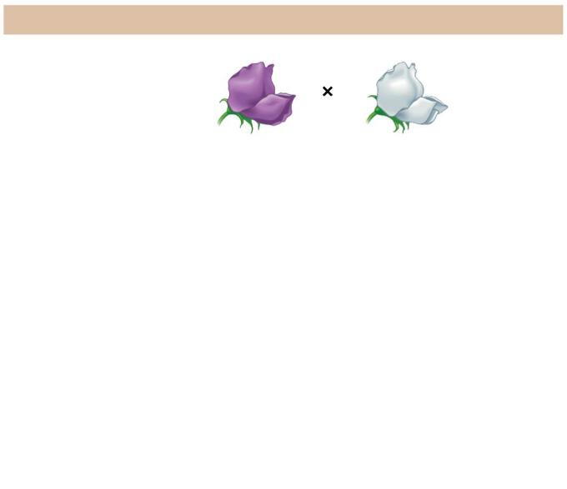
Figure 9.3a-1
The Experiment
P generation (true-breeding parents)
Purple flowers
White flowers
Notes:
Figure 9.3a-1 Crosses tracking one character (flower color) (step 1)

Slide 17
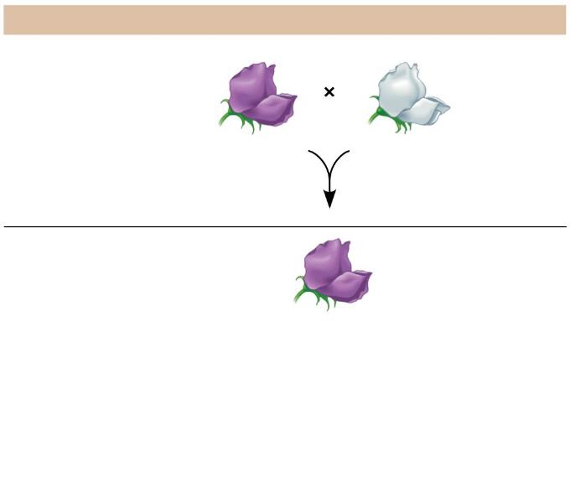
Figure 9.3a-2
The Experiment
P generation (true-breeding parents)
Purple flowers
White flowers
F₁ generation
All plants have purple flowers
Notes:
Figure 9.3a-2 Crosses tracking one character (flower color) (step 2)

Slide 18
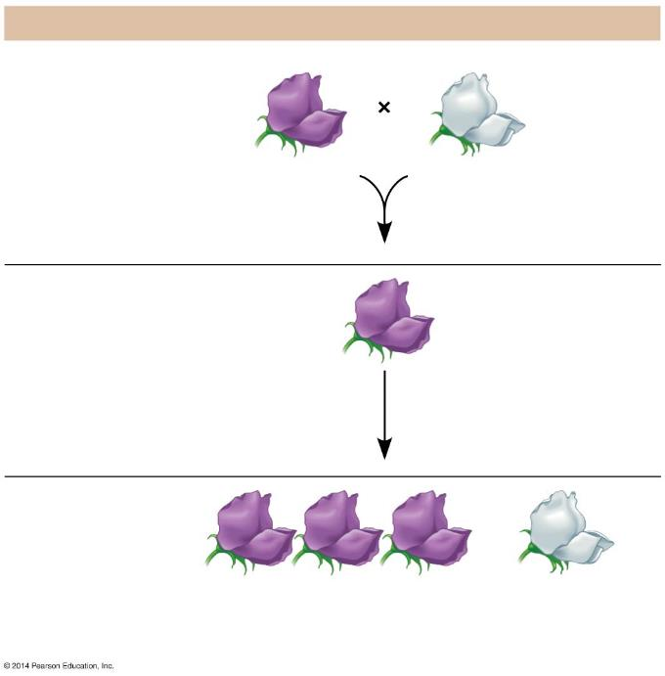
Figure 9.3a-3
The Experiment
P generation (true-breeding parents)
Purple flowers
White flowers
F₁ generation
All plants have purple flowers
Fertilization among F₁ plants (F₁ × F₁)
F₂ generation
3
4
1
4
of plants have purple flowers
of plants have white flowers
Notes:
Figure 9.3a-3 Crosses tracking one character (flower color) (step 3)

Slide 19
9.3 Mendel’s law of segregation describes the inheritance of a single character
Mendel developed four hypotheses, described below using modern terminology.
Alleles are alternative versions of genes that account for variations in inherited characters.
For each character, an organism inherits two alleles, one from each parent. The alleles can be the same or different.
A homozygous genotype has identical alleles.
A heterozygous genotype has two different alleles.
Notes:
Student Misconceptions and Concerns
• Students using Punnett squares need to be reminded that the calculations are expected statistical probabilities and not absolutes. Just as we would expect that any six playing cards dealt might be half black and half red, we frequently find that this is not true. This might be a good time to show how larger sample sizes increase the likelihood that sampling will reflect expected ratios.
Teaching Tips
• This early material introduces many definitions that are vital to understanding the later discussions in this chapter. Therefore, students need to be encouraged to master these definitions immediately. This may be a good time for a short quiz to encourage their progress.
• Many students benefit from a little quick practice with a Punnett square. Have them try these crosses for practice: (a) PP × pp and (b) Pp × pp.
• For students struggling with basic terminology, an analogy between a genetic trait and a pair of shoes might be helpful. A person might wear a pair of shoes in which both shoes match (homozygous), or less likely, a person might wear shoes that do not match (heterozygous).
• Another analogy that might help struggling students is a pair of people trying to make a decision about where to eat tonight. One person wants to eat at a restaurant; the other wants to eat a meal at home. If this “heterozygous” couple eats at home, the dominant allele “wins.”
Active Lecture Tips
• See the Media Review: “Learn.Genetics” Genetic Science Learning Center from the University of Utah on the Instructor Exchange. Visit the Instructor Exchange in the MasteringBiology instructor resource area for a description of this activity.
• See the activity Interactive Celebrity Parents Genetic Inheritance Game on the Instructor Exchange. Visit the Instructor Exchange in the MasteringBiology instructor resource area for a description of this activity.

Slide 20
9.3 Mendel’s law of segregation describes the inheritance of a single character
If the alleles of an inherited pair differ
One determines the organism’s appearance and is called the dominant allele.
The other has no noticeable effect on the organism’s appearance and is called the recessive allele.
The phenotype is the appearance or expression of a trait.
The genotype is the genetic makeup of a trait.
The same phenotype may be determined by more than one genotype.
Notes:
Student Misconceptions and Concerns
• Students using Punnett squares need to be reminded that the calculations are expected statistical probabilities and not absolutes. Just as we would expect that any six playing cards dealt might be half black and half red, we frequently find that this is not true. This might be a good time to show how larger sample sizes increase the likelihood that sampling will reflect expected ratios.
Teaching Tips
• This early material introduces many definitions that are vital to understanding the later discussions in this chapter. Therefore, students need to be encouraged to master these definitions immediately. This may be a good time for a short quiz to encourage their progress.
• Many students benefit from a little quick practice with a Punnett square. Have them try these crosses for practice: (a) PP × pp and (b) Pp × pp.
• For students struggling with basic terminology, an analogy between a genetic trait and a pair of shoes might be helpful. A person might wear a pair of shoes in which both shoes match (homozygous), or less likely, a person might wear shoes that do not match (heterozygous).
• Another analogy that might help struggling students is a pair of people trying to make a decision about where to eat tonight. One person wants to eat at a restaurant; the other wants to eat a meal at home. If this “heterozygous” couple eats at home, the dominant allele “wins.”
Active Lecture Tips
• See the Media Review: “Learn.Genetics” Genetic Science Learning Center from the University of Utah on the Instructor Exchange. Visit the Instructor Exchange in the MasteringBiology instructor resource area for a description of this activity.
• See the activity Interactive Celebrity Parents Genetic Inheritance Game on the Instructor Exchange. Visit the Instructor Exchange in the MasteringBiology instructor resource area for a description of this activity.

Slide 21
Answer in Notebooks:
#4. If B is Brown Eyes and b is Blue Eyes
Create a 3 examples of possible genotypes and phenotypes.

Slide 22
9.3 Mendel’s law of segregation describes the inheritance of a single character
A sperm or egg carries only one allele for each inherited character because allele pairs separate (segregate) from each other during the production of gametes. This statement is called the law of segregation.
The fusion of gametes at fertilization creates allele pairs once again.
Notes:
Student Misconceptions and Concerns
• Students using Punnett squares need to be reminded that the calculations are expected statistical probabilities and not absolutes. Just as we would expect that any six playing cards dealt might be half black and half red, we frequently find that this is not true. This might be a good time to show how larger sample sizes increase the likelihood that sampling will reflect expected ratios.
Teaching Tips
• This early material introduces many definitions that are vital to understanding the later discussions in this chapter. Therefore, students need to be encouraged to master these definitions immediately. This may be a good time for a short quiz to encourage their progress.
• Many students benefit from a little quick practice with a Punnett square. Have them try these crosses for practice: (a) PP × pp and (b) Pp × pp.
• For students struggling with basic terminology, an analogy between a genetic trait and a pair of shoes might be helpful. A person might wear a pair of shoes in which both shoes match (homozygous), or less likely, a person might wear shoes that do not match (heterozygous).
• Another analogy that might help struggling students is a pair of people trying to make a decision about where to eat tonight. One person wants to eat at a restaurant; the other wants to eat a meal at home. If this “heterozygous” couple eats at home, the dominant allele “wins.”
Active Lecture Tips
• See the Media Review: “Learn.Genetics” Genetic Science Learning Center from the University of Utah on the Instructor Exchange. Visit the Instructor Exchange in the MasteringBiology instructor resource area for a description of this activity.
• See the activity Interactive Celebrity Parents Genetic Inheritance Game on the Instructor Exchange. Visit the Instructor Exchange in the MasteringBiology instructor resource area for a description of this activity.

Slide 23
9.3 Mendel’s law of segregation describes the inheritance of a single character
Mendel’s hypotheses also explain the 3:1 ratio in the F₂ generation.
The F₁ hybrids all have a Pp genotype.
A Punnett square shows the four possible combinations of alleles that could occur when these gametes combine.
Notes:
Student Misconceptions and Concerns
• Students using Punnett squares need to be reminded that the calculations are expected statistical probabilities and not absolutes. Just as we would expect that any six playing cards dealt might be half black and half red, we frequently find that this is not true. This might be a good time to show how larger sample sizes increase the likelihood that sampling will reflect expected ratios.
Teaching Tips
• This early material introduces many definitions that are vital to understanding the later discussions in this chapter. Therefore, students need to be encouraged to master these definitions immediately. This may be a good time for a short quiz to encourage their progress.
• Many students benefit from a little quick practice with a Punnett square. Have them try these crosses for practice: (a) PP × pp and (b) Pp × pp.
• For students struggling with basic terminology, an analogy between a genetic trait and a pair of shoes might be helpful. A person might wear a pair of shoes in which both shoes match (homozygous), or less likely, a person might wear shoes that do not match (heterozygous).
• Another analogy that might help struggling students is a pair of people trying to make a decision about where to eat tonight. One person wants to eat at a restaurant; the other wants to eat a meal at home. If this “heterozygous” couple eats at home, the dominant allele “wins.”
Active Lecture Tips
• See the Media Review: “Learn.Genetics” Genetic Science Learning Center from the University of Utah on the Instructor Exchange. Visit the Instructor Exchange in the MasteringBiology instructor resource area for a description of this activity.
• See the activity Interactive Celebrity Parents Genetic Inheritance Game on the Instructor Exchange. Visit the Instructor Exchange in the MasteringBiology instructor resource area for a description of this activity.

Slide 24
Figure 9.3b-0-1
The Explanation
P generation
Genetic makeup (alleles)
Purple flowers
White flowers
PP
pp
Gametes
All
P
All
p
Notes:
Figure 9.3b-0-1 An explanation of the crosses in Figure 9.3a (step 1)

Slide 25
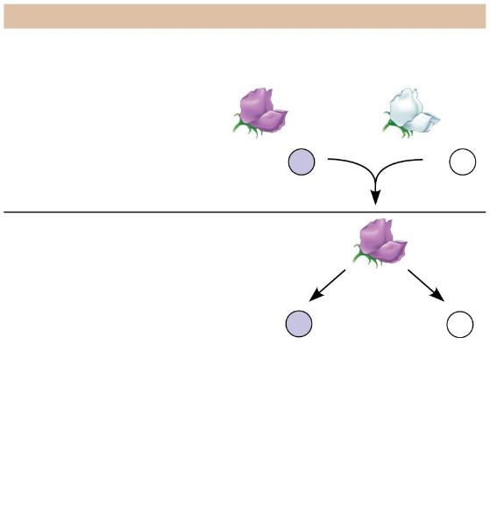
Figure 9.3b-0-2
The Explanation
P generation
Genetic makeup (alleles)
Purple flowers
White flowers
PP
pp
Gametes
All
P
All
p
F₁ generation (hybrids)
All
Pp
Alleles segregate
Gametes
1
2
P
1
2
p
Notes:
Figure 9.3b-0-2 An explanation of the crosses in Figure 9.3a (step 2)

Slide 26
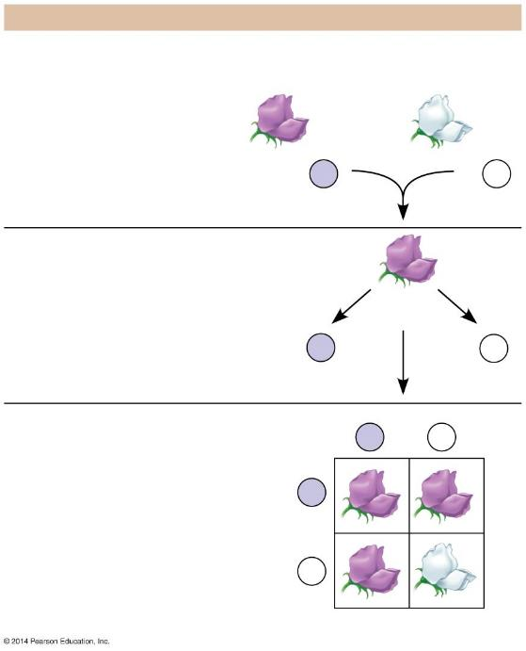
Figure 9.3b-0-3
The Explanation
P generation
Genetic makeup (alleles)
Purple flowers
White flowers
PP
pp
Gametes
All
P
All
p
F₁ generation (hybrids)
All
Pp
Alleles segregate
Gametes
1
2
P
1
2
p
Fertilization
F₂ generation
Sperm from F₁ plant
P
p
Results:
Phenotypic ratio 3 purple : 1 white
P
PP
Pp
Eggs from F₁ plant
Genotypic ratio 1 PP : 2 Pp : 1 pp
p
Pp
pp
Results
Notes:
Figure 9.3b-0-3 An explanation of the crosses in Figure 9.3a (step 3)

Slide 27
9.4 Homologous chromosomes bear the alleles for each character
A locus (plural, loci) is the specific location of a gene along a chromosome.
For a pair of homologous chromosomes (homologs), alleles of a gene reside at the same locus.
Homozygous individuals have the same allele on both homologs.
Heterozygous individuals have a different allele on each homolog.
Notes:
Student Misconceptions and Concerns
• Students using Punnett squares need to be reminded that the calculations are expected statistical probabilities and not absolutes. Just as we would expect that any six playing cards dealt might be half black and half red, we frequently find that this is not true. This might be a good time to show how larger sample sizes increase the likelihood that sampling will reflect expected ratios.
Teaching Tips
• Figure 9.4 can be of great benefit when introducing genetic terminology of genes. For students struggling to think abstractly, such a visual aid may be essential when describing these features in lecture.
Active Lecture Tips
• See the Media Review: “Learn.Genetics” Genetic Science Learning Center from the University of Utah on the Instructor Exchange. Visit the Instructor Exchange in the MasteringBiology instructor resource area for a description of this activity.
• See the activity Pairs of Shoes and Pairs of Chromosomes on the Instructor Exchange. Visit the Instructor Exchange in the MasteringBiology instructor resource area for a description of this activity.
• See the activity Interactive Celebrity Parents Genetic Inheritance Game on the Instructor Exchange. Visit the Instructor Exchange in the MasteringBiology instructor resource area for a description of this activity.

Slide 28
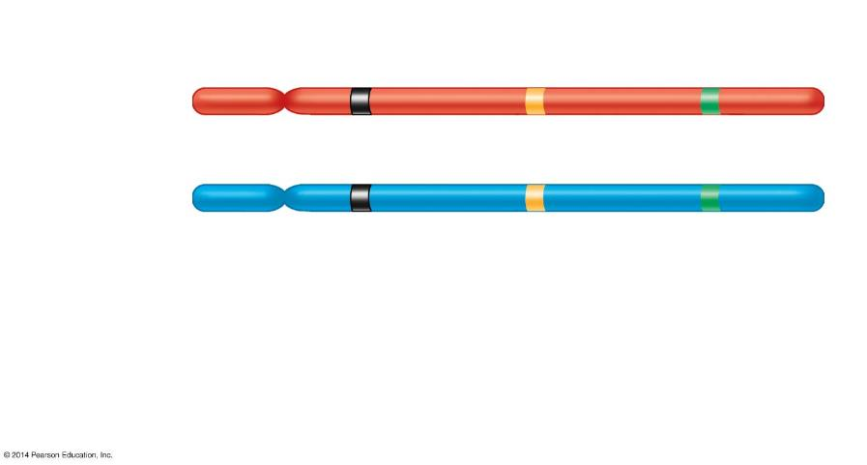
Figure 9.4
Gene loci
Dominant allele
P
a
B
Homologous chromosomes
P
a
b
Recessive allele
Genotype:
PP
aa
Bb
Homozygous for the dominant allele
Homozygous for the recessive allele
Heterozygous, with one dominant and one recessive
allele
Notes:
Figure 9.4 Three gene loci on homologous chromosomes

Slide 29
Answer in Notebooks:
#5. Draw 2 chromosomes and insert any 4 letters within each chromosome to show a homozygous dominant condition.

Slide 30
B = Black Fur b = Brown Fur
 | If the mother is homozygous recessive and the father is homozygous dominant. a) Write the genotype probabilities. b) Write the phenotype probabilities.

Slide 31
B = Black Fur b = Brown Fur
 | 2. If the mother is heterozygous and the father is heterozygous. a) Write the genotype probabilities. b) Write the phenotype probabilities.

Slide 32
B = Black Fur b = Brown Fur
 | 3. If the mother is homozygous recessive and the father is heterozygous. a) Write the genotype probabilities. b) Write the phenotype probabilities.

Slide 33
B = Black Fur b = Brown Fur
 | 4. If the mother is heterozygous and the father is homozygous dominant. a) Write the genotype probabilities. b) Write the phenotype probabilities.

