Slide 1
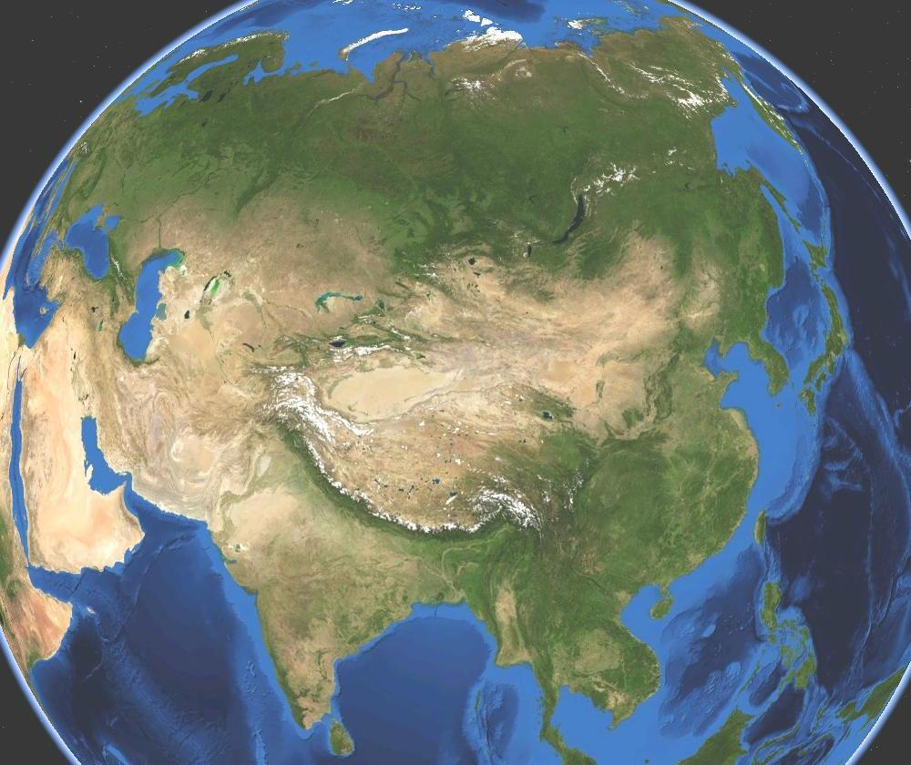
HISTORY OF ASIA
8,000 BCE - Present

Slide 2
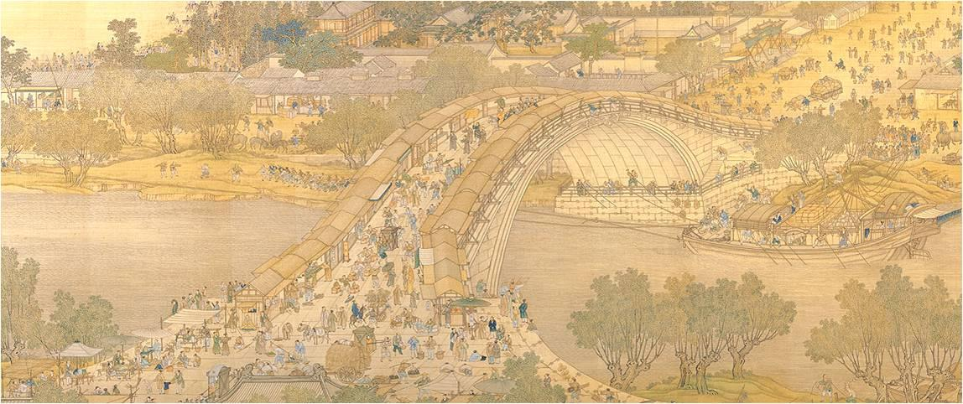
TABLE OF CONTENTS
8000 - 600 BCE
->Nancy Lin
600 BCE - 600 CE
->Boyuan Zhang
600 CE - 1450
->Michele Lin and Li Ping Lin
1450 - 1750
->Eric Luo and Peter Chen
1750 - 1900
->Stephanie Liang
1900-Present
->Qiu Chang Wu
Period 9
H4WX
Ms. Garcia

Slide 3
8,000 BCE- 600 BCE
Ancient Asia

Slide 4
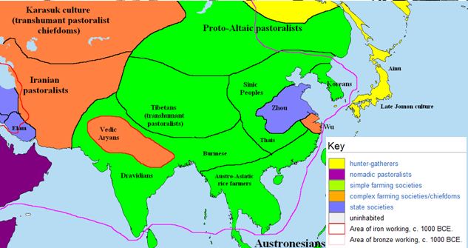
8,000 BCE-600 BCE

Slide 5
INTERACTION BETWEEN HUMANS AND THE ENVIRONMENT
MIGRATION
-10,000- 8,000 BCE: Humans migrated out of Africa and populated Asia
PATTERNS OF SETTLEMENT
-Central Asia:
->3,500- 3,000 BCE: hunter-gatherer and fishing populations form
->By 2,000 BCE, most humans were pastoral nomads. There were few agricultural centers.
-South Asia:
->3,000-1,500 BCE: Indus River Valley civilizations develop (e.g.:Harappa and Mohenjo-Daro)
-Southeast Asia:
->8,000 BCE: agricultural communities begin -East Asia:
->8,000-1,000 BCE: small agricultural communities form along the Yellow River (planted millet and rice) and in Japan (with the Jomon people) and Korea
TECHNOLOGY
-Domestication of animals for food, clothing, materials for shelter, and as "beasts of burden"
-Use of irrigation canals to improve agriculture
-Bronze tools developed (Bronze Age)

Slide 6
DEVELOPMENT AND INTERACTION OF CULTURES
RELIGIONS/BELIEF SYSTEMS
-Central Asia:
->1,200-1,000 BCE: Zoroastrianism develops (concept of good [Ahura Mazda] against evil [Ahriman], belief in Day of Judgment and prophets)
-South Asia:
->1,500 BCE: the invading Aryans introduce the Sanskrit language, Vedas, Hinduism, and the caste system
->By 700 BCE: Jainism (emphasis on reverence of life) and Buddhism (path of enlightenment and nirvana) develops
-Southeast Asia:
->700 BCE: Buddhism becomes popular after being spread through the trade network
-East Asia:
->China:
=>Shang kings used oracle bones,divination, and ancestor worship
=>1,045 BCE: Zhou kings develop the "Mandate of Heaven"
->Japan: rulers were also considered shamans, animism was common (Shinto religion)
SCIENCE AND TECHNOLOGY
-Ideographic writing system develops in China
-Exchange of technological advances spread throughout Asia as a result of extensive trade (Japan learns about wet-rice farming, religions spread, etc.)

Slide 7
STATE-BUILDING, EXPANSION, AND CONFLICT
POLITICAL STRUCTURES AND FORMS OF GOVERNANCE
-Central Asia:
->Pastoral nomads congregated into small groups of families. Males governed the group.
-South Asia:
->1,500 BCE: Aryans conquered Dravidians and establish a warrior aristocracy.
->3,000-1,500 BCE: Indus River Valley civilizations most likely theocracies
-Southeast Asia:
->1,000-800 BCE: Governments organized around temples and trade centers
->centralized farming settlements formed and traveled to fertile fields if necessary
-East Asia:
->China:
=>1,500-1,045 BCE: Shang kings develop a feudal society (main occupation was territorial expansion)
=> 1,045 BCE: Zhou kings conquer Shang settlements and continue to expand feudal society
->Japan: Jomon people conquered by Yayoi people from mainland Asia

Slide 8
CREATION, EXPANSION, AND INTERACTION OF ECONOMIC SYSTEMS
AGRICULTURAL AND PASTORAL PRODUCTION
-Central Asia:
->Pastoral nomads follow herds of livestock, hunted, and gathered plants
-Southeast Asia: ->Planted planted yams, bananas, taro, and rice
-East Asia: ->Planted millet and rice, silk was created
TRADE AND COMMERCE
-Barter system devised to trade items-Central Asia: Nomads traded livestock for necessities in agricultural centers
-South Asia:
->Trade begins with surrounding regions
-Southeast Asia:
->Maritime trade was a common means of exchanging goods around the region
-East Asia:
->China:
=>Shang dynasty conquered other states and required tributes (tributary system)
=>Zhou dynasty: vassal states gave tributes to the Zhou king
=> Beginnings of the Silk Road began

Slide 9
DEVELOPMENT AND TRANSFORMATION OF SOCIAL STRUCTURES
GENDER ROLES AND RELATIONS
-Emergence of gender division of labor as agricultural societies develop-> gender inequality
-Women became responsible for the home while men worked in the fields
-Central Asia: patriarchal nomadic societies
FAMILY AND KINSHIP
-Women had more rights in South Asia and Southeast Asia (were able to hold property and participate in religious rituals)
-Most households were dominated by the male-they made the important decisions and had the most power
RACIAL AND ETHNIC CONSTRUCTION
-South Asia:caste system alienates people based on their skin color and "religious purity"
SOCIAL AND ECONOMIC CLASSES
-Southeast Asia: Shang rulers preside over a hierarchical society. Zhou rulers continue this hierarchical society
-Increased agricultural production led to a need for an organized system of government and specialization of labor -> leads to social stratification (aristocrats at the top, peasants at the bottom)

Slide 10
600 BCE—600 CE
Asia

Slide 11
Interactions Between Humans and the Environment
•206 BCE- 220 CE: Han Dynasty, invention of paper
•420—589 CE: Southern and Northern Dynasties, Invention of the stirrup
•Great migration of the Han towards the southern regions of China in order to escape the Wu Hu nations of the north.

Slide 12
Development and Interaction of Cultures
•563 BCE: Siddhartha Gautama Buddha is born.
•551-479 BCE: Confucius walked the earth and taught the value of knowledge and a system of mutual respect and politeness between superiors and inferiors.
•269—232 BCE: Ashoka reigns over Mauryan India and facilitates the widespread propagation of Buddhism, which eventually reaches China and Eastern Asia.
•207 BCE—220 CE: In China, the Han Dynasty brings about a sense of cultural identity for the Han Chinese that lasts for the rest of Chinese history.

Slide 13
State building, Expansion and Conflict
600 BCE—600 CE, China: System of imperial government and Dynastic Cycle
Constant battle between China and the various northern barbarians. The Wu Hu people would rule most of northern China from 428—589 CE as the Northern Dynasties.
Peasant revolutions became hallmarks of the end of a dynasty.
321—185 BCE: Mauryan Empire in India ruled from Afghanistan to Bangladesh. Ashoka attacks Kalinga in 262 BCE, and the bloody war that ensued caused him to embrace Buddhism and nonviolence.
End of Mauryan Empire left India in shifting powers until 320—550 CE, when the Gupta Empire reigned. Many later governments would imitate these two empires.

Slide 14
Creation, Expansion and Interaction of Economic Systems
321-186 BCE: Centralized taxation introduced in India. Freed up farmers and the economy from messy local taxation.
221-267 BCE: Great Wall unified. Government-forced relocation of peasants provided
206 BCE-220 CE: Han troops keep the Silk Road secure and open. Trade is able to flourish.

Slide 15
Development and transformation of social structures
•Confucius: The basis for Chinese morality is laid down by Confucius during the Spring and Autumn period. These include ren, yi, and li.
•Replaced harsh Legalism of the Qin Dynasty
•During the Gupta Empire, Indian urbanization caused an increase in value of men who can inherit. Women became increasingly oppressed, were stripped of property rights, and society began making them more of a subservient class.

Slide 16
600 - 1450

Slide 17
Interactions between humans and the environment
- The migration of Turks in the 1100s, caused by conversion to Islam, want of gold and jewels and the invasion into India introduced strong Muslim presence in India
- The nomadic lifestyle of the Mongols allowed them to conquer much of Asia in the 1200s
-This Mongolian expansion was mainly because shortage of grass forced them to raid or trade. This expansion connected Asia, allowed easy communication, trade, diffusion of culture and religion
- The movement and interaction of people led to the spread of the Black Plague in the 1300s

Slide 18
Development and interaction of cultures
- Spread of religion aided by increase in trade became a unifying force or source of conflict
- Confucianism and Buddhism played a part in the cultural identity in East Asia
- Islam, founded in the 600s, created a cultural world that transcended political boundaries and later spread throughout Asia by the Silk Road
- India and China greatly influenced the culture and religion of its surrounding civilizations (Southeast Asia, Japan, Korea)
-Explorers such as Marco Polo (1254 - 1324), Ibn Battuta (1304 - 1368) and Zheng He (1371 - 1433) spread knowledge about other civilizations though their travels

Slide 19
State-building, expansion, and conflict
-China became one of the most advanced and influential civilizations in the world as it urbanized under the Song (960)
- The political structures of many centralized government ( Byzantine, Tang, Song, Arab Caliphates) were built on the successful model of the past while decentralized areas ( Japan ) developed systems that deals with their situation
- In Japan, a form of feudalism emerged (1185)
- The Mongols created on of the largest empires in history, unifying Eurasia under its political system in the 1200s.

Slide 20
Creation, expansion, and interaction of economic systems
- Growth in long-distance trade ( eg Silk Road, Indian Ocean, Mediterranean Sea, trans-Saharan trade ) led to the spread of ideas, religion, and technology ( compass, gunpowder, paper money )
- China's Port of Canton became a trading center during the Song dynasty (960 - 1270)
- The Crusades (starting in 1096) encouraged trade with Muslim merchants, created increase in demand for Asian goods
- Mongol expansion (1200s) brought together the economy of Asia, as it connected the economic systems of the various lands it conquered.

Slide 21
Development and transformation of social structures
- Patriarchal values dominate, but religions such as Islam, Christianity, and Buddhism promoted equality of all believers in eyes of God,offering an alternative life for women (monastic life )
- Upper-class women found themselves more restricted to religious and cultural expectations compared to their lower-class counterparts.
-> The upper-class women of China were subject to foot-binding (a practice established under the Song in 1200) , which created tiny feet, but crippled the women
- Artisans and craftsman gained importance as they made valued products, such as porcelain (especially during the Ming (1368-1644) )
- Urbanized societies allowed for more social mobility (ex. China's civil service exam).

Slide 22
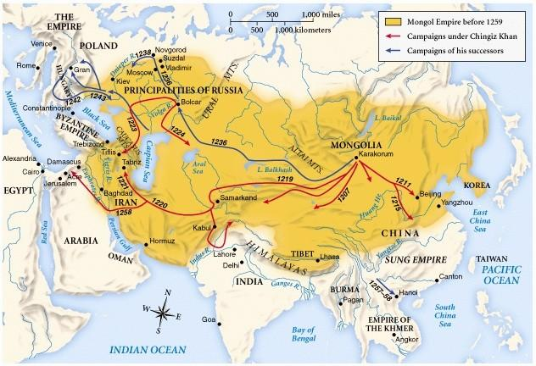
Asia under the Mongol Empire circa 1259

Slide 23
Asia
1450-1750

Slide 24
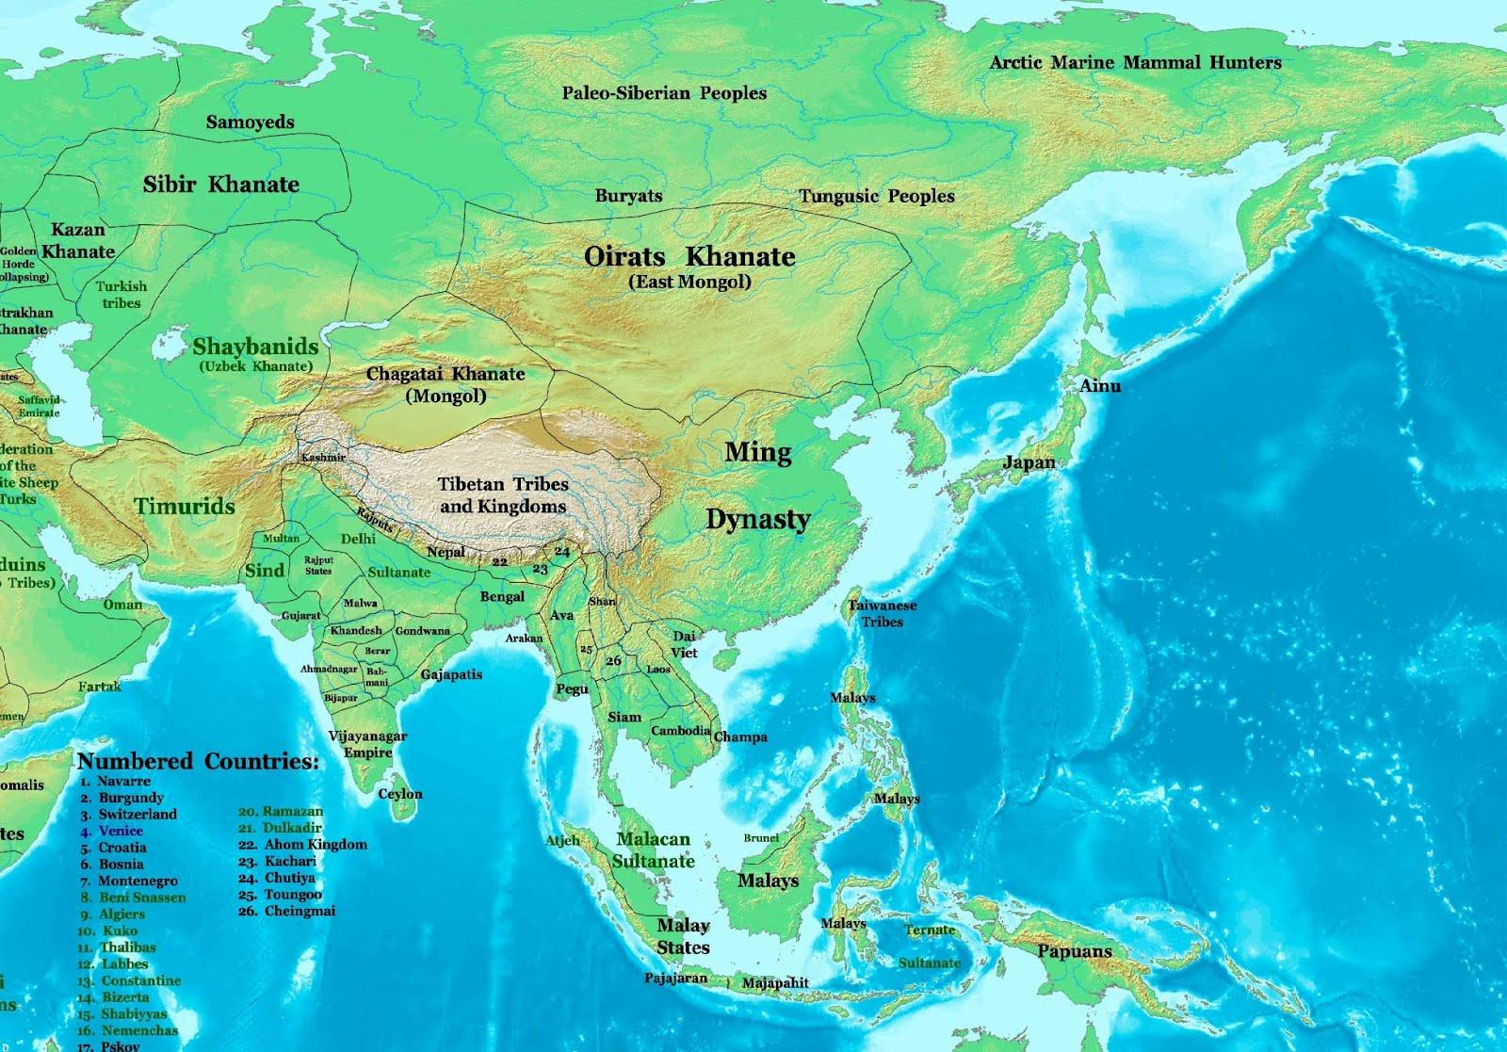
Map of Asia, Around 1500

Slide 25
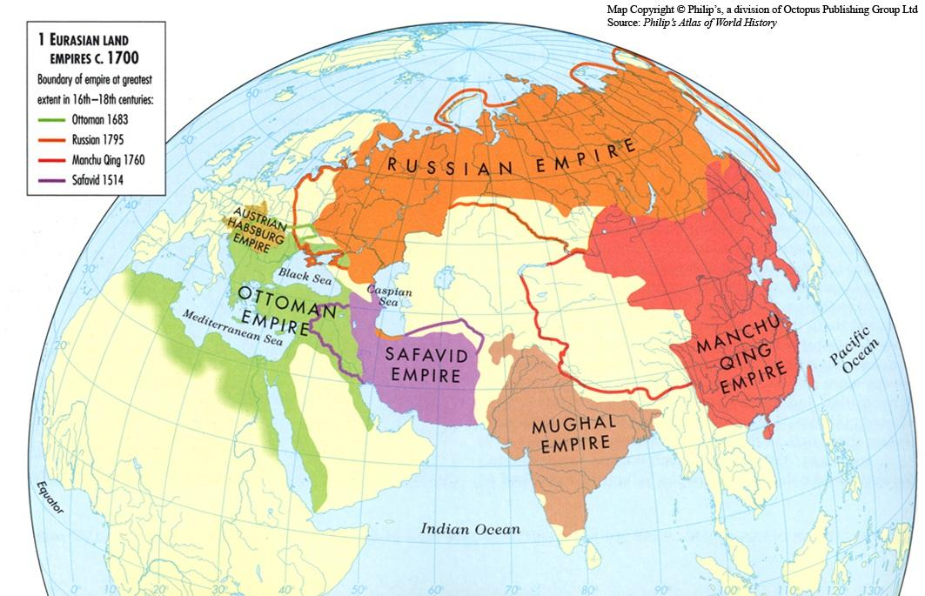
Map of Asia, Around 1700

Slide 26
Interaction Between Humans and the Environment
Russian conquest of Siberia due to fur trade: Russian immigration to Siberia
Population boom due to introduction of "New World Crops" from Columbia Exchange
Widespread use of variolation in China which later pass to Europe
Chinese migration to Southeast Asia due to later Ming's open trade policies and to flee from Qing

Slide 27
Development and Interaction of Cultures
While the Mughal Empire's leaders were Muslim, they were tolerant of Hindus
Islamization of Southeast Asia
Introduction of muskets to China and Japan in the 1500s
Jesuit Missionary in China: Christianity, European sciences
Manchu leaders forced Han and other minority groups to wear queue and Manchu style clothing

Slide 28
State Building, Expansion and Conflict
China- Ming Dynasty (1368-1644) and the Manchus started the Qing Dynasty (1644-1912)
India- Mughal Empire (1526-1857) started after Babur defeated the Delhi Sultanate
Japan- Ashikaga Shogunate(1336-1573), land ruled mostly by daimyo
  Reunification of Japan (1560-1615) --> Oda Nobunga---> Toyotomi Hideyoshi---> Tokugawa Ieyasu

Slide 29
Creation,Expansion, and Interaction of Economic System
Ming Dynasty- Zheng He's Voyage--> tributary system, 1st European explorer-->trade
Qing Dynasty- Also had a tributary system
  Both Ming and Qing promoted agriculture
  "Canton System" and limited foreign contact
Japan- "isolationism" only allowed one part: Nagasaki
  Tokugawa- period of economic growth,
Mughal- cotton trade
  British East India Company at Bombay and Dutch East India Company at Ceylon
Southeast Asia- Dutch controlled Indonesia, economically important

Slide 30
Development and Transformation of Social Structures
Ming and Qing- Confucianism: filial piety
  Manchus: women were inferior; foot binding
  mostly peasant society-->merchants--> scholars/government officials
Japan- Women subordinate to men, but did learn to read and write
  Confucianism affected life in Japan
  Bushido Code
  Samurai-->Peasant-->Artisan-->Merchants
Mughal- Islam, Hindu(caste system), Buddhism mixe
  female aristocrats, women served husband

Slide 31
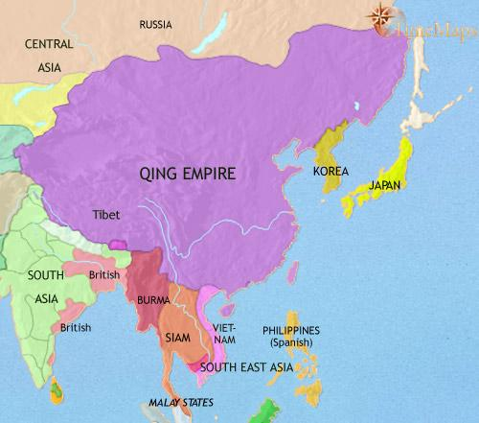
Asia, 1750-1900
East Asia,
1789

Slide 32
Interactions between humans and the environment
1750 - 1900
In China, drought and famine led to uprisings.
Foreign powers forced China to open to foreign trade; many foreigners settled along the Chinese coast.
Japan: more urban growth; national infrastructure was built (canals, roads, and ports)
  sent upper class to Europe and America to learn engineering, economics, and military science
European colonization of SE Asia: the Dutch - Indonesia; France - Indochina, Britain - Burma, Malaysia; the US - the Phillippines; Germany - Pacific Islands
  Europeans exploited these nations' resources.

Slide 33
Development and interaction of cultures
1750 - 1900
Missionaries in China: interfered w/ traditional Chinese culture but also brought scientific knowledge (eg.medicine)
State Shintoism in Meiji: gov't-sponsored religion
  Japanese superiority and emperor as descendant of the gods
India: British created group of Western-educated natives
  British eliminated "inhumane" cultural and religious (esp. Hindu) practices
  Hindu and Muslim practices led to Sepoy Rebellion
France brought modern technology to Indochina; converted Westernized natives to Catholicism.

Slide 34
1750 - 1900

Slide 35
State-building, expansion, and conflict
1750 - 1900
Qing Dynasty: oppressive rule and bad economic conditions by incompetent emperors; weakening in the late 1800s and collapsed in 1911
  Taiping Rebellion, Self-Strengthening Movement, Boxer Rebellion
Tokugawa Shogunate: highly dictatorial rule
Meiji Japan: Meiji Restoration; Constitution of 1890
  By the 1800s -> militaristic and nationalistic.
India under control of the British East India Company.
  Sepoy Rebellion
SE Asia colonized by Western powers (except Thailand)

Slide 36
Creation, expansion, and interaction of economic systems
1750 - 1900
Qing Dynasty: China didn't modernize or industrialize -> backwards and forced by Western powers to grant economic concessions
  exports: tea, silk, and porcelain
  Opium Wars: reversed the balance of trade
Starting 1868, Japan modernized and industrialized to avoid falling into the hands of Western powers.
In 1870s, Japan militarized and expanded empire, becoming an imperial power.
India: industrialized under British rule (the Raj) for economic exploitation
SE Asia: source of resources to be exploited by colonial powers (Thailand modernized Western-style)

Slide 37
Development and transformation of social structures
1750 - 1900
Qing Dynasty: filial piety
Tokugawa regime: rigidly stratified society with hereditary privileges (eg. samurai class from feudal era)
In 1871, Meiji abolished feudalism and rigid social hierarchy ended.
  political positions dependent on merit and exam
  merchant/middle class grew in size and influence as they modernized
  industrial lower classes suffered from industrial working conds.
In India, Caste system: rigid social structure (with the untouchables at the bottom)

Slide 38
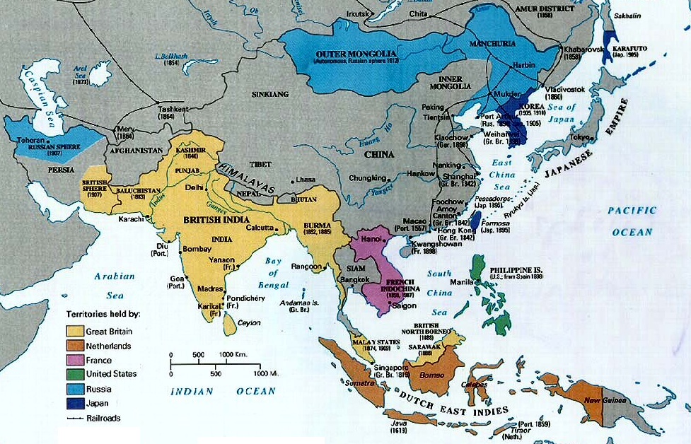
Asia, 1750-1900
(Map Of 1800s)

Slide 39
Modern Asian History
1900- Present

Slide 40
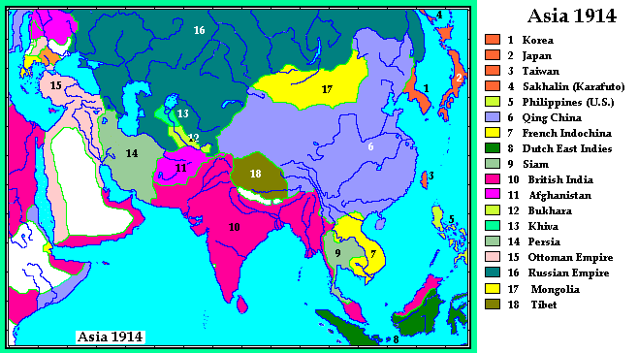

Slide 41
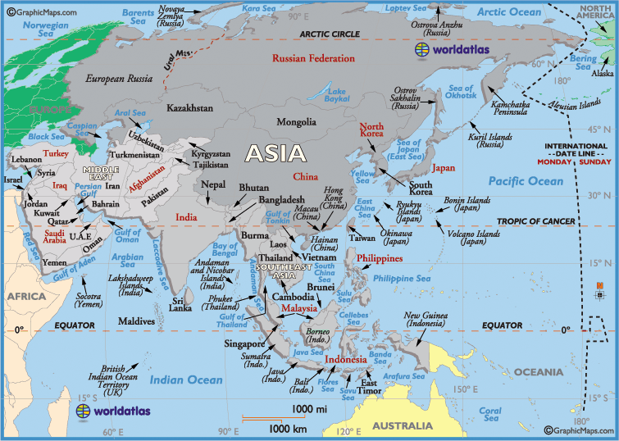
Asia as of 2012

Slide 42
Interaction Between Humans and Environment
War's destruction of Environment:
- Radiation from Nuclear Testing, Bio-Warfare + Chemical Warfare
- Bombing in Hiroshima and Nagasaki(1945)
- Napalmed forests in Vietnam
Effects of Industrialization of Modernization:
- Increase use of energy, resources, production of toxic, chemical, and nuclear
waste
Diseases:
- The Asian Flu (H2N2, 1957-8)
- The Hong Kong Flu (H3N2 1968-1969)
- Cholera , Malaria, Tuberculosis; still present threats in (overpopulated) cities with sanitary problems
The Green Revolution (1960s- Present)(PARTICULARLY IN INDIA)
- Development in agriculture leads to the increasing usage of pesticides fertilizers + machinery to increase yield of food
Southeast Asian Tsunami (2004)
Fukushima crisis caused by Japanese Earthquake(2011)

Slide 43
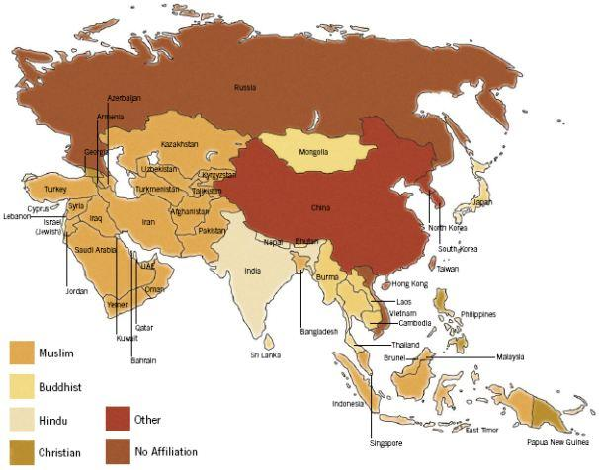
Major Religion in the Asian Countries

Slide 44
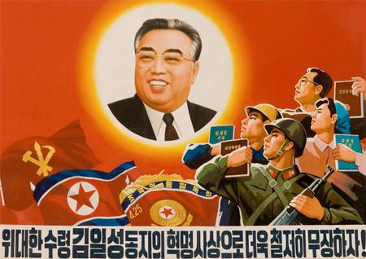
Development and Interaction of Cultures
- Asian countries get most of their understanding about modern technology from the west, but builds upon the initial ideas to better them (Japan + South Korea dominance in electronics in the world market)
- Art, literature, and media in Russia, China, and North Korea was mainly for propaganda used by the communist.
- Development of mass media, communication, and technology caused by enlargement of the consumerism.
- Islam's prominence in the Middle East, South, Central, Southeast Asia (Indonesia has the largest islamic population in the world)
- Glasnost + relaxation of Soviet grasp allowed for the Islamic Revival in Central Asia(1980s)

Slide 45
Statebuilding, Expansion, and Conflict
Political forms of government:
- North + South Split after Korean War( N = communism, S = democracy)
- Independence from Western imperialism in SE Asia (1930s - 1975)
- Military/ Authoritarian Regimes : Khmer Rouge in Cambodia(M), Ferdinand Marcos in Philippines(A), Sukarno + Suharto in Indonesia(A), South Korea until 1987(A), and Myanmar and Thailand(M).
- Communist political parties popped up throughout all of Asia
- Theocratic Governments in the Middle East ( Iran, Afghanistan, etc)
Nationalist movements:
- Bolshevik Revolution (1919)
- Indian Independence Movement (c. 1825 - 1947)
- Liberation of China (1949) ( Great Leap 1956, Cultural Revolution 1965, Open Door 1979)
- Religious fundamentalism in the Middle East (1970s - Present)
- Collapse of Soviet Russia 1991
Wars:
- Wars for independence (Indochina wars, Civil wars between political parties, Middle East conflicts, etc.)

Slide 46
Creation, Expansion, and Interaction of Economic Systems
Agricultural Production:
- Rice, Wheat, Oilseed, Sugarcane and Cotton, (Maize, tea, and coffee in India)
- China produces the highest yield of wheat and rice than any other country.
Trade and Commerce:
- OPEC + APEC ( Organization of Petroleum Exporting Countries Asia- Pacific Economic Cooperation)
- ASEAN - "Association of Southeast Asian Nations" helped with boosting economic, social, and cultural development as well as cooperation between Nations
- The Asian Tigers: A group consist of South Korea, Singapore, Hong Kong, and Taiwan all followed the Japanese Model for major economic growth(Free market Capitalism).
Capitalism and Socialism:
- Socialist Market Economy (China) - Partly state run, partly private investments.
- Major conglomerates like Mcdonalds, Pizza Hut, Coca Cola, and etc have many locations in Asia.
- There a few Asian conglomerates: Sony, Samsung, Mitsubishi, Toyota, etc. that have marketed very well outside of Asia(MOSTLY JAPANESE)

Slide 47
Development and Transformation of Social Structures
Gender Roles and Relations:
- Majority of farm laborers are female (89.5% in India)
- Islamic Fundamentalism continue to perpetuate women's role in a secondary and "traditional" fashion.( This is especially true in the Middle East
- Girls are allowed to have compulsory education in many countries, but enrollment into secondary school is much lower the boys.
- Job discrimination and wage gaps for educated women looking to compete with a male dominated society because usually take maternity leaves
Family and Kinship:
- Rising Education for Women = Less likely to start a family at a young age.
- "The Family Planning Policy", to lower the birth rates in China
Social and Economic Classes:
- The widening gap in the distribution of wealth( In many major cities, there are the high rises to the slums )
- Rural -> Urban migration(unskilled laborers, usually) for factory work; cheap labor for multinational corporations to exploit.

Slide 48
Bibliography
Blackwell, Fritz. India: A Global Studies Handbook. Santa Barbara: ABC-CLIO, 2004. Print.
Golden, Peter B. Central Asia in World History. New York: Oxford University Press, Inc., 2011. Print.
Gordon, Stewart. "When Asia Was the World [Hardcover]." When Asia Was the World. Da Capo Press. Web. 28 Apr. 2012.
Henshall, Kenneth. A History of Japan. 2nd Edition. New York: Palgrave Macmillan, 1994,2004. Print.
Laden, Jennifer, and Patrick Whelan. AP World History. New York : Kaplan, 2011. Print.
Ebrey, Patricia Buckley; Walthall, Anne; Palais, James B. (2006), Pre-Modern East Asia: A Cultural, Social, and Political History, Boston: Houghton-Mifflin Company
Lewis, Mark Edward (1999), "Warring States Political History", in Loewe, Michael; Shaughnessy, Edward L., The Cambridge history of ancient China: from the origins of civilization to 221 B.C., Cambridge University Press
Lockard, Craig A. Southeast Asia in World History. New York: Oxford University Press, Inc., 2009. Print.
Majumdar, R.C. (1977).Ancient India, New Delhi: Motilal Banarsidass
Perry, David. "The Mongol Empire." History 270 The Silk Road. Dominican University, 2008. Web. 03 May 2012. <http://domin.dom.edu/faculty/dperry/hist270silk/calendar/changes/mongols/lecture.htm>.
Raychaudhuri, H.C. (1972). Political History of Ancient India, Calcutta: University of Calcutta
Ropp, Paul S. China in World History. New York: Oxford University Press, Inc., 2010. Print.
Wright, David Curtis. The History of China. Second Edition. Santa Barbara: Greenwood, 2011. Print.
Asia for Educators. Columbia University, 2009. Web. 20 Apr. 2012 http://afe.easia.columbia.edu/index.html Timeline of East Asia History. N.p., n.d. Web. 3 May 2012.
Valentin, Anthony. "World History Review." World History Review. Valentin, 2012. Web. 02 May 2012. <http://worldhistoryreview.org/courses/spring-term-h2g/sp-lessons/>.
LaFleur, Robert André. China: A Global Studies Handbook. Santa Barbara, CA: ABC-CLIO, 2003. Print.
Jin Meisheng, 1959, “The vegetables are green, the cucumbers plumb, the yield is abundant” Publisher: Shanghai People's Fine Arts Publishing House
Nikolay Kochergin, 1920 “Long live the Red Army” Publisher: Revvoensovet, Moscow

Slide 49
cont' of Bibliography
-Kyoto Protocol." Unfccc. The United Nations. Web. 03 May 2012. <http://unfccc.int/kyoto_protocol/items/2830.php>.
- Rossabi, Morris. "Women in Modern Mongolia." Asia Society. Web. 03 May 2012. <http://asiasociety.org/countries/traditions/women-modern-mongolia>.
- UN. "INDIA." SD : People : Asia's Women in Agriculture, Environment and Rural Production :. Food and Agriculture Organization of the United Nations. Web. 03 May 2012. <http://www.fao.org/sd/WPdirect/WPre0108.htm>.
- "World Crop Production Summary." USDA Foreign Agricultural Service (FAS). Foreign Agricultural Service, Apr. 2012. Web. 03 May 2012. <http://www.fas.usda.gov/psdonline/psdreport.aspx?hidReportRetrievalName=BVS>.
- "The End of India's Green Revolution?" BBC News. BBC, 29 May 2006. Web. 3 May 2012. <http://news.bbc.co.uk/2/hi/south_asia/4994590.stm>.
Mapping Globalization. Princeton University, University of Washington. Web. 03 May 2012.
Craig, Edward (1998), Routledge Encyclopedia of Philosophy, Volume 7, Taylor & Francis
- Sadiman, Arief S. "CHALLENGES IN EDUCATION IN SOUTHEAST ASIA."CHALLENGES IN EDUCATION IN SOUTHEAST ASIA. SEAMEO Library, 11 Nov. 2004. Web. 11 May 2012. <http://www.seameo.org/vl/library/dlwelcome/publications/paper/india04.htm>.
-"The Transnationalizing Labour Force:Current Trends and Future Projections in Asia Labour's Migration | Asia Monitor Resource Centre." The Transnationalizing Labour Force:Current Trends and Future Projections in Asia Labour's Migration | Asia Monitor Resource Centre. Asia Monitor Research Center, 6 Mar. 2009. Web. 11 May 2012. <http://www.amrc.org.hk/alu_article/the_transnationalizing_labour_force_current_trends_and_future_projections_in_asia_labour>.
- Laffan, Michael. "Islam in Southeast Asia." Asia Society. Asia Society. Web. 12 May 2012. <http://asiasociety.org/countries/traditions/islam-southeast-asia>.

Slide 50
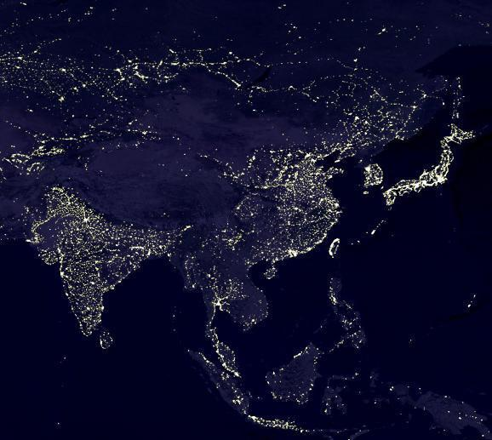
ASIA
Qiu Chang Wu Michele Lin
Peter Chen Nancy Lin
Stephanie Liang Eric Luo
Li Ping Lin Boyuan Zhang

