Slide 2
Photosynthesis
Photosynthesis 2

Slide 3
Answer in Notebooks:
#1. What is the equation for Cellular Respiration?
#2. What is the equation for Photosynthesis?

Slide 4
7.1 Photosynthesis fuels the biosphere
Plants are autotrophs
make their own food through the process of photosynthesis
Notes:
Teaching Tips
• The evolution of chloroplasts from photosynthetic prokaryotes living inside of eukaryotic cells is discussed in Module 4.15. If your students have not already read Chapter 4, consider discussing this theory of endosymbiosis.
Some students might think that the term “producers” applies to the production of oxygen by plants. In turn, they might think that consumers are organisms that use oxygen (which would include all aerobic organisms). Extra care may be needed to clarify the definitions of these frequently used terms.
Active Lecture Tips
• When introducing the diverse ways that plants impact our lives, challenge your students to work with students seated nearby to come up with a list of products made from plants that they come across on a regular basis. The collective lists from your students can be surprisingly long and might help to build up your catalog of examples.

Slide 5
Answer in Notebook:
#3. Give examples of the following (use internet if necessary)
Photoautotrophs
Chemoautotrophs
Heterotrophs

Slide 6
7.1 Photosynthesis fuels the biosphere
Photosynthesis in plants takes place in chloroplasts.
Notes:
Teaching Tips
• The evolution of chloroplasts from photosynthetic prokaryotes living inside of eukaryotic cells is discussed in Module 4.15. If your students have not already read Chapter 4, consider discussing this theory of endosymbiosis.
Some students might think that the term “producers” applies to the production of oxygen by plants. In turn, they might think that consumers are organisms that use oxygen (which would include all aerobic organisms). Extra care may be needed to clarify the definitions of these frequently used terms.
Active Lecture Tips
• When introducing the diverse ways that plants impact our lives, challenge your students to work with students seated nearby to come up with a list of products made from plants that they come across on a regular basis. The collective lists from your students can be surprisingly long and might help to build up your catalog of examples.

Slide 7
7.2 Photosynthesis occurs in chloroplasts in plant cells
Chlorophyll
is an important light-absorbing pigment in chloroplasts
plays a central role in converting solar energy to chemical energy.
Notes:
Teaching Tips
• The authors note the analogous roles of the thylakoid space and the intermembrane space of a mitochondrion. Students might be encouraged to create a list of the similarities in structure and function of mitochondria and chloroplasts through these related chapters.
• The living world contains many examples of adaptations to increase surface area. Some examples are the many folds of the inner mitochondrial membrane; the highly branched surfaces of plant roots, fish gills, and human lungs; and the highly branched system of capillaries in the tissues of our bodies. Consider relating this broad principle to the extensive folding of the thylakoid membranes.

Slide 8
7.2 Photosynthesis occurs in chloroplasts in plant cells
Chloroplasts are concentrated in the cells of the mesophyll, the green tissue in the interior of the leaf.
Stomata are tiny pores in the leaf that allow
carbon dioxide to enter and
oxygen to exit.
Veins in the leaf deliver water absorbed by roots.
Notes:
Teaching Tips
• The authors note the analogous roles of the thylakoid space and the intermembrane space of a mitochondrion. Students might be encouraged to create a list of the similarities in structure and function of mitochondria and chloroplasts through these related chapters.
• The living world contains many examples of adaptations to increase surface area. Some examples are the many folds of the inner mitochondrial membrane; the highly branched surfaces of plant roots, fish gills, and human lungs; and the highly branched system of capillaries in the tissues of our bodies. Consider relating this broad principle to the extensive folding of the thylakoid membranes.

Slide 9
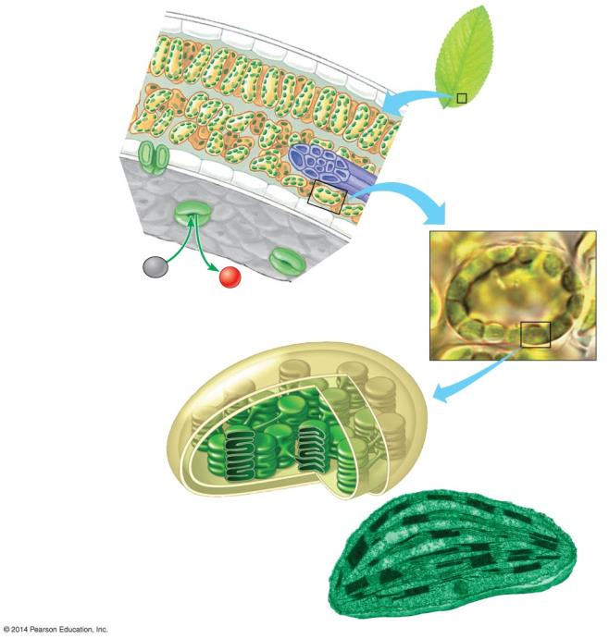
Figure 7.2-0
Leaf Cross Section
Mesophyll
Leaf
Vein
Mesophyll Cell
CO₂
O₂
Stoma
Chloroplast
Inner and outer membranes
Granum
Thylakoid
Thylakoid space
Stroma
Notes:
Figure 7.2-0 Zooming in on the location and structure of chloroplasts

Slide 10
7.2 Photosynthesis occurs in chloroplasts in plant cells
Chloroplasts consist of an envelope of two membranes, which encloses an inner compartment filled with a thick fluid called stroma
Stroma contains a system of interconnected membranous sacs called thylakoids.
Notes:
Teaching Tips
• The authors note the analogous roles of the thylakoid space and the intermembrane space of a mitochondrion. Students might be encouraged to create a list of the similarities in structure and function of mitochondria and chloroplasts through these related chapters.
• The living world contains many examples of adaptations to increase surface area. Some examples are the many folds of the inner mitochondrial membrane; the highly branched surfaces of plant roots, fish gills, and human lungs; and the highly branched system of capillaries in the tissues of our bodies. Consider relating this broad principle to the extensive folding of the thylakoid membranes.

Slide 11
7.2 Photosynthesis occurs in chloroplasts in plant cells
Thylakoids
are often concentrated in stacks called grana
have an internal compartment called the thylakoid space, which has functions analogous to the intermembrane space of a mitochondrion in the generation of ATP.
Thylakoid membranes also house much of the machinery that converts light energy to chemical energy.
Notes:
Teaching Tips
• The authors note the analogous roles of the thylakoid space and the intermembrane space of a mitochondrion. Students might be encouraged to create a list of the similarities in structure and function of mitochondria and chloroplasts through these related chapters.
• The living world contains many examples of adaptations to increase surface area. Some examples are the many folds of the inner mitochondrial membrane; the highly branched surfaces of plant roots, fish gills, and human lungs; and the highly branched system of capillaries in the tissues of our bodies. Consider relating this broad principle to the extensive folding of the thylakoid membranes.

Slide 12
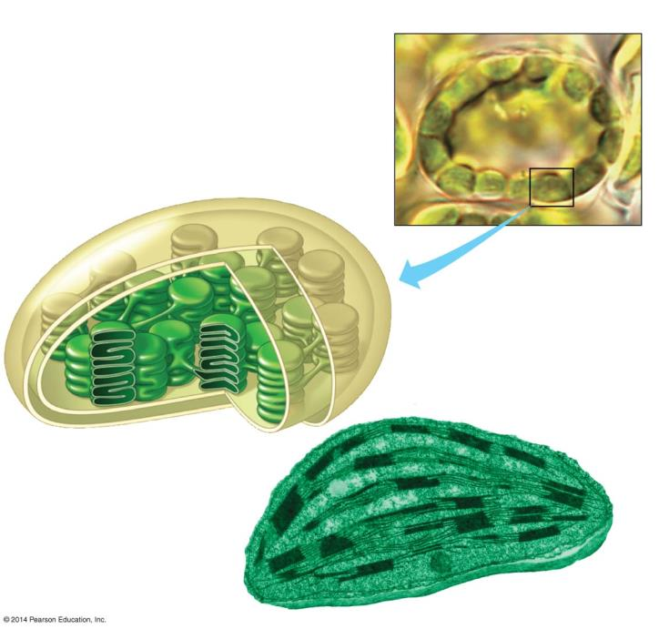
Figure 7.2-2
Mesophyll Cell
Chloroplast
Inner and outer membranes
Granum
Thylakoid
Thylakoid space
Stroma
Notes:
Figure 7.2-2 Zooming in on the location and structure of chloroplasts (part 2)

Slide 13
7.4 Photosynthesis is a redox process, as is cellular respiration
Photosynthesis, like respiration, is a redox (oxidation-reduction) process.
CO₂ becomes reduced to sugar as electrons, along with hydrogen ions (H⁺) from water, are added to it.
Water molecules are oxidized when they lose electrons along with hydrogen ions.
Notes:
Teaching Tips
• In our world, energy is frequently converted to a usable form in one place and used in another. For example, electricity is generated by power plants, transferred to our homes, and used to run computers, create light, and help us prepare foods. Consider relating this common energy transfer to the two-stage process of photosynthesis.
Active Lecture Tips
• See the activity Photosynthesis and Respiration: Are They Similar on the Instructor Exchange. Visit the Instructor Exchange in the MasteringBiology instructor resource area for a description of this activity.

Slide 14
Figure 7.4a
Becomes reduced
6 CO₂ + 6 H₂O
C₆H₁₂O₆ + 6 O₂
Becomes oxidized
Notes:
Figure 7.4a Photosynthesis (uses light energy)

Slide 15
Answer in Notebooks:
#4. Define the following (relating to molecules)
Reduction
Oxidation

Slide 16
7.4 Photosynthesis is a redox process, as is cellular respiration
In photosynthesis,
light energy is captured by chlorophyll molecules to boost the energy of electrons
light energy is converted to chemical energy
chemical energy is stored in the chemical bonds of sugars.
Notes:
Teaching Tips
• In our world, energy is frequently converted to a usable form in one place and used in another. For example, electricity is generated by power plants, transferred to our homes, and used to run computers, create light, and help us prepare foods. Consider relating this common energy transfer to the two-stage process of photosynthesis.
Active Lecture Tips
• See the activity Photosynthesis and Respiration: Are They Similar on the Instructor Exchange. Visit the Instructor Exchange in the MasteringBiology instructor resource area for a description of this activity.

Slide 17
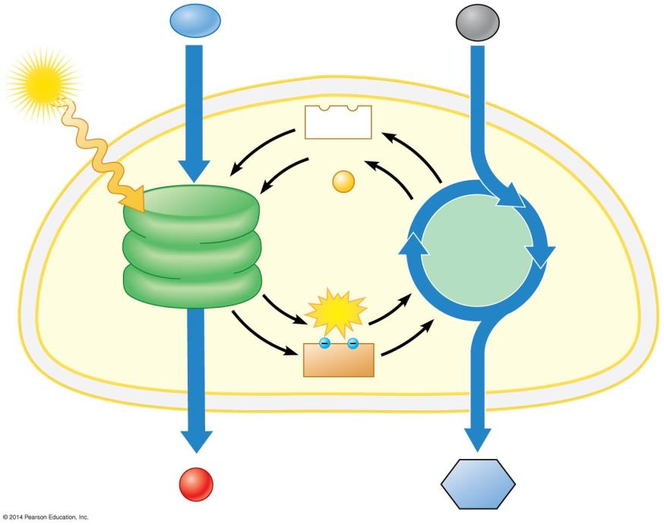
Figure 7.5-3
H₂O
CO₂
Light
NADP ⁺
ADP
+
P
Light Reactions (in thylakoids)
Calvin Cycle (in stroma)
ATP
NADPH
Chloroplast
O₂
Sugar
Notes:
Figure 7.5-3 An overview of the two stages of photosynthesis in a chloroplast (step 3)

Slide 18
The Light Reactions:
Converting Solar Energy to Chemical Energy

Slide 19
7.6 Visible radiation absorbed by pigments drives the light reactions
Sunlight contains energy called electromagnetic energy or radiation.
Visible light is only a small part of the electromagnetic spectrum, the full range of electromagnetic wavelengths.
Electromagnetic energy travels in waves.
The wavelength is the distance between the crests of two adjacent waves.
Notes:
Student Misconceptions and Concerns
• The authors note that electromagnetic energy travels through space in waves that are like ripples made by a pebble dropped into a puddle. This wave imagery is helpful but can confuse students when energy is also thought of as discrete packets called photons. The dual nature of light, which exhibits the properties of waves and particles, may need to be discussed further if students are to do more than just accept definitions.
• The authors note that sunlight is a type of radiation. Many students think of radiation as a result of radioactive decay, a serious threat to health. The diverse types of radiation and the varying energy associated with each might need to be explained.
• Even at the college level, students struggle to understand why we perceive certain colors. The authors discuss the specific absorption and reflection of certain wavelengths of light, noting which colors are absorbed and which are reflected (and thus available for our eyes to detect). Consider spending time to make sure that your students understand how photosynthetic pigments absorb and reflect certain wavelengths.
Teaching Tips
Consider bringing a prism to class and demonstrating the spectrum of light. Depending on what you have available, it can be a dramatic reinforcement.
Active Lecture Tips
• See the activity Demonstration of the Light Dependent Reactions of Photosynthesis Using Students as Molecules on the Instructor Exchange. Visit the Instructor Exchange in the MasteringBiology instructor resource area for a description of this activity.
• See the activity Satellite TV and Photosystems on the Instructor Exchange. Visit the Instructor Exchange in the MasteringBiology instructor resource area for a description of this activity.

Slide 20
7.6 Visible radiation absorbed by pigments drives the light reactions
Light behaves as discrete packets of energy called photons.
A photon is a fixed quantity of light energy.
The shorter the wavelength, the greater the energy.
Notes:
Student Misconceptions and Concerns
• The authors note that electromagnetic energy travels through space in waves that are like ripples made by a pebble dropped into a puddle. This wave imagery is helpful but can confuse students when energy is also thought of as discrete packets called photons. The dual nature of light, which exhibits the properties of waves and particles, may need to be discussed further if students are to do more than just accept definitions.
• The authors note that sunlight is a type of radiation. Many students think of radiation as a result of radioactive decay, a serious threat to health. The diverse types of radiation and the varying energy associated with each might need to be explained.
• Even at the college level, students struggle to understand why we perceive certain colors. The authors discuss the specific absorption and reflection of certain wavelengths of light, noting which colors are absorbed and which are reflected (and thus available for our eyes to detect). Consider spending time to make sure that your students understand how photosynthetic pigments absorb and reflect certain wavelengths.
Teaching Tips
Consider bringing a prism to class and demonstrating the spectrum of light. Depending on what you have available, it can be a dramatic reinforcement.
Active Lecture Tips
• See the activity Demonstration of the Light Dependent Reactions of Photosynthesis Using Students as Molecules on the Instructor Exchange. Visit the Instructor Exchange in the MasteringBiology instructor resource area for a description of this activity.
• See the activity Satellite TV and Photosystems on the Instructor Exchange. Visit the Instructor Exchange in the MasteringBiology instructor resource area for a description of this activity.

Slide 21
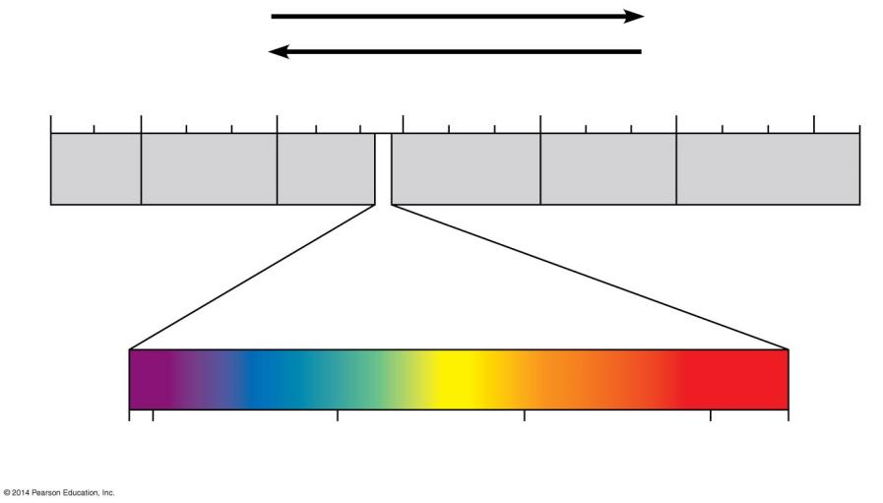
Figure 7.6a
Shorter wavelength
Longer wavelength
Higher energy
Lower energy
10⁻⁵ nm 10⁻³ nm 1 nm 10³ nm 10⁶ nm 1 m 10³ m
Gamma rays
X-rays
UV
Infrared
Micro- waves
Radio waves
Visible light
380 400 500 600 700 750
Wavelength (nm)
Notes:
Figure 7.6a The electromagnetic spectrum and the wavelengths of visible light

Slide 22
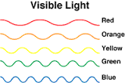
Answer in Notebooks:
#5. What has more energy
Gamma Rays or UV rays?
Microwaves or Radio waves?
Orange light or Green light?

Slide 23
Animation: Light and Pigments

Slide 24
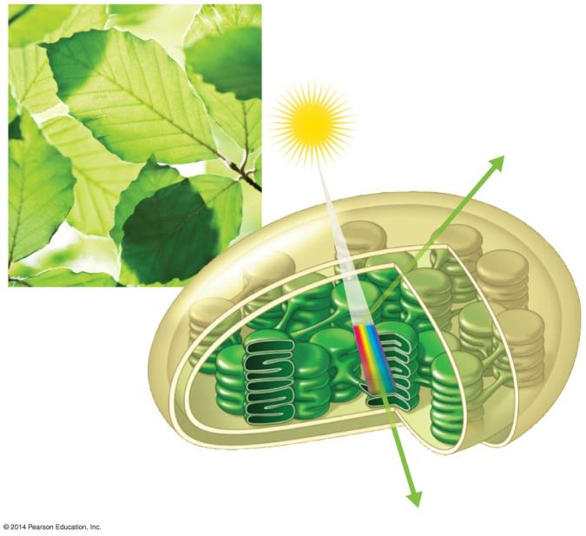
Figure 7.6b-0
Light
Reflected light
Chloroplast
Thylakoid
Absorbed light
Transmitted light
Notes:
Figure 7.6b-0 The interaction of light with a chloroplast

Slide 25
7.6 Visible radiation absorbed by pigments drives the light reactions
Chloroplasts contain several different pigments, which absorb light of different wavelengths.
Chlorophyll a absorbs mainly blue-violet and red light and reflects mainly green light.
Chlorophyll b absorbs mainly blue and orange and reflects (appears) olive-green.

Slide 26
7.6 Visible radiation absorbed by pigments drives the light reactions
Carotenoids
broaden the spectrum of colors that can drive photosynthesis
provide photoprotection, absorbing and dissipating excessive light energy that would otherwise damage chlorophyll or interact with oxygen to form reactive oxidative molecules.

Slide 27
7.7 Photosystems capture solar energy
Within a thylakoid membrane, chlorophyll and other pigment molecules
absorb photons
transfer the energy to other pigment molecules.
In the thylakoid membrane, chlorophyll molecules are organized along with other pigments and proteins into photosystems.
Notes:
Student Misconceptions and Concerns
• Even at the college level, students struggle to understand why we perceive certain colors. The authors discuss the specific absorption and reflection of certain wavelengths of light, noting which colors are absorbed and which are reflected (and thus available for our eyes to detect). Consider spending time to make sure that your students understand how photosynthetic pigments absorb and reflect certain wavelengths.
Teaching Tips
• The authors discuss a phenomenon that most students have noticed: dark surfaces heat up faster in the sun than do lighter-colored surfaces. This is an opportunity to demonstrate to your students the various depths of scientific explanations and help them appreciate their own educational progress. In elementary school, they might have learned that the sun heats darker surfaces faster than lighter surfaces. In high school, they may have learned more about light energy and the fact that dark surfaces absorb more of this energy than lighter surfaces. Now, in college, they are learning that at the atomic level, darker surfaces absorb the energy of more photons, exciting more electrons, which then fall back to a lower state, releasing more heat.
Active Lecture Tips
• See the activity Demonstration of the Light Dependent Reactions of Photosynthesis Using Students as Molecules on the Instructor Exchange. Visit the Instructor Exchange in the MasteringBiology instructor resource area for a description of this activity.
• See the activity Satellite TV and Photosystems on the Instructor Exchange. Visit the Instructor Exchange in the MasteringBiology instructor resource area for a description of this activity.

Slide 28
7.7 Photosystems capture solar energy
A photosystem consists of a number of light-harvesting complexes surrounding a reaction-center complex.
A light-harvesting complex contains various pigment molecules bound to proteins.
functions as a light-gathering antenna.
Notes:
Student Misconceptions and Concerns
• Even at the college level, students struggle to understand why we perceive certain colors. The authors discuss the specific absorption and reflection of certain wavelengths of light, noting which colors are absorbed and which are reflected (and thus available for our eyes to detect). Consider spending time to make sure that your students understand how photosynthetic pigments absorb and reflect certain wavelengths.
Teaching Tips
• The authors discuss a phenomenon that most students have noticed: dark surfaces heat up faster in the sun than do lighter-colored surfaces. This is an opportunity to demonstrate to your students the various depths of scientific explanations and help them appreciate their own educational progress. In elementary school, they might have learned that the sun heats darker surfaces faster than lighter surfaces. In high school, they may have learned more about light energy and the fact that dark surfaces absorb more of this energy than lighter surfaces. Now, in college, they are learning that at the atomic level, darker surfaces absorb the energy of more photons, exciting more electrons, which then fall back to a lower state, releasing more heat.
Active Lecture Tips
• See the activity Demonstration of the Light Dependent Reactions of Photosynthesis Using Students as Molecules on the Instructor Exchange. Visit the Instructor Exchange in the MasteringBiology instructor resource area for a description of this activity.
• See the activity Satellite TV and Photosystems on the Instructor Exchange. Visit the Instructor Exchange in the MasteringBiology instructor resource area for a description of this activity.

Slide 29
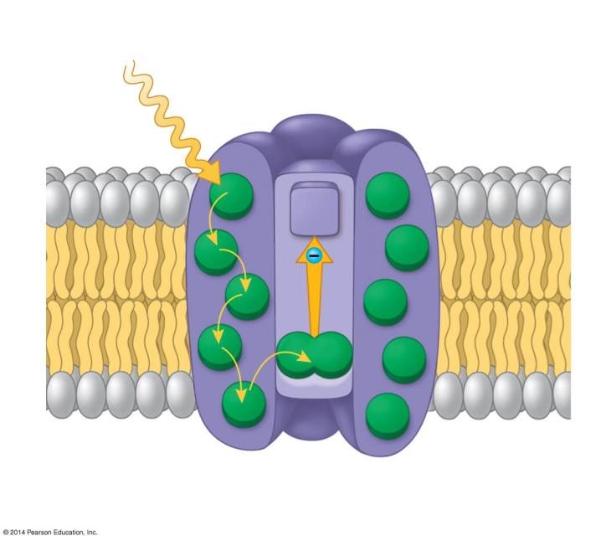
Figure 7.7b
Photosystem
Light
Light-harvesting complexes
Reaction-center complex
Primary electron acceptor
STROMA
Thylakoid membrane
THYLAKOID SPACE
Pigment molecules
Transfer of energy
Pair of chlorophyll a molecules
Notes:
Figure 7.7b A light-excited pair of chlorophyll molecules in the reaction center of a photosystem passing an excited electron to a primary electron acceptor

Slide 30
7.7 Photosystems capture solar energy
The light energy is passed from molecule to molecule within the photosystem.
Finally it reaches the reaction center
Chlorophyll a pair transfers an electron to primary electron acceptor
Notes:
Student Misconceptions and Concerns
• Even at the college level, students struggle to understand why we perceive certain colors. The authors discuss the specific absorption and reflection of certain wavelengths of light, noting which colors are absorbed and which are reflected (and thus available for our eyes to detect). Consider spending time to make sure that your students understand how photosynthetic pigments absorb and reflect certain wavelengths.
Teaching Tips
• The authors discuss a phenomenon that most students have noticed: dark surfaces heat up faster in the sun than do lighter-colored surfaces. This is an opportunity to demonstrate to your students the various depths of scientific explanations and help them appreciate their own educational progress. In elementary school, they might have learned that the sun heats darker surfaces faster than lighter surfaces. In high school, they may have learned more about light energy and the fact that dark surfaces absorb more of this energy than lighter surfaces. Now, in college, they are learning that at the atomic level, darker surfaces absorb the energy of more photons, exciting more electrons, which then fall back to a lower state, releasing more heat.
Active Lecture Tips
• See the activity Demonstration of the Light Dependent Reactions of Photosynthesis Using Students as Molecules on the Instructor Exchange. Visit the Instructor Exchange in the MasteringBiology instructor resource area for a description of this activity.
• See the activity Satellite TV and Photosystems on the Instructor Exchange. Visit the Instructor Exchange in the MasteringBiology instructor resource area for a description of this activity.

Slide 31
7.7 Photosystems capture solar energy
Two types of photosystems (photosystem I and photosystem II) cooperate in the light reactions.
Each photosystem has a characteristic reaction-center complex, with a special pair of chlorophyll a molecules associated with a particular primary electron acceptor.
Notes:
Student Misconceptions and Concerns
• Even at the college level, students struggle to understand why we perceive certain colors. The authors discuss the specific absorption and reflection of certain wavelengths of light, noting which colors are absorbed and which are reflected (and thus available for our eyes to detect). Consider spending time to make sure that your students understand how photosynthetic pigments absorb and reflect certain wavelengths.
Teaching Tips
• The authors discuss a phenomenon that most students have noticed: dark surfaces heat up faster in the sun than do lighter-colored surfaces. This is an opportunity to demonstrate to your students the various depths of scientific explanations and help them appreciate their own educational progress. In elementary school, they might have learned that the sun heats darker surfaces faster than lighter surfaces. In high school, they may have learned more about light energy and the fact that dark surfaces absorb more of this energy than lighter surfaces. Now, in college, they are learning that at the atomic level, darker surfaces absorb the energy of more photons, exciting more electrons, which then fall back to a lower state, releasing more heat.
Active Lecture Tips
• See the activity Demonstration of the Light Dependent Reactions of Photosynthesis Using Students as Molecules on the Instructor Exchange. Visit the Instructor Exchange in the MasteringBiology instructor resource area for a description of this activity.
• See the activity Satellite TV and Photosystems on the Instructor Exchange. Visit the Instructor Exchange in the MasteringBiology instructor resource area for a description of this activity.

Slide 32
7.8 Two photosystems connected by an electron transport chain generate ATP and NADPH
How is light energy transformed into the chemical energy of ATP and NADPH?
Electrons are:
removed from water
passed from photosystem II to photosystem I
accepted by NADP⁺, reducing it to NADPH.
Between the two photosystems, the electrons
move down an electron transport chain
provide energy for the synthesis of ATP.
Notes:
Teaching Tips
• • The authors develop a mechanical analogy for the energy levels and movement of electrons in the light reaction. Figure 7.8 equates the height of an electron with its energy state. Thus, electrons captured at high levels carry more energy than electrons in lower positions. Although this figure can be very effective, students might need to be carefully led through the analogy to understand precisely what is represented.
Active Lecture Tips
• See the activity Demonstration of the Light Dependent Reactions of Photosynthesis Using Students as Molecules on the Instructor Exchange. Visit the Instructor Exchange in the MasteringBiology instructor resource area for a description of this activity.
• See the activity Satellite TV and Photosystems on the Instructor Exchange. Visit the Instructor Exchange in the MasteringBiology instructor resource area for a description of this activity.

Slide 33
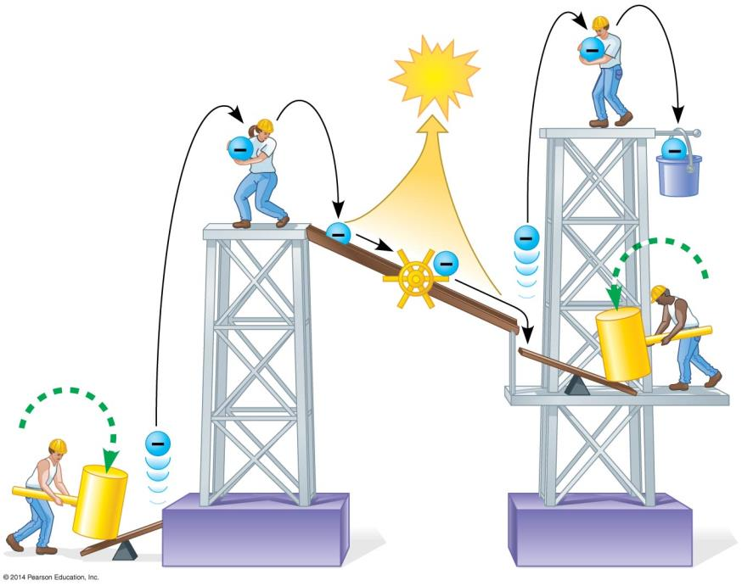
Figure 7.8
ATP
NADPH
Electron transport chain ramp
Photon
Photon
Photosystem II
Photosystem I
Notes:
Figure 7.8 A mechanical analogy of the light reactions

Slide 34
Answer in Notebooks:
#6. Explain the diagram/ The light reactions of Photosynthesis

Slide 35
7.9 VISUALIZING THE CONCEPT: The light reactions take place within the thylakoid membranes
Light energy absorbed by the two photosystems drives the flow of electrons from water to NADPH.
The electron transport chain helps to produce the concentration gradient of H⁺ across the thylakoid membrane, which drives H⁺ through ATP synthase, producing ATP.
Because the initial energy input is light (“photo”), this chemiosmotic production of ATP is called photophosphorylation.
Notes:
Teaching Tips
• Module 7.9 can be the basis for an excellent comparison between oxidative phosphorylation in mitochondria and photophosphorylation in chloroplasts. If your students have not already read or discussed chemiosmosis in mitochondria, consider assigning Modules 6.6 and 6.10 to show the similarities of these processes. (As noted in Module 7.2, the thylakoid space is analogous to the intermembrane space of mitochondria.)

Slide 36
Answer in Notebooks:
#7. What is photophosphorylation?

Slide 37
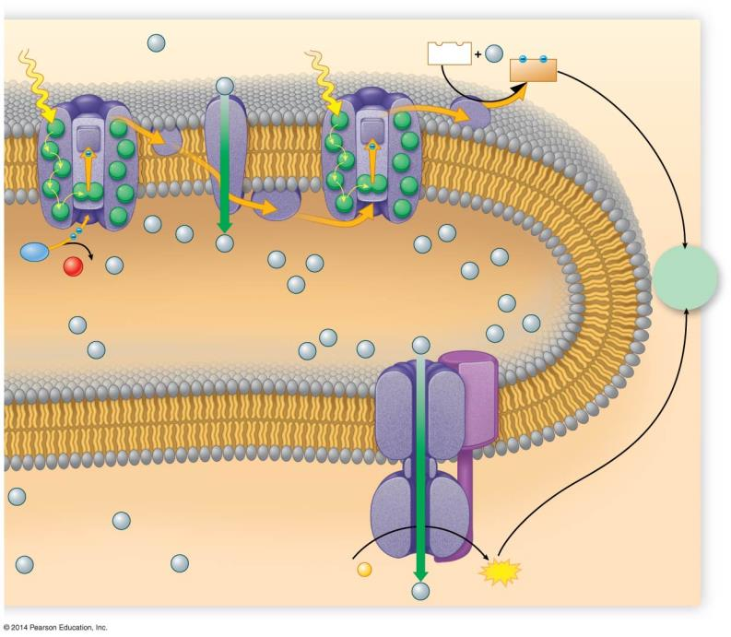
Figure 7.9-5
Light
H⁺
Electron transport chain
Light
Photosystem II
Photosystem I
NADP⁺
H⁺
H⁺
NADPH
H⁺
H⁺
H₂O
H⁺
H⁺
H⁺
1
H⁺
H⁺
H⁺
1
O₂ + 2
H⁺
To Calvin Cycle
2
H⁺
H⁺
H⁺
H⁺
THYLAKOID SPACE
H⁺
H⁺
H⁺
H⁺
H⁺
H⁺
H⁺
Thylakoid membrane
ATP synthase
H⁺
STROMA
H⁺
H⁺
H⁺
ADP +
P
ATP
H⁺
Notes:
Figure 7.9-5 The light reactions (step 5)

Slide 38
The Calvin Cycle:
Reducing CO₂ to Sugar

Slide 39
7.10 ATP and NADPH power sugar synthesis in the Calvin cycle
The Calvin cycle makes sugar within a chloroplast.
To produce sugar, the necessary ingredients are
atmospheric CO₂
ATP and NADPH generated by the light reactions
Notes:
Student Misconceptions and Concerns
• The terms light reactions and dark reactions can lead students to conclude that each set of reactions occurs at different times of the day. However, the Calvin cycle in most plants occurs during daylight, when NADPH and ATP from the light reactions are readily available.
Teaching Tips
• Glucose is not the direct product of the Calvin cycle, as might be expected from the general equation for photosynthesis. Instead, as noted in the text, G3P is the main product. Clarify the diverse uses of G3P in the production of many important plant molecules.

Slide 40
7.10 ATP and NADPH power sugar synthesis in the Calvin cycle
The Calvin cycle uses CO₂, NADPH, and ATP to produce an energy-rich, three-carbon sugar called glyceraldehyde 3-phosphate (G3P).
A plant cell uses G3P to make
glucose
sucrose
other organic molecules
Notes:
Student Misconceptions and Concerns
• The terms light reactions and dark reactions can lead students to conclude that each set of reactions occurs at different times of the day. However, the Calvin cycle in most plants occurs during daylight, when NADPH and ATP from the light reactions are readily available.
Teaching Tips
• Glucose is not the direct product of the Calvin cycle, as might be expected from the general equation for photosynthesis. Instead, as noted in the text, G3P is the main product. Clarify the diverse uses of G3P in the production of many important plant molecules.

Slide 41
7.10 ATP and NADPH power sugar synthesis in the Calvin cycle
The steps of the Calvin cycle include
carbon fixation
reduction
release of one molecule of G3P
regeneration of the starting molecule, ribulose bisphosphate (RuBP).

Slide 42
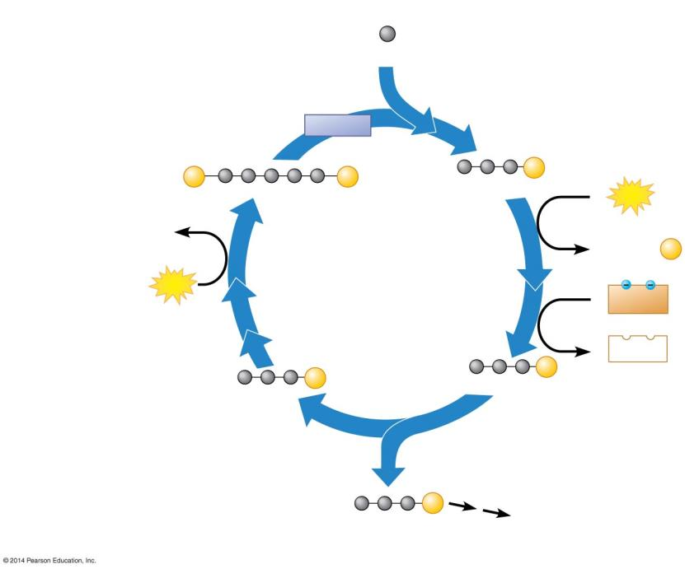
Figure 7.10-2
Input
3
Step 1 Carbon fixation
CO₂
Rubisco
3
P
P
6
P
RuBP
3-PGA
6
ATP
3 ADP
Step 4
6 ADP + P
Regeneration of RuBP
CALVIN CYCLE
3
ATP
6
NADPH
6
NADP⁺
5
6
P
P
G3P
G3P
Step 2 Reduction
Step 3
Release of one molecule of G3P
1
P
Glucose and other compounds
G3P
Output
Notes:
Figure 7.10-2 An overview of the Calvin cycle (part 2)

Slide 43
Answer in Notebooks:
#8. Explain the Calvin Cycle

Slide 44
Answer in Notebooks:
#9. How many CO2, ATP, and NADPH molecules are needed to make one molecule of glucose?
Why is this high number of ATP and NADPH molecules consistent with the value of glucose as an energy source?

Slide 45
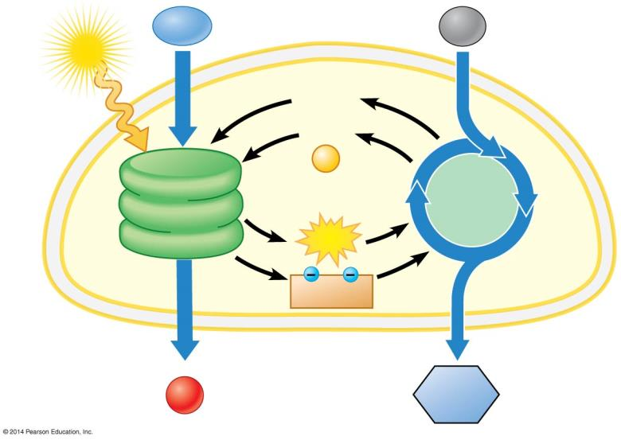
Figure 7.10-1
H₂O
CO₂
Light
NADP⁺
ADP
+
P
Light Reactions
Calvin Cycle
ATP
NADPH
Chloroplast
O₂
Sugar
Notes:
Figure 7.10-1 An overview of the Calvin cycle (part 1)

Slide 46
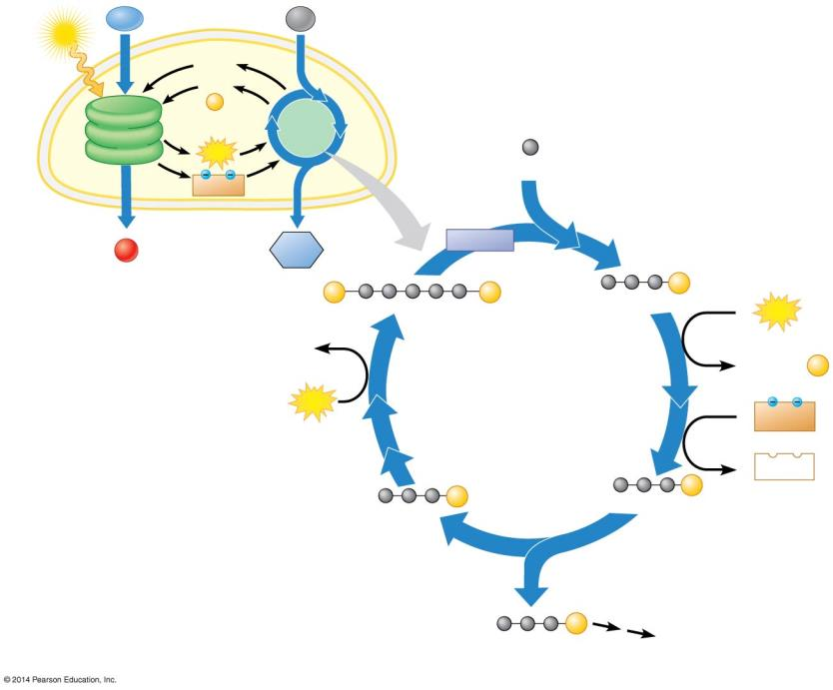
Figure 7.10-0
Light
H₂O
CO₂
NADP⁺
ADP
+
P
Light Reactions
Calvin Cycle
Input
ATP
3
Step 1 Carbon fixation
CO₂
NADPH
Chloroplast
Rubisco
O₂
Sugar
3
P
P
6
P
RuBP
3-PGA
6
ATP
3 ADP
P
Step 4
P
P
6 ADP + P
Regeneration of RuBP
CALVIN CYCLE
3
ATP
6
NADPH
6
NADP⁺
5
P
6
P
G3P
G3P
Step 2 Reduction
Step 3
Release of one molecule of G3P
1
P
G3P
Output
Glucose and other compounds
Notes:
Figure 7.10-0 An overview of the Calvin cycle

Slide 47
7.11 EVOLUTION CONNECTION: Other methods of carbon fixation have evolved in hot, dry climates
Most plants use CO₂ directly from the air, and carbon fixation occurs when the enzyme rubisco adds CO₂ to RuBP.
Such plants are called C₃ plants because the first product of carbon fixation is a three-carbon compound, 3-PGA.
Notes:
Teaching Tips
• If you can find examples of C₃, C₄, and CAM plants, consider bringing them to class. Referring to living plants helps students understand these abstract concepts. Nice photographs can serve as a substitute.
• Relate the properties of C₃ and C₄ plants to the regions of the country where each is grown. Students might generally understand that crops have specific requirements, but may not specifically relate these physiological differences to their geographic sites of production or specific evolutionary histories.

Slide 48
7.11 EVOLUTION CONNECTION: Other methods of carbon fixation have evolved in hot, dry climates
In hot and dry weather, C₃ plants close their stomata to reduce water loss, but this prevents CO₂ from entering the leaf and O₂ from leaving.
Notes:
Teaching Tips
• If you can find examples of C₃, C₄, and CAM plants, consider bringing them to class. Referring to living plants helps students understand these abstract concepts. Nice photographs can serve as a substitute.
• Relate the properties of C₃ and C₄ plants to the regions of the country where each is grown. Students might generally understand that crops have specific requirements, but may not specifically relate these physiological differences to their geographic sites of production or specific evolutionary histories.

Slide 49
7.11 EVOLUTION CONNECTION: Other methods of carbon fixation have evolved in hot, dry climates
As O₂ builds up in a leaf, rubisco adds O₂ instead of CO₂ to RuBP, and a two-carbon product of this reaction is then broken down in the cell.
This process is called photorespiration because it occurs in the light, consumes O₂, and releases CO₂.
But unlike cellular respiration, it uses ATP instead of producing it.
Notes:
Teaching Tips
• If you can find examples of C₃, C₄, and CAM plants, consider bringing them to class. Referring to living plants helps students understand these abstract concepts. Nice photographs can serve as a substitute.
• Relate the properties of C₃ and C₄ plants to the regions of the country where each is grown. Students might generally understand that crops have specific requirements, but may not specifically relate these physiological differences to their geographic sites of production or specific evolutionary histories.

Slide 50
Photorespiration

Slide 51
7.11 EVOLUTION CONNECTION: Other methods of carbon fixation have evolved in hot, dry climates
C₄ plants are so named because they first fix CO₂ into a four-carbon compound.
When the weather is hot and dry, C₄ plants keep their stomata mostly closed, thus conserving water.
minimizes photorespiration
optimizes the Calvin cycle
Notes:
Teaching Tips
• If you can find examples of C₃, C₄, and CAM plants, consider bringing them to class. Referring to living plants helps students understand these abstract concepts. Nice photographs can serve as a substitute.
• Relate the properties of C₃ and C₄ plants to the regions of the country where each is grown. Students might generally understand that crops have specific requirements, but may not specifically relate these physiological differences to their geographic sites of production or specific evolutionary histories.

Slide 52
7.11 EVOLUTION CONNECTION: Other methods of carbon fixation have evolved in hot, dry climates
CAM plants conserve water by opening their stomata and admitting CO₂ only at night.
CO₂ is fixed into a four-carbon compound, which banks CO₂ at night and releases it to the Calvin cycle during the day.
Notes:
Teaching Tips
• If you can find examples of C₃, C₄, and CAM plants, consider bringing them to class. Referring to living plants helps students understand these abstract concepts. Nice photographs can serve as a substitute.
• Relate the properties of C₃ and C₄ plants to the regions of the country where each is grown. Students might generally understand that crops have specific requirements, but may not specifically relate these physiological differences to their geographic sites of production or specific evolutionary histories.

Slide 53
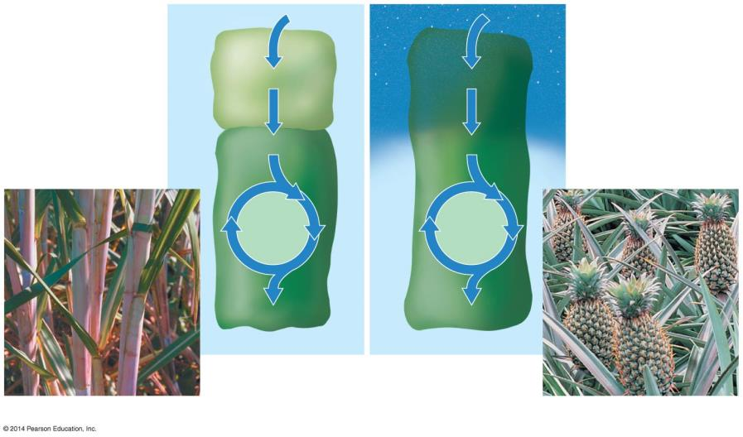
Figure 7.11-0
Mesophyll cell
CO₂
Night
CO₂
4-C compound
4-C compound
Bundle- sheath cell
CO₂
CO₂
Calvin Cycle
Calvin Cycle
Sugar
Sugar
C₄ plant
Day
CAM plant
Sugarcane
Pineapple
Notes:
Figure 7.11-0 Comparison of C₄ and CAM photosynthesis

Slide 54
Photosynthesis
Photosynthesis 2
C3 C4 CAM
C3 vs. C4

Slide 55
Answer in Notebooks:
#10. Give examples of the following:
C3 Plants
C4 Plants
CAM Plants

Slide 56
