Slide 1
Simple Epithelium
Simple squamous epithelium consists of a single layer of flat, scale-like cells
adapted for diffusion and filtration (found in lungs and kidneys)
Endothelium lines the heart and blood vessels.
Mesothelium lines the thoracic and abdominopelvic cavities and covers the organs within them.
Simple cuboidal epithelium consists of a single layer of cube-shaped cells
adapted for secretion and absorption

Slide 2
Simple Epithelium
Simple columnar epithelium consists of a single layer of rectangular cells and can exist in two forms
Nonciliated simple columnar epithelium contains microvilli
increase surface area and the rate of absorption
goblet cells secrete mucus
Ciliated simple columnar epithelium contains cells with hair-like processes called cilia
provides motility and helps to move fluids or particles along a surface

Slide 3
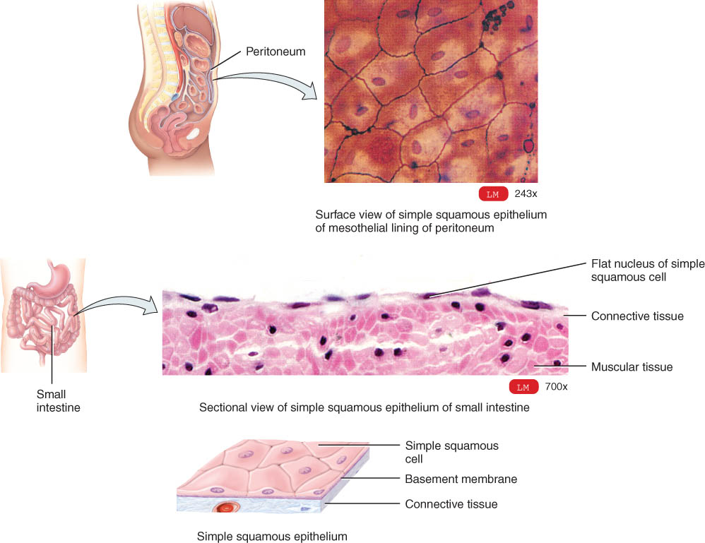
Simple Squamous Epithelium
Single layer of flat cells
very thin --- controls diffusion, osmosis and filtration
blood vessel lining (endothelium) and lining of body cavities (mesothelium)
nuclei are centrally located
Cells are in direct contact with each other.

Slide 4
Examples of Simple Squamous
Surface view of lining of peritoneal cavity
Section of intestinal showing serosa

Slide 5
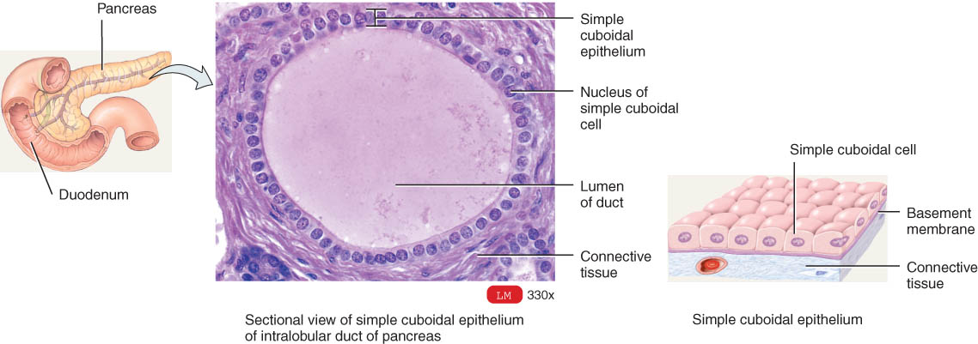
Simple Cuboidal Epithelium
Single layer of cube-shaped cells viewed from the side
nuclei are round and centrally located
lines tubes of kidney
adapted for absorption or secretion

Slide 6
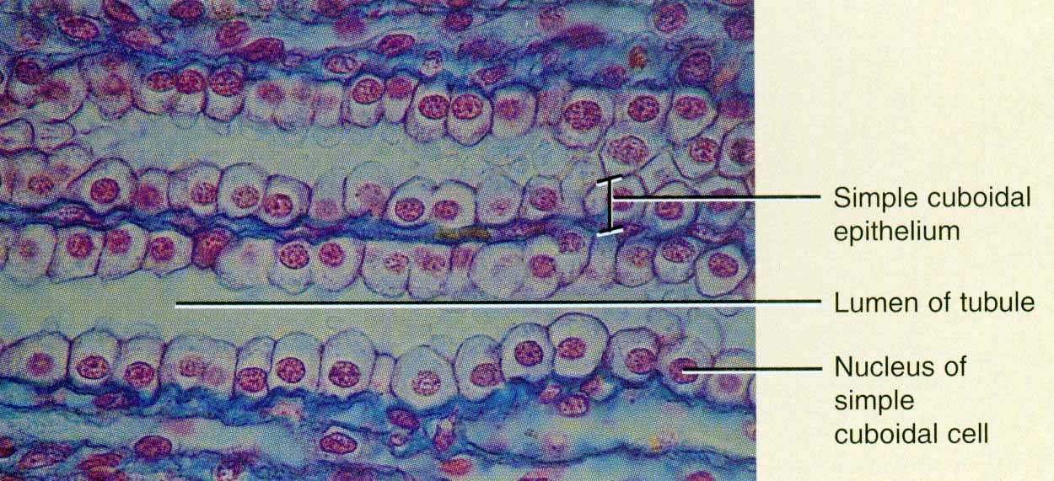
Example of Simple Cuboidal
X-Sectional view of kidney tubules

Slide 7
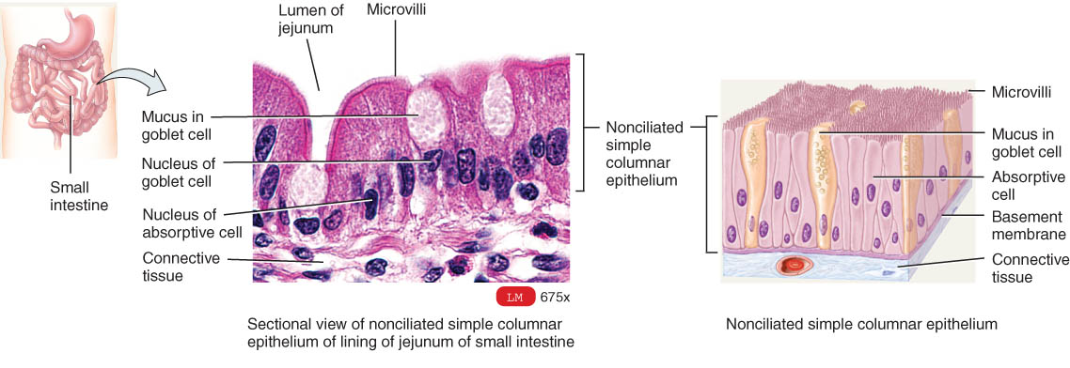
Nonciliated Simple Columnar
Single layer rectangular cells
Unicellular glands (goblet cells) secrete mucus
lubricate GI, respiratory, reproductive and urinary systems
Microvilli (non-motile, fingerlike membrane projections)
adapted for absorption in GI tract (stomach to rectum)

Slide 8
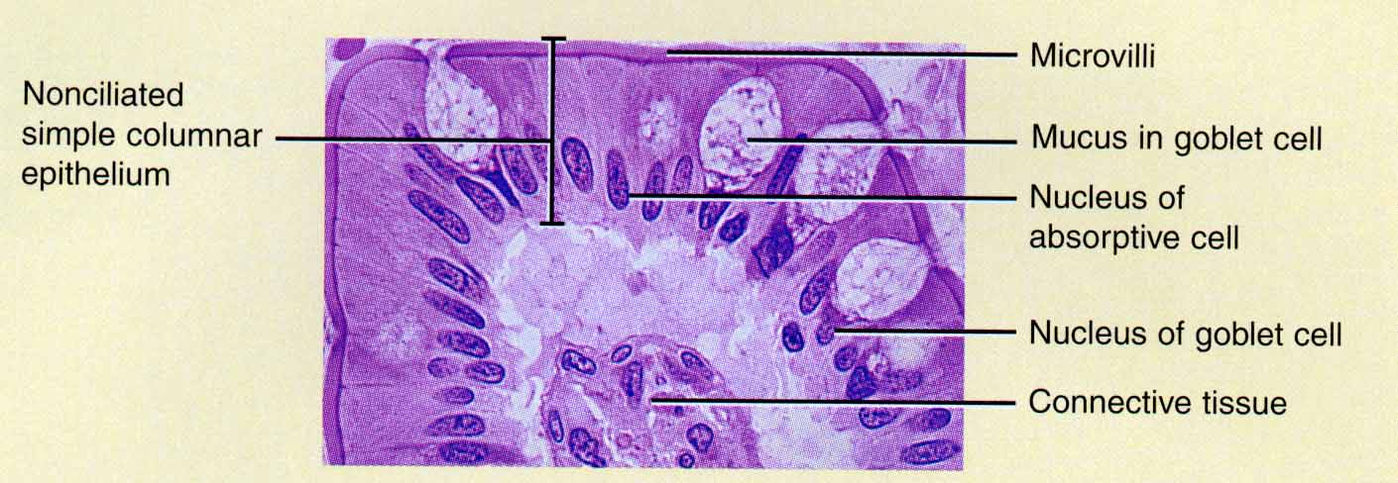
Ex. Nonciliated Simple Columnar
Section from small intestine

Slide 9
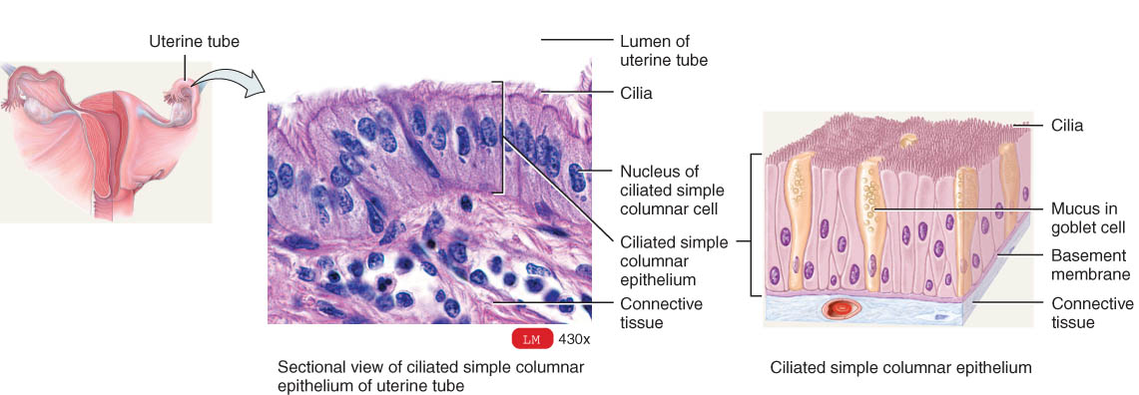
Ciliated Simple Columnar Epithelium
Single layer rectangular cells with cilia
Cilia (motile membrane extensions) move mucus
found in respiratory system and in fallopian tubes

Slide 10
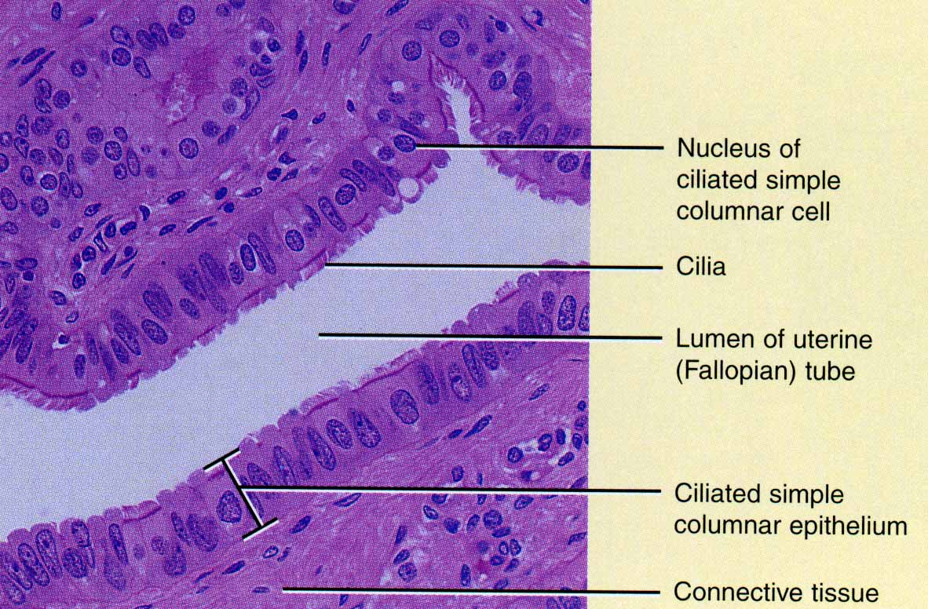
Ex. Ciliated Simple Columnar
Section of uterine tube

Slide 11
Pseudostratified Epithelium
Pseudostratified epithelium appears to have several layers because the nuclei are at various levels.
All cells are attached to the basement membrane but some do not reach the apical surface.
In pseudostratified ciliated columnar epithelium, the cells that reach the surface either secrete mucus (goblet cells) or bear cilia that sweep away mucus and trapped foreign particles.
Pseudostratified nonciliated columnar epithelium contains no cilia or goblet cells.

Slide 12
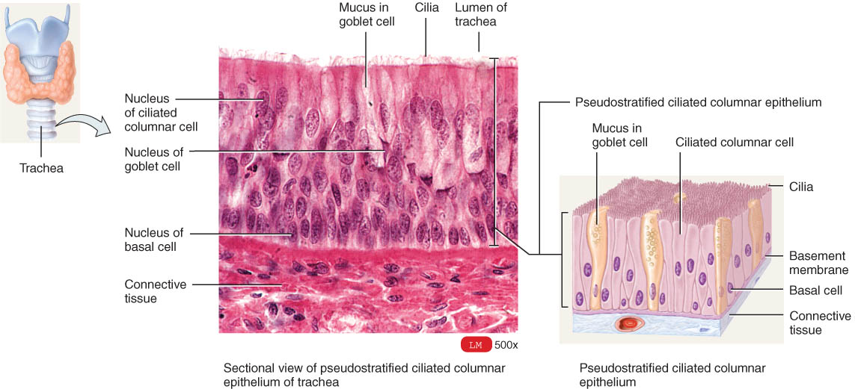
Pseudostratified Ciliated Columnar Epithelium
Single cell layer of cells of variable height
Nuclei are located at varying depths (appear layered.)
Found in respiratory system, male urethra & epididymis

Slide 13
Stratified Epithelium
Epithelia have at least two layers of cells.
more durable and protective
name depends on the shape of the surface (apical) cells
Stratified squamous epithelium consists of several layers of cells
top layer of cells is flat
deeper layers of cells vary cuboidal to columnar.
basal cells replicate by mitosis
Keratinized stratified squamous epithelium
a tough layer of keratin (a protein resistant to friction and repels bacteria) is deposited in the surface cells.
Nonkeratinized epithelium remains moist.

