Slide 1
Meiosis and Crossing Over

Slide 2
http://www.cbsnews.com/news/billionaire-doctor-fights-cancer-in-unconventional-way/
Haploid vs. Diploid

Slide 3
8.11 Chromosomes are matched in homologous pairs
In humans, somatic cells have 46 chromosomes forming 23 pairs of homologous chromosomes.
Somatic cells are body cells – all cells of the body other than sperm and egg
Notes:
Student Misconceptions and Concerns
• Some students might conclude that sex chromosomes function only in determining the sex of an individual. As the authors note, sex chromosomes contain genes not involved in sex determination.
Teaching Tips
• Students might recall some basic genetics, remembering that for many traits a person receives a separate “signal” from mom and dad. These separate signals for the same trait are carried on the same portion of homologous chromosomes, such as the freckle trait noted in Module 8.11 of the textbook.
Active Lecture Tips
• See the Activity Student Demonstration of Mitosis and Meiosis Using Chromosome Cut-Outs as Models on the Instructor Exchange. Visit the Instructor Exchange in the MasteringBiology instructor resource area for a description of this activity.

Slide 4
8.11 Chromosomes are matched in homologous pairs
Homologous chromosomes
Same Length
Same Centromere Position
Same Staining Pattern
Notes:
Student Misconceptions and Concerns
• Some students might conclude that sex chromosomes function only in determining the sex of an individual. As the authors note, sex chromosomes contain genes not involved in sex determination.
Teaching Tips
• Students might recall some basic genetics, remembering that for many traits a person receives a separate “signal” from mom and dad. These separate signals for the same trait are carried on the same portion of homologous chromosomes, such as the freckle trait noted in Module 8.11 of the textbook.
Active Lecture Tips
• See the Activity Student Demonstration of Mitosis and Meiosis Using Chromosome Cut-Outs as Models on the Instructor Exchange. Visit the Instructor Exchange in the MasteringBiology instructor resource area for a description of this activity.

Slide 5
8.11 Chromosomes are matched in homologous pairs
A locus (plural, loci) is the position of a gene.
Different versions of a gene may be found at the same locus on the two chromosomes of a homologous pair

Slide 6
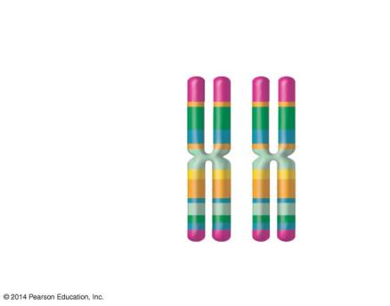
Figure 8.11
Pair of homologous duplicated chromosomes
Locus
Centromere
Sister chromatids
One duplicated chromosome
Notes:
Figure 8.11 A pair of homologous chromosomes

Slide 7
8.11 Chromosomes are matched in homologous pairs
The human sex chromosomes X and Y differ in size and genetic composition.
The other 22 pairs of chromosomes are autosomes with the same size and genetic composition.
Notes:
Student Misconceptions and Concerns
• Some students might conclude that sex chromosomes function only in determining the sex of an individual. As the authors note, sex chromosomes contain genes not involved in sex determination.
Teaching Tips
• Students might recall some basic genetics, remembering that for many traits a person receives a separate “signal” from mom and dad. These separate signals for the same trait are carried on the same portion of homologous chromosomes, such as the freckle trait noted in Module 8.11 of the textbook.
Active Lecture Tips
• See the Activity Student Demonstration of Mitosis and Meiosis Using Chromosome Cut-Outs as Models on the Instructor Exchange. Visit the Instructor Exchange in the MasteringBiology instructor resource area for a description of this activity.

Slide 8
8.12 Gametes have a single set of chromosomes
An organism’s life cycle is the sequence of stages leading from the adults of one generation to the adults of the next.
Humans and many animals and plants are diploid, because all somatic cells contain pairs of homologous chromosomes.
Notes:
Student Misconceptions and Concerns
• Students might not immediately see the need for meiosis in sexual reproduction. Consider an example of what would happen over many generations if gametes were produced by mitosis. The resulting genetic doubling is prevented if each gamete has only half the genetic material of the adult cells.
Teaching Tips
• Consider helping students think through mitosis and meiosis by developing an analogy to pairs of shoes. In this case, any given species has a certain number of pairs of shoes, or homologous chromosomes.
• In the shoe analogy, females have 23 pairs of matching shoes, while males have 22 matching pairs and 1 odd pair . . . maybe a sandal and a sneaker!
• You might want to get your students thinking by asking them why eggs and sperm are different. (This depends upon the species, but within vertebrates, eggs and sperm are specialized for different tasks. Sperm are adapted to move to an egg and donate a nucleus. Eggs contain a nucleus and most of the cytoplasm of the future zygote. Thus eggs are typically larger, nonmotile, and full of cellular resources to sustain cell division and growth.)
Active Lecture Tips
• See the Activity Student Demonstration of Mitosis and Meiosis Using Chromosome Cut-Outs as Models on the Instructor Exchange. Visit the Instructor Exchange in the MasteringBiology instructor resource area for a description of this activity.

Slide 9
8.12 Gametes have a single set of chromosomes
Gametes
Eggs and sperm
are said to be haploid because each cell has a single set of chromosomes.
Notes:
Student Misconceptions and Concerns
• Students might not immediately see the need for meiosis in sexual reproduction. Consider an example of what would happen over many generations if gametes were produced by mitosis. The resulting genetic doubling is prevented if each gamete has only half the genetic material of the adult cells.
Teaching Tips
• Consider helping students think through mitosis and meiosis by developing an analogy to pairs of shoes. In this case, any given species has a certain number of pairs of shoes, or homologous chromosomes.
• In the shoe analogy, females have 23 pairs of matching shoes, while males have 22 matching pairs and 1 odd pair . . . maybe a sandal and a sneaker!
• You might want to get your students thinking by asking them why eggs and sperm are different. (This depends upon the species, but within vertebrates, eggs and sperm are specialized for different tasks. Sperm are adapted to move to an egg and donate a nucleus. Eggs contain a nucleus and most of the cytoplasm of the future zygote. Thus eggs are typically larger, nonmotile, and full of cellular resources to sustain cell division and growth.)
Active Lecture Tips
• See the Activity Student Demonstration of Mitosis and Meiosis Using Chromosome Cut-Outs as Models on the Instructor Exchange. Visit the Instructor Exchange in the MasteringBiology instructor resource area for a description of this activity.

Slide 10
8.12 Gametes have a single set of chromosomes
The human life cycle begins when a haploid sperm fuses with a haploid egg in fertilization.
The zygote, formed by fertilization, is now diploid.
Mitosis of the zygote and its descendants generates all the somatic cells into the adult form

Slide 11
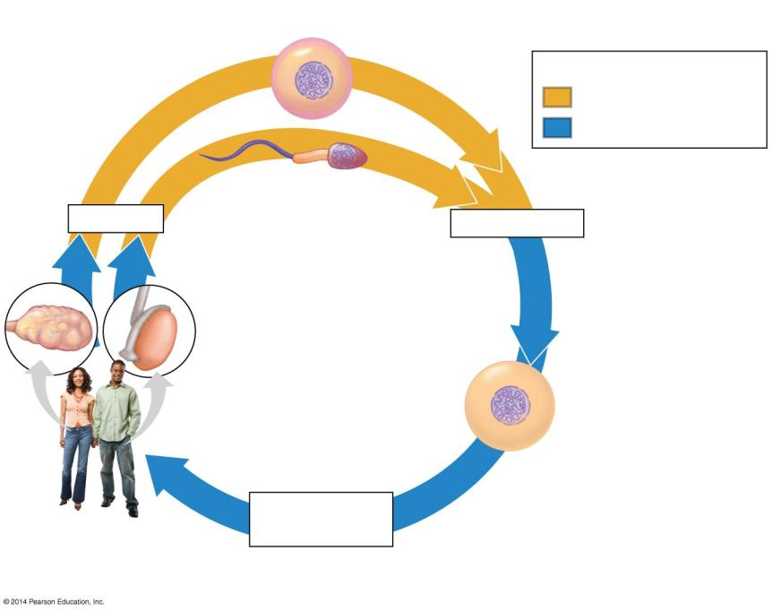
Figure 8.12a
Haploid gametes (n = 23)
n
Key
n
Haploid stage (n)
Egg cell
Diploid stage (2n)
n
n
Sperm cell
Meiosis
Fertilization
Ovary
Testis
2n
Diploid
zygote (2n = 46)
Mitosis and
development
Multicellular diploid adults (2n = 46)
Notes:
Figure 8.12a The human life cycle

Slide 12
Answer in Notebooks:
#11. Differentiate between:
Somatic Cells vs. Gametes
Autosomes vs. Sex Chromosomes
Haploid vs. Diploid

Slide 13
8.12 Gametes have a single set of chromosomes
Gametes are made by meiosis in the ovaries and testes.
Meiosis reduces the chromosome number by half.
Notes:
Student Misconceptions and Concerns
• Students might not immediately see the need for meiosis in sexual reproduction. Consider an example of what would happen over many generations if gametes were produced by mitosis. The resulting genetic doubling is prevented if each gamete has only half the genetic material of the adult cells.
Teaching Tips
• Consider helping students think through mitosis and meiosis by developing an analogy to pairs of shoes. In this case, any given species has a certain number of pairs of shoes, or homologous chromosomes.
• In the shoe analogy, females have 23 pairs of matching shoes, while males have 22 matching pairs and 1 odd pair . . . maybe a sandal and a sneaker!
• You might want to get your students thinking by asking them why eggs and sperm are different. (This depends upon the species, but within vertebrates, eggs and sperm are specialized for different tasks. Sperm are adapted to move to an egg and donate a nucleus. Eggs contain a nucleus and most of the cytoplasm of the future zygote. Thus eggs are typically larger, nonmotile, and full of cellular resources to sustain cell division and growth.)
Active Lecture Tips
• See the Activity Student Demonstration of Mitosis and Meiosis Using Chromosome Cut-Outs as Models on the Instructor Exchange. Visit the Instructor Exchange in the MasteringBiology instructor resource area for a description of this activity.

Slide 14
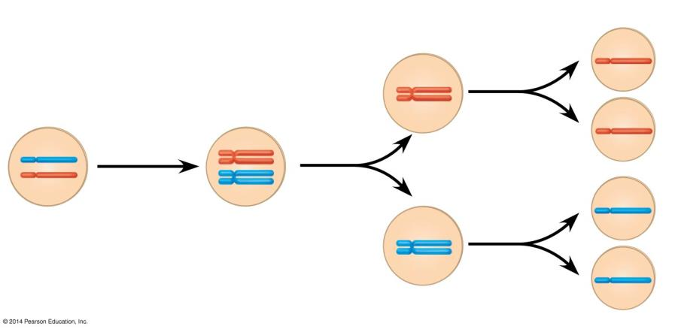
Figure 8.12b
Interphase
Meiosis I
Meiosis II
Sister chromatids
1
2
3
Sister chromatids separate
Haploid cells
Chromosomes duplicate
Homologous chromosomes
separate
A pair of
homologous chromosomes in a diploid
parent cell
A pair of duplicated homologous
chromosomes
Notes:
Figure 8.12b How meiosis halves chromosome number

Slide 15
8.13 Meiosis reduces the chromosome number from diploid to haploid
Meiosis is a type of cell division that produces haploid gametes in diploid organisms.
Two haploid gametes may then combine in fertilization to restore the diploid state in the zygote.
Notes:
Student Misconceptions and Concerns
• Students might not immediately see the need for meiosis in sexual reproduction. Consider an example of what would happen over many generations if gametes were produced by mitosis. The resulting genetic doubling is prevented if each gamete has only half the genetic material of the adult cells.
Teaching Tips
• Challenge students to identify which stage of meiosis is most like mitosis. Comparing the specific events of mitosis, meiosis I, and meiosis II to each other allows students to identify essential differences.
Active Lecture Tips
• See the Activity Student Demonstration of Mitosis and Meiosis Using Chromosome Cut-Outs as Models on the Instructor Exchange. Visit the Instructor Exchange in the MasteringBiology instructor resource area for a description of this activity.

Slide 16
8.13 Meiosis reduces the chromosome number from diploid to haploid
Duplication of chromosomes occurs before mitosis and meiosis
meiosis is followed by two consecutive cell divisions
mitosis is followed by only one cell division.
Because in meiosis, one duplication of chromosomes is followed by two divisions, each of the four daughter cells produced has a haploid set of chromosomes.
Notes:
Student Misconceptions and Concerns
• Students might not immediately see the need for meiosis in sexual reproduction. Consider an example of what would happen over many generations if gametes were produced by mitosis. The resulting genetic doubling is prevented if each gamete has only half the genetic material of the adult cells.
Teaching Tips
• Challenge students to identify which stage of meiosis is most like mitosis. Comparing the specific events of mitosis, meiosis I, and meiosis II to each other allows students to identify essential differences.
Active Lecture Tips
• See the Activity Student Demonstration of Mitosis and Meiosis Using Chromosome Cut-Outs as Models on the Instructor Exchange. Visit the Instructor Exchange in the MasteringBiology instructor resource area for a description of this activity.

Slide 17
8.13 Meiosis reduces the chromosome number from diploid to haploid
Interphase
Like mitosis, meiosis is preceded by an interphase, during which the chromosomes duplicate.
Notes:
Student Misconceptions and Concerns
• Students might not immediately see the need for meiosis in sexual reproduction. Consider an example of what would happen over many generations if gametes were produced by mitosis. The resulting genetic doubling is prevented if each gamete has only half the genetic material of the adult cells.
Teaching Tips
• Challenge students to identify which stage of meiosis is most like mitosis. Comparing the specific events of mitosis, meiosis I, and meiosis II to each other allows students to identify essential differences.
Active Lecture Tips
• See the Activity Student Demonstration of Mitosis and Meiosis Using Chromosome Cut-Outs as Models on the Instructor Exchange. Visit the Instructor Exchange in the MasteringBiology instructor resource area for a description of this activity.

Slide 18
8.13 Meiosis reduces the chromosome number from diploid to haploid
Meiosis I – Prophase I key events
The nuclear membrane dissolves.
Chromatin tightly coils up.
Homologous chromosomes, each composed of two sister chromatids, come together in pairs in a process called synapsis.
Notes:
Student Misconceptions and Concerns
• Students might not immediately see the need for meiosis in sexual reproduction. Consider an example of what would happen over many generations if gametes were produced by mitosis. The resulting genetic doubling is prevented if each gamete has only half the genetic material of the adult cells.
Teaching Tips
• Challenge students to identify which stage of meiosis is most like mitosis. Comparing the specific events of mitosis, meiosis I, and meiosis II to each other allows students to identify essential differences.
Active Lecture Tips
• See the Activity Student Demonstration of Mitosis and Meiosis Using Chromosome Cut-Outs as Models on the Instructor Exchange. Visit the Instructor Exchange in the MasteringBiology instructor resource area for a description of this activity.

Slide 19
Meiosis I – Prophase I Continued…
During synapsis, chromatids of homologous chromosomes exchange segments in a process called crossing over.
The chromosome tetrads move toward the center of the cell.

Slide 20
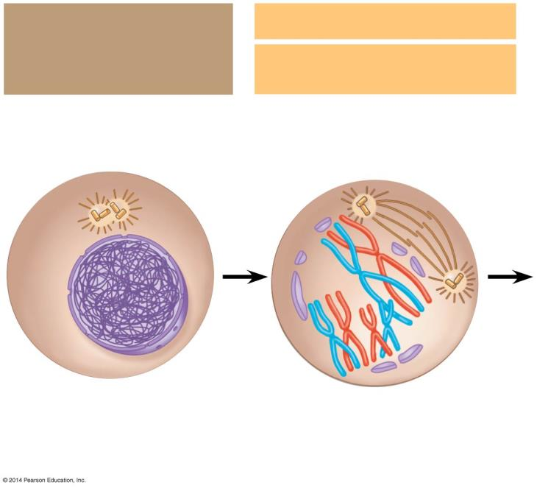
Figure 8.13-2
Interphase: Chromosomes duplicate
Meiosis I:
Prophase I
Sites of crossing over
Centrosomes
Spindle
Tetrad
Nuclear envelope
Chromatin
Sister chromatids
Fragments of the nuclear
envelope
Notes:
Figure 8.13-2 The stages of meiosis (part 2)

Slide 21
8.13 Meiosis reduces the chromosome number from diploid to haploid
Meiosis I – Metaphase I: Tetrads align at the cell equator.
Meiosis I – Anaphase I
Homologous pairs separate and move toward opposite poles of the cell.
Unlike mitosis, the sister chromatids making up each doubled chromosome remain attached.
Notes:
Student Misconceptions and Concerns
• Students might not immediately see the need for meiosis in sexual reproduction. Consider an example of what would happen over many generations if gametes were produced by mitosis. The resulting genetic doubling is prevented if each gamete has only half the genetic material of the adult cells.
Teaching Tips
• Challenge students to identify which stage of meiosis is most like mitosis. Comparing the specific events of mitosis, meiosis I, and meiosis II to each other allows students to identify essential differences.
Active Lecture Tips
• See the Activity Student Demonstration of Mitosis and Meiosis Using Chromosome Cut-Outs as Models on the Instructor Exchange. Visit the Instructor Exchange in the MasteringBiology instructor resource area for a description of this activity.

Slide 22
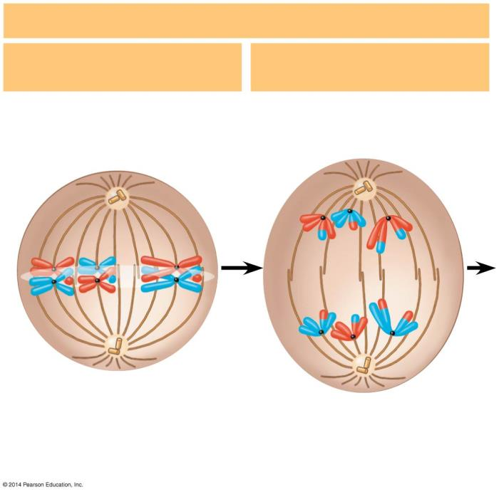
Figure 8.13-3
Meiosis I:
Metaphase I
Anaphase I
Spindle microtubules attached to a kinetochore
Sister chromatids remain attached
Metaphase
plate
Centromere (with a kinetochore)
Homologous chromosomes separate
Notes:
Figure 8.13-3 The stages of meiosis (part 3)

Slide 23
8.13 Meiosis reduces the chromosome number from diploid to haploid
Meiosis I – Telophase
Duplicated chromosomes have reached the poles.
Usually, cytokinesis occurs along with telophase.
Notes:
Student Misconceptions and Concerns
• Students might not immediately see the need for meiosis in sexual reproduction. Consider an example of what would happen over many generations if gametes were produced by mitosis. The resulting genetic doubling is prevented if each gamete has only half the genetic material of the adult cells.
Teaching Tips
• Challenge students to identify which stage of meiosis is most like mitosis. Comparing the specific events of mitosis, meiosis I, and meiosis II to each other allows students to identify essential differences.
Active Lecture Tips
• See the Activity Student Demonstration of Mitosis and Meiosis Using Chromosome Cut-Outs as Models on the Instructor Exchange. Visit the Instructor Exchange in the MasteringBiology instructor resource area for a description of this activity.

Slide 24
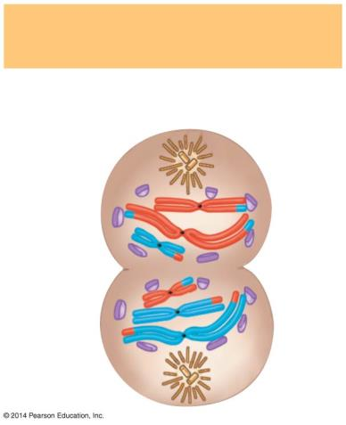
Figure 8.13-5
Telophase I and Cytokinesis
Cleavage furrow
Notes:
Figure 8.13-5 The stages of meiosis (part 5)

Slide 25
8.13 Meiosis reduces the chromosome number from diploid to haploid
Meiosis II follows meiosis I without chromosome duplication.
Each of the two haploid products enters meiosis II.
Meiosis II – Prophase II
A spindle forms and moves chromosomes toward the middle of the cell.
Notes:
Student Misconceptions and Concerns
• Students might not immediately see the need for meiosis in sexual reproduction. Consider an example of what would happen over many generations if gametes were produced by mitosis. The resulting genetic doubling is prevented if each gamete has only half the genetic material of the adult cells.
Teaching Tips
• Challenge students to identify which stage of meiosis is most like mitosis. Comparing the specific events of mitosis, meiosis I, and meiosis II to each other allows students to identify essential differences.
Active Lecture Tips
• See the Activity Student Demonstration of Mitosis and Meiosis Using Chromosome Cut-Outs as Models on the Instructor Exchange. Visit the Instructor Exchange in the MasteringBiology instructor resource area for a description of this activity.

Slide 26
8.13 Meiosis reduces the chromosome number from diploid to haploid
Meiosis II – Metaphase II:
Duplicated chromosomes align at the cell equator like they are in mitosis.
Meiosis II – Anaphase II
Sister chromatids separate.
Individual chromosomes move toward opposite poles.
Notes:
Student Misconceptions and Concerns
• Students might not immediately see the need for meiosis in sexual reproduction. Consider an example of what would happen over many generations if gametes were produced by mitosis. The resulting genetic doubling is prevented if each gamete has only half the genetic material of the adult cells.
Teaching Tips
• Challenge students to identify which stage of meiosis is most like mitosis. Comparing the specific events of mitosis, meiosis I, and meiosis II to each other allows students to identify essential differences.
Active Lecture Tips
• See the Activity Student Demonstration of Mitosis and Meiosis Using Chromosome Cut-Outs as Models on the Instructor Exchange. Visit the Instructor Exchange in the MasteringBiology instructor resource area for a description of this activity.

Slide 27
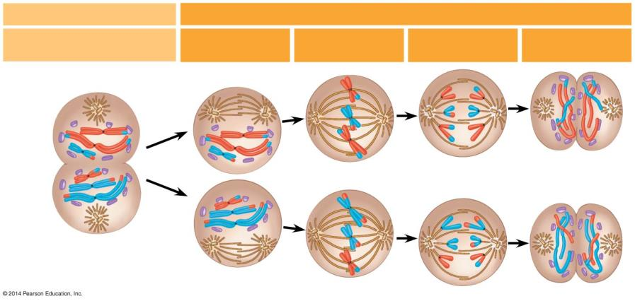
Figure 8.13-4
Meiosis II: Sister chromatids separate
Telophase I and Cytokinesis
Prophase II
Metaphase II
Anaphase II
Telophase II and Cytokinesis
Cleavage furrow
Sister chromatids separate
Haploid daughter cells forming
Notes:
Figure 8.13-4 The stages of meiosis (part 4)

Slide 28
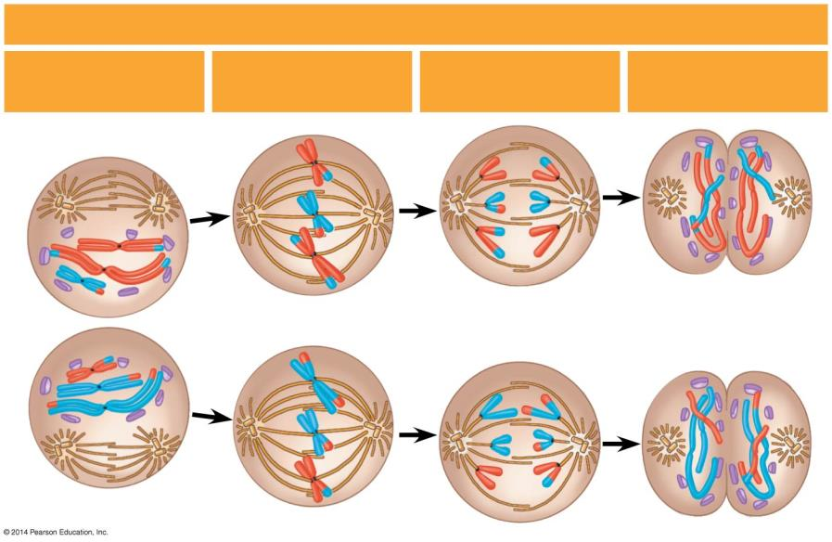
Figure 8.13-6
Meiosis II: Sister chromatids separate
Telophase II and Cytokinesis
Prophase II
Metaphase II
Anaphase II
Sister chromatids separate
Haploid daughter cells forming
Notes:
Figure 8.13-6 The stages of meiosis (part 6)

Slide 29
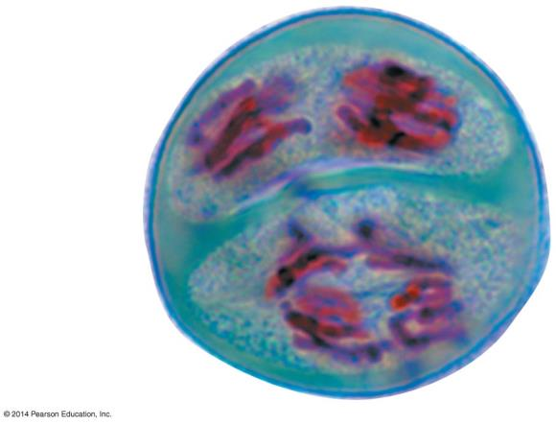
Figure 8.13-7
Two lily cells
undergo meiosis II
Notes:
Figure 8.13-7 The stages of meiosis (part 7)

Slide 30
8.13 Meiosis reduces the chromosome number from diploid to haploid
Meiosis II – Telophase II
Chromosomes have reached the poles of the cell.
A nuclear envelope forms around each set of chromosomes.
With cytokinesis, four haploid cells are produced.
Notes:
Student Misconceptions and Concerns
• Students might not immediately see the need for meiosis in sexual reproduction. Consider an example of what would happen over many generations if gametes were produced by mitosis. The resulting genetic doubling is prevented if each gamete has only half the genetic material of the adult cells.
Teaching Tips
• Challenge students to identify which stage of meiosis is most like mitosis. Comparing the specific events of mitosis, meiosis I, and meiosis II to each other allows students to identify essential differences.
Active Lecture Tips
• See the Activity Student Demonstration of Mitosis and Meiosis Using Chromosome Cut-Outs as Models on the Instructor Exchange. Visit the Instructor Exchange in the MasteringBiology instructor resource area for a description of this activity.

Slide 31
8.14 VISUALIZING THE CONCEPT: Mitosis and meiosis have important similarities and differences
Mitosis and meiosis both begin with diploid parent cells that have chromosomes duplicated during the previous interphase.
However, the end products differ.
Mitosis produces two genetically identical diploid somatic daughter cells.
Meiosis produces four genetically unique haploid gametes.
Notes:
Student Misconceptions and Concerns
• Students might not immediately see the need for meiosis in sexual reproduction. Consider an example of what would happen over many generations if gametes were produced by mitosis. The resulting genetic doubling is prevented if each gamete has only half the genetic material of the adult cells.
Teaching Tips
• How meiosis results in four haploid cells yet mitosis yields two diploid cells is often memorized but seldom understood. It can be explained like this. Consider a pair of chromosomes in a cell before any cell divisions. This pair of chromosomes duplicates such that two chromosomes become four (although each pair of sister chromatids are joined at their centromeres). Therefore, mitosis and meiosis each typically begin with four “chromosomes” after replication but before division. Mitosis divides once, producing two cells, each with two chromosomes. Meiosis divides twice, sorting the four chromosomes into four separate cells.
• Consider emphasizing a crucial difference between the processes of mitosis and meiosis. In mitosis, sister chromatids separate at metaphase. In meiosis I metaphase, sister chromatids stay together, and homologous pairs of chromosomes separate. Consider sketching a comparison of the alignment of the chromosomes at mitosis metaphase and metaphase meiosis I. Module 8.14 helps to make this important distinction. You might create a test question in which you ask students to draw several pairs of homologous chromosomes lined up at metaphase in mitosis versus meiosis I.
Active Lecture Tips
• See the Activity Student Demonstration of Mitosis and Meiosis Using Chromosome Cut-Outs as Models on the Instructor Exchange. Visit the Instructor Exchange in the MasteringBiology instructor resource area for a description of this activity.

Slide 32
Figure 8.14-1
MITOSIS
MEIOSIS I
Parent cell 2n = 4
Notes:
Figure 8.14-1 Comparison of mitosis and meiosis (step 1)

Slide 33
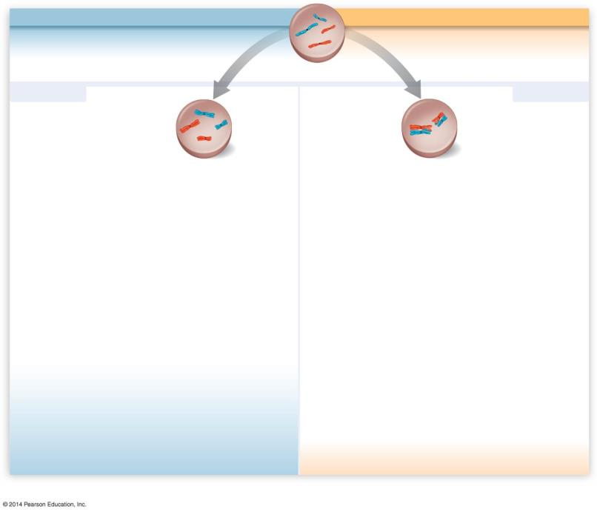
Figure 8.14-2
MITOSIS
MEIOSIS I
Chromosomes are duplicated
Chromosomes are duplicated
Parent cell 2n = 4
Prophase
Prophase I
Homologous chromosomes pair up
Homologous chromosomes
remain separate
Crossing over
Notes:
Figure 8.14-2 Comparison of mitosis and meiosis (step 2)

Slide 34
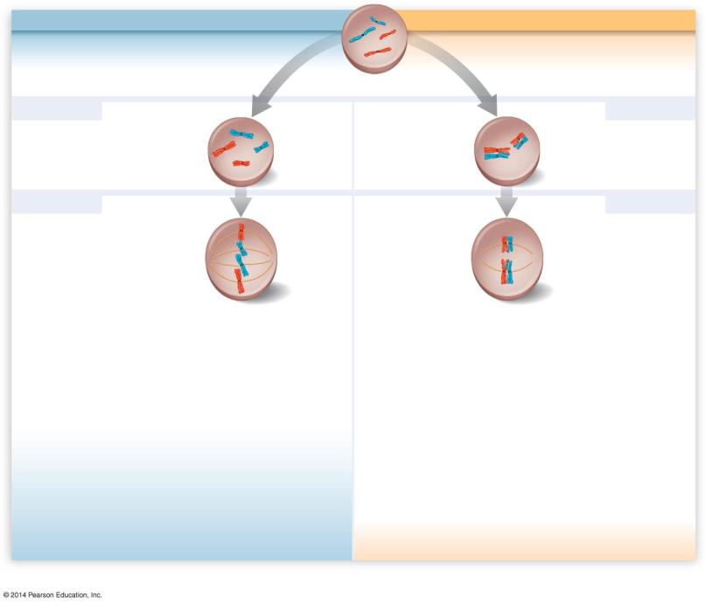
Figure 8.14-3
MITOSIS
MEIOSIS I
Chromosomes are duplicated
Chromosomes are duplicated
Parent cell 2n = 4
Prophase
Prophase I
Homologous chromosomes pair up
Homologous chromosomes
remain separate
Crossing over
Metaphase
Metaphase I
Chromosomes line up at the metaphase plate
Pairs of homologous chromosomes line up at the metaphase plate
Notes:
Figure 8.14-3 Comparison of mitosis and meiosis (step 3)

Slide 35
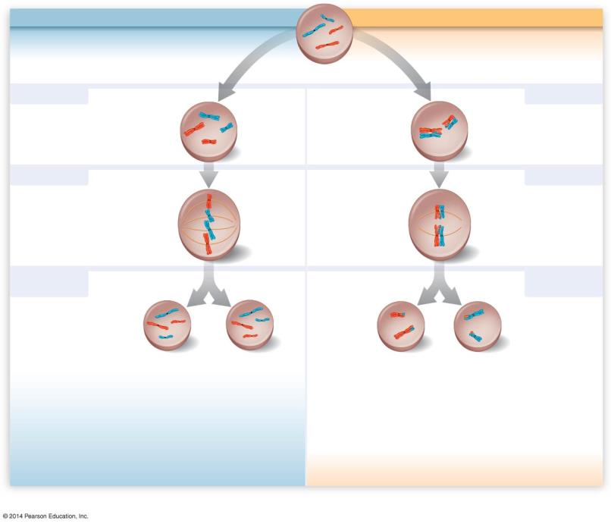
Figure 8.14-4
MITOSIS
MEIOSIS I
Chromosomes are duplicated
Chromosomes are duplicated
Parent cell 2n = 4
Prophase
Prophase I
Homologous chromosomes pair up
Homologous chromosomes
remain separate
Crossing over
Metaphase
Metaphase I
Chromosomes line up at the metaphase plate
Pairs of homologous chromosomes line up at the metaphase plate
Anaphase Telophase
Anaphase I Telophase I
Homologous chromosomes are separated
Sister chromatids are separated
Sister chromatids remain attached
2n
2n
n = 2
n = 2
Notes:
Figure 8.14-4 Comparison of mitosis and meiosis (step 4)

Slide 36
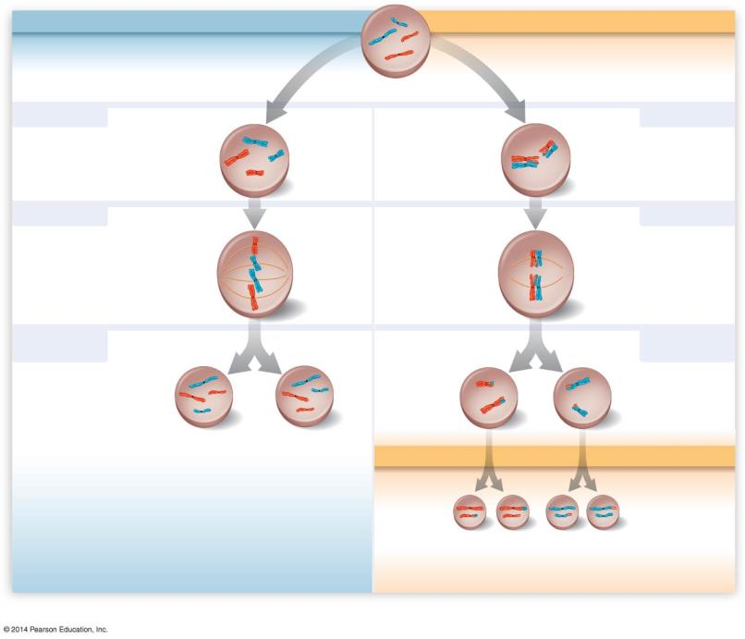
Figure 8.14-5
MITOSIS
MEIOSIS I
Chromosomes are duplicated
Chromosomes are duplicated
Parent cell 2n = 4
Prophase
Prophase I
Homologous chromosomes pair up
Homologous chromosomes
remain separate
Crossing over
Metaphase
Metaphase I
Chromosomes line up at the metaphase plate
Pairs of homologous chromosomes line up at the metaphase plate
Anaphase Telophase
Anaphase I Telophase I
Homologous chromosomes are separated
Sister chromatids are separated
Sister chromatids remain attached
2n
2n
n = 2
n = 2
MEIOSIS II
Sister chromatids are separated
n
n
n
n
Notes:
Figure 8.14-5 Comparison of mitosis and meiosis (step 5)

Slide 37
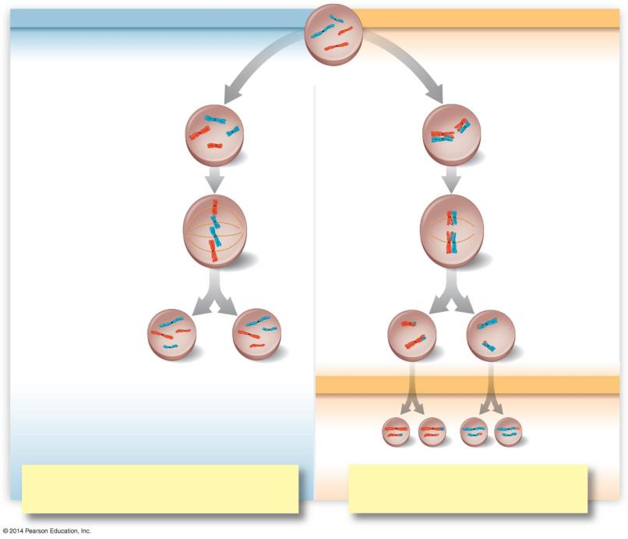
Figure 8.14-6
MITOSIS
MEIOSIS I
MEIOSIS II
One division of the nucleus and cytoplasm Result: Two genetically identical diploid cells Used for: Growth, tissue repair, asexual reproduction
Two divisions of the nucleus and cytoplasm Result: Four genetically unique haploid cells Used for: Sexual reproduction
Notes:
Figure 8.14-6 Comparison of mitosis and meiosis (step 6)

Slide 38
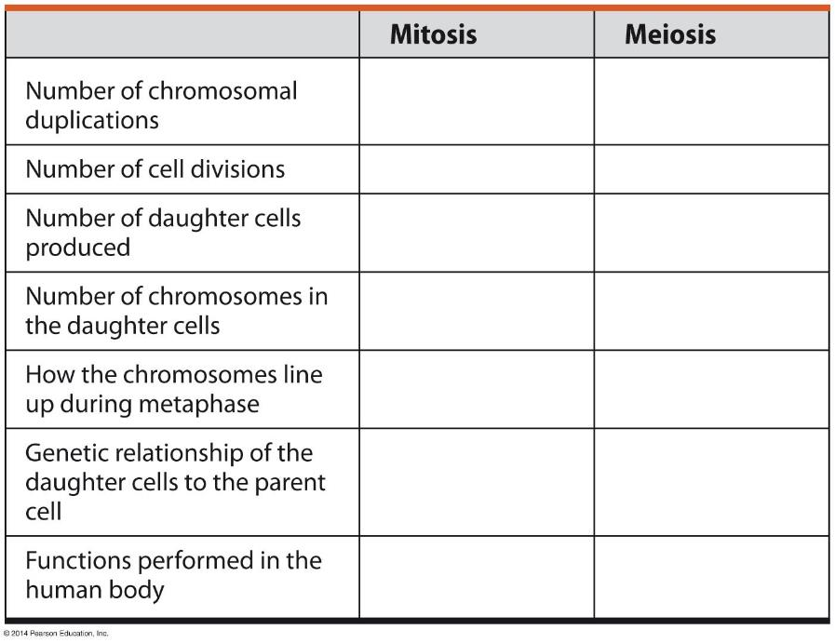
Answer in Notebooks:
#12. Compare and Contrast Mitosis and Meiosis

Slide 39
Meiosis
Meiosis
Meiosis Mr. Anderson

Slide 40
8.15 Independent orientation of chromosomes in meiosis and random fertilization lead to varied offspring
Genetic variation in gametes results from
independent orientation (at metaphase I)
random fertilization
Notes:
Teaching Tips
• The possible number of combinations produced by independent orientation of human chromosomes at meiosis metaphase I is 2²³, , or 8,388,608. This number squared is more than 70 trillion. The authors rounded down to 8 million for 2²³, and squared this, to estimate 64 trillion possible combinations. But more precisely, the number of possible zygotes produced by a single pair of reproducing humans, based solely on independent assortment and random fertilization, is over 70 trillion!
• Another way to represent the various combinations produced by independent orientation of chromosomes at meiosis metaphase I is to continue the shoe analogy. Imagine that you have two pairs of shoes. One pair is black; the other is white. You want to make a new pair of shoes by drawing one shoe from each original pair. Four possible pairs can be made. You can have (1) the left black and left white, (2) the right black and right white, (3) the left black and right white, or (4) the right black and left white. Actually using two pairs of shoes from your students can inject humor and create a concrete example that reduces confusion. For an additional bit of humor, ask the class if 46 students want to contribute their shoes as you try to demonstrate all 8,388,608 combinations!
Active Lecture Tips
• See the Activity Student Demonstration of Mitosis and Meiosis Using Chromosome Cut-Outs as Models on the Instructor Exchange. Visit the Instructor Exchange in the MasteringBiology instructor resource area for a description of this activity.

Slide 41
8.15 Independent orientation of chromosomes in meiosis and random fertilization lead to varied offspring
Independent orientation at metaphase I
Each pair of chromosomes independently aligns at the cell equator.
There is an equal probability of the maternal or paternal chromosome facing a given pole.
The number of combinations for chromosomes packaged into gametes is 2^{n}, where n = haploid number of chromosomes.
Notes:
Teaching Tips
• The possible number of combinations produced by independent orientation of human chromosomes at meiosis metaphase I is 2²³, , or 8,388,608. This number squared is more than 70 trillion. The authors rounded down to 8 million for 2²³, and squared this, to estimate 64 trillion possible combinations. But more precisely, the number of possible zygotes produced by a single pair of reproducing humans, based solely on independent assortment and random fertilization, is over 70 trillion!
• Another way to represent the various combinations produced by independent orientation of chromosomes at meiosis metaphase I is to continue the shoe analogy. Imagine that you have two pairs of shoes. One pair is black; the other is white. You want to make a new pair of shoes by drawing one shoe from each original pair. Four possible pairs can be made. You can have (1) the left black and left white, (2) the right black and right white, (3) the left black and right white, or (4) the right black and left white. Actually using two pairs of shoes from your students can inject humor and create a concrete example that reduces confusion. For an additional bit of humor, ask the class if 46 students want to contribute their shoes as you try to demonstrate all 8,388,608 combinations!
Active Lecture Tips
• See the Activity Student Demonstration of Mitosis and Meiosis Using Chromosome Cut-Outs as Models on the Instructor Exchange. Visit the Instructor Exchange in the MasteringBiology instructor resource area for a description of this activity.

Slide 42
8.15 Independent orientation of chromosomes in meiosis and random fertilization lead to varied offspring
Random fertilization means that the combination of each unique sperm with each unique egg increases genetic variability.
Notes:
Teaching Tips
• The possible number of combinations produced by independent orientation of human chromosomes at meiosis metaphase I is 2²³, , or 8,388,608. This number squared is more than 70 trillion. The authors rounded down to 8 million for 2²³, and squared this, to estimate 64 trillion possible combinations. But more precisely, the number of possible zygotes produced by a single pair of reproducing humans, based solely on independent assortment and random fertilization, is over 70 trillion!
• Another way to represent the various combinations produced by independent orientation of chromosomes at meiosis metaphase I is to continue the shoe analogy. Imagine that you have two pairs of shoes. One pair is black; the other is white. You want to make a new pair of shoes by drawing one shoe from each original pair. Four possible pairs can be made. You can have (1) the left black and left white, (2) the right black and right white, (3) the left black and right white, or (4) the right black and left white. Actually using two pairs of shoes from your students can inject humor and create a concrete example that reduces confusion. For an additional bit of humor, ask the class if 46 students want to contribute their shoes as you try to demonstrate all 8,388,608 combinations!
Active Lecture Tips
• See the Activity Student Demonstration of Mitosis and Meiosis Using Chromosome Cut-Outs as Models on the Instructor Exchange. Visit the Instructor Exchange in the MasteringBiology instructor resource area for a description of this activity.

Slide 43
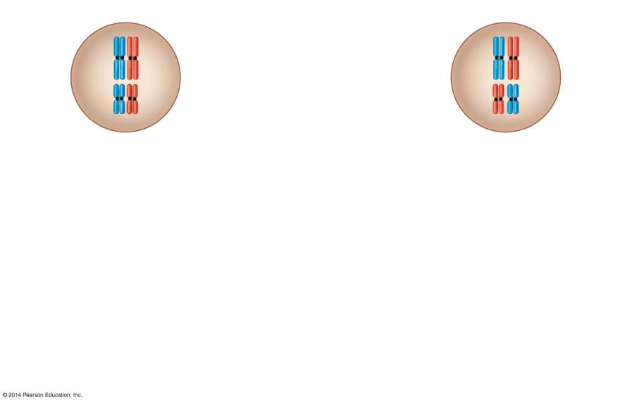
Figure 8.15-1
Possibility A
Possibility B
Two equally probable arrangements of chromosomes at
metaphase I
Notes:
Figure 8.15-1 Results of the independent orientation of chromosomes at metaphase I (step 1)

Slide 44
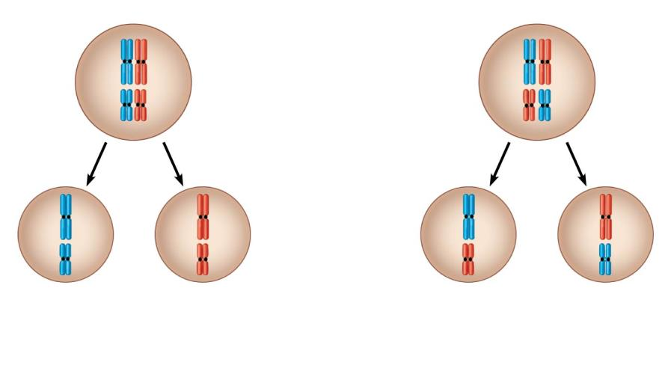
Figure 8.15-2
Possibility A
Possibility B
Two equally probable arrangements of chromosomes at
metaphase I
Metaphase II
Notes:
Figure 8.15-2 Results of the independent orientation of chromosomes at metaphase I (step 2)

Slide 45
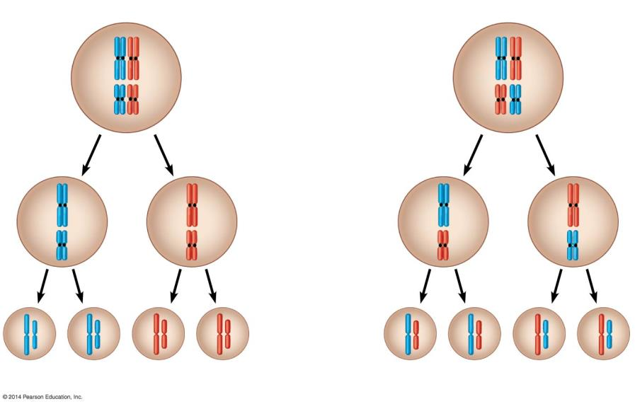
Figure 8.15-3
Possibility A
Possibility B
Two equally probable arrangements of chromosomes at
metaphase I
Metaphase II
Gametes
Combination 1
Combination 2
Combination 3
Combination 4
Notes:
Figure 8.15-3 Results of the independent orientation of chromosomes at metaphase I (step 3)

Slide 46
8.16 Homologous chromosomes may carry different versions of genes
Separation of homologous chromosomes during meiosis can lead to genetic differences between gametes.
Homologous chromosomes may have different versions of a gene at the same locus.
Notes:
Teaching Tips
• You might have some fun with the concept of different versions of genes. Playing with the pun “jeans,” ask students if all jeans are the same. (Some are stone washed, some have buttons instead of zippers, some have more pockets than others, etc.) These versions of clothing jeans are like different versions of genetic genes, representing options and sources of diversity.
Active Lecture Tips
• See the Activity Student Demonstration of Mitosis and Meiosis Using Chromosome Cut-Outs as Models on the Instructor Exchange. Visit the Instructor Exchange in the MasteringBiology instructor resource area for a description of this activity.

Slide 47
8.16 Homologous chromosomes may carry different versions of genes
One version was inherited from the maternal parent and the other came from the paternal parent.
Since homologous chromosomes move to opposite poles during anaphase I, gametes will receive either the maternal or paternal version of the gene.

Slide 48
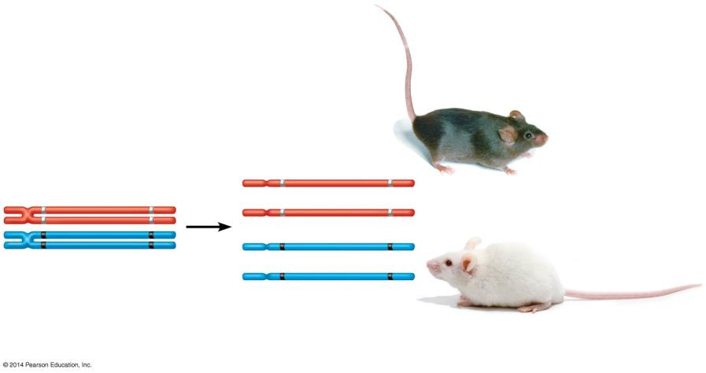
Figure 8.16-0
Coat-color genes
Eye-color genes
Brown C
Black E
C
E
Brown coat (C);
black eyes (E)
C
E
Meiosis
c
e
c
e
c
e
White
Pink
Tetrad in parent cell (homologous pair of duplicated chromosomes)
Chromosomes of
the four gametes
White coat (c);
pink eyes (e)
Notes:
Figure 8.16-0 Differing genetic information (coat color and eye color) on homologous chromosomes

Slide 49
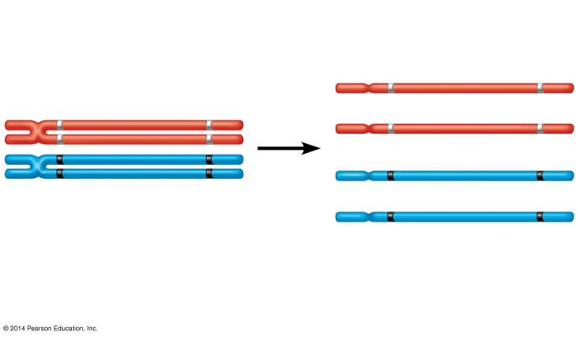
Figure 8.16-1
Coat-color genes
Eye-color genes
Brown C
Black E
C
E
C
E
Meiosis
c
e
c
e
c
e
White
Pink
Tetrad in parent cell (homologous pair of duplicated chromosomes)
Chromosomes of
the four gametes
Notes:
Figure 8.16-1 Differing genetic information (coat color and eye color) on homologous chromosomes (part 1)

Slide 50
8.17 Crossing over further increases genetic variability
Genetic recombination is the production of new combinations of genes due to crossing over.
Notes:
Teaching Tips
• If you wish to continue the shoe analogy, crossing over is somewhat like exchanging the shoelaces in a pair of shoes (although this analogy is quite limited). A point to make is that the shoes (chromosomes) before crossing over are what you inherited . . . either from the sperm or the egg; but, as a result of crossing over, you no longer pass along exactly what you inherited. Instead, you pass along a combination of homologous chromosomes (think of shoes with switched shoelaces). Critiquing this limited analogy may also help students to think through the process of crossing over.
• In the shoe analogy, after exchanging shoelaces, we have “recombinant shoes”!
• Challenge students to consider the number of unique humans that can be formed by the processes of the independent orientation of chromosomes, random fertilization, and crossing over. Without crossing over, we already calculated over 70 trillion possibilities. But as the text notes in Module 8.17, there are typically one to three crossover events for each human chromosome, and these can occur at many different places along the length of the chromosome. The potential number of combinations far exceeds any number that humans can comprehend, representing the truly unique nature of each human being (an important point that delights many students!).
Active Lecture Tips
• See the Activity Student Demonstration of Mitosis and Meiosis Using Chromosome Cut-Outs as Models on the Instructor Exchange. Visit the Instructor Exchange in the MasteringBiology instructor resource area for a description of this activity.

Slide 51
8.17 Crossing over further increases genetic variability
Crossing over is an exchange of corresponding segments between nonsister chromatids of homologous chromosomes.
Nonsister chromatids join at a chiasma (plural, chiasmata), the site of attachment and crossing over.
Corresponding amounts of genetic material are exchanged between maternal and paternal (nonsister) chromatids.

Slide 52
Animation: Crossing Over

Slide 53
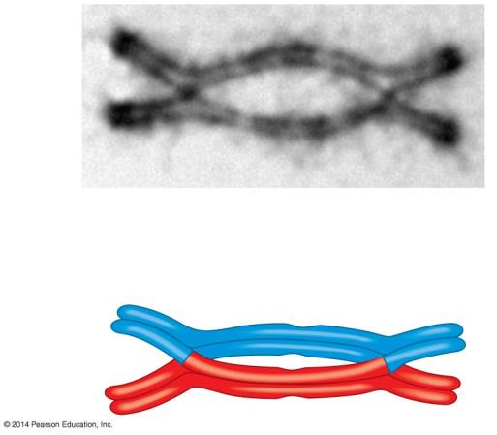
Figure 8.17a-0
Sister chromatids
Chiasma
Tetrad
Notes:
Figure 8.17a-0 Chiasmata, the sites of crossing over

Slide 54
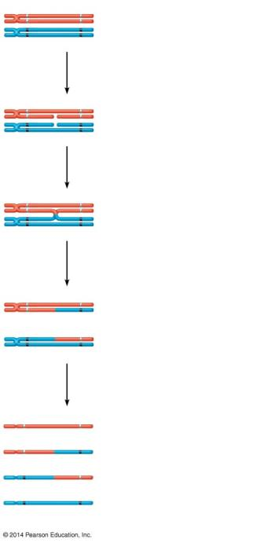
Figure 8.17b-0
C
E
Tetrad
(pair of homologous chromosomes in synapsis)
c
e
1
Breakage of nonsister chromatids
C
E
c
e
2
Joining of nonsister chromatids
C
E
Chiasma
c
e
3
Separation of homologous chromosomes at anaphase I
C
E
C
e
c
E
c
e
4
Separation of chromatids at anaphase II and completion of meiosis
C
E
Parental type of chromosome
C
e
Recombinant chromosome
c
E
Recombinant chromosome
c
e
Parental type of chromosome
Gametes of four genetic types
Notes:
Figure 8.17b-0 How crossing over leads to genetic recombination

Slide 55
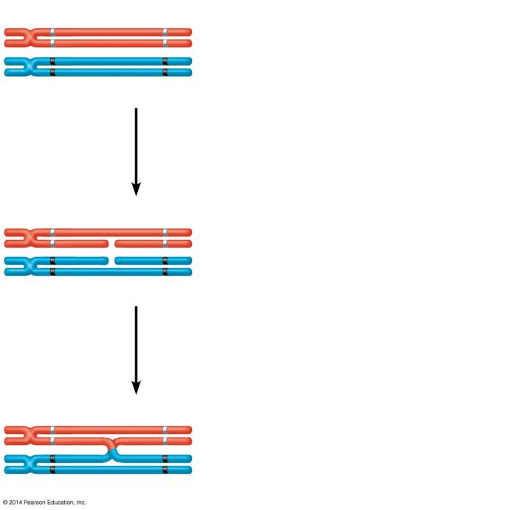
Figure 8.17b-1
C
E
Tetrad
(pair of homologous chromosomes in synapsis)
c
e
1
Breakage of nonsister chromatids
C
E
c
e
2
Joining of nonsister chromatids
C
E
Chiasma
c
e
Notes:
Figure 8.17b-1 How crossing over leads to genetic recombination (part 1)

Slide 56
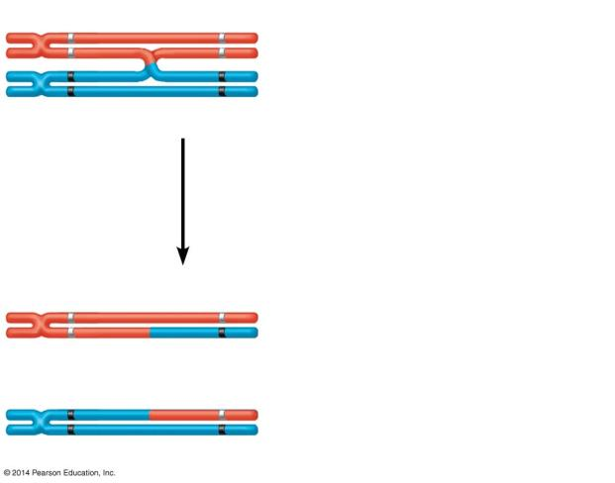
Figure 8.17b-2
C
E
Chiasma
c
e
3
Separation of homologous chromosomes at anaphase I
C
E
C
e
c
E
c
e
Notes:
Figure 8.17b-2 How crossing over leads to genetic recombination (part 2)

Slide 57
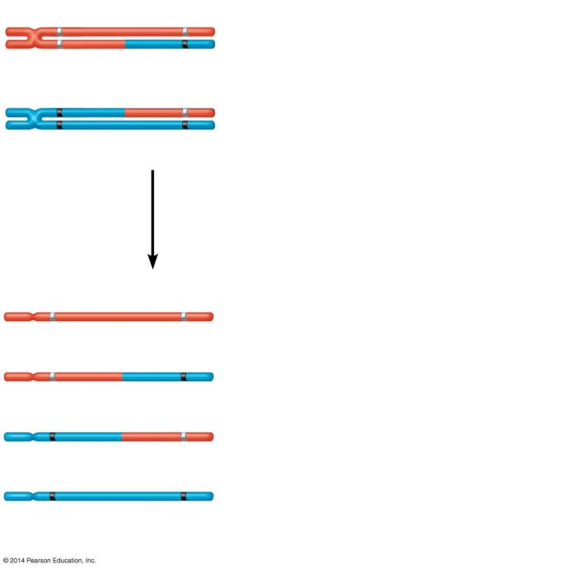
Figure 8.17b-3
C
E
C
e
c
E
c
e
4
Separation of chromatids at anaphase II and completion of meiosis
C
E
Parental type of chromosome
C
e
Recombinant chromosome
c
E
Recombinant chromosome
c
e
Parental type of chromosome
Gametes of four genetic types
Notes:
Figure 8.17b-3 How crossing over leads to genetic recombination (part 3)

Slide 58
Crossing Over

Slide 59
Animation: Genetic Variation

Slide 60
Answer in Notebooks:
#13. Describe 3 ways in which genetic variation can occur.

