Slide 1
Transdermal Drug Administration
method of drug passage across the epidermis and into the blood vessels of the dermis
drug absorption is most rapid in areas where skin is thin (scrotum, face and scalp)
Examples:
nitroglycerin (prevention of chest pain from coronary artery disease)
scopolamine ( motion sickness)
estradiol (estrogen replacement therapy)
nicotine (stop smoking alternative)

Slide 2
MAINTAINING HOMEOSTASIS: SKIN WOUND HEALING

Slide 3
Epidermal Wound Healing
Abrasion or minor burn
Basal cells migrate across the wound (Figure 5.6a)
Contact inhibition with other cells stops migration
Epidermal growth factor stimulates basal cells to divide and replace the ones that have moved into the wound (Figure 5.6b).
Full thickness of epidermis results from further cell division

Slide 4
Deep Wound Healing
When an injury extends to tissues deep to the epidermis, the repair process is more complex than epidermal healing, and scar formation results.
Healing occurs in 4 phases
inflammatory phase has clot unite wound edges and WBCs arrive from dilated and more permeable blood vessels
migratory phase begins the regrowth of epithelial cells and the formation of scar tissue by the fibroblasts
proliferative phase is a completion of tissue formation
maturation phase sees the scab fall off

Slide 5
Scar formation
hypertrophic scar remains within the boundaries of the original wound
keloid scar extends into previously normal tissue
collagen fibers are very dense and fewer blood vessels are present so the tissue is lighter in color

Slide 6
Phases of Deep Wound Healing
During the inflammatory phase, a blood clot unites the wound edges, epithelial cells migrate across the wound, vasodilatation and increased permeability of blood vessels deliver phagocytes, and fibroblasts form (Figure 5.6c).
During the migratory phase, epithelial cells beneath the scab bridge the wound, fibroblasts begin scar tissue, and damaged blood vessels begin to grow. During this phase, tissue filling the wound is called granulation tissue.

Slide 7
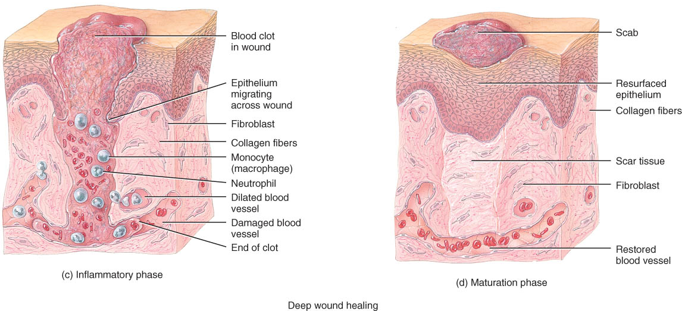
Phases of Deep Wound Healing

Slide 8
Phases of Deep Wound Healing (con’t)
During the proliferative phase, the events of the migratory phase intensify.
During the maturation phase, the scab sloughs off, the epidermis is restored to normal thickness, collagen fibers become more organized, fibroblasts begin to disappear, and blood vessels are restored to normal (Figure 5.6d).
Scar tissue formation (fibrosis) can occur in deep wound healing.

Slide 9
DEVELOPMENT OF THE INTEGUMENTARY SYSTEM
Epidermis develops from ectodermal germ layer
Hair, nails, and skin glands are epidermal derivatives (Figure 5.7).
The connective tissue and blood vessels associated with the gland develop from mesoderm.
Dermis develops from mesenchymal mesodermal germ layer cells

Slide 10
Development of the Skin
Timing
at 8 weeks, fetal “skin” is simple cuboidal
nails begin to form at 10 weeks, but do not reach the fingertip until the 9th month
dermis forms from mesoderm by 11 weeks
by 16 weeks, all layers of the epidermis are present
oil and sweat glands form in 4th and 5th month
by 6th months, delicate fetal hair (lanugo) has formed
Slippery coating of oil and sloughed off skin called vernix caseosa is present at birth

Slide 11
Age Related Structural Changes
Collagen fibers decrease in number & stiffen
Elastic fibers become less elastic
Fibroblasts decrease in number
decrease in number of melanocytes (gray hair, blotching)
decrease in Langerhans cells (decreased immune responsiveness)
reduced number and less-efficient phagocytes

Slide 12
AGING AND THE INTEGUMENTARY SYSTEM
Most of the changes occur in the dermis
wrinkling, slower growth of hair and nails
dryness and cracking due to sebaceous gland atrophy
Walls of blood vessels in dermis thicken so decreased nutrient availability leads to thinner skin as subcutaneous fat is lost.
anti-aging treatments
microdermabrasion, chemical peel, laser resurfacing, dermal fillers, Botuliism toxin injection, and non surgical face lifts.
Sun screens and sun blocks help to minimize photodamage from ultraviolet exposure

Slide 13
Photodamage
Ultraviolet light (UVA and UVB) both damage the skin
Acute overexposure causes sunburn
DNA damage in epidermal cells can lead to skin cancer
UVA produces oxygen free radicals that damage collagen and elastic fibers and lead to wrinkling of the skin

