Slide 2
Adaptations
Biological Adaptation
is any structural (morphological or anatomical), physiological, or behavioral characteristics of an organisms or group of organisms (such as species) that make it better suited in its environment and consequently improves its chances of survival and reproductive success.
“…most of his theory of evolution focused on the role of natural selection in the gradual adaptation of a population to its environment.”

Slide 3
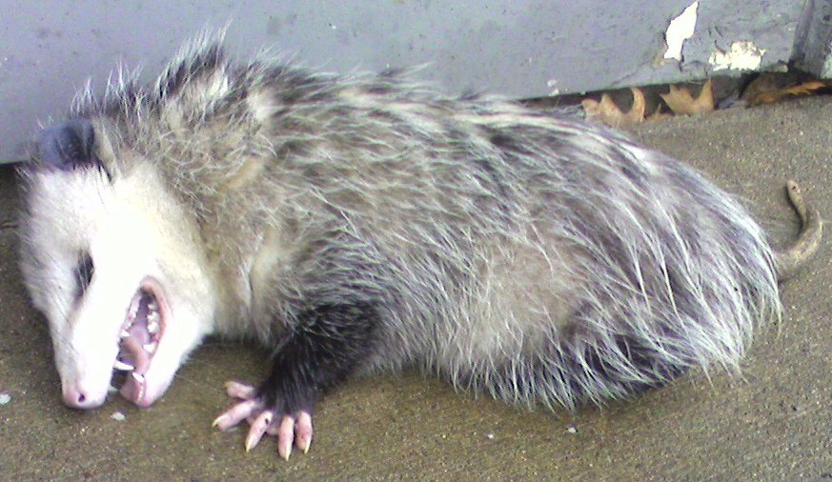
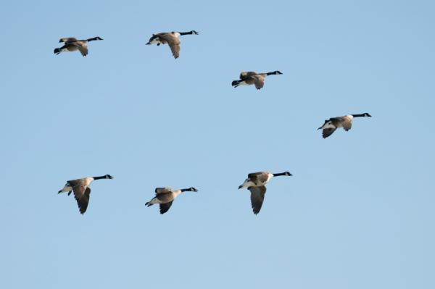
Behavioral Adaptations
Adaptations that affect how an organism acts

Slide 4
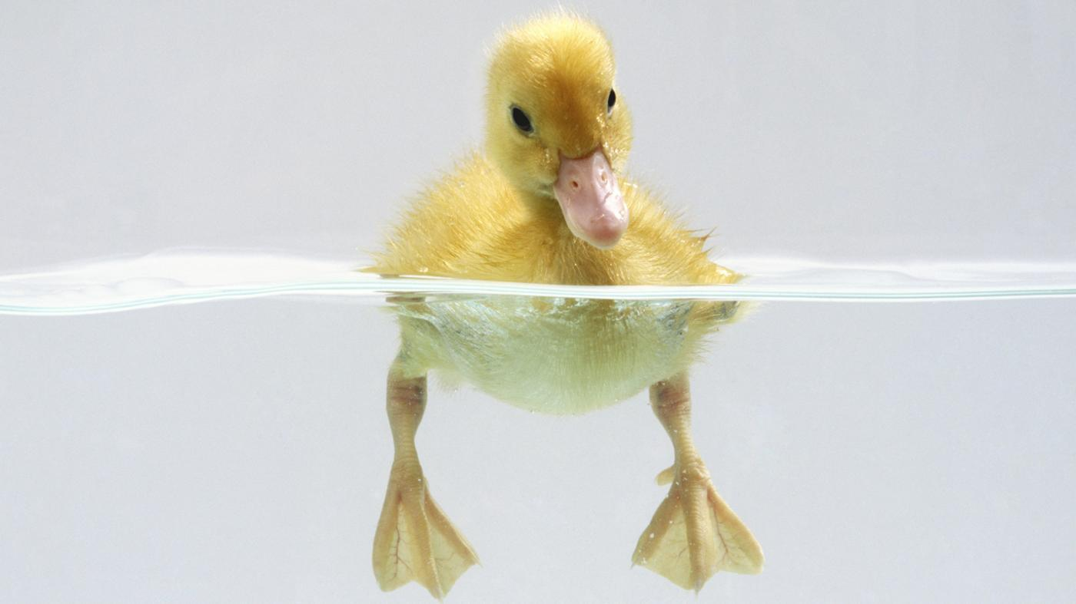
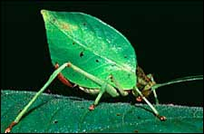
Structural Adaptations
An organism's environment shapes its appearance

Slide 5
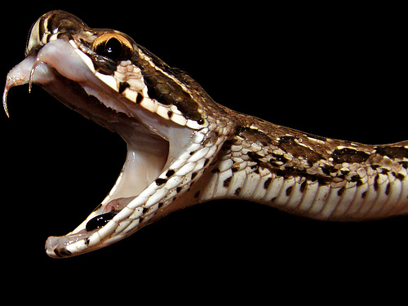
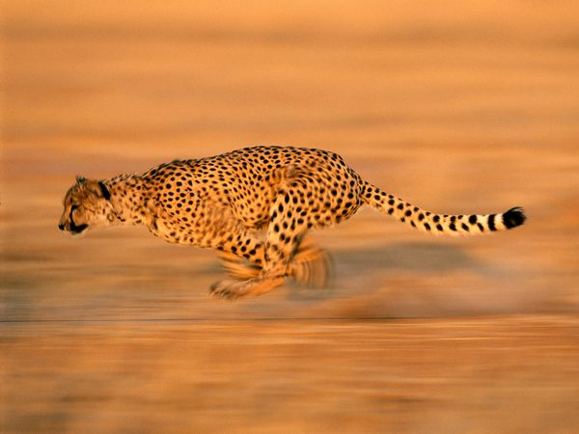
Physiological Adaptations
Based on body chemistry and metabolism, physiological adaptations usually don't show from the outside.

Slide 6
Answer in Notebooks:
#8. Differentiate between the following types of adaptations: Behavioral, Structural, and Physiological.

Slide 7
Defining Species

Slide 8
14.1 The origin of species is the source of biological diversity
Microevolution is the change in the gene pool of a population from one generation to the next.
Speciation is the process by which one species splits into two or more species.
Each time speciation occurs, the diversity of life increases.
Notes:
Student Misconceptions and Concerns
• Students might not realize that evolutionary change includes both (a) linear events, in which a species changes over time, and (b) branching events, which produce new species and diversity. Some students simply expect that whenever new species evolve, they replace their ancestors.
Teaching Tips
• Challenge your students to explain why the field of paleontology has largely been concerned with macroevolution. The broader perspective of evolutionary change studied by paleontologists rarely permits an examination of change within a species.

Slide 9
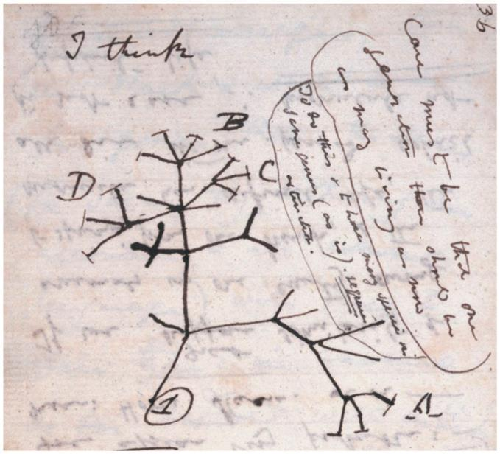
Figure 14.1
Notes:
Figure 14.1 Sketch made by Darwin as he pondered the origin of species

Slide 10
14.1 The origin of species is the source of biological diversity
Over the course of 3.5 billion years,
an ancestral species first gave rise to two or more different species
which then branched to new lineages
which branched again
until we arrive at the millions of species that live, or once lived, on Earth.
Notes:
Student Misconceptions and Concerns
• Students might not realize that evolutionary change includes both (a) linear events, in which a species changes over time, and (b) branching events, which produce new species and diversity. Some students simply expect that whenever new species evolve, they replace their ancestors.
Teaching Tips
• Challenge your students to explain why the field of paleontology has largely been concerned with macroevolution. The broader perspective of evolutionary change studied by paleontologists rarely permits an examination of change within a species.

Slide 11
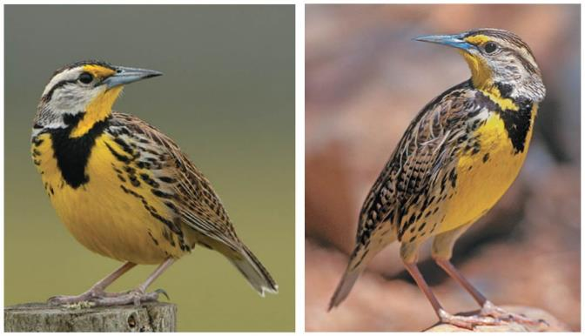
Figure 14.2a-0
Notes:
Figure 14.2a-0 Similarity between two species: the eastern meadowlark (left) and western meadowlark (right)

Slide 12
14.2 There are several ways to define a species
How similar are members of the same species?
Whereas the individuals of many species exhibit fairly limited variation in physical appearance, certain other species—our own, for example—seem extremely varied.
Notes:
Student Misconceptions and Concerns
• Students might have never considered how species are naturally kept separate and unique. Instead, students may consider species as fixed entities, especially the species to which they belong. To help ease students into the topic, consider pointing out that species do not reflect an even spectrum of diversity. Instead, there are many groups of clearly related organisms (owls, grasses, sharks, beetles, butterflies, trees, mushrooms, and bacteria, for example). Ask students to consider why such groupings exist. Could such groupings represent shared ancestry?
Active Lecture Tips
• Before lecturing about species concepts, consider a short writing assignment. Have students work individually or in small groups, without the benefit of books, to define a species.

Slide 13
Figure 14.2b
Notes:
Figure 14.2b Diversity within one species

Slide 14
14.2 There are several ways to define a species
The biological species concept
a group of populations whose members have the potential to interbreed in nature and produce fertile offspring
(offspring that themselves can reproduce).
Thus, members of a biological species are united by being reproductively compatible, at least potentially.
Notes:
Student Misconceptions and Concerns
• Students might have never considered how species are naturally kept separate and unique. Instead, students may consider species as fixed entities, especially the species to which they belong. To help ease students into the topic, consider pointing out that species do not reflect an even spectrum of diversity. Instead, there are many groups of clearly related organisms (owls, grasses, sharks, beetles, butterflies, trees, mushrooms, and bacteria, for example). Ask students to consider why such groupings exist. Could such groupings represent shared ancestry?
Active Lecture Tips
• Before lecturing about species concepts, consider a short writing assignment. Have students work individually or in small groups, without the benefit of books, to define a species.

Slide 15
14.2 There are several ways to define a species
Reproductive isolation
prevents genetic exchange (gene flow)
maintains a boundary between species.
Hybrids: Result of interbreeding between 2 different species
Notes:
Student Misconceptions and Concerns
• Students might have never considered how species are naturally kept separate and unique. Instead, students may consider species as fixed entities, especially the species to which they belong. To help ease students into the topic, consider pointing out that species do not reflect an even spectrum of diversity. Instead, there are many groups of clearly related organisms (owls, grasses, sharks, beetles, butterflies, trees, mushrooms, and bacteria, for example). Ask students to consider why such groupings exist. Could such groupings represent shared ancestry?
Active Lecture Tips
• Before lecturing about species concepts, consider a short writing assignment. Have students work individually or in small groups, without the benefit of books, to define a species.

Slide 16
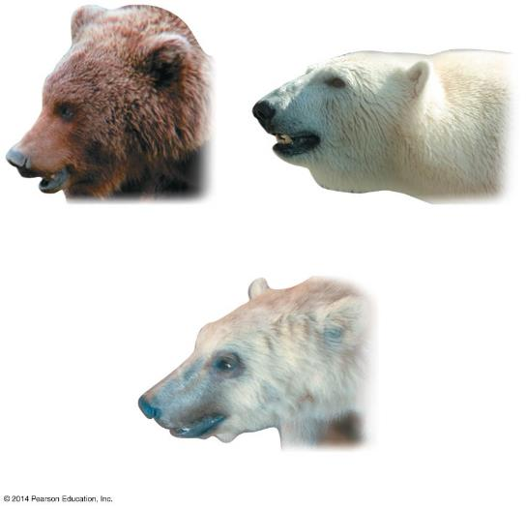
Figure 14.2c-0
Grizzly bear
Polar bear
Hybrid “grolar” bear
Notes:
Figure 14.2c-0 Hybridization between two species of bears

Slide 17
Mechanisms of Speciation

Slide 18
14.4 In allopatric speciation, geographic isolation leads to speciation
A key event in the origin of a new species is the separation of a population from other populations of the same species.
Changes in allele frequencies caused by natural selection, genetic drift, and mutation will not be diluted by alleles entering from other populations (gene flow)
Notes:
Student Misconceptions and Concerns
• Students must understand that species do not evolve because of need. Biological diversity exists and the environment selects. Evolution is not deliberate; it is reactive. Species do not deliberately change. There is no plan. As teachers, we must take care that our descriptions of evolution accurately reflect its process. The use of the passive voice in descriptions of evolution is one way of doing this.
• Most of us are unable to comprehend the vast lengths of time considered by geologists. Exercises and examples can increase this comprehension. Consider the number of seconds in a year (60 × 60 × 24 × 365.25 = 31,557,600) or how much money you could spend each day if you spent $1 million a year ($1,000,000/365 = $2,739.73/day).
• Students also need to be reminded that 1 billion is 1,000 million. Many students (and some politicians) easily confuse million and billion without realizing the scale of the error.
Teaching Tips
• The isolation of a few individuals from a parent population may result from a catastrophic weather or geological event. Ask your students to think back to news footage of torrential rains, massive debris rocketing down a river, and the struggles of animals to haul themselves onto these rafts. Better yet, show them a short news clip of such events. Dramatic weather and geological events may be rare in our lifetimes but are frequent enough to play a role in speciation.
Active Lecture Tips
• See the Activity Video Review: YouTube – Bang Goes the Theory: Evolution Made Simple at the Instructor Exchange in the MasteringBiology instructor resource area or at the following address. http://www.youtube.com/watch?v=YYLKt5J-KKY&noredirect=1

Slide 19
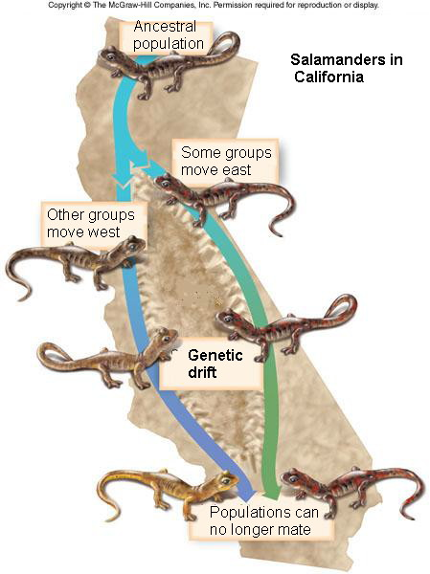
14.4 In allopatric speciation, geographic isolation leads to speciation
In allopatric speciation, the initial block to gene flow may come from a geographic barrier that isolates a population
Notes:
Student Misconceptions and Concerns
• Students must understand that species do not evolve because of need. Biological diversity exists and the environment selects. Evolution is not deliberate; it is reactive. Species do not deliberately change. There is no plan. As teachers, we must take care that our descriptions of evolution accurately reflect its process. The use of the passive voice in descriptions of evolution is one way of doing this.
• Most of us are unable to comprehend the vast lengths of time considered by geologists. Exercises and examples can increase this comprehension. Consider the number of seconds in a year (60 × 60 × 24 × 365.25 = 31,557,600) or how much money you could spend each day if you spent $1 million a year ($1,000,000/365 = $2,739.73/day).
• Students also need to be reminded that 1 billion is 1,000 million. Many students (and some politicians) easily confuse million and billion without realizing the scale of the error.
Teaching Tips
• The isolation of a few individuals from a parent population may result from a catastrophic weather or geological event. Ask your students to think back to news footage of torrential rains, massive debris rocketing down a river, and the struggles of animals to haul themselves onto these rafts. Better yet, show them a short news clip of such events. Dramatic weather and geological events may be rare in our lifetimes but are frequent enough to play a role in speciation.
Active Lecture Tips
• See the Activity Video Review: YouTube – Bang Goes the Theory: Evolution Made Simple at the Instructor Exchange in the MasteringBiology instructor resource area or at the following address. http://www.youtube.com/watch?v=YYLKt5J-KKY&noredirect=1

Slide 20
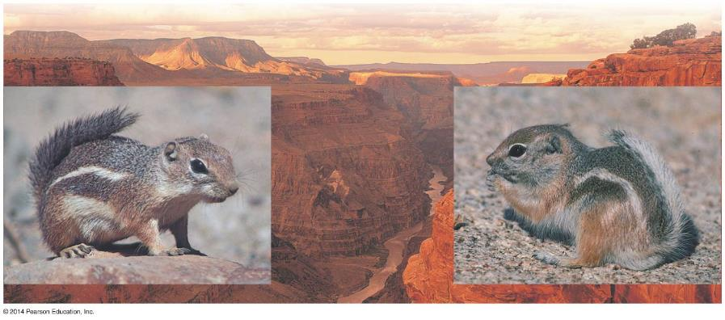
Figure 14.4a-0
South rim
North rim
A. harrisii
A. leucurus
Notes:
Figure 14.4a-0 Allopatric speciation of geographically isolated antelope squirrels

Slide 21
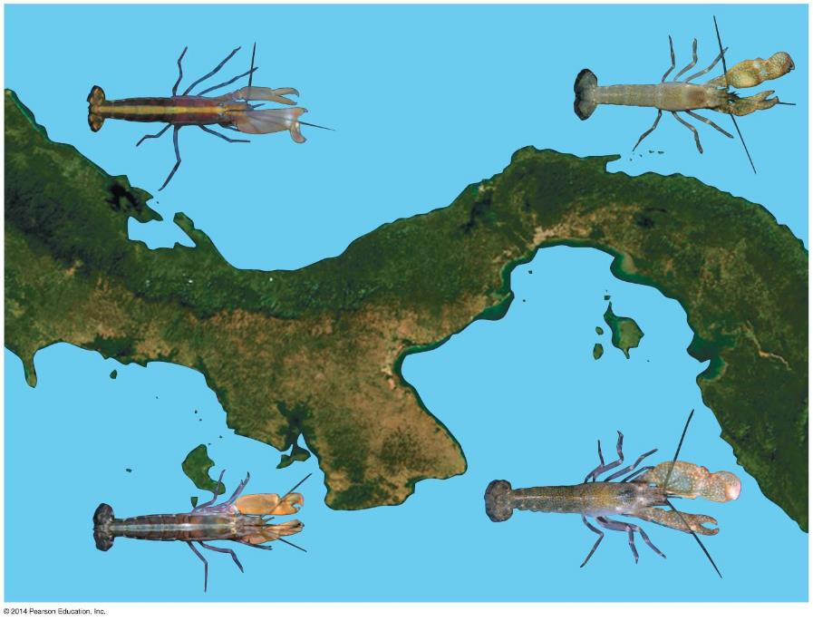
Figure 14.4b
A. formosus
A. nuttingi
ATLANTIC OCEAN
Isthmus of Panama
PACIFIC OCEAN
A. panamensis
A. millsae
Notes:
Figure 14.4b Allopatric speciation in snapping shrimp

Slide 22
14.6 Sympatric speciation takes place without geographic isolation
Sympatric speciation occurs when a new species arises within the same geographic area as its parent species.
Gene flow between populations may be reduced by
Polyploidy
An organism that has more than 2 complete sets of chromosomes as a result of an accident of cell division.
habitat differentiation
sexual selection
Form of natural selection in which individuals with certain inherited traits are more likely to obtain mates.
Notes:
Student Misconceptions and Concerns
• Students must understand that species do not evolve because of need. Biological diversity exists and the environment selects. Evolution is not deliberate; it is reactive. Species do not deliberately change. There is no plan. As teachers, we must take care that our descriptions of evolution accurately reflect its process. The use of the passive voice in descriptions of evolution is one way of doing this.
• Most of us are unable to comprehend the vast lengths of time considered by geologists. Exercises and examples can increase this comprehension. Consider the number of seconds in a year (60 × 60 × 24 × 365.25 = 31,557,600) or how much money you could spend each day if you spent $1 million a year ($1,000,000/365 = $2,739.73/day).
• Students also need to be reminded that 1 billion is 1,000 million. Many students (and some politicians) easily confuse million and billion without realizing the scale of the error.
Teaching Tips
• The Silvery Salamander, Ambystoma platineum, is a triploid, all-female species living in parts of the U.S. Midwest. It is believed to have formed by the hybridization of two related species thousands of years ago. It is an unusual example of sympatric speciation in animals. A good starting point for learning more about this species is http://www.inhs.illinois.edu/animals_plants/herps/species/am_platine.html.
Active Lecture Tips
• See the Activity Video Review: YouTube – Bang Goes the Theory: Evolution Made Simple at the Instructor Exchange in the MasteringBiology instructor resource area or at the following address. http://www.youtube.com/watch?v=YYLKt5J-KKY&noredirect=1

Slide 23
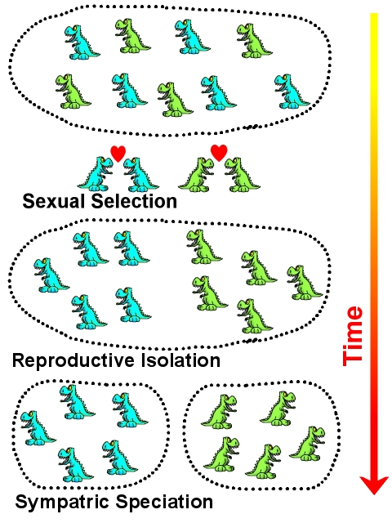

Slide 24
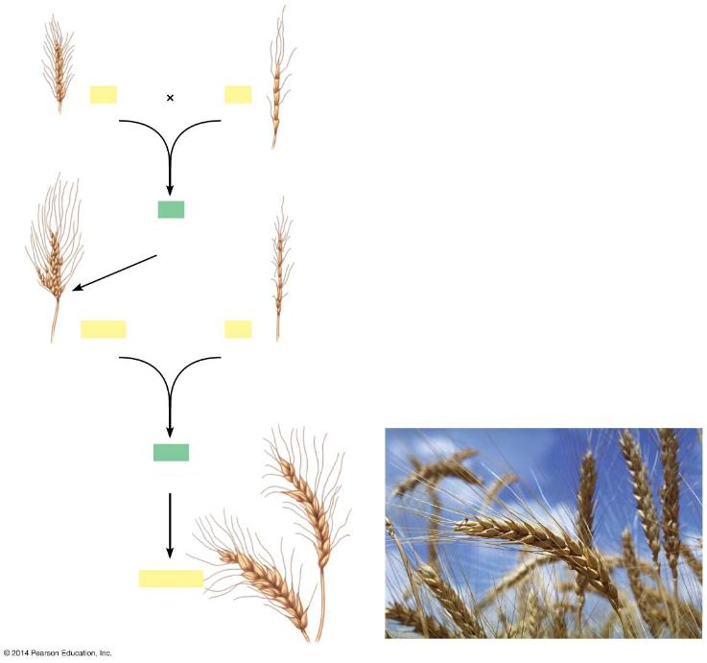
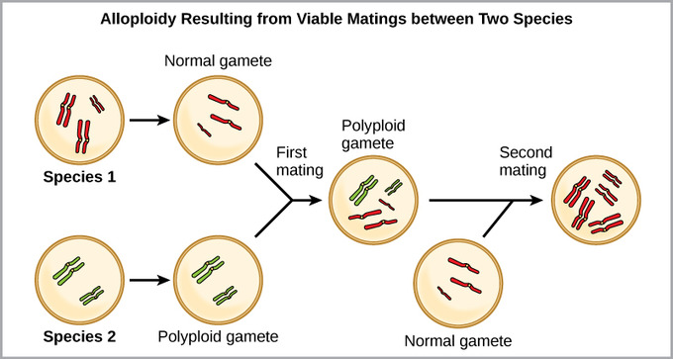
Figure 14.7-0
AA
BB
Domesticated Triticum monococcum (14 chromosomes)
Wild Triticum (14 chromosomes)
1
Hybridization
AB
Sterile hybrid (14 chromosomes)
2
Cell division error and self-fertilization
AABB
DD
T. turgidum Emmer wheat (28 chromosomes)
Wild T. tauschii (14 chromosomes)
3
Hybridization
ABD
Sterile hybrid (21 chromosomes)
4
Cell division error and self-fertilization
AABBDD
T. aestivum Bread wheat (42 chromosomes)
Notes:
Figure 14.7-0 The evolution of bread wheat, Triticum aestivum

Slide 25
In Notebooks:
#9. Differentiate between Allopatric and Sympatric Speciation and give an example of each.

Slide 26
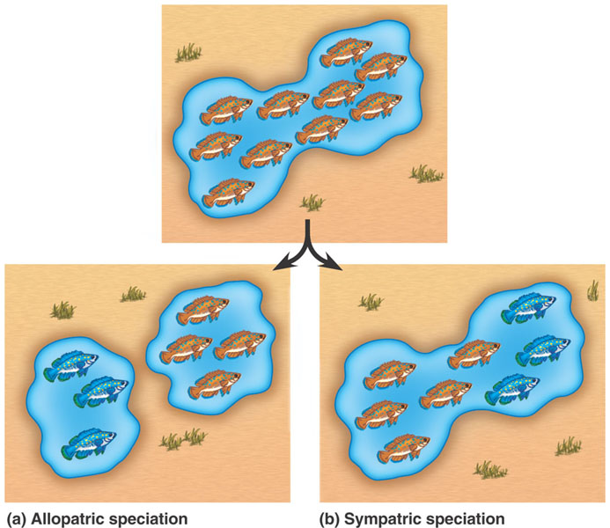

Slide 27
14.8 Isolated islands are often showcases of speciation
Isolated island chains are often inhabited by unique collections of species.
Islands that have physically diverse habitats and that are far enough apart to permit populations to evolve in isolation but close enough to allow occasional dispersions to occur are often the sites of multiple speciation events.
Adaptive Radiation: The evolution of many diverse species from a common ancestor is known as.
Notes:
Student Misconceptions and Concerns
• Students must understand that species do not evolve because of need. Biological diversity exists and the environment selects. Evolution is not deliberate; it is reactive. Species do not deliberately change. There is no plan. As teachers, we must take care that our descriptions of evolution accurately reflect its process. The use of the passive voice in descriptions of evolution is one way of doing this.
• Most of us are unable to comprehend the vast lengths of time considered by geologists. Exercises and examples can increase this comprehension. Consider the number of seconds in a year (60 × 60 × 24 × 365.25 = 31,557,600) or how much money you could spend each day if you spent $1 million a year ($1,000,000/365 = $2,739.73/day).
• Students also need to be reminded that 1 billion is 1,000 million. Many students (and some politicians) easily confuse million and billion without realizing the scale of the error.
Teaching Tips
• An analogy might be made between the specialized functions of finch beaks and the many types of screwdrivers (or pliers) that exist today. Each type of screwdriver (Phillips, flathead, hex, etc.) represents a specialization for a particular job or a generalist approach, useful in a variety of applications.
• Numerous examples of adaptive radiations exist in the Hawaiian Islands. Hawaiian honeycreepers (birds), fruit flies, and species of the plant genera Cyrtandra and Geranium are excellent examples for additional illustration.
Active Lecture Tips
• See the Activity Video Review: YouTube – Bang Goes the Theory: Evolution Made Simple at the Instructor Exchange in the MasteringBiology instructor resource area or at the following address. http://www.youtube.com/watch?v=YYLKt5J-KKY&noredirect=1

Slide 28
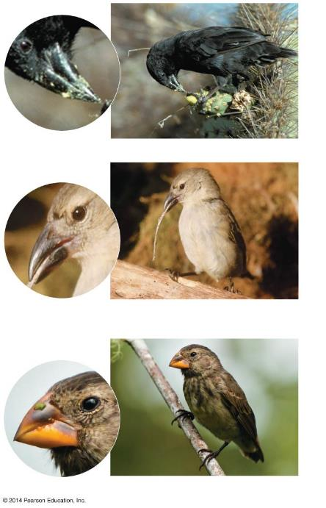
Figure 14.8-0
Cactus-seed-eater (cactus finch)
Tool-using insect-eater (woodpecker finch)
Seed-eater (large ground finch)
Notes:
Figure 14.8-0 Examples of differences in beak shape and size in Galápagos finches, each adapted for a specific diet

Slide 29
14.11 Speciation can occur rapidly or slowly
There are two models for the tempo of speciation.
The punctuated equilibria model draws on the fossil record, where species change most as they arise from an ancestral species and then change relatively little for the rest of their existence.
Other species appear to have evolved more gradually.
The time interval between speciation events varies from a few thousand years to tens of millions of years.
Notes:
Student Misconceptions and Concerns
• Students must understand that species do not evolve because of need. Biological diversity exists and the environment selects. Evolution is not deliberate; it is reactive. Species do not deliberately change. There is no plan. As teachers, we must take care that our descriptions of evolution accurately reflect its process. The use of the passive voice in descriptions of evolution is one way of doing this.
• Most of us are unable to comprehend the vast lengths of time considered by geologists. Exercises and examples can increase this comprehension. Consider the number of seconds in a year (60 × 60 × 24 × 365.25 = 31,557,600) or how much money you could spend each day if you spent $1 million a year ($1,000,000/365 = $2,739.73/day).
• Students also need to be reminded that 1 billion is 1,000 million. Many students (and some politicians) easily confuse million and billion without realizing the scale of the error.
• The concept of rarity is likely to be misunderstood when applied to geologic time. Events such as major floods, earthquakes, or asteroid impacts, which might be so rare as to occur every 1,000 years, are actually common in geological terms. Students might not realize that 1,000 such events would be expected to occur over a million years.
Active Lecture Tips
• Have your students work in pairs to think of analogous examples of punctuated equilibrium in our culture. One such example is the switch from vinyl records to compact discs, with the brief transitional form of cassette tapes (which students currently entering college may barely remember). Between the years 1900 and 2000, there were both long periods of stasis (vinyl records) and a relatively short period of transition to CDs and now to digital music files (who knows how long they will last?). Similarly, black and white TV to color or to high-definition and soon 3-D represent similar punctuated changes. Debating the validity of analogies can itself be instructive as students articulate the biological principles and compare them to the analogies.
• See the Activity Video Review: YouTube – Bang Goes the Theory: Evolution Made Simple at the Instructor Exchange in the MasteringBiology instructor resource area or at the following address. http://www.youtube.com/watch?v=YYLKt5J-KKY&noredirect=1

Slide 30
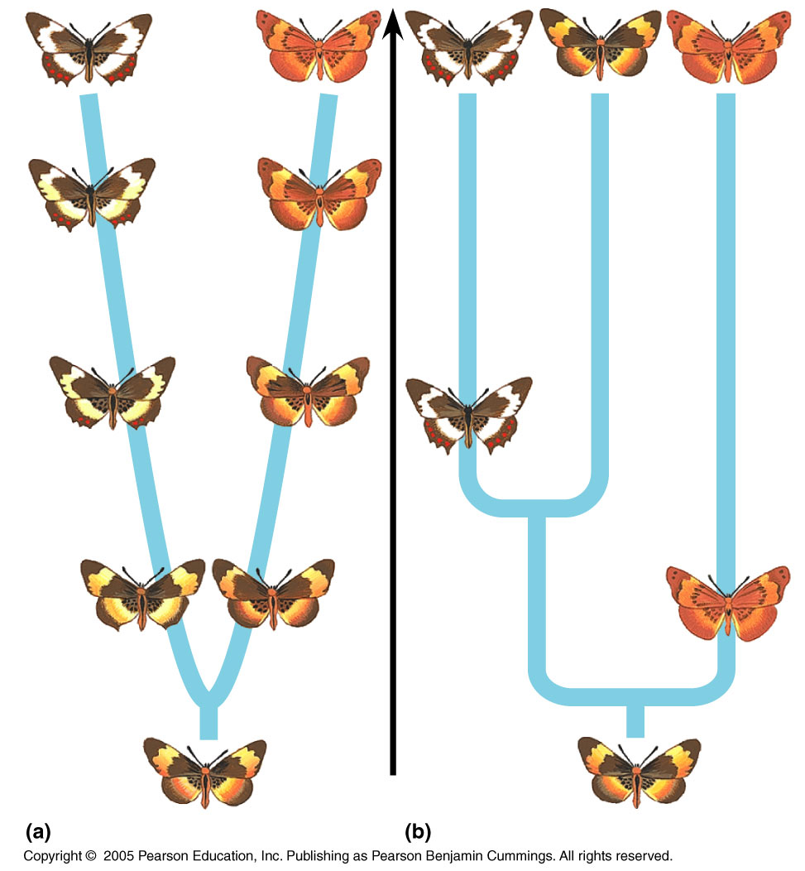

Slide 31
In Notebooks:
#10. Differentiate between Punctuate Equilibrium and Gradualism. Give an example of each.

Slide 32
Animation: Macroevolution

