Slide 1
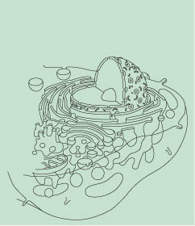
Chapter 3
The Cellular Level of Organization

Slide 2
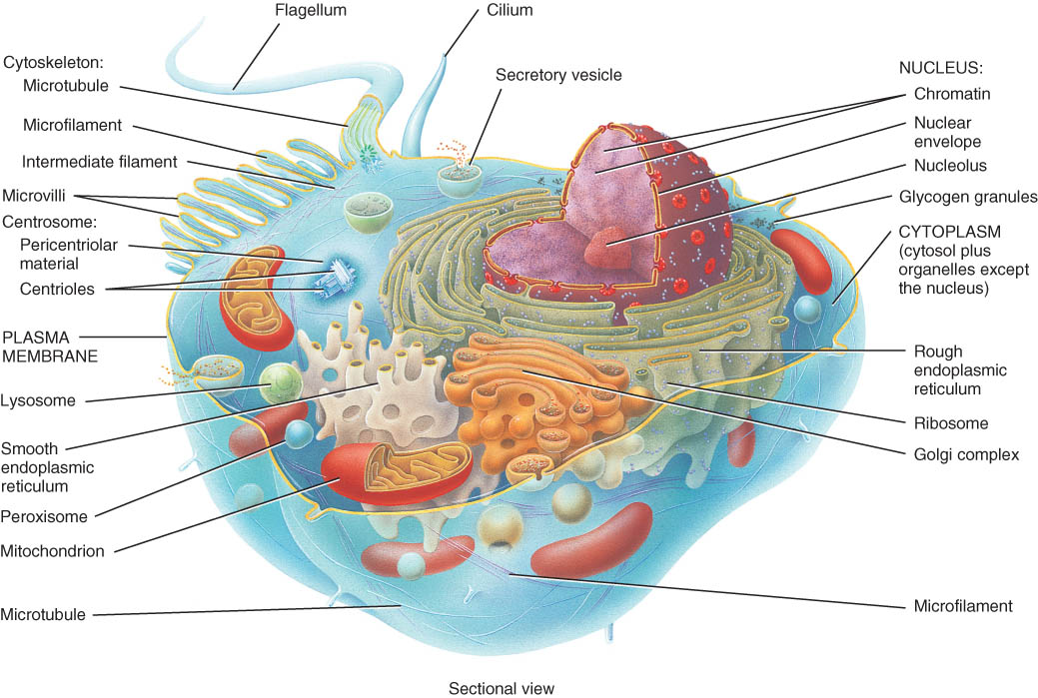
INTRODUCTION
A cell is the basic, living, structural, and functional unit of the body.
Cytology is the study of cell structure, and cell physiology is the study of cell function.

Slide 3
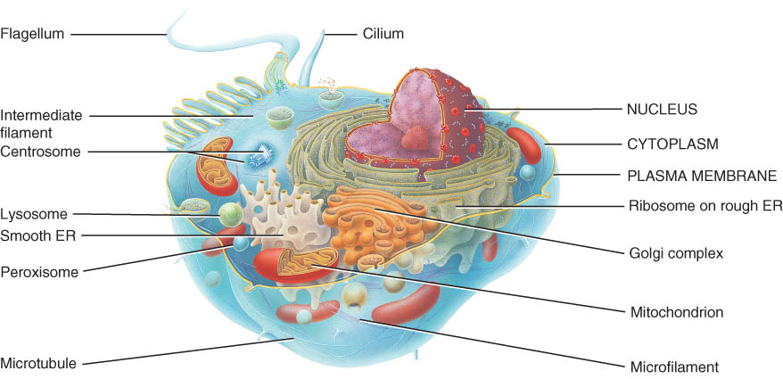
PARTS of a CELL
A generalized view of the cell is a composite of many different cells in the body.
No single cell includes all of the features seen in the generalized cell.

Slide 4
PARTS of a CELL
The cell can be divided into three principal parts for ease of study.
Plasma (cell) membrane
Cytoplasm
Cytosol (fluid portion)
Organelles (except for the nucleus)
Nucleus

Slide 5
Plasma Membrane
Flexible but sturdy barrier that surrounds cytoplasm of cell
Fluid mosaic model describes its structure
membrane is 50 % lipid & 50 % protein
lipid is barrier to entry or exit of substances
proteins are “gatekeepers” -- regulate traffic
50 lipid molecules for each protein molecule

Slide 6
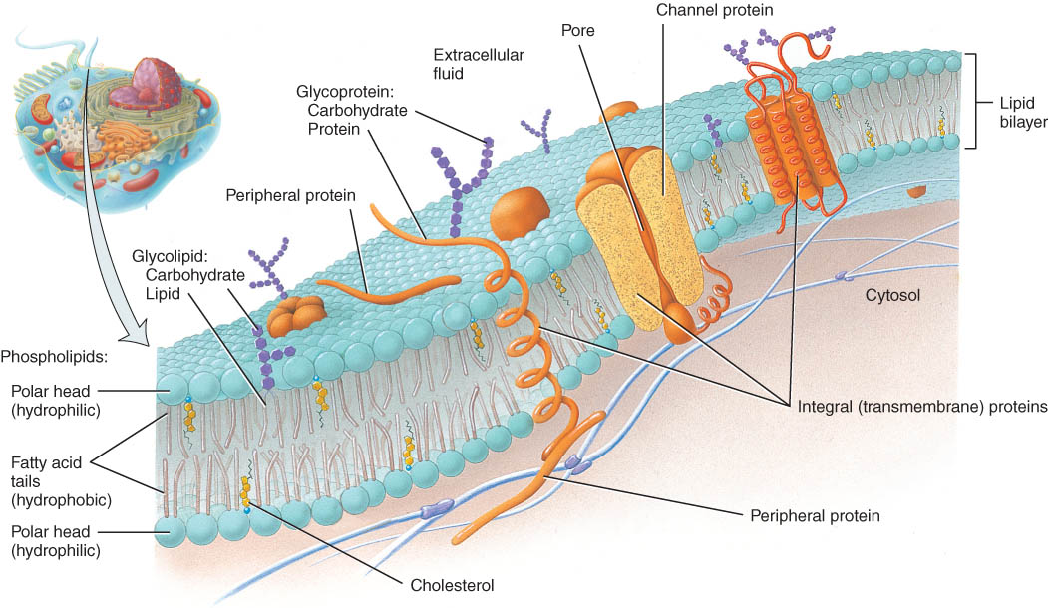
The Lipid Bilayer
The lipid bilayer is the basic framework of the plasma membrane and is made up of three types of lipid molecules: phospholipids, cholesterol, and glycolipids.

Slide 7
Membrane Permeability
Plasma membranes are selectively permeable.
Some things can pass through and others cannot.
The membrane is also permeable to water.

Slide 8
Gradients Across the Plasma Membrane
A concentration gradient is the difference in the concentration of a chemical between one side of the plasma membrane and the other.

Slide 9
TRANSPORT ACROSS THE PLASMA MEMBRANE
Processes to move substances across the cell membrane are essential to the life of the cell.
Some substances cross the lipid bilayer while others cross through ion channels.
Transport processes that move substances across the cell membrane are either active or passive.

Slide 10
TRANSPORT ACROSS THE PLASMA MEMBRANE
Passive processes do not require energy expenditure
Active transport requires cellular energy.
Materials can also enter or leave the cell through vesicle transport.

Slide 11
Passive Transport
moves substances down their concentration gradient with only their kinetic energy, moves from an area of higher concentration to lower concentration, cell does not expend energy.

Slide 12
Principles of Diffusion – a passive process
Diffusion is the random mixing of particles that occurs in a solution as a result of the kinetic energy of the particles.
Diffusion rate across plasma membranes is influenced by several factors:
Steepness of the concentration gradient
Temperature
Size or mass of the diffusing substance
Surface area
Diffusion distance

Slide 13
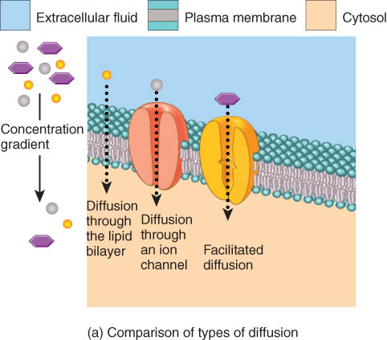
Diffusion Through the Lipid Bilayer
It is important for gas exchange, absorption of some nutrients, and excretion of some wastes.

Slide 14
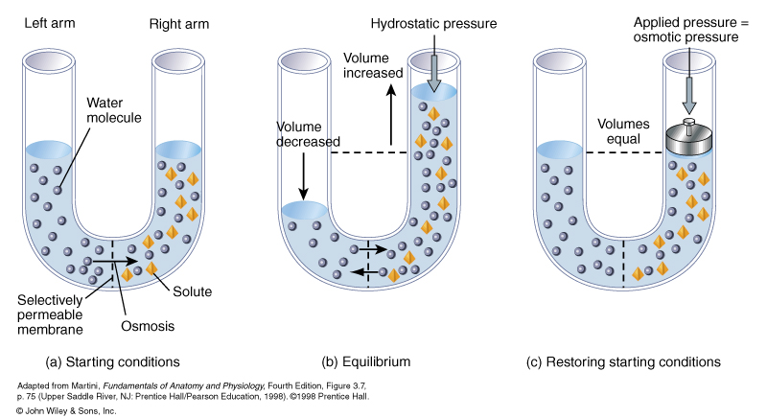
Osmosis – passive process
Osmosis is the net movement of a solvent through a selectively permeable membrane.
Osmosis occurs only when the membrane is permeable to water but not to certain solutes.

