Slide 1
Inventors and Inventions- How to remember who made what!
Created by Mrs. Pagotto

Slide 2
Peter Cooper= Choo Choo (Made first American steam locomotive)
Peter Cooper= Choo Choo (Made first American steam locomotive)

Slide 3
Andrew Meikle= made the thresher to separate the kernels from the husks

Slide 4
Samuel F.B. Morse = improved long distance communication FaceBook= communication

Slide 5
Samuel Slater= Father of the American Revolution; Created the first spinning mill.

Slide 6
Cyrus McCormick= invented the mechanical reaper to cut the wheat -Imagine Miley Cyrus in a music video with the Grimm Reaper

Slide 7
Eli Whitney= First to use interchangeable parts

Slide 8
John Deere= developed the first light weight steel plow John Deere tractors

Slide 9
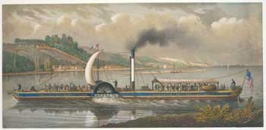
Robert Fulton= created steamboat Move Full steam ahead!

Slide 10
Henry Miller Shreve= developed steamship that could travel up the Mississippi H Mississippi Shreve

Slide 11
Francis Cabot Lowell: put three stages of textile production under one roof
1. Francis
2. Cabot
3. Lowell

