Slide 1
PLANTS

Slide 2
Plant origins
Plants probably originated from green algae living in oceans
1. Both have cell wall w/ cellulose
2. Both contain the same kinds of chlorophyll and carotenoids
3. Both have starch as product of photosynthesis.

Slide 3
Adapting to life on land
1. Need protection from drying out
a. water needs to move via osmosis b/w cells
b. most land plants developed a waxy cuticle which prevents water loss at outer cells.
2. Need to exchange gases w/ air
plants need to take in CO₂ and release O₂ during photosynthesis
b. Though the cuticle covers the surface of the plant, it contains pores (stomata) through which these gases can pass (CO₂ must be dissolved in water – a thin film surrounding the internal cells).

Slide 4
3. Need a transport system to provide all the cells in a multicellular body w/nutrients.
a. Vascular tissues → transport materials from one part of the plant to another.
4. Need support to grow upright

Slide 5
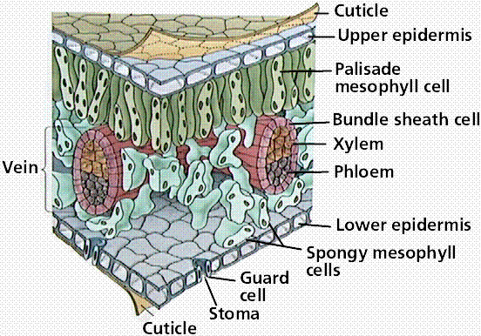

Slide 6
II. Plant life cycle
A. Plants have an alternation of generations.
1. Gametophyte generation
a. development of gametes (gametangia)
b. haploid (1n)
2. Sporophyte generation
a. production of spores with protective structures (sporangia)
b. diploid (2n)
https://www.youtube.com/watch?v=iWaX97p6y9U

Slide 7
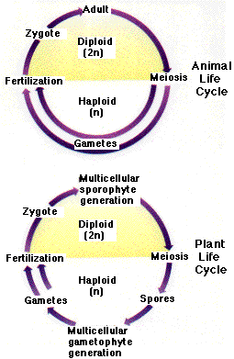
plants

Slide 8
Nonvascular Plants
- not very common
- need a moist environment to reproduce, photosynthesize, etc.
- gametophyte gen. is the main stage of life
- limited size

Slide 9
A. Bryophytes → mosses, liverworts & hornworts
1. no true leaves or roots
2. no cuticle
3. Gametophyte generation is dominant and most visible. Anchored to substrate by rhizoids. Flagellated sperm require water to travel to archegonia (where eggs are).
Notes:
Bryophytes = nonvascular plants; Bryophyta = specific phylum name of mosses. They are not synonyms.

Slide 10
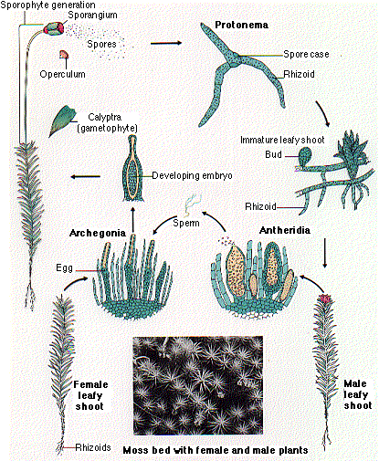

Slide 11
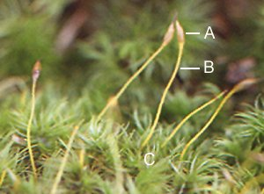
C – sex organs A & B – stalk and capsule

Slide 12
II. Vascular Plant
• first appeared ~420 mya
• they have vascular tissue
- xylem = conducts H2O and minerals from roots to shoots
- phloem = transports food (sugars) from leaves to rest of plants
• sporophyte gen. is larger and more conspicuous than gametophyte gen.
A. Seedless vascular plants
1. club mosses
-- sporangia –produce spores

Slide 13
2. phylum Pterophyta (ferns)
a. diverse group
b. underground stem called a rhizome
c. fiddleheads → tightly coiled new leaves which unfurl into fronds – mature leaves

Slide 14
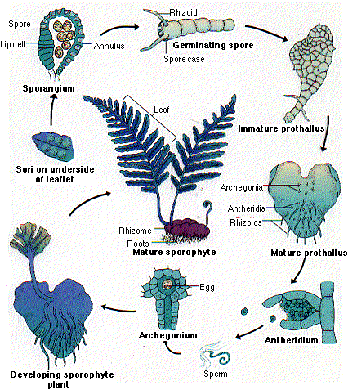

Slide 15
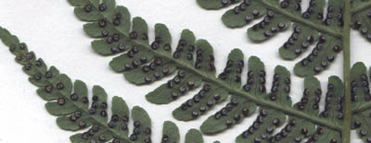
Spores -- sori

Slide 16
B. Seed bearing plants
• A seed is an embryo w/ a food supply enclosed in a tough protective coat.
• Most diverse of all plant groups.
• gymnosperms (naked seeds) or angiosperms (seeds in a vessel)

Slide 17
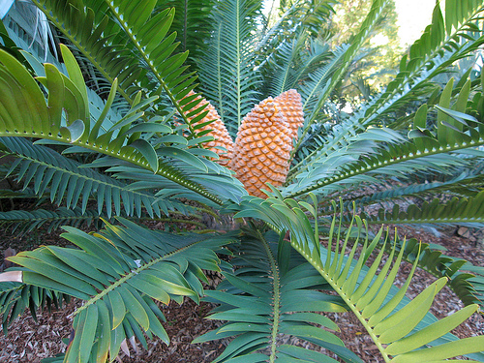
1. gymnosperms
a. Cycadophyta – more prevalent in dino ages (Mesozoic Era); only ~100 extant species today
-- tropical and suffering from habitat loss

Slide 18
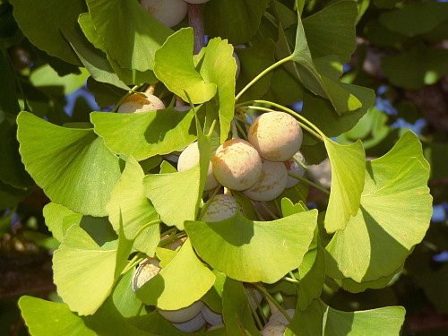
b. Ginkgophyta – only 1 species exists today →ginkgo biloba
-- gymnosperms that lose their leaves in the fall
-- male and female trees; smelly seed (pods)
Notes:
There is another gymnosperm phylum → Gnetophyta with 3 genera, ephedra is one of the plants in this (decongestants)

Slide 19
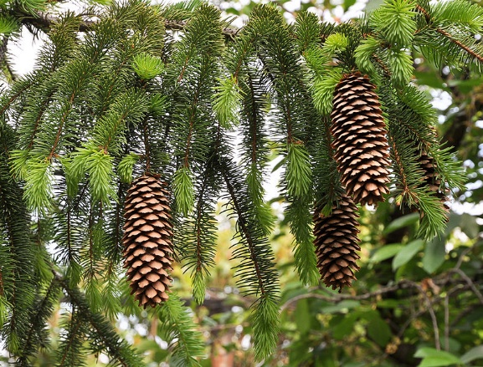
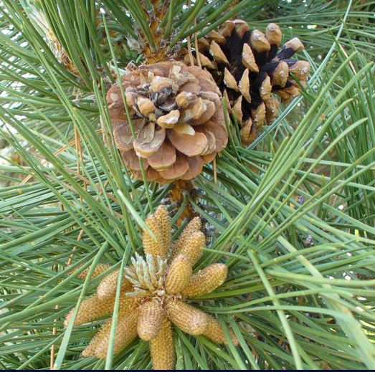
c. Coniferophyta – most common; seeds develop in woody scales of cones
i. sperm is contained in pollen – from male cone
ii. The egg is contained in the female cone

Slide 20
iii. Wind blows the pollen from the male to the female cone, once fertilized the embryo remains attached to the female cone until it is ready to be released in the wind.

Slide 21
2. Angiosperms – flowering plants
- contain ovaries which surround and protect seeds
- very diverse group
https://www.youtube.com/watch?v=h9oDTMXM7M8
https://www.youtube.com/watch?v=HLYPm2idSTE

Slide 22
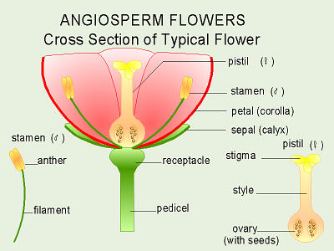

Slide 23
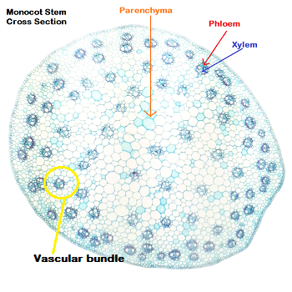
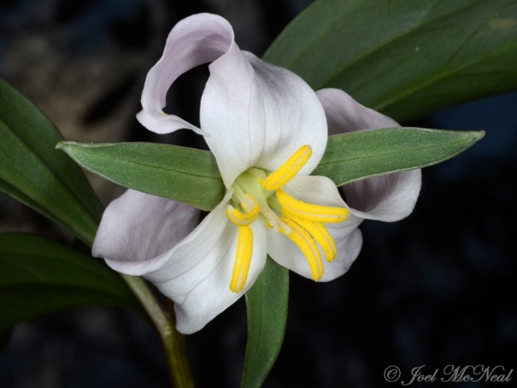
a. Monocots (Class Monocotyledonae)
i. embryos w/ a single cotyledon (seed leaf)
ii. parallel vein structure
iii. flower parts in multiples of 3
iv. scattered vascular bundles

Slide 24
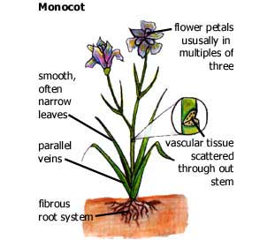
Look at fibrous root system

Slide 25
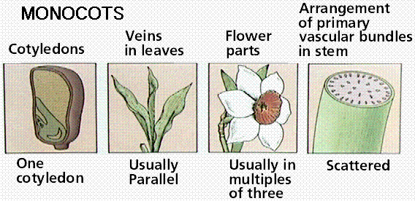

Slide 26
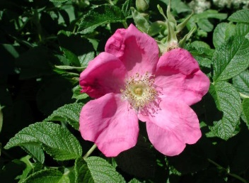
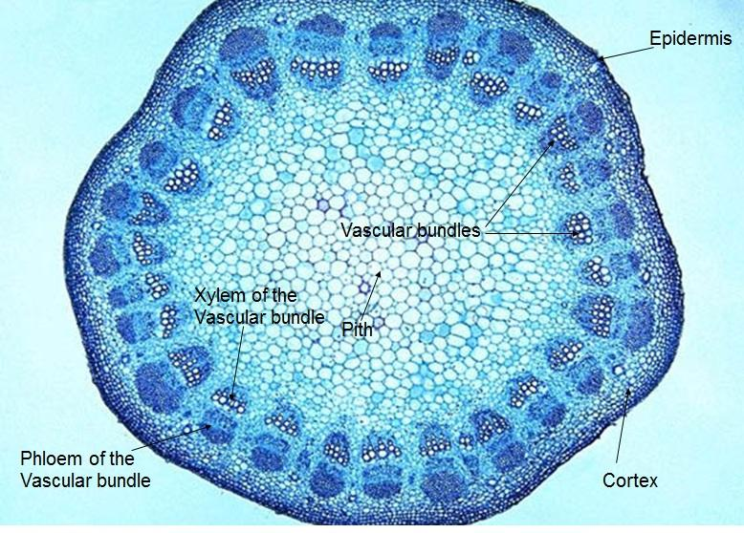
b. Dicots
i. embryos w/2 cotyledons (seed leaves)
ii. net vein structure on leaves
iii. flower parts in multiples of 4 or 5
iv. vascular bundles in a ring

Slide 27
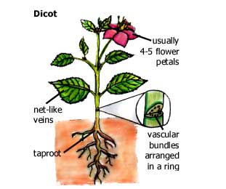
Look at tap root

Slide 28
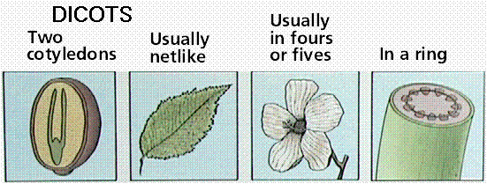

Slide 29
Water transport w/in plants
- transpiration = loss of water vapor from leaves and stem of plants
- Tension-Cohesion theory:
Water leaves the plant leaf through the stomata, the cohesive properties of water enable it to stick together and the adhesive properties allow water to move up the xylem walls pulling water through the roots (like water through a straw).

Slide 30
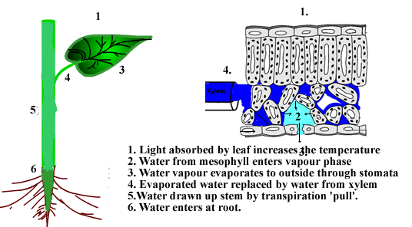

Slide 31
III. Growth in plants
A. Meristems generate cells for new organs – plants grow indeterminately
1. meristem – perpetual embryonic tissue
a. apical meristems – at tips of roots and shoots to grow in length (primary growth)
b. lateral meristems – vascular and cork cambium grows in thickness (secondary growth)
http://www.pbslearningmedia.org/asset/lsps07_int_treelife/

Slide 32
B. Tropisms – growth response in plants resulting in a curve toward (pos) or away (neg) stimuli
1. phototropism – response to light
2. gravitotropism – response to gravity
3. thigmotropism – response to touch

Slide 33
