Slide 1
Systematics

Slide 2
Phylogeny - The scientific discipline within biology whose goal is the determination of the evolutionary history and relationships among organisms
Systematics– The use of phylogeny in classifying organisms.
Cladistics – Shows evolutionary relationship between taxa (groups)
– members of a group share a common evolutionary history, and are thus more closely related to one another than they are to other groups of organisms

Slide 3
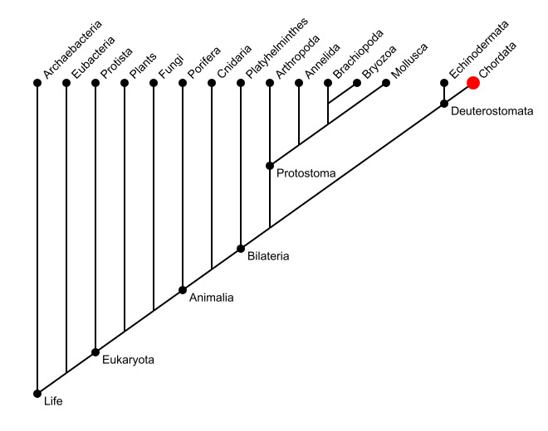
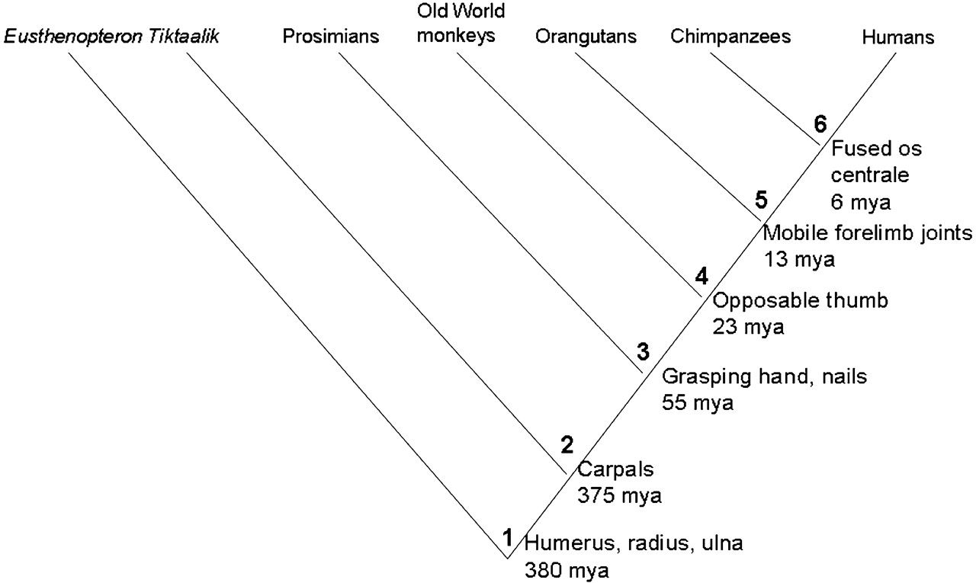

Slide 4
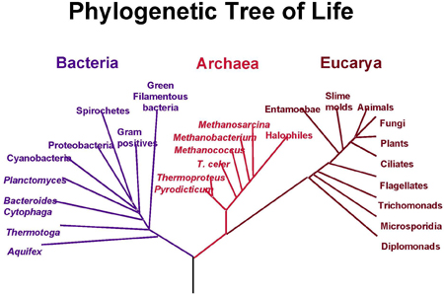
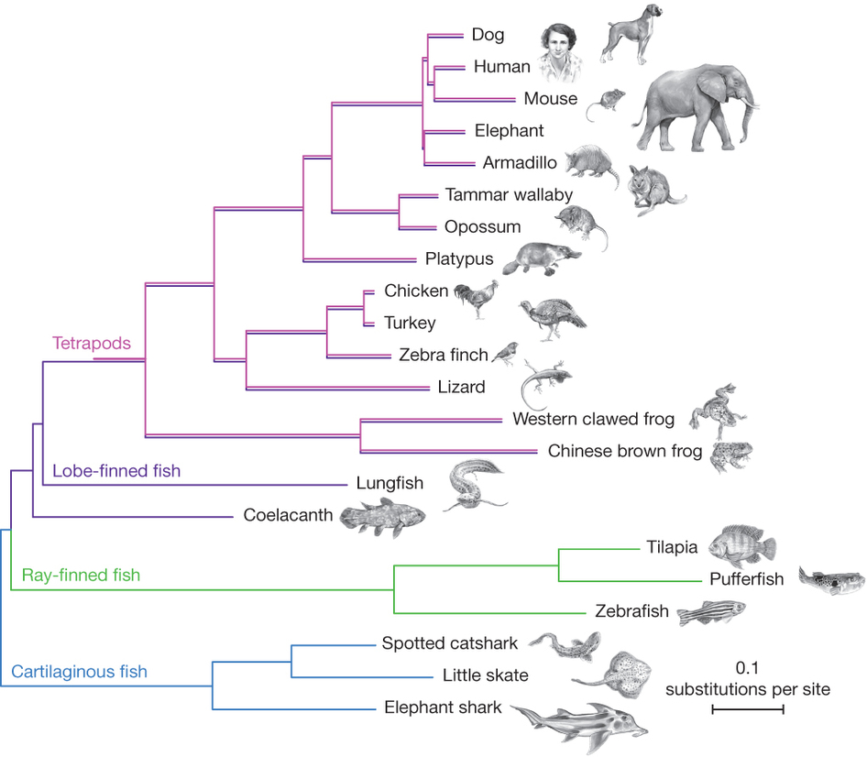

Slide 5
Taxonomy

Slide 6
Taxonomy – the scientific discipline of identifying, naming and classifying organisms
- we typically just use the binomial system of nomenclature for discussion (genus and species)
ex. Panthera pardus (leopard)
Escherichia coli (e coli bacterium)
Homo sapiens (humans)

Slide 7
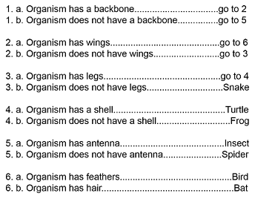
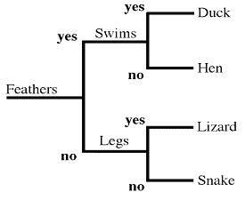
Dichotomous Key
Tool that allows users to identify items or organisms in a systematic and reproducible fashion.

Slide 8
Answer in Notebooks:
#1. Create a Dichotomous Key to identify people in your group.
Set up a series of questions that can be split into two parts.
Start by using general characters moving towards more specific.

Slide 9
Answer in Notebooks: 1B.

Slide 10
Answer in Notebooks: 1C.
Place an X in the chart for the traits that match the organism.
Place the organisms in order on a cladogram (oldest to most recent)
Add the traits to the cladogram.
 | Hair | Eyes | Bipedal | Legs
Human
Snake
Monkey
Lizard

Slide 11
Eight levels of taxa
3 Domains – broadest classification
1. bacteria
2. archaea
3. eukarya

Slide 12
Domain
Kingdom
Phylum
Class
Order
Family
Genus
Species

Slide 13
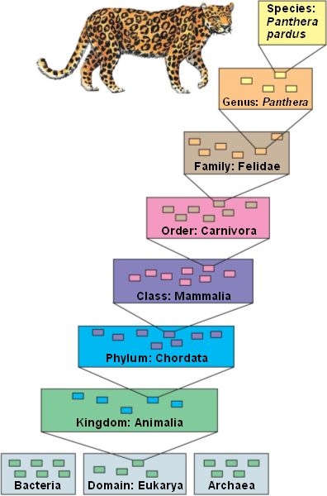

Slide 14
Answer in Notebooks:
#2. Come up with an Acronym to remember the 8 levels of classification.

Slide 15
3 Domains of Life
Virus
Bacteria
Archaea
Protists

Slide 16
~ Viruses – not truly alive because they cannot reproduce without living cells and no metabolism
- various in shape and size though smaller than bacteria
- capsid – protein shell enclosing the viral DNA
- bacteriophage – virus that infects bacteria
Notes:
Tiniest virus is smaller than ribosome, the largest still need powerful microscopes to view
Bacteriophage – sometimes just called phages

Slide 17
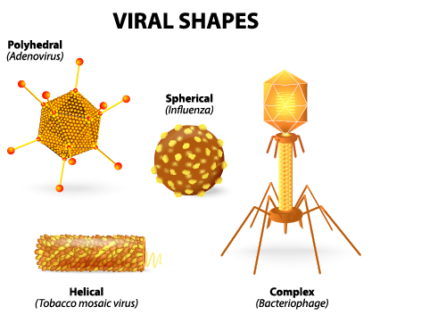

Slide 18
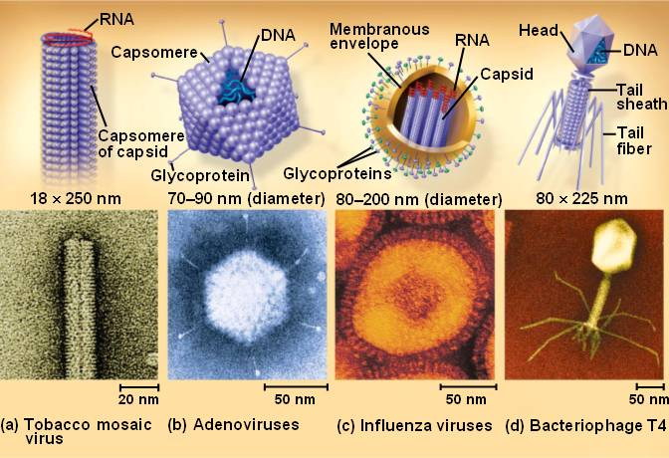

Slide 19
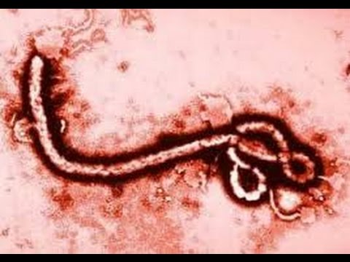
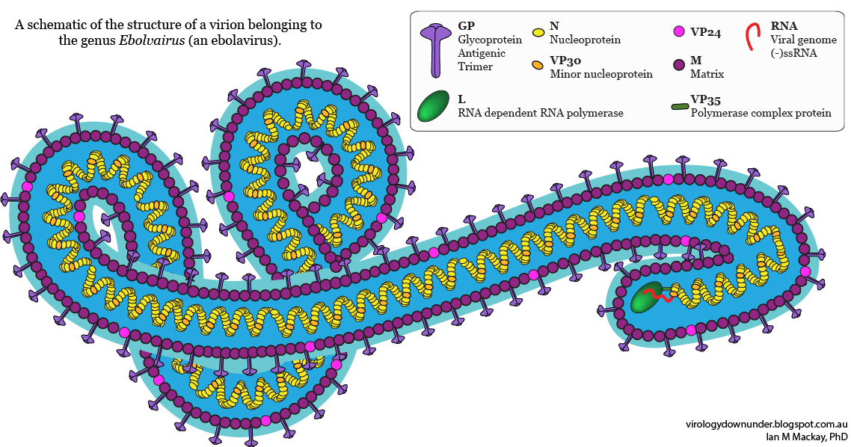

Slide 20
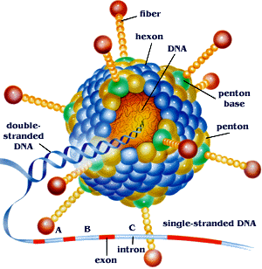
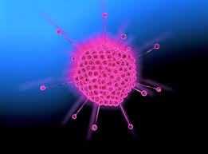

Slide 21
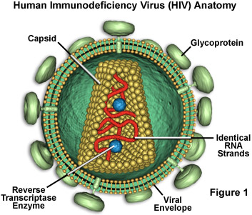
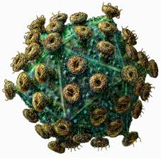

Slide 22
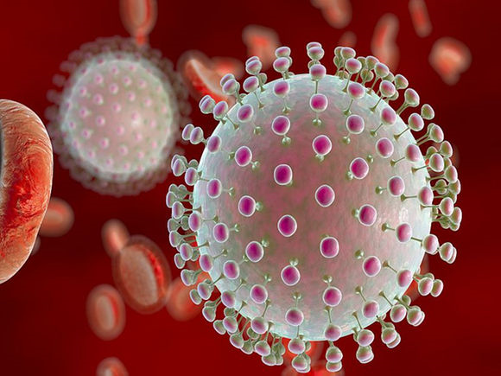
In May 2015, the Pan American Health Organization (PAHO) issued an alert regarding the first confirmed Zika virus infection in Brazil and on Feb 1, 2016, the World Health Organization (WHO) declared Zika virus a public health emergency of international concern (PHEIC). Local transmission has been reported in many other countries and territories. Zika virus likely will continue to spread to new areas.

Slide 23
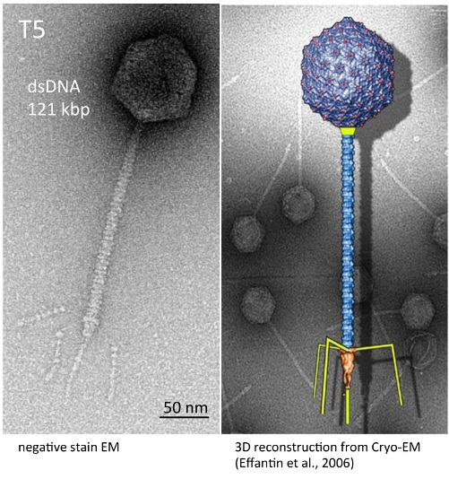

Slide 24
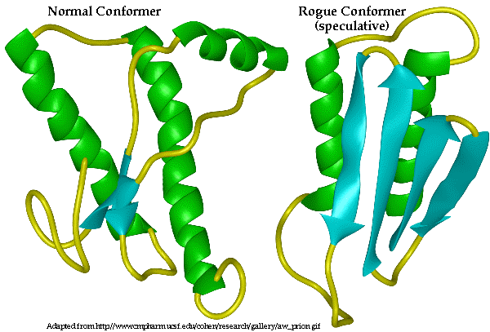
Prions are infectious proteins that fold abnormally and trigger the misfolding of other, similar proteins. Eventually, the buildup of misfolded proteins can cause lesions to form in the brain, leading to disease

Slide 25
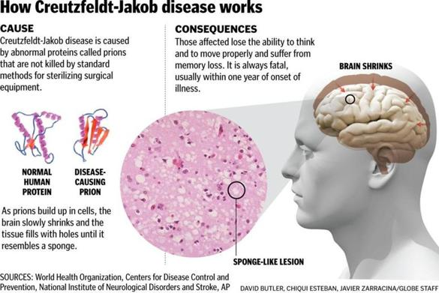

Slide 26
Answer in Notebooks:
#3. What is a similarity between Viruses and Prions?
What is a difference between Viruses and Prions?

Slide 27
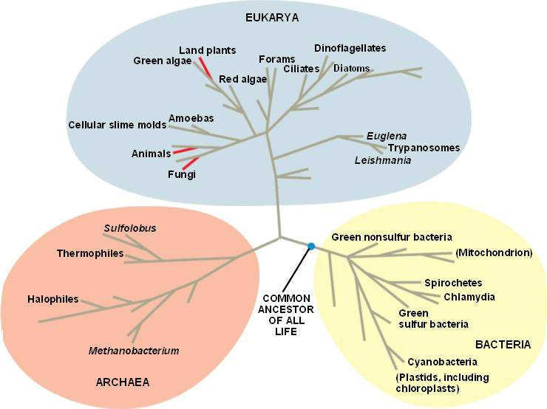

Slide 28
Prokaryotes
Our microbiota consists of the community of microorganisms that live in and on our bodies.
Notes:
Student Misconceptions and Concerns
• Students might think of evolution as a progression, with eukaryotes somehow fundamentally “better” than prokaryotes. However, as the authors note, a world of eukaryotes cannot exist without prokaryotes. Further, prokaryotes can survive without eukaryotes, and did so for at least the first billion years of life on Earth!
• Students may think that hand washing and the use of soap, especially antibacterial soap, leave the washed parts free of bacteria. The tremendous numbers of bacteria that typically remain and routinely reside on and within our bodies are little appreciated.
Teaching Tips
• Much of this chapter describes the traits and habits of single-celled prokaryotes and single-celled eukaryotes. Students might benefit by developing a series of tables that allow them to quickly review the properties of various groups, organized by size, shape, cell wall structure, surface modifications, and/or mode of nutrition.
• Students might easily be led to believe that we have already documented the diversity of life on Earth. However, by most estimates, we have identified fewer than 10% of the suspected species of eukaryotes. The ongoing discovery of new prokaryotes humbles microbiologists working today. The diversity of prokaryotic life may very well be beyond human determination.
• Many students struggle with concepts of size and volume. For example, they may not realize that a cube twice as wide as another cube has a volume eight times greater. The text notes that the diameter of eukaryotic cells is about ten times greater than the diameter of prokaryotic cells. Thus, the volume of eukaryotic cells can be nearly 1,000 times greater than prokaryotic cells.
• Consider making some sort of timeline to scale in a hallway, long laboratory, or the side of the lecture hall, marking it proportionally as follows:
0.0%: Earth forms. (4.6 billion years ago)
13%: Earth’s crust solidifies. (4 billion years ago)
15–25%: The first life appears. (3.5–3.9 billion years ago)
41%: Photosynthetic prokaryotes start producing an oxygen-rich atmosphere. (2.7 billion years ago)
54%: The first eukaryotes appear. (2.1 billion years ago)
67%: The first multicellular eukaryotes appear. (1.5 billion years ago)
89%: Plants first invade land. (500 million years ago)
99.9%: Human and ape ancestries diverge! (6–7 million years ago)
• Remind students that the term “bacteria” is not equivalent to the term “prokaryotes.” A discussion of the domains Archaea and Bacteria will help with this distinction.
Active Lecture Tips
• Students often have difficulty grasping geologic timescales. Many students (and politicians) do not intuitively understand that a billion is a thousand times greater than a million. Consider having students work in pairs in your class to quickly calculate:
a. If an earthquake occurs or a volcano erupts once every 1,000 years, how often will one or the other take place over a million years? (Answer: 1,000 times.) Note that what is rare to us becomes common in geologic terms.
b. The age of a human when he or she reaches the one-billionth second of life (if we begin counting at birth, the answer is 31.688 years). Then have them calculate how long it takes to live 1,000,000 seconds. (Answer: about 11.6 days.)

Slide 29
Phototroph vs. Chemotroph
Prokaryotes exhibit much more nutritional diversity than eukaryotes, allowing them to inhabit almost every nook and cranny on Earth.
Two sources of energy are used.
Phototrophs capture energy from sunlight.
2. Chemotrophs harness the energy stored in chemicals.
Notes:
Student Misconceptions and Concerns
• Students might think of evolution as a progression, with eukaryotes somehow fundamentally “better” than prokaryotes. However, as the authors note, a world of eukaryotes cannot exist without prokaryotes. Further, prokaryotes can survive without eukaryotes, and did so for at least the first billion years of life on Earth!
• Students may think that hand washing and the use of soap, especially antibacterial soap, leave the washed parts free of bacteria. The tremendous numbers of bacteria that typically remain and routinely reside on and within our bodies are little appreciated.
Teaching Tips
• Much of this chapter describes the traits and habits of single-celled prokaryotes and single-celled eukaryotes. Students might benefit by developing a series of tables that allow them to quickly review the properties of various groups, organized by size, shape, cell wall structure, surface modifications, and/or mode of nutrition.
Students might easily be led to believe that we have already documented the diversity of life on Earth. However, by most estimates, we have identified fewer than 10% of the suspected species of eukaryotes. The ongoing discovery of new prokaryotes humbles microbiologists working today. The diversity of prokaryotic life may very well be beyond human determination.
• Chemoautotrophs permit ecosystems that do not rely upon sunlight for a source of metabolic energy (though Earth would quickly freeze solid without the sun!). Students may have been taught that all ecosystems are based upon photosynthesis. Chemoautotrophs are an exception.
Active Lecture Tips
• Consider asking students to work in pairs in class to examine the four modes of nutrition presented in Figure 16.4. Ask them to predict which of the four modes of nutrition are typically used by (A) plants, (B) animals, and (C) fungi. Unusual exceptions to these patterns are also an opportunity for some critical thinking.

Slide 30
Autotroph vs. Heterotroph
Two sources of carbon are used by prokaryotes.
Autotrophs obtain carbon atoms from carbon dioxide.
Heterotrophs obtain their carbon atoms from the organic compounds present in other organisms.
Notes:
Student Misconceptions and Concerns
• Students might think of evolution as a progression, with eukaryotes somehow fundamentally “better” than prokaryotes. However, as the authors note, a world of eukaryotes cannot exist without prokaryotes. Further, prokaryotes can survive without eukaryotes, and did so for at least the first billion years of life on Earth!
• Students may think that hand washing and the use of soap, especially antibacterial soap, leave the washed parts free of bacteria. The tremendous numbers of bacteria that typically remain and routinely reside on and within our bodies are little appreciated.
Teaching Tips
• Much of this chapter describes the traits and habits of single-celled prokaryotes and single-celled eukaryotes. Students might benefit by developing a series of tables that allow them to quickly review the properties of various groups, organized by size, shape, cell wall structure, surface modifications, and/or mode of nutrition.
Students might easily be led to believe that we have already documented the diversity of life on Earth. However, by most estimates, we have identified fewer than 10% of the suspected species of eukaryotes. The ongoing discovery of new prokaryotes humbles microbiologists working today. The diversity of prokaryotic life may very well be beyond human determination.
• Chemoautotrophs permit ecosystems that do not rely upon sunlight for a source of metabolic energy (though Earth would quickly freeze solid without the sun!). Students may have been taught that all ecosystems are based upon photosynthesis. Chemoautotrophs are an exception.
Active Lecture Tips
• Consider asking students to work in pairs in class to examine the four modes of nutrition presented in Figure 16.4. Ask them to predict which of the four modes of nutrition are typically used by (A) plants, (B) animals, and (C) fungi. Unusual exceptions to these patterns are also an opportunity for some critical thinking.

Slide 31
The terms that describe how prokaryotes obtain energy and carbon are combined to describe their modes of nutrition.
Photoautotrophs harness sunlight for energy and use CO₂ for carbon.
Photoheterotrophs obtain energy from sunlight but get their carbon atoms from organic sources.
Chemoautotrophs harvest energy from inorganic chemicals and use carbon from CO₂ to make organic molecules.
Chemoheterotrophs acquire energy and carbon from organic molecules.
Notes:
Student Misconceptions and Concerns
• Students might think of evolution as a progression, with eukaryotes somehow fundamentally “better” than prokaryotes. However, as the authors note, a world of eukaryotes cannot exist without prokaryotes. Further, prokaryotes can survive without eukaryotes, and did so for at least the first billion years of life on Earth!
• Students may think that hand washing and the use of soap, especially antibacterial soap, leave the washed parts free of bacteria. The tremendous numbers of bacteria that typically remain and routinely reside on and within our bodies are little appreciated.
Teaching Tips
• Much of this chapter describes the traits and habits of single-celled prokaryotes and single-celled eukaryotes. Students might benefit by developing a series of tables that allow them to quickly review the properties of various groups, organized by size, shape, cell wall structure, surface modifications, and/or mode of nutrition.
Students might easily be led to believe that we have already documented the diversity of life on Earth. However, by most estimates, we have identified fewer than 10% of the suspected species of eukaryotes. The ongoing discovery of new prokaryotes humbles microbiologists working today. The diversity of prokaryotic life may very well be beyond human determination.
• Chemoautotrophs permit ecosystems that do not rely upon sunlight for a source of metabolic energy (though Earth would quickly freeze solid without the sun!). Students may have been taught that all ecosystems are based upon photosynthesis. Chemoautotrophs are an exception.
Active Lecture Tips
• Consider asking students to work in pairs in class to examine the four modes of nutrition presented in Figure 16.4. Ask them to predict which of the four modes of nutrition are typically used by (A) plants, (B) animals, and (C) fungi. Unusual exceptions to these patterns are also an opportunity for some critical thinking.

Slide 32
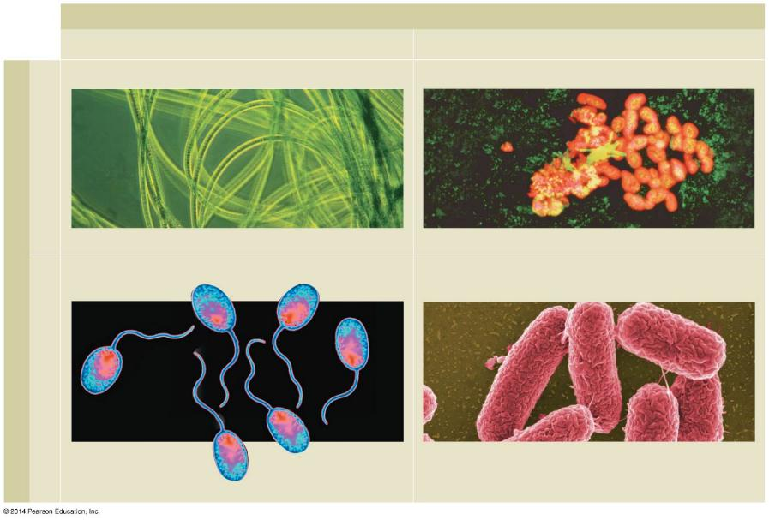
Figure 16.4-0
Energy source
Sunlight
Chemicals
Photoautotrophs
Chemoautotrophs
CO₂
Oscillatoria
Unidentified “rock-eating” bacteria
Carbon source
Photoheterotrophs
Chemoheterotrophs
Organic compounds
Salmonella typhimurium
Rhodopseudomonas
Notes:
Figure 16.4-0 Sources of energy and carbon in prokaryotic modes of nutrition

Slide 33
Answer in Notebooks:
#4. Create and complete this chart:
 | Source of Energy | Source of Carbon
Photoautotroph
Chemoautotroph
Photoheterotroph
Chemoheterotroph

Slide 34
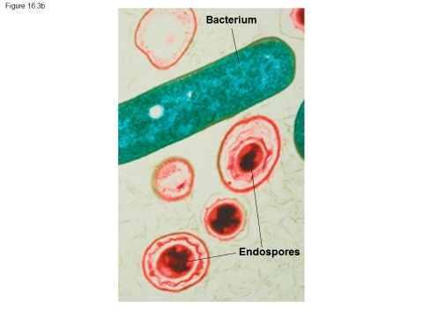
Some prokaryotes form specialized cells called endospores that remain dormant through harsh conditions.
Notes:
Student Misconceptions and Concerns
• Students might think of evolution as a progression, with eukaryotes somehow fundamentally “better” than prokaryotes. However, as the authors note, a world of eukaryotes cannot exist without prokaryotes. Further, prokaryotes can survive without eukaryotes, and did so for at least the first billion years of life on Earth!
• Students may think that hand washing and the use of soap, especially antibacterial soap, leave the washed parts free of bacteria. The tremendous numbers of bacteria that typically remain and routinely reside on and within our bodies are little appreciated.
Teaching Tips
• Much of this chapter describes the traits and habits of single-celled prokaryotes and single-celled eukaryotes. Students might benefit by developing a series of tables that allow them to quickly review the properties of various groups, organized by size, shape, cell wall structure, surface modifications, and/or mode of nutrition.
• Students might easily be led to believe that we have already documented the diversity of life on Earth. However, by most estimates, we have identified fewer than 10% of the suspected species of eukaryotes. The ongoing discovery of new prokaryotes humbles microbiologists working today. The diversity of prokaryotic life may very well be beyond human determination.
• Some modeling clay (oil-based clay never dries out) and toothpicks can be used to make some quick and easy visual aids to demonstrate the various shapes of these bacteria for lecture. The construction of these diverse shapes can also make for a quick lab activity.
• Module 16.2 provides a broad spectrum of bacterial form and function. If you are selectively assigning chapters, consider this module of high importance.
• The exponential growth of bacteria is like the growth represented in the correct answer to the classic math question “Would you rather have a million dollars or start out with just a penny for the first day of the month, but have your pay doubled every remaining day of that month?” Choosing the doubling amount pays off at about $10 million after just one month!
• Students may need help thinking through why short generation times and large numbers of offspring permit rapid evolution. The authors address this important aspect of evolution in Module 16.3. However, students may need additional clarity and examples to better understand the speed of evolutionary change permitted in bacteria as compared to longer-lived organisms such as whales, elephants, and humans.

Slide 35
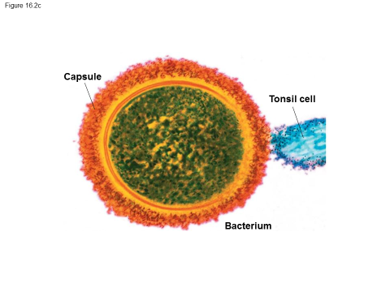
The cell wall of many prokaryotes is covered by a capsule, a sticky layer of polysaccharides or protein.
Notes:
Student Misconceptions and Concerns
• Students might think of evolution as a progression, with eukaryotes somehow fundamentally “better” than prokaryotes. However, as the authors note, a world of eukaryotes cannot exist without prokaryotes. Further, prokaryotes can survive without eukaryotes, and did so for at least the first billion years of life on Earth!
• Students may think that hand washing and the use of soap, especially antibacterial soap, leave the washed parts free of bacteria. The tremendous numbers of bacteria that typically remain and routinely reside on and within our bodies are little appreciated.
Teaching Tips
• Much of this chapter describes the traits and habits of single-celled prokaryotes and single-celled eukaryotes. Students might benefit by developing a series of tables that allow them to quickly review the properties of various groups, organized by size, shape, cell wall structure, surface modifications, and/or mode of nutrition.
• Students might easily be led to believe that we have already documented the diversity of life on Earth. However, by most estimates, we have identified fewer than 10% of the suspected species of eukaryotes. The ongoing discovery of new prokaryotes humbles microbiologists working today. The diversity of prokaryotic life may very well be beyond human determination.
• Some modeling clay (oil-based clay never dries out) and toothpicks can be used to make some quick and easy visual aids to demonstrate the various shapes of these bacteria for lecture. The construction of these diverse shapes can also make for a quick lab activity.
• Module 16.2 provides a broad spectrum of bacterial form and function. If you are selectively assigning chapters, consider this module of high importance.

Slide 36
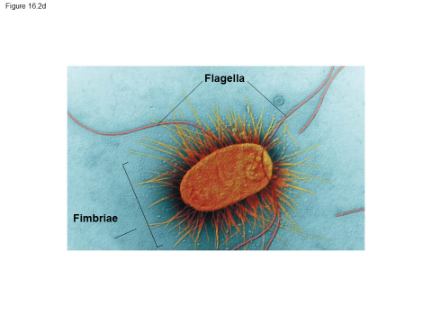
Some prokaryotes have external structures that extend beyond the cell wall
Flagella are adaptations that enable them to move about in response to chemical or physical signals in their environment.
Hairlike projections called fimbriae enable prokaryotes to stick
Notes:
Student Misconceptions and Concerns
• Students might think of evolution as a progression, with eukaryotes somehow fundamentally “better” than prokaryotes. However, as the authors note, a world of eukaryotes cannot exist without prokaryotes. Further, prokaryotes can survive without eukaryotes, and did so for at least the first billion years of life on Earth!
• Students may think that hand washing and the use of soap, especially antibacterial soap, leave the washed parts free of bacteria. The tremendous numbers of bacteria that typically remain and routinely reside on and within our bodies are little appreciated.
Teaching Tips
• Much of this chapter describes the traits and habits of single-celled prokaryotes and single-celled eukaryotes. Students might benefit by developing a series of tables that allow them to quickly review the properties of various groups, organized by size, shape, cell wall structure, surface modifications, and/or mode of nutrition.
• Students might easily be led to believe that we have already documented the diversity of life on Earth. However, by most estimates, we have identified fewer than 10% of the suspected species of eukaryotes. The ongoing discovery of new prokaryotes humbles microbiologists working today. The diversity of prokaryotic life may very well be beyond human determination.
• Some modeling clay (oil-based clay never dries out) and toothpicks can be used to make some quick and easy visual aids to demonstrate the various shapes of these bacteria for lecture. The construction of these diverse shapes can also make for a quick lab activity.
• Module 16.2 provides a broad spectrum of bacterial form and function. If you are selectively assigning chapters, consider this module of high importance.
• The exponential growth of bacteria is like the growth represented in the correct answer to the classic math question “Would you rather have a million dollars or start out with just a penny for the first day of the month, but have your pay doubled every remaining day of that month?” Choosing the doubling amount pays off at about $10 million after just one month!
• Students may need help thinking through why short generation times and large numbers of offspring permit rapid evolution. The authors address this important aspect of evolution in Module 16.3. However, students may need additional clarity and examples to better understand the speed of evolutionary change permitted in bacteria as compared to longer-lived organisms such as whales, elephants, and humans.

Slide 37
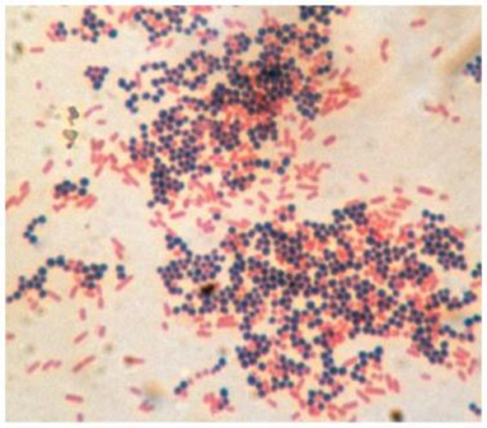
Nearly all prokaryotes have a cell wall.
When stained with Gram stain, cell walls of bacteria are either
gram-positive, with simpler cell walls containing peptidoglycan
gram-negative,
with less peptidoglycan.
These bacteria are more
complex and more likely to
cause disease.
Notes:
Student Misconceptions and Concerns
• Students might think of evolution as a progression, with eukaryotes somehow fundamentally “better” than prokaryotes. However, as the authors note, a world of eukaryotes cannot exist without prokaryotes. Further, prokaryotes can survive without eukaryotes, and did so for at least the first billion years of life on Earth!
• Students may think that hand washing and the use of soap, especially antibacterial soap, leave the washed parts free of bacteria. The tremendous numbers of bacteria that typically remain and routinely reside on and within our bodies are little appreciated.
Teaching Tips
• Much of this chapter describes the traits and habits of single-celled prokaryotes and single-celled eukaryotes. Students might benefit by developing a series of tables that allow them to quickly review the properties of various groups, organized by size, shape, cell wall structure, surface modifications, and/or mode of nutrition.
• Students might easily be led to believe that we have already documented the diversity of life on Earth. However, by most estimates, we have identified fewer than 10% of the suspected species of eukaryotes. The ongoing discovery of new prokaryotes humbles microbiologists working today. The diversity of prokaryotic life may very well be beyond human determination.
• Some modeling clay (oil-based clay never dries out) and toothpicks can be used to make some quick and easy visual aids to demonstrate the various shapes of these bacteria for lecture. The construction of these diverse shapes can also make for a quick lab activity.
• Module 16.2 provides a broad spectrum of bacterial form and function. If you are selectively assigning chapters, consider this module of high importance.

Slide 38
Answer in Notebooks:
#5. What color is gram-positive bacteria?
What color is gram-negative bacteria?
Which type is more likely to cause disease?

Slide 39
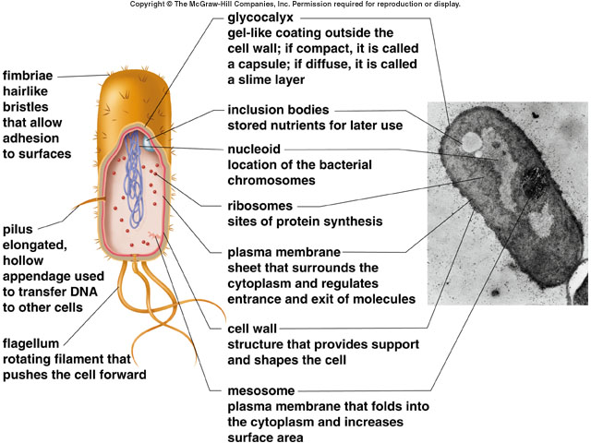
Bacteria (eubacteria)
-Most are unicellular though some species can aggregate into colonies.
Notes:
Cells in a biofilm secrete signaling molecules that recruit nearby cells causing the colonies to grow. The cells also produce proteins that stick the cells to the substrate and to one another. Channels allow nutrients to reach interior cells and wastes to be excreted.

Slide 40
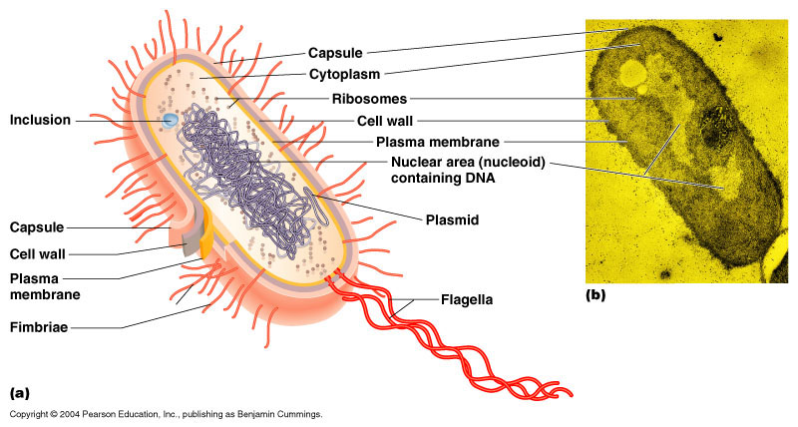
Diagram of a bacterium

Slide 41
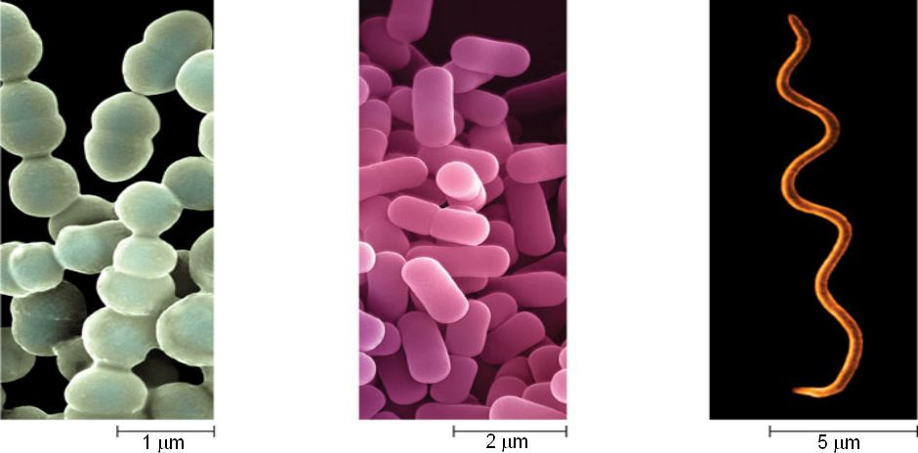
Eubacteria can be differentiated by their shape and the way they aggregate
Cocci spherical prokaryotes. They occur singly, in pairs, or in chains (such as these streptococci).
Bacilli
are rod-shaped prokaryotes. They are usually solitary, sometimes the rods are arranged in chains.
Spiral prokaryotes such as these spirochetes are corkscrew-shaped.

Slide 42
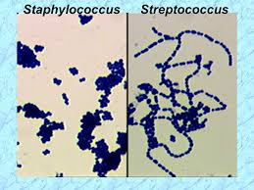
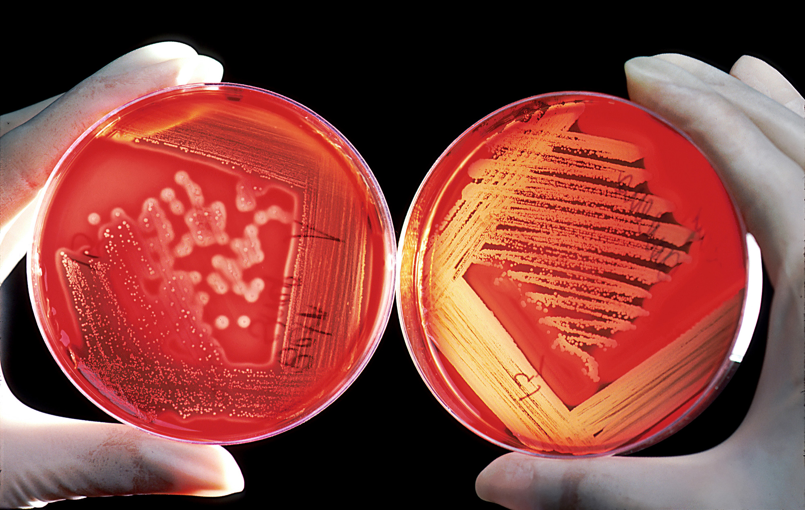
Strep vs. Staph
Strep is in a line
Staph clumps together

Slide 43
5 Classifications of Bacteria
1. Proteobacteria
Gram negative, symbiotic, and 4 modes of nutrition
Rhizobium, Thiomargarita namibiensis
2. Gram-positive bacteria
Rivals proteobacteria in diversity
Actinomycetes – Streptomyces, streptococcus, Bacillus anthracis
3. Cyanobacteria
Plantlike, oxygen generating photosynthesis
Anabaena

Slide 44
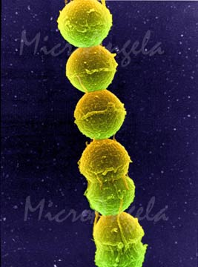
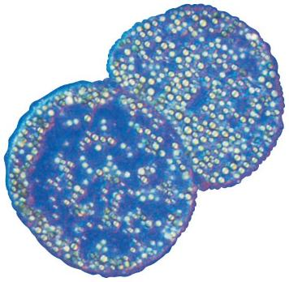
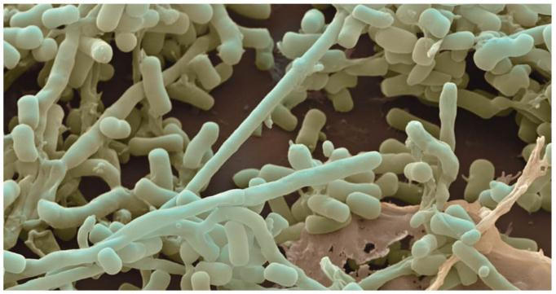
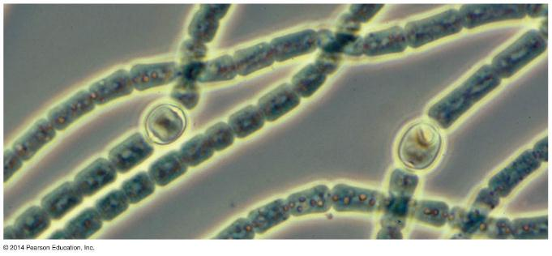
Thiomargarita namibiensis
Streptococcus
Streptomyces
Anabaena

Slide 45
4. Chlamydias
Live in Eukaryotic host cells
Chlamydia trachomatis
5. Spirochetes
Spiral through environment by rotating, internal filaments
Treponema palladium and Borrelia burgdoferi

Slide 46
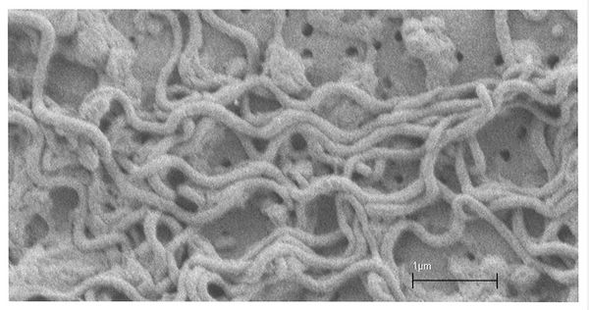
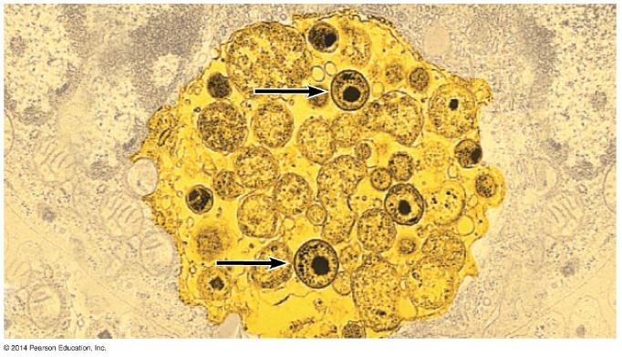
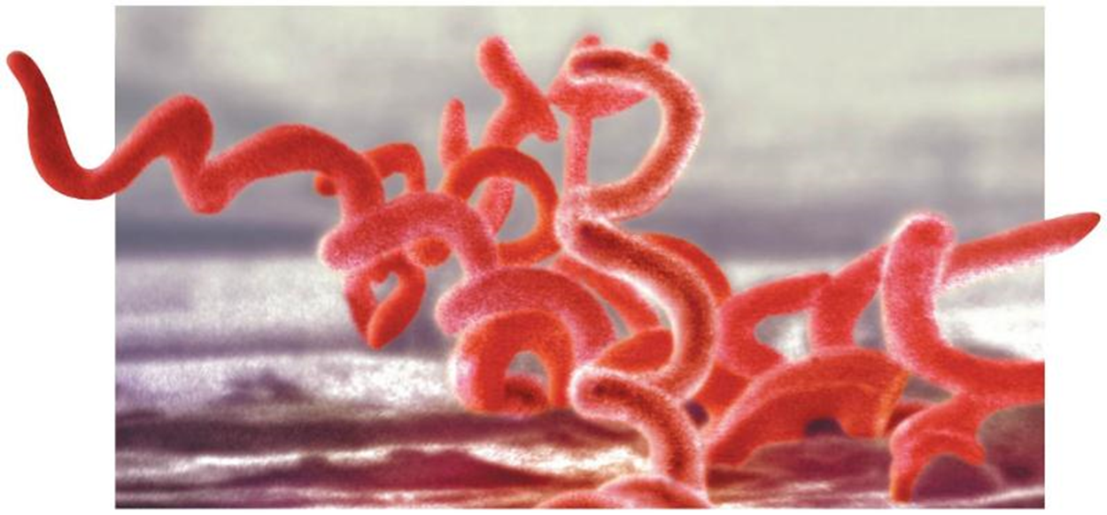
T. Pallidum -- syphillus
Chlamydia trachomatis

Slide 47
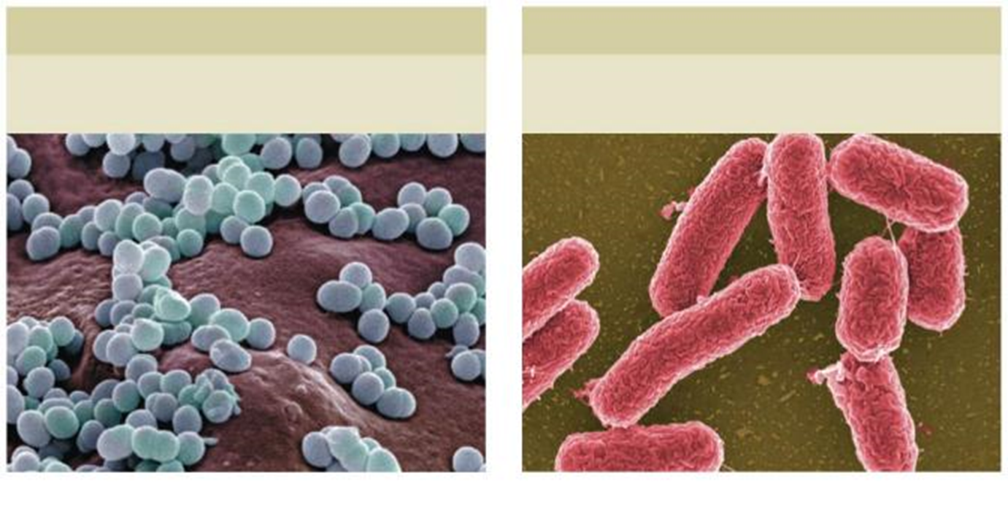
Exotoxins are proteins that bacterial cells secrete into their environment
Staphylococcus aureus
Endotoxins are components of the outer membrane of gram-negative bacteria that are released when the cell dies or is digested by a defensive cell.
Salmonella

Slide 48
Answer in Notebooks:
#6. Illustrate the following types of bacteria:
Cocci Bacilli Spiral
Streptobacilli Staphylococcus

Slide 50
Archaea (archeabacteria) – more recently shared ancestor with eukaryotes than bacteria.
first archaeans found thrived in extreme habitats – called extremophiles
Halophiles – adapted to highly saline conditions (Dead Sea, Great Salt Lake, etc.)

Slide 51
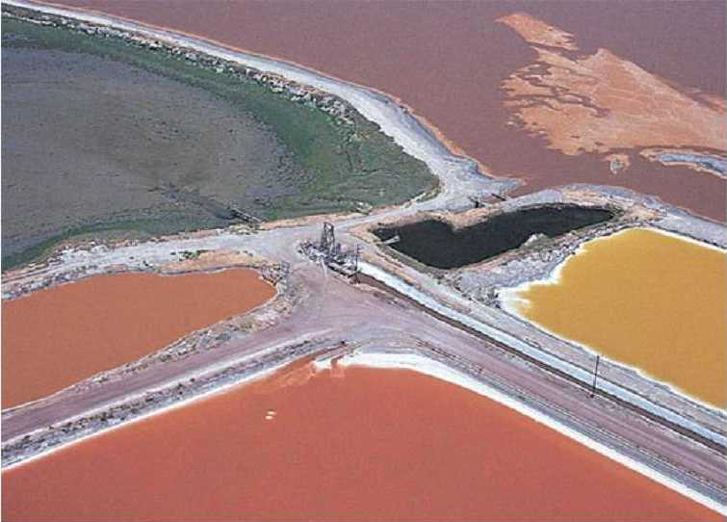
Halophiles living in salt beds → colors from photosynthetic chemical rhodopsin

Slide 52
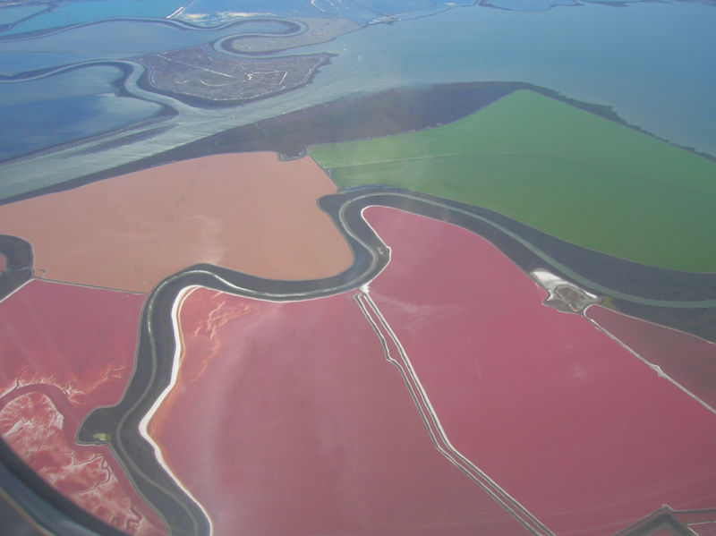
Salt ponds in San Francisco Bay filled with halophiles

Slide 53
Thermoacidophiles
- thrive in temperatures above boiling and/or extremely acidic conditions
- unique DNA /protein adaptations allow for survival at temperatures that are usually fatal

Slide 54
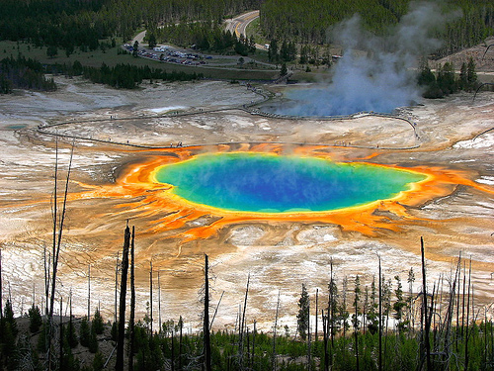
Grand Prismatic Spring – Yellowstone - boiling hot water/ sulfuric acid

Slide 55
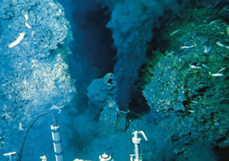

Slide 56
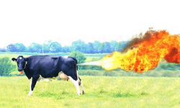
Methanogens – slightly more moderate living conditions
- strictest anaerobes
- found under kilometers of ice in Greenland, swamps, marshes, and animalian guts (termites, cattle)

Slide 57
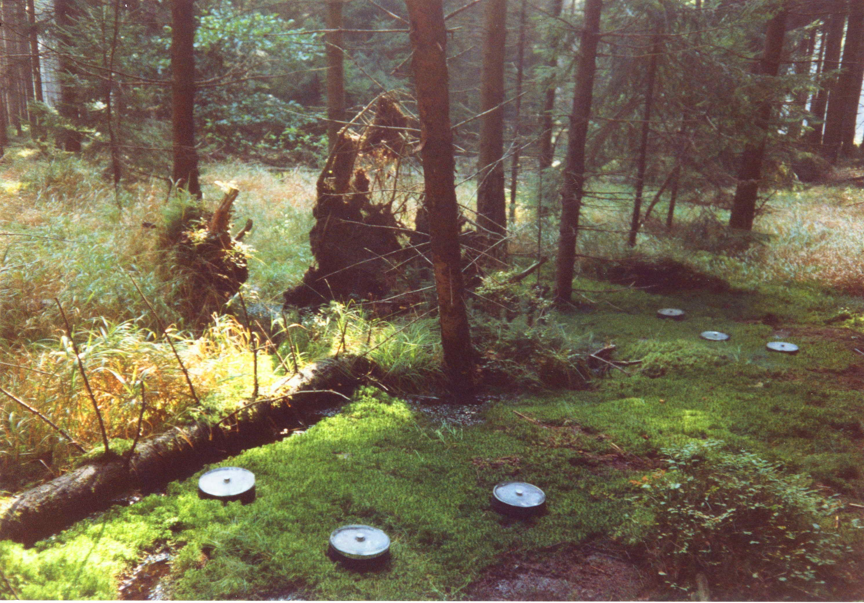
These are wells to access methane gas produced in a peat bog from methanogens

Slide 58
Answer in Notebooks:
#7. Give an example of each:
Halophiles
Thermoacidophiles
Methanogens

Slide 60
Eukaryotes (see beginning of year info)
Protists – informal group that most taxonomists have reclassified into several separate kingdoms (matter of convenience to call them protists)
some are autotrophs, some heterotrophs and some are called mixotrophs b/c they combine the two.
the “not quites”
- like a fungus, but not quite
- like an animal, but not quite
- like a plant, but not quite

Slide 61
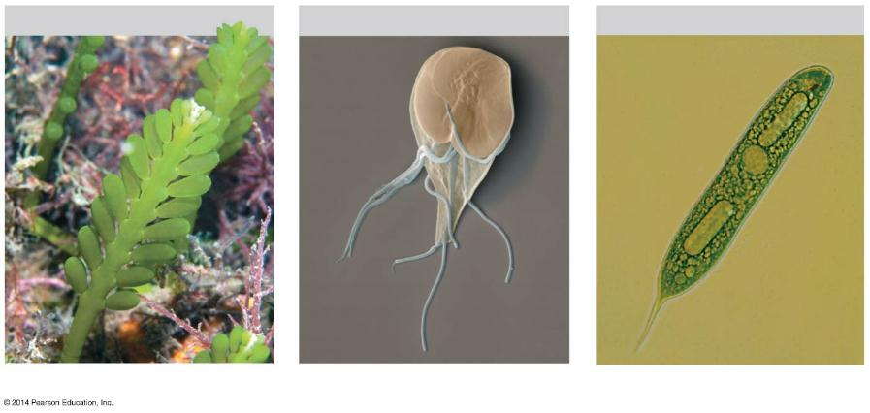
Figure 16.12a-0
Autotrophy
Heterotrophy
Mixotrophy
Caulerpa, a green alga
Giardia, a parasite
Euglena
Notes:
Figure 16.12a-0 Protist modes of nutrition

Slide 62
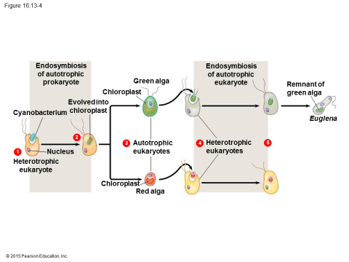
Endosymbiosis of unicellular algae is the key to much of protist diversity

Slide 63
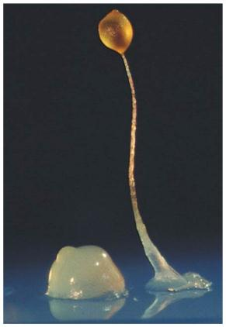
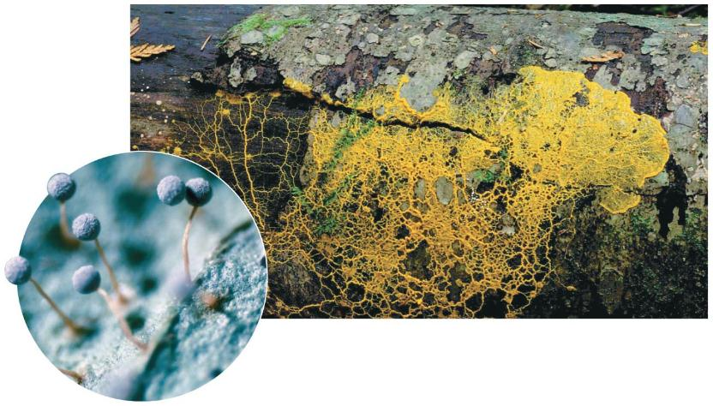
not quite fungus = slime molds
- fungus like spore dispersal with amoeba like genetics
plasmodial slime mold: Physarum
cellular slime mold, Dictyostelium

Slide 64
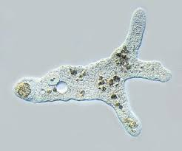
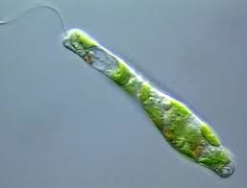
not quite animals = amoeba, paramecium, plasmodium, euglena
- can be motile

Slide 65
not quite plants = algae
- photosynthesize

Slide 66
“SAR”
Stramenopiles – autotrophic
-diatoms, brown algae, and water molds
Alveolates - autotrophs, heterotrophs, and mixotrophs
-dinoflagellates and ciliates
Rhizaria – pseudopodia
- Amoebas, foraminiferans, and radiolarians

Slide 67
Excavata
- Euglena, Giardia intestinalis, Trypansoma, and Trichomonas vaginalis

Slide 68
Unikonts
Ameobozoans – lobe shaped pseudopodia
- Plasmodial slime mold and Cellular slime mold

Slide 69
Archaeplastids
Red Algae
Both unicellular and multicellular autotrophs
Green Algae
- Chlamydomonas and Volvox

Slide 70
Answer in Notebooks:
8#. What are protists?

