Slide 1
Plantations and Slavery Spread
Ch 11.2

Slide 2
Plantations and Slavery Spread
Before We Learned:
Now we will learn:
New industries and inventions changed the way people lived and worked in the early 1800s.
The invention of the cotton gin and the demand for cotton caused slavery to spread in the South.

Slide 3
Vocabulary
cotton gin — machine that made cleaning seeds from cotton faster
Eli Whitney — inventor of the cotton gin
Nat Turner — leader of an 1831 slave rebellion in Virginia
Spirituals – religious folk songs

Slide 4
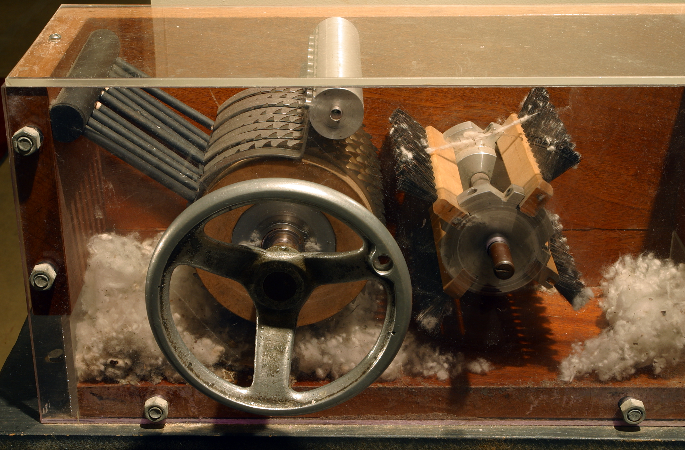
The Cotton Boom
Key Question: How did the invention of the cotton gin change Southern life?

Slide 5
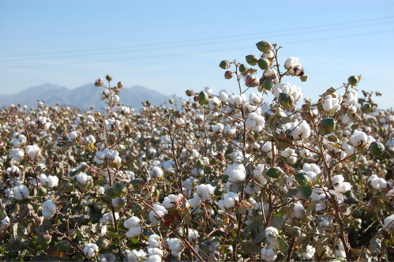
The Cotton Boom
The Industrial Revolution increased the number of goods being produced, which also increased the demand for raw materials.
England needed huge quantities of cotton to produce goods to sell throughout the British Empire.
Cotton growers in the South wanted to meet this demand.

Slide 6
The Cotton Boom
The Cotton Gin
Cotton was hard to clean by hand. A worker could clean just one pound of cotton in a day.
In 1793, Eli Whitney invented a machine for cleaning cotton.
With this new machine- one worker could clean as many as 50 pounds of cotton a day!
The cotton gin helped set the South on a very different course of economic development than the North.

Slide 7
The Cotton Boom
Due to the cotton gin, cotton production increased and the South raised millions of bales of cotton each year.
This placed a high demand for slavery, and slavery spread. In 1808, it became illegal to import slaves from Africa, but the birthrate of American slaves increased.
About 1/3 of white families owned slaves in 1840. Of these slave owning families, 1/10 had large plantations with 20 or more slaves.
Although most Southern farmers owned few or no slaves, many supported slavery since they hoped that someday they would be able to in order to raise more cotton and make more money.

Slide 8
The Cotton Boom
Key Question Review
How did the invention of the cotton gin change Southern life?
THINK ABOUT
mills increased demand for cotton; short-fibered cotton hard to clean
gin made cotton profitable; Southern production went up dramatically
slavery spread as demand for farm workers grew

Slide 9
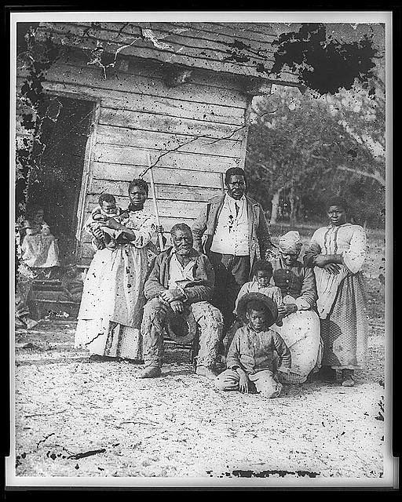
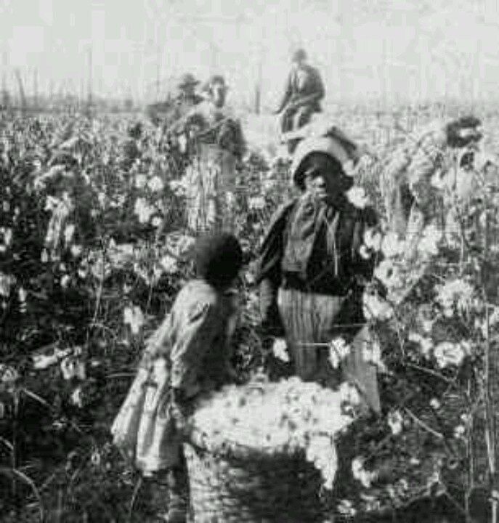
African Americans in the South
Key Question
What was life like for African Americans in the South?

Slide 10
African Americans in the South
In 1840, 1/3 of the South’s population were slaves.
About ½ of the enslaved people worked on plantations; others worked as domestic servants, skilled craftsmen, factory hands, and day laborers.
Some slaves were hired out and allowed to keep part of their earnings.
Slaves were considered property according to the law.
About 5% of African Americans were born free in 1840.
Not allowed to be educated.
Not allowed to vote.
Employers refused to hire them.
Threat of being captured and sold into slavery.

Slide 11
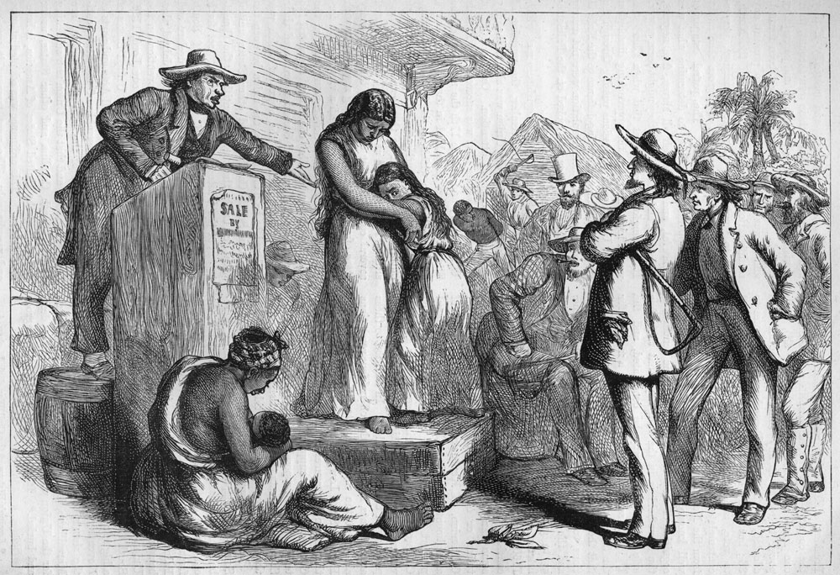
African Americans in the South
Families Under Slavery- Families were ripped apart when sold

Slide 12
African Americans in the South
Slave Rebellions
Some slaves rebelled in order to fight slavery
Numerous slaves that revolted were hanged
Nat Turner: led a famous rebellion in Southampton County, Virginia in 1831
Starting on August 21, Turner and 70 followers killed about 55 white men, women and children
Most of Turner’s men were captured when they ran out of ammunition. Others were killed.
Turner was caught at the end of October, tried, and hanged.
His rebellion spread fear in the South and whites killed more than 200 African Americans in revenge.
The state of Virginia considered ending slavery due to this, but the proposal was narrowly defeated.
Other states passed harsh laws that further limited the freedom of both free and enslaved African Americans.

Slide 14
African Americans in the South
A COMMON CULTURE
By the early 1800s, there was a distinctive African-American culture in the south
Enslaved African-Americans bonded together to endure the brutal conditions of Southern plantation life
Religion was a cornerstone of African-American culture

Slide 15
African Americans in the South
Religion
Slave owners tried using the Bible to teach slaves to obey their masters.
Slaves on the contrary, found hope in the Bible, especially in the book of Exodus
Exodus tells of how Moses lead the Hebrews out of slavery in Egypt
Many slaves thought this example offered a message of hope for themselves as well
Enslaved people expressed their beliefs in spirituals
Many spirituals voiced the desire for freedom
Some spirituals even contained coded messages about a planned escape for freedom or an owner’s unexpected return!
African-American spirituals later had a strong influence on blues, jazz, and other forms of American music

Slide 16
African Americans in the South
Key Question
What was life like for African Americans in the South?
THINK ABOUT
most African Americans enslaved; half on plantations, others in cities
often treated harshly, families separated; many resisted, some rebelled
religion important. What are spirituals?

