Slide 1
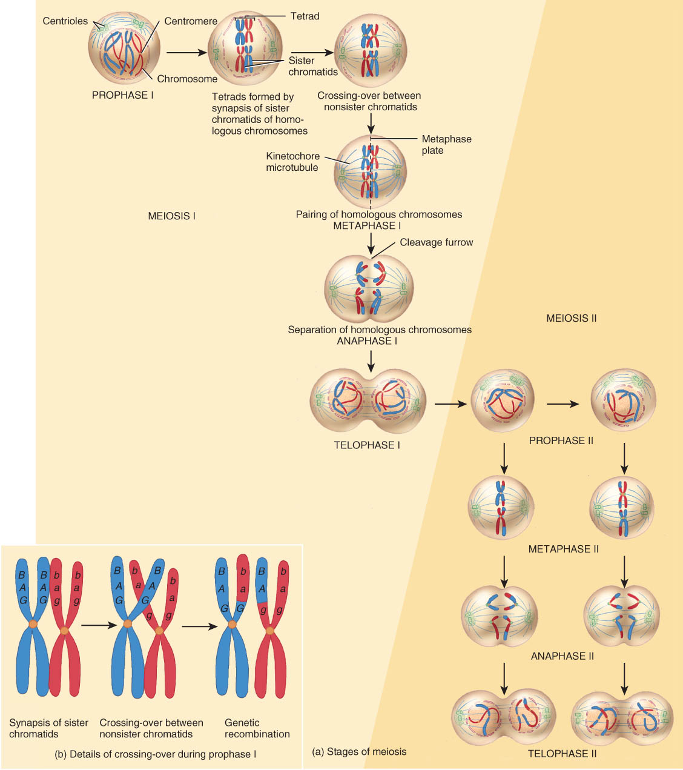
Reproductive Cell Division
Meiosis results in the production of haploid cells that contain only 23 chromosomes.
Meiosis occurs in two successive stages: meiosis I and meiosis II.
This form of cell division creates gametes, or sex cells; eggs or sperm.
Results in the production of a new individual.

Slide 2
Control of Cell Destiny
The three possible destinies of a cell are to remain alive and functioning without dividing, to grow and divide, or to die.
Maturation promoting factor (MPF) induces cell division.
Cell death, a process called apoptosis, is triggered either from outside the cell or from inside the cell due to a “cell-suicide” gene.
Necrosis is a pathological cell death due to injury.
Tumor-suppressor genes can produce proteins that normally inhibit cell division resulting in the uncontrollable cell growth known as cancer.

Slide 3
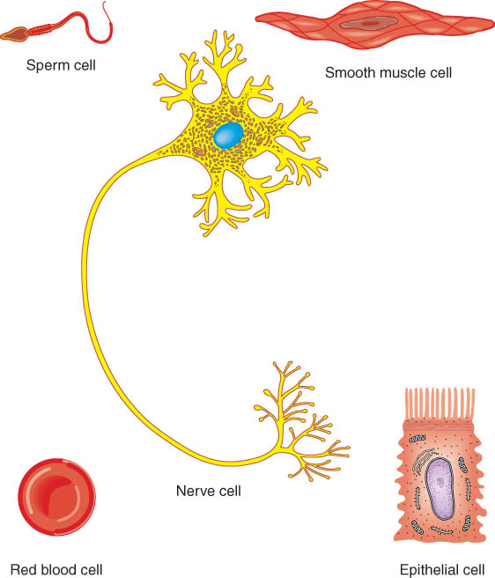
CELLULAR DIVERSITY
Not all cells look alike, nor do they perform identical functional roles in the body.
The cells vary considerably
100 trillion cells in the body -- 200 different types
Vary in size and shape related to their function.

Slide 5
CELLS AND AGING
Aging is a normal process accompanied by a progressive alteration of the body’s homeostatic adaptive responses; the specialized branch of medicine that deals with the medical problems and care of elderly persons is called geriatrics.
The physiological signs of aging are a gradual deterioration in function and capacity to respond to environmental stresses.
These signs are related to a net decrease in the number of cells in the body and to the dysfunctioning of the cells that remain.

Slide 6
CELLS AND AGING continued…
The extracellular components of tissues (e.g., collagen fibers and elastin) also change with age.
Many theories of aging have been proposed, including genetically programmed cessation of cell division, glucose addition to proteins, free radical reactions, and excessive immune responses.

Slide 7
Progeria and Werner’s Syndrome
Progeria is caused by a genetic deficit in which telomeres are very short…causes premature aging.
Werner’s Syndrome, adult onset progeriod syndrome, is an inherited disease which causes premature aging. The gene has recently been identified. Only occurs after puberty.

Slide 8
DISORDERS: HOMEOSTATIC IMBALANCES
Cancer is a group of diseases characterized by uncontrolled cell proliferation.
Cells that divide without control develop into a tumor or neoplasm.
A cancerous neoplasm is called a malignant tumor or malignancy. It has the ability to undergo metastasis, the spread of cancerous cells to other parts of the body. A benign tumor is a noncancerous growth.

Slide 9
Cancer = out of control cell division
Hyperplasia = increased number of cell divisions
benign tumor does not metastasize or spread
malignant---spreads due to cells that detach from tumor and enter blood or lymph
Causes -- carcinogens, x-rays, viruses
every cell has genes that regulate growth & development
mutation in those genes due to radiation or chemical agents causes excess production of growth factors
Carcinogenesis
multistep process that takes years and many different mutations occur

Slide 10
Types of Cancer
Carcinomas arise from epithelial cells.
Melanomas are cancerous growths of melanocytes.
Sarcomas arise from muscle cells or connective tissues.
Leukemia is a cancer of blood-forming organs.
Lymphoma is a cancer of lymphatic tissue.
Growth and Spread of Cancer
Cancer cells divide rapidly and continuously.
They trigger angiogenesis, the growths of new networks of blood vessels.
Cancer cells can leave their site of origin and travel to other tissues or organs, a process called metastasis.

Slide 11
Causes of Cancer
The normal counterparts of oncogenes are called proto-oncogenes; these are found in every cell and carry out normal cellular functions until a malignant change occurs via a mutation.
Carcinogenesis is a multistep process involving mutation of oncogenes and anti-oncogenes; as many as 10 distinct mutations may have to accumulate in a cell before it becomes cancerous.

Slide 12
Treatment of Cancer
Treatment of cancer is difficult because it is not a single disease and because all the cells in a tumor do not behave in the same way.
Various treatments include
Surgery
Chemotherapy
radiation therapy
cryotherapy

Slide 13
The End!!!!

