Slide 1
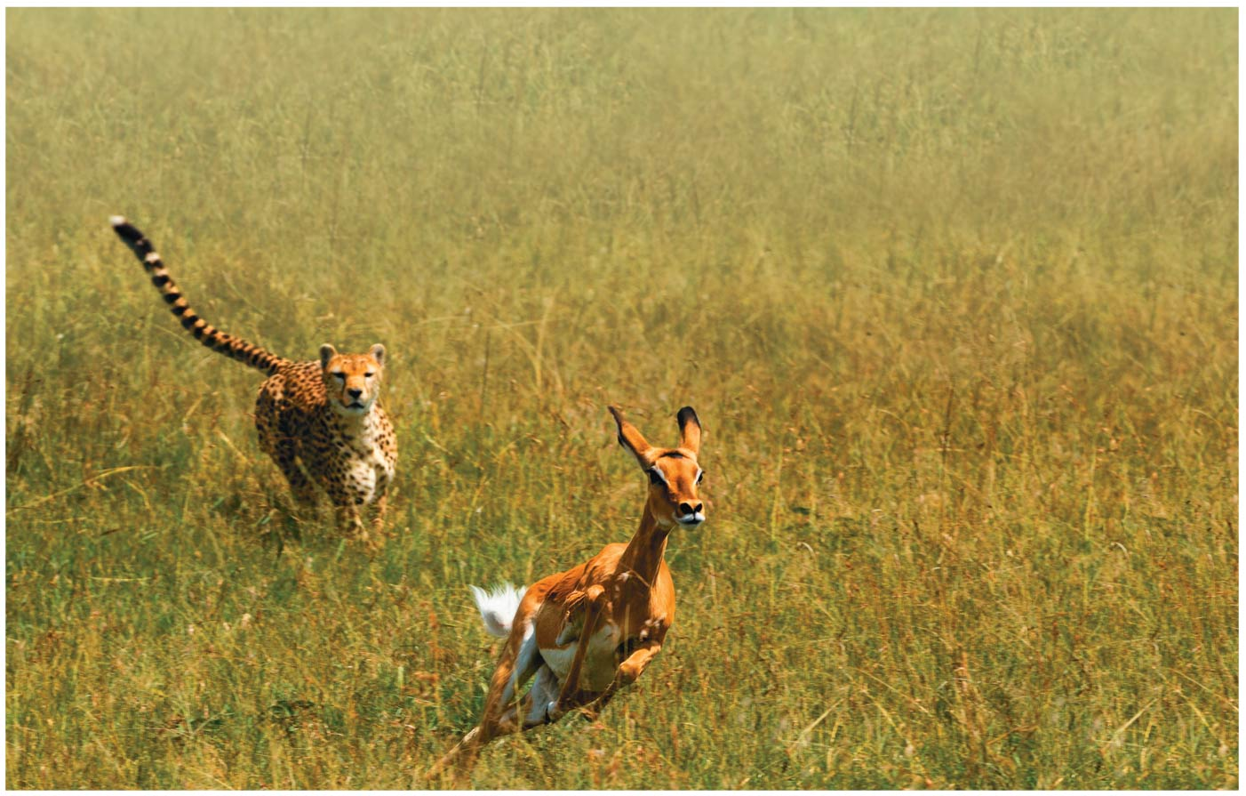
Figure 11.1
Notes:
Figure 11.1 How does cell signaling trigger the desperate flight of this impala?

Slide 2
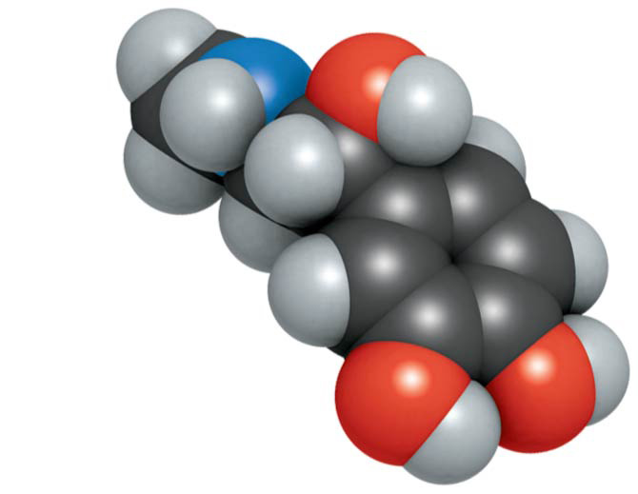
Figure 11.1a
Epinephrine
Notes:
Figure 11.1a How does cell signaling trigger the desperate flight of this impala? (part 1: epinephrine molecule)

Slide 3
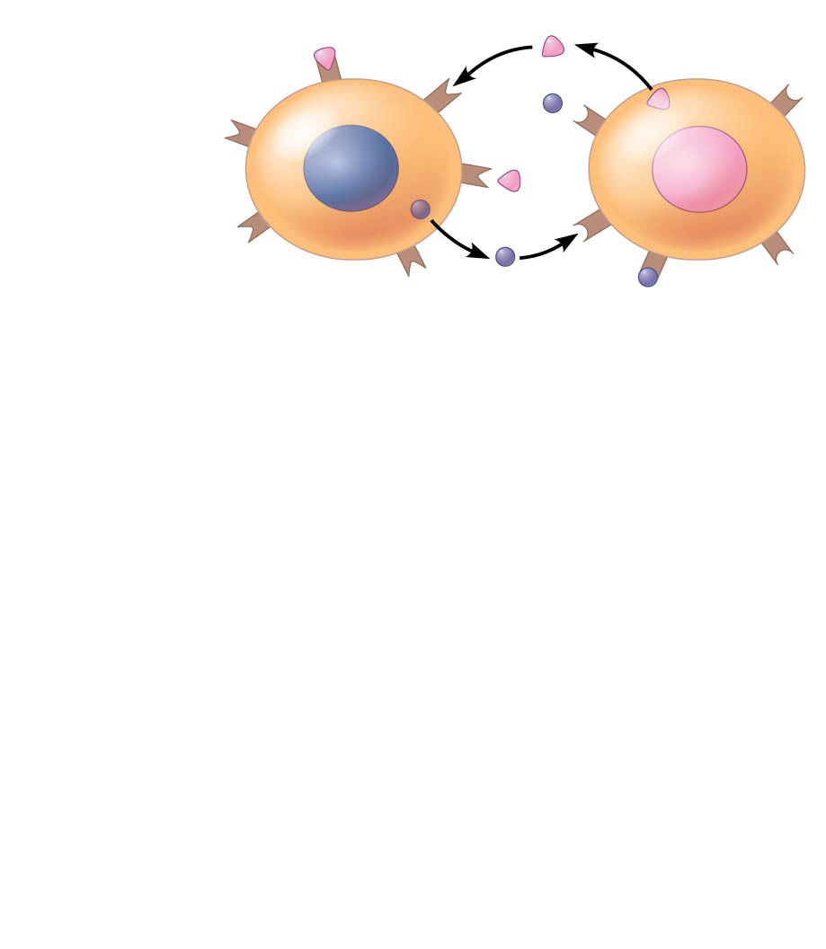
Figure 11.2-1
Exchange of mating factors
Receptor
α factor
1
a
α
Yeast cell, mating type a
a factor
Yeast cell, mating type α
Notes:
Figure 11.2-1 Communication between mating yeast cells (step 1)

Slide 4
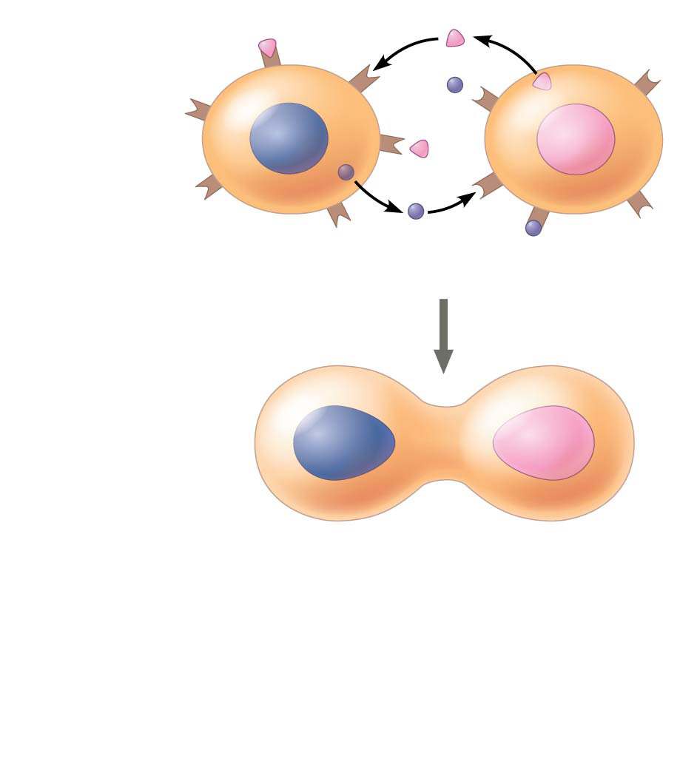
Figure 11.2-2
Exchange of mating factors
Receptor
α factor
1
a
α
Yeast cell, mating type a
a factor
Yeast cell, mating type α
2
Mating
a
α
Notes:
Figure 11.2-2 Communication between mating yeast cells (step 2)

Slide 5
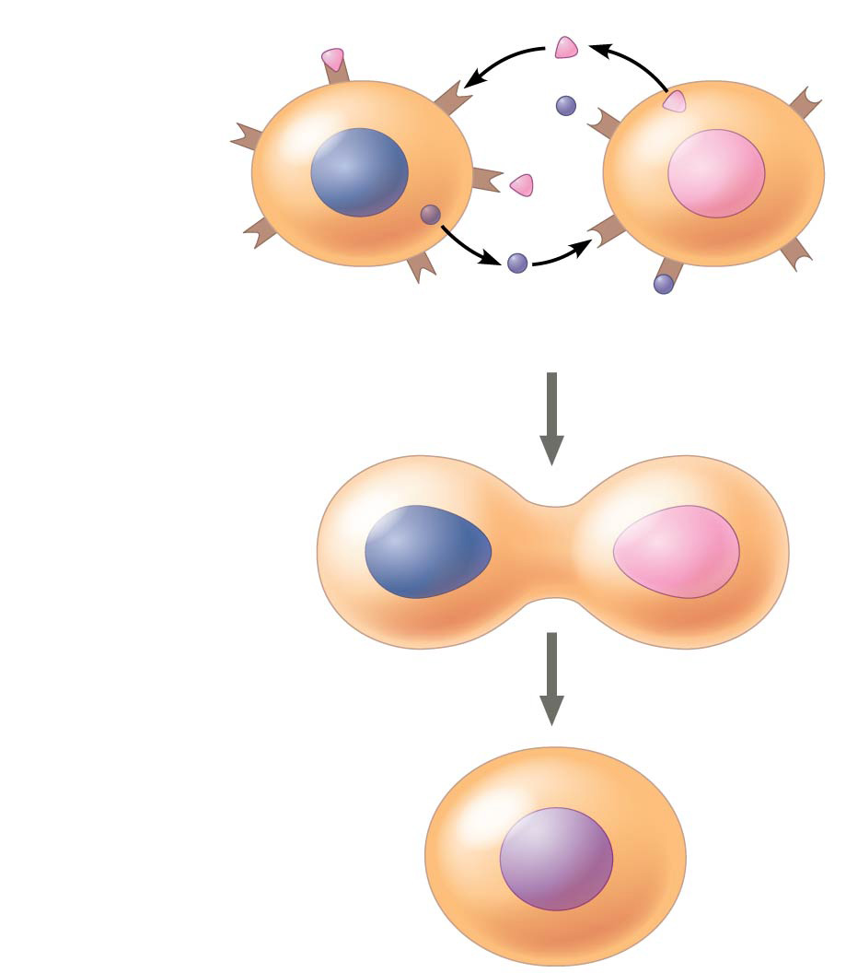
Figure 11.2-3
Exchange of mating factors
Receptor
α factor
1
a
α
Yeast cell, mating type a
a factor
Yeast cell, mating type α
2
Mating
a
α
3
New a/α cell
a/ α
Notes:
Figure 11.2-3 Communication between mating yeast cells (step 3)

Slide 6
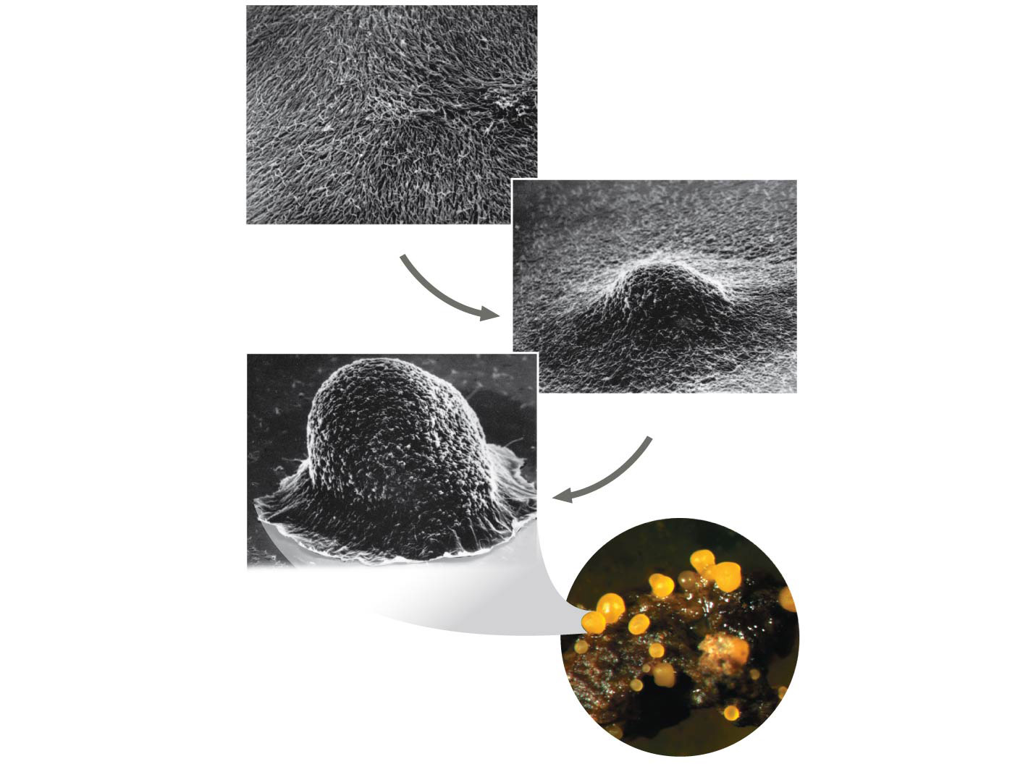
Figure 11.3
1
Individual rod-shaped cells
2
2
Aggregation in progress
0.5 mm
3
Spore-forming structure (fruiting body)
2.5 mm
Fruiting bodies
Notes:
Figure 11.3 Communication among bacteria

Slide 7
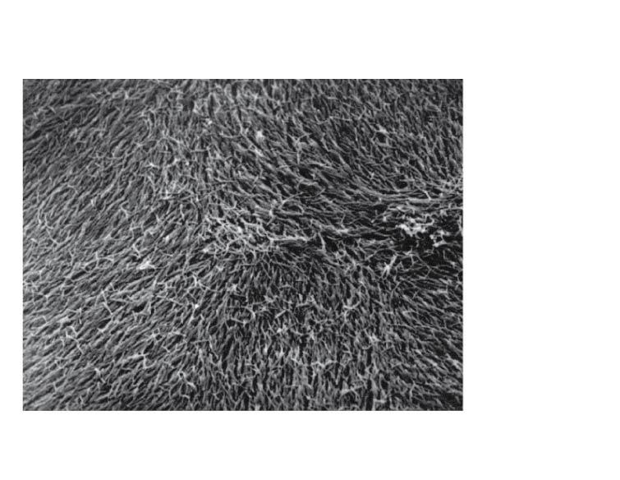
Figure 11.3a
0.5 mm
1
Individual rod-shaped cells
Notes:
Figure 11.3a Communication among bacteria (part 1: individual cells, SEM)

Slide 8
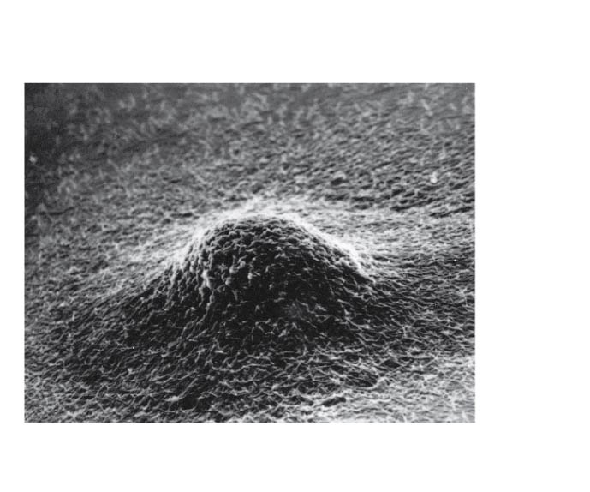
Figure 11.3b
0.5 mm
2
Aggregation in progress
Notes:
Figure 11.3b Communication among bacteria (part 2: aggregation in progress, SEM)

Slide 9
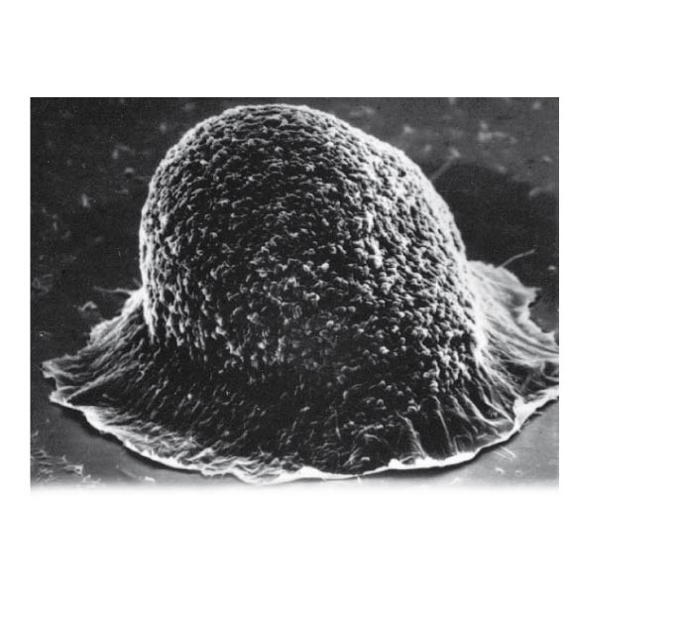
Figure 11.3c
0.5 mm
3
Spore-forming structure (fruiting body)
Notes:
Figure 11.3c Communication among bacteria (part 3: spore-forming structure, SEM)

Slide 10
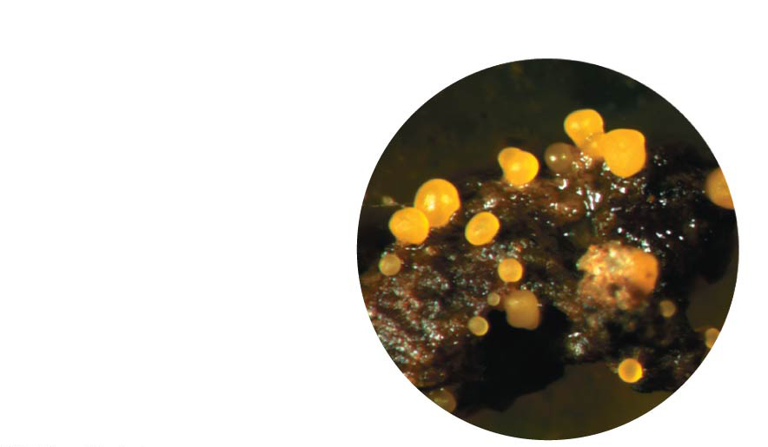
Figure 11.3d
2.5 mm
Fruiting bodies
Notes:
Figure 11.3d Communication among bacteria (part 4: fruiting bodies, LM)

Slide 11
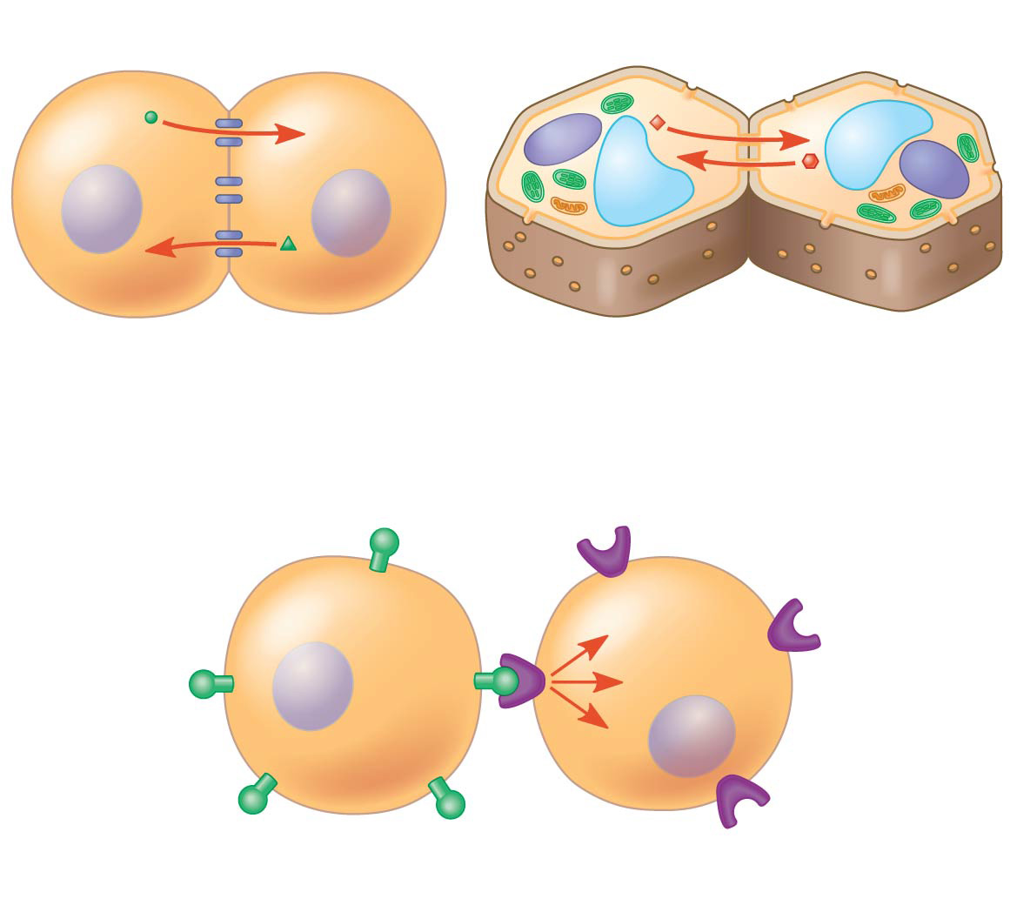
Figure 11.4
Cell wall
Plasma membranes
Gap junctions between animal cells
Plasmodesmata between plant cells
(a) Cell junctions
(b) Cell-cell recognition
Notes:
Figure 11.4 Communication by direct contact between cells

Slide 12
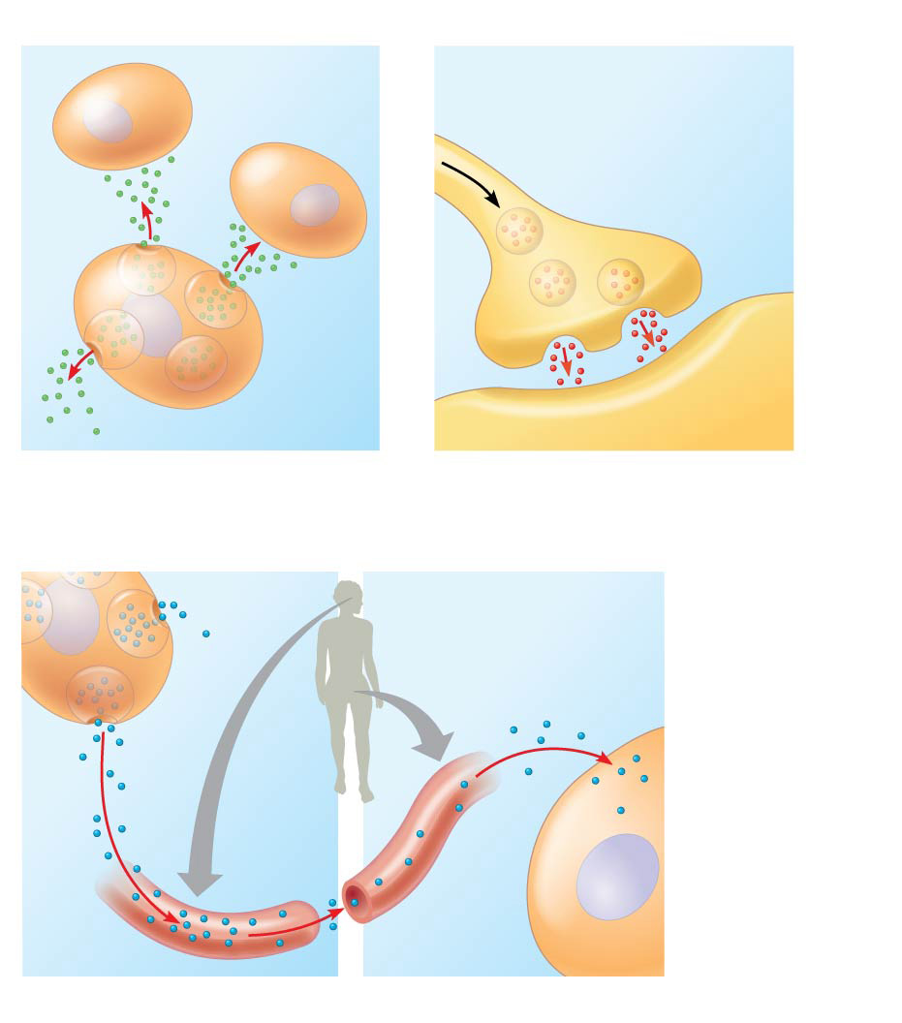
Figure 11.5
Local signaling
Target cells
Electrical signal triggers release of neurotransmitter.
Neurotransmitter diffuses across synapse.
Secreting cell
Secretory vesicles
Local regulator
Target cell
(a) Paracrine signaling
(b) Synaptic signaling
Long-distance signaling
Endocrine cell
Target cell specifically binds hormone.
Hormone travels in bloodstream.
Blood vessel
(c) Endocrine (hormonal) signaling
Notes:
Figure 11.5 Local and long-distance cell signaling by secreted molecules in animals

Slide 13
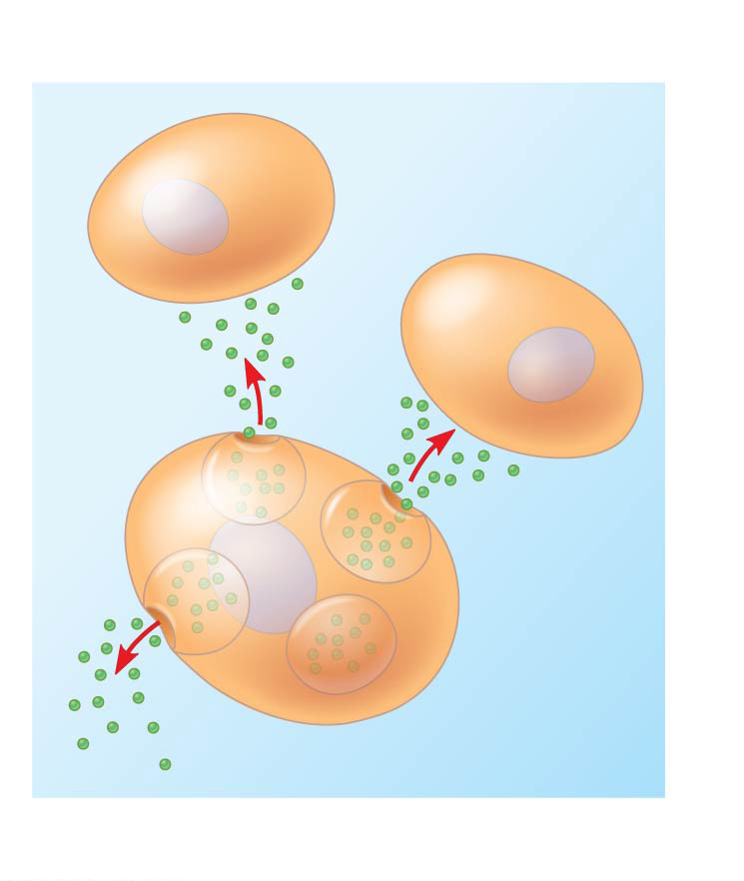
Figure 11.5a
Local signaling
Target cells
Secreting cell
Secretory vesicles
Local regulator
(a) Paracrine signaling
Notes:
Figure 11.5a Local and long-distance cell signaling by secreted molecules in animals (part 1: local signaling, paracrine)

Slide 14
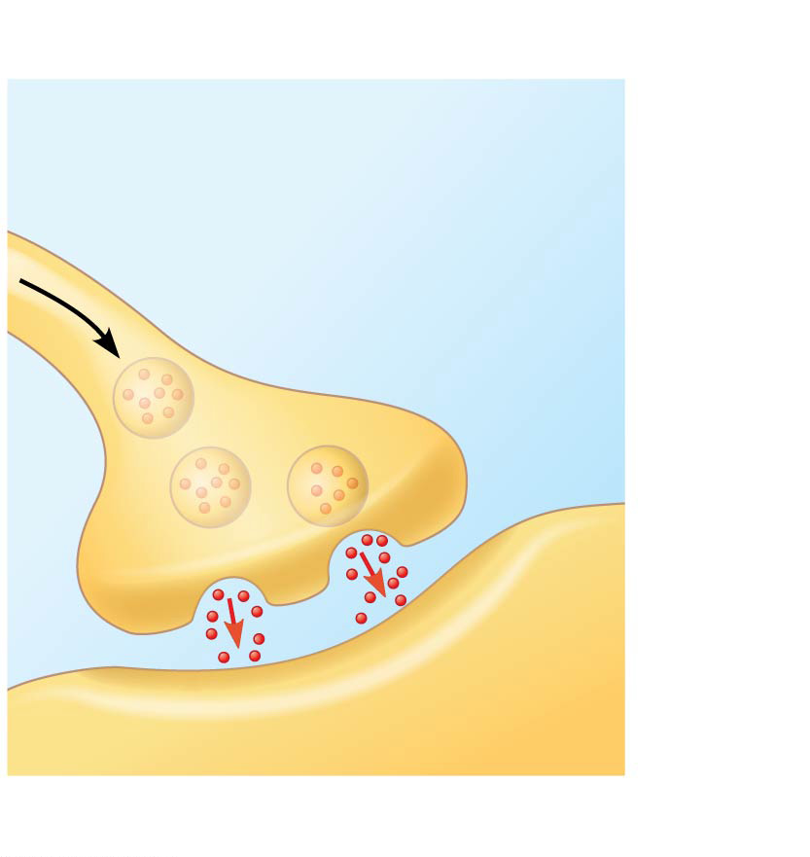
Figure 11.5b
Local signaling
Electrical signal triggers release of neurotransmitter.
Neurotransmitter diffuses across synapse.
Target cell
(b) Synaptic signaling
Notes:
Figure 11.5b Local and long-distance cell signaling by secreted molecules in animals (part 2: local signaling, synaptic)

Slide 15
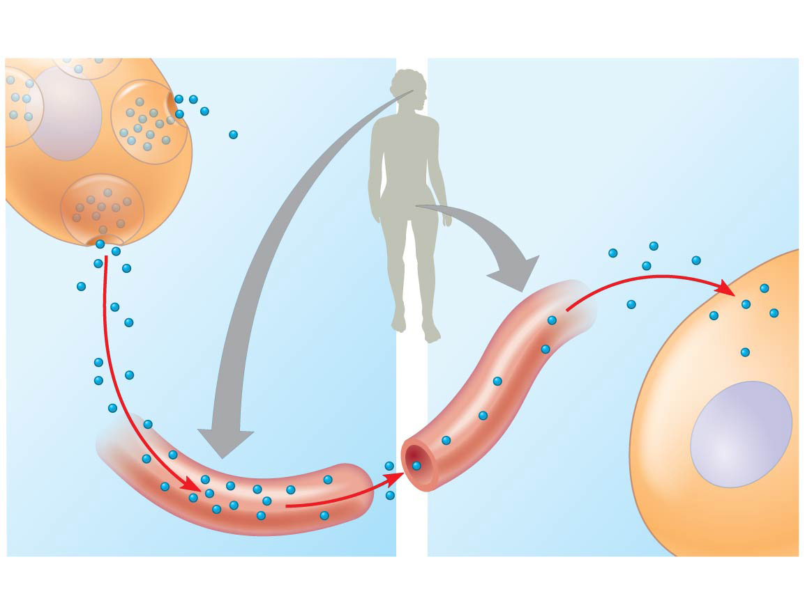
Figure 11.5c
Long-distance signaling
Endocrine cell
Target cell specifically binds hormone.
Hormone travels in bloodstream.
Blood vessel
(c) Endocrine (hormonal) signaling
Notes:
Figure 11.5c Local and long-distance cell signaling by secreted molecules in animals (part 3: long-distance signaling, endocrine)

Slide 16
Figure 11.6-1
EXTRACELLULAR FLUID
CYTOPLASM
Plasma membrane
1
Reception
Receptor
Signaling molecule
Notes:
Figure 11.6-1 Overview of cell signaling (step 1)

Slide 17
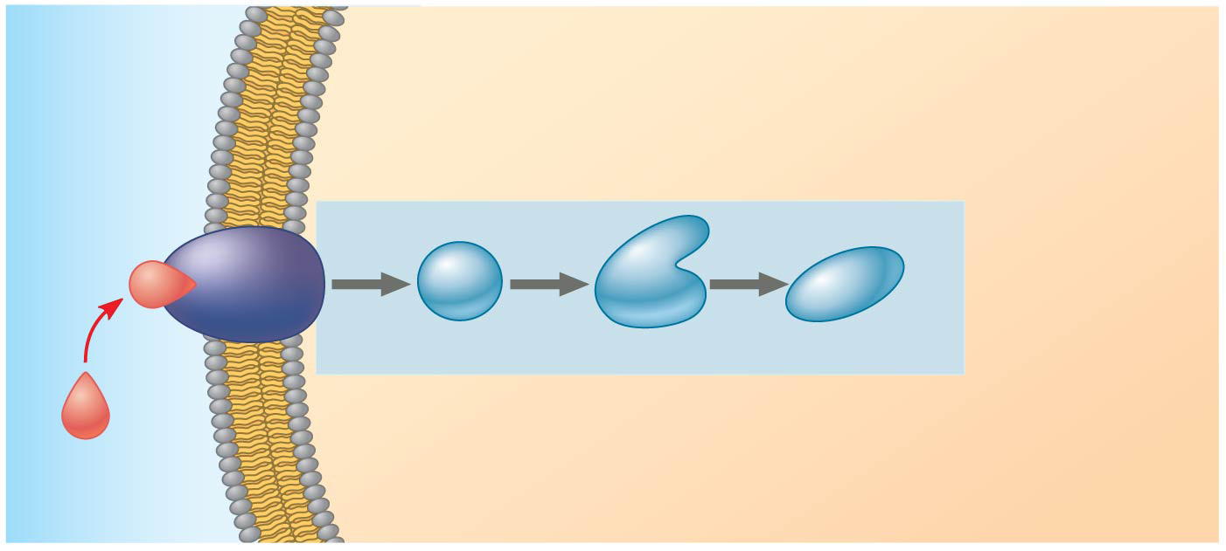
Figure 11.6-2
EXTRACELLULAR FLUID
CYTOPLASM
Plasma membrane
1
Reception
2
Transduction
Receptor
1
2
3
Relay molecules
Signaling molecule
Notes:
Figure 11.6-2 Overview of cell signaling (step 2)

Slide 18
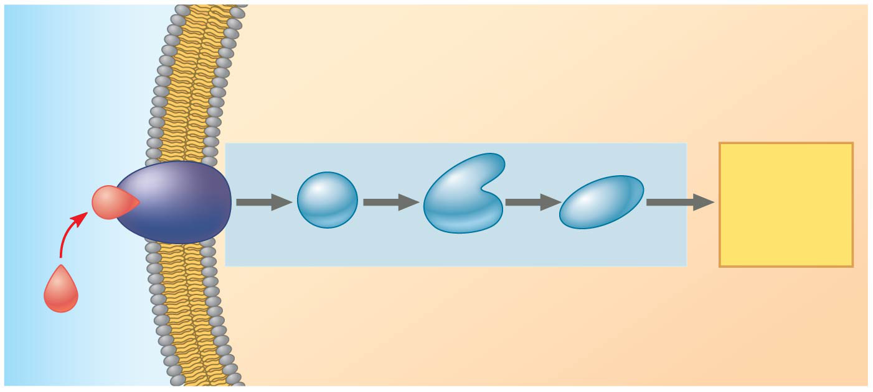
Figure 11.6-3
EXTRACELLULAR FLUID
CYTOPLASM
Plasma membrane
1
Reception
2
Transduction
3
Response
Receptor
Activation of cellular response
1
2
3
Relay molecules
Signaling molecule
Notes:
Figure 11.6-3 Overview of cell signaling (step 3)

Slide 19
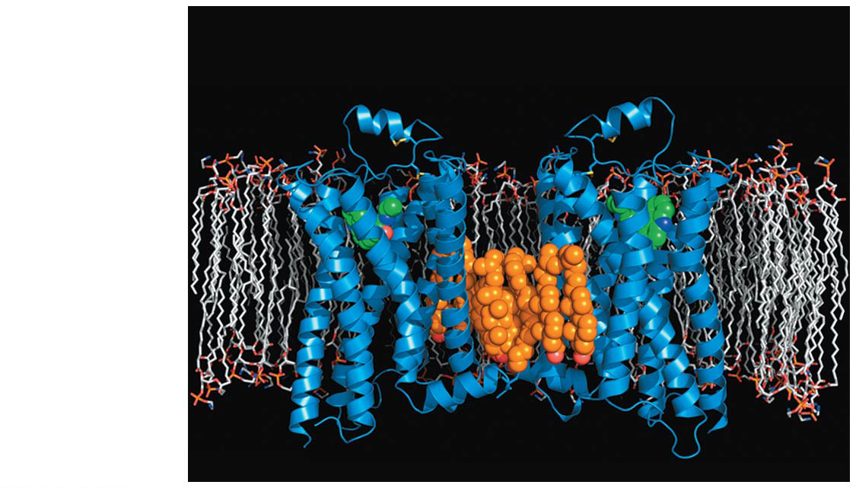
Figure 11.7
β₂-adrenergic receptors
Molecule mimicking ligand
Plasma membrane
Cholesterol
Notes:
Figure 11.7 The structure of a G protein-coupled receptor (GPCR)

Slide 20
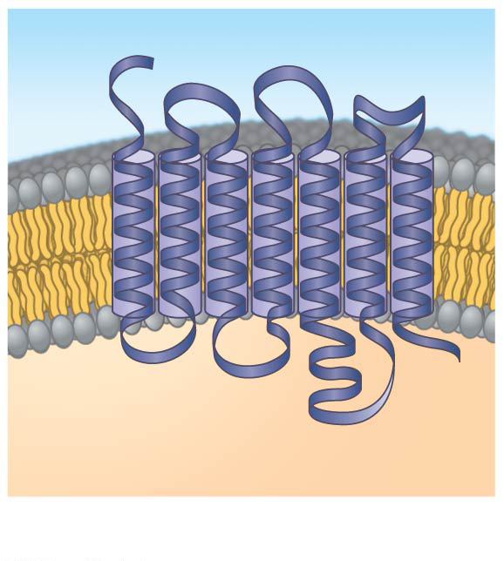
Figure 11.8a
Signaling molecule binding site
Segment that interacts with G proteins
G protein-coupled receptor
Notes:
Figure 11.8a Exploring cell-surface transmembrane receptors (part 1: GPCR ribbon model)

Slide 21
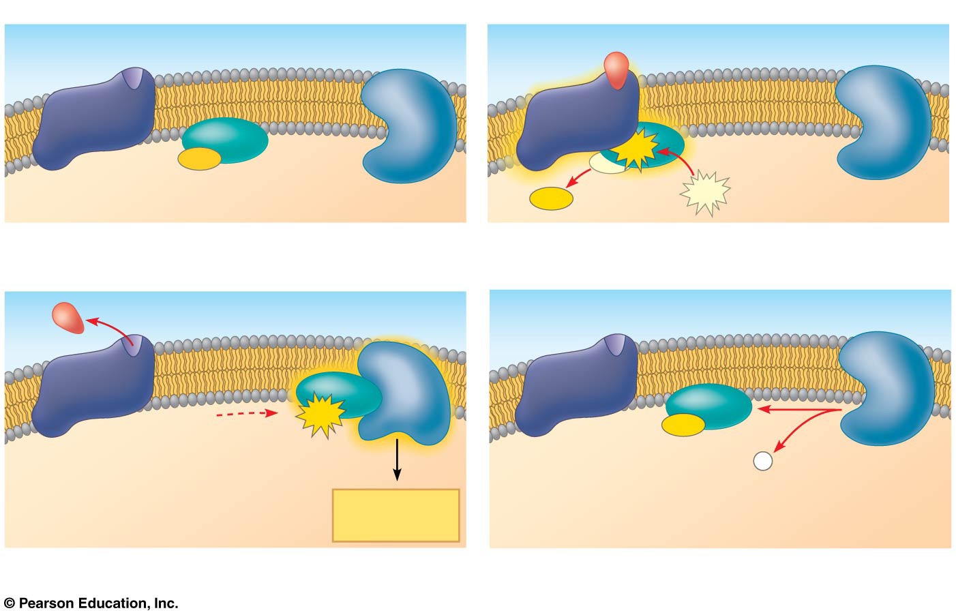
Figure 11.8b
Signaling molecule
Inactive enzyme
G protein-coupled receptor
Plasma membrane
Activated receptor
GDP
GTP
GDP
G protein (inactive)
GTP
CYTOPLASM
Enzyme
GDP
1
2
Activated enzyme
GTP
GDP
P
i
Cellular response
3
4
Notes:
Figure 11.8b Exploring cell-surface transmembrane receptors (part 2: GPCR signaling)

Slide 22
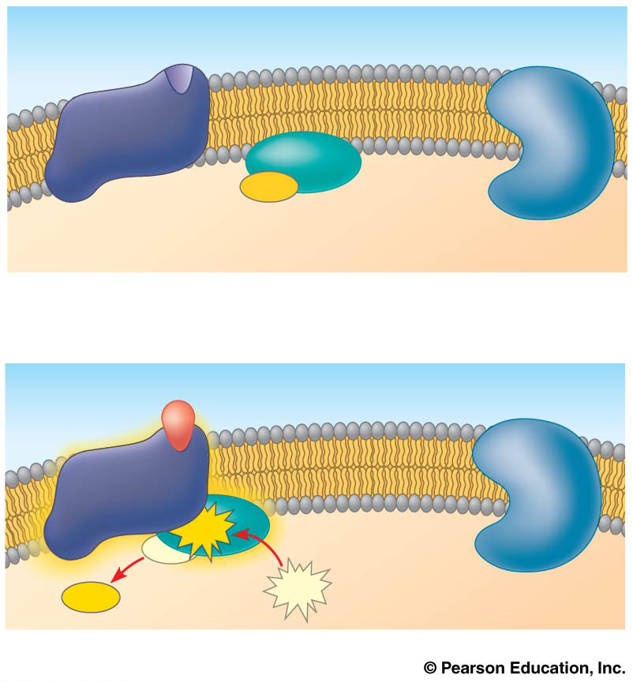
Figure 11.8ba
G protein-coupled receptor
Plasma membrane
GDP
G protein (inactive)
CYTOPLASM
Enzyme
1
Signaling molecule
Inactive enzyme
Activated receptor
GTP
GDP
GDP
GTP
2
Notes:
Figure 11.8ba Exploring cell-surface transmembrane receptors (part 2a: GPCR signaling, activation)

Slide 23
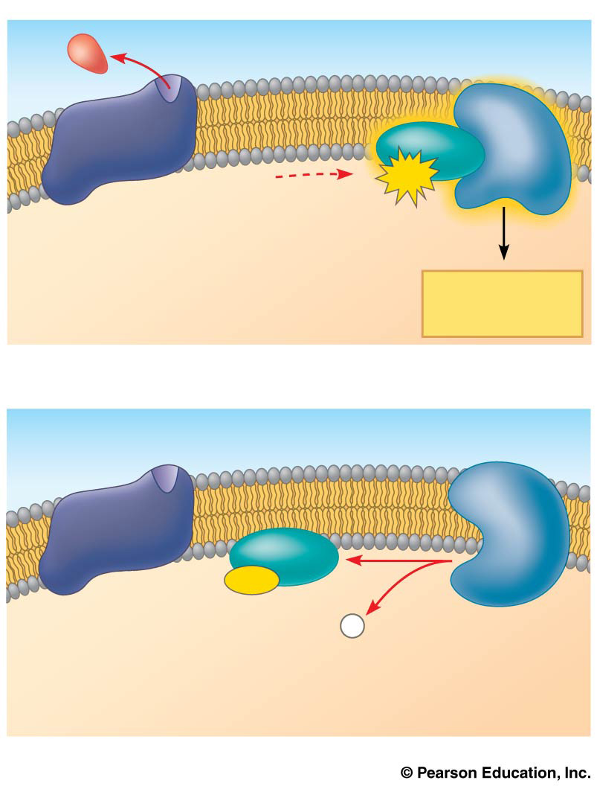
Figure 11.8bb
Activated enzyme
GTP
Cellular response
3
GDP
P
i
4
Notes:
Figure 11.8bb Exploring cell-surface transmembrane receptors (part 2b: GPCR signaling, cellular response and hydrolysis)

Slide 24
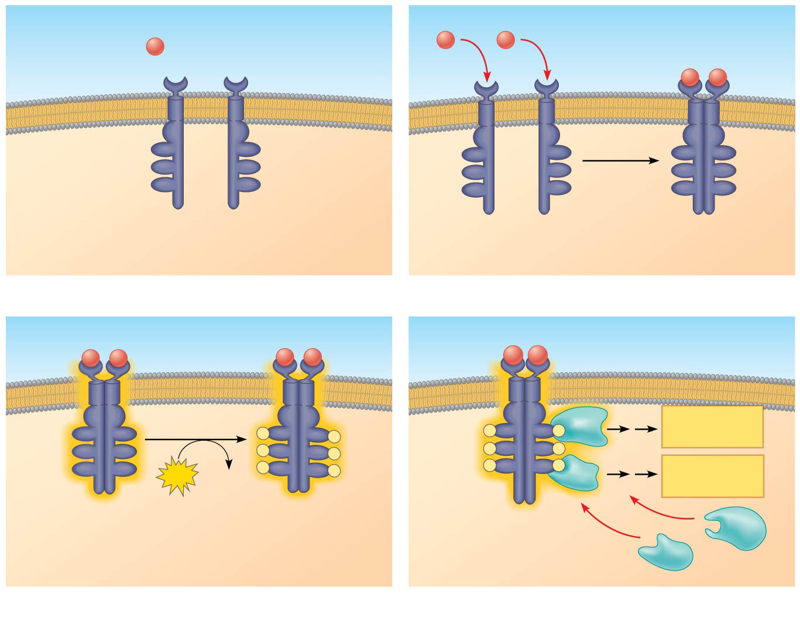
Figure 11.8c
Signaling molecule (ligand)
Signaling molecule
Ligand-binding site
α helix in the membrane
Tyrosines
Tyr
Tyr
Tyr
Tyr
Tyr
Tyr
Tyr
Tyr
Tyr
Tyr
Tyr
Tyr
Tyr
Tyr
Tyr
Tyr
Tyr
Tyr
Receptor tyrosine kinase proteins (inactive monomers)
Dimer
CYTOPLASM
1
2
Activated relay proteins
Cellular response 1
Tyr
Tyr
P
Tyr
Tyr
P
P
Tyr
Tyr
P
Tyr
Tyr
P
Tyr
Tyr
P
P
Tyr
Tyr
P
Tyr
Tyr
6
ATP
6 ADP
P
Tyr
Tyr
P
P
Tyr
Tyr
P
Cellular response 2
Activated tyrosine kinase regions (unphosphorylated dimer)
Fully activated receptor tyrosine kinase (phos- phorylated dimer)
Inactive relay proteins
3
4
Notes:
Figure 11.8c Exploring cell-surface transmembrane receptors (part 3: RTKs)

Slide 25
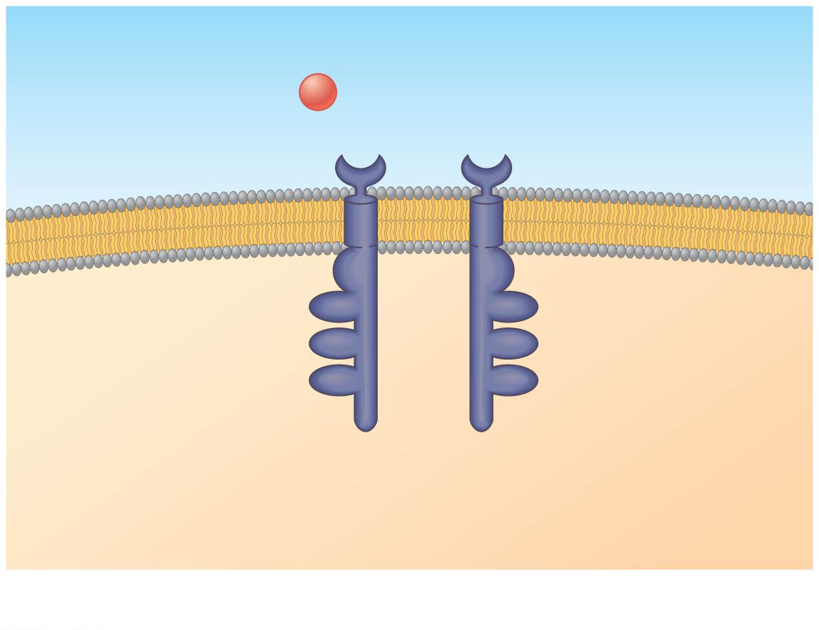
Figure 11.8ca
Signaling molecule (ligand)
Ligand-binding site
α helix in the membrane
Tyr
Tyr
Tyrosines
Tyr
Tyr
Tyr
Tyr
Receptor tyrosine kinase proteins (inactive monomers)
CYTOPLASM
1
Notes:
Figure 11.8ca Exploring cell-surface transmembrane receptors (part 3a: RTKs, inactive)

Slide 26
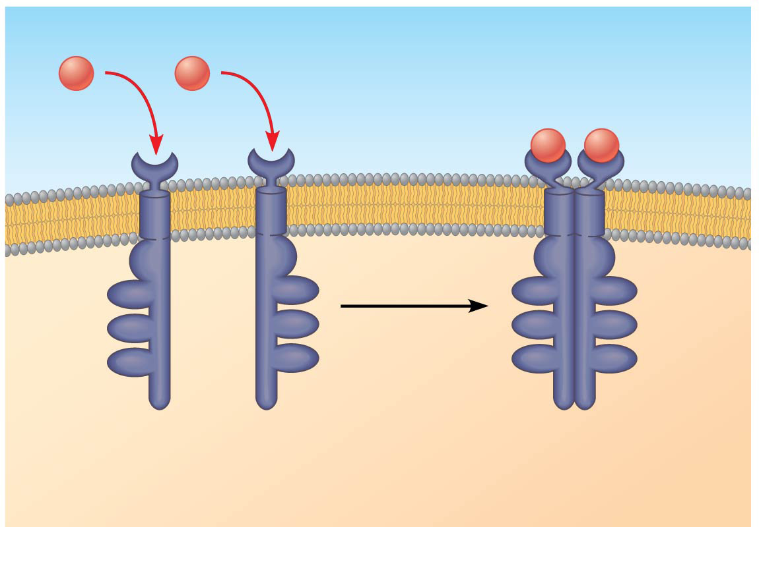
Figure 11.8cb
Signaling molecule
Tyr
Tyr
Tyr
Tyr
Tyr
Tyr
Tyr
Tyr
Tyr
Tyr
Tyr
Tyr
Dimer
2
Notes:
Figure 11.8cb Exploring cell-surface transmembrane receptors (part 3b: RTKs, dimerization)

Slide 27
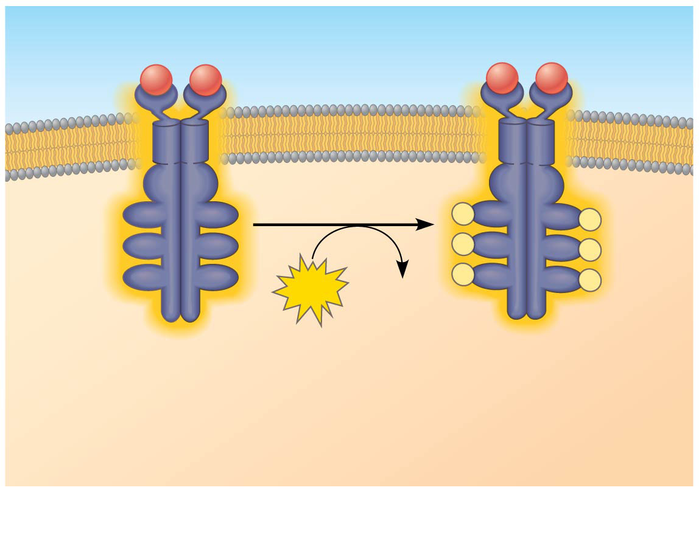
Figure 11.8cc
Tyr
Tyr
P
Tyr
Tyr
P
Tyr
Tyr
P
Tyr
Tyr
P
Tyr
Tyr
P
Tyr
Tyr
6
ATP
6 ADP
P
Activated tyrosine kinase regions (unphosphorylated dimer)
Fully activated receptor tyrosine kinase (phos- phorylated dimer)
3
Notes:
Figure 11.8cc Exploring cell-surface transmembrane receptors (part 3c: RTKs, phosphorylation)

Slide 28
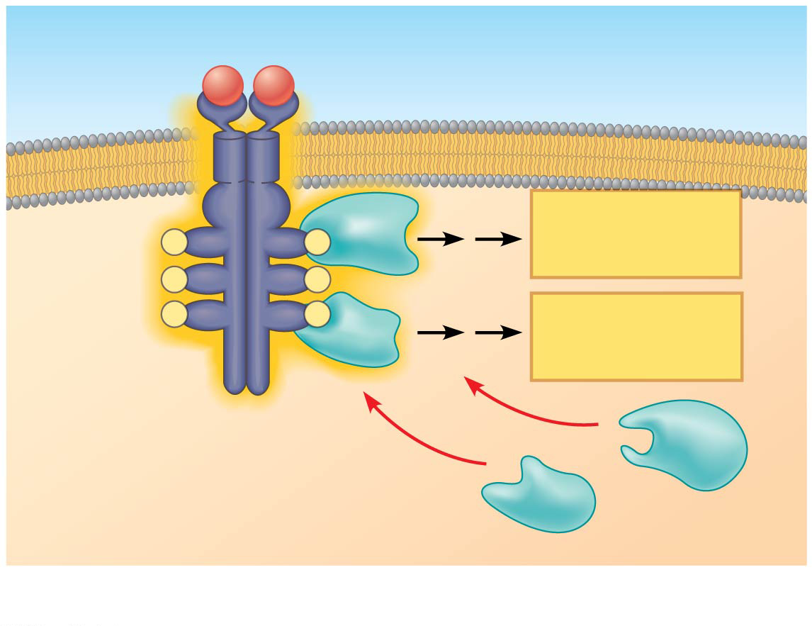
Figure 11.8cd
Activated relay proteins
Cellular response 1
P
Tyr
P
Tyr
P
Tyr
Tyr
P
P
Tyr
P
Cellular response 2
Tyr
Inactive relay proteins
4
Notes:
Figure 11.8cd Exploring cell-surface transmembrane receptors (part 3d: RTKs, cellular response)

Slide 29
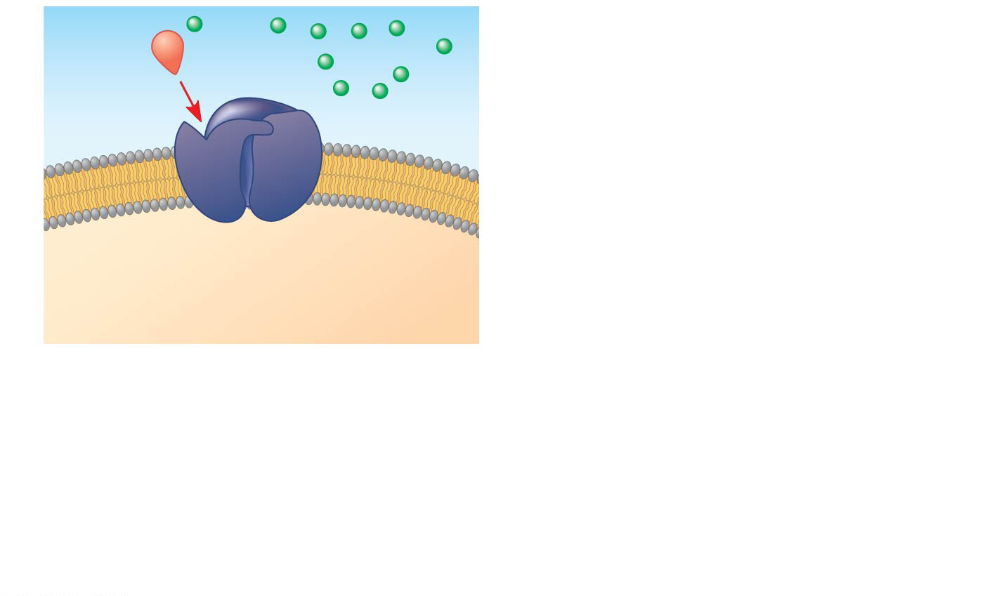
Figure 11.8d-1
1
Gate closed
Ions
Signaling molecule (ligand)
Ligand-gated ion channel receptor
Plasma
membrane
Notes:
Figure 11.8d-1 Exploring cell-surface transmembrane receptors (part 4: ion channel receptors, step 1)

Slide 30
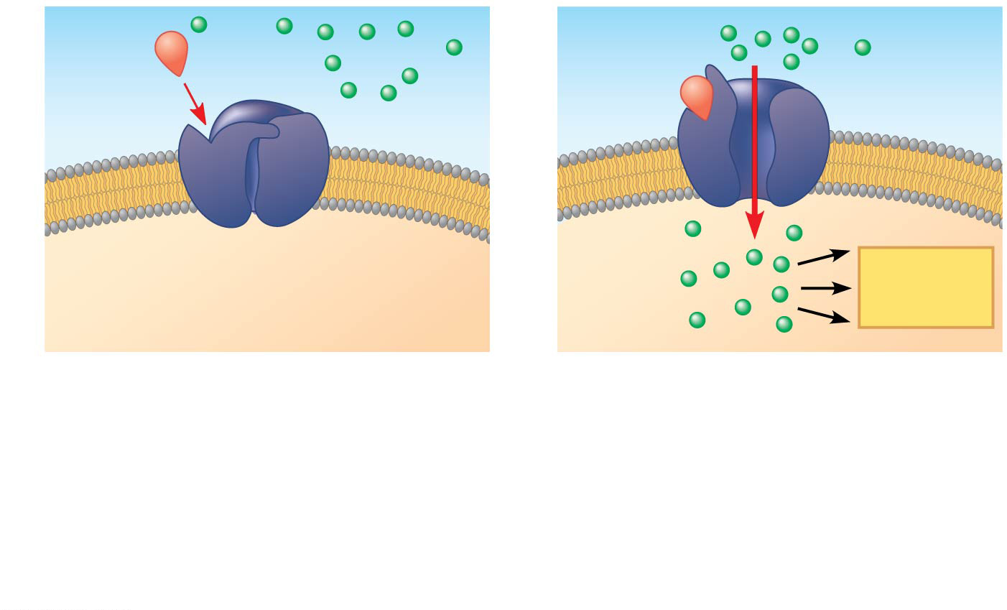
Figure 11.8d-2
1
2
Gate open
Gate closed
Ions
Signaling molecule (ligand)
Plasma
membrane
Cellular response
Ligand-gated ion channel receptor
Notes:
Figure 11.8d-2 Exploring cell-surface transmembrane receptors (part 4: ion channel receptors, step 2)

Slide 31
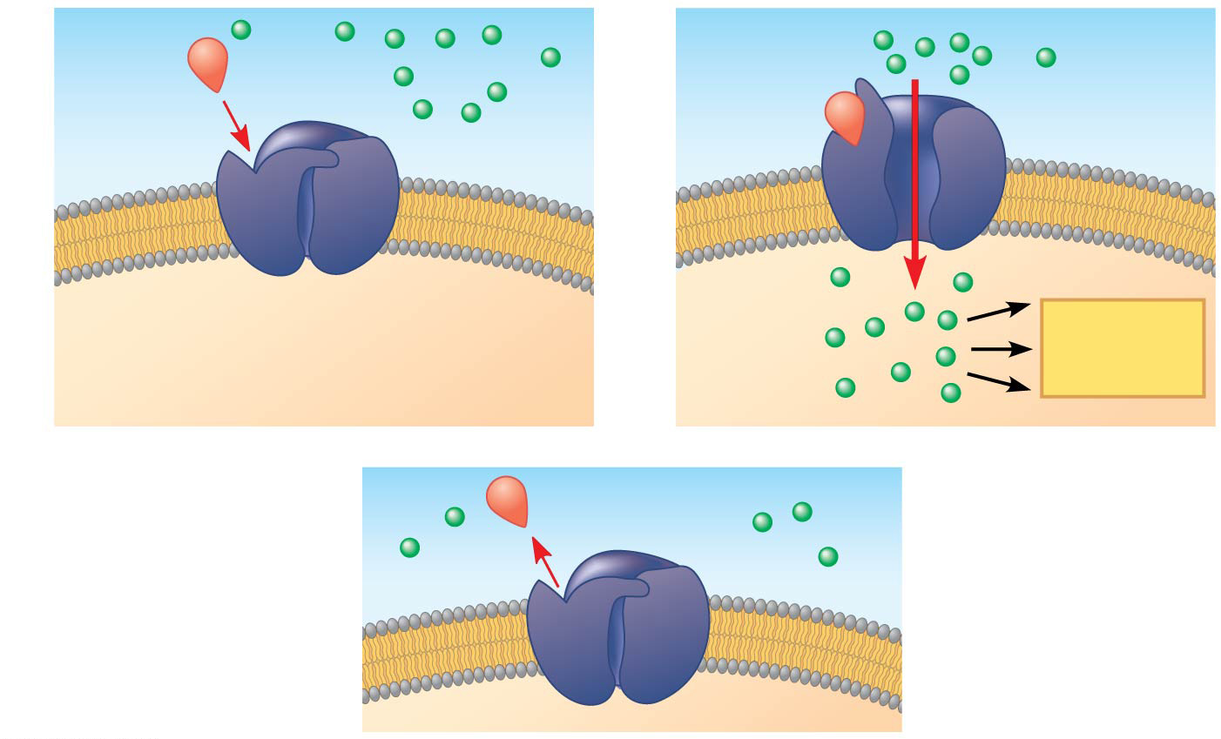
Figure 11.8d-3
1
2
Gate open
Gate closed
Ions
Signaling molecule (ligand)
Plasma
membrane
Cellular response
Ligand-gated ion channel receptor
3
Gate closed
Notes:
Figure 11.8d-3 Exploring cell-surface transmembrane receptors (part 4: ion channel receptors, step 3)

Slide 32
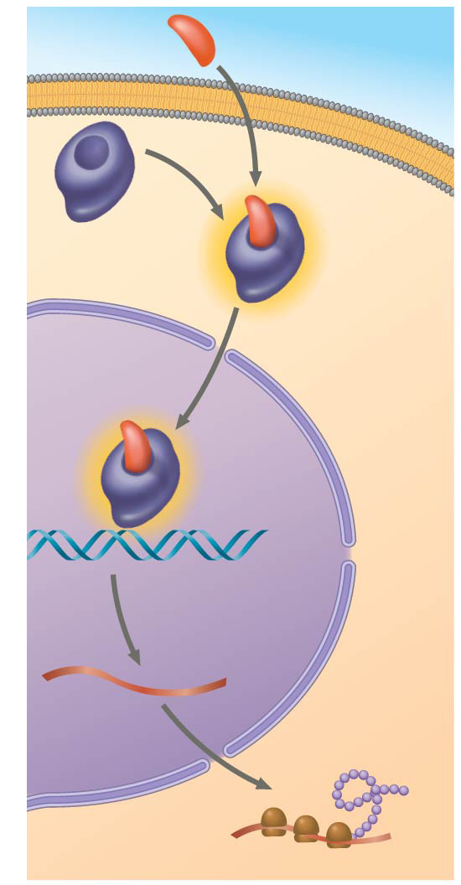
Figure 11.9
Hormone (aldosterone)
EXTRA- CELLULAR FLUID
Plasma
membrane
Receptor protein
Hormone- receptor complex
DNA
mRNA
New protein
NUCLEUS
CYTOPLASM
Notes:
Figure 11.9 Steroid hormone interacting with an intracellular receptor

Slide 33
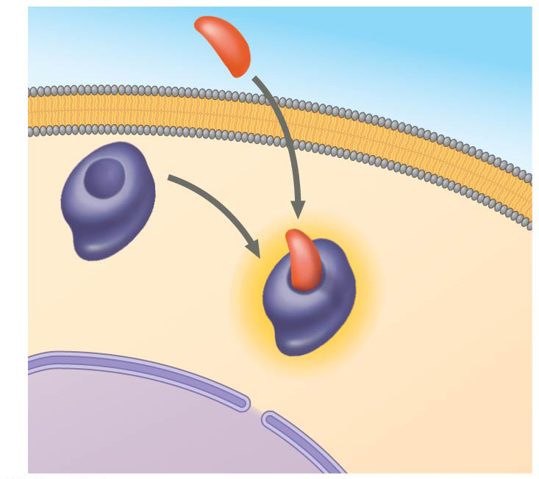
Figure 11.9a
Hormone (aldosterone)
EXTRA- CELLULAR FLUID
Plasma
membrane
Receptor protein
Hormone- receptor complex
NUCLEUS
CYTOPLASM
Notes:
Figure 11.9a Steroid hormone interacting with an intracellular receptor (part 1: cytoplasm)

Slide 34
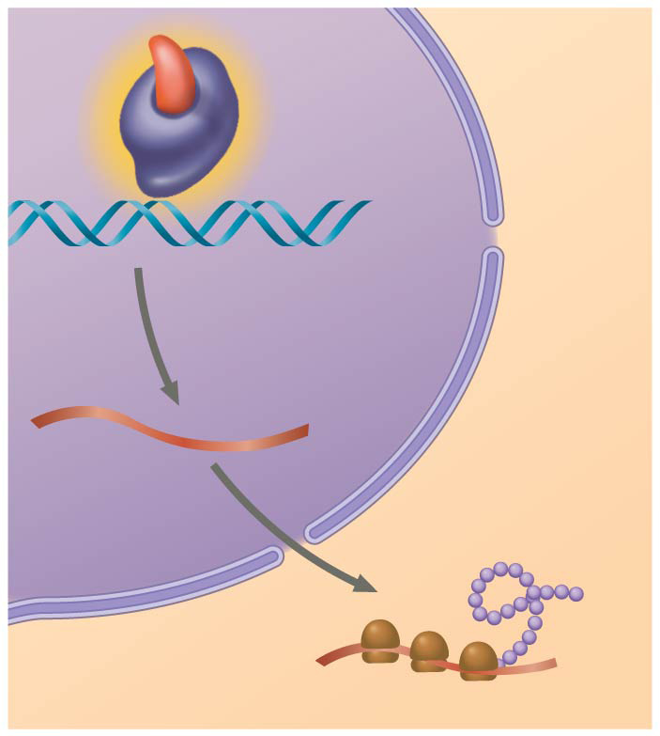
Figure 11.9b
Hormone- receptor complex
DNA
mRNA
New protein
NUCLEUS
CYTOPLASM
Notes:
Figure 11.9b Steroid hormone interacting with an intracellular receptor (part 2: nucleus)

Slide 35
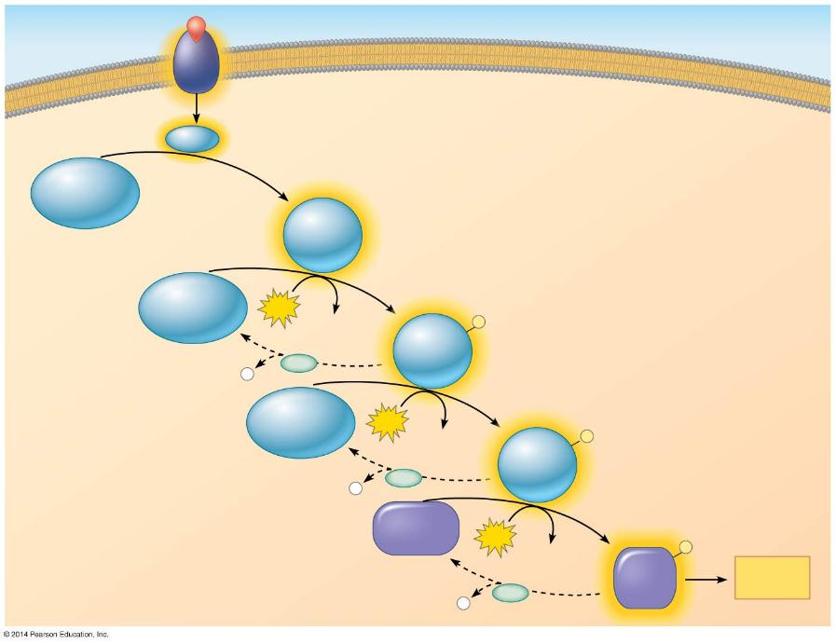
Figure 11.10
Signaling molecule
Receptor
Activated relay
molecule
Inactive protein kinase 1
Active protein kinase 1
Inactive protein kinase 2
ATP
Phosphorylation cascade
ADP
Active protein kinase 2
P
P
PP
i
Inactive protein kinase 3
ATP
ADP
Active protein kinase 3
P
P
PP
i
Inactive protein
ATP
P
ADP
Active protein
Cellular
response
P
PP
i
Notes:
Figure 11.10 A phosphorylation cascade

Slide 36
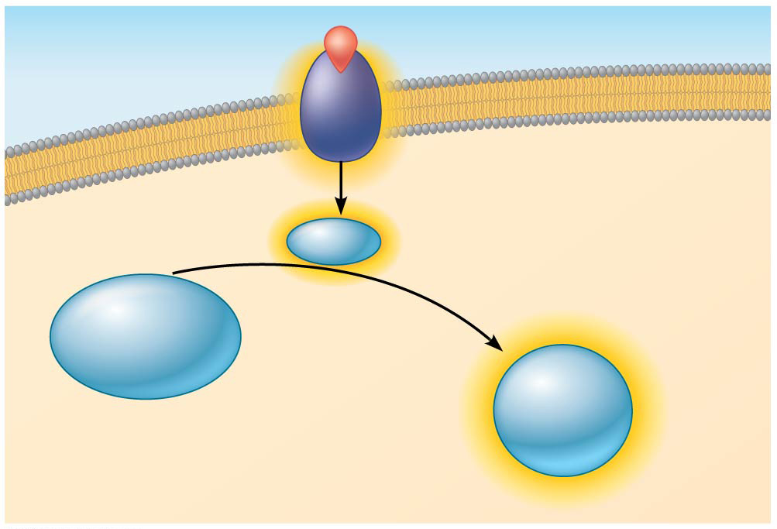
Figure 11.10a
Signaling molecule
Receptor
Activated relay
molecule
Inactive protein kinase 1
Active protein kinase 1
Notes:
Figure 11.10a A phosphorylation cascade (part 1: cascade initiation)

Slide 37
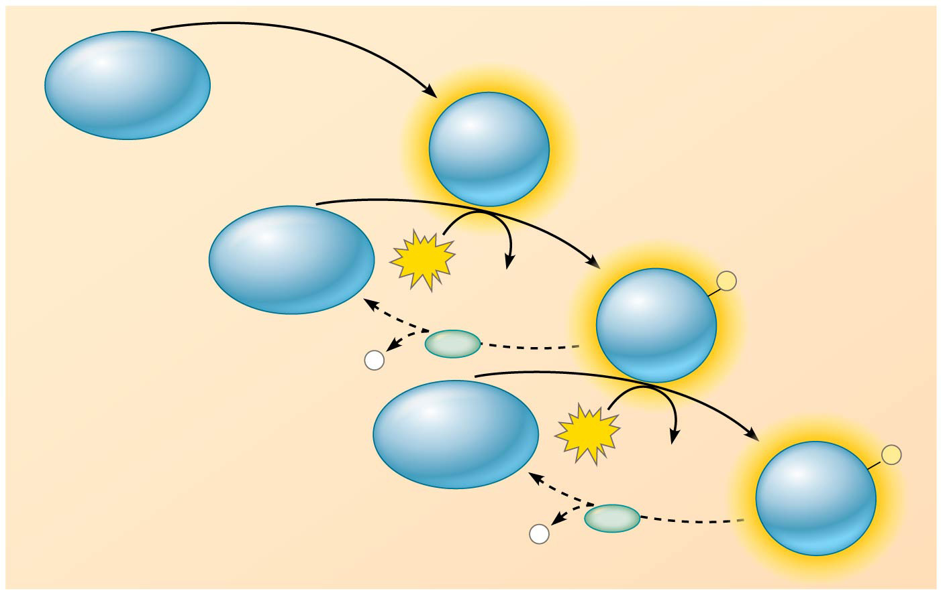
Figure 11.10b
Phosphorylation cascade
Inactive protein kinase 1
Active protein kinase 1
Inactive protein kinase 2
ATP
ADP
Active protein kinase 2
P
PP
P
i
Inactive protein kinase 3
ATP
ADP
Active protein kinase 3
P
PP
P
i
Notes:
Figure 11.10b A phosphorylation cascade (part 2: phosphorylation cascade)

Slide 38
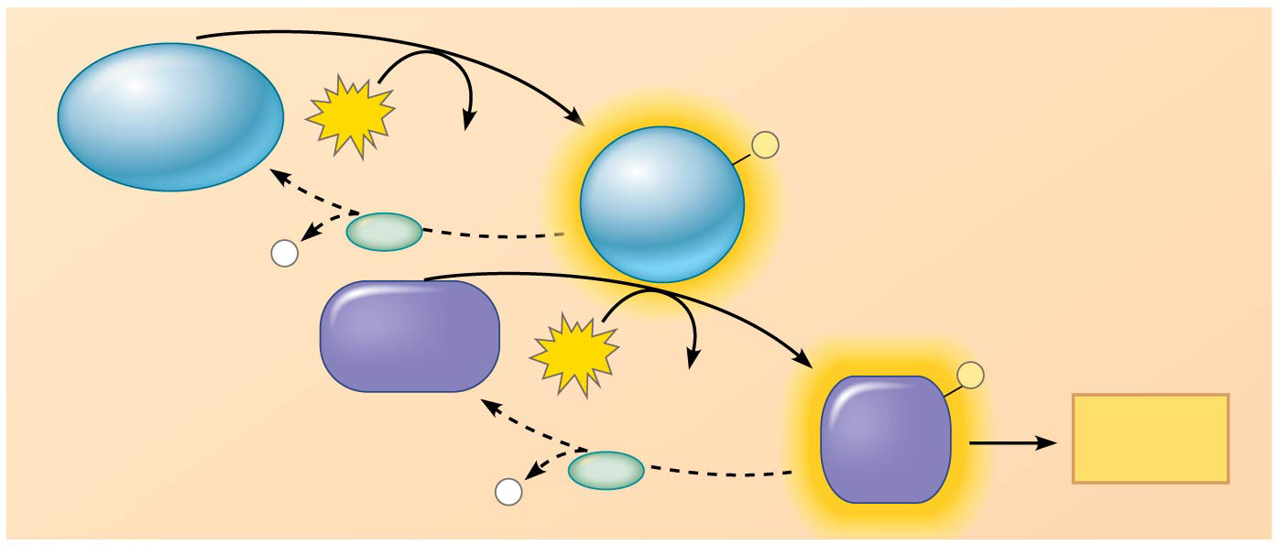
Figure 11.10c
Inactive protein kinase 3
ATP
ADP
Active protein kinase 3
P
PP
P
i
Inactive protein
ATP
ADP
P
Active protein
Cellular response
PP
P
i
Notes:
Figure 11.10c A phosphorylation cascade (part 3: cellular response)

Slide 39
Figure 11.11
Adenylyl cyclase
Phosphodiesterase
Pyrophosphate
H₂O
ATP
cAMP
AMP
Notes:
Figure 11.11 Cyclic AMP

Slide 40
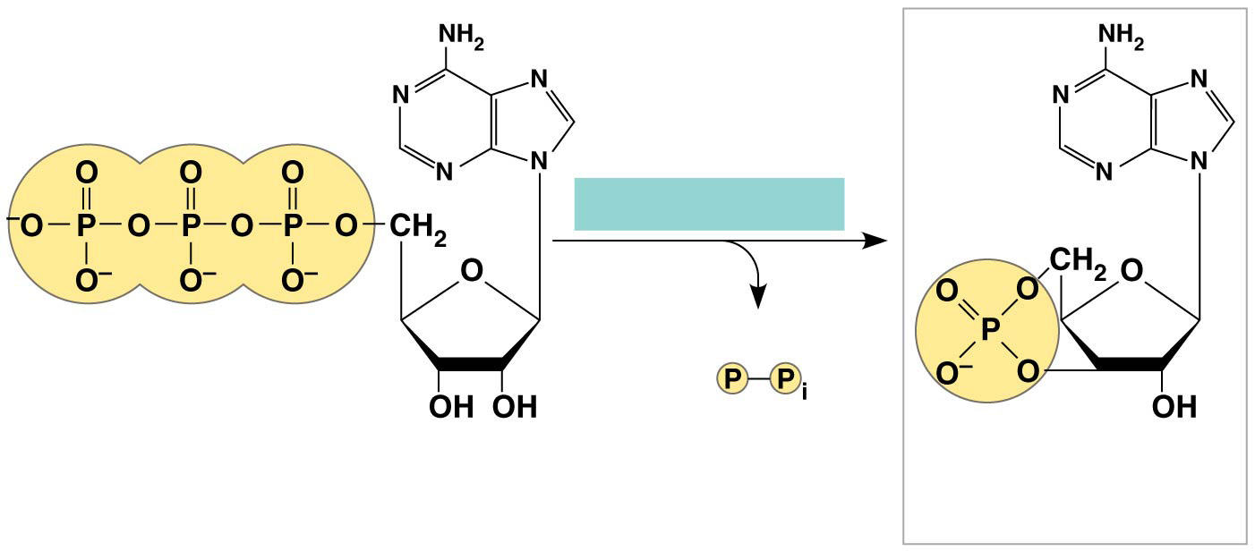
Figure 11.11a
Adenylyl cyclase
Pyrophosphate
ATP
cAMP
Notes:
Figure 11.11a Cyclic AMP (part 1: adenylyl cyclase)

Slide 41
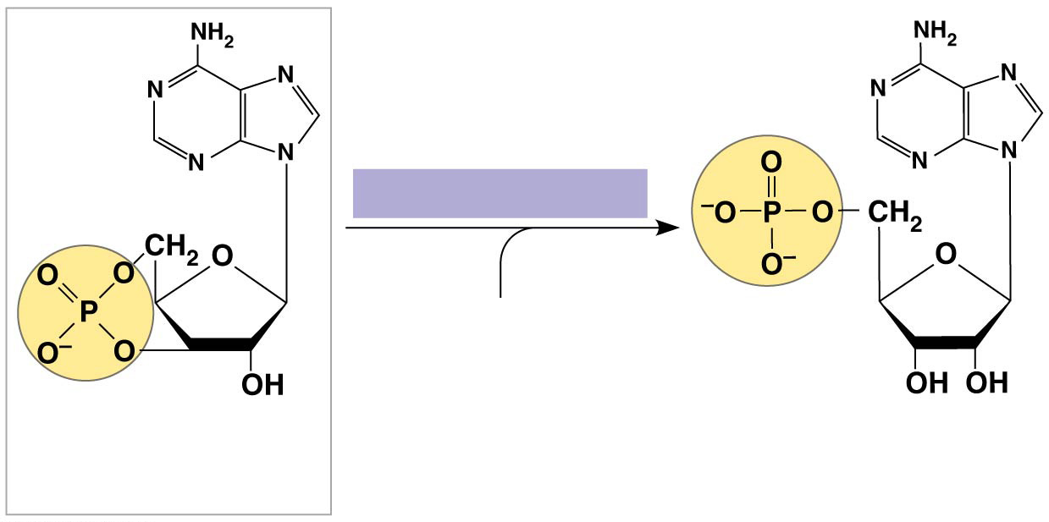
Figure 11.11b
Phosphodiesterase
H₂O
cAMP
AMP
Notes:
Figure 11.11b Cyclic AMP (part 2: phosphodiesterase)

Slide 42
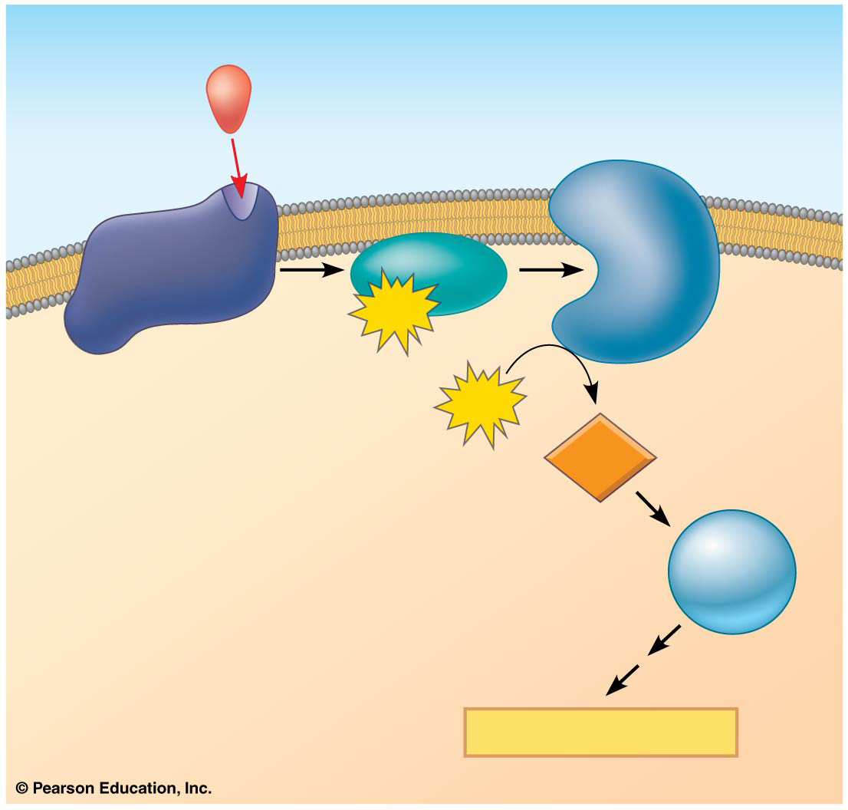
Figure 11.12
First messenger (signaling molecule such as epinephrine)
Adenylyl cyclase
G protein
GTP
G protein-coupled receptor
ATP
Second messenger
cAMP
Protein kinase A
Cellular responses
Notes:
Figure 11.12 cAMP as a second messenger in a G protein signaling pathway

Slide 43
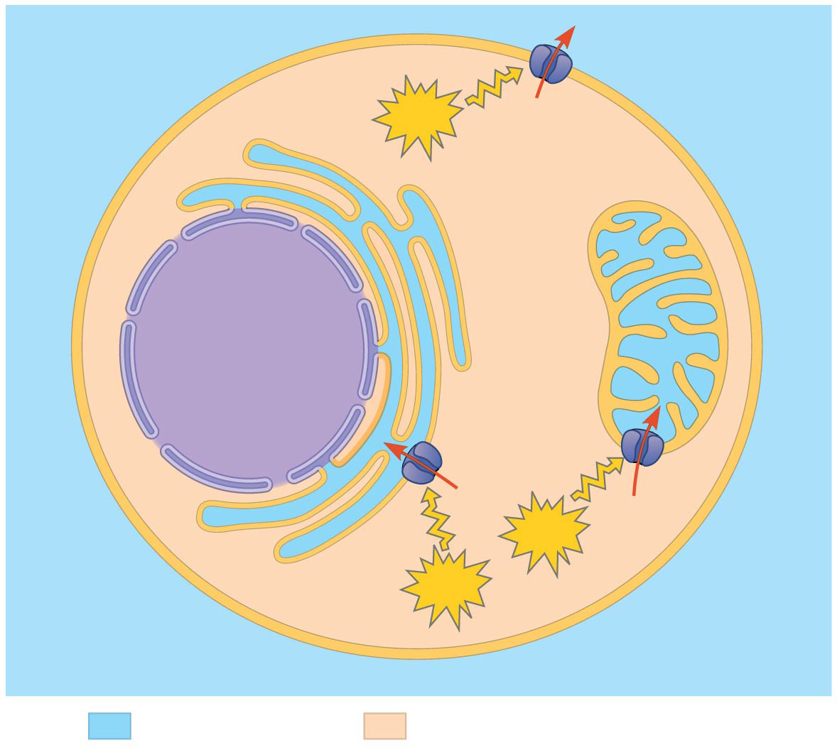
Figure 11.13
Endoplasmic reticulum (ER)
Plasma membrane
ATP
Mitochondrion
Nucleus
Ca²⁺ pump
ATP
CYTOSOL
ATP
EXTRACELLULAR FLUID
Key
High [Ca²⁺]
Low [Ca²⁺]
Notes:
Figure 11.13 The maintenance of calcium ion concentrations in an animal cell

Slide 44
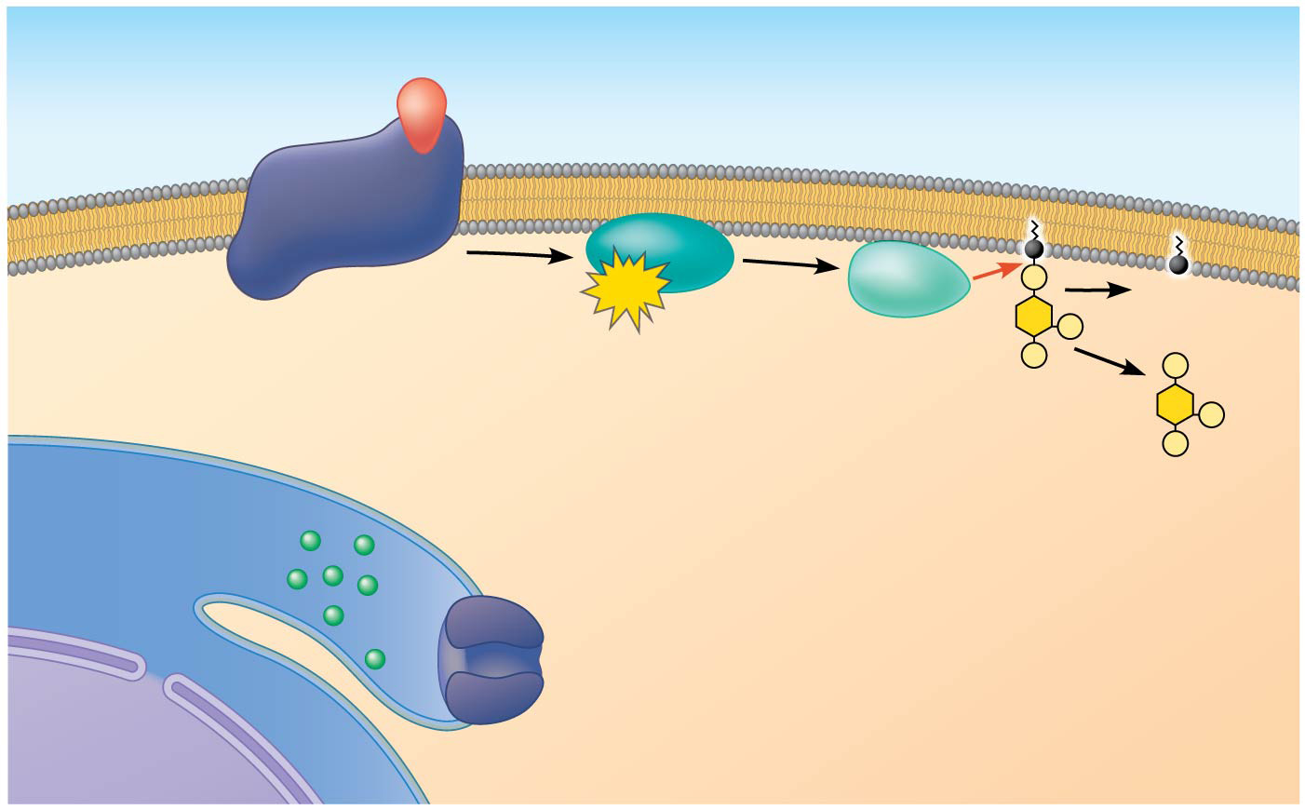
Figure 11.14-1
EXTRA- CELLULAR FLUID
Signaling molecule (first messenger)
G protein
GTP
DAG
CYTOSOL
G protein-coupled receptor
Phospholipase C
PIP₂
IP₃-gated calcium channel
IP₃
Endoplasmic reticulum (ER) lumen
(second messenger)
Ca²⁺
Nucleus
Notes:
Figure 11.14-1 Calcium and IP₃ in signaling pathways (step 1)

Slide 45
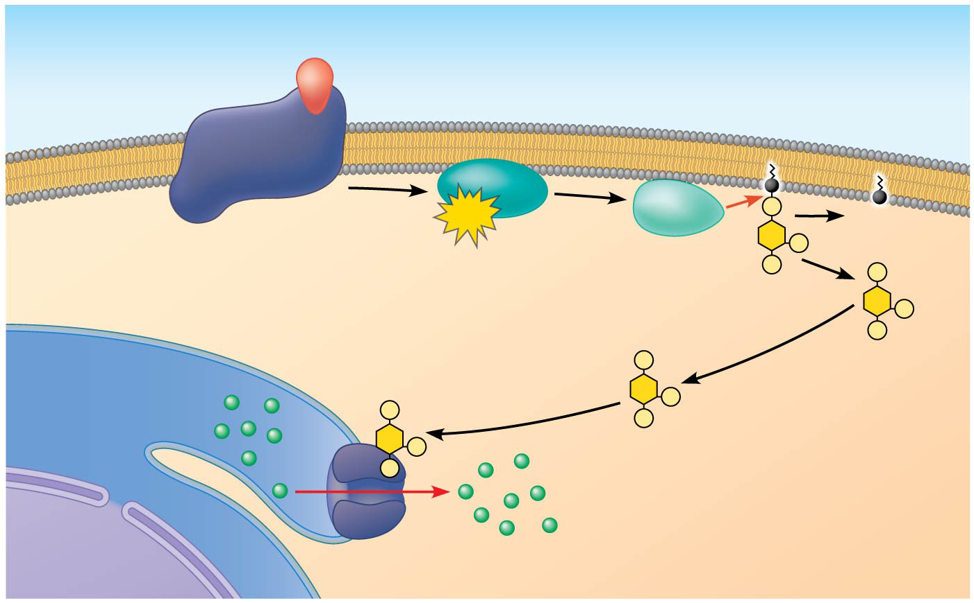
Figure 11.14-2
EXTRA- CELLULAR FLUID
Signaling molecule (first messenger)
G protein
GTP
DAG
CYTOSOL
G protein-coupled receptor
Phospholipase C
PIP₂
IP₃-gated calcium channel
IP₃
Endoplasmic reticulum (ER) lumen
(second messenger)
Ca²⁺
Ca²⁺ (second messenger)
Nucleus
Notes:
Figure 11.14-2 Calcium and IP₃ in signaling pathways (step 2)

Slide 46
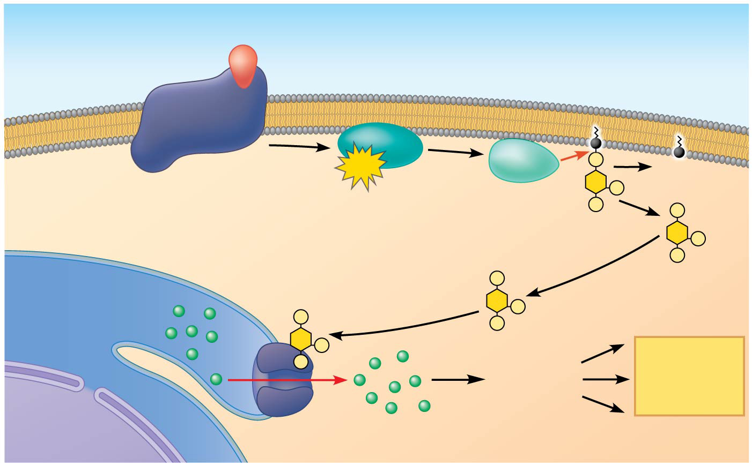
Figure 11.14-3
EXTRA- CELLULAR FLUID
Signaling molecule (first messenger)
G protein
GTP
DAG
CYTOSOL
G protein-coupled receptor
Phospholipase C
PIP₂
IP₃-gated calcium channel
IP₃
Endoplasmic reticulum (ER) lumen
(second messenger)
Ca²⁺
Various proteins activated
Cellular responses
Ca²⁺ (second messenger)
Nucleus
Notes:
Figure 11.14-3 Calcium and IP₃ in signaling pathways (step 3)

Slide 47
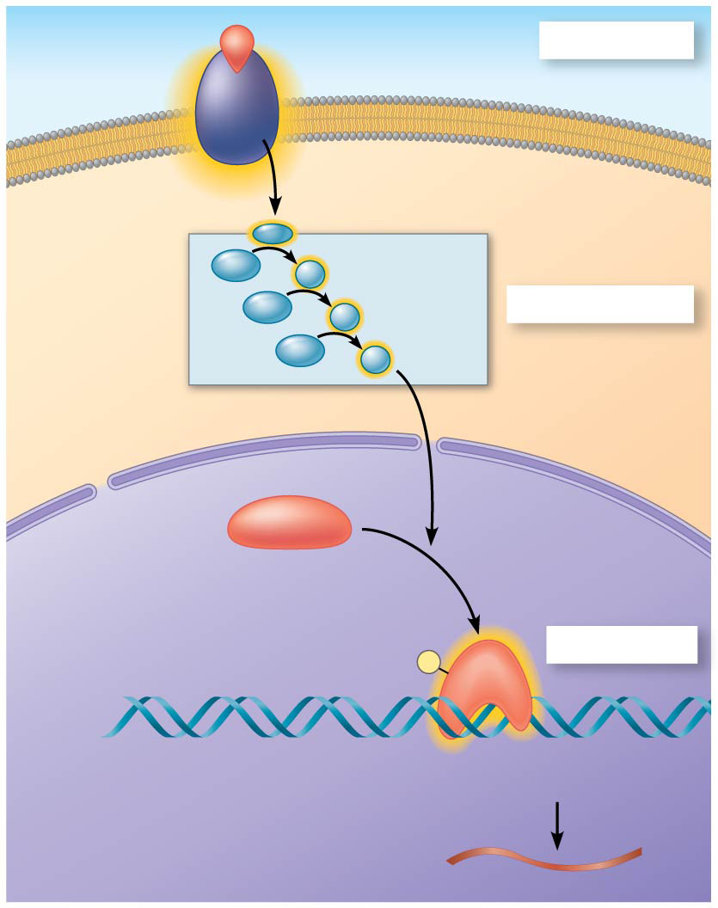
Figure 11.15
Growth factor
Reception
Receptor
Phospho- rylation cascade
Transduction
CYTOPLASM
Inactive transcription factor
Active transcription factor
Response
P
DNA
Gene
NUCLEUS
mRNA
Notes:
Figure 11.15 Nuclear responses to a signal: the activation of a specific gene by a growth factor

Slide 48
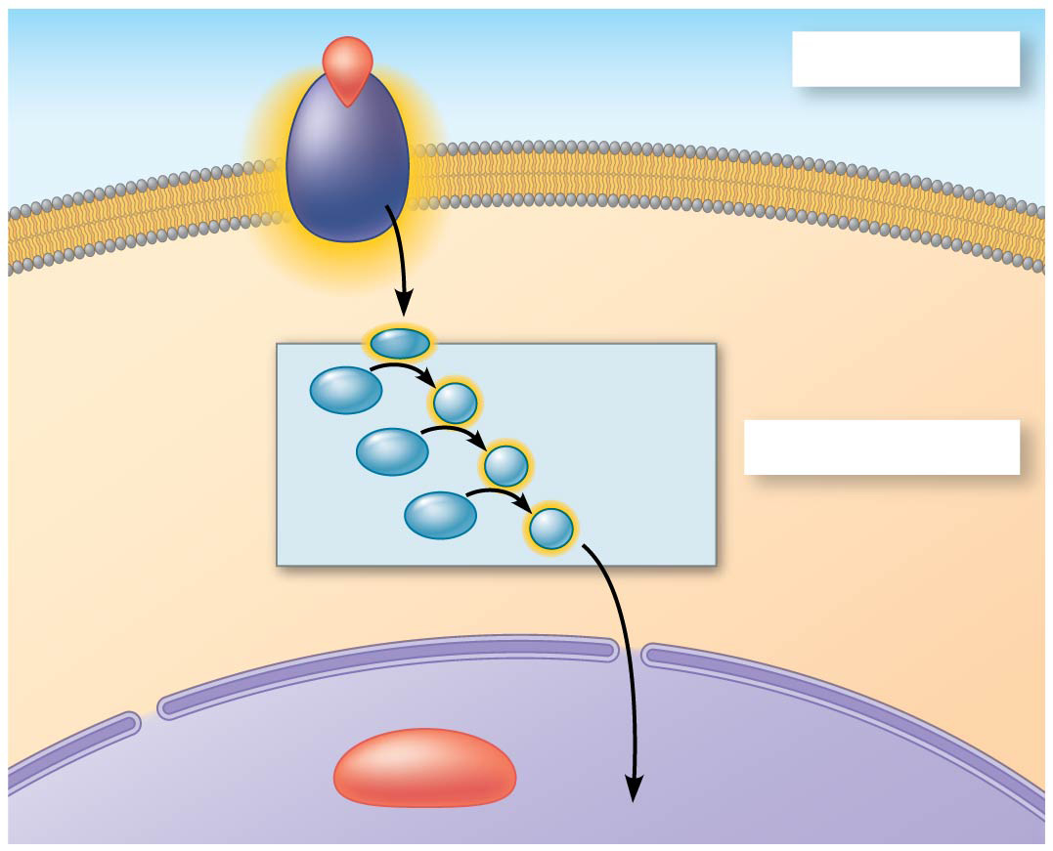
Figure 11.15a
Growth factor
Reception
Receptor
Phospho- rylation cascade
Transduction
CYTOPLASM
Inactive transcription factor
NUCLEUS
Notes:
Figure 11.15a Nuclear responses to a signal: the activation of a specific gene by a growth factor (part 1: cytoplasm)

Slide 49
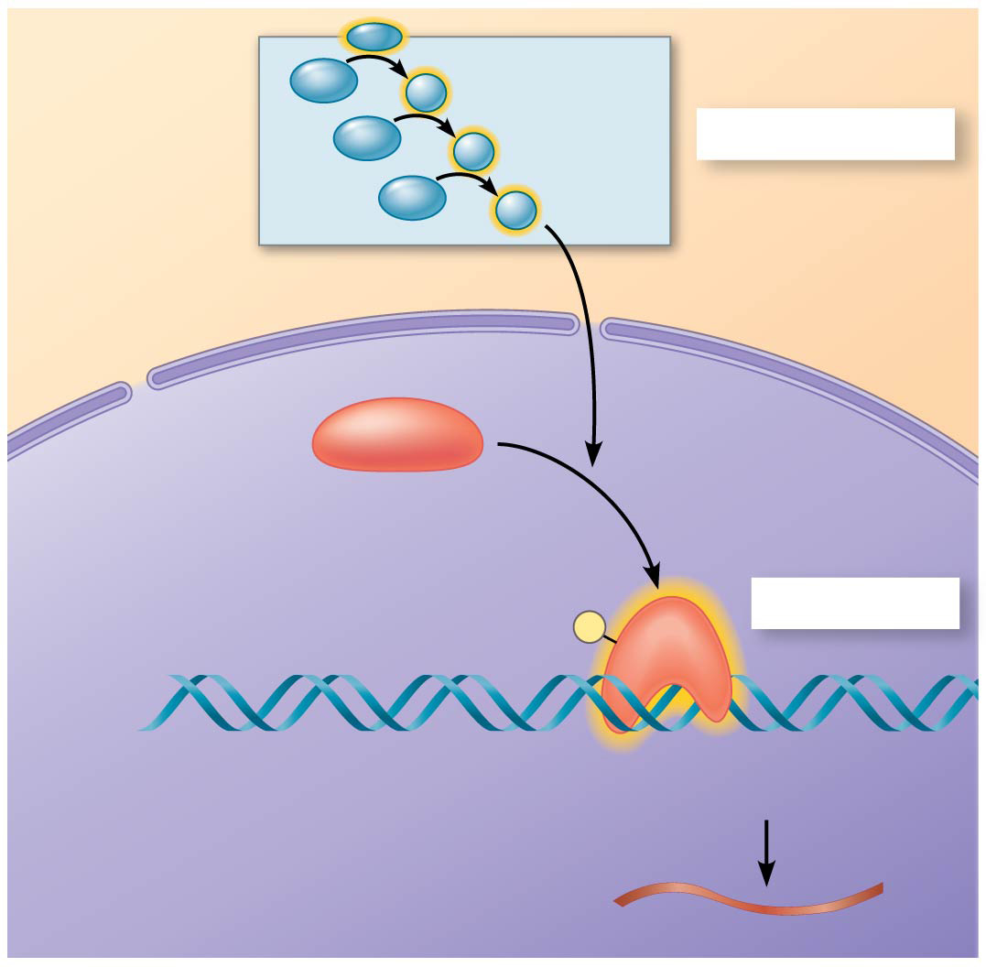
Figure 11.15b
Phospho- rylation cascade
Transduction
CYTOPLASM
Inactive transcription factor
Active transcription factor
Response
P
DNA
Gene
NUCLEUS
mRNA
Notes:
Figure 11.15b Nuclear responses to a signal: the activation of a specific gene by a growth factor (part 2: nucleus)

Slide 50
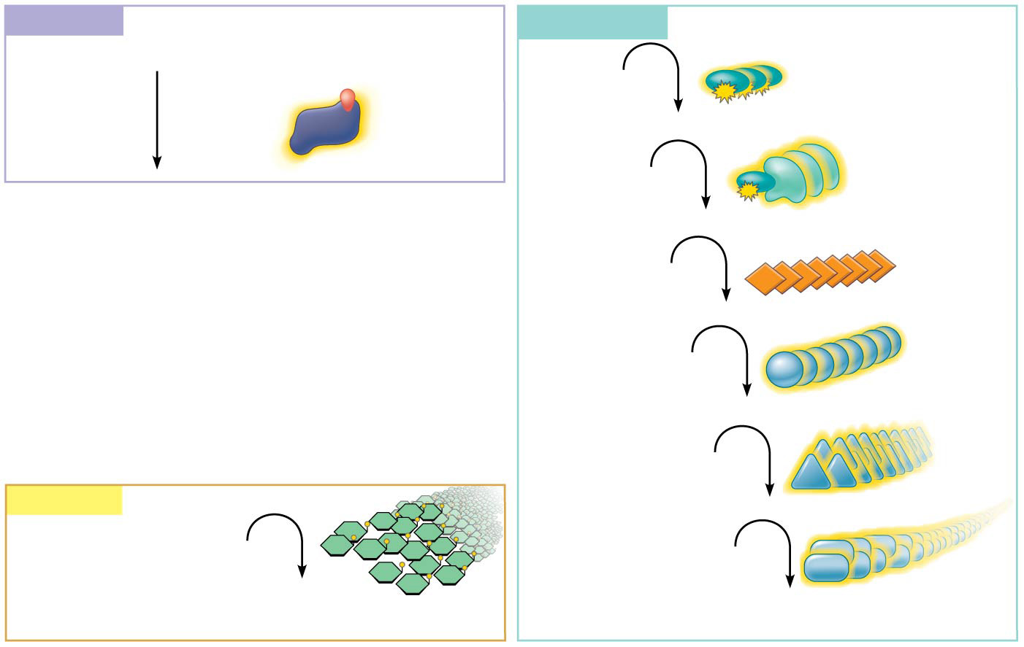
Figure 11.16
Reception
Transduction
Binding of epinephrine to G protein-coupled receptor (1 molecule)
Inactive G protein
Active G protein (10² molecules)
Inactive adenylyl cyclase
Active adenylyl cyclase (10²)
ATP
Cyclic AMP (10⁴)
Inactive protein kinase A
Active protein kinase A (10⁴)
Inactive phosphorylase kinase
Response
Active phosphorylase kinase (10⁵)
Glycogen
Inactive glycogen phosphorylase
Glucose 1-phosphate (10⁸ molecules)
Active glycogen phosphorylase (10⁶)
Notes:
Figure 11.16 Cytoplasmic response to a signal: the stimulation of glycogen breakdown by epinephrine (adrenaline)

Slide 51
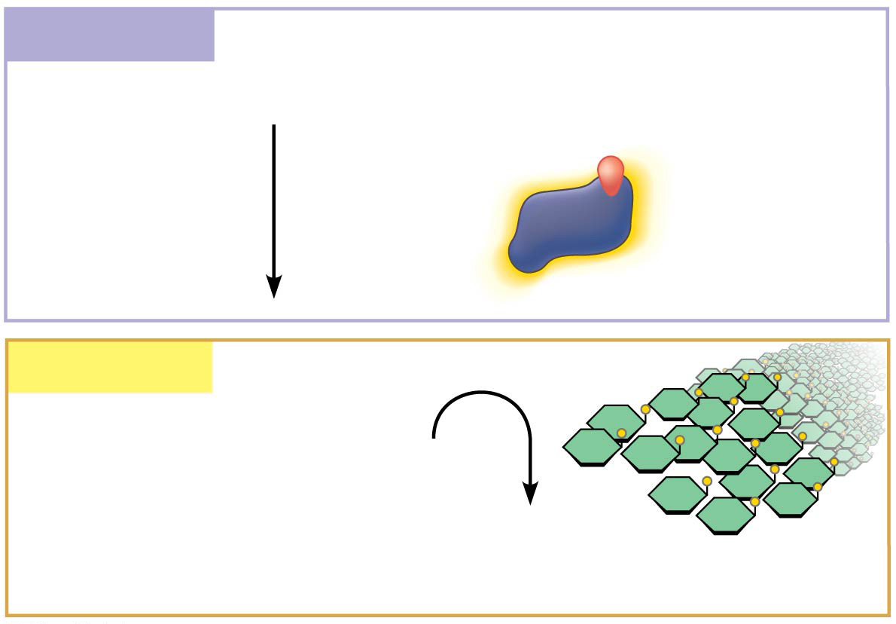
Figure 11.16a
Reception
Binding of epinephrine to G protein-coupled receptor (1 molecule)
Response
Glycogen
Glucose 1-phosphate (10⁸ molecules)
Notes:
Figure 11.16a Cytoplasmic response to a signal: the stimulation of glycogen breakdown by epinephrine (adrenaline) (part 1: reception and response)

Slide 52
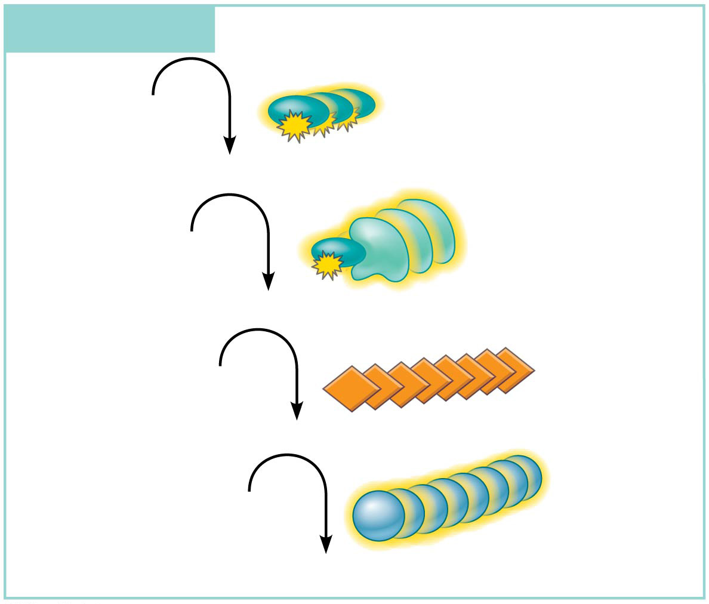
Figure 11.16b
Transduction
Inactive G protein
Active G protein (10² molecules)
Inactive adenylyl cyclase
Active adenylyl cyclase (10²)
ATP
Cyclic AMP (10⁴)
Inactive protein kinase A
Active protein kinase A (10⁴)
Notes:
Figure 11.16b Cytoplasmic response to a signal: the stimulation of glycogen breakdown by epinephrine (adrenaline) (part 2: transduction, active protein kinase A)

Slide 53
Figure 11.16c
Transduction
Cyclic AMP (10⁴)
Inactive protein kinase A
Active protein kinase A (10⁴)
Inactive phosphorylase kinase
Active phosphorylase kinase (10⁵)
Inactive glycogen phosphorylase
Active glycogen phosphorylase (10⁶)
Notes:
Figure 11.16c Cytoplasmic response to a signal: the stimulation of glycogen breakdown by epinephrine (adrenaline) (part 3: transduction, active glycogen phosphorylase)

Slide 54
Figure 11.17
Signaling molecule
Receptor
Relay mole-
cules
Activation or inhibition
Response 1
Response 2
Response 3
Response 4
Response 5
Cell A: Pathway leads to a single response.
Cell B: Pathway branches, leading to two responses.
Cell C: Cross-talk occurs between two pathways.
Cell D: Different receptor leads to a different response.
Notes:
Figure 11.17 The specificity of cell signaling

Slide 55
Figure 11.17a
Signaling molecule
Receptor
Relay mole-
cules
Response 1
Response 2
Response 3
Cell A: Pathway leads to a single response.
Cell B: Pathway branches, leading to two responses.
Notes:
Figure 11.17a The specificity of cell signaling (part 1: single response and branched pathway)

Slide 56
Figure 11.17b
Activation or inhibition
Response 4
Response 5
Cell C: Cross-talk occurs between two pathways.
Cell D: Different receptor leads to a different response.
Notes:
Figure 11.17b The specificity of cell signaling (part 2: cross-talk and different receptor with different response)

Slide 57
Figure 11.18
Signaling molecule
Plasma membrane
Receptor
Three different protein kinases
Scaffolding protein
Notes:
Figure 11.18 A scaffolding protein

Slide 58
Figure 11.19
2 µm
Notes:
Figure 11.19 Apoptosis of a human white blood cell

Slide 59
Figure 11.20
Ced-9 protein (active) inhibits Ced-4 activity
Cell
forms blebs
Ced-9 (inactive)
Mitochondrion
Death- signaling molecule
Active Ced-4
Active Ced-3
Other proteases
Ced-4
Ced-3
Nucleases
Receptor for death- signaling molecule
Activation cascade
Inactive proteins
(a) No death signal
(b) Death signal
Notes:
Figure 11.20 Molecular basis of apoptosis in C. elegans

Slide 60
Figure 11.20a
Ced-9 protein (active) inhibits Ced-4 activity
Mitochondrion
Ced-4
Ced-3
Receptor for death- signaling molecule
Inactive proteins
(a) No death signal
Notes:
Figure 11.20a Molecular basis of apoptosis in C. elegans (part 1: no death signal)

Slide 61
Figure 11.20b
Cell
forms blebs
Ced-9 (inactive)
Death- signaling molecule
Active Ced-4
Active Ced-3
Other proteases
Nucleases
Activation cascade
(b) Death signal
Notes:
Figure 11.20b Molecular basis of apoptosis in C. elegans (part 2: death signal)

Slide 62
Figure 11.21
Cells undergoing apoptosis
Space between digits
Interdigital tissue
1 mm
Notes:
Figure 11.21 Effect of apoptosis during paw development in the mouse

Slide 63
Figure 11.21a
Interdigital tissue
1 mm
Notes:
Figure 11.21a Effect of apoptosis during paw development in the mouse (part 1: interdigital tissue)

Slide 64
Figure 11.21b
Cells undergoing apoptosis
1 mm
Notes:
Figure 11.21b Effect of apoptosis during paw development in the mouse (part 2: apoptosis)

Slide 65
Figure 11.21c
Space between digits
1 mm
Notes:
Figure 11.21c Effect of apoptosis during paw development in the mouse (part 3: space between digits)

Slide 66
Figure 11.UN01a
1
Mating factor activates receptor.
Mating factor
Shmoo projection forming
G protein-coupled receptor
Formin
P
Fus3
Actin subunit
GDP
GTP
P
Phosphoryl- ation cascade
2
G protein binds GTP and becomes activated.
Formin
Formin
P
4
Fus3 phos- phorylates formin, activating it.
Fus3
Fus3
Microfilament
P
5
Formin initiates growth of microfilaments that form the shmoo projections.
3
Phosphorylation cascade activates Fus3, which moves to plasma membrane.
Notes:
Figure 11.UN01a Skills exercise: using experiments to test a model (part 1: shmoo formation)

Slide 67
Figure 11.UN01aa
1
Mating factor activates receptor.
Mating factor
G protein-coupled receptor
GDP
GTP
Phosphoryl- ation cascade
2
G protein binds GTP and becomes activated.
Fus3
Fus3
P
3
Phosphorylation cascade activates Fus3, which moves to plasma membrane.
Notes:
Figure 11.UN01aa Skills exercise: using experiments to test a model (part 1a: shmoo formation, phosphorylation cascade)

Slide 68
Figure 11.UN01ab
Shmoo projection forming
Formin
P
Fus3
Actin subunit
P
Formin
Formin
P
4
Fus3 phos- phorylates formin, activating it.
Microfilament
5
Formin initiates growth of microfilaments that form the shmoo projections.
Notes:
Figure 11.UN01ab Skills exercise: using experiments to test a model (part 1b: shmoo formation, activation of formin)

Slide 69
Figure 11.UN01b
Wild type
Notes:
Figure 11.UN01b Skills exercise: using experiments to test a model (part 2: wild type)

Slide 70
Figure 11.UN01c
ΔFus3
Notes:
Figure 11.UN01c Skills exercise: using experiments to test a model (part 3: ∆Fus3)

Slide 71
Figure 11.UN01d
Δformin
Notes:
Figure 11.UN01d Skills exercise: using experiments to test a model (part 4: ∆formin)

Slide 72
Figure 11.UN02
1
Reception
2
Transduction
3
Response
Receptor
Activation of cellular response
1
2
3
Relay molecules
Signaling molecule
Notes:
Figure 11.UN02 Summary of key concepts: epinephrine cell-signaling pathway

Slide 73
Figure 11.UN03
Notes:
Figure 11.UN03 Test your understanding, question 13 (five basic tastes)

