Slide 1
Mitochondria
Mitochondria are the site of ATP production in the cell by the catabolism of nutrient molecules.
Powerhouse of the cell.
Mitochondria self-replicate using their own DNA.
increases with increased need for ATP
Mitochondrial DNA (genes) are usually inherited only from the mother.

Slide 2
Clinical Application:
Mitochondrial myopathies are inherited muscle disorders resulting from faulty mitochondrial genes. As a result muscles become weak and fatigue easily.

Slide 3
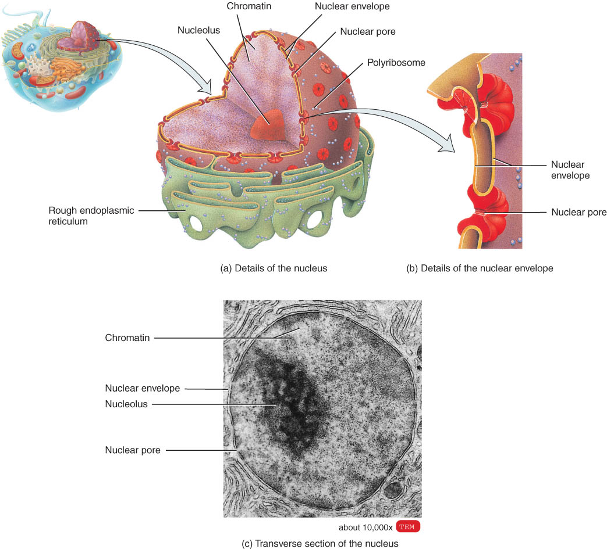
NUCLEUS
The nucleus is usually the most prominent feature of a cell.

Slide 4
NUCLEUS
Most body cells have a single nucleus; some (red blood cells) have none, whereas others (skeletal muscle fibers) have several.
The parts of the nucleus include the nuclear envelope which is perforated by channels called nuclear pores, nucleoli, and genetic material (DNA).
Within the nucleus are the cell’s hereditary units, called genes, which are arranged in single file along chromosomes.

Slide 5
Nucleus
The nucleus is the heart of every cell, its control center. Inside the nucleus are forty-six threadlike structures known as chromosomes, and each one of these structures contains thousands of genes.

Slide 6
Genomics
Genomics is the study of the relationships between the genome and the biological functions of an organism.
Genomic medicine hopes to design drugs to treat genetic diseases.

