Slide 1
LIFE IN A COMMUNITY

Slide 2
Refresher:
organism → living thing
species → a group of organisms that can interbreed to produce fertile offspring
population → group of organisms of the same species living in the same
area at the same time
community → all of the populations interacting in a particular area
ecosystem → the community and its physical environment

Slide 3
Habitat – the environment in which a species normally lives or the location of a living organism
Ecological Niche – the role of an organism in its environment (sum of biotic & abiotic resources in its environment)
Can 2 populations occupy the exact same niche at the same time in a community?

Slide 4
Types of interactions in a community
A. predator – prey
-- one organism benefits/the other doesn’t
Can predation benefit the prey population?
B. Competition – neither benefits
(limited resources)
intraspecific – b/w members of the same species
interspecific – b/w organisms of different species

Slide 5
C. Symbiosis – two organisms living in direct physical contact
ex. lichens – fungus + algae
mutualism – both members benefit
ex. N fixing bacteria in legume roots; termites + their cellulose digesting microbes

Slide 6
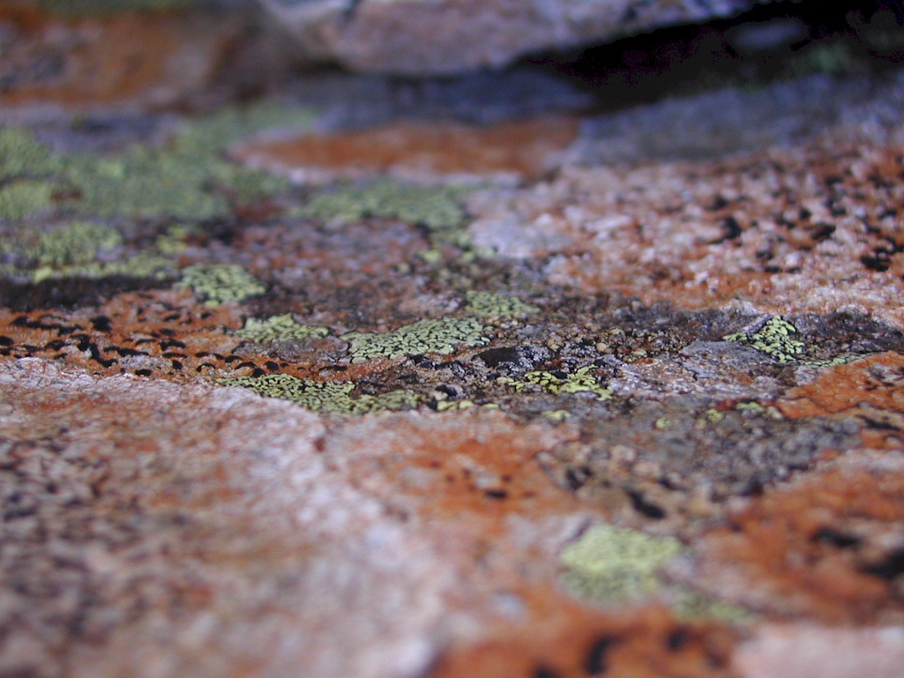

Slide 7
2. commensalism – one member benefits, the other unaffected
i.e. cowbirds and cattle egrets and grazing herbivores; perhaps shark + remora

Slide 8
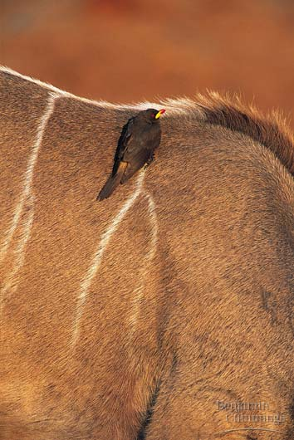

Slide 9
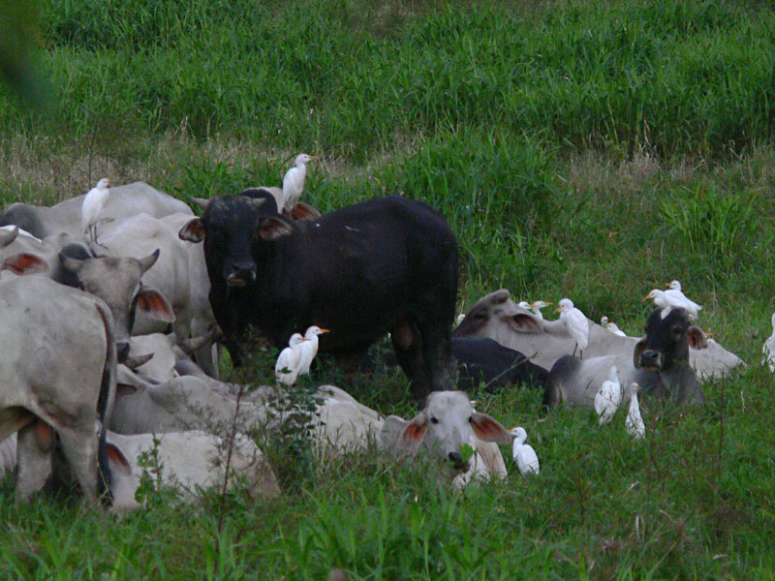

Slide 10
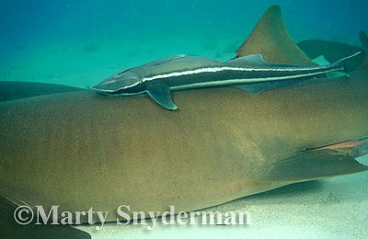

Slide 11
3. Parasitism – one organism (parasite) lives off of another (host) as a food source (one benefits, the other does not)
ex. leeches on others, fleas on a dog, ticks on a deer, molds on plants

Slide 12
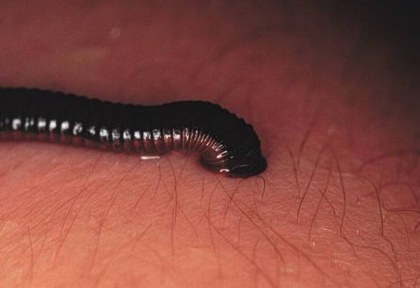

Slide 13
D. Detritivore – an organism that ingests nonliving organic matter
ex. vultures, bacteria
E. Saprophyte - an organism that lives on or in nonliving organic matter, secreting digestive enzymes into it and absorbing the products of digestion.
ex. fungus

Slide 14
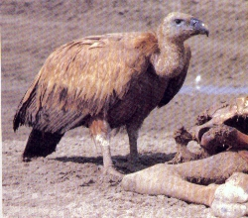

Slide 15
Hurt(-), helped(+), or not affected(0)
Name of Interaction | Species A | Species B
Mutualism | + | +
Commensalism | + | 0
Competition | - | -
Herbivory | + | -
Predation | + | -
Parasitism | + | -

Slide 16
Ecosystem Structure
Ecosystems are connected – there are few, if any, true boundaries.

Slide 17
I. Energy limits an ecosystem
A. The sun is the energy source for most ecosystems
1. Photosynthetic organisms (producers) are required to transfer solar energy into ecosystem energy
a. the size of a community is determined by the # of producers

Slide 18
b. gross primary productivity -- total amt of solar energy fixed into chemical energy via photosynthesis
-- most used for growth and maintenance
c. net primary productivity – the energy left over (stored as starch) and available for food to consumers [found using dried mass]

Slide 19
B. Energy flow from producers to consumers is pyramidal in terms of energy
- trophic levels = feeding levels
1. Energy pyramids – only about 1/10 of the energy of one level is available to the next higher level
a. pyramid of energy – kcals
b. pyramid of biomass – kg
c. pyramid of numbers

Slide 20
2. Food chain – show energy transfer relationships (single path)
3. Food web – many feeding relationships in ecosystem

Slide 21
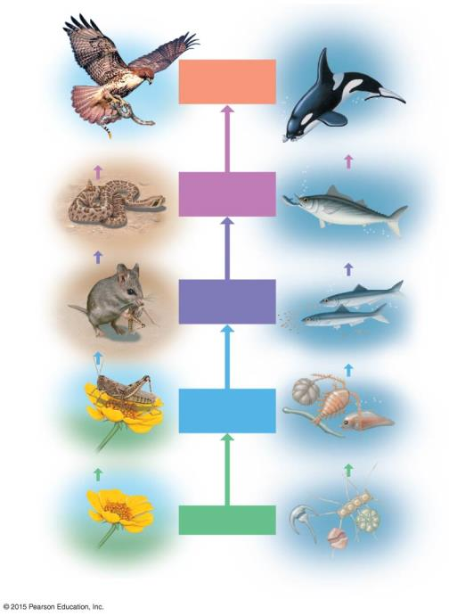
Figure 37.8
Quaternary
consumers
Hawk
Killer whale
Tertiary
consumers
Snake
Tuna
Secondary
consumers
Mouse
Herring
Primary
consumers
Grasshopper
Zooplankton
Producers
Plant
Phytoplankton
A terrestrial food chain
An aquatic food chain
Notes:
Figure 37.8 Two food chains

Slide 22
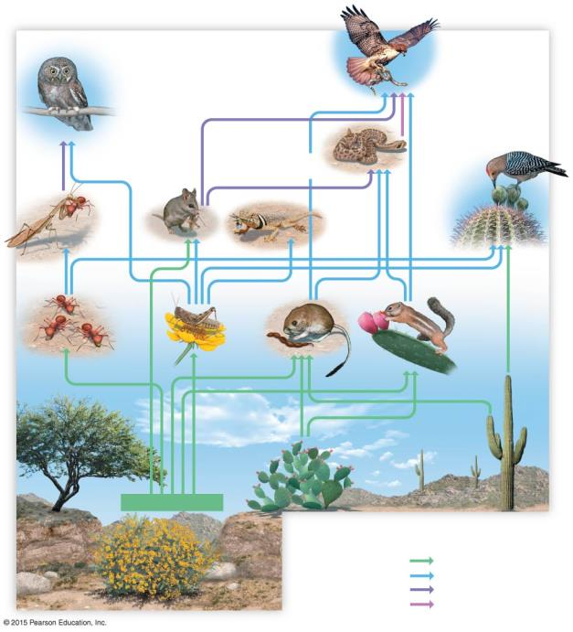
Figure 37.9-4
Producers provide the chemical
energy and nutrients used by all
other members of the food web.
Red-tailed
hawk
Secondary, tertiary,
and quaternary
consumer
Secondary and
tertiary consumer
Elf owl
Gila
woodpecker
Western
diamondback
Primary
and
secondary
consumer
Praying
mantis
Grasshopper
mouse
Secondary
consumer
Collared lizard
Primary
consumer
Primary
consumer
Grasshopper
Harris’s
antelope
squirrel
Harvester
ants
Desert
kangaroo
rat
Prickly pear
cactus
Saguaro
cactus
Mesquite
Producers (plants)
Brittlebush
Nutrient Transfer
From
To
Producers
Primary consumers
Primary consumers
Secondary consumers
Secondary consumers
Tertiary consumers
Tertiary consumers
Quaternary consumers
Notes:
Figure 37.9-4 A food web (step 4)

