Slide 2
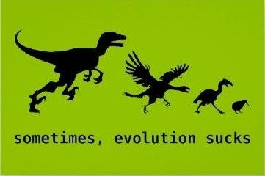

Slide 3
Introduction
In the 1960s, the World Health Organization (WHO) launched a campaign to eradicate malaria.
They focused on killing the mosquitoes that carry the parasite from person to person by massive spraying of the pesticide DDT.
Early success was followed by rebounding mosquito populations that had evolved resistance to the pesticide DDT.
Today, malaria causes more than a million deaths and 250 million cases of illness each year.

Slide 4
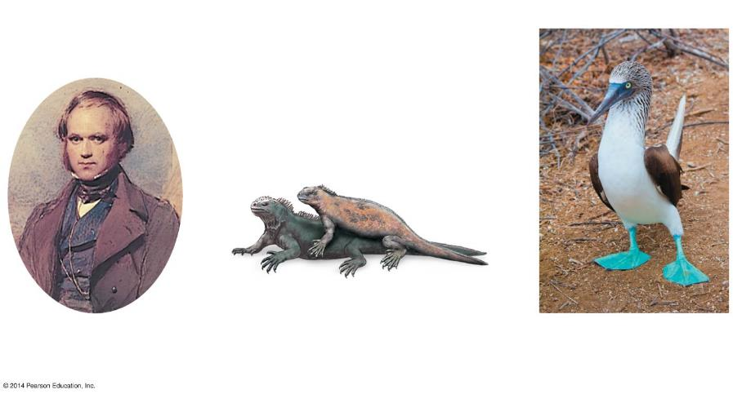
Figure 13.0-2
Chapter 13: Big Ideas
Darwin’s Theory of Evolution
The Evolution of Populations
Mechanisms of Microevolution
Notes:
Figure 13.0-2 Chapter 13: Big Ideas

Slide 5
Darwin’s Theory of Evolution

Slide 6
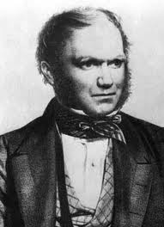
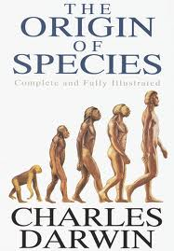
Charles Darwin
English Naturalist
In 1859 he published “On the Origin of Species by Means of Natural Selection”
Convincing evidence that species evolve and a reasonable mechanism explaining how evolution occurs

Slide 7
Background on Darwin
Dad was a wealthy doctor
At age 16 Darwin was sent to Edinburgh, Scotland to study medicine
Repeatedly skipped lectures to collect biological specimens
1827 was sent to Cambridge University to become a minister – He got his degree
More interested in natural science
1831 (age 22) Darwin went on a voyage with the HMS Beagle as a naturalist

Slide 8
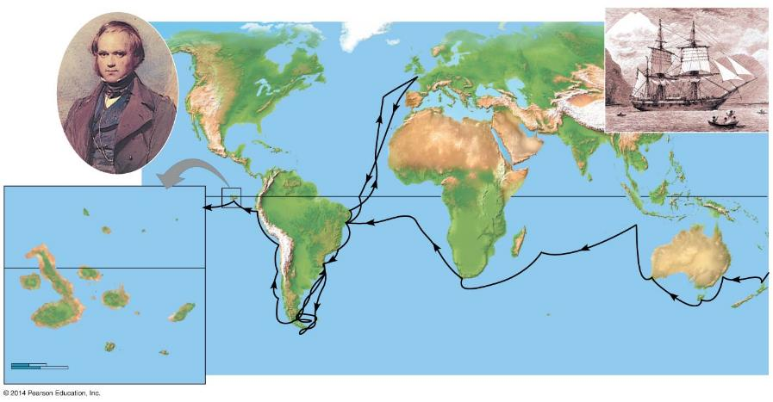
Figure 13.1a-0
Darwin in 1840
HMS Beagle in port
Great Britain
Asia
North America
Europe
ATLANTIC OCEAN
Africa
PACIFIC OCEAN
PACIFIC OCEAN
Pinta
Galápagos Islands
South America
Equator
Marchena
Genovesa
Santiago
Equator
Andes
Australia
Daphne Islands
Cape of Good Hope
Fernan- dina
Pinzón
PACIFIC OCEAN
Santa Fe
Tasmania
Isabela
Santa Cruz
San Cristobal
Cape Horn
New Zealand
0
40 km
Florenza
Tierra del Fuego
Española
0
40 miles
Notes:
Figure 13.1a-0 The voyage of the Beagle (1831–1836)

Slide 9
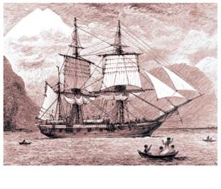
Figure 13.1a-4
HMS Beagle in port
Charles Darwin
Notes:
Figure 13.1a-4 The voyage of the Beagle (1831–1836) (part 4)

Slide 10
Scientists Before Darwin
Lucretius (2000 years ago)– Roman philosopher that 1st proposed the idea that life evolves
Jean Baptiste Lamarck (1809) –Changes in species linked to “Physical Conditions of Life”
Believed that over the lifetime of an individual, physical features increase in size because of use or disuse
These changes then passed to offspring

Slide 11
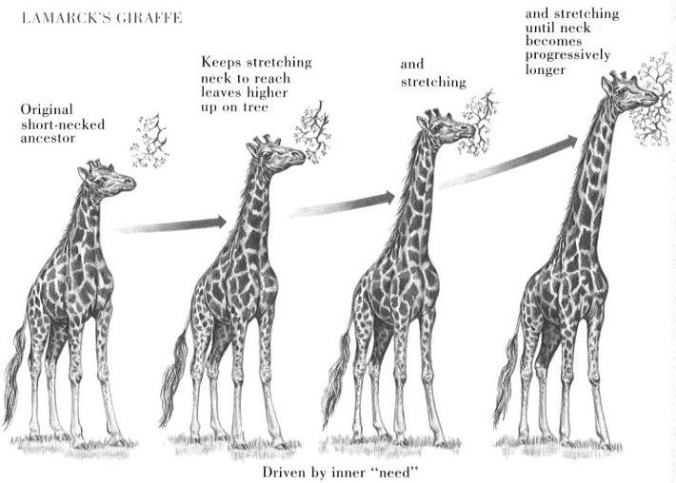
Lamarck

Slide 12
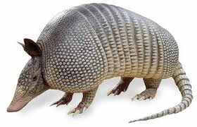
Darwin’s Observations
Read Charles Lyell’s book “Principles of Geology”
Lyell proposed that the surface of the earth changed slowly over time
In South America Darwin found fossils of extinct armadillos
These fossilized animals closely
resembled the armadillos living
in the area
present-day species are the descendants of ancient ancestors that they still resemble in some ways

Slide 13
13.1 A sea voyage helped Darwin frame his theory of evolution
Adaptations
Diverse modifications (inherited characters) that enhance an organism’s ability to survive and reproduce in a particular environment
1. Inherited variations exist within genes of every population/species
Result of random mutation and translation errors
An inherited trait that has become common in a population because the trait provides a selective advantage
Notes:
Student Misconceptions and Concerns
• Students often think that Charles Darwin was the first to suggest that life evolves: the early contributions by Greek philosophers such as Anaximander and the work of Jean Baptiste de Lamarck are unappreciated. Consider emphasizing these earlier contributions.
• Students often misunderstand the basic process of evolution and instead express a Lamarckian point of view. Organisms do not evolve structures because of want or need. Instead, evolution is a passive process in which the environment favors certain traits that exist within a population. Adaptations evolve in populations. Organisms do not actively or willingly evolve.
• Students must understand that the environment does the selecting (editing) in natural selection. Species do not evolve because of need. Biological diversity exists, and the environment selects. Evolution is not deliberate; it is reactive. As teachers, we must be careful in how we express evolution to best reflect this process. For example, the statement “Birds evolved wings” may make it sound as if birds did something deliberately, that there might have been a committee with a plan! “Wings evolved in birds” is more accurate, in that something happened to birds through a process. This use of the passive voice in our descriptions of evolution better reflects the nature of evolution.
• Students often think of evolution as a process that improves. But an adaptation in one context might be a handicap in another context. Reptiles are not “better” animals than fish. Neither could survive long in the other’s environment. Instead, the adaptations found in reptiles allow them to survive in a terrestrial environment, as those of fish allow them to survive in an aquatic one.
• Students might become confused by some scientific debates. Evolution can be considered on three levels, sometimes referred to as (a) fact, (b) course, and (c) mechanism: (a) Does evolution occur? (b) Who gave rise to whom? and (c) Is natural selection the only mechanism of evolution that produces adaptations? Students who listen to scientific debates about the course of evolution might think that the fact of evolution is under attack. Doubts about ancestry can be misconstrued as doubts about evolution itself. Make sure students understand these distinctions.
Teaching Tips
• Consider beginning your unit on evolution by asking each student to explain how a particular adaptation evolved. The evolution of flight in birds is a good example. Reviewing these student explanations can provide great insight into the misconceptions that students may bring to the class.
• Many resources related to Charles Darwin are available on the Internet. The following are only a few examples:
www.ucmp.berkeley.edu/history/evolution.html and www.natcenscied.org are extensive sites rich with details and references.
www.literature.org/authors/darwin-charles/ includes the texts of The Voyage of the Beagle, The Origin of Species first and sixth editions, and The Descent of Man.
http://williamcalvin.com/bookshelf/down_hse.htm includes details of Charles Darwin’s home.
www.talkorigins.org is an extensive usenet newsgroup devoted to the discussion and debate of biological and physical origins.
Active Lecture Tips
• See the Activity What Force of Microevolution Is Exemplified? on the Instructor Exchange. Visit the Instructor Exchange in the MasteringBiology instructor resource area for a description of this activity.
• See the Activity What Do My Classmates Think About Evolution? What Do Scientists Believe About Religion? on the Instructor Exchange. Visit the Instructor Exchange in the MasteringBiology instructor resource area for a description of this activity.

Slide 14
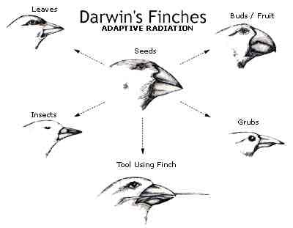

Slide 15
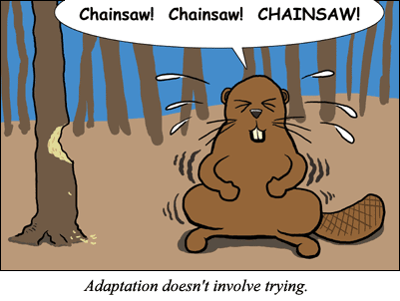

Slide 16
13.1 A sea voyage helped Darwin frame his theory of evolution
Consequently, scientists regard Darwin’s concept of evolution by means of natural selection as a theory
2. In a particular environment some individuals of a population or species are better suited to survive (variation) and have more offspring (Natural Selection)
Those able to survive will reproduce
Notes:
Student Misconceptions and Concerns
• Students often think that Charles Darwin was the first to suggest that life evolves: the early contributions by Greek philosophers such as Anaximander and the work of Jean Baptiste de Lamarck are unappreciated. Consider emphasizing these earlier contributions.
• Students often misunderstand the basic process of evolution and instead express a Lamarckian point of view. Organisms do not evolve structures because of want or need. Instead, evolution is a passive process in which the environment favors certain traits that exist within a population. Adaptations evolve in populations. Organisms do not actively or willingly evolve.
• Students must understand that the environment does the selecting (editing) in natural selection. Species do not evolve because of need. Biological diversity exists, and the environment selects. Evolution is not deliberate; it is reactive. As teachers, we must be careful in how we express evolution to best reflect this process. For example, the statement “Birds evolved wings” may make it sound as if birds did something deliberately, that there might have been a committee with a plan! “Wings evolved in birds” is more accurate, in that something happened to birds through a process. This use of the passive voice in our descriptions of evolution better reflects the nature of evolution.
• Students often think of evolution as a process that improves. But an adaptation in one context might be a handicap in another context. Reptiles are not “better” animals than fish. Neither could survive long in the other’s environment. Instead, the adaptations found in reptiles allow them to survive in a terrestrial environment, as those of fish allow them to survive in an aquatic one.
• Students might become confused by some scientific debates. Evolution can be considered on three levels, sometimes referred to as (a) fact, (b) course, and (c) mechanism: (a) Does evolution occur? (b) Who gave rise to whom? and (c) Is natural selection the only mechanism of evolution that produces adaptations? Students who listen to scientific debates about the course of evolution might think that the fact of evolution is under attack. Doubts about ancestry can be misconstrued as doubts about evolution itself. Make sure students understand these distinctions.
Teaching Tips
• Consider beginning your unit on evolution by asking each student to explain how a particular adaptation evolved. The evolution of flight in birds is a good example. Reviewing these student explanations can provide great insight into the misconceptions that students may bring to the class.
• Many resources related to Charles Darwin are available on the Internet. The following are only a few examples:
www.ucmp.berkeley.edu/history/evolution.html and www.natcenscied.org are extensive sites rich with details and references.
www.literature.org/authors/darwin-charles/ includes the texts of The Voyage of the Beagle, The Origin of Species first and sixth editions, and The Descent of Man.
http://williamcalvin.com/bookshelf/down_hse.htm includes details of Charles Darwin’s home.
www.talkorigins.org is an extensive usenet newsgroup devoted to the discussion and debate of biological and physical origins.
Active Lecture Tips
• See the Activity What Force of Microevolution Is Exemplified? on the Instructor Exchange. Visit the Instructor Exchange in the MasteringBiology instructor resource area for a description of this activity.
• See the Activity What Do My Classmates Think About Evolution? What Do Scientists Believe About Religion? on the Instructor Exchange. Visit the Instructor Exchange in the MasteringBiology instructor resource area for a description of this activity.

Slide 17
13.1 A sea voyage helped Darwin frame his theory of evolution
Evolution
the idea that living species are descendants of ancestral species that were different from present-day ones and that natural selection is the mechanism for evolutionary change
3. Over time, the traits that make certain individuals of a population able to survive and reproduce tend to spread in that population
Favorable Traits
Notes:
Student Misconceptions and Concerns
• Students often think that Charles Darwin was the first to suggest that life evolves: the early contributions by Greek philosophers such as Anaximander and the work of Jean Baptiste de Lamarck are unappreciated. Consider emphasizing these earlier contributions.
• Students often misunderstand the basic process of evolution and instead express a Lamarckian point of view. Organisms do not evolve structures because of want or need. Instead, evolution is a passive process in which the environment favors certain traits that exist within a population. Adaptations evolve in populations. Organisms do not actively or willingly evolve.
• Students must understand that the environment does the selecting (editing) in natural selection. Species do not evolve because of need. Biological diversity exists, and the environment selects. Evolution is not deliberate; it is reactive. As teachers, we must be careful in how we express evolution to best reflect this process. For example, the statement “Birds evolved wings” may make it sound as if birds did something deliberately, that there might have been a committee with a plan! “Wings evolved in birds” is more accurate, in that something happened to birds through a process. This use of the passive voice in our descriptions of evolution better reflects the nature of evolution.
• Students often think of evolution as a process that improves. But an adaptation in one context might be a handicap in another context. Reptiles are not “better” animals than fish. Neither could survive long in the other’s environment. Instead, the adaptations found in reptiles allow them to survive in a terrestrial environment, as those of fish allow them to survive in an aquatic one.
• Students might become confused by some scientific debates. Evolution can be considered on three levels, sometimes referred to as (a) fact, (b) course, and (c) mechanism: (a) Does evolution occur? (b) Who gave rise to whom? and (c) Is natural selection the only mechanism of evolution that produces adaptations? Students who listen to scientific debates about the course of evolution might think that the fact of evolution is under attack. Doubts about ancestry can be misconstrued as doubts about evolution itself. Make sure students understand these distinctions.
Teaching Tips
• Consider beginning your unit on evolution by asking each student to explain how a particular adaptation evolved. The evolution of flight in birds is a good example. Reviewing these student explanations can provide great insight into the misconceptions that students may bring to the class.
• Many resources related to Charles Darwin are available on the Internet. The following are only a few examples:
www.ucmp.berkeley.edu/history/evolution.html and www.natcenscied.org are extensive sites rich with details and references.
www.literature.org/authors/darwin-charles/ includes the texts of The Voyage of the Beagle, The Origin of Species first and sixth editions, and The Descent of Man.
http://williamcalvin.com/bookshelf/down_hse.htm includes details of Charles Darwin’s home.
www.talkorigins.org is an extensive usenet newsgroup devoted to the discussion and debate of biological and physical origins.
Active Lecture Tips
• See the Activity What Force of Microevolution Is Exemplified? on the Instructor Exchange. Visit the Instructor Exchange in the MasteringBiology instructor resource area for a description of this activity.
• See the Activity What Do My Classmates Think About Evolution? What Do Scientists Believe About Religion? on the Instructor Exchange. Visit the Instructor Exchange in the MasteringBiology instructor resource area for a description of this activity.

Slide 18
13.2 The study of fossils provides strong evidence for evolution
Fossils
are the imprints or remains of organisms that lived in the past
document differences between past and present organisms
reveal that many species have become extinct
4. Overwhelming evidence from Fossils and many other sources that living species evolved from organisms that are extinct
Ancestors
Notes:
Student Misconceptions and Concerns
• Students might expect that every living organism will leave fossils and that we should be able to find them. Furthermore, they might falsely conclude that the absence of evidence is evidence of absence. Understanding the rare circumstances under which fossils form (the scientific study of fossil formation is referred to as taphonomy), the geological processes that distort and destroy layers (for example, earthquakes and glaciers), and the long odds against the discovery of fossils helps students understand why the fossil record is limited.
• Students who struggle with the concept of evolution may also bring personal objections to the classroom. Modules 13.2–13.4, on the evidence of evolution, permit a demonstration of the scientific method, in which confidence in our conclusions increases based on multiple, independent lines of evidence. Science requires evidence and cannot rely upon faith or supernatural explanations.
• Students often misunderstand the basic process of evolution and instead express a Lamarckian point of view. Organisms do not evolve structures because of want or need. Instead, evolution is a passive process in which the environment favors certain traits that exist within a population. Adaptations evolve in populations. Organisms do not actively or willingly evolve.
• Students must understand that the environment does the selecting (editing) in natural selection. Species do not evolve because of need. Biological diversity exists, and the environment selects. Evolution is not deliberate; it is reactive. As teachers, we must be careful in how we express evolution to best reflect this process. For example, the statement “Birds evolved wings” may make it sound as if birds did something deliberately, that there might have been a committee with a plan! “Wings evolved in birds” is more accurate, in that something happened to birds through a process. This use of the passive voice in our descriptions of evolution better reflects the nature of evolution.
• Students often think of evolution as a process that improves. But an adaptation in one context might be a handicap in another context. Reptiles are not “better” animals than fish. Neither could survive long in the other’s environment. Instead, the adaptations found in reptiles allow them to survive in a terrestrial environment, as those of fish allow them to survive in an aquatic one.
• Students might become confused by some scientific debates. Evolution can be considered on three levels, sometimes referred to as (a) fact, (b) course, and (c) mechanism: (a) Does evolution occur? (b) Who gave rise to whom? and (c) Is natural selection the only mechanism of evolution that produces adaptations? Students who listen to scientific debates about the course of evolution might think that the fact of evolution is under attack. Doubts about ancestry can be misconstrued as doubts about evolution itself. Make sure students understand these distinctions.
Teaching Tips
• The sequence, but not the absolute age, of layers is revealed by the stratifications in sedimentary rocks. This is like peeling the layers of wallpaper from the walls of a very old house that has been inhabited by many owners. By the sequence, we can tell which layers are older, but not the absolute ages of each layer.
• Beginning college students are likely to have scant or uneven knowledge of the subject of fossils. Describe several ways that a fossil’s age can be determined (for example, radiometric dating, association with other fossils of known age in the same layer, correlation to other strata of known ages). These methods demonstrate the importance of independent lines of evidence and consistency.
• Any sort of a fossil makes a nice visual aid. Of course, the larger the fossil, the better. Many shops in natural history museums carry large and common fossils that can be purchased for less than $50.00. Crinoid stems from the Midwest or marine shells from Montana can make the point that life and ecosystems change over time.
Active Lecture Tips
• See the Activity What Force of Microevolution Is Exemplified? on the Instructor Exchange. Visit the Instructor Exchange in the MasteringBiology instructor resource area for a description of this activity.
• See the Activity What Do My Classmates Think About Evolution? What Do Scientists Believe About Religion? on the Instructor Exchange. Visit the Instructor Exchange in the MasteringBiology instructor resource area for a description of this activity.

Slide 19
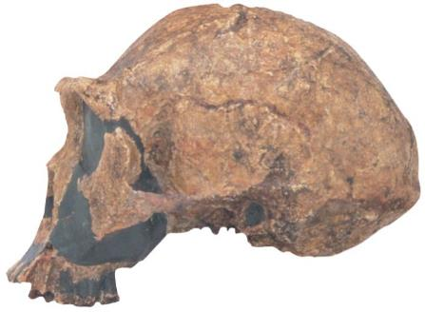
Figure 13.2a
For example, the fossilized skull of one of our early relatives, Homo erectus, represents someone who lived 1.5 million years ago in Africa.
Notes:
Figure 13.2a Skull of Homo erectus

Slide 20
13.2 The study of fossils provides strong evidence for evolution
The fossil record is incomplete because
many of Earth’s organisms did not live in areas that favor fossilization
fossils that did form were in rocks later distorted or destroyed by geologic processes
not all fossils that have been preserved are accessible to paleontologists.
Notes:
Student Misconceptions and Concerns
• Students might expect that every living organism will leave fossils and that we should be able to find them. Furthermore, they might falsely conclude that the absence of evidence is evidence of absence. Understanding the rare circumstances under which fossils form (the scientific study of fossil formation is referred to as taphonomy), the geological processes that distort and destroy layers (for example, earthquakes and glaciers), and the long odds against the discovery of fossils helps students understand why the fossil record is limited.
• Students who struggle with the concept of evolution may also bring personal objections to the classroom. Modules 13.2–13.4, on the evidence of evolution, permit a demonstration of the scientific method, in which confidence in our conclusions increases based on multiple, independent lines of evidence. Science requires evidence and cannot rely upon faith or supernatural explanations.
• Students often misunderstand the basic process of evolution and instead express a Lamarckian point of view. Organisms do not evolve structures because of want or need. Instead, evolution is a passive process in which the environment favors certain traits that exist within a population. Adaptations evolve in populations. Organisms do not actively or willingly evolve.
• Students must understand that the environment does the selecting (editing) in natural selection. Species do not evolve because of need. Biological diversity exists, and the environment selects. Evolution is not deliberate; it is reactive. As teachers, we must be careful in how we express evolution to best reflect this process. For example, the statement “Birds evolved wings” may make it sound as if birds did something deliberately, that there might have been a committee with a plan! “Wings evolved in birds” is more accurate, in that something happened to birds through a process. This use of the passive voice in our descriptions of evolution better reflects the nature of evolution.
• Students often think of evolution as a process that improves. But an adaptation in one context might be a handicap in another context. Reptiles are not “better” animals than fish. Neither could survive long in the other’s environment. Instead, the adaptations found in reptiles allow them to survive in a terrestrial environment, as those of fish allow them to survive in an aquatic one.
• Students might become confused by some scientific debates. Evolution can be considered on three levels, sometimes referred to as (a) fact, (b) course, and (c) mechanism: (a) Does evolution occur? (b) Who gave rise to whom? and (c) Is natural selection the only mechanism of evolution that produces adaptations? Students who listen to scientific debates about the course of evolution might think that the fact of evolution is under attack. Doubts about ancestry can be misconstrued as doubts about evolution itself. Make sure students understand these distinctions.
Teaching Tips
• The sequence, but not the absolute age, of layers is revealed by the stratifications in sedimentary rocks. This is like peeling the layers of wallpaper from the walls of a very old house that has been inhabited by many owners. By the sequence, we can tell which layers are older, but not the absolute ages of each layer.
• Beginning college students are likely to have scant or uneven knowledge of the subject of fossils. Describe several ways that a fossil’s age can be determined (for example, radiometric dating, association with other fossils of known age in the same layer, correlation to other strata of known ages). These methods demonstrate the importance of independent lines of evidence and consistency.
• Any sort of a fossil makes a nice visual aid. Of course, the larger the fossil, the better. Many shops in natural history museums carry large and common fossils that can be purchased for less than $50.00. Crinoid stems from the Midwest or marine shells from Montana can make the point that life and ecosystems change over time.
Active Lecture Tips
• See the Activity What Force of Microevolution Is Exemplified? on the Instructor Exchange. Visit the Instructor Exchange in the MasteringBiology instructor resource area for a description of this activity.
• See the Activity What Do My Classmates Think About Evolution? What Do Scientists Believe About Religion? on the Instructor Exchange. Visit the Instructor Exchange in the MasteringBiology instructor resource area for a description of this activity.

Slide 21
13.3 SCIENTIFIC THINKING: Fossils of transitional forms support Darwin’s theory of evolution
Many fossils link early extinct species with species living today.
A series of fossils traces the gradual modification of jaws and teeth in the evolution of mammals from a reptilian ancestor.
A series of fossils documents the evolution of whales from a group of land mammals.
Notes:
Student Misconceptions and Concerns
• Students who struggle with the concept of evolution may also bring personal objections to the classroom. Modules 13.2–13.4, on the evidence of evolution, permit a demonstration of the scientific method, in which confidence in our conclusions increases based on multiple, independent lines of evidence. Science requires evidence and cannot rely upon faith or supernatural explanations.
• Students often misunderstand the basic process of evolution and instead express a Lamarckian point of view. Organisms do not evolve structures because of want or need. Instead, evolution is a passive process in which the environment favors certain traits that exist within a population. Adaptations evolve in populations. Organisms do not actively or willingly evolve.
• Students must understand that the environment does the selecting (editing) in natural selection. Species do not evolve because of need. Biological diversity exists, and the environment selects. Evolution is not deliberate; it is reactive. As teachers, we must be careful in how we express evolution to best reflect this process. For example, the statement “Birds evolved wings” may make it sound as if birds did something deliberately, that there might have been a committee with a plan! “Wings evolved in birds” is more accurate, in that something happened to birds through a process. This use of the passive voice in our descriptions of evolution better reflects the nature of evolution.
• Students often think of evolution as a process that improves. But an adaptation in one context might be a handicap in another context. Reptiles are not “better” animals than fish. Neither could survive long in the other’s environment. Instead, the adaptations found in reptiles allow them to survive in a terrestrial environment, as those of fish allow them to survive in an aquatic one.
• Students might become confused by some scientific debates. Evolution can be considered on three levels, sometimes referred to as (a) fact, (b) course, and (c) mechanism: (a) Does evolution occur? (b) Who gave rise to whom? and (c) Is natural selection the only mechanism of evolution that produces adaptations? Students who listen to scientific debates about the course of evolution might think that the fact of evolution is under attack. Doubts about ancestry can be misconstrued as doubts about evolution itself. Make sure students understand these distinctions.
Teaching Tips
• The philosophy of science is based in large part on its tentative nature, as ideas are subject to change with the discovery of new evidence and better explanations. Often, lessons on the process of science focus on the details of conducting careful studies with large sample sizes. The investigations of whale evolution in Module 13.3 illustrate this important tentative nature of science.
Active Lecture Tips
• See the Activity What Force of Microevolution Is Exemplified? on the Instructor Exchange. Visit the Instructor Exchange in the MasteringBiology instructor resource area for a description of this activity.
• See the Activity What Do My Classmates Think About Evolution? What Do Scientists Believe About Religion? on the Instructor Exchange. Visit the Instructor Exchange in the MasteringBiology instructor resource area for a description of this activity.

Slide 22
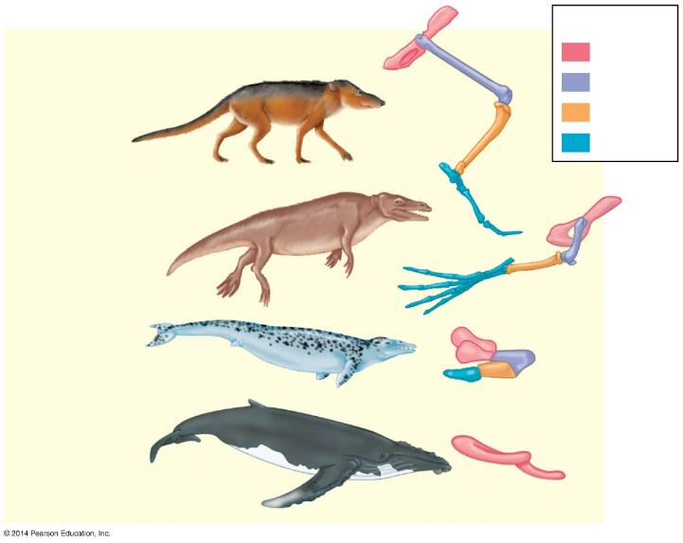
Figure 13.3b
Key
Pelvis
Femur
Pakicetus
Tibia
Foot
Rodhocetus
Dorudon
Living cetaceans
Notes:
Figure 13.3b The transition to life in the sea

