Slide 1
Lesson 3: Big Business
The Big Idea: The expansion of industry resulted in the growth of big business
Why It Matters Now: Many of the strategies used today in industry, such as consolidation, have their origins in the late 19th century.
Key Terms and People: Andrew Carnegie / Laissez-Faire / Social Darwinism / Vertical Integration / Horizontal Integration / J.P. Morgan / John D. Rockefeller / Trust / Monopoly / Sherman Antitrust Act

Slide 2
I. A Favorable Climate
A. Belief in Free Markets
The U.S. economy is based on a form of capitalism called free enterprise
Competition and consumer demand drive the economy
Late 1800’s business leaders mostly believed in Laissez-Faire capitalism
For the most part, government stayed out of business
Only in times of struggle did businesses turn to the government for assistance

Slide 3
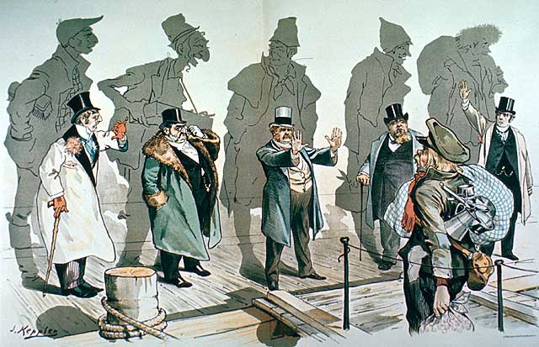
B. Social Darwinism
This philosophy tried to explain why some lived in poverty and some became wealthy
Based on Darwin’s idea of survival of the fittest
Natural selection would strain out those who could not survive
Herbert Spencer applied this theory to human society
This led to the general understanding that gov’t did not need to intervene
Walter Rauschenbusch – A NY minister who disagreed
He claimed that the competition brought out the worst in people

Slide 4
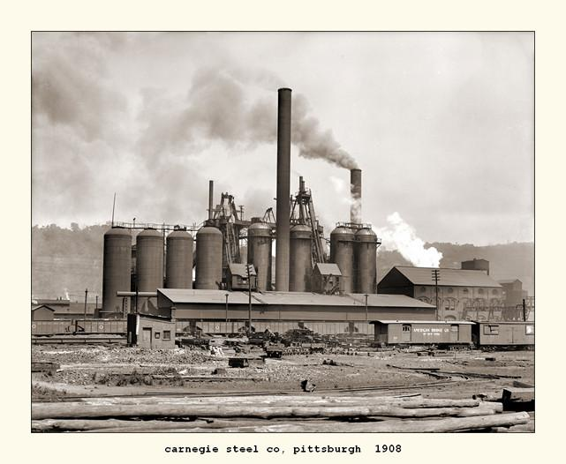
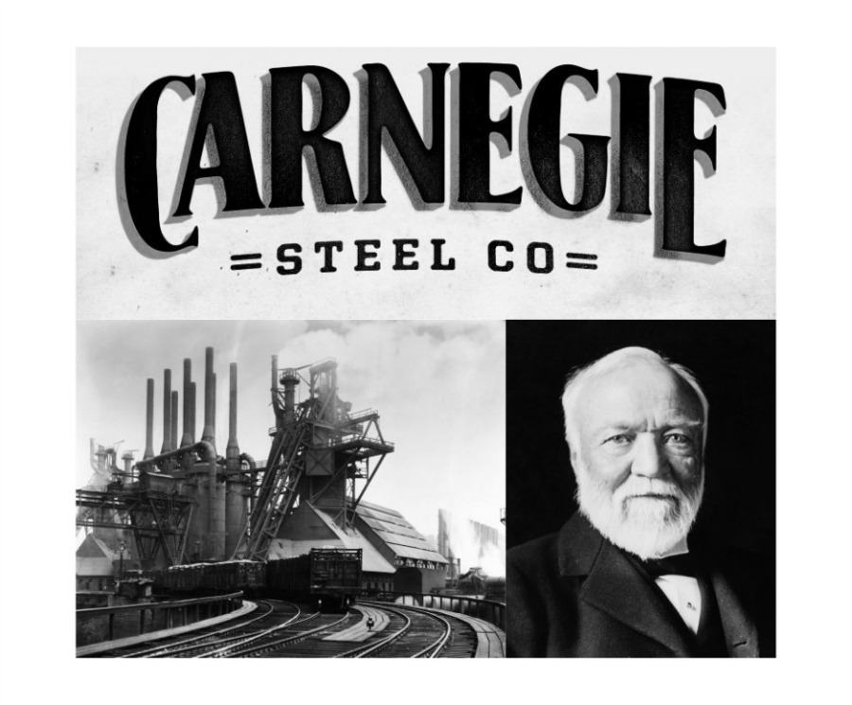
II. New Business Strategies
A. Maximizing Profits
1899: Andrew Carnegie’s Steel Corporation makes more steel than all the steel factories in Britain
Why? How?
Better products produced more cheaply
New machinery and techniques
Attracted talent by offering stock
Encouraged competition within
Vertical integration
Horizontal integration

Slide 5
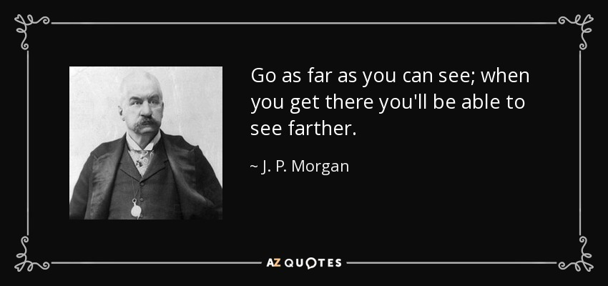
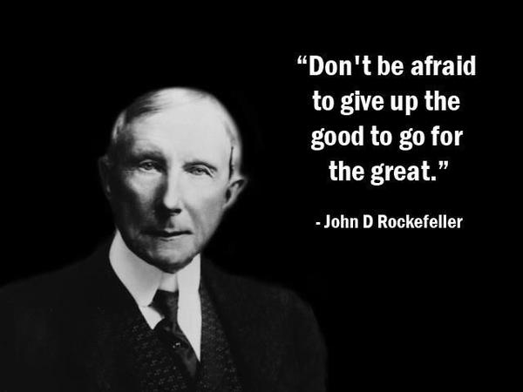
B. Eliminating the Competition
J.P. Morgan: Created holding companies.
Bought out the stock of other companies
Controlled steel, railroads and farming equipment
1901: Merged Carnegie Steel and U.S. Steel
John D. Rockefeller: Formed trusts.
Competing companies put control of their businesses under a single group of trustees
The separate companies are run as one large organization
Rockefeller’s Standard Oil Co. controlled 90% of U.S. oil

Slide 6
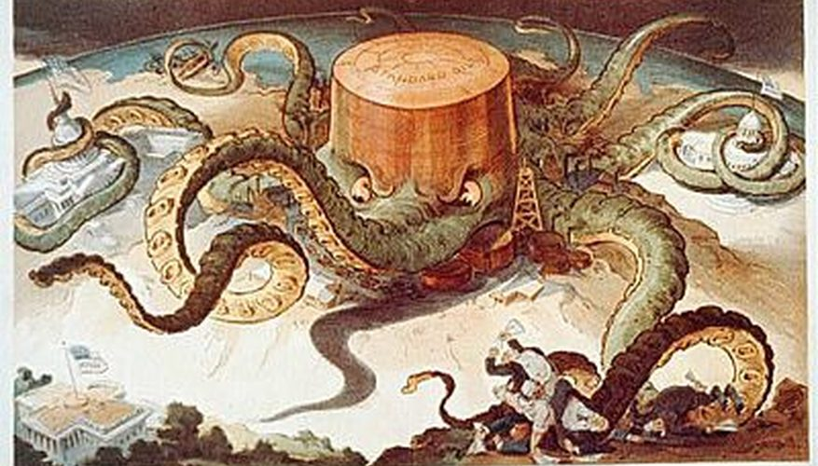
C. Fewer Choices
Carnegie, Morgan and Rockefeller created near monopolies
*** Near control of the production, wages and prices of an industry
Lack of competition creates little variety and low quality
This can also mean excessive prices
Workers have very few options for employment

Slide 7
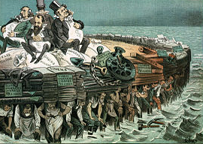
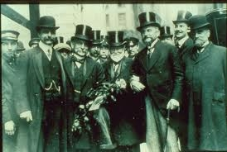
D. A Mixed Legacy
These men were both admired and despised.
Some referred to them as Captains of Industry
Carnegie donated millions under his “Gospel of Wealth” philosophy
… Others as Robber Barons
Many made their fortunes on the low pay and deplorable conditions that others faced

Slide 8
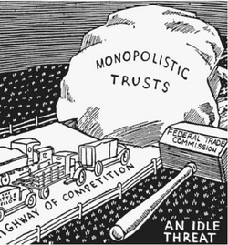
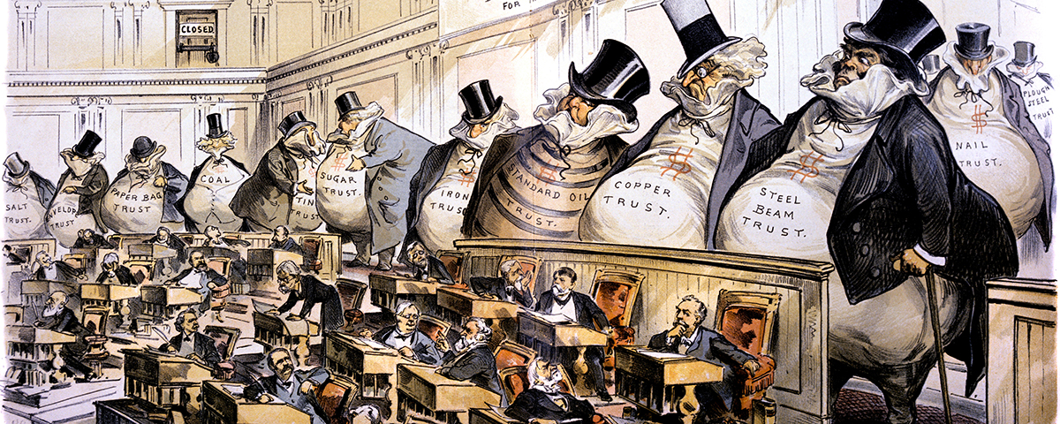
III. Government and Business
A. Government Regulation
The government took action to protect against these monopolistic trends
1890: Sherman Antitrust Act: Made it illegal to form a trust that interfered with free trade… Also prohibited monopolies.
Became very difficult to enforce. The Supreme Court threw out 7 of 8 cases.
Sherman Antitrust was also unclear about shutting down monopolies in the manufacturing of a good as well as trade.
United States v. E.C. Knight Co. ruled against that they could not.

Slide 9
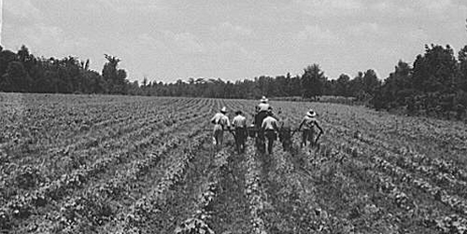
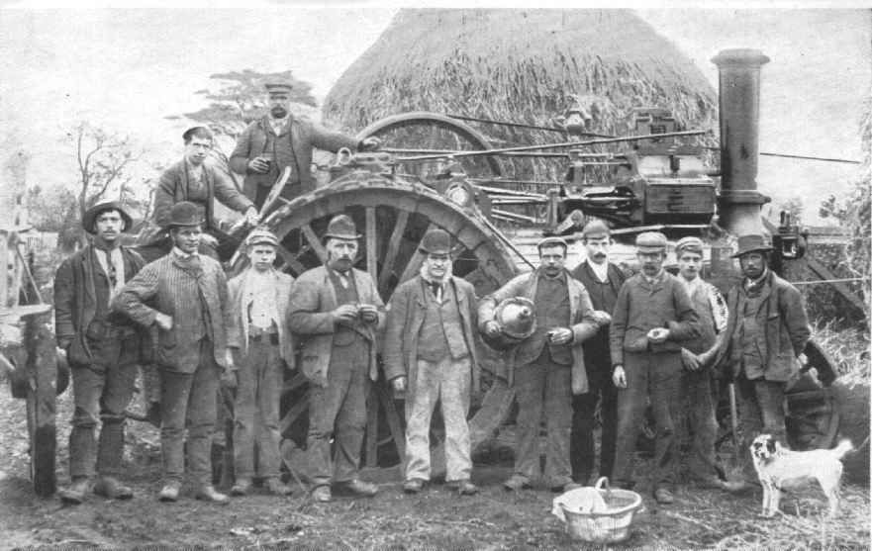
B. Business Boom Bypasses the South
This expansion focused in the north where there were natural and urban resources
Still struggling from the Civil War, the South lacked capital
Northern business leaders had 90% of stock in southern railroads
Southern farmers faced high shipping rates and tariffs
Hope remained in forestry, mining, tobacco, furniture, and textiles

