Slide 1

Chapter 13
From Randomness to Probability

Slide 2
Dealing with Random Phenomena
A random phenomenon is a situation in which we know what outcomes could happen, but we don’t know which particular outcome did or will happen.
In general, each occasion upon which we observe a random phenomenon is called a trial.
At each trial, we note the value of the random phenomenon, and call it an outcome.
When we combine outcomes, the resulting combination is an event.
The collection of all possible outcomes is called the sample space.

Slide 3
The Law of Large Numbers
First a definition . . .
When thinking about what happens with combinations of outcomes, things are simplified if the individual trials are independent.
  Roughly speaking, this means that the outcome of one trial doesn’t influence or change the outcome of another.
  For example, coin flips are independent.

Slide 4
Teaching tip
While flipping coins is easy to do in class, you will probably introduce probability and randomness better if you use something that isn’t 50-50. For example, you can flip thumb tacks. There is board game that involves rolling plastic pigs. They can be fun to roll.
Have students repeat an event many times and estimate the probability.

Slide 5
The Law of Large Numbers (cont.)
The Law of Large Numbers (LLN) says that the long-run relative frequency of repeated independent events gets closer and closer to a single value.
We call the single value the probability of the event.
Because this definition is based on repeatedly observing the event’s outcome, this definition of probability is often called empirical probability.

Slide 6
The Nonexistent Law of Averages
The LLN says nothing about short-run behavior.
Relative frequencies even out only in the long run, and this long run is really long (infinitely long, in fact).
The so called Law of Averages (that an outcome of a random event that hasn’t occurred in many trials is “due” to occur) doesn’t exist at all.

Slide 7
Modeling Probability
When probability was first studied, a group of French mathematicians looked at games of chance in which all the possible outcomes were equally likely. They developed mathematical models of theoretical probability.
  It’s equally likely to get any one of six outcomes from the roll of a fair die.
  It’s equally likely to get heads or tails from the toss of a fair coin.
However, keep in mind that events are not always equally likely.
  A skilled basketball player has a better than 50-50 chance of making a free throw.

Slide 8
Modeling Probability (cont.)
The probability of an event is the number of outcomes in the event divided by the total number of possible outcomes.
P(A) =
# of outcomes in A
# of possible outcomes

Slide 9
Personal Probability
In everyday speech, when we express a degree of uncertainty without basing it on long-run relative frequencies or mathematical models, we are stating subjective or personal probabilities.
Personal probabilities don’t display the kind of consistency that we will need probabilities to have, so we’ll stick with formally defined probabilities.

Slide 10
The First Three Rules of Working with Probability
We are dealing with probabilities now, not data, but the three rules don’t change.
  Make a picture.
  Make a picture.
  Make a picture.

Slide 11
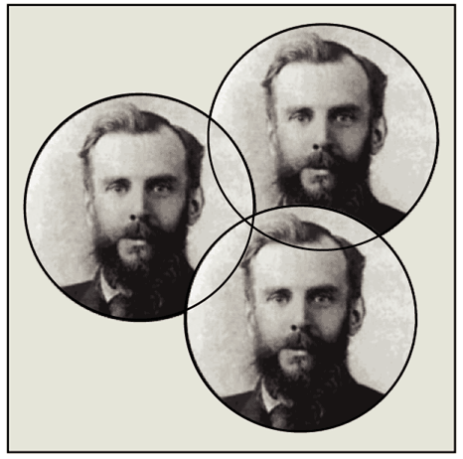
The First Three Rules of Working with Probability (cont.)
The most common kind of picture to make is called a Venn diagram.
We will see Venn diagrams in practice shortly…

Slide 12
Formal Probability
Two requirements for a probability:
  A probability is a number between 0 and 1.
  For any event A, 0 ≤ P(A) ≤ 1.

Slide 13
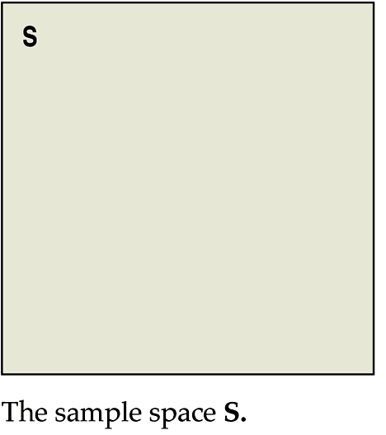
Formal Probability (cont.)
Probability Assignment Rule:
  The probability of the set of all possible outcomes of a trial must be 1.
  P(S) = 1 (S represents the set of all possible outcomes.)

Slide 14
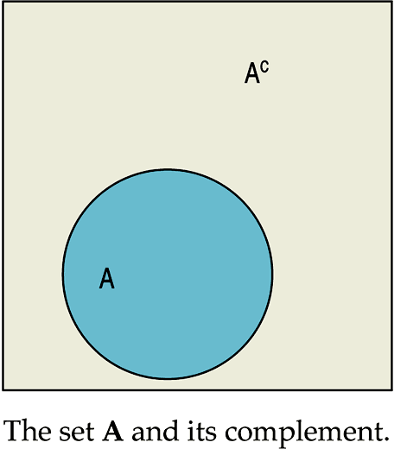
Formal Probability (cont.)
Complement Rule:
  The set of outcomes that are not in the event A is called the complement of A, denoted A^{C}.
  The probability of an event occurring is 1 minus the probability that it doesn’t occur: P(A) = 1 – P(A^{C})

Slide 15
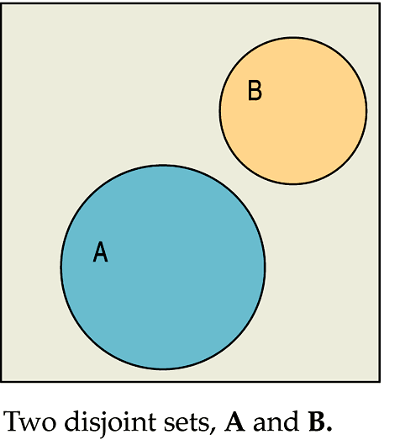
Formal Probability (cont.)
Addition Rule:
  Events that have no outcomes in common (and, thus, cannot occur together) are called disjoint (or mutually exclusive).

Slide 16
Formal Probability (cont.)
Addition Rule (cont.):
  For two disjoint events A and B, the probability that one or the other occurs is the sum of the probabilities of the two events.
  , provided that A and B are disjoint.

Slide 17
Formal Probability (cont.)
Multiplication Rule:
  For two independent events A and B, the probability that both A and B occur is the product of the probabilities of the two events.
  , provided that A and B are independent.

Slide 18
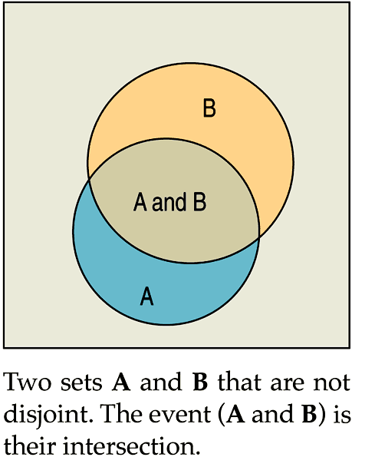
Formal Probability (cont.)
Multiplication Rule (cont.):
  Two independent events A and B are not disjoint, provided the two events have probabilities greater than zero:

Slide 19
Formal Probability (cont.)
Multiplication Rule:
  Many Statistics methods require an Independence Assumption, but assuming independence doesn’t make it true.
  Always Think about whether that assumption is reasonable before using the Multiplication Rule.

Slide 20
Formal Probability - Notation
Notation alert:
In this text we use the notation
In other situations, you might see the following:
  P(A or B) instead of
  P(A and B) instead of

Slide 21
Putting the Rules to Work
In most situations where we want to find a probability, we’ll use the rules in combination.
A good thing to remember is that it can be easier to work with the complement of the event we’re really interested in.

Slide 22
What Can Go Wrong?
Beware of probabilities that don’t add up to 1.
  To be a legitimate probability distribution, the sum of the probabilities for all possible outcomes must total 1.
Don’t add probabilities of events if they’re not disjoint.
  Events must be disjoint to use the Addition Rule.

Slide 23
What Can Go Wrong? (cont.)
Don’t multiply probabilities of events if they’re not independent.
  The multiplication of probabilities of events that are not independent is one of the most common errors people make in dealing with probabilities.
Don’t confuse disjoint and independent—disjoint events can’t be independent.

Slide 24
What have we learned?
Probability is based on long-run relative frequencies.
The Law of Large Numbers speaks only of long-run behavior.
  Watch out for misinterpreting the LLN.

Slide 25
What have we learned? (cont.)
There are some basic rules for combining probabilities of outcomes to find probabilities of more complex events. We have the:
  Probability Assignment Rule
  Complement Rule
  Addition Rule for disjoint events
  Multiplication Rule for independent events

Slide 26
AP Tip
For even the most simple probability problem, always show work. It may even just be to show the fraction that you used to calculate the percent.

