Slide 1
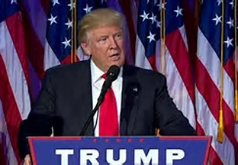
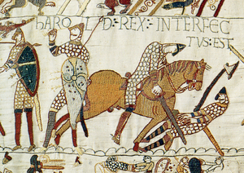
INFLUENCES ON PERSPECTIVE
FAKE NEWS!!! FAKE NEWS!! SAD!!!
Norman view of Battle of Hastings - Bayeux Tapestry
Why histories may be different?

Slide 2
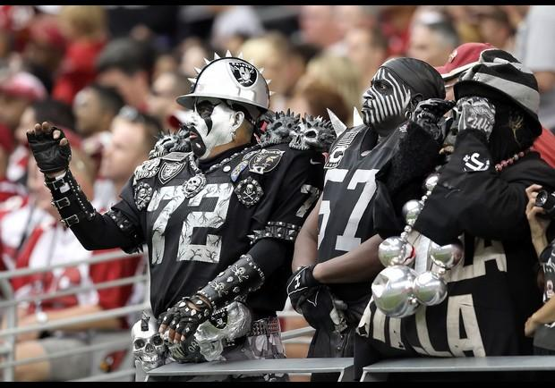
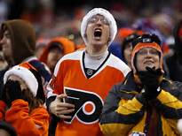
Passion
- Prejudices or biases that a person may have; which side does one favor.
- Examples:
Rabid sports fans!!
http://media.philly.com/images/600*450/20120104_inq_fitz04-c.JPG
http://blogs-images.forbes.com/mikeozanian/files/2011/09/04uvbKRfuN07e_5427.jpg

Slide 3
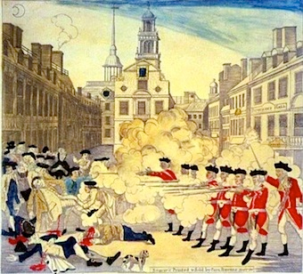
On the left is an engraving by Paul Revere – Study it carefully.
- Do you know the event that is being shown?
- Make three observations (things that you notice).

Slide 4
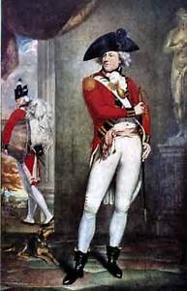
Answer these questions:
How much snow was on the ground? Was it night or day?
Where was the British officer standing – in front or in back of his men?
What is the comparison that Revere wants to show between the Boston citizenry and the British soldiers? Why? What was Revere’s purpose?

Slide 5
The Boston Massacre occurred on March 5, 1770. By many accounts, a young boy began to taunt the British sentry on duty. The guard took a swing with his musket; he may have struck the lad while others suggest he missed. More taunting ensues. More and more townspeople gathered as bells were ringing which normally meant a fire or some crisis was occurring. Seven British soldiers, including the captain, came to the guard’s aid. More townspeople arrived; the crowd in the hundreds closed in. Bats (cudgels) used on ships and in rope making appeared in the crowd.
Violence escalated from verbal affronts to thrown projectiles. Snowballs made from snow and ice as well as other materials were being thrown towards the British. The captain who was standing in front of his men did not have the authority to order the British to fire their muskets. But, being hit with a flying object, a British soldier dropped his weapon. Angrily, he picked up his weapon and fired without orders. Other British soldiers opened fire until the British captain regained control and ordered the men to stop. Three colonists died on the scene; two died later.
After reading the account above, what are some of the differences between the engraving and the writing?

Slide 6
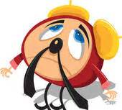
Importance
Importance is the idea that historical events lose significance (importance) over time

Slide 7
ANSWER THESE FOUR QUESTIONS.
Name TWO NATURAL DISASTERS which occurred in the United States in which at least three thousand people died.
Name the LARGEST NATURAL DISASTER to occur in Pennsylvania.
IN WHICH BATTLE did General GEORGE ARMSTRONG CUSTER die?
What ACT OF TERRORISM occurred in North America in December of 1773?

Slide 8
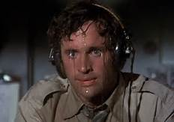
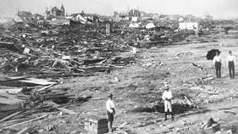
Answer to Question #1
1980 Heat Wave – June – September, 1980 – approximately 10 – 15 THOUSAND people died
2. Galveston Hurricane – on September 8 – 9, 1900 – 8 – 12 THOUSAND people died.
3. 1901 Heat Wave: 9,508 people died.

Slide 9
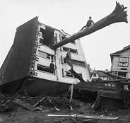
Answer to Question #2
Johnstown Flood
(May 31, 1889)
Flood occurred in western Pennsylvania when a dam broke above the town after a day of torrential rain
2,209 people died

Slide 10
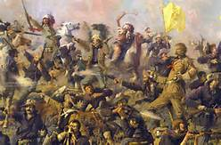
Answer to Question #3
The Battle of Little Big Horn a.k.a. The Battle of Greasy Grass

Slide 11
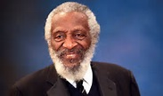
Quote by Dick Gregory
We used to root for the Indians against the cavalry, because we didn't think it was fair in the history books that when the CAVALRY WON it was a GREAT VICTORY, and when the INDIANS WON it was a MASSACRE.
---Dick Gregory
** Dick Gregory was an African-American comedian of the 1960s – 1990s. He was a major activist in the Civil Rights Movement for minorities.

Slide 12
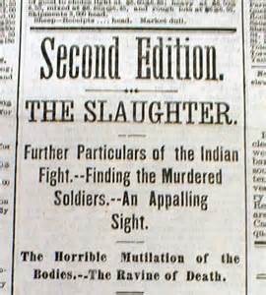
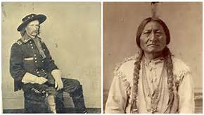
What words in the headlines indicate a biased article?
George Armstrong Custer – leading candidate for POTUS in 1876.
Sitting Bull – goes on to star in Buffalo Bill’s Wild West Shows.

Slide 13
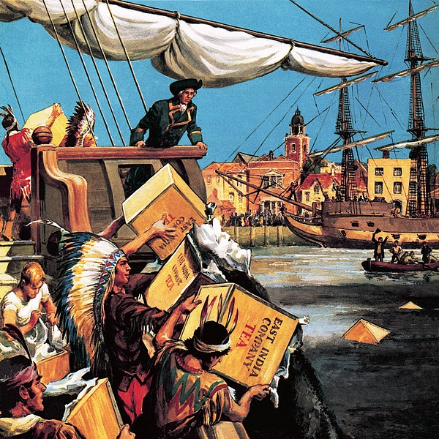
Answer to Question #4
The Boston Tea Party
But Mr. Stemler, didn’t our patriotic American colonists throw the tea overboard? How can you call the Boston Tea Party an ACT OF TERRORISM?
Remember, one side’s TERRORISM is another side’s act of FREEDOM. From the British view, the act was sabotage/terrorism.

Slide 14
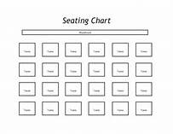
Location
Where you are physically in relation to the action
You are here!!

Slide 15
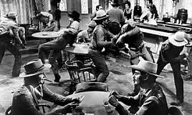
Old Cowboy Movies- saloon fights
What do you notice about the position of the two main fighters in the video?
https://www.youtube.com/watch?v=4WYdMB_j2Lw#action=share

Slide 16
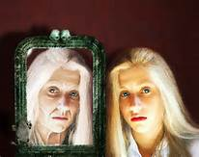
Imagination
What you think happened?
How memory changes over time?

Slide 17
What is unique about this vase? Look carefully.

Slide 18
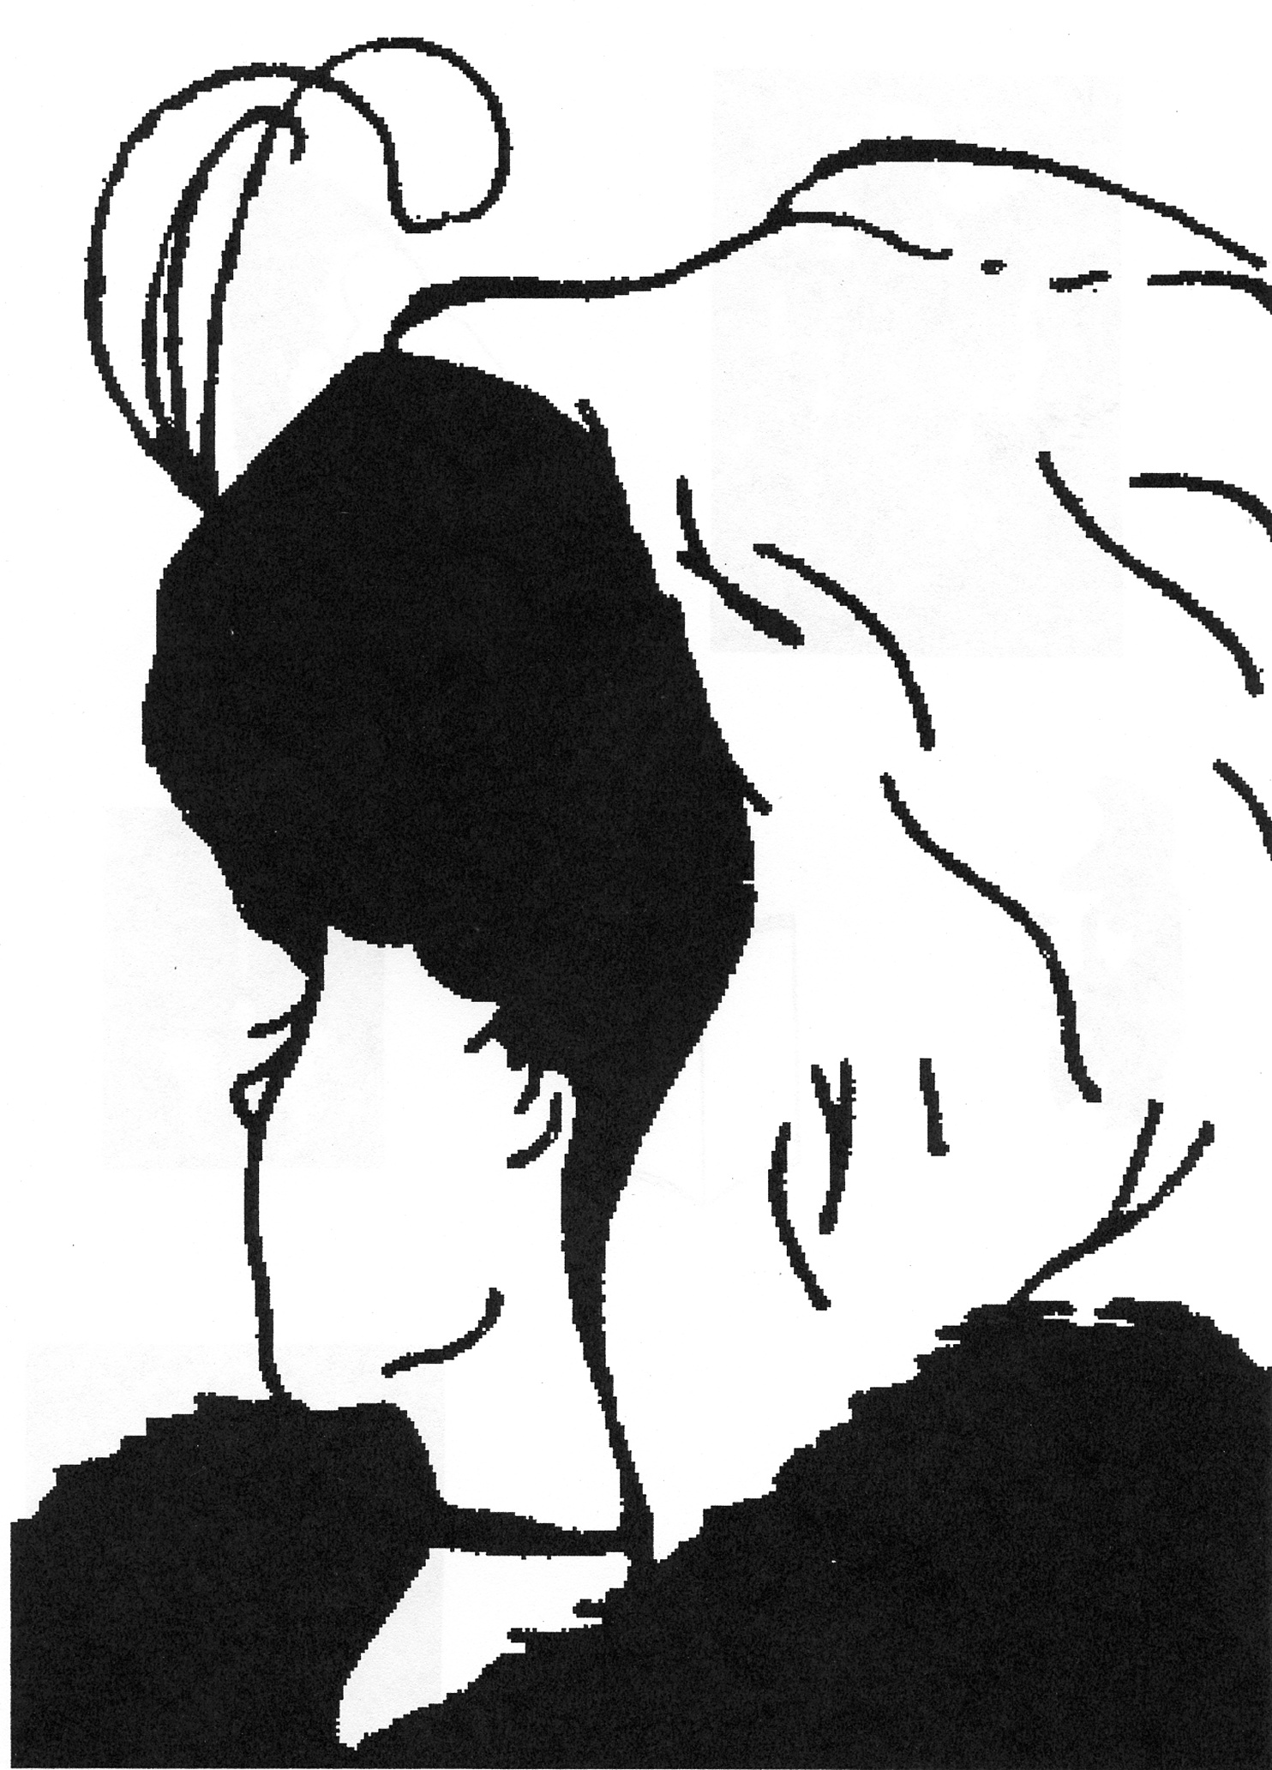
What do you see in this drawing?

Slide 19
Time
Over a span of years, attitudes change or new information is found that changes a perspective about groups, ideas, or events.
- Ex: Women, DNA Testing

Slide 20
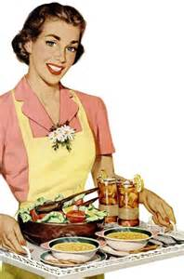
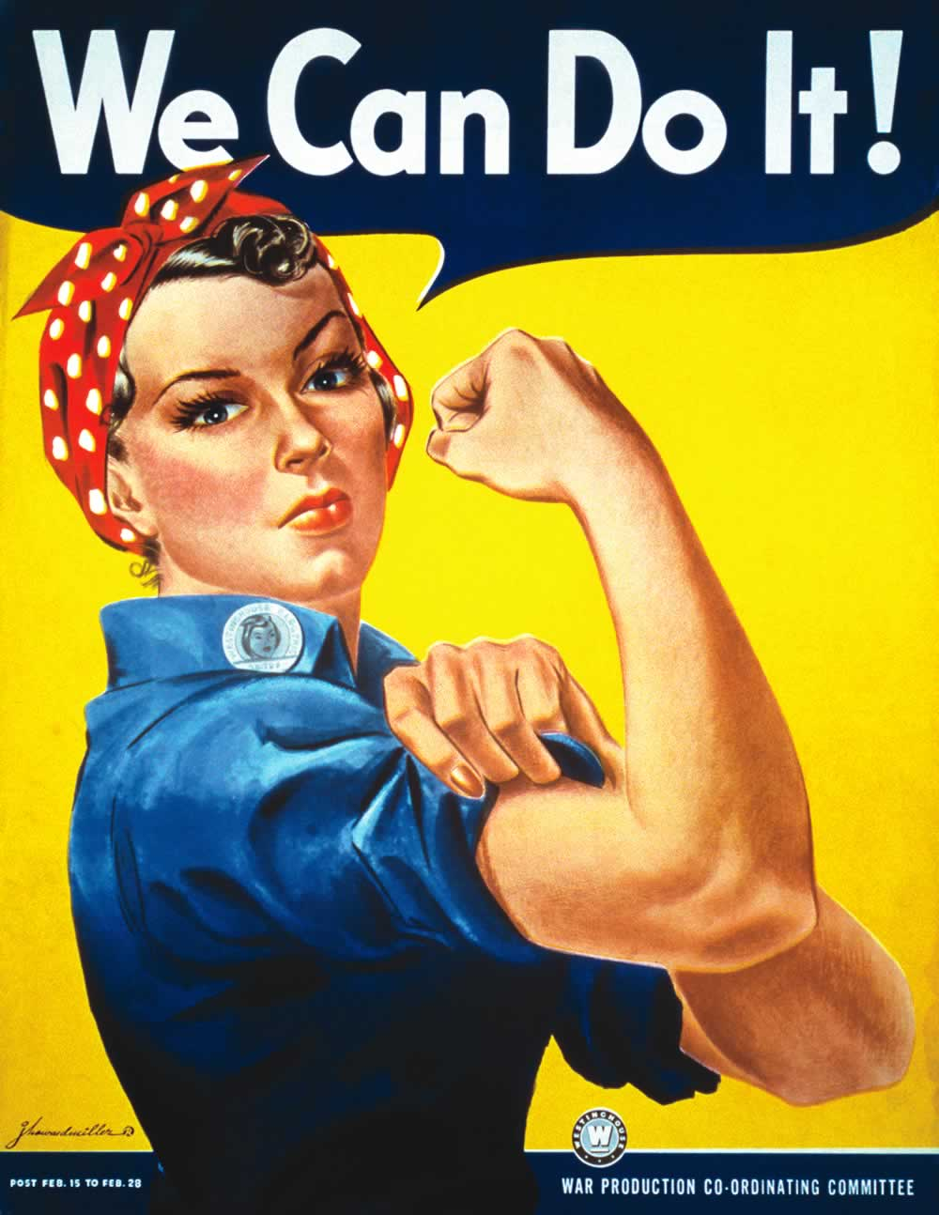
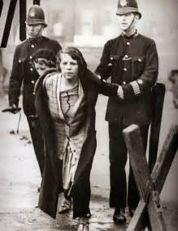
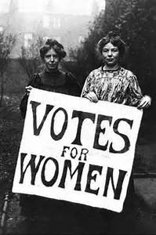
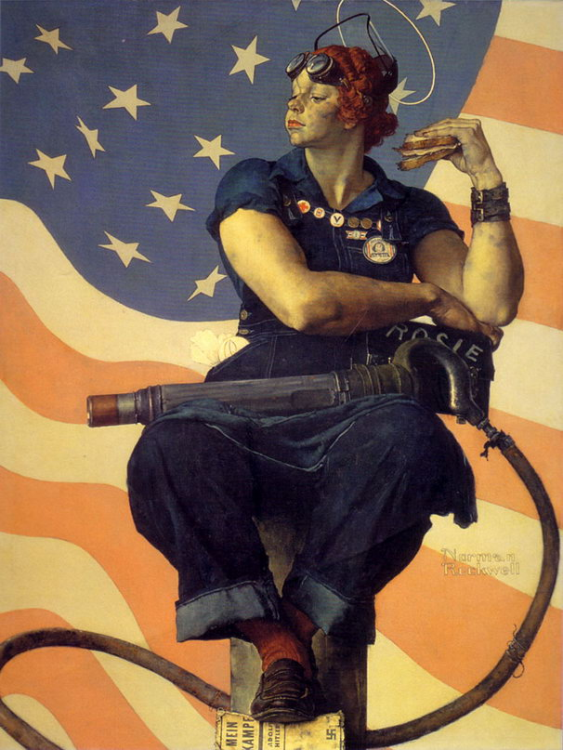
Example: Women’s Studies
- the idea of women has changed over the years
Women are strong minded and can do almost anything. Women are intelligent and add to our society in many ways.
Women should stay at home and take care of the family. Women are delicate and frail.
Women are too uninformed to have the right to vote.
Women are smart enough to vote.

Slide 21
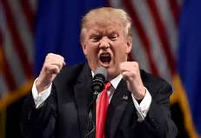
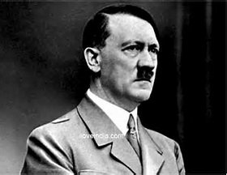
Coercion or Bullying/Propaganda
Intimidation factor to make you believe something
Examples:
Some German historians wrote false stories about events that were happening in Germany during the Nazi regime for fear they would be killed or sent away.
President Trump implies that one cannot trust the “main stream” media.
FAKE NEWS!!!

Slide 22
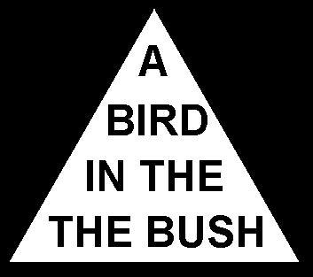
Read the words in the triangle aloud with Mr. Stemler.

Slide 23
Paul Revere etching of a famous event in the history of Boston and the United States made within a couple of days of the shooting.

