Slide 1
http://www.gao.gov/products/GAO-10-847T

Slide 3
10.2 DNA and RNA are polymers of nucleotides
DNA and RNA are nucleic acids consisting of long chains (polymers) of chemical units (monomers) called nucleotides.
One of the two strands of DNA is a DNA polynucleotide, a nucleotide polymer (chain).
Notes:
The Structure of the Genetic Material
Student Misconceptions and Concerns
• If your class has not yet studied Chapter 3, consider assigning Module 3.15 on Nucleic Acids before addressing the contents of Chapter 10.
• Students often confuse the terms nucleic acids, nucleotides, and bases. It helps to note the hierarchy of relationships: nucleic acids consist of long chains of nucleotides (polynucleotides), while nucleotides include nitrogenous bases.
Teaching Tips
• The descriptions of the discovery of DNA’s structure are a good time to point out that science is a collaborative effort. Watson, Crick, and Wilkins earned Nobel Prizes due to their historic conclusions based upon the work of many others (including Franklin, Griffith, Hershey, Chase, and Chargaff).
• Consider comparing DNA, RNA, and proteins to a train (polymer). DNA and RNA are like a train of various lengths and combinations of four types of train cars (monomers). Proteins are also “trains” of various lengths but made of a combination of 20 types of train cars.

Slide 4
10.2 DNA and RNA are polymers of nucleotides
A nucleotide is composed of a
nitrogenous base
five-carbon sugar
phosphate group
The nucleotides are joined to one another by a sugar-phosphate backbone.

Slide 5
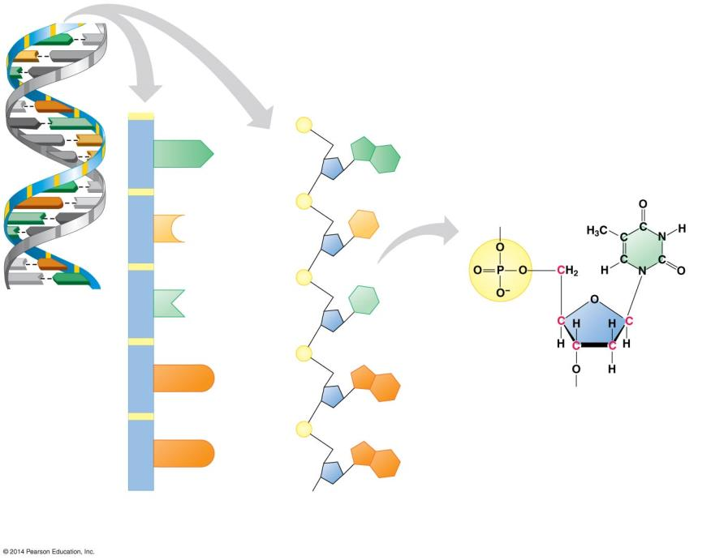
Figure 10.2a-0
A
T
C
G
T
A
Sugar-phosphate backbone
C
G
A
T
Phosphate group
G
C
A
A
G
Nitrogenous base
Nitrogenous base (can be A, G, C, or T)
A
T
Covalent bond joining nucleotides
G
C
Sugar
T
A
C
C
T
A
C
G
T
A
DNA nucleotide
Thymine (T)
A DNA double helix
T
T
Phosphate group
G
G
Sugar (deoxyribose)
DNA nucleotide
G
G
Two representations of a DNA polynucleotide
Notes:
Figure 10.2a-0 The structure of a DNA polynucleotide

Slide 6
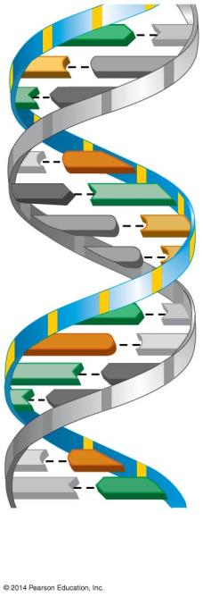
Figure 10.2a-1
A
T
C
G
T
A
C
G
A
T
G
C
G
A
T
G
C
T
A
T
A
C
G
T
A
A DNA double helix
Notes:
Figure 10.2a-1 The structure of a DNA polynucleotide (part 1)

Slide 7
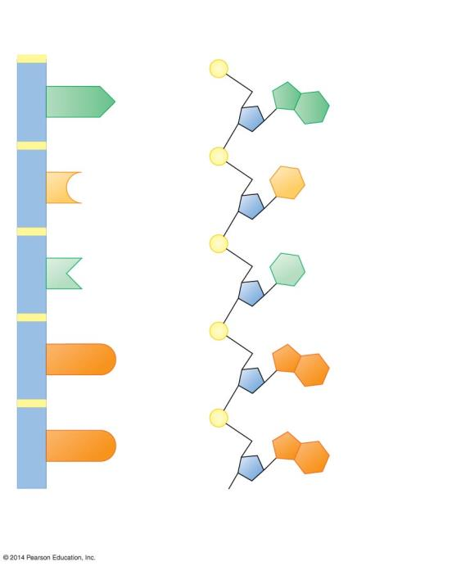
Figure 10.2a-2
Sugar-phosphate backbone
Phosphate group
A
A
Nitrogenous base
Covalent bond joining nucleotides
Sugar
C
C
DNA nucleotide
T
T
G
G
G
G
Two representations of a DNA polynucleotide
Notes:
Figure 10.2a-2 The structure of a DNA polynucleotide (part 2)

Slide 8
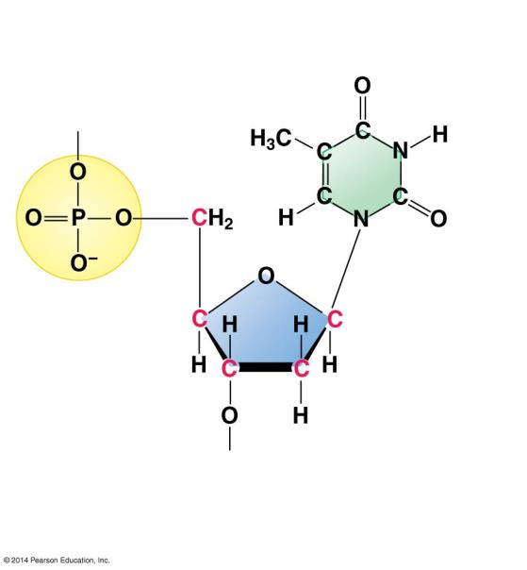
Figure 10.2a-3
Nitrogenous base (can be A, G, C, or T)
Thymine (T)
Phosphate group
Sugar (deoxyribose)
DNA nucleotide
Notes:
Figure 10.2a-3 The structure of a DNA polynucleotide (part 3)

Slide 9
10.2 DNA and RNA are polymers of nucleotides
Each type of DNA nucleotide has a different nitrogen-containing base:
adenine (A)
cytosine (C)
thymine (T)
guanine (G)
Notes:
The Structure of the Genetic Material
Student Misconceptions and Concerns
• If your class has not yet studied Chapter 3, consider assigning Module 3.15 on Nucleic Acids before addressing the contents of Chapter 10.
• Students often confuse the terms nucleic acids, nucleotides, and bases. It helps to note the hierarchy of relationships: nucleic acids consist of long chains of nucleotides (polynucleotides), while nucleotides include nitrogenous bases.
Teaching Tips
• The descriptions of the discovery of DNA’s structure are a good time to point out that science is a collaborative effort. Watson, Crick, and Wilkins earned Nobel Prizes due to their historic conclusions based upon the work of many others (including Franklin, Griffith, Hershey, Chase, and Chargaff).
• Consider comparing DNA, RNA, and proteins to a train (polymer). DNA and RNA are like a train of various lengths and combinations of four types of train cars (monomers). Proteins are also “trains” of various lengths but made of a combination of 20 types of train cars.

Slide 10
Animation: DNA and RNA Structure

Slide 11
Figure 10.2b-0
Thymine (T)
Cytosine (C)
Adenine (A)
Guanine (G)
Pyrimidines
Purines
Notes:
Figure 10.2b-0 The nitrogenous bases of DNA

Slide 12
10.2 DNA and RNA are polymers of nucleotides
The full name for DNA is deoxyribonucleic acid, with nucleic referring to DNA’s location in the nuclei of eukaryotic cells.
RNA (ribonucleic acid) is unlike DNA in that it
uses the sugar ribose (instead of deoxyribose in DNA) and
has a nitrogenous base uracil (U) instead of thymine.
Notes:
The Structure of the Genetic Material
Student Misconceptions and Concerns
• If your class has not yet studied Chapter 3, consider assigning Module 3.15 on Nucleic Acids before addressing the contents of Chapter 10.
• Students often confuse the terms nucleic acids, nucleotides, and bases. It helps to note the hierarchy of relationships: nucleic acids consist of long chains of nucleotides (polynucleotides), while nucleotides include nitrogenous bases.
Teaching Tips
• The descriptions of the discovery of DNA’s structure are a good time to point out that science is a collaborative effort. Watson, Crick, and Wilkins earned Nobel Prizes due to their historic conclusions based upon the work of many others (including Franklin, Griffith, Hershey, Chase, and Chargaff).
• Consider comparing DNA, RNA, and proteins to a train (polymer). DNA and RNA are like a train of various lengths and combinations of four types of train cars (monomers). Proteins are also “trains” of various lengths but made of a combination of 20 types of train cars.

Slide 13
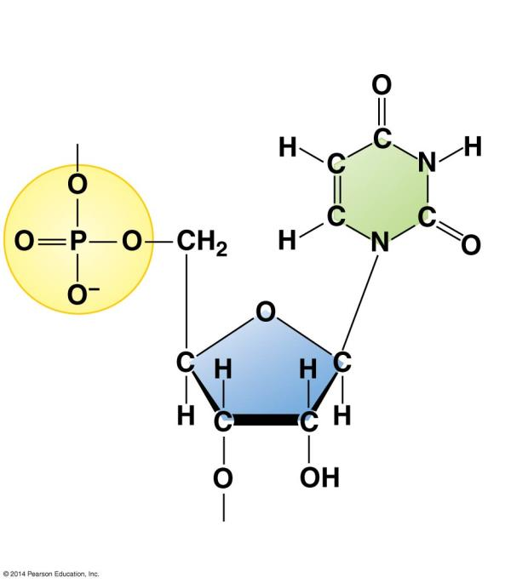
Figure 10.2c
Nitrogenous base (can be A, G, C, or U)
Phosphate group
Uracil (U)
Sugar (ribose)
Notes:
Figure 10.2c An RNA nucleotide

Slide 14
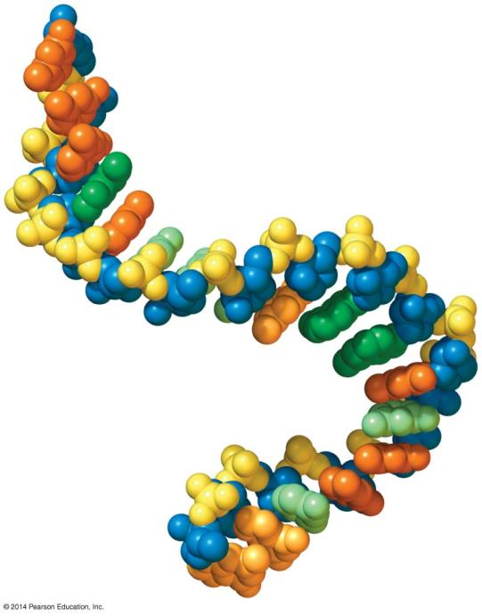
Figure 10.2d
Adenine
Guanine
Phosphate
Ribose
Uracil
Cytosine
Notes:
Figure 10.2d A computer model showing part of an RNA polynucleotide

Slide 15
10.3 DNA is a double-stranded helix
American James D. Watson journeyed to Cambridge University in England, where the more senior Francis Crick was studying protein structure with a technique called X-ray crystallography.
While visiting the laboratory of Maurice Wilkins at King’s College in London, Watson saw an X-ray image of DNA produced by Wilkins’s colleague, Rosalind Franklin.
Notes:
Student Misconceptions and Concerns
• If your class has not yet studied Chapter 3, consider assigning module 3.15 on Nucleic Acids before addressing the contents of Chapter 10.
• Students often confuse the terms nucleic acids, nucleotides, and bases. It helps to note the hierarchy of relationships: nucleic acids consist of long chains of nucleotides (polynucleotides), while nucleotides include nitrogenous bases.
Teaching Tips
• The descriptions of the discovery of DNA’s structure are a good time to point out that science is a collaborative effort. Watson, Crick, and Wilkins earned Nobel Prizes due to their historic conclusions based upon the work of many others (including Franklin, Griffith, Hershey, Chase, and Chargaff).
Active Lecture Tips
• The authors note that the structure of DNA is analogous to a twisted rope ladder. In class, challenge your students to pair up with someone nearby to explain what the parts of the ladder represent. Answer: The wooden rungs represent pairs of nitrogenous bases joined by hydrogen bonds. Each rope represents a sugar-phosphate backbone.
• See the Activity I’m Not Sure I Liked James Watson: Using a Video to Tell the Most Exciting Discovery in Biology on the Instructor Exchange. Visit the Instructor Exchange in the MasteringBiology instructor resource area for a description of this activity.

Slide 16
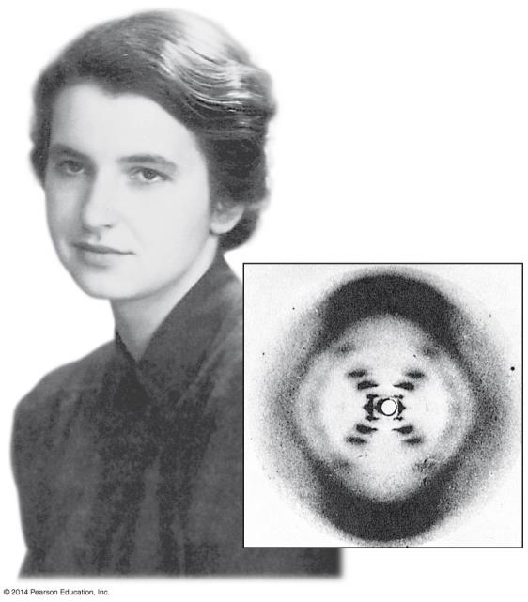
Figure 10.3a-0
Notes:
Figure 10.3a-0 Rosalind Franklin and her X-ray image of DNA

Slide 17
10.3 DNA is a double-stranded helix
Watson deduced the basic shape of DNA to be a helix (spiral) with a uniform diameter and the nitrogenous bases located above one another like a stack of dinner plates.
The thickness of the helix suggested that it was made up of two polynucleotide strands.
Notes:
Student Misconceptions and Concerns
• If your class has not yet studied Chapter 3, consider assigning Module 3.15 on Nucleic Acids before addressing the contents of Chapter 10.
• Students often confuse the terms nucleic acids, nucleotides, and bases. It helps to note the hierarchy of relationships: nucleic acids consist of long chains of nucleotides (polynucleotides), while nucleotides include nitrogenous bases.
Teaching Tips
• The descriptions of the discovery of DNA’s structure are a good time to point out that science is a collaborative effort. Watson, Crick, and Wilkins earned Nobel Prizes due to their historic conclusions based upon the work of many others (including Franklin, Griffith, Hershey, Chase, and Chargaff).
Active Lecture Tips
• The authors note that the structure of DNA is analogous to a twisted rope ladder. In class, challenge your students to pair up with someone nearby to explain what the parts of the ladder represent. Answer: The wooden rungs represent pairs of nitrogenous bases joined by hydrogen bonds. Each rope represents a sugar-phosphate backbone.
• See the Activity I’m Not Sure I Liked James Watson: Using a Video to Tell the Most Exciting Discovery in Biology on the Instructor Exchange. Visit the Instructor Exchange in the MasteringBiology instructor resource area for a description of this activity.

Slide 18
10.3 DNA is a double-stranded helix
Watson and Crick realized that DNA consisted of two polynucleotide strands wrapped into a double helix.
The sugar-phosphate backbone is on the outside.
The nitrogenous bases are perpendicular to the backbone in the interior.
Specific pairs of bases give the helix a uniform shape.
A pairs with T, forming two hydrogen bonds, and
G pairs with C, forming three hydrogen bonds.
Notes:
Student Misconceptions and Concerns
• If your class has not yet studied Chapter 3, consider assigning Module 3.15 on Nucleic Acids before addressing the contents of Chapter 10.
• Students often confuse the terms nucleic acids, nucleotides, and bases. It helps to note the hierarchy of relationships: nucleic acids consist of long chains of nucleotides (polynucleotides), while nucleotides include nitrogenous bases.
Teaching Tips
• The descriptions of the discovery of DNA’s structure are a good time to point out that science is a collaborative effort. Watson, Crick, and Wilkins earned Nobel Prizes due to their historic conclusions based upon the work of many others (including Franklin, Griffith, Hershey, Chase, and Chargaff).
Active Lecture Tips
• The authors note that the structure of DNA is analogous to a twisted rope ladder. In class, challenge your students to pair up with someone nearby to explain what the parts of the ladder represent. Answer: The wooden rungs represent pairs of nitrogenous bases joined by hydrogen bonds. Each rope represents a sugar-phosphate backbone.
• See the Activity I’m Not Sure I Liked James Watson: Using a Video to Tell the Most Exciting Discovery in Biology on the Instructor Exchange. Visit the Instructor Exchange in the MasteringBiology instructor resource area for a description of this activity.

Slide 19
Animation: DNA Double Helix

Slide 20
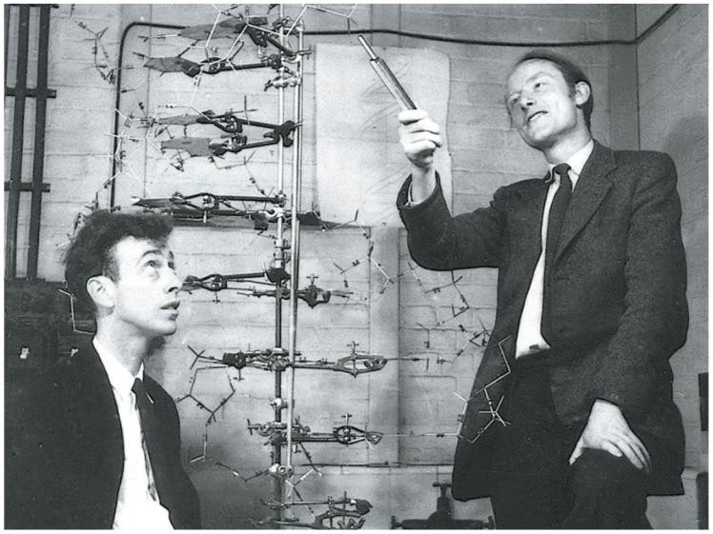
Figure 10.3b
Notes:
Figure 10.3b Watson and Crick in 1953 with their model of the DNA double helix

Slide 21
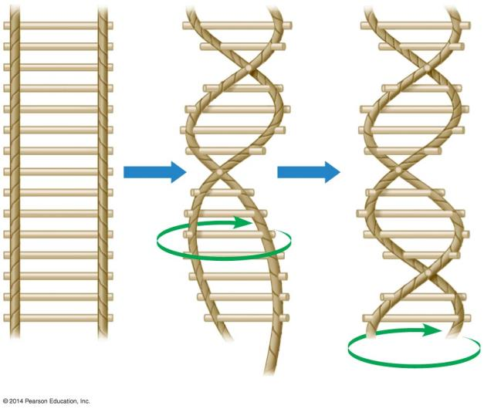
Figure 10.3c
Twist
Notes:
Figure 10.3c A rope ladder analogy for the double helix

Slide 22
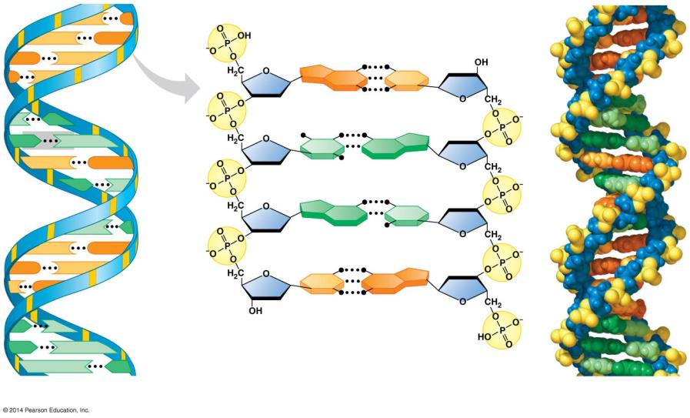
Figure 10.3d-0
C
G
C
G
Hydrogen bond
G
C
G
C
G
C
Base pair
T
A
A
T
T
A
C
G
A
T
A
T
T
A
C
G
G
C
C
G
C
G
A
T
A
T
T
A
Ribbon model
Partial chemical structure
Computer model
Notes:
Figure 10.3d-0 Three representations of DNA

Slide 23
10.3 DNA is a double-stranded helix
In 1962, the Nobel Prize was awarded to James D. Watson, Francis Crick, and Maurice Wilkins.
Rosalind Franklin probably would have received the prize as well but for her death from cancer in 1958.
Nobel Prizes are never awarded posthumously.
The Watson-Crick model gave new meaning to the words genes and chromosomes. The genetic information in a chromosome is encoded in the nucleotide sequence of DNA.
Notes:
Student Misconceptions and Concerns
• If your class has not yet studied Chapter 3, consider assigning Module 3.15 on Nucleic Acids before addressing the contents of Chapter 10.
• Students often confuse the terms nucleic acids, nucleotides, and bases. It helps to note the hierarchy of relationships: nucleic acids consist of long chains of nucleotides (polynucleotides), while nucleotides include nitrogenous bases.
Teaching Tips
• The descriptions of the discovery of DNA’s structure are a good time to point out that science is a collaborative effort. Watson, Crick, and Wilkins earned Nobel Prizes due to their historic conclusions based upon the work of many others (including Franklin, Griffith, Hershey, Chase, and Chargaff).
Active Lecture Tips
• The authors note that the structure of DNA is analogous to a twisted rope ladder. In class, challenge your students to pair up with someone nearby to explain what the parts of the ladder represent. Answer: The wooden rungs represent pairs of nitrogenous bases joined by hydrogen bonds. Each rope represents a sugar-phosphate backbone.
• See the Activity I’m Not Sure I Liked James Watson: Using a Video to Tell the Most Exciting Discovery in Biology on the Instructor Exchange. Visit the Instructor Exchange in the MasteringBiology instructor resource area for a description of this activity.

Slide 24
https://www.youtube.com/watch?v=q6PP-C4udkA

