Slide 1
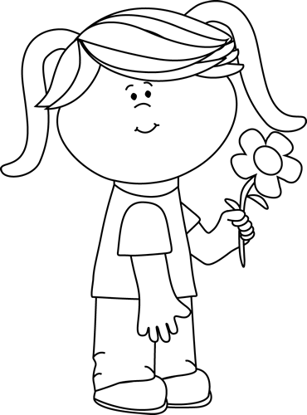
I need help from the counselor!
Name______________Date______
Teacher (homeroom)____ _____
My problem is (circle one):
friends home school other My problem is this big (circle one):
1 2 3 4 5 6 7 8 9 10
I need help from the counselor!
Name______________Date______
Teacher (homeroom)___________
My problem is (circle one):
friends home school other
My problem is this big (circle one):
1 2 3 4 5 6 7 8 9 10

