Slide 1
Welcome to the Library!
Mrs. Burrell-- Librarian (Day 6)
Mrs. Heitzman-- Library Assistant

Slide 2
Visiting the Library
6th grade- PD 11
Circulation desk
Passes- always, unless with class
Sign-in sheet- always, unless with class
Notes:
5th grade: 5 books at a time unless problem arises
6th-12th: 10 books at a time unless problem arises
Due dates: 3 weeks from checkout
Renewal:

Slide 3
Checking Out Books
Where? Circ desk staff or self-checkout computer
How? Give name, have book scanned
How many? 5 for 5th grade; 10 for 6th-12th grade (unless problems occur)
How long? 3 weeks
Due dates? Stamped on date due card in pocket of each book

Slide 4
Renewing Books
2 renewal maximum
Each renewal provides 3 weeks from date of renewal
Can renew online if you don’t have any overdue books
See library staff if additional renewals are needed
Book must be brought to staff for additional renewals

Slide 5
Returning Books
Book return at end of circ desk (preferred-- quicker check-in)
Book return in hallway (no excuse!)

Slide 6
Fines???
No fines charged for overdue books
If book is more than 90 days overdue, it will be assumed lost, and you will be charged for the book.
Book must be returned or paid for to avoid an obligation.

Slide 7
Book Locations
Fiction
Special Collections
Nonfiction
RED DOTS
New Books Historical Fiction Sports Fiction Graphic Novels | Careers Biographies Magazines

Slide 8
Using the Destiny Catalog
Personal log-in (search both buildings’ catalogs, place hold, make recommendations) EX: username: 23aburrell, PW: lunch#
My Info tab
Search
Place holds
Make recommendations
Write reviews
Copies tab
Call number headings: HF, SPO, GN, J, 92

Slide 9
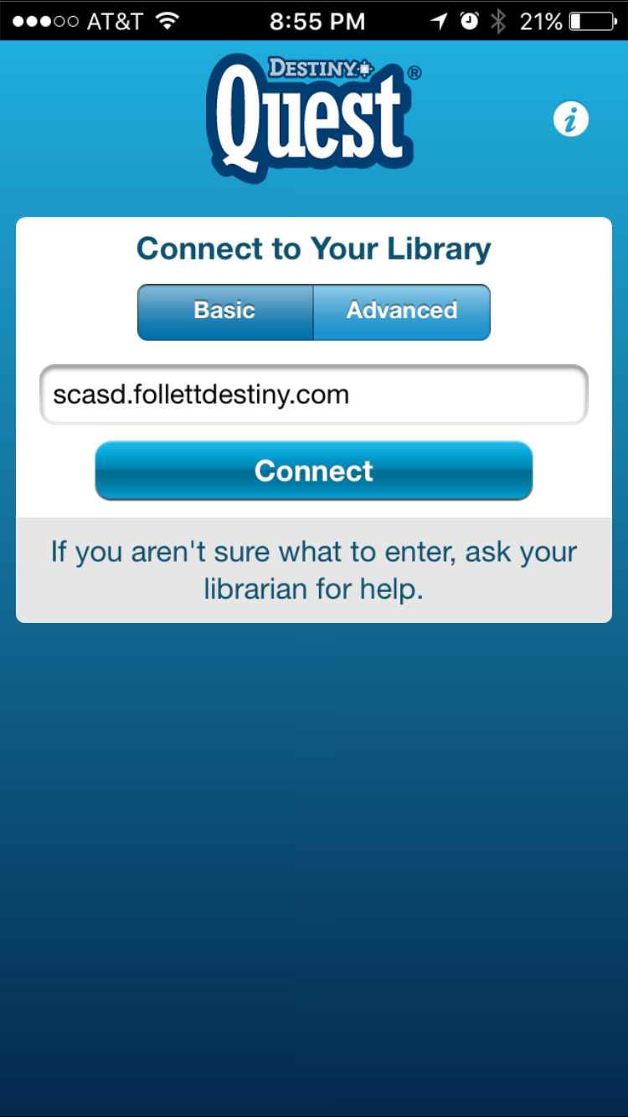
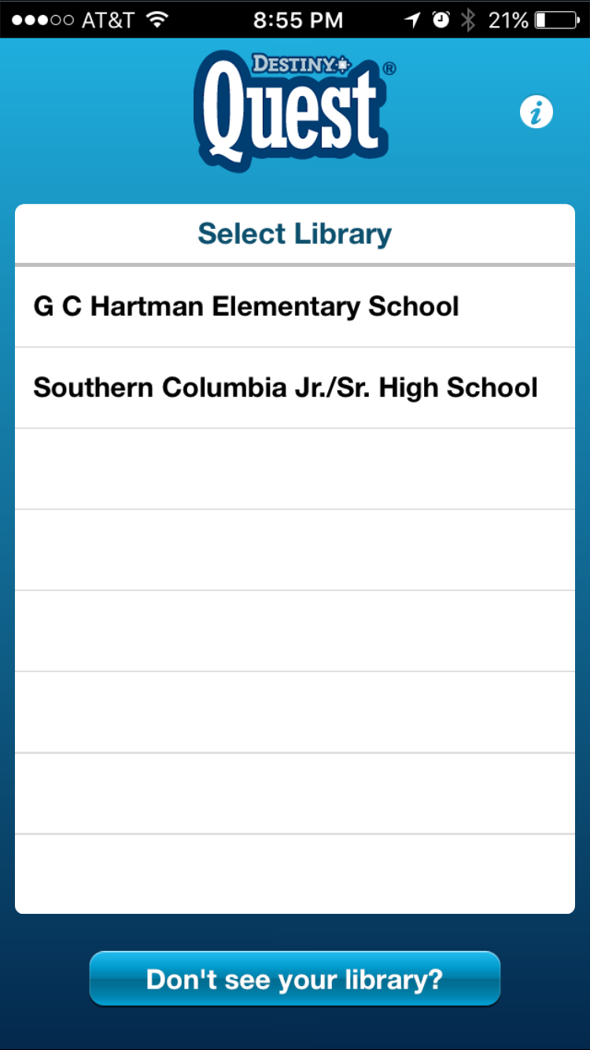
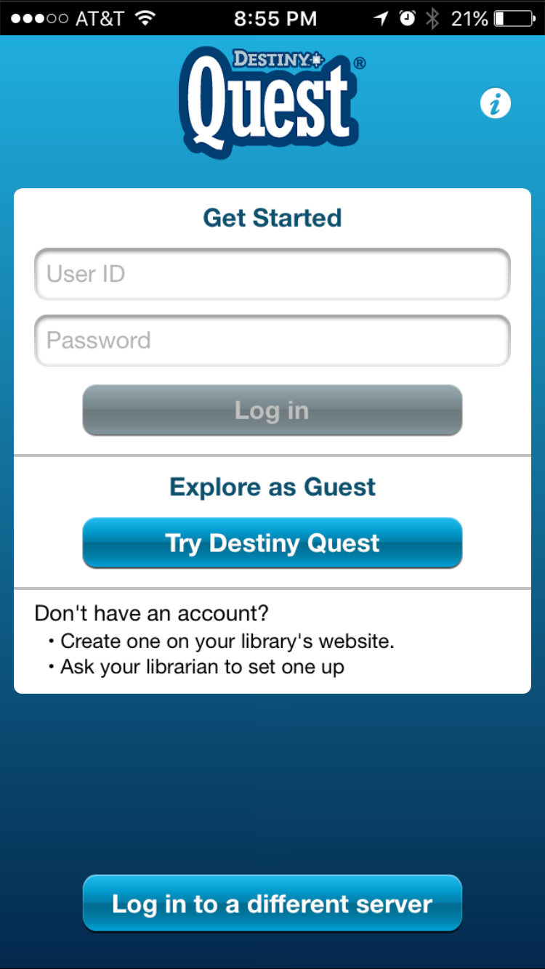
App (iPhone, Android)
Destiny Quest

Slide 10
Don’t forget about Office 365!
Same log-in as last year
Example: UN-- 23aburrell@scasd.us PW-- lunch#SCA
No flash drive needed- nothing to lose!
Access to Office on any computer at home or school
Share documents with group members

Slide 11
Time to look for books!

