Slide 1
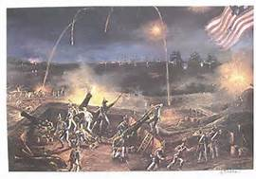
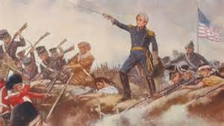
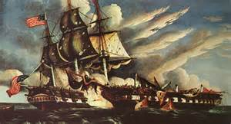
CH 10 Sec 3: War of 1812
Path to War
Bombing of Fort McHenry
Gen. Andrew Jackson at the Battle of New Orleans
USS Constitution
“Old Ironsides”

Slide 2
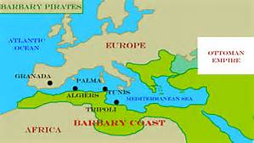
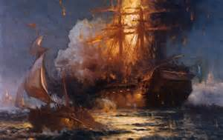
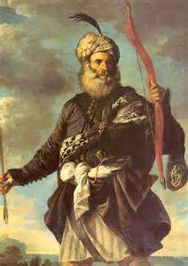
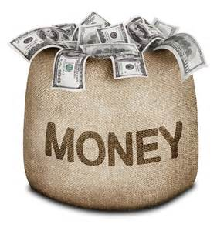
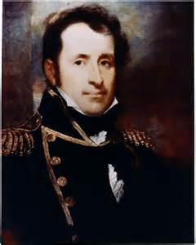
Tripolitan War
War with Tripoli against Barbary pirates
- Barbary Coast – north African coast
Reason: U.S. refuses to pay tribute so Barbary pirates raided merchant ships
Jefferson sends small navy to free US sailors
US merchants trading all over the world – 2nd tribute
Stephen Decatur

Slide 3
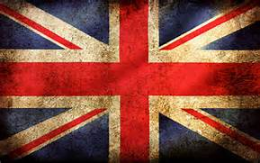
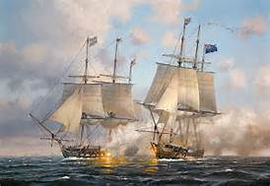
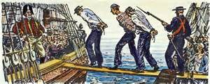
Problems with England and France
BOTH countries raid American ships
England impress American sailors – kidnaps them for use in their Navy
USS Chesapeake vs. HMS Leopard

Slide 4
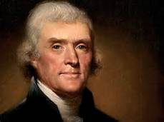
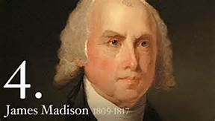
American Policy – Stay Neutral
Thomas Jefferson – “peaceful coercion”
Congress passes the EMBARGO Act of 1807
Designed to protect American sailors
No trading to foreign ports
US ports closed to British ships
Hurts American economy most
2. James Madison – becomes President in 1809
- no French or English trade depending on which ends raids first

Slide 5
Embargo Act of 1807 Political Cartoon
What do you observe?

Slide 6
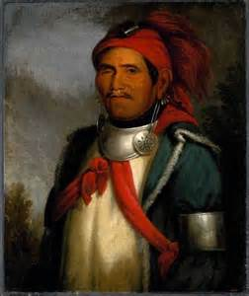
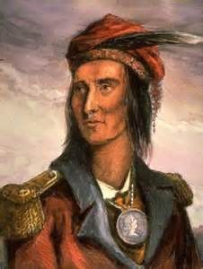
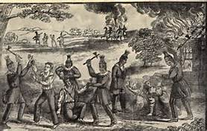
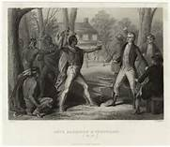
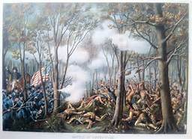
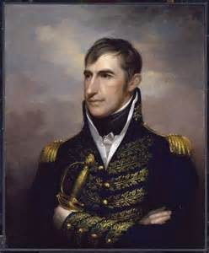
Native American Problems
The Prophet
Tecumseh
England encourages NATAM raids
Tecumseh confronts Harrison
1. England & NATAMS block US growth westward
2. NATAMS cede more land to US
3. TECUMSEH, Shawnee Chief – stop US expansion; tries to unite tribes to prevent expansion.
4. Battle of Tippecanoe
a. makes William H. Harrison a hero
b. Secures NW Territory for US
Battle of Tippecanoe
Harrison

Slide 7
RECAP: EVENTS – PRE-WAR of 1812
WAR in Tripoli w/ BARBARY PIRATES (1801 – 1805)
2. Impressment OF US SAILORS BY ENGLAND; SEIZING OF SHIPS & CARGO BY ENGLAND & FRANCE
3. Embargo ACT OF 1807 – NO Trade
4. GROWING PROBLEMS W/NATAMS IN THE WEST

