Slide 1
What is economics?
Chapter 1

Slide 2
Section 1: Scarcity and the factors of production
Economics and You
Economics is the study of how individuals, businesses, and governments make choices when faced with a limited supply of resources.
Scarcity forces us to decide what is important.

Slide 3
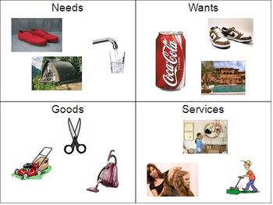
I. Scarcity and Choice
Need = Something essential for survival
Want = Something desired but not essential
Goods = physical objects that someone produces
Services = Actions or services performed by a person

Slide 4
I-A. The Problem of Limits
Wants and needs are unlimited
Goods and services are limited – this is called scarcity.
Scarcity forces choices
Economics = how we make choices to fulfill wants / needs

Slide 5
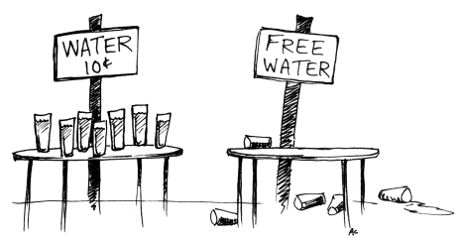
I-B. Scarcity Vs. Shortage
Shortage = Producers unwilling to produce more of a good/service than consumers want
Unlike shortages, scarcity always exists

Slide 6
II. Entrepreneurs and the Factors of Production
Entrepreneurs = People who decide how to combine resources to create new goods and services.
Must assemble the factors of production
These are land / labor / capital

Slide 7
II-A. Land
Land = All natural resources used to produce goods and services
II-B. Labor
Labor = The effort people devote to tasks for which they are paid
II-C. Capital
Capital = Any human made resource that is used to produce other goods and services.
Physical Capital – AKA Capital Goods. These are buildings, equipment, and tools.
Human Capital – The knowledge and skills a worker gains through education and experience.

Slide 8
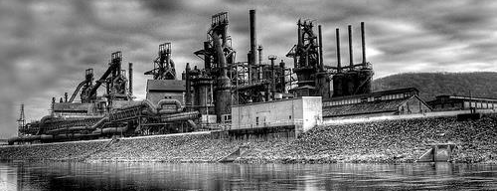
II – D. Benefits of Capital
Capital is the key factor in production
It makes producers more productive
Example…. A dishwasher
Extra Time / More Knowledge / More Productivity

Slide 9
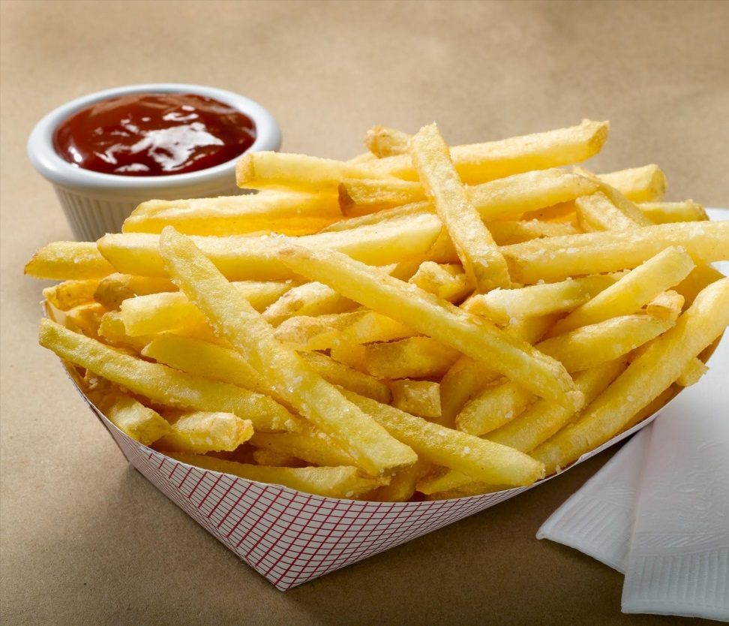
III. Scarce Resources
Goods and services are scarce because resources are scarce
Example… French Fries
All resources have alternative uses

Slide 10
Section 2: Opportunity Cost
Economics and You
Doing one thing is giving up the opportunity to do something else.

Slide 11
I. Trade-Offs – giving up one benefit to gain another
I-A. Individuals and Trade Offs
Being in a play prevents you from being in track
I-B. Businesses and Trade Offs
Farming broccoli prevents you from farming squash
I-C. Governments and Trade Offs
“guns or butter”
Spend money on military or domestic needs?
The reason for any trade off is scarcity

Slide 12
II. Determining Opportunity Cost
The most desirable alternative given up as the result of a decision
Sleep late or get up and study?
Sleep late or get up for breakfast?
Sleep late or get up to leave on vacation?

Slide 13
II-A. Using a Decision Making Grid
 | Alternatives
 | Sleep late | Wake up early to study
Benefits | Enjoy more sleep Have more energy during the day | Better grade on test Teacher / Parent approval Personal satisfaction
Benefits forgone | Better grade on test Teacher/Parent approval Personal Satisfaction | Enjoy more sleep Have more energy during the day
Opportunity Cost | Extra study time | Extra sleep time

Slide 14
II-B. Making the Decision
By choosing, we are willing to accept opportunity cost
Different alternatives change our perception of cost
“Choosing is refusing”

Slide 15
III. Thinking at the Margin
III-A. Cost/Benefit Analysis
Compare sacrifices and gains
Sometimes called cost/benefit analysis
Marginal cost = the cost of adding one unit
Marginal benefit = the extra benefit of adding one unit

Slide 16
III-B. Decision Making at the Margin
“all or nothing decisions”
Decisions can be made in varying degrees
The best decisions are those made at the margin
Options | Benefit | Opportunity Cost
1st hour of extra study time | C on test | 1 hour of sleep
2nd hour of extra study time | B on test | 2 hours of sleep
3rd hour of extra study time | B+ on test | 3 hours of sleep

Slide 17
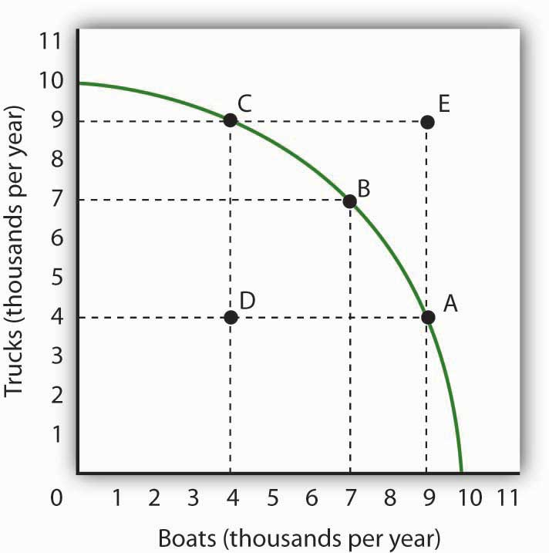
Section 3: Production Possibilities Curves
Economics and You

Slide 18
I. Production Possibilities
I-A. Drawing a Production Possibilities Curve
A graph that shows alternative ways to use an economy’s productive resources
Capeland – 15 million pairs of shoes or 21 million tons of watermelons
Watermelons (millions of tons) | Shoes (millions of pairs)
0 | 15
8 | 14
14 | 12
18 | 9
20 | 5
21 | 0

Slide 19
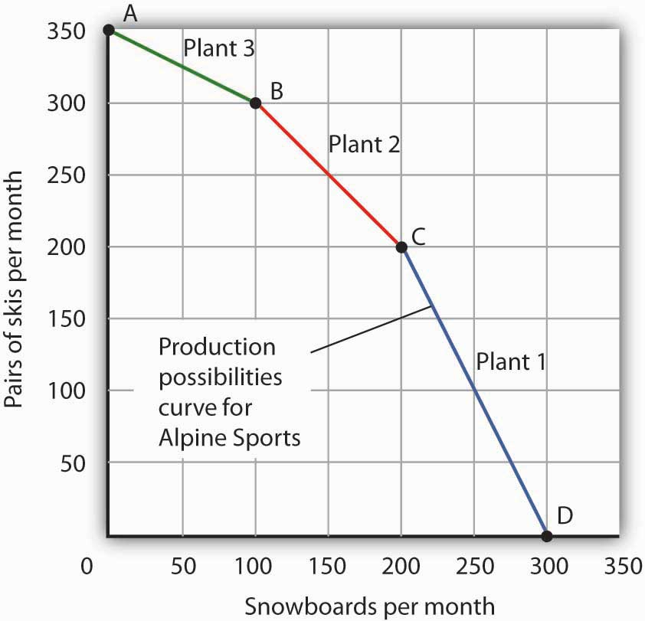
I-B. Trade-Offs
Each point on the frontier represents a trade off
Necessary because the factors of production are scarce

Slide 20
II. Efficiency, Growth, and Cost
II-A. Efficiency
Use of resources in a way that maximizes the output of goods and services
Underutilization – using fewer resources than the economy is capable of using
Future production possibilities frontier
II-B. Growth
In reality, the curve is always moving
Change in land, labor, or capital changes the curve
“shifted to the right” / “shifted to the left”

Slide 21
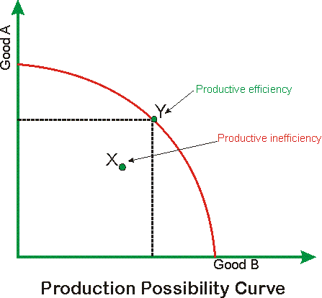

Slide 22
II-C. Cost
The curve can determine opportunity cost
Law of increasing costs
As production shifts from one item to another, more and more resources are necessary to increase production of the second item

Slide 23
III. Technology and Education
Examination of the possible goods and services based on available resources
Technology – the process used to create goods and services
Technology impacts the possible output of a production possibilities curve
Can increase a nation’s efficiency
Education can do this as well

