Slide 1
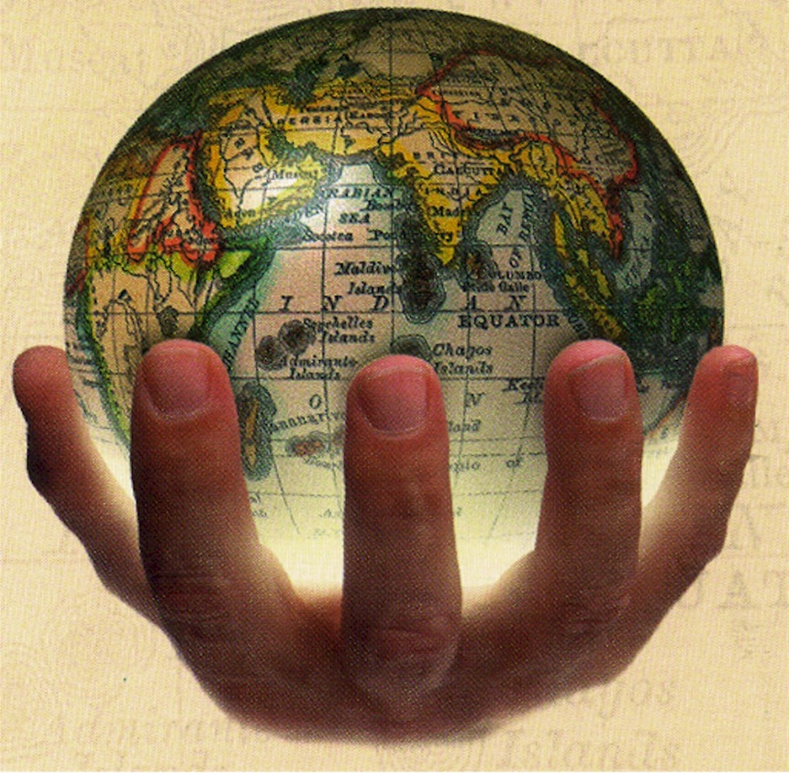
U.S. Imperialism
Global competition prompts the United States to expand its influence and territory, engage in conflicts around the globe, and build the Panama Canal.

Slide 2
U.S. Imperialism
Did American Imperialism have a positive or negative impact on the world and on the United States?
LESSON 1
Imperialism and America
LESSON 2
The Spanish-American War
LESSON 3
Acquiring New Lands
LESSON 4
America as a World Power

Slide 3
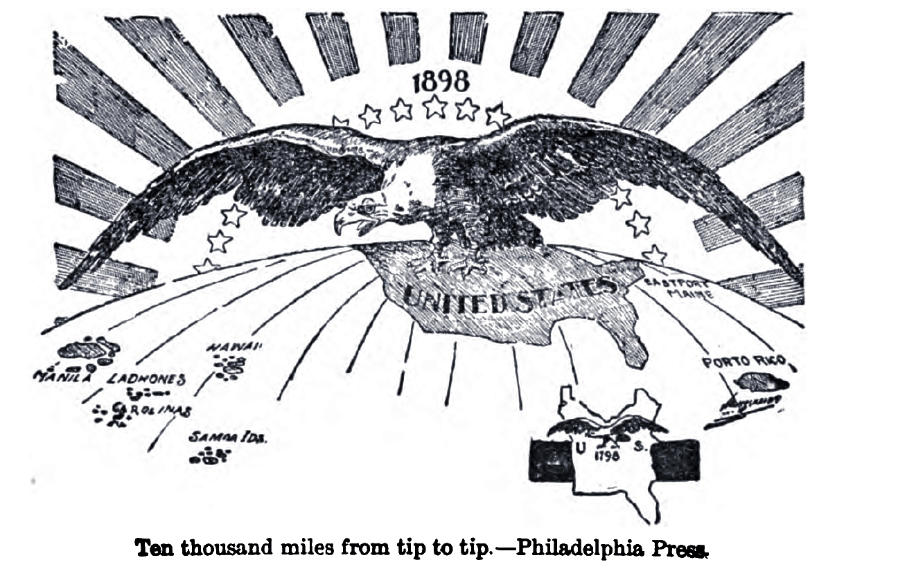
LESSON 1
Imperialism and America
Beginning in 1867 and continuing through the century, global competition causes the United States to expand.

Slide 4
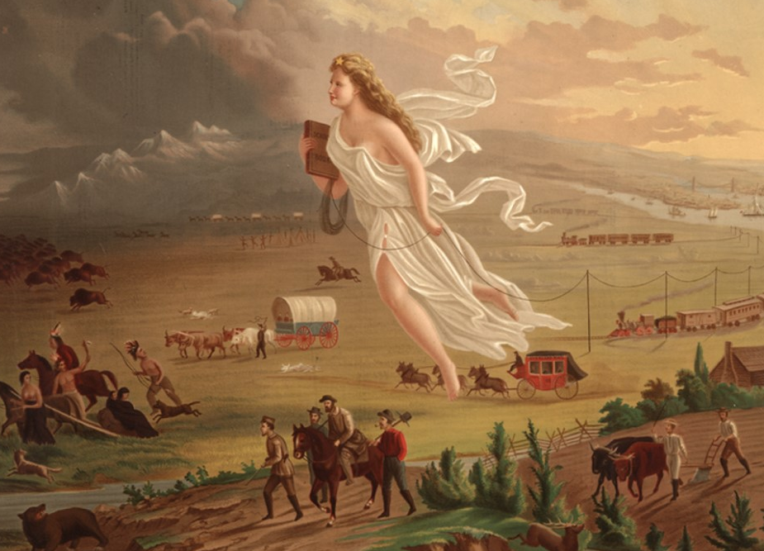
LESSON 1
Imperialism and America
American Expansionism
U.S. expands the size of the nation West toward the Pacific Ocean
Early Encounters
New port cities on the Pacific allow U.S. to expand global trade network
Attempt to expand diplomatic relation with China and Japan
U.S. uses gunboat diplomacy to open Japanese ports to trade
U.S. leaders want to join Europeans imperialists in establishing colonies
Imperialism—policy of extending control over weaker nations
Global Competition
In 1800s, Europeans divide up most of Africa, compete for China
Japan joins race for China; U.S. decides to expand overseas
Three factors fuel U.S. imperialism: military strength, new markets, cultural superiority
Continued…

Slide 5
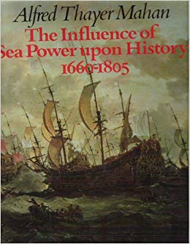
Lesson 1
American Expansionism (continued)
Desire for Military Strength
Admiral Alfred T. Mahan urges U.S. to build up navy to compete
U.S. builds modern battleships, becomes third largest naval power
Thirst for New Markets
U.S. farms, factories produce more than Americans can consume
U.S. needs raw materials, new markets for goods
Foreign trade: solution to overproduction, unemployment, depression
Belief in Cultural Superiority
Some combine Social Darwinism, belief in superiority of Anglo-Saxons
Argue U.S. has duty to Christianize, civilize “inferior peoples”

Slide 6
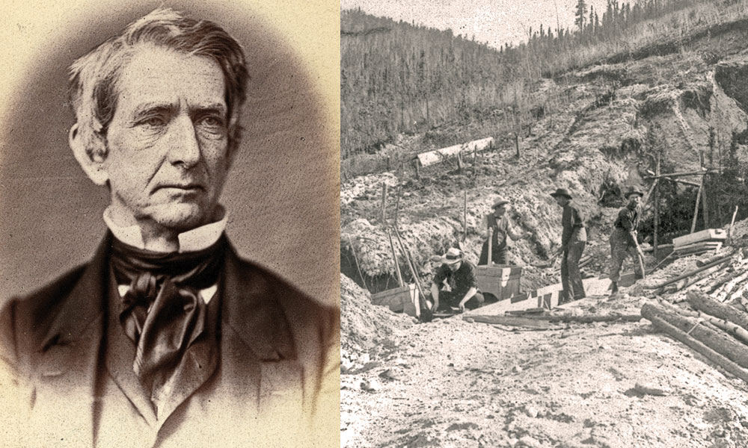
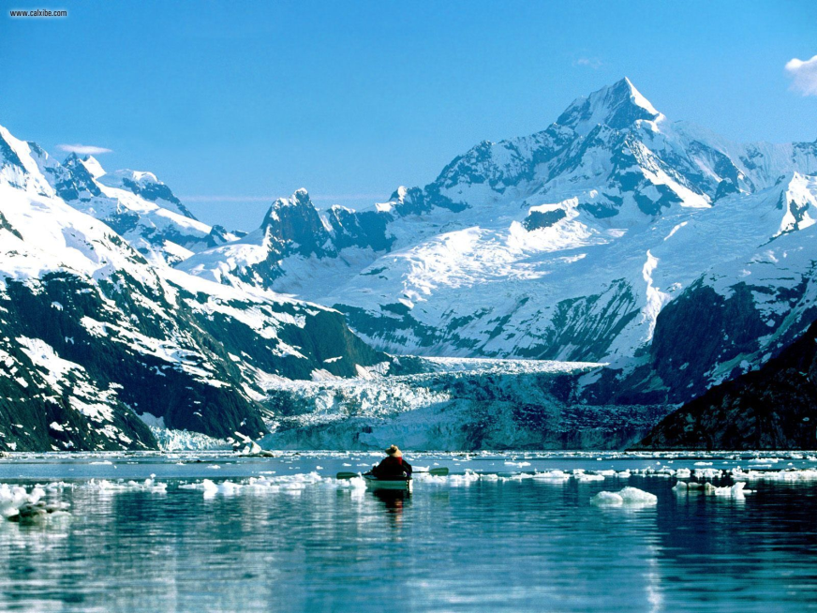
LESSON 1
Imperialism and America
The United States Acquires Alaska
William Seward—Secretary of State under Lincoln, Johnson
1867, arranges purchase of Alaska from Russia for $7.2 million
has trouble convincing House to fund purchase
Alaska called “Seward’s Icebox,” “Seward’s Folly”
Alaska rich in timber, minerals, oil

Slide 7
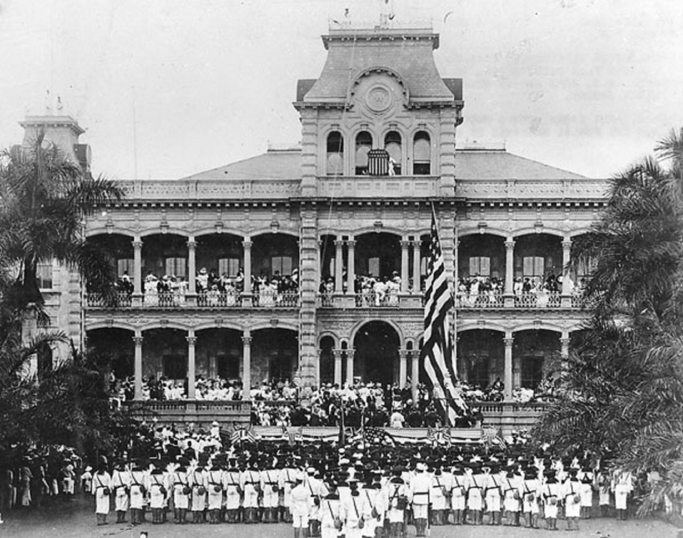
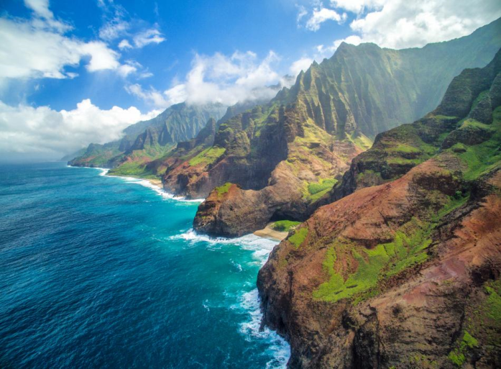
LESSON 1
Imperialism and America
The United States Takes Hawaii
Since 1790s, U.S. merchants stop in Hawaii on way to China, India
1820s, Yankee missionaries found schools, churches on islands
The Cry for Annexation
Mid-1800s, American-owned sugar plantations 75% of islands’ wealth
1887, U.S. pressures Hawaii to allow naval base at Pearl Harbor
becomes refueling station
1890 McKinley Tariff eliminates duty-free status of Hawaiian sugar
By 1900, foreigners outnumber native Hawaiians 3 to 1
Planters call for U.S. to annex islands so will not have to pay duty
Continued…

Slide 8
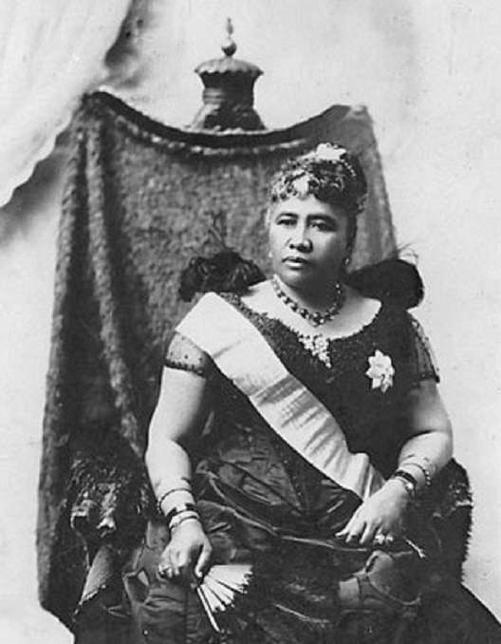
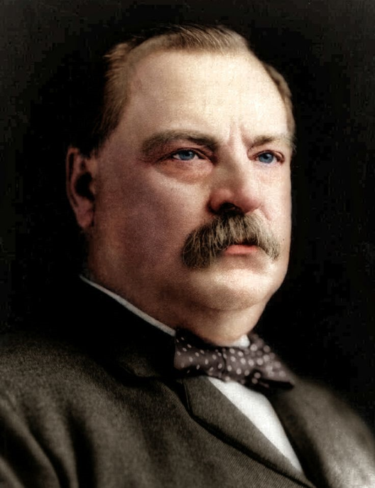
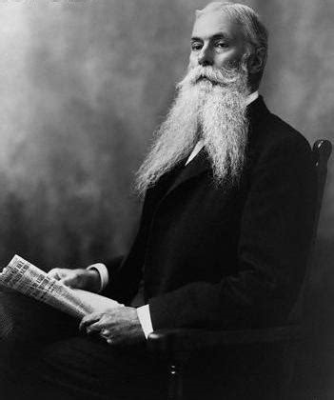
Lesson 1
The United States Takes Hawaii (continued)
The End of a Monarchy
1887, businessmen force King Kalakaua to limit vote to landowners
Queen Liliuokalani tries to remove landowning requirement
With help of marines, business groups overthrow the queen
Set up government headed by Sanford B. Dole
President Cleveland cannot make Dole surrender power to queen
recognizes Republic of Hawaii
Under President McKinley, Congress proclaims Hawaii U.S. territory

Slide 9
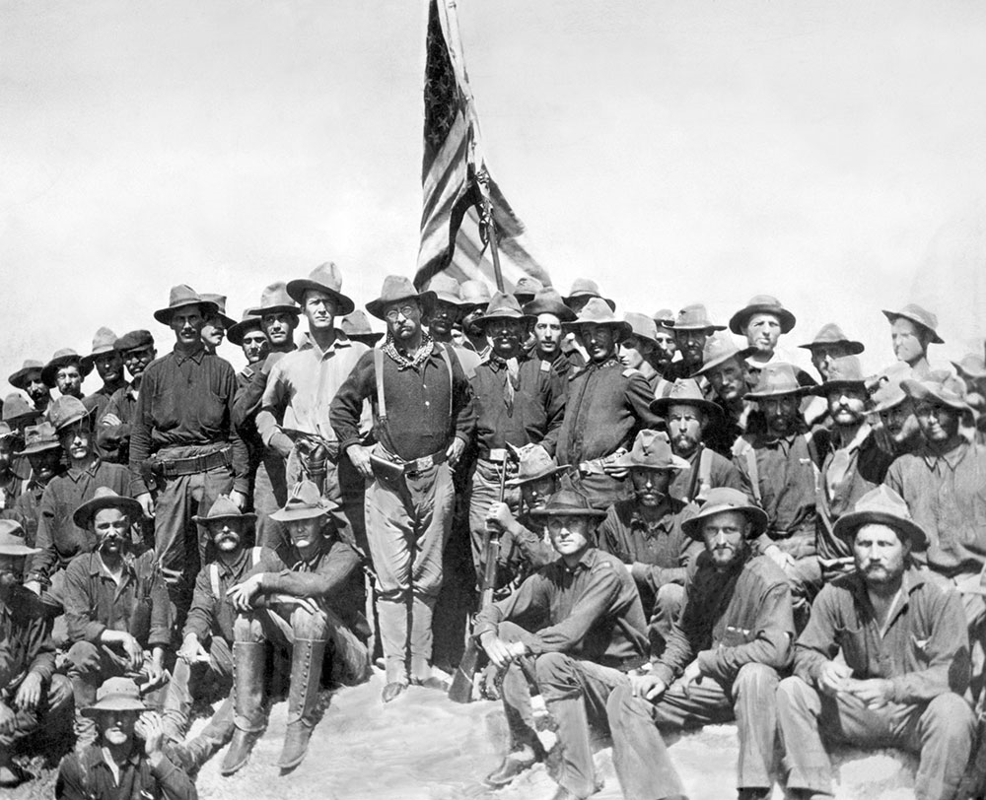
LESSON 2
The Spanish-American War
In 1898, the United States goes to war to help Cuba win its independence from Spain.

Slide 10
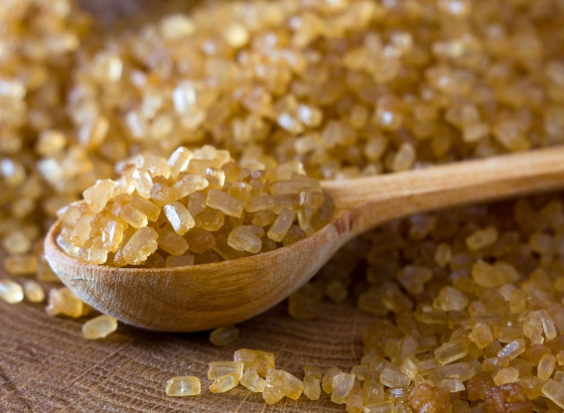
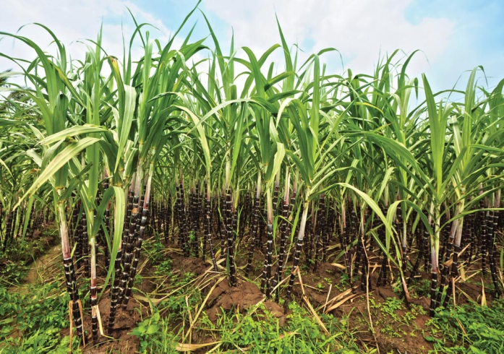
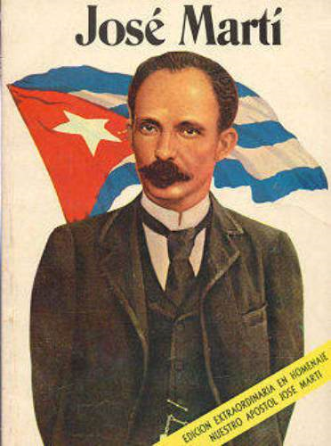
LESSON 2
The Spanish-American War
Cubans Rebel Against Spain
By the late-1800s, Spain power as a colonial nation had declined
American Interest in Cuba
U.S. long interested in Cuba; wants to buy Cuba from Spain
During 1868–1878 war for independence, American sympathies with Cuba
1886 abolition of slavery leads to U.S. investment in sugar cane
The Second War for Independence
José Martí—poet, journalist—launches second revolution in 1895
Guerrilla campaign destroys American-owned sugar mills, plantations
U.S. public opinion split:
business wants to support Spain
others favor Cuban cause

Slide 11
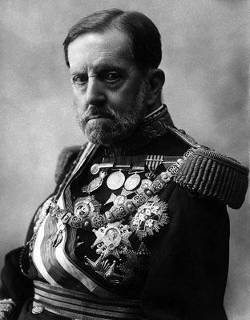
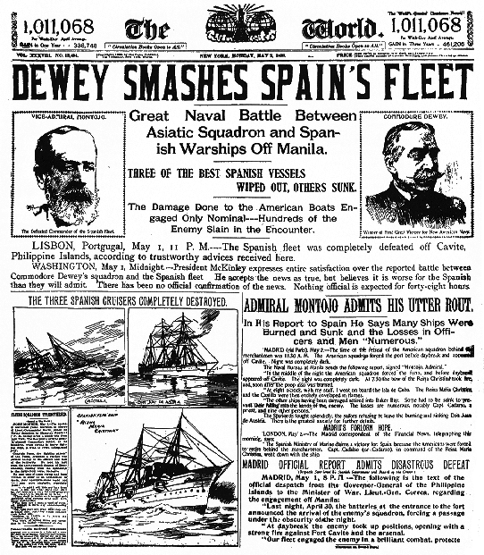
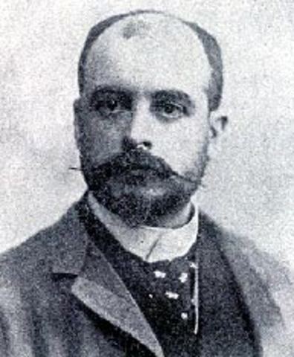
LESSON 2
The Spanish-American War
War Fever Escalates
1896, General Valeriano Weyler sent to Cuba to restore order
Puts about 300,000 Cubans in concentration camps
Headline Wars
Newspapers exploit Weyler’s actions in circulation war; Hearst vs. Pulitzer
Yellow journalism—sensational writing used to lure, enrage readers
The De Lôme Letter
Headlines increase American sympathy for independent Cuba
McKinley wants to avoid war, tries diplomacy to resolve crisis
Private letter by Spanish minister Enrique Dupuy de Lôme published
calls McKinley weak, swayed by public
Spain apologizes, de Lôme resigns; American public angry
Continued…

Slide 12
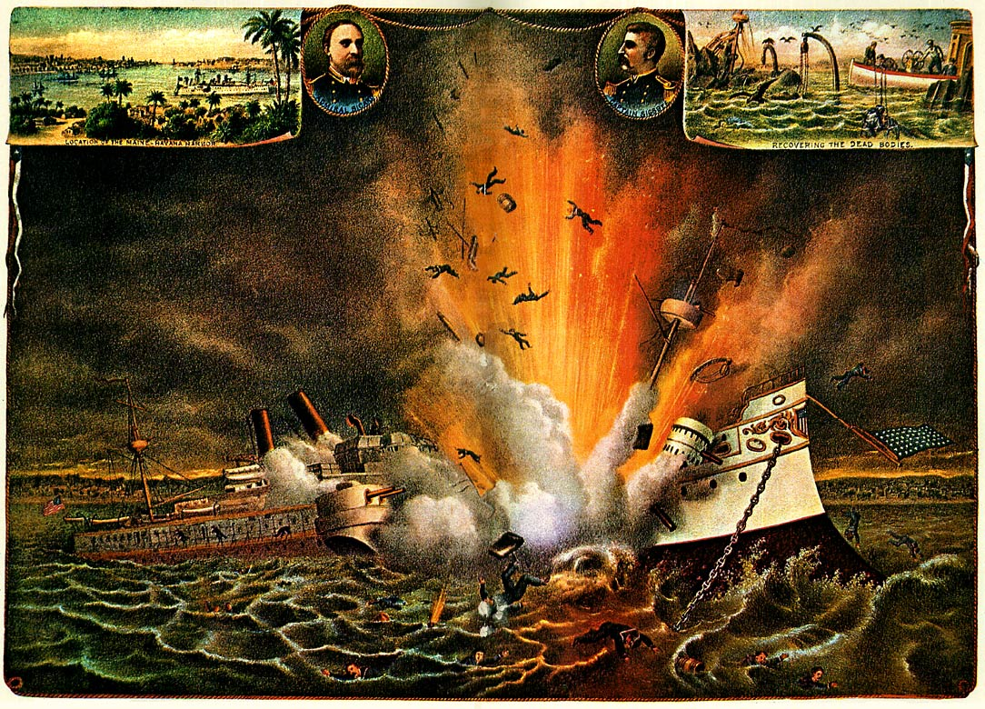
Lesson 2
War Fever Escalates (continued)
The USS Maine Explodes
U.S.S. Maine sent to pick up U.S. citizens, protect U.S. property
Ship blows up in Havana harbor; newspapers blame Spain

Slide 13
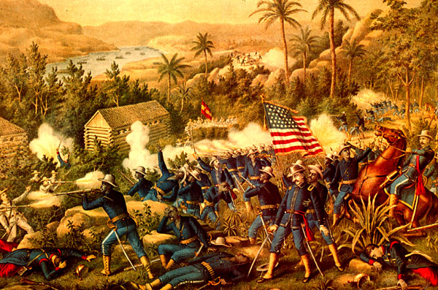
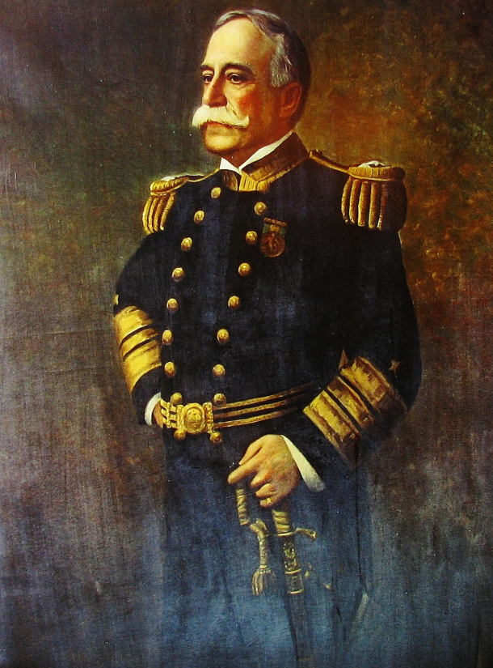
LESSON 2
The Spanish-American War
War with Spain Erupts
Spain agrees to most U.S. demands, public opinion still favors war
U.S. declares war April 1898
The War in the Philippines
First battle with Spain occurs in Spanish colony of the Philippines
Commodore George Dewey destroys Spanish fleet in Manila harbor
Filipino rebels, led by Emilio Aguinaldo, support the U.S.
August 1898, Spanish troops in Manila surrender to U.S
The War in the Caribbean
U.S. blockades Cuba; Spanish fleet in Santiago de Cuba harbor
Unlike navy, U.S. army has small professional force, many volunteers
volunteers ill-prepared, ill-supplied
Continued…

Slide 14
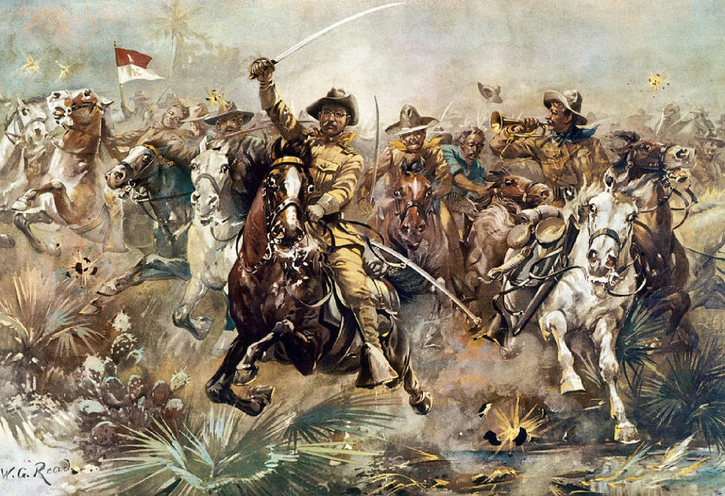
Lesson 2
War with Spain Erupts (continued)
Rough Riders
Rough Riders—Leonard Wood, Theodore Roosevelt lead volunteer cavalry
Roosevelt declared hero of attack on strategic San Juan Hill
Spanish fleet tries to escape blockade, is destroyed in naval battle
U.S. troops invade Puerto Rico soon after
Treaty of Paris
Spain, U.S. sign armistice August 1898; meet in Paris to make treaty
Spain frees Cuba; hands Guam, Puerto Rico to U.S.; sells Philippines
Debate over the Treaty
Treaty of Paris touches off great debate over imperialism
McKinley tries to justify annexation of Philippines on moral grounds
Opponents give political, moral, economic arguments against

