Slide 1
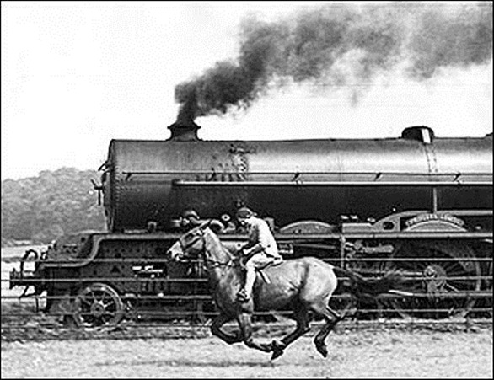
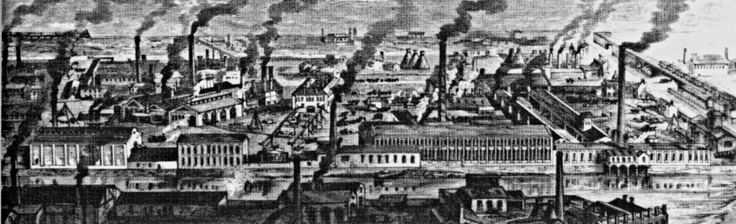
Module 3: Industrialization

Slide 2
Lesson 1: The Expansion of Industry
The Big Idea: At the end of the 19th Century, natural resources, creative ideas, and growing markets fueled an industrial boom
Why It Matters Now: Technological developments of the late 19th century paved the way for the continued growth of American Industry
Key Terms and People: Edwin Drake / Bessemer Process / Thomas Alva Edison / Lewis H. Latimer / Christopher Sholes / Alexander Graham Bell

Slide 3
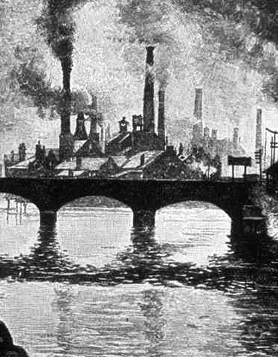
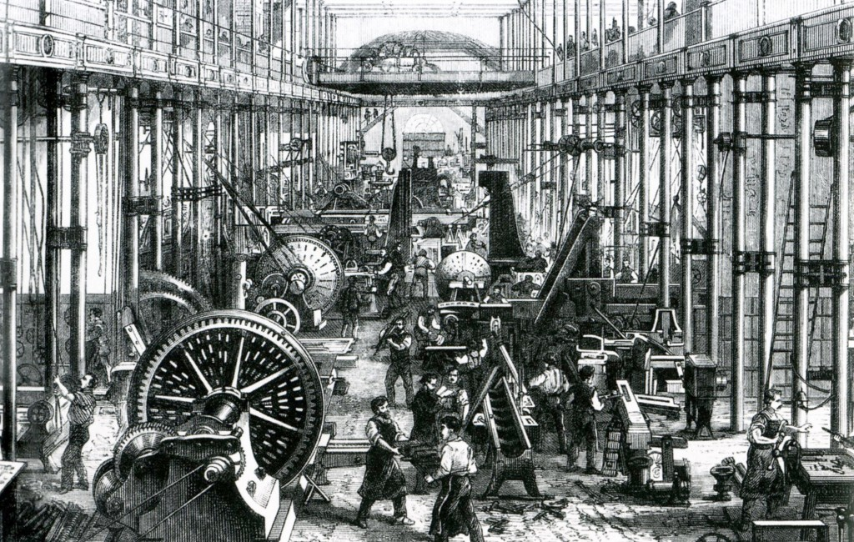
I. Natural Resources Fuel Industrialization
New technologies and industries emerge
Factories and machines replace manual labor
U.S. becomes the world’s leading industrial power
Reasons:
Natural resources
Government support
Growing Population

Slide 4
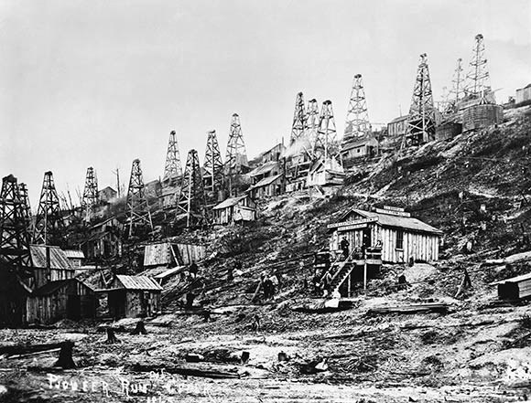
A. Black Gold
1840’s: Americans begin using kerosene in lanterns
Abraham Gesner 1st distills fuel from coal/oil
1859: Edwin L. Drake drills oil in Titusville, PA
Starts an oil boom ranging from PA to TX
Automobiles eventually create a demand for gasoline

Slide 5
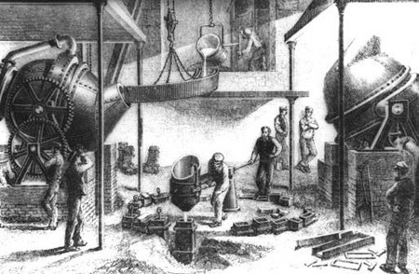
B. The Bessemer Steel Process
U.S. was rich in coal & iron deposits
Steele = Iron – Carbon
1850: Henry Bessemer and William Kelley develop the Bessemer Process
Creates 90% of American steel by the 1880s
Replaces by the open hearth process (could also use scrap metal)

Slide 6
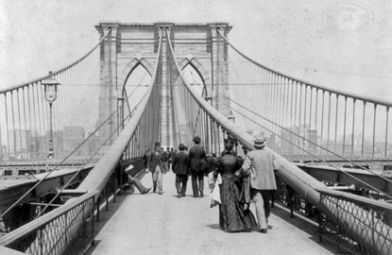
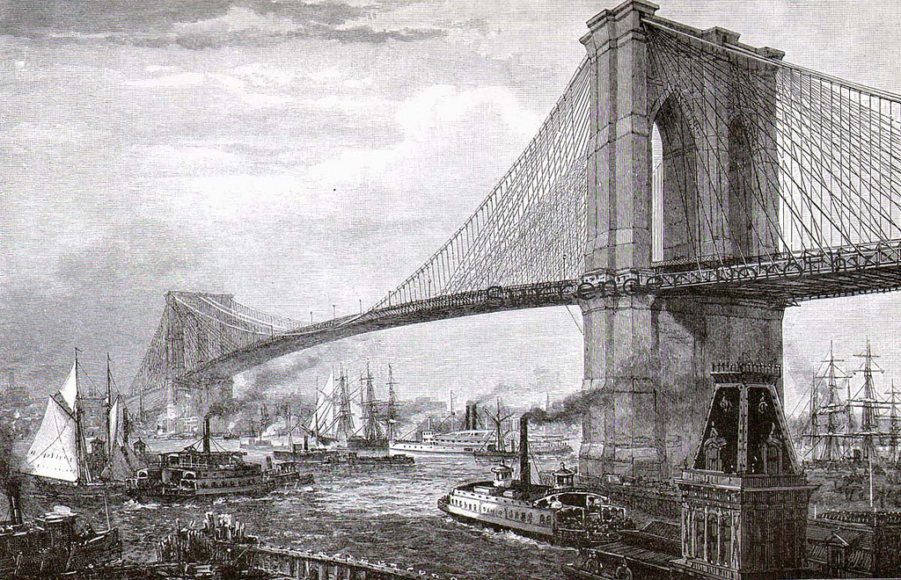
C. New Uses for Steel
Railroads are the biggest customers
Cyrus McCormick & John Deere create reapers and plows
Decreased labor causes relocation
1883: The Brooklyn Bridge - 1,595 ft.
2nd only to Pyramids as largest manmade structure at the time
William Le Baron Jenney: 1st steel frame skyscrapers
Responsible for today’s city skylines

Slide 7
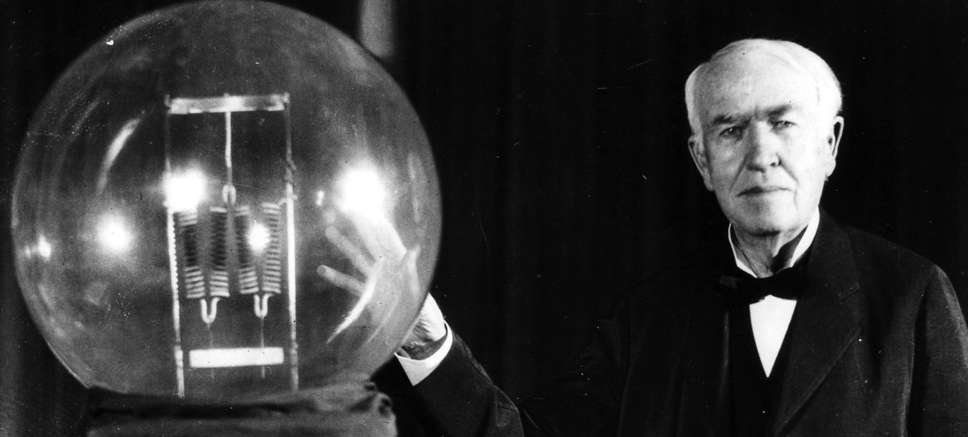
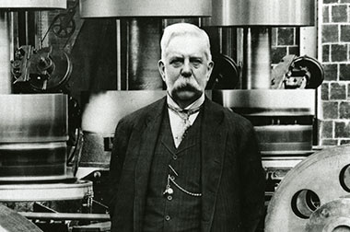
II. Inventions Promote Change
A. The Power of Electricity
1876: Thomas Alva Edison – Menlo Park, New Jersey
1879: Develops the incandescent light bulb
1881:Lewis H. Latimer adds a carbon filament
Also developed today’s electrical production/distribution systems
George Westinghouse: Increased safety and decreased cost
Soon prompted new appliances, growth of cities, and the relocation of businesses (Ex. Automobiles in Detroit, Michigan)

Slide 8
B. Inventions Change Lifestyles
Christopher Sholes: 1876 invention of the typewriter
Alexander Graham Bell & Thomas Watson: 1876 invention of the telephone
Both created jobs for women and revolutionized the workplace
Women made up 5% of office workers in 1870 and 40% in 1910
Machinery now ran clothing factories, but promised more industrial jobs
Machines reduced labor
Jan Ernst Matzeliger and Margaret Knight in shoemaking
Less required skill, more power in the marketplace
New inventions also increased living standards
Higher standards of living attracted migrant workers and potential customers

