Slide 1
Inorganic Acids, Bases & Salts.
Acids, bases and salts always dissociate into ions if they are dissolved in water.
Acid & bases react in the body to form salts
A salt, when dissolved in water, dissociates into cations and anions. Many salts are present in the body and are formed when acids and bases react with each other.
Electrolytes are important salts in the body that carry electric current (in nerve or muscle)

Slide 2
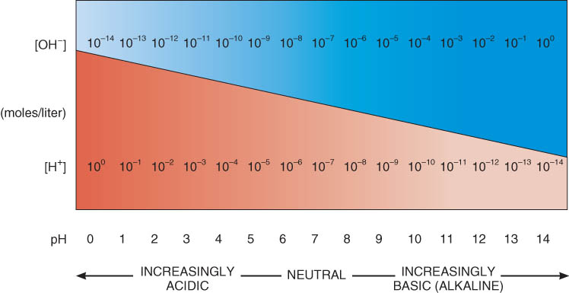
Concept of pH
pH scale runs from 0 to 14 (concentration of H+ in moles/liter)
pH of 7 is neutral
(distilled water -- concentration of OH- and H+ are equal)
pH below 7 is acidic
pH above 7 is alkaline

Slide 3
Acid-Base Balance: The Concept of pH
Biochemical reactions are very sensitive to even small changes in acidity or alkalinity.
pH of blood is 7.35 to 7.45
gastric juice 1.2 to 3.0
saliva 6.35 to 6.85
bile 7.6 to 8.6
A solution’s acidity or alkalinity is based on the pH scale

Slide 4
Maintaining pH: Buffer Systems
The pH values of different parts of the body are maintained fairly constant by buffer systems, which usually consist of a weak acid and a weak base.
convert strong acids or bases into weak acids or bases.

Slide 5
ORGANIC COMPOUNDS Carbon and Its Functional Groups
The carbon that organic compounds always contain has several properties that make it particularly useful to living organisms.
It can react with one to several hundred other carbon atoms
forms large molecules of many different shapes.
Many carbon compounds do not dissolve easily in water
useful materials for building body structures.
Carbon compounds are mostly or entirely held together by covalent bonds and tend to decompose easily
organic compounds are a good source of energy.

Slide 6
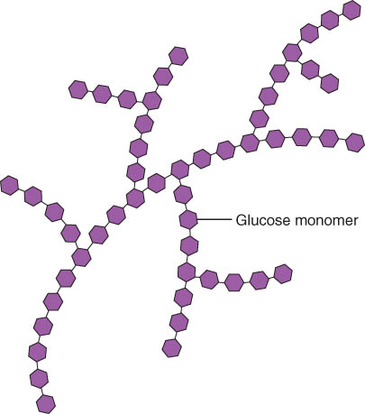
1. Carbohydrates
Carbohydrates provide most of the energy needed for life and include sugars, starches, glycogen, and cellulose
Provide an immediate source of energy
formed from C, H, and O
source of energy for ATP formation
2-3 % of total body weight
glycogen is stored in liver and muscle tissue
three major groups based on their size:
monosaccharides, disaccharides, and polysaccharides

Slide 7
Monosaccharides and Disaccharides: Sugars
Monosaccharides include glucose, main energy-supplying compound of the body.
Humans absorb only 3 simple sugars without further digestion in our small intestine
glucose is found in syrup & honey
fructose found in fruit
galactose found in dairy products

Slide 8
Clinical Application:
Lactose intolerance is a deficiency of the enzyme lactase. As a result undigested lactose remains in the feces and bacterial fermentation of lactose produces gas.
Inherited disorder: Galactosemia
Infant lacks enzyme.
If galactosemia is untreated, high levels of galactose cause vomiting, diarrhea, lethargy, low blood sugar, brain damage, jaundice, liver enlargement, cataracts, susceptibility to infection, and death.
Treatment is elimination of milk from the diet.

Slide 9
Polysaccharides
Polysaccharides are the largest carbohydrates and may contain hundreds of monosaccharides.
The principal polysaccharide in the human body is glycogen, which is stored in the liver or skeletal muscles.
When blood sugar level drops, the liver hydrolyzes glycogen to yield glucose which is released from the liver into the blood

Slide 10
2. Lipids
Lipids, like carbohydrates, contain carbon, hydrogen, and oxygen.
They are
hydrophobic
mostly insoluble in water
combines with proteins (lipoproteins) for transport in blood

Slide 11
Lipids = fats
Formed from C, H and O
fats
phospholipids
steroids
lipoproteins
some vitamins
18-25% of body weight

Slide 12
Triglycerides
Triglycerides - lipids in the body and provide protection, insulation, and energy (both immediate and stored).
At room temperature, triglycerides may be either solid (fats) or liquid (oils).
Triglycerides provide more than twice as much energy per gram as either carbohydrates or proteins.
Triglyceride storage is virtually unlimited.
Excess dietary carbohydrates, proteins, fats, and oils will be deposited in adipose tissue as triglycerides.
Very concentrated form of energy
9 calories/gram compared to 4 for proteins & carbohydrates
our bodies store triglycerides in fat cells if we eat extra food

