Slide 1
Chapter 48 Populations and Communities

Slide 2
Main Ideas:
Exponential and logistic growth of populations
Limiting factors in population growth
Interactions between communities and ecosystems

Slide 3
Section 48-1 Population Growth

Slide 4
What is a population?
A population is a group of organism that all belong to the same species and live in a given area at the same time.

Slide 5
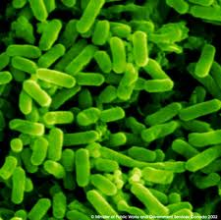
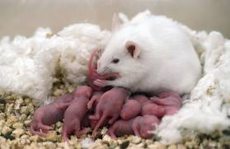
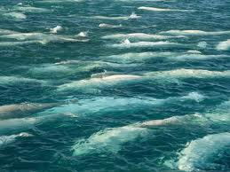
Give three examples of a population:
White mice in a laboratory
E. Coli bacteria in your intestines
A pod of beluga whales in the Pacific Ocean

Slide 6
Almost any organism provided with ideal conditions for growth and reproduction will experience a rapid increase in its population. If nothing stops the population from growing, it will continue to expand faster and faster.

Slide 7
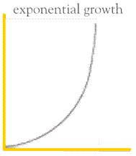
Number of indivuals
time

Slide 8
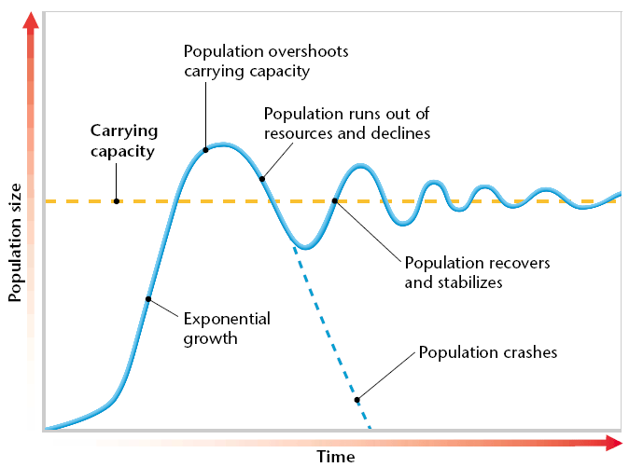
Realistically, populations do not increase indefinitely. Most populations go through a number of growth phases.
D
C
E
[ steady state ]
B
A

Slide 9
A initial growth (lag phase) - population begins to grow slowly
B exponential growth - population grows quickly because few animals are dying and a great many are being reproduced
C population growth slows- still growing, but at a slower rate
D population growth rate slows, not decrease
E steady state- the birth rate and death rate average to a growth rate of zero
D
C
E
[ steady state ]
B
A

Slide 10
During the steady state the growth rate is zero. A straight line drawn through this region of the graph will tell how big the population is. Ecologists say this line represents the carrying capacity. What is carrying capacity?
The carrying capacity is the number of individuals that a particular environment can support.

Slide 11
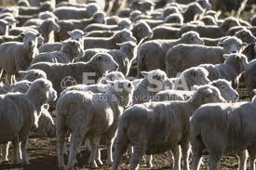
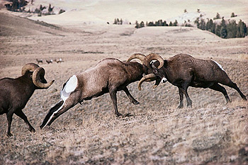
What factors will keep the carrying capacity steady?
Certain environmental factors keep the population from growing any further, including lack of food, overcrowding, and competition between individuals.

Slide 12
Section 48-2: Factors That Control Population Growth

Slide 13
Note: The number of individuals of a certain species per unit area is called population density.
Density = D n = number of individuals A = area
D = n
A

Slide 14
Calculate the density of the following populaions:
a.What is the population density of 150,500 army ants in section of land (area = 10 cm²)?
b. What is the population density of students in this room? (area approx. 71.92 m²)?

Slide 15
Density-dependent limiting factors are factors that control population size in a large population. These include: competition, predation, parasitism and crowding.

Slide 16
Explain competition as a limiting factor:
When populations become crowded, individuals compete with one another for available resources.
The more individuals there are, the more of them there are to use up the resources (food, water).
The fewer individuals around, the less they compete.

Slide 17
What is predation?
Predator-prey relationship where one animal eats the other.
Fact: The more dense a population is, the more prey available for the predator.
Fact: Predators become more numerous with more food source.
Fact: Prey death rate will increase, thus decreasing population.
Fact: Predators begin to starve and their population will then decrease.
Fact: prey population will then begin to increase since few predators.

Slide 18
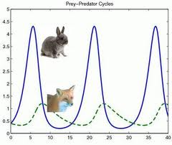
Number of individuals (hundreds)
Months

Slide 19
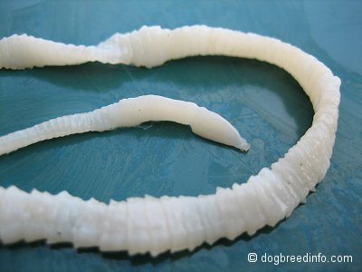
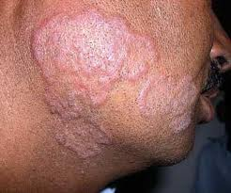
How can parasitism work as a density-dependent limiting factor?
Host: organism that the parasite gets food or nutrients off of
Parasite: organism that feeds or lives off of another organism, without killing it (initially)
Like predators, parasites work most effectively if hosts are present in large numbers. Crowding helps parasites travel from one host to another. Stress related to crowding can also reduce a host’s resistance to parasites. As a result, parasitism often affects large, concentrated population more than small, scattered ones.
It is to the parasite’s advantage not to be too deadly.

Slide 20
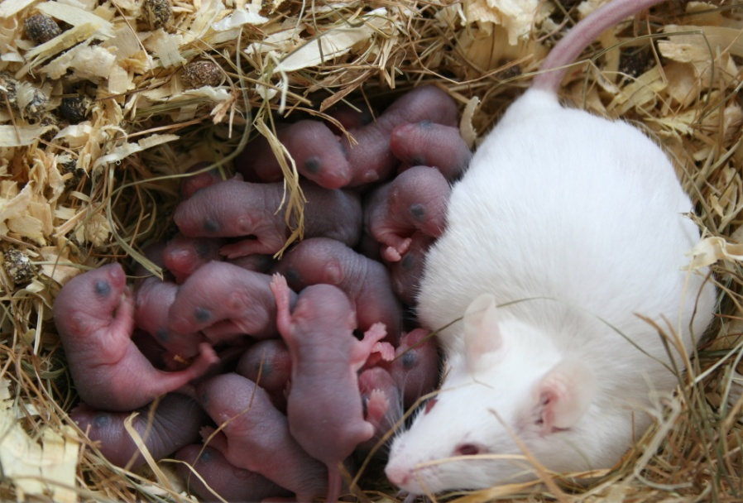
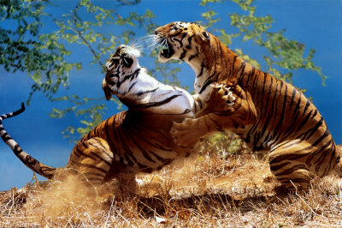
How does crowding affect a population?
Certain species of animals fight among themselves if they are overcrowded. Too much fighting and crowding can cause high levels of stress. As a result, animals fight more and breed less. Females may neglect, kill or eat their young. All of these factors combine to lower the birthrate.

Slide 21
How is density-independent limiting factors different from density-dependent limiting factors?
Natural occurrences such as storms, cold weather , and dry weather can nearly wipe out entire populations. These population “crashes” can happen regardless of how large the population is at the time. Population density does not matter in such cases, so these occurrences are referred to as density-independent limiting factors.

Slide 22
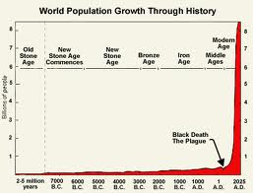
Look at the Human Population Growth graph (Fig 48-9) on page 1039. Describe the size of the human population of the course of history:

Slide 23
Section 48-3 Interactions Within and Between Communities

Slide 24
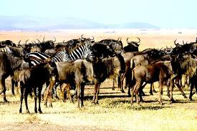
What is a community?
A community consists of all the populations of organism living in a given area.

Slide 25
Define symbiosis:
Symbiosis is a relationship between organisms or groups of organisms.
These relationships can either harm, help, or have no effect on the participants.

Slide 26
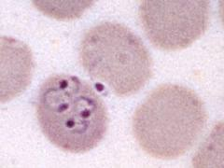
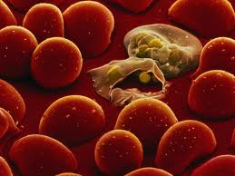
Define parasitism and give one example:
Parasitism is a relationship in which one species benefits and the other is harmed from the relationship.
Example: ringworm
tapeworm
malaria

Slide 27
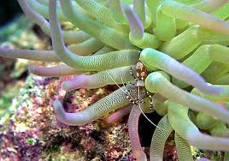
Define commensalism and give one example:
A relationship between organisms in which one member benefits ant the other is not harmed, or unaffected.
Example: Coral reef where shrimp live within the stinging tentacles of sea anemones

Slide 28
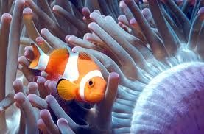
Define mutualism and give one example:
Mutualism is a relationship in which two species live together is such a way that both species benefit.
Example: Clownfish and sea anemone

Slide 29
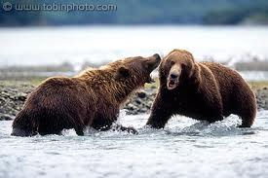
Define competition and give one example:
Competition is a relationship in which both species are harmed, either physically or in population numbers.
Example: bears fighting for territory

Slide 30
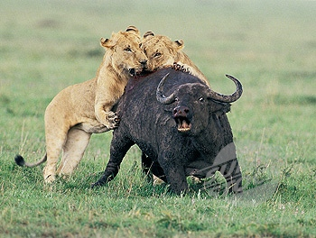
Define predation and give one example:
Predation is a relationship in which one species kills and eats the other species. One is harmed and the other benefits.
Example:

