Slide 2
Answer in Notebooks
#1. Why do cells divide, why don’t they just get bigger?

Slide 3
Cell Division and Reproduction

Slide 4
8.1 Cell division plays many important roles in the lives of organisms
The ability of organisms to reproduce their own kind is a key characteristic of life.
Notes:
Student Misconceptions and Concerns
• As the textbook authors note in Module 8.1, biologists use the term “daughter” to indicate offspring and not gender. Students with little experience in this terminology can easily become confused.
• Some basic familiarity or faint memory of mitosis and meiosis might result in a lack of enthusiasm for these topics in some of your students. Consider beginning such lectures with important topics related to cellular reproduction. For example, cancer cells reproduce uncontrollably, stem cells have the capacity to regenerate lost or damaged tissues, and the study of embryonic stem cells is variously restricted and regulated by government.
Teaching Tips
• Sometimes the most basic questions can challenge students and get them focused on the subject at hand. Consider asking your students why we expect that dogs will produce dogs, cats will produce more cats, and chickens will only produce chickens. Why does like produce like?

Slide 5
8.1 Cell division plays many important roles in the lives of organisms
Cell division
2 “daughter” cells - genetically identical to each other and original “parent” cell
Duplication of chromosomes -structures that contain most of the cell’s DNA
Sorts new sets of chromosomes into the resulting pair of daughter cells.
Notes:
Student Misconceptions and Concerns
• As the textbook authors note in Module 8.1, biologists use the term “daughter” to indicate offspring and not gender. Students with little experience in this terminology can easily become confused.
• Some basic familiarity or faint memory of mitosis and meiosis might result in a lack of enthusiasm for these topics in some of your students. Consider beginning such lectures with important topics related to cellular reproduction. For example, cancer cells reproduce uncontrollably, stem cells have the capacity to regenerate lost or damaged tissues, and the study of embryonic stem cells is variously restricted and regulated by government.
Teaching Tips
• Sometimes the most basic questions can challenge students and get them focused on the subject at hand. Consider asking your students why we expect that dogs will produce dogs, cats will produce more cats, and chickens will only produce chickens. Why does like produce like?

Slide 6
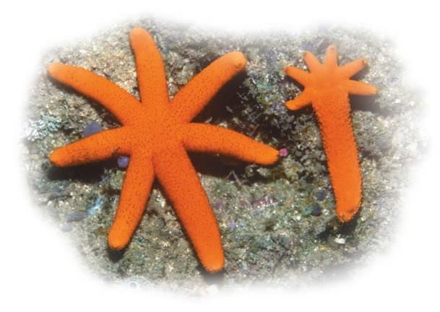
8.1 Cell division plays many important roles in the lives of organisms
Asexual reproduction
Offspring are identical to the original cell or organism
Involves inheritance of all genes from one parent.
Notes:
Student Misconceptions and Concerns
• As the textbook authors note in Module 8.1, biologists use the term “daughter” to indicate offspring and not gender. Students with little experience in this terminology can easily become confused.
• Some basic familiarity or faint memory of mitosis and meiosis might result in a lack of enthusiasm for these topics in some of your students. Consider beginning such lectures with important topics related to cellular reproduction. For example, cancer cells reproduce uncontrollably, stem cells have the capacity to regenerate lost or damaged tissues, and the study of embryonic stem cells is variously restricted and regulated by government.
Teaching Tips
• Sometimes the most basic questions can challenge students and get them focused on the subject at hand. Consider asking your students why we expect that dogs will produce dogs, cats will produce more cats, and chickens will only produce chickens. Why does like produce like?

Slide 7
8.1 Cell division plays many important roles in the lives of organisms
Sexual reproduction
Offspring that are similar to the parents but show variations in traits
involves inheritance of unique sets of genes from two parents.

Slide 8
Answer in Notebooks
#2. Differentiate between Asexual and Sexual Reproduction.

Slide 9
8.1 Cell division plays many important roles in the lives of organisms
Cell division is used for
reproduction of single-celled organisms
growth of multicellular organisms from a fertilized egg into an adult
repair and replacement of cells
production of sperm and eggs
Notes:
Student Misconceptions and Concerns
• As the textbook authors note in Module 8.1, biologists use the term “daughter” to indicate offspring and not gender. Students with little experience in this terminology can easily become confused.
• Some basic familiarity or faint memory of mitosis and meiosis might result in a lack of enthusiasm for these topics in some of your students. Consider beginning such lectures with important topics related to cellular reproduction. For example, cancer cells reproduce uncontrollably, stem cells have the capacity to regenerate lost or damaged tissues, and the study of embryonic stem cells is variously restricted and regulated by government.
Teaching Tips
• Sometimes the most basic questions can challenge students and get them focused on the subject at hand. Consider asking your students why we expect that dogs will produce dogs, cats will produce more cats, and chickens will only produce chickens. Why does like produce like?

Slide 10
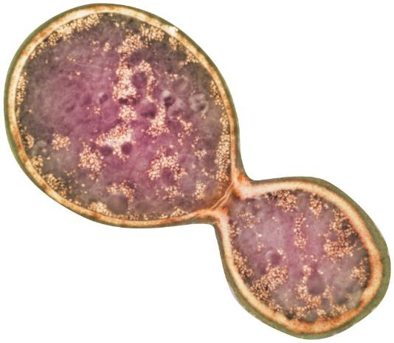
8.2 Prokaryotes reproduce by binary fission
Prokaryotes (single-celled bacteria and archaea) reproduce by binary fission (“dividing in half”)
The chromosome of a prokaryote is typically
a single circular DNA molecule associated with proteins and
much smaller than those of eukaryotes.
Notes:
Student Misconceptions and Concerns
• Some basic familiarity or faint memory of mitosis and meiosis might result in a lack of enthusiasm for these topics in some of your students. Consider beginning such lectures with important topics related to cellular reproduction. For example, cancer cells reproduce uncontrollably, stem cells have the capacity to regenerate lost or damaged tissues, and the study of embryonic stem cells is variously restricted and regulated by government.
Teaching Tips
• The principle that “every cell comes from another cell” is worth thinking through with your class. Students might expect that, like automobiles, computers, and cell phones, parts are constructed and cells are assembled. In our society, few nonliving products are generated only from existing products (try to think of such examples). For example, you do not need a painting to paint or a house to construct a house. Yet, this is a common expectation in biology. Further, students who think through this principle might ask how the first cells formed. They might wonder further whether the same environments that produced these cells are still in existence. The conditions on Earth when life first formed were very different from those we know today. Chapter 15 of the textbook addresses the origin and early evolution of life on Earth.
• Consider contrasting the timing of DNA replication and cytokinesis in prokaryotes and eukaryotes. In prokaryotes, addressed in Module 8.2 of the textbook, these processes are overlapping. However, as revealed in the next few modules, these events are separate in eukaryotes.

Slide 11
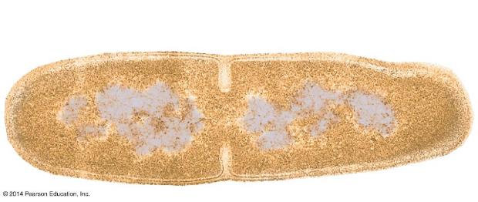
8.2 Prokaryotes reproduce by binary fission
Binary fission of a prokaryote occurs in three stages:
duplication of the chromosome and separation of the copies
continued elongation of the cell and movement of the copies
division into two daughter cells.
Notes:
Student Misconceptions and Concerns
• Some basic familiarity or faint memory of mitosis and meiosis might result in a lack of enthusiasm for these topics in some of your students. Consider beginning such lectures with important topics related to cellular reproduction. For example, cancer cells reproduce uncontrollably, stem cells have the capacity to regenerate lost or damaged tissues, and the study of embryonic stem cells is variously restricted and regulated by government.
Teaching Tips
• The principle that “every cell comes from another cell” is worth thinking through with your class. Students might expect that, like automobiles, computers, and cell phones, parts are constructed and cells are assembled. In our society, few nonliving products are generated only from existing products (try to think of such examples). For example, you do not need a painting to paint or a house to construct a house. Yet, this is a common expectation in biology. Further, students who think through this principle might ask how the first cells formed. They might wonder further whether the same environments that produced these cells are still in existence. The conditions on Earth when life first formed were very different from those we know today. Chapter 15 of the textbook addresses the origin and early evolution of life on Earth.
• Consider contrasting the timing of DNA replication and cytokinesis in prokaryotes and eukaryotes. In prokaryotes, addressed in Module 8.2 of the textbook, these processes are overlapping. However, as revealed in the next few modules, these events are separate in eukaryotes.

Slide 12
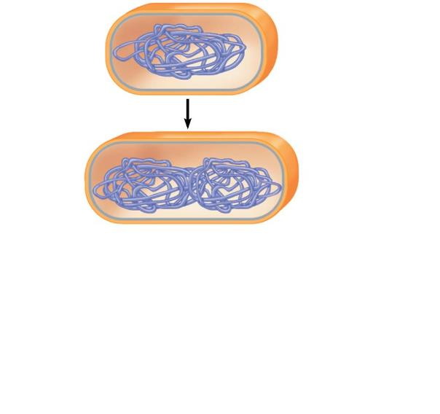
Figure 8.2a-1
Plasma membrane
Prokaryotic chromosome
Cell wall
Duplication of the chromosome and separation of the copies
1
Notes:
Figure 8.2a-1 Binary fission of a prokaryotic cell (step 1)

Slide 13
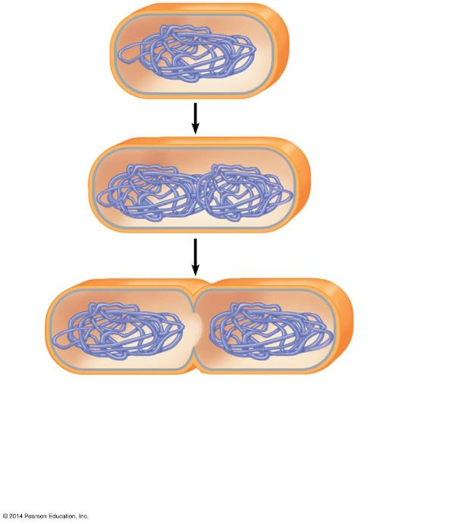
Figure 8.2a-2
Plasma membrane
Prokaryotic chromosome
Cell wall
Duplication of the chromosome and separation of the copies
1
Continued elongation of the cell and movement of the copies
2
Notes:
Figure 8.2a-2 Binary fission of a prokaryotic cell (step 2)

Slide 14
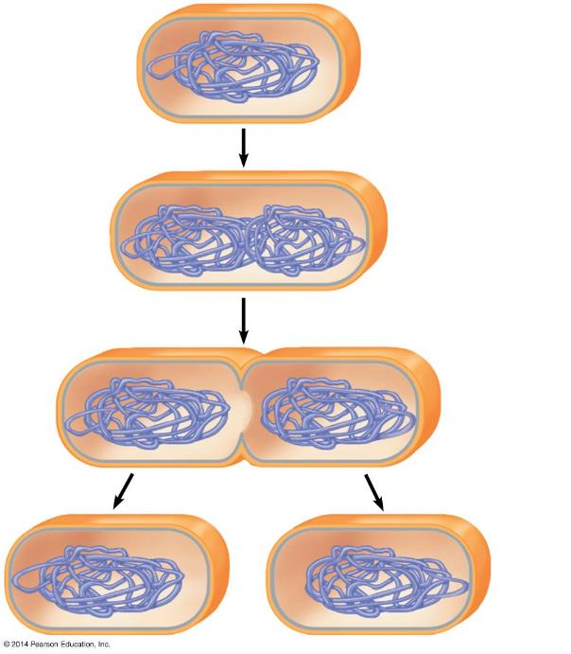
Figure 8.2a-3
Plasma membrane
Prokaryotic chromosome
Cell wall
Duplication of the chromosome and separation of the copies
1
Continued elongation of the cell and movement of the copies
2
Division into two daughter cells
3
Notes:
Figure 8.2a-3 Binary fission of a prokaryotic cell (step 3)

Slide 15
Answer in Notebooks:
#3. Briefly describe or illustrate the process of binary fission.
#4. What type of organisms reproduce by using binary fission?

Slide 16
The Eukaryotic Cell Cycle and Mitosis

Slide 17
8.3 The large, complex chromosomes of eukaryotes duplicate with each cell division
Eukaryotic cells
are more complex and larger than prokaryotic cells
have more genes
store most of their genes on multiple chromosomes within the nucleus
Each eukaryotic species has a characteristic number of chromosomes in each cell nucleus.
Notes:
Student Misconceptions and Concerns
• Students often seem confused by the difference between a DNA molecule and a chromosome. This is especially problematic when discussing DNA replication.
• Students are often confused by photographs of chromosomes. Such photographs, such as Figure 8.3B, typically show duplicated chromosomes during some aspect of cell division. It remains unclear to many (a) why chromosome structure is typically different between interphase G₁ and the stages of division and (b) why chromosomes are not photographed during interphase (the stage in which chromosomes are typically first discussed) before the chromosomes duplicate.
Teaching Tips
• Figure 8.3B is an important point of reference for some basic terminology. Consider referring to it as you distinguish between a DNA molecule and a chromosome, unreplicated and replicated chromosomes, and the nature of sister chromatids.
• Consider an analogy between the precise packaging of DNA into chromosomes and packing a home for a move to another home. Tap into the intuitive advantages of packaging DNA using this or any other analogy of highly packaged materials (perhaps a boxed “desk” that requires some assembly).
• The concepts of DNA replication and sister chromatids are often obstacles for many students. If you can find twist ties or other bendable wire, you can demonstrate or have students model the difference between (a) a chromosome before DNA replication and (b) sister chromatids after DNA replication. One piece of wire will represent a chromosome before replication. Two twist ties twisted about each other can represent sister chromatids. We have doubled the DNA, but the molecules remain attached (although not attached in the same way as the wire). You might also want to point out that when sister chromatids are separated, they are considered separate chromosomes.

Slide 18
8.3 The large, complex chromosomes of eukaryotes duplicate with each cell division
Eukaryotic chromosomes are composed of chromatin consisting of
one long DNA molecule
proteins that help maintain the chromosome structure and control the activity of its genes.
Notes:
Student Misconceptions and Concerns
• Students often seem confused by the difference between a DNA molecule and a chromosome. This is especially problematic when discussing DNA replication.
• Students are often confused by photographs of chromosomes. Such photographs, such as Figure 8.3B, typically show duplicated chromosomes during some aspect of cell division. It remains unclear to many (a) why chromosome structure is typically different between interphase G₁ and the stages of division and (b) why chromosomes are not photographed during interphase (the stage in which chromosomes are typically first discussed) before the chromosomes duplicate.
Teaching Tips
• Figure 8.3B is an important point of reference for some basic terminology. Consider referring to it as you distinguish between a DNA molecule and a chromosome, unreplicated and replicated chromosomes, and the nature of sister chromatids.
• Consider an analogy between the precise packaging of DNA into chromosomes and packing a home for a move to another home. Tap into the intuitive advantages of packaging DNA using this or any other analogy of highly packaged materials (perhaps a boxed “desk” that requires some assembly).
• The concepts of DNA replication and sister chromatids are often obstacles for many students. If you can find twist ties or other bendable wire, you can demonstrate or have students model the difference between (a) a chromosome before DNA replication and (b) sister chromatids after DNA replication. One piece of wire will represent a chromosome before replication. Two twist ties twisted about each other can represent sister chromatids. We have doubled the DNA, but the molecules remain attached (although not attached in the same way as the wire). You might also want to point out that when sister chromatids are separated, they are considered separate chromosomes.

Slide 19
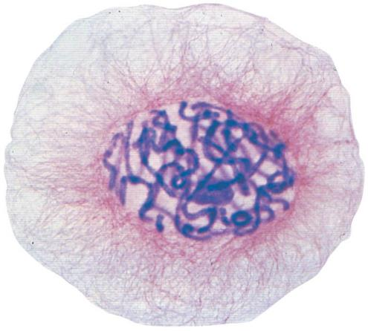
8.3 The large, complex chromosomes of eukaryotes duplicate with each cell division
To prepare for division, the chromatin becomes
highly compact
visible with a microscope

Slide 20
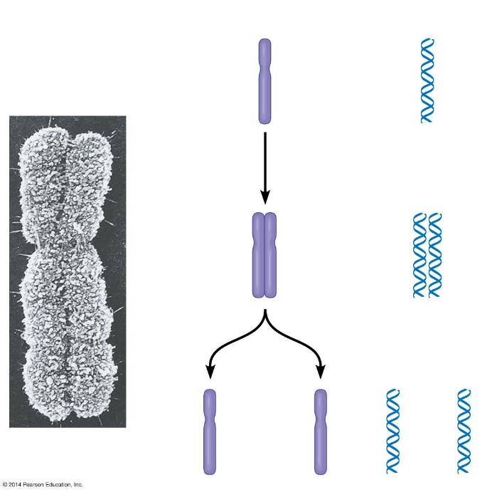
Figure 8.3b-0
Chromosomes
Chromosomal DNA molecules
Sister chromatids
Chromosome duplication
Sister chromatids
Centromere
Separation of sister chromatids and distribution into two daughter cells
Notes:
Figure 8.3b-0 Chromosome duplication and distribution

Slide 21
8.3 The large, complex chromosomes of eukaryotes duplicate with each cell division
duplicates all of its chromosomes, resulting in two copies called sister chromatids.
The sister chromatids are joined at a narrowed “waist” called the centromere.
Notes:
Student Misconceptions and Concerns
• Students often seem confused by the difference between a DNA molecule and a chromosome. This is especially problematic when discussing DNA replication.
• Students are often confused by photographs of chromosomes. Such photographs, such as Figure 8.3B, typically show duplicated chromosomes during some aspect of cell division. It remains unclear to many (a) why chromosome structure is typically different between interphase G₁ and the stages of division and (b) why chromosomes are not photographed during interphase (the stage in which chromosomes are typically first discussed) before the chromosomes duplicate.
Teaching Tips
• Figure 8.3B is an important point of reference for some basic terminology. Consider referring to it as you distinguish between a DNA molecule and a chromosome, unreplicated and replicated chromosomes, and the nature of sister chromatids.
• Consider an analogy between the precise packaging of DNA into chromosomes and packing a home for a move to another home. Tap into the intuitive advantages of packaging DNA using this or any other analogy of highly packaged materials (perhaps a boxed “desk” that requires some assembly).
• The concepts of DNA replication and sister chromatids are often obstacles for many students. If you can find twist ties or other bendable wire, you can demonstrate or have students model the difference between (a) a chromosome before DNA replication and (b) sister chromatids after DNA replication. One piece of wire will represent a chromosome before replication. Two twist ties twisted about each other can represent sister chromatids. We have doubled the DNA, but the molecules remain attached (although not attached in the same way as the wire). You might also want to point out that when sister chromatids are separated, they are considered separate chromosomes.

Slide 22
8.3 The large, complex chromosomes of eukaryotes duplicate with each cell division
When a cell divides, the sister chromatids
separate from each other and are then called chromosomes
sort into separate daughter cells.

Slide 23
Answer in Notebooks
#5. Define the following terms:
Chromatin:
Sister Chromatid:
Chromosome:

Slide 24
8.4 The cell cycle includes growing and division phases
The cell cycle is an ordered sequence of events that extends from the time a cell is first formed from a dividing parent cell until its own division.
Notes:
Teaching Tips
• The textbook authors note in Module 8.4 that each of your students consists of about 10 trillion cells. It is likely that this number is beyond comprehension for most of your students. Consider sharing several simple examples of the enormity of that number to try to make it more meaningful. For example, the U.S. population in 2014 is about 317 million people. To give every one of those people about $31,500, we will need a total of 10 trillion dollars. Here is another example. If we gave you $32,000 every second, it would take 10 years to give you 10 trillion dollars. The U.S. Debt Clock helps relate these large numbers to the U.S. national debt at www.usdebtclock.org.
• In G₁, the chromosomes have not duplicated. But by G₂, chromosomes consist of sister chromatids. If you have created a demonstration of sister chromatids, relate DNA replication and sister chromatids to the cell cycle.

Slide 25
8.4 The cell cycle includes growing and division phases
The cell cycle consists of two stages, characterized as follows:
Interphase: duplication of cell contents
G₁—growth, increase in cytoplasm
S—duplication of chromosomes
G₂—growth, preparation for division
Notes:
Teaching Tips
• The textbook authors note in Module 8.4 that each of your students consists of about 10 trillion cells. It is likely that this number is beyond comprehension for most of your students. Consider sharing several simple examples of the enormity of that number to try to make it more meaningful. For example, the U.S. population in 2014 is about 317 million people. To give every one of those people about $31,500, we will need a total of 10 trillion dollars. Here is another example. If we gave you $32,000 every second, it would take 10 years to give you 10 trillion dollars. The U.S. Debt Clock helps relate these large numbers to the U.S. national debt at www.usdebtclock.org.
• In G₁, the chromosomes have not duplicated. But by G₂, chromosomes consist of sister chromatids. If you have created a demonstration of sister chromatids, relate DNA replication and sister chromatids to the cell cycle.

Slide 26
8.4 The cell cycle includes growing and division phases
The cell cycle consists of two stages, characterized as follows:
Mitotic phase: division
Mitosis—division of the nucleus
Cytokinesis—division of cytoplasm

Slide 27
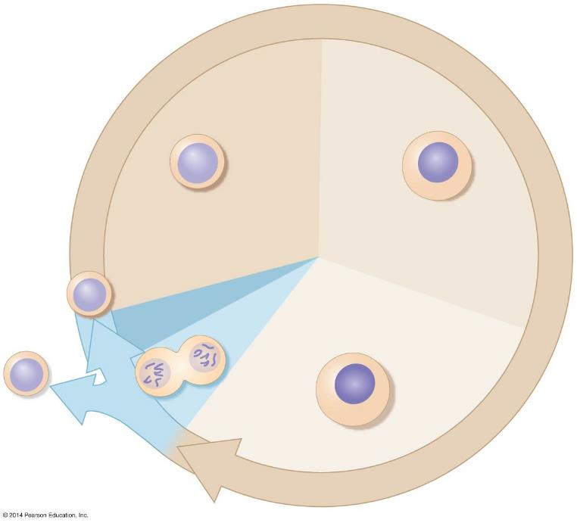
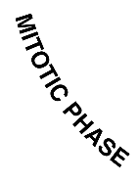
Figure 8.4
G₁ (first gap)
S (DNA synthesis)
M
Cytokinesis
G₂ (second gap)
Mitosis
Notes:
Figure 8.4 The eukaryotic cell cycle

Slide 28
Answer in Notebooks:
#6. In which phase does a cell spend most of its time?

Slide 29
8.5 Cell division is a continuum of dynamic changes
Mitosis progresses through a series of stages:
prophase
prometaphase
metaphase
anaphase
telophase
Cytokinesis often overlaps telophase.
Notes:
Teaching Tips
• Students might keep better track of the sequence of events in a cell cycle by simply memorizing the letters IPPMAT, which are the first letters of interphase, prophase, prometaphase, metaphase, anaphase, and telophase.
Active Lecture Tips
• See the Activity Student Demonstration of Mitosis and Meiosis Using Chromosome Cut-Outs as Models on the Instructor Exchange. Visit the Instructor Exchange in the MasteringBiology instructor resource area for a description of this activity.

Slide 30
8.5 Cell division is a continuum of dynamic changes
A mitotic spindle
is required to divide the chromosomes
guides the separation of the two sets of daughter chromosomes
is composed of microtubules and associated proteins.
Notes:
Teaching Tips
• Students might keep better track of the sequence of events in a cell cycle by simply memorizing the letters IPPMAT, which are the first letters of interphase, prophase, prometaphase, metaphase, anaphase, and telophase.
Active Lecture Tips
• See the Activity Student Demonstration of Mitosis and Meiosis Using Chromosome Cut-Outs as Models on the Instructor Exchange. Visit the Instructor Exchange in the MasteringBiology instructor resource area for a description of this activity.

Slide 31
8.5 Cell division is a continuum of dynamic changes
Spindle microtubules emerge from two centrosomes, microtubule-organizing regions in the cytoplasm of eukaryotic cells.

Slide 32
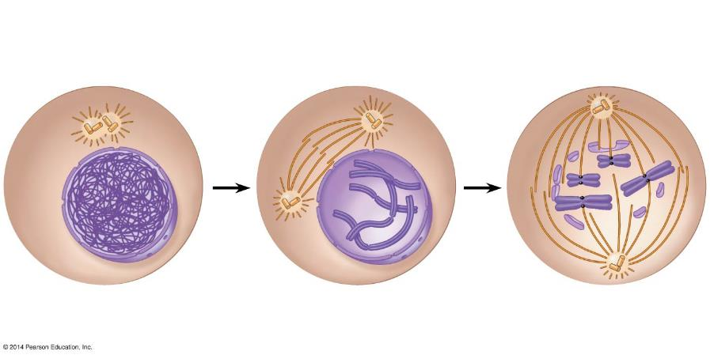
Figure 8.5-2
Interphase
Prophase
Prometaphase
Fragments of the nuclear envelope
Centrosomes
Chromatin
Early mitotic spindle
Centrosome
Kinetochore
Nuclear envelope
Centromere
Plasma membrane
Spindle microtubules
Chromosome, consisting of two sister chromatids
Notes:
Figure 8.5-2 The stages of cell division by mitosis: interphase through prometaphase

Slide 33
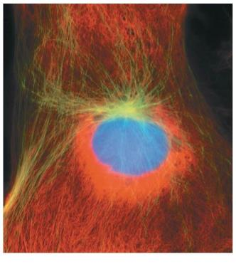
8.5 Cell division is a continuum of dynamic changes
Interphase
The cytoplasmic contents double.
Two centrosomes form.
Chromosomes duplicate in the nucleus during the S phase.
Notes:
Teaching Tips
• Students might keep better track of the sequence of events in a cell cycle by simply memorizing the letters IPPMAT, which are the first letters of interphase, prophase, prometaphase, metaphase, anaphase, and telophase.
Active Lecture Tips
• See the Activity Student Demonstration of Mitosis and Meiosis Using Chromosome Cut-Outs as Models on the Instructor Exchange. Visit the Instructor Exchange in the MasteringBiology instructor resource area for a description of this activity.

Slide 34
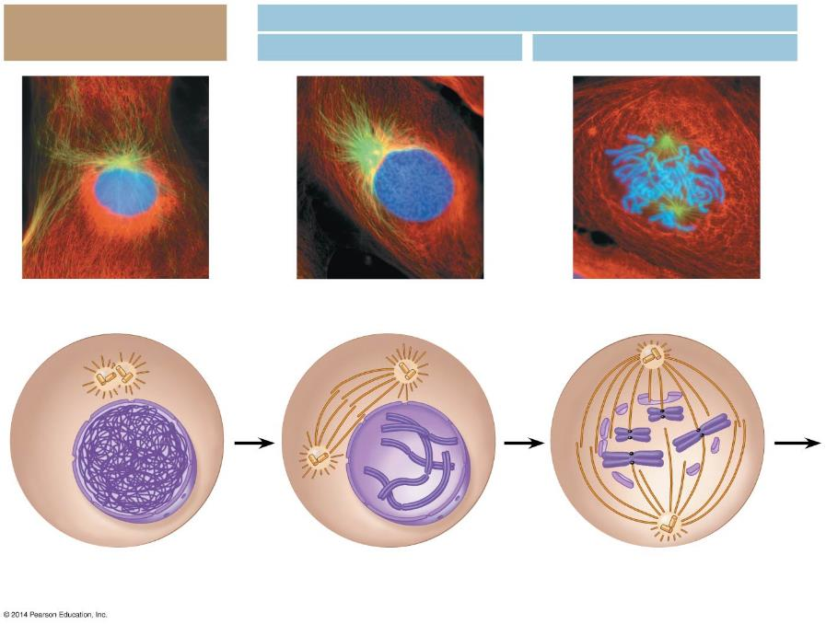
Figure 8.5-1
Mitosis
Interphase
Prophase
Prometaphase
Centrosomes
Early mitotic spindle
Fragments of the nuclear envelope
Chromatin
Centrosome
Kinetochore
Nuclear envelope
Centromere
Spindle microtubules
Plasma membrane
Chromosome, consisting of two sister chromatids
Notes:
Figure 8.5-1 The stages of cell division by mitosis: interphase through prometaphase

Slide 35
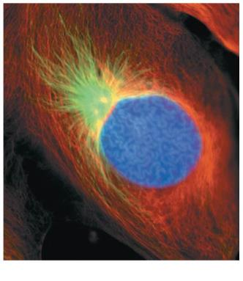
8.5 Cell division is a continuum of dynamic changes
Prophase
In the nucleus, chromosomes
become more tightly coiled
and folded.
In the cytoplasm, the mitotic spindle begins to form as microtubules rapidly grow out from the centrosomes.
Notes:
Teaching Tips
• Students might keep better track of the sequence of events in a cell cycle by simply memorizing the letters IPPMAT, which are the first letters of interphase, prophase, prometaphase, metaphase, anaphase, and telophase.
Active Lecture Tips
• See the Activity Student Demonstration of Mitosis and Meiosis Using Chromosome Cut-Outs as Models on the Instructor Exchange. Visit the Instructor Exchange in the MasteringBiology instructor resource area for a description of this activity.

Slide 36
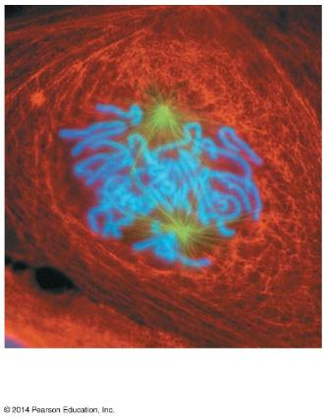
8.5 Cell division is a continuum of dynamic changes
Prometaphase
The nuclear envelope breaks
Into fragments and disappears.
Microtubules extend from the centrosomes into the nuclear region.
Some spindle microtubules attach to the kinetochores.
Other microtubules meet those from the opposite poles.
Notes:
Teaching Tips
• Students might keep better track of the sequence of events in a cell cycle by simply memorizing the letters IPPMAT, which are the first letters of interphase, prophase, prometaphase, metaphase, anaphase, and telophase.
Active Lecture Tips
• See the Activity Student Demonstration of Mitosis and Meiosis Using Chromosome Cut-Outs as Models on the Instructor Exchange. Visit the Instructor Exchange in the MasteringBiology instructor resource area for a description of this activity.

Slide 37
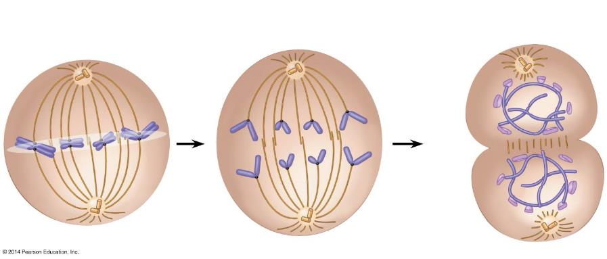
Figure 8.5-7
Metaphase
Anaphase
Telophase and Cytokinesis
Metaphase plate
Cleavage furrow
Nuclear envelope forming
Separated chromosomes
Mitotic spindle
Notes:
Figure 8.5-7 The stages of cell division by mitosis: metaphase through cytokinesis

Slide 38
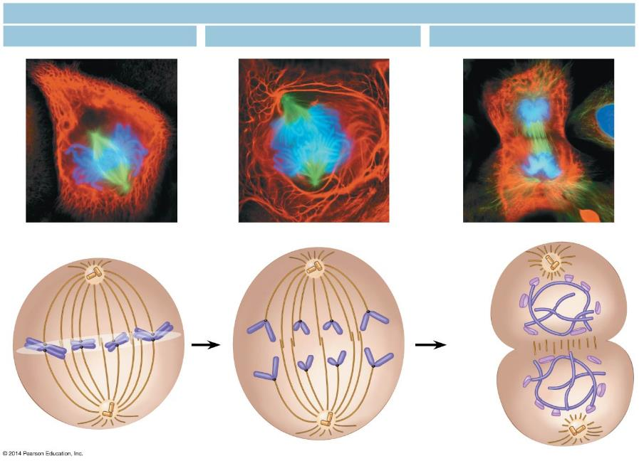
Figure 8.5-6
Mitosis
Metaphase
Anaphase
Telophase and Cytokinesis
Metaphase plate
Cleavage furrow
Nuclear envelope forming
Separated chromosomes
Mitotic spindle
Notes:
Figure 8.5-6 The stages of cell division by mitosis: metaphase through cytokinesis

Slide 39
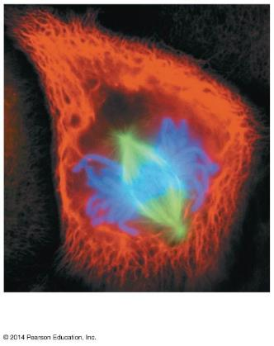
8.5 Cell division is a continuum of dynamic changes
Metaphase
The mitotic spindle is fully formed.
Chromosomes align at the cell equator.
Kinetochores of sister chromatids are facing the opposite poles of the spindle.
Notes:
Teaching Tips
• Students might keep better track of the sequence of events in a cell cycle by simply memorizing the letters IPPMAT, which are the first letters of interphase, prophase, prometaphase, metaphase, anaphase, and telophase.
Active Lecture Tips
• See the Activity Student Demonstration of Mitosis and Meiosis Using Chromosome Cut-Outs as Models on the Instructor Exchange. Visit the Instructor Exchange in the MasteringBiology instructor resource area for a description of this activity.

Slide 40
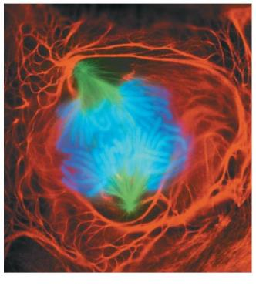
8.5 Cell division is a continuum of dynamic changes
Anaphase
Sister chromatids separate at the centromeres.
Daughter chromosomes are moved to
opposite poles of the cell as motor proteins move the chromosomes along the spindle microtubules and kinetochore microtubules shorten.
Spindle microtubules not attached to chromosomes lengthen, moving the poles farther apart.
At the end of anaphase, the two ends of the cell have equal collections of chromosomes.
Notes:
Teaching Tips
• Students might keep better track of the sequence of events in a cell cycle by simply memorizing the letters IPPMAT, which are the first letters of interphase, prophase, prometaphase, metaphase, anaphase, and telophase.
Active Lecture Tips
• See the Activity Student Demonstration of Mitosis and Meiosis Using Chromosome Cut-Outs as Models on the Instructor Exchange. Visit the Instructor Exchange in the MasteringBiology instructor resource area for a description of this activity.

Slide 41
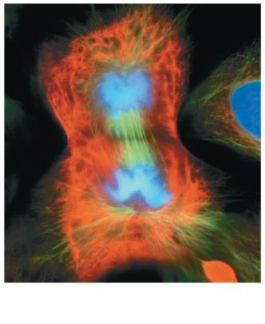
8.5 Cell division is a continuum of dynamic changes
Telophase
The cell continues to elongate
The nuclear envelope forms around chromosomes at each pole, establishing daughter nuclei
Chromatin uncoils
The mitotic spindle disappears
Notes:
Teaching Tips
• Students might keep better track of the sequence of events in a cell cycle by simply memorizing the letters IPPMAT, which are the first letters of interphase, prophase, prometaphase, metaphase, anaphase, and telophase.
Active Lecture Tips
• See the Activity Student Demonstration of Mitosis and Meiosis Using Chromosome Cut-Outs as Models on the Instructor Exchange. Visit the Instructor Exchange in the MasteringBiology instructor resource area for a description of this activity.

Slide 42
8.5 Cell division is a continuum of dynamic changes
During cytokinesis, the cytoplasm is divided into separate cells.
Cytokinesis usually occurs simultaneously with telophase.
Notes:
Teaching Tips
• Students might keep better track of the sequence of events in a cell cycle by simply memorizing the letters IPPMAT, which are the first letters of interphase, prophase, prometaphase, metaphase, anaphase, and telophase.
Active Lecture Tips
• See the Activity Student Demonstration of Mitosis and Meiosis Using Chromosome Cut-Outs as Models on the Instructor Exchange. Visit the Instructor Exchange in the MasteringBiology instructor resource area for a description of this activity.

Slide 43
Answer in Notebooks:
#7. Draw and Briefly Explain the 4 stages of Mitosis.

