Slide 1
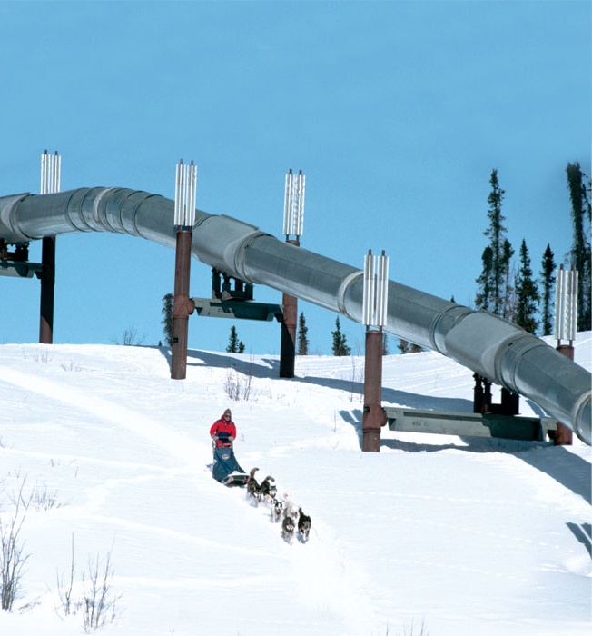
The Economy of the West
Lesson 2
Vocabulary
telecommunications
conservationist
Reading Skill
Make Generalizations
What is the economy of the West?
Notes:
Teacher Notes
Oil, lumber, and minerals are resources that provide many jobs in the West.
Ranching and farming are important to the economy of the West.
Movies and high-tech manufacturing are growing industries.
Tourism is an important part of the economy of the West.

Slide 2
Natural Resources
The Economy of the West
Timber
Minerals
Oil
Natural gas
Fish
Gold Rush in California and Alaska
Alaska pipeline
Notes:
Teacher Notes
Explain that after gold was discovered in California’s Sacramento Valley in 1848, thousands of gold-seekers hurried to the West to mine for the precious metal. Because the biggest wave of gold miners arrived in 1849, they came to be called “Forty-Niners.”
Talk About It! Some people sold everything they owned to afford the journey West to look for gold. Why did so many people rush to the West when they heard that gold had been discovered there?
(Student responses should mention that gold is a valuable metal. People went West hoping to find gold to sell for big profits and to become rich.)

Slide 3
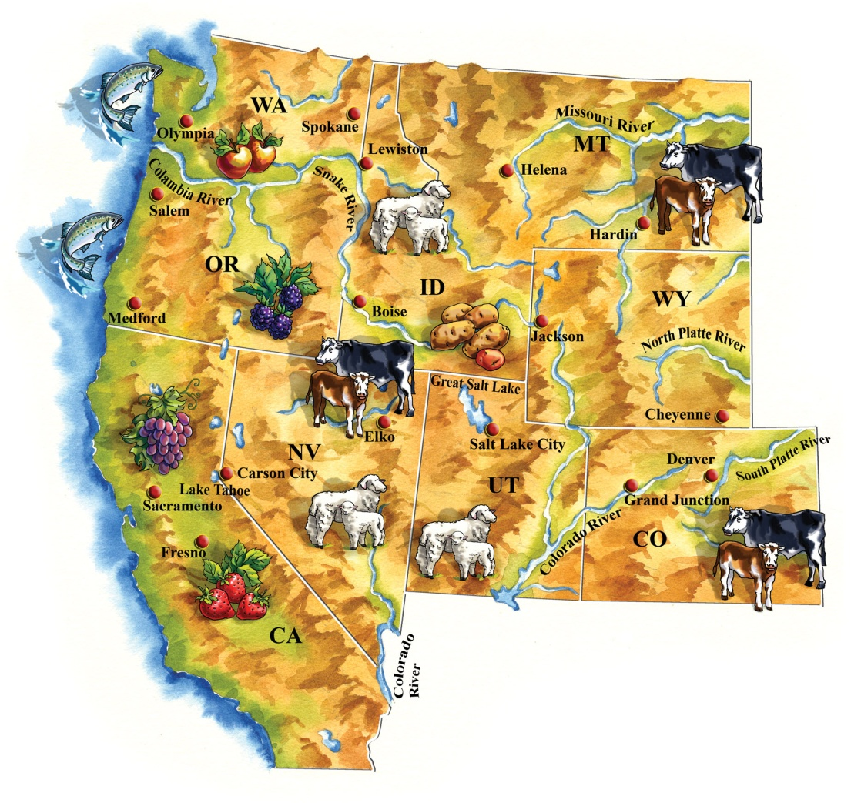
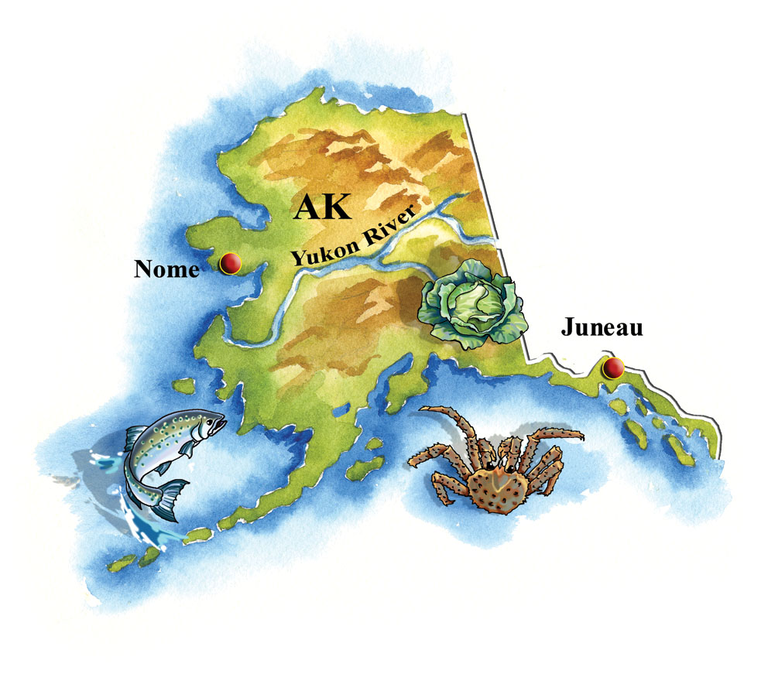
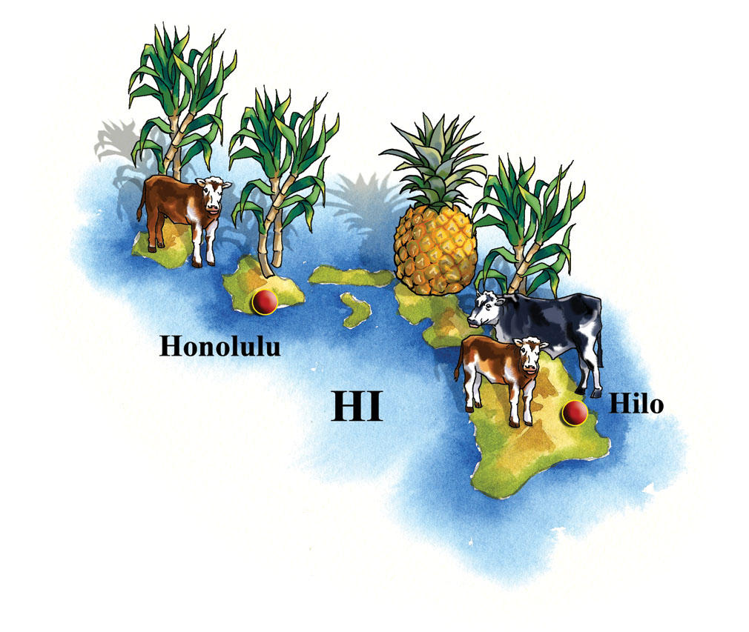
By Land and Sea
The Economy of the West
Landforms vary greatly
Good land for farming
Grasslands for ranching
Coastal areas for fishing
Sugarcane and pineapples in Hawaii
Notes:
Teacher Notes
Tell students that the fertile land of California’s Central Valley is used to grow many food crops. In fact, the Central Valley produces more fruits, nuts, and vegetables than almost anywhere else on Earth!
Think About It! Pineapples and sugarcane are two of Hawaii’s important crops. Why do you think that Hawaii has food crops different from other states in the West? (Responses should mention Hawaii’s tropical climate.)

Slide 4
Making it Out West
The Economy of the West
Technology
Movie industry
Computers in the Silicon Valley
Computer equipment
Telecommunications
Federal Government
Military bases
Much of land owned by government
Flat deserts good for testing planes and missiles
Supports scientific research
Notes:
Teacher Notes
Telecommunications means the use of technology for communication, such as telephones, cell phones, satellites, and e-mail.
Explain that in addition to its important natural resources, the economy of the West also depends on technology and the federal government.
The federal government is the top customer of companies in Utah that manufacture rocket engines. It supports research to monitor earthquakes and volcanoes. Many military bases are located throughout the west.

Slide 5
Service Jobs
The Economy of the West
Tourists come for natural beauty and recreation.
Tourism creates many jobs.
National Parks
Protect wilderness and wildlife
Conservationists
Attract many visitors
Notes:
Teacher Notes
Write About It! Find out about one national park in the West. What makes this park special? (Students should do some basic research into national parks of the West, then write a few sentences describing what makes one of the parks interesting or unique.)

