Slide 1
19.11 The hominin branch of the primate tree includes species that coexisted
Paleoanthropology is the study of human origins and evolution, the brief history since the divergence of human and chimpanzee lineages.
Paleoanthropologists have unearthed
about 20 species of extinct hominins, species that are more closely related to humans than to chimpanzees
thousands of hominin fossils.
Notes:
Student Misconceptions and Concerns
• Students are likely to believe that human evolution resembled the popular “march of progress” image, which depicts a series of apes giving way to increasingly modern-looking and upright humans in a linear progression. Such images are common and can be found easily by searching “human evolution” on a Google image search. As suggested by Figure 19.11, the human family tree instead has many branches, with multiple species existing simultaneously for long periods (more than a million years). Furthermore, representing the diversity of hominin evolution as a narrow progression from past to present is misleading. It would be the equivalent of depicting any one student’s family history as a direct lineage of grandparent to parent to student, ignoring all siblings and cousins.
• Students and biologists in general often expect evolutionary intermediates to have characteristics that are an average of ancestors and descendants. They may expect intermediate forms to have intermediate traits. The concept of mosaic evolution, in which intermediates demonstrate a mixture of primitive and derived traits, more accurately depicts the history of life. As discussed in Module 19.12, human ancestors did not walk partially upright with mid-sized brains. Instead, upright posture evolved before larger brains, revealing a “mosaic” of traits.
• Students may continue to struggle with false Lamarckian concepts of evolution. They should be reminded that organisms do not acquire characteristics because of want or need. Instead, naturally occurring genetic variations are selected for or against depending on a population’s interactions with its environment. Many students need to be reminded about the process of natural selection wherever it applies.
Teaching Tips
• Figure 19.11 is an excellent way to introduce the history of human evolution. The vertical bars represent the known history of each species based upon the discovery of fossils. However, the relationships between the species are not represented because of uncertainty. The ongoing efforts to clarify human ancestral relationships provide a case study of the process of science, which involves forming tentative hypotheses that are refined as more evidence and insight are added.
• There are many excellent Internet sites addressing aspects of human evolution. The Leakey Foundation website lists a variety of them at http://leakeyfoundation.org.
Active Lecture Tips
• See the Activity What Do My Classmates Think About Evolution? What Do Scientists Believe About Religion? on the Instructor Exchange. Visit the Instructor Exchange in the MasteringBiology instructor resource area for a description of this activity.

Slide 2
Hominid : the group consisting of all modern and extinct Great Apes (that is, modern humans, chimpanzees, gorillas and orang-utans plus all their immediate ancestors).
Hominin: the group consisting of modern humans, extinct human species and all our immediate ancestors (including members of the genera Homo, Australopithecus, Paranthropus and Ardipithecus).

Slide 3
Convergent Evolution: The process in which species that are not closely related evolve similar traits
Divergent Evolution: Two different species share the same ancestral origins but have evolved differently

Slide 4
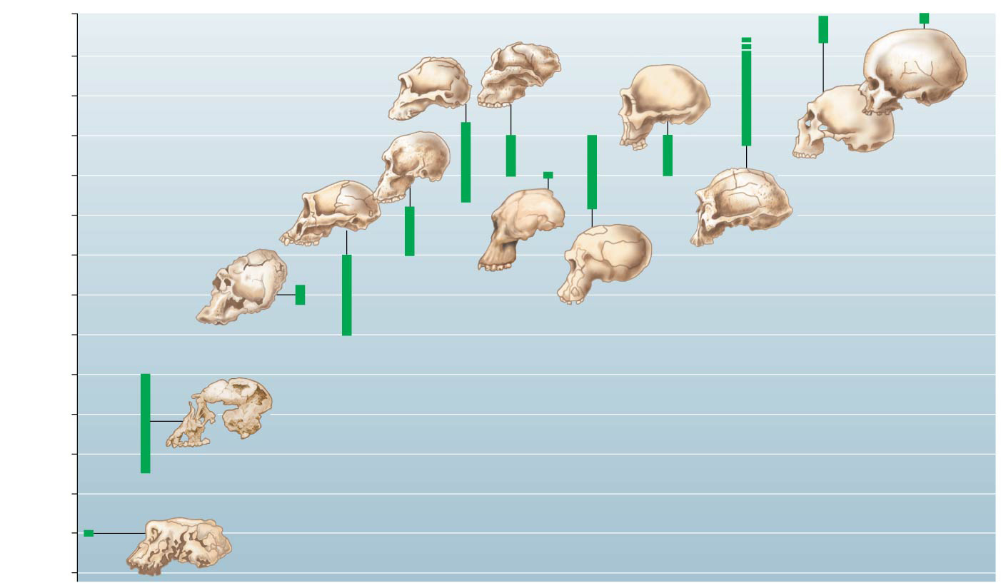
Figure 19.11-0
0
Paranthropus
robustus
Homo
ergaster
?
0.5
Paranthropus
boisei
1.0
Homo
sapiens
1.5
Australopithecus
africanus
2.0
Homo
neanderthalensis
2.5
Australopithecus
afarensis
3.0
Homo
erectus
Millions of years ago
Australopithecus
sediba
3.5
Homo
habilis
4.0
Kenyanthropus
platyops
4.5
5.0
Ardipithecus
ramidus
5.5
6.0
6.5
Sahelanthropus
tchadensis
7.0
Notes:
Figure 19.11-0 A timeline for some hominin species

Slide 5
19.11 The hominin branch of the primate tree includes species that coexisted
The oldest hominin yet discovered, Sahelanthropus tchadensis, lived about 7 to 6 million years ago.
The fossil record suggests that hominin diversity increased dramatically between 4 and 2 million years ago.
The first fossil member of our own genus, Homo, dates from that time.
By 1 million years ago, only species of Homo existed.
Eventually, all Homo species except one—our own—ended in extinction.
Notes:
Student Misconceptions and Concerns
• Students are likely to believe that human evolution resembled the popular “march of progress” image, which depicts a series of apes giving way to increasingly modern-looking and upright humans in a linear progression. Such images are common and can be found easily by searching “human evolution” on a Google image search. As suggested by Figure 19.11, the human family tree instead has many branches, with multiple species existing simultaneously for long periods (more than a million years). Furthermore, representing the diversity of hominin evolution as a narrow progression from past to present is misleading. It would be the equivalent of depicting any one student’s family history as a direct lineage of grandparent to parent to student, ignoring all siblings and cousins.
• Students and biologists in general often expect evolutionary intermediates to have characteristics that are an average of ancestors and descendants. They may expect intermediate forms to have intermediate traits. The concept of mosaic evolution, in which intermediates demonstrate a mixture of primitive and derived traits, more accurately depicts the history of life. As discussed in Module 19.12, human ancestors did not walk partially upright with mid-sized brains. Instead, upright posture evolved before larger brains, revealing a “mosaic” of traits.
• Students may continue to struggle with false Lamarckian concepts of evolution. They should be reminded that organisms do not acquire characteristics because of want or need. Instead, naturally occurring genetic variations are selected for or against depending on a population’s interactions with its environment. Many students need to be reminded about the process of natural selection wherever it applies.
Teaching Tips
• Figure 19.11 is an excellent way to introduce the history of human evolution. The vertical bars represent the known history of each species based upon the discovery of fossils. However, the relationships between the species are not represented because of uncertainty. The ongoing efforts to clarify human ancestral relationships provide a case study of the process of science, which involves forming tentative hypotheses that are refined as more evidence and insight are added.
• There are many excellent Internet sites addressing aspects of human evolution. The Leakey Foundation website lists a variety of them at http://leakeyfoundation.org.
Active Lecture Tips
• See the Activity What Do My Classmates Think About Evolution? What Do Scientists Believe About Religion? on the Instructor Exchange. Visit the Instructor Exchange in the MasteringBiology instructor resource area for a description of this activity.

Slide 6
19.12 Australopiths were bipedal and had small brains
Unlike chimpanzees, humans
walk upright
have larger brains
Notes:
Student Misconceptions and Concerns
• Students are likely to believe that human evolution resembled the popular “march of progress” image, which depicts a series of apes giving way to increasingly modern-looking and upright humans in a linear progression. Such images are common and can be found easily by searching “human evolution” on a Google image search. As suggested by Figure 19.11, the human family tree instead has many branches, with multiple species existing simultaneously for long periods (more than a million years). Furthermore, representing the diversity of hominin evolution as a narrow progression from past to present is misleading. It would be the equivalent of depicting any one student’s family history as a direct lineage of grandparent to parent to student, ignoring all siblings and cousins.
• Students and biologists in general often expect evolutionary intermediates to have characteristics that are an average of ancestors and descendants. They may expect intermediate forms to have intermediate traits. The concept of mosaic evolution, in which intermediates demonstrate a mixture of primitive and derived traits, more accurately depicts the history of life. As discussed in Module 19.12, human ancestors did not walk partially upright with mid-sized brains. Instead, upright posture evolved before larger brains, revealing a “mosaic” of traits.
• Students may continue to struggle with false Lamarckian concepts of evolution. They should be reminded that organisms do not acquire characteristics because of want or need. Instead, naturally occurring genetic variations are selected for or against depending on a population’s interactions with its environment. Many students need to be reminded about the process of natural selection wherever it applies.
Teaching Tips
• There are many excellent Internet sites addressing aspects of human evolution. The Leakey Foundation website lists a variety of them at http://leakeyfoundation.org.
• Multiple independent lines of evidence supporting the idea that upright body posture evolved before larger brains are discussed in Module 19.12. This provides an example of the process of science in action, where confidence in the validity of a theory grows as the quality and number of lines of evidence supporting it increase.
Active Lecture Tips
• See the Activity What Do My Classmates Think About Evolution? What Do Scientists Believe About Religion? on the Instructor Exchange. Visit the Instructor Exchange in the MasteringBiology instructor resource area for a description of this activity.

Slide 7
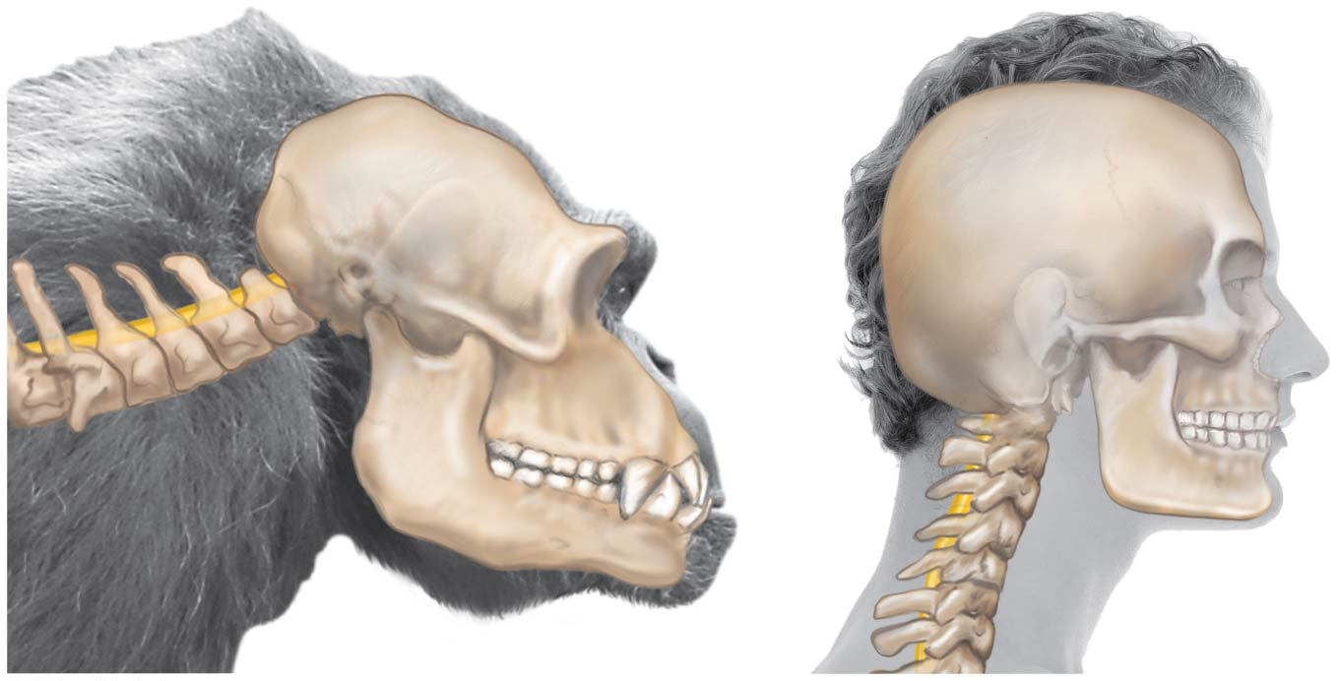
19.12 Australopiths were bipedal and had small brains
A clue to bipedalism is the location of the opening in the base of the skull through which the spinal cord exits.
Notes:
Student Misconceptions and Concerns
• Students are likely to believe that human evolution resembled the popular “march of progress” image, which depicts a series of apes giving way to increasingly modern-looking and upright humans in a linear progression. Such images are common and can be found easily by searching “human evolution” on a Google image search. As suggested by Figure 19.11, the human family tree instead has many branches, with multiple species existing simultaneously for long periods (more than a million years). Furthermore, representing the diversity of hominin evolution as a narrow progression from past to present is misleading. It would be the equivalent of depicting any one student’s family history as a direct lineage of grandparent to parent to student, ignoring all siblings and cousins.
• Students and biologists in general often expect evolutionary intermediates to have characteristics that are an average of ancestors and descendants. They may expect intermediate forms to have intermediate traits. The concept of mosaic evolution, in which intermediates demonstrate a mixture of primitive and derived traits, more accurately depicts the history of life. As discussed in Module 19.12, human ancestors did not walk partially upright with mid-sized brains. Instead, upright posture evolved before larger brains, revealing a “mosaic” of traits.
• Students may continue to struggle with false Lamarckian concepts of evolution. They should be reminded that organisms do not acquire characteristics because of want or need. Instead, naturally occurring genetic variations are selected for or against depending on a population’s interactions with its environment. Many students need to be reminded about the process of natural selection wherever it applies.
Teaching Tips
• There are many excellent Internet sites addressing aspects of human evolution. The Leakey Foundation website lists a variety of them at http://leakeyfoundation.org.
• Multiple independent lines of evidence supporting the idea that upright body posture evolved before larger brains are discussed in Module 19.12. This provides an example of the process of science in action, where confidence in the validity of a theory grows as the quality and number of lines of evidence supporting it increase.
Active Lecture Tips
• See the Activity What Do My Classmates Think About Evolution? What Do Scientists Believe About Religion? on the Instructor Exchange. Visit the Instructor Exchange in the MasteringBiology instructor resource area for a description of this activity.

Slide 8
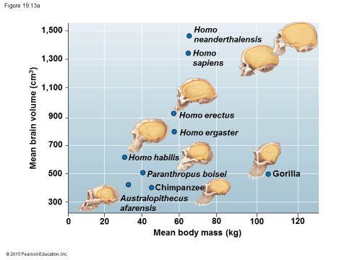
19.13 Larger brains mark the evolution of Homo
Homo sapiens has a brain size of around 1,300 cm³.
Australopiths had such small brains (400–450 cm³) that they were too small to be members of Homo.
Notes:
Student Misconceptions and Concerns
• Students are likely to believe that human evolution resembled the popular “march of progress” image, which depicts a series of apes giving way to increasingly modern-looking and upright humans in a linear progression. Such images are common and can be found easily by searching “human evolution” on a Google image search. As suggested by Figure 19.11, the human family tree instead has many branches, with multiple species existing simultaneously for long periods (more than a million years). Furthermore, representing the diversity of hominin evolution as a narrow progression from past to present is misleading. It would be the equivalent of depicting any one student’s family history as a direct lineage of grandparent to parent to student, ignoring all siblings and cousins.
• Students and biologists in general often expect evolutionary intermediates to have characteristics that are an average of ancestors and descendants. They may expect intermediate forms to have intermediate traits. The concept of mosaic evolution, in which intermediates demonstrate a mixture of primitive and derived traits, more accurately depicts the history of life. As discussed in Module 19.12, human ancestors did not walk partially upright with mid-sized brains. Instead, upright posture evolved before larger brains, revealing a “mosaic” of traits.
• Students may continue to struggle with false Lamarckian concepts of evolution. They should be reminded that organisms do not acquire characteristics because of want or need. Instead, naturally occurring genetic variations are selected for or against depending on a population’s interactions with its environment. Many students need to be reminded about the process of natural selection wherever it applies.
Teaching Tips
• There are many excellent Internet sites addressing aspects of human evolution. The Leakey Foundation website lists a variety of them at http://leakeyfoundation.org.
• Students may wonder if people living today with large brains are indeed more intelligent than their smaller-brained colleagues. Although this relationship may generally be true between species, there is no clear evidence that it is valid within a species.
• Students may wish to debate whether we are more intelligent than our cave-dwelling ancestors. What is the distinction between knowledge and intelligence? If your course permits it, these could be some interesting discussions.
Active Lecture Tips
• See the Activity What Do My Classmates Think About Evolution? What Do Scientists Believe About Religion? on the Instructor Exchange. Visit the Instructor Exchange in the MasteringBiology instructor resource area for a description of this activity.

Slide 9
19.14 From origins in Africa, Homo sapiens spread around the world
The ancestors of humans originated in Africa.
The oldest known fossils with the definitive characteristics of our own species
were discovered in Ethiopia and
are 160,000 and 195,000 years old.
Notes:
Student Misconceptions and Concerns
• Students are likely to believe that human evolution resembled the popular “march of progress” image, which depicts a series of apes giving way to increasingly modern-looking and upright humans in a linear progression. Such images are common and can be found easily by searching “human evolution” on a Google image search. As suggested by Figure 19.11, the human family tree instead has many branches, with multiple species existing simultaneously for long periods (more than a million years). Furthermore, representing the diversity of hominin evolution as a narrow progression from past to present is misleading. It would be the equivalent of depicting any one student’s family history as a direct lineage of grandparent to parent to student, ignoring all siblings and cousins.
• Students and biologists in general often expect evolutionary intermediates to have characteristics that are an average of ancestors and descendants. They may expect intermediate forms to have intermediate traits. The concept of mosaic evolution, in which intermediates demonstrate a mixture of primitive and derived traits, more accurately depicts the history of life. As discussed in Module 19.12, human ancestors did not walk partially upright with mid-sized brains. Instead, upright posture evolved before larger brains, revealing a “mosaic” of traits.
• Students may continue to struggle with false Lamarckian concepts of evolution. They should be reminded that organisms do not acquire characteristics because of want or need. Instead, naturally occurring genetic variations are selected for or against depending on a population’s interactions with its environment. Many students need to be reminded about the process of natural selection wherever it applies.
Teaching Tips
• There are many excellent Internet sites addressing aspects of human evolution. The Leakey Foundation website lists a variety of them at http://leakeyfoundation.org.
• Excavations of Neanderthal habitation sites have revealed fascinating details of their existence. Student research into these artifacts can stimulate interest and enjoyable conversations. Considering asking your students to identify one artifact of Neanderthal culture that reveals something about the way they lived. A Google search of “Neanderthal culture artifact” will be a good start.
• Module 19.14 notes that the oldest known fossils of modern humans have been dated to about 160,000–200,000 years ago. Appreciating the relative youthfulness of our species can be difficult. Consider this short activity. Have students calculate the percentage of time that our species has existed (generously at 200,000 years) compared to the age of the Earth (4.6 billion years) and compared to the approximate age of multicellular animal life (about 600 million years). Your strongest students might enjoy this final calculation. If the entire history of Earth represents one calendar year, what fraction of that year represents the period of modern human existence? The answers would be as follows: Our species has existed for 1/23,000th of Earth’s history = 0.0000434 = 0.00434%; our species has existed for 1/3000th of the time that multicellular animal life has existed, 0.0333%. If the 4.6-billion-year history of Earth represented one calendar year, our species has been present for the last 23 minutes of that year. (0.0000434 × 365.25 × 24 × 60 = 22.83 minutes.)
Active Lecture Tips
• See the Activity What Do My Classmates Think About Evolution? What Do Scientists Believe About Religion? on the Instructor Exchange. Visit the Instructor Exchange in the MasteringBiology instructor resource area for a description of this activity.

Slide 10
19.14 From origins in Africa, Homo sapiens spread around the world
Molecular evidence about the origin of humans supports the conclusions drawn from fossils.
DNA studies indicate
that Europeans and Asians share a more recent common ancestor
that many African lineages represent earlier branches on the human tree
that all living humans have ancestors that originated as H. sapiens in Africa.
Notes:
Student Misconceptions and Concerns
• Students are likely to believe that human evolution resembled the popular “march of progress” image, which depicts a series of apes giving way to increasingly modern-looking and upright humans in a linear progression. Such images are common and can be found easily by searching “human evolution” on a Google image search. As suggested by Figure 19.11, the human family tree instead has many branches, with multiple species existing simultaneously for long periods (more than a million years). Furthermore, representing the diversity of hominin evolution as a narrow progression from past to present is misleading. It would be the equivalent of depicting any one student’s family history as a direct lineage of grandparent to parent to student, ignoring all siblings and cousins.
• Students and biologists in general often expect evolutionary intermediates to have characteristics that are an average of ancestors and descendants. They may expect intermediate forms to have intermediate traits. The concept of mosaic evolution, in which intermediates demonstrate a mixture of primitive and derived traits, more accurately depicts the history of life. As discussed in Module 19.12, human ancestors did not walk partially upright with mid-sized brains. Instead, upright posture evolved before larger brains, revealing a “mosaic” of traits.
• Students may continue to struggle with false Lamarckian concepts of evolution. They should be reminded that organisms do not acquire characteristics because of want or need. Instead, naturally occurring genetic variations are selected for or against depending on a population’s interactions with its environment. Many students need to be reminded about the process of natural selection wherever it applies.
Teaching Tips
• There are many excellent Internet sites addressing aspects of human evolution. The Leakey Foundation website lists a variety of them at http://leakeyfoundation.org.
• Excavations of Neanderthal habitation sites have revealed fascinating details of their existence. Student research into these artifacts can stimulate interest and enjoyable conversations. Considering asking your students to identify one artifact of Neanderthal culture that reveals something about the way they lived. A Google search of “Neanderthal culture artifact” will be a good start.
• Module 19.14 notes that the oldest known fossils of modern humans have been dated to about 160,000–200,000 years ago. Appreciating the relative youthfulness of our species can be difficult. Consider this short activity. Have students calculate the percentage of time that our species has existed (generously at 200,000 years) compared to the age of the Earth (4.6 billion years) and compared to the approximate age of multicellular animal life (about 600 million years). Your strongest students might enjoy this final calculation. If the entire history of Earth represents one calendar year, what fraction of that year represents the period of modern human existence? The answers would be as follows: Our species has existed for 1/23,000th of Earth’s history = 0.0000434 = 0.00434%; our species has existed for 1/3000th of the time that multicellular animal life has existed, 0.0333%. If the 4.6-billion-year history of Earth represented one calendar year, our species has been present for the last 23 minutes of that year. (0.0000434 × 365.25 × 24 × 60 = 22.83 minutes.)
Active Lecture Tips
• See the Activity What Do My Classmates Think About Evolution? What Do Scientists Believe About Religion? on the Instructor Exchange. Visit the Instructor Exchange in the MasteringBiology instructor resource area for a description of this activity.

Slide 11
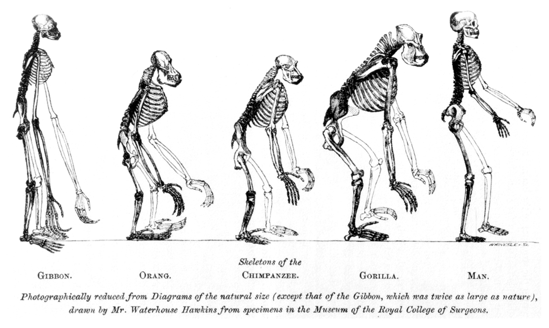
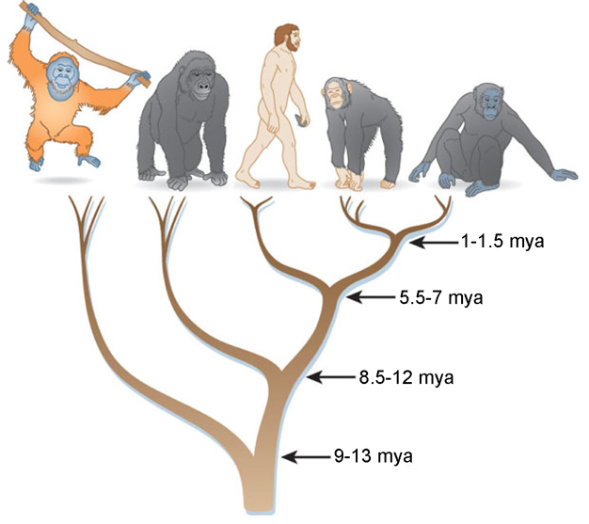

Slide 12
Humans evolved from a common ancestor with apes – not apes themselves
https://www.youtube.com/watch?v=V3U5KkOYRkA
https://www.youtube.com/watch?v=xT8Np0gI1dI
https://www.youtube.com/watch?v=BRY1_fq116M

